Slide 1

Web Development
Lecture 01: Introduction to Web Development
Esmot Ara Tuli
SDU Center for Industrial Software Engineering

Slide 2
You first

Slide 3
Knowing you
Have you developed a web application?
What do you expect from this course?
What would you like to learn?
What do you know? Web framework/language, Security/Scalability topics, Architecture

Slide 4
Now us

Slide 5
Context
Course
Web Development
Lecture: Esmot Ara Tuli (etu@mmmi.sdu.dk)
  Software and Web development? Yes
Practical: Rebecca De Rosa (rede@mmmi.sdu.dk)
TAs:
    Donát Zsombor Ötvös (doutv24@student.sdu.dk )
    Nedas Bartkus (nebar24@student.sdu.dk)

Slide 6
Course description
Content
  The module focuses on the design and development of web applications. In doing so, the module provides motivation for the use of web technologies in software development. In addition, the module delivers knowledge of the unique requirements for using the internet for data communication and a web browser as the interface between users and the system, including security and performance. Moreover, students acquire technical skills to develop web applications, both on the front-end (HTML, CSS, and JavaScript) and the back-end (web servers).

Slide 7
Course description
Learning objectives - Knowledge
Explain the fundamental building blocks underlying web applications.
Explain how data is exchanged and processed between users and server-side programs.
Justify the best practices for building robust web applications, such as security, efficiency, and testing.
Learning objectives - Skills
Design and develop a web application, both user interface and server-side processing, that fulfills specific requirements.
Implement a dynamic and interactive web application, where interfaces change according to server-side data and user inputs.
Apply secure coding principles to prevent common web vulnerabilities (e.g., code injection, XSS, broken authentication).
Analyze web applications behavior, identifying the causes of functional errors, performance issues, and security weaknesses.
Learning objectives - Competences
Analyze how the requirements of a system influence the adoption of web technologies.
Design and implement web-based systems, such that the system is clearly defined, the different components are divided into different modules, and similar components are grouped together in similar modules (modular web based systems).
Analyze which parts of a web-based software system are critical for non-functional properties such as security and efficiency.

Slide 8
Course description
Content
It provides both an introduction to web technology (HTTP, HTML, CSS, and JavaScript) as well as skills in web servers.
Learning objectives - Knowledge
Web applications, web interoperability standards, best practices within web security
Learning objectives - Skills
Develop architecture, design, and implementation of a distributed web application
Learning objectives - Competences
Design and implement an efficient and scalable web-based system

Slide 9
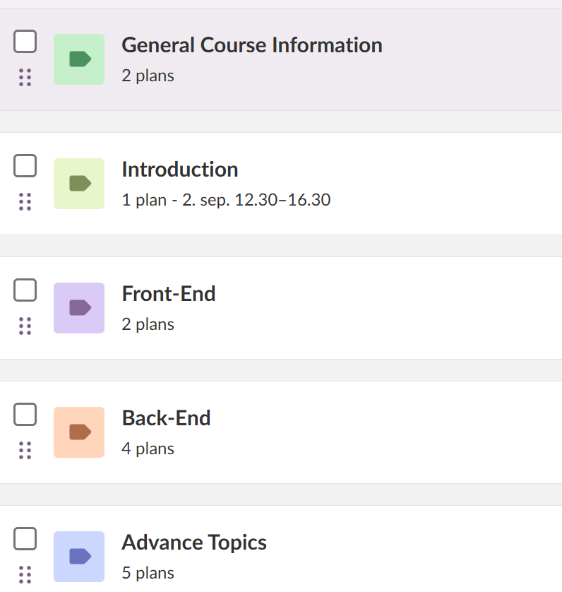

Preliminary Plan
In itslearning
Preliminary: It can (will) change
Recomendation: Look every week for any updates

Slide 10


Classes
Web: itslearning, discord, and course webpage
Lecture: 12:30-14:30
Exercise Session: 14:30-16:30
Lectures
Wednesday from 12.30 to 14.30 (ish)
Exercises from 14:30 to 16:30 PM
Exercises: Work in assignments / exam
Supervision: in class and online (discord, itslearning, mail)

Slide 11
What is this course

Slide 12
Expectations
We do not focus on a tool
Technology (NodeJS, npm)
Programming language (JavaScript, Java, C#, PHP) Framework (Laravel, Ruby on Rails, Django, Angular, Vue)
Library (JQuery, React, Bootstrap)
We do focus on techniques and theories
  Design and implement a web-based system,
  Considering non-functional requirements (security, performance, etc)

Slide 13
Expectations
We do not learn tools, we learn theory and techniques
We use tools to apply those techniques

Slide 14
Expectations
We do not learn tools, we learn theory and techniques
We use tools to apply those techniques
    We are not learning a tool/framework/programming language
    We learn the concept behind those tools and use them in web dev
    We learn good practices to design/develop web applications

Slide 15
Expectations
We do not learn tools, we learn theory and techniques
We use tools to apply those techniques
    HTML, CSS, JavaScript
    PHP, Laravel (MVC framework)

Slide 16
Expectations
We do not learn tools, we learn theory and techniques
We use tools to apply those techniques
We develop web solutions for people
You know clients’ needs, requirements, etc.
    Why building a web solution?
    Why not building a web solution?

Slide 17
Examination and
Evaluation

Slide 18
Evaluation
Graded Assignments
Coding Skills
Written Exam
Theory and Coding Knowledge
Final Grade: Overall Assessment

Slide 19
Evaluation: Graded Assignments
Coding assignments: program something
During exercise hours:
      07 October: Front-End (the 30th of October platform testing will be made)
      11 November: Back-End
      02 December: Security
Coding without AI

Slide 20
Evaluation: Written Exam
2 hour written exam
    Part 1: 30 min MCQ with multiple answers
    Part 2: 1.5 hours open-ended questions

Slide 21
Evaluation: Written Exam
    Part 1: MCQ with multiple answers
    No aids
    Focus on course content: lectures and slides

Slide 22
Evaluation: Written Exam
    Part 2: Open-ended questions
    Aids: Everything but no online and no AI
    Skills to build a Web Application
    Motivation/Requirements: e.g., why build one in the first place?
    Theory <==> Code: e.g., why and how to secure passords?
    Non-functional requirements: e.g., how to measure performance?

Slide 23
Evaluation: Written Exam
    Part 2: Open-ended questions
    Aids: Everything but no online and no AI
    Skills to build a Web Application: Project Assignment
    Design and Implement MVC Type of application (using Laravel)
    Topic: anything, but good for MVC
    Music library, Videogame library, restaurant system, …
    You can ask Rebecca and TAs for assistance choosing the topic
    You can work by yourself or in pairs

Slide 24
Evaluation: Written Exam
    Part 2: Open-ended questions
    Aids: Everything but no online and no AI
    Project
    Questions combine course topics and (your) web application

Slide 25
Evaluation
Graded Assignments
Coding Skills
Written Exam
Theory and Coding Knowledge
Final Grade: Overall Assessment

Slide 26
Evaluation: Web Development
Grading
Working web application + Hands-in Assigments
Final grade: 80% Final Written Exam (20% MCQ + 60% of open questions) + 20% Assignments

Slide 27
Exercise hours
We use the exercise hours to work in the project
Project focused on helping with the exam
Project focused on helping with the graded coding assignments
Week 5, 9 and 13 for graded assignments
Week 4, 8 and 11 to test coding setup for graded assignments
TAs (and Rebecca) will be available to discuss technical and theoretical questions
TAs (and Rebecca) will be available to discuss project work
TAs are available during exercise hours

Slide 28
Week 1 - Exercise
Prepare workstation
Choose project:
  Why is it a good topic?
  Why is a web implementation a good solution for your topic?
Play around HTML
If you work with a partner:
  Coding assignments and written exam are individual
  Recommendation: discuss ideas but program your own code
Use weekly exercises to prepare for the graded assignments and the exam

Slide 29
Academic Honesty
Do not cheat!
Collaboration is important in software engineering:
  Code sharing: GitHub
  Ask other developers: StackOverflow Tutorials
Do not copy the code! Write your code and solutions
Tip: changing the name of vars does not count as writing your code

Slide 30
Academic honesty: AI
Do not use AI*: ChatGPT, Copilot, etc
To look up the solution/source code
Stack-overflow driven-development: Bad
ChatGPT-driven development: You may fail the course
Careful when using it for writing the report
It can be used, but be careful

Slide 31
Let's start

Slide 32
Web Development
Motivation, HTML, & HTTP
Esmot Ara Tuli
SDU Software Engineering

Slide 33
Motivation

Slide 34
Motivation: web app/tech
Why do we build web applications?
Why don’t we stay only with native or mobile apps?

Slide 35
Motivation: web app/tech
When not to build a web application?
What kind of applications would you develop without using web tech??

Slide 36
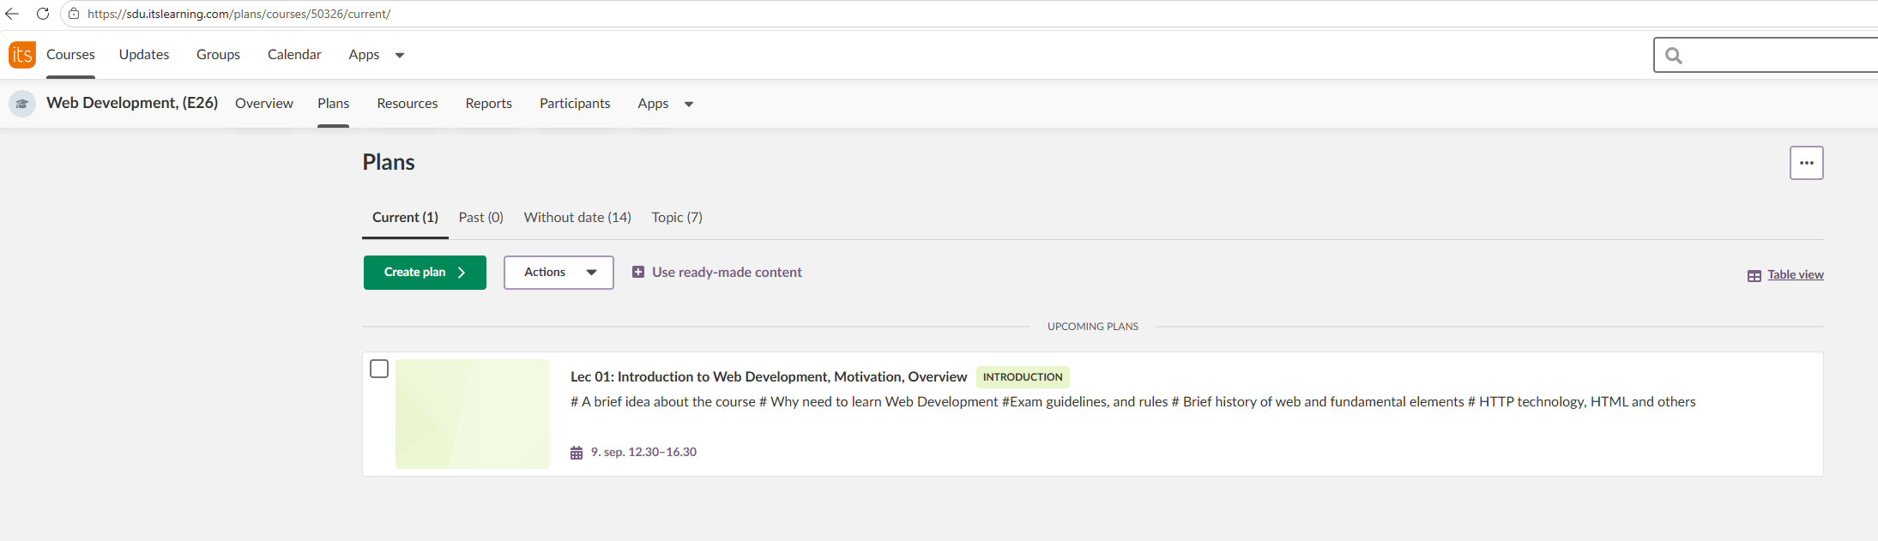
What are web apps?
Web app: applications developed using web technologies
Web technologies: basically, the internet
Software that runs on a remote server that is being accessed via a browser

Slide 37
What are web apps?
Web app: applications developed using web technologies
Web technologies: basically, the internet
Why building web apps?
    Accessible anytime, anywhere (with internet connection)
    Easier to maintain and update
    Platform independent (due to modern browsers)
    No installations (due to modern browsers)

Slide 38
Web apps have their own difficulties
Web app: applications developed using web technologies
Web technologies: basically, the internet
  Performance: data transmission + server execution
  Scalability: Multiple users at the same time
  Security: data over the internet
  Personalization and authentication: different users using the same servers

Slide 39
The Web

Slide 40
The Web
The web
Everything started in 1989 at the European Organization for Nuclear Research (CERN) in Switzerland.
Tim Berners-Lee proposed a "database of linked documents": World Wide Web.
1990: protocol, "language", browser (WorldWideWeb) and server
1991-1993: more browsers: ViolaWWW, Erwise and Mosaic
1992: The URL
1993: Goes public
1994: W3C: web standards and protocols

Slide 41


The Web
1994: Geocities
Geocities moderator, the game

Slide 42
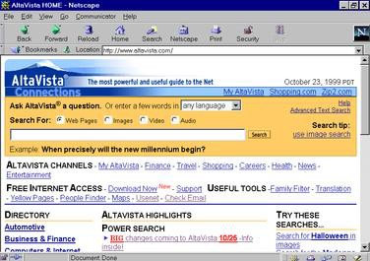
The Web
1994: Geocities
1994: Yahoo!
1995: Altavista

Slide 43
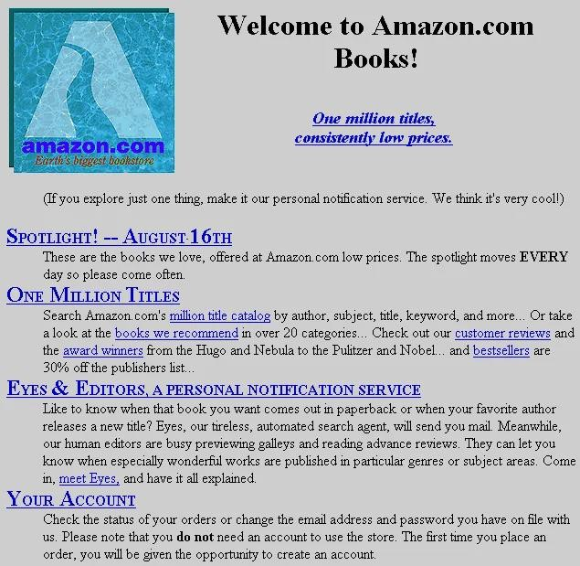
The Web
1994: Geocities
1994: Yahoo!
1995: Altavista
1995: Amazon

Slide 44
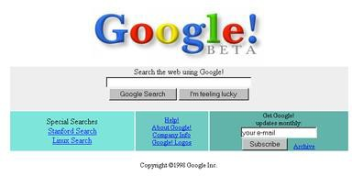
The Web
1994: Geocities
1994: Yahoo!
1995: Altavista
1995: Amazon
1998: Google

Slide 45
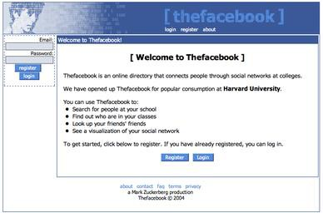
The Web
1994: Geocities
1994: Yahoo!
1995: Altavista
1995: Amazon
1998: Google
2004: Facebook

Slide 46
The Web
Web 1.0 (The Static Web) – ~1990s
Nature: Read-only web (mostly static pages).
Users: Consumers of information, not creators.
Content: Basic HTML websites, no interactivity.
Examples: Yahoo directory pages, GeoCities sites, early blogs.

Slide 47
The Web
Web 3.0 (The Decentralized / Semantic Web) – ~2015+
Read–Write–Own web. Give users control over their data and digital identity.
Features:
  Decentralization: Built on blockchain and peer-to-peer networks.
  Ownership: Users own digital assets (NFTs, tokens).
  Smart contracts: Self-executing agreements without middlemen.
  Semantic web: Machines can "understand" and process data (AI-driven).
  Privacy & security: Less reliance on centralized companies.
Examples:
  Ethereum, Solana (blockchains).
  Decentralized apps (dApps).
  Metaverse platforms (Decentraland, Sandbox).
  Crypto wallets (MetaMask).
Web 4.0 = ?

Slide 48
HTTP

Slide 49
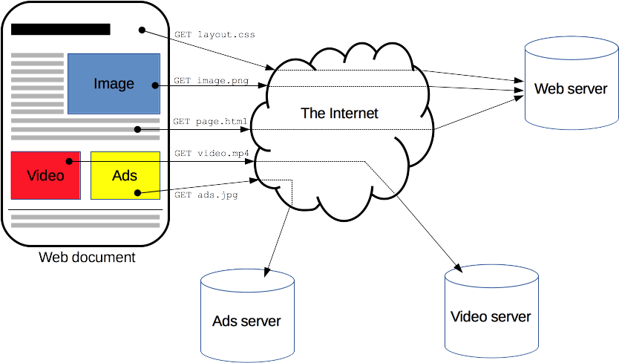
HTTP
HTTP stands for Hypertext Transfer Protocol.
It is a communication standard that allows web browsers and servers to exchange information over the internet.
Loading a page: loading resources
Client-Server protocol
HyperText Transfer Protocol
HyperText: text with links
TCP over port 80
https://developer.mozilla.org/en-US/docs/Web/HTTP/Overview

Slide 50
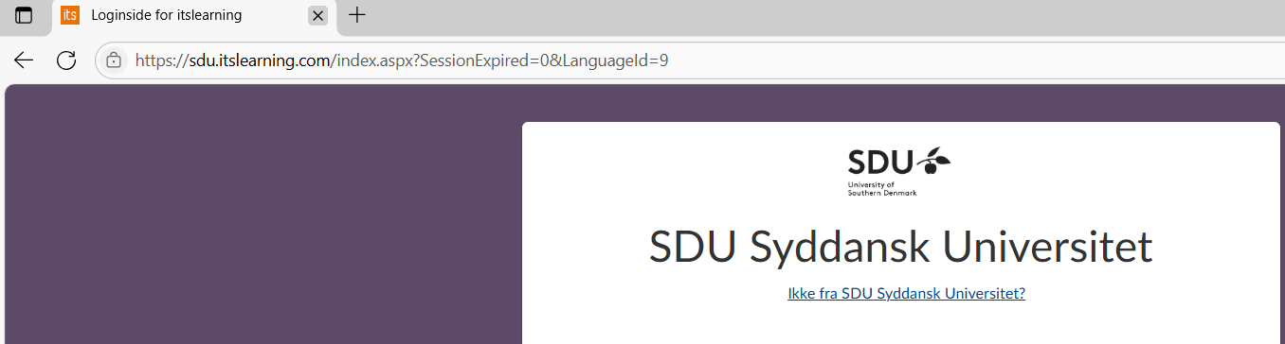
HTTPS (Hypertext Transfer Protocol Secure)
Secure version of HTTP that encrypts communication between browser and server.
Uses TLS/SSL to provide encryption, authentication, and integrity.
Establishes a handshake before data exchange.
Default standard for modern websites.
Required for many browser features (e.g., HTTP/2, geolocation APIs).

Slide 51
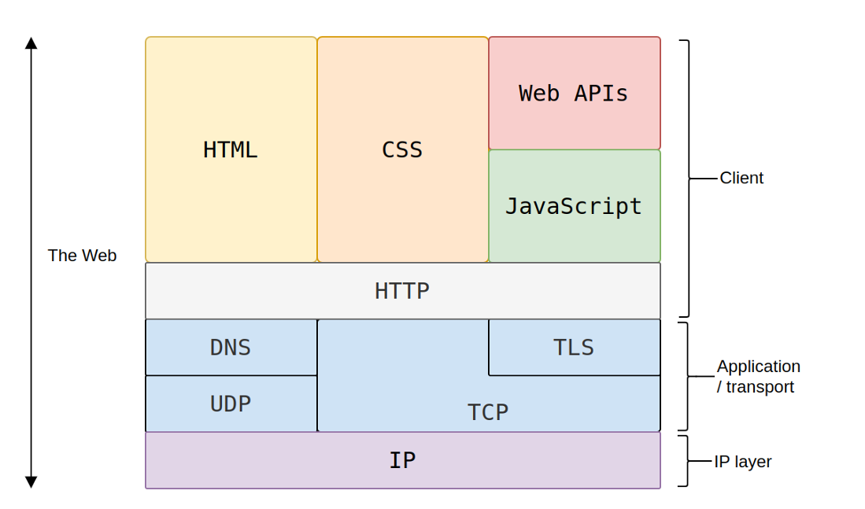
HTTP
The web consists in several layer of communications
https://developer.mozilla.org/en-US/docs/Web/HTTP/Overview

Slide 52
HTTP
The simplest structure
Client
Server

Slide 53
HTTP
In "reality"
Client
Proxy
Proxy
Server

Slide 54
HTTP
Request/Response pattern
The client asks to the server: request
Server answers to the client: response
HTTP is asymmetric
The client initiates the communication.
The Server waits for a request.
The server cannot send anything to a client without the client asked

Slide 55
HTTP
Client
Request
Server
Response

Slide 56
HTTP and Web apps
Software that runs on a remote server that is being accessed via a browser
Client
Request
Server
Response

Slide 57
HTTP and Web apps
Software that runs on a remote server that is being accessed via a browser
Client
Request
Server
Browser Front-end: UI
Server
Back-end
Response

Slide 58
HTTP
Request/Response pattern
  Client asks to the server: request
  Server answers to client: response
HTTP is asymmetric
  Client initiates the communication
  Server waits for a request
  Server cannot send anything to a client without the client asked

Slide 59
Methods
HTTP defines different types of requests: methods
GET | Request a resource: retrieve data
HEAD | Request only header
PUT | Replace entity with request payload
POST | Submit a new entity
DELETE | Delete entity
TRACE | Echo request
CONNECT | Start a two-way communications
OPTIONS | Query communication options of the resource
PATCH | Partial modification to an entity

Slide 60
Response status code
A request triggers a response, which containts a status code to indicate how the server handled the request.
1xx | Information
2xx | Success
3xx | Redirection
4xx | Client error
5xx | Server error
https://http.cat/

Slide 61
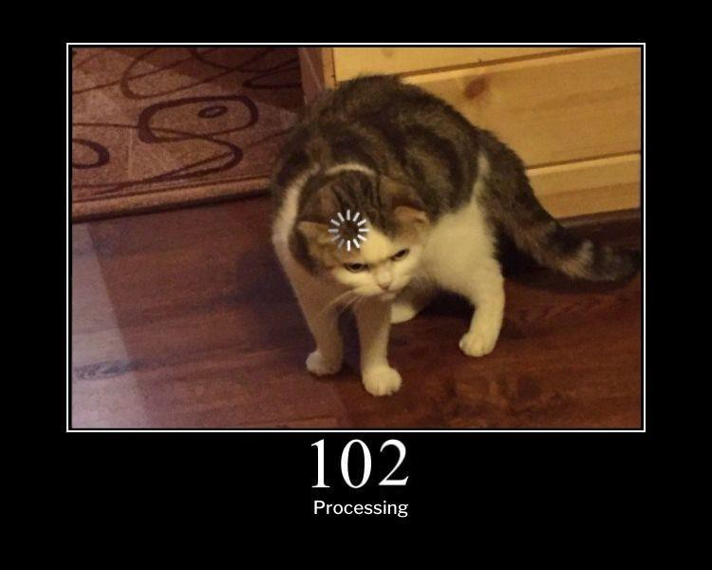
Response status code
A request triggers a response, which containts a status code to indicate how the server handled the request.
1xx | Information
2xx | Success
3xx | Redirection
4xx | Client error
5xx | Server error
https://http.cat/

Slide 62
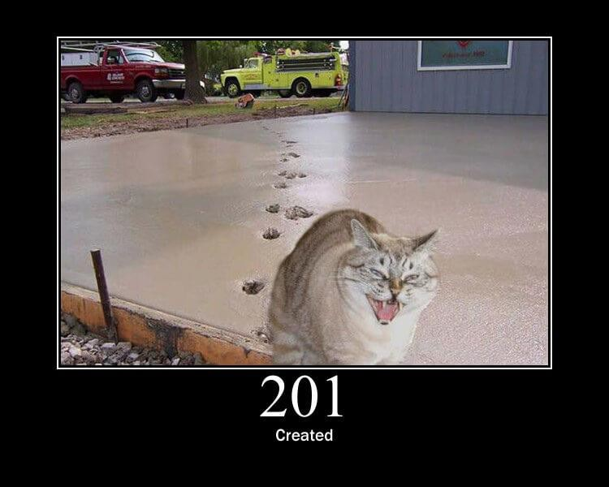
Response status code
A request triggers a response, which containts a status code to indicate how the server handled the request.
1xx | Information
2xx | Success
3xx | Redirection
4xx | Client error
5xx | Server error
https://http.cat/

Slide 63
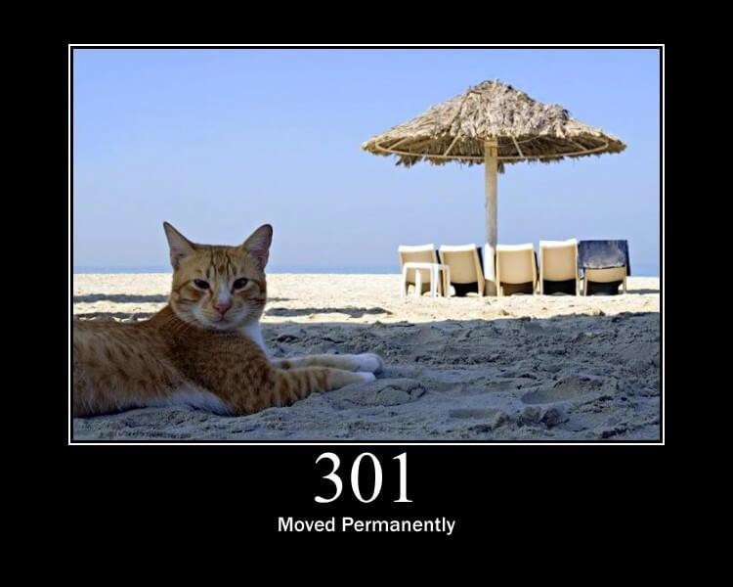
Response status code
A request triggers a response, which containts a status code to indicate how the server handled the request.
1xx | Information
2xx | Success
3xx | Redirection
4xx | Client error
5xx | Server error
https://http.cat/

Slide 64

Response status code
A request triggers a response, which containts a status code to indicate how the server handled the request.
1xx | Information
2xx | Success
3xx | Redirection
4xx | Client error
5xx | Server error
https://http.cat/

Slide 65

Response status code
A request triggers a response, which containts a status code to indicate how the server handled the request.
1xx | Information
2xx | Success
3xx | Redirection
4xx | Client error
5xx | Server error
https://http.cat/

Slide 66
Message structure
Start line: request or response line
Message headers Blank line Message body
Blank line
Message body

Slide 67
Message structure: request
Start line: request or response line
Message headers Blank line Message body
Blank line
Message body
GET /doc/test.html HTTP/1.1 Host: www.test101.com
Accept: image/gif, image/jpeg, */* Accept-Languge: en-us
Accept-Encoding: gzip, deflate
User-Agent: Mozilla/4.0 Content-Length: 35
BookId=12345&author=Tan+Ah+Teck

Slide 68
Message structure: response
Start line: request or response line
Message headers Blank line Message body
Blank line
Message body
HTTP/1.1 200 OK
Date: Sun, 08 Feb xxxx 01:11:12 GMT Server: Apache/1.3.29 (Win32)
Last-Modified: Sat, 07 Feb xxxx ETag: "0-23-4024c3a5"
Accept-Ranges: bytes Content-Length: 35
Connection: close
Content-Type: text/html
<h1>My Home page</h1>

Slide 69
Uniform Resource Locator (URL)
URLs describe the location of a resource
Format:
protocol://hostname:port/path-and-file-name
protocol | http, https, ftp, file, mailto, …
hostname | DNS domain name or IP address of server
port | TCP port number (80/443 default for http/https)
path-and-file-name | Name and location of resource
https://www.sdu.dk/-/media/images/forsiden_nytsdu/megamenu_spots_270x170px/bib-mega-4.png

Slide 70
HTTP History
HTTP/0.9
HTTP/1.0
HTTP/1.1
HTTP/2
HTTP/3

Slide 71
HTTP History
1991
First prototype Only GET
No headers Hypertext only
Connection closed after response
HTTP/0.9
HTTP/1.0
HTTP/1.1
HTTP/2
HTTP/3

Slide 72
HTTP History
HTTP/0.9
HTTP/1.0
HTTP/1.1
HTTP/2
HTTP/3
1996
Supports: GET, HEAD, POST
Headers
Not limited to hypertext (css, img …)
Connection closed after response

Slide 73
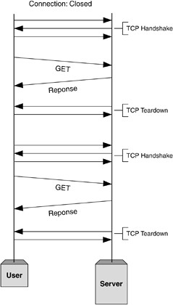
HTTP History
1996
Supports: GET, HEAD, POST
Headers
Not limited to hypertext (css, img …)
Connection closed after response
https://medium.com/platform-engineer/evolution-of-http-69cfe6531ba0

Slide 74
HTTP History
HTTP/0.9
HTTP/1.0
HTTP/1.1
HTTP/2
HTTP/3
1999
Supports: all methods Headers
Not limited to hypertext (css …)
Connection: long-lived

Slide 75
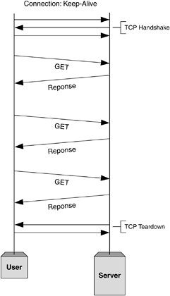
HTTP History
1999
Supports: all methods Headers
Not limited to hypertext (css …)
Connection: long-lived
Q: Why this is important? (compare with 1.0)
https://medium.com/platform-engineer/evolution-of-http-69cfe6531ba0

Slide 76
HTTP History
HTTP/0.9
HTTP/1.0
HTTP/1.1
HTTP/2
HTTP/3
2015
All previous HTTP/1.1 Reduce latency
Support for other protocols

Slide 77
HTTP History
HTTP/0.9
HTTP/1.0
HTTP/1.1
HTTP/2
HTTP/3
2021
QUIC instead of TCP
+Faster
+Reliable
+Secure
Notes:
What is the difference between TCP and UDP?

Slide 78
HTTP/3: QUIC
Always TLS, always secure (more in Security lecture)
Reliability over UDP
Connection ID: changes in IP do not interrupt connection
Multiple data streams

Slide 79
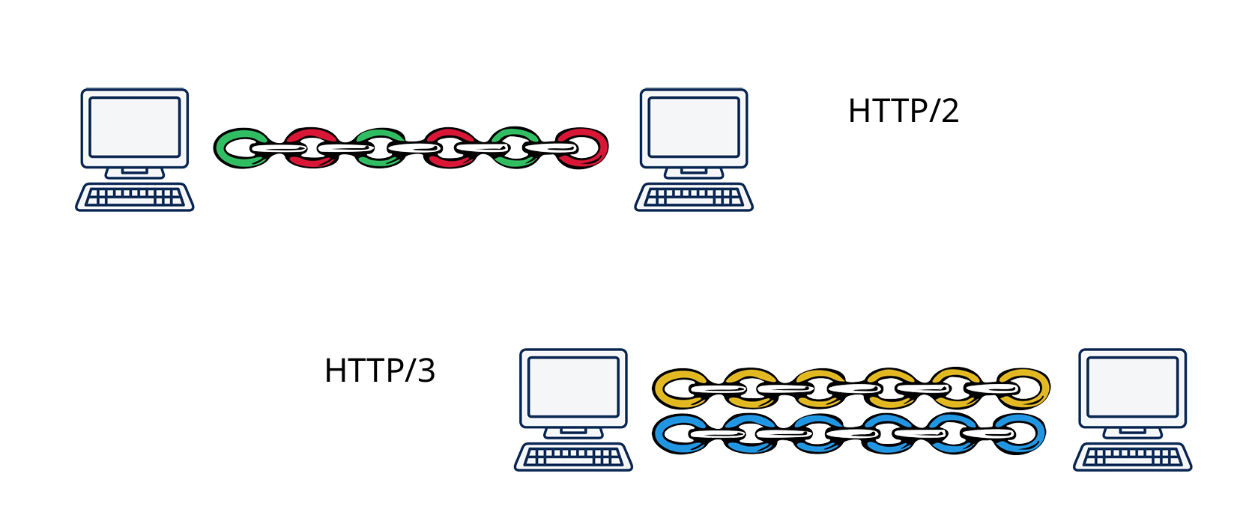
HTTP/3: Multiple streams

Slide 80
CURD

Slide 81
CURD operations
Operations for manipulating data: Create, Read, Update, delete
We use CRUD applications as an entry point to learn web apps
GET | Request a resource: retrieve data | Read
PUT | Replace entity with request payload | Update
POST | Submit a new entity | Create
DELETE | Delete entity | Delete
PATCH | Partial modification to an entit | Update

Slide 82
CURD operations
Operations for manipulating data: Create, Read, Update, delete
We use CRUD applications as an entry point to learn web apps
GET | Request a resource: retrieve data | Read | Ecommerce: products
PUT | Replace entity with request payload | Update | Blog: posts
POST | Submit a new entity | Create | Social media: comments
DELETE | Delete entity | Delete
PATCH | Partial modification to an entit | Update | Library: books

Slide 83
CURD operations
Operations for manipulating data: Create, Read, Update, delete
We use CRUD applications as an entry point to learn web apps
GET | Request a resource: retrieve data | Read | Ecommerce: products
PUT | Replace entity with request payload | Update | Blog: posts
POST | Submit a new entity | Create | Social media: comments
DELETE | Delete entity | Delete
PATCH | Partial modification to an entit | Update | Library: books
Assignments/ Exams
You must develop a web app with CRUD operations in mind

Slide 84
Chrome dev tools

Slide 85
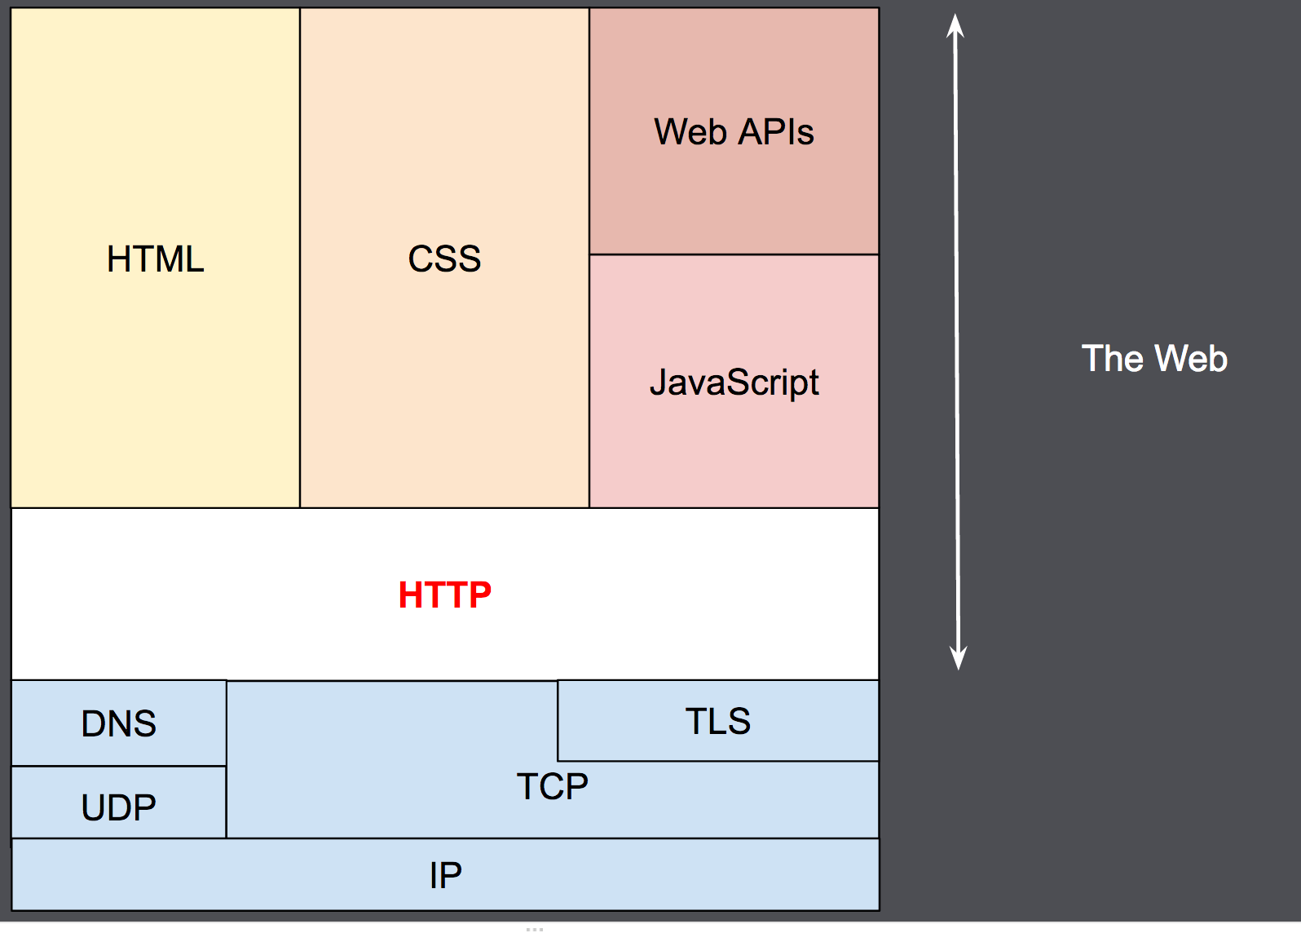
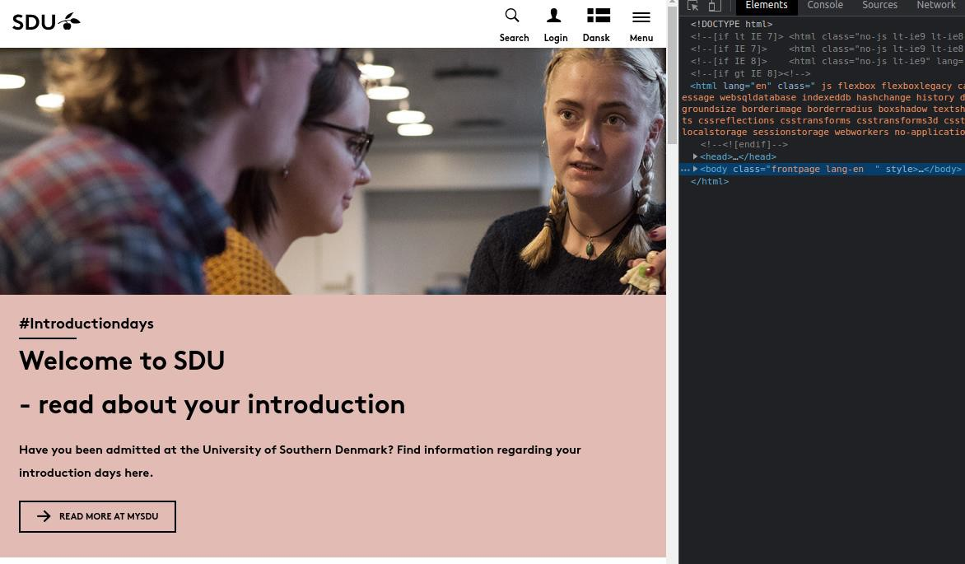
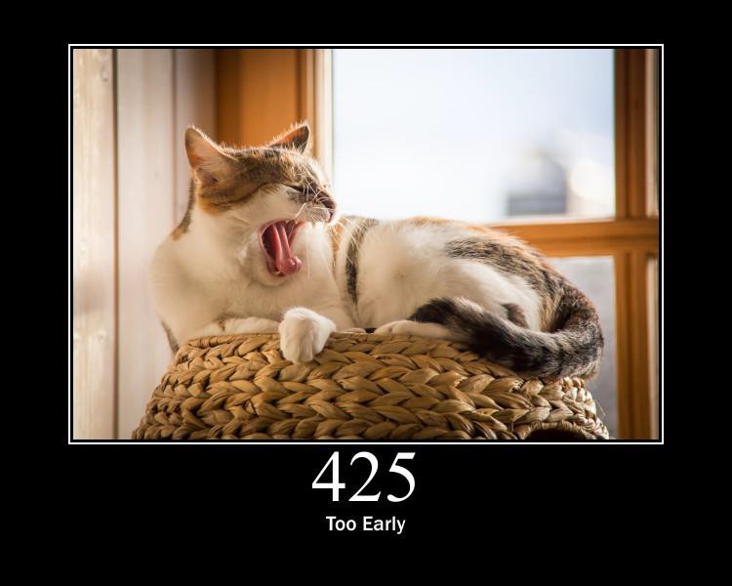
Summary
Web history
HTTP
CURD
Chrome Dev Tools

