Slide 1

Web Development
Lecture 02: Front-End (HTML-CSS)
Esmot Ara Tuli
SDU Center for Industrial Software Engineering

Slide 2
Before we start

Slide 3
Portfolio
Front-end
HTML5 semantic elements CSS
JavaScript to dynamically add/remove elements
Back-end: data manipulation
Create, Store, Edit, Delete data (using a database)
Display all resources (index), display one resource (show)
Authentication / Authorization
Log in using a password
(At least) two users: logged user and guest (not logged) user

Slide 4
Portfolio weekly task: UI Design
Before We Dive into UI Design:
Make a List of What Your Project Will Do (Functional & Non-functional Requirements), submit on its learning
Non-exhaustive: Don't worry! This list doesn’t need to be perfect or complete. I'm not grading it! The goal is to help us understand what your project will look like and if it’s big enough for this course.
Functional requirements are about what your app should do (e.g., user login, creating posts).
Non-functional requirements focus on how it should work (e.g., fast loading times, secure passwords).

Slide 5
Portfolio weekly task: UI Design
Recommendations
Start with a Simple Design (It Doesn't Have to Be Fancy!)
You can either draw it by hand or use a tool (like Figma, Sketch, or Adobe XD).
Keep it simple! Just get the basic layout and flow of the pages.
Use HTML5 Semantic Elements for Structure (We will learn today)
Style it Up with CSS (We will learn today)
Think About Where You’ll Use JavaScript (We'll Work on This Next Week!)

Slide 6
Previous Class

Slide 7
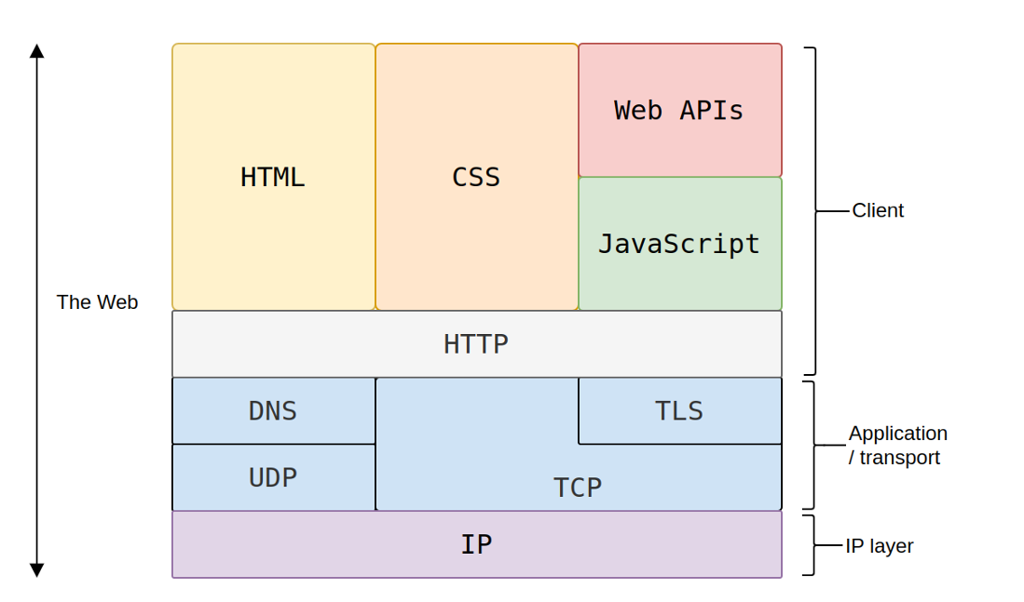
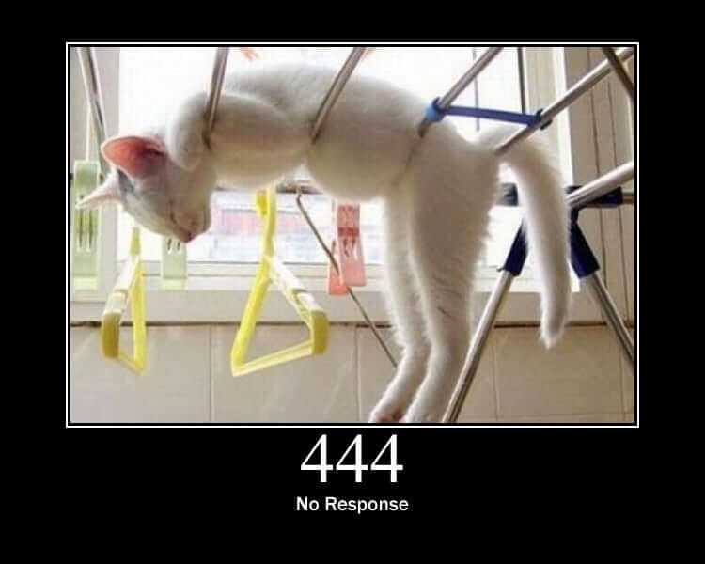
Summary
Overview & Motivation
Web history
HTTP

Slide 8
Why Front-End Matters

Slide 9

UX problems
Poor Navigation
Slow Load Times
Non-Responsive Design
Overloaded or Cluttered Interfaces
Poor Search Functionality
Many More

Slide 10
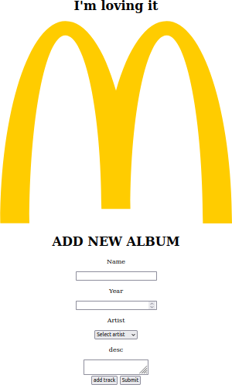
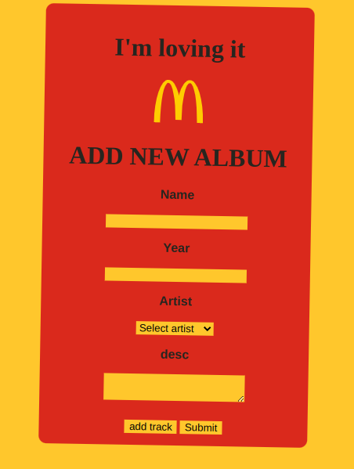

Slide 11
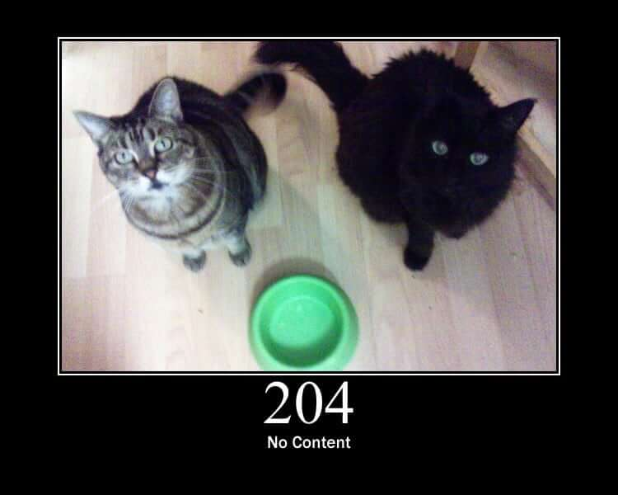
HTML

Slide 12
HTML
Hyper Text Markup Language Standard for creating web pages.
It describes a structured format for describing documents, which a web browser interprets and display as a web page.
It relies on HTML Elements.

Slide 13
HTML
HTML elements have a start and end tag
<p>Hello World</p>
A HTML page consists of several elements
<p>
Hello World
</p>
p
Start Tag
Content
End Tag
Element
<!DOCTYPE html>
<html>
<head>
. . .
</head>
<body>
. . .
</body>
</html>
Which flavor of HTML
Header: everything that is not content
Body: actual content
HTML element wraps the document

Slide 14
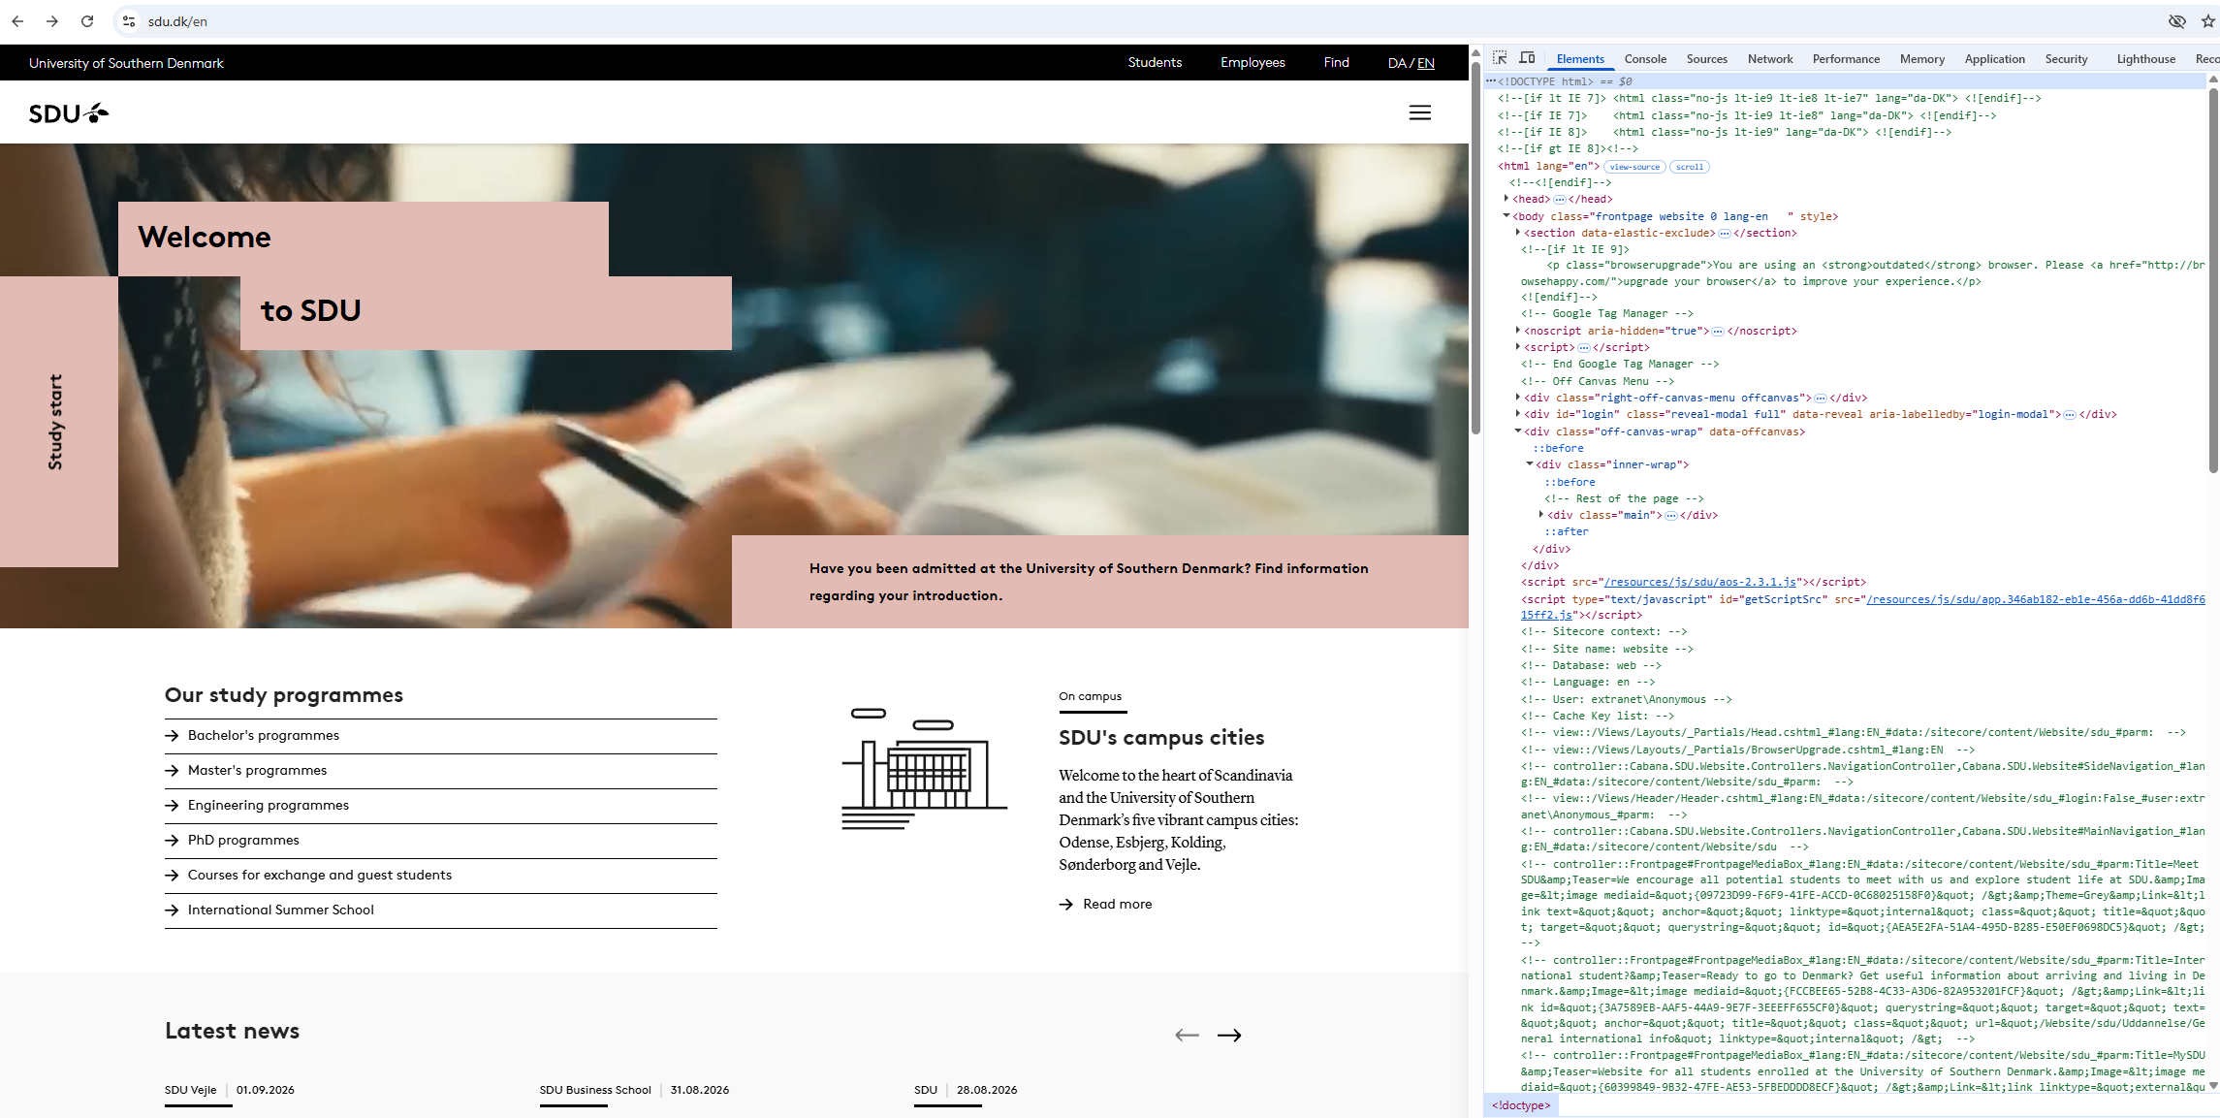
HTML

Slide 15
HTML
A HTML page consists of several elements
…
head
<!DOCTYPE html>
<html>
<head>
. . .
</head>
<body>
. . .
</body>
</html>
…
html
…
…
body
…

Slide 16
HTML elements
<h1>
<p>
<a href="a-link">
<div>
<ul> <ol>
header (h2,h3,...)
paragraph a link
a block
an unordered/ordered list
Empty elements
<img src="image">
<br/>
add image line break

Slide 17
HTML more elements
Primary
html, body, head
Body Elements
p, br, h1-h6, a, div, img, hr
Formatting Elements
em, i, strong, b, blockquote, span
Head Elements
title, style, link, script, base, meta

Slide 18
HTML element attributes
They provide additional information about the element An element can have 0 to n attributes
<div id='header' …> … </div>
<div id='header'>
...
</div>
Start Tag
Attribute name=value
Content
End Tag

Slide 19
HTML Forms

Slide 20
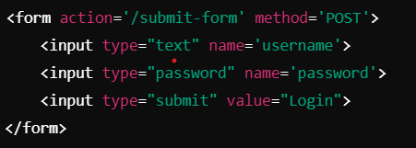
HTML Forms
HTML 2.0
Inputs from users
<form action='a-request' method='a-method'>
<input type="a-type" name='an-identifier'>

Slide 21



HTML Forms
Input types:
text
radio
checkbox
submit

Slide 22
HTML Forms
Submit with a get:
GET somepage.html?field1=value1&field2=value2
Headers Empty body
Submit with a post POST somepage.html Headers

Slide 23
HTML Forms
Submit with a get:
GET somepage.html?field1=value1&field2=value2
Headers Empty body
Submit with a post POST somepage.html Headers
Q: When using GET or POST? Why? Examples?

Slide 24
HTML History

Slide 25
HTML History
HTML 1
HTML 2
HTML 3
HTML 4
HTML 5
1993

Slide 26
HTML History
HTML 1
HTML 2
HTML 3
HTML 4
HTML 5
1995
Form
Table

Slide 27
HTML History
HTML 1
HTML 2
HTML 3
HTML 4
HTML 5
1997
Several improvements

Slide 28
HTML History
HTML 1
HTML 2
HTML 3
HTML 4
HTML 5
1997
Several improvements

Slide 29

HTML History
2008
No more flash
Semantic elements
HTML 1
HTML 2
HTML 3
HTML 4
HTML 5

Slide 30
HTML 5 more elements
Graphic
video, audio, canvas Expandable sections summary, details Semantic elements
header, article, section, footer, nav

Slide 31
HTML Semantic Element vs Non-Semantic
Semantic HTML Elements
These elements clearly describe their purpose and the type of content they contain.
Examples: <header>, <footer>, <article>, <section>, <nav>, <aside>, <main>
Non-Semantic (Normal) HTML Elements
These elements don’t provide any meaning about the content they wrap. They are generic containers.
Examples: <div>, <p>

Slide 32
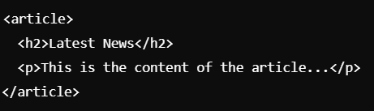
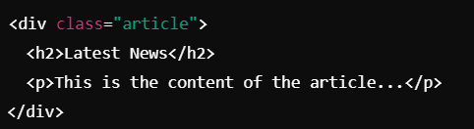
HTML Semantic Element vs Non-Semantic
<div>
<h2>Latest News</h2>
<p>This is the content of the article...</p>
</div>

Slide 33
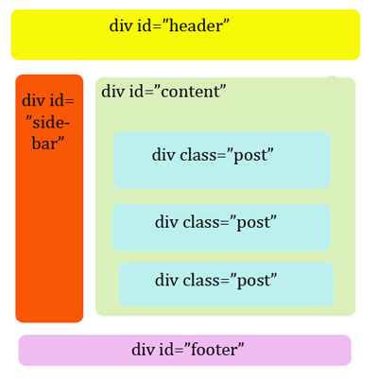
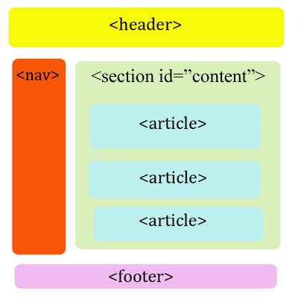
HTML Semantic Element vs Non-Semantic
Add semantic to your content
Before: HTML4
After: HTML5
https://ltlatnd.wordpress.com/2010/05/04/what-is-html5/

Slide 34
HTML 5 Semantic model
Add semantic to your content
Useful for
Search engines
Other websites
Web accessibility
https://ltlatnd.wordpress.com/2010/05/04/what-is-html5/

Slide 35
HTML History
But…
HTML 1
HTML 2
HTML 3
HTML 4
HTML 5
XML is for data representation and structure, while HTML is for displaying content on the web.
Use XHTML if you need strict XML compliance and integration with XML-based systems, or if you’re working with legacy systems that use XHTML. However, for most modern web development, HTML5 is generally recommended due to its broader feature set, flexibility, and support across browsers.

Slide 36
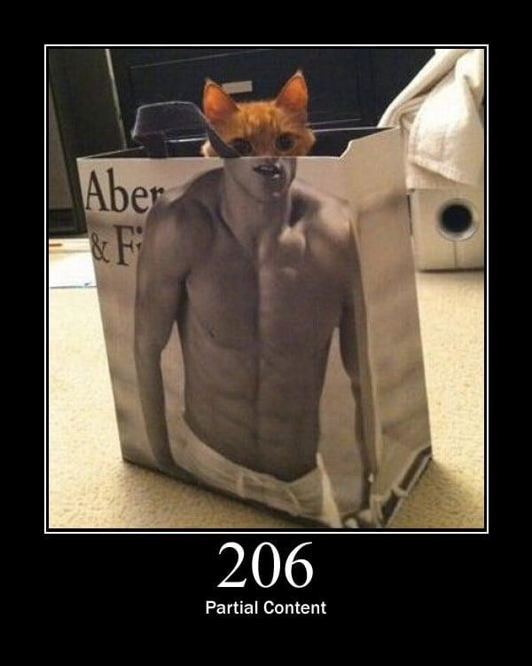
CSS

Slide 37
CSS
Cascading Style Sheets
CSS describes rules about the style and layout of web pages
HTML structures web pages
CSS makes web pages look good (or bad)

Slide 38

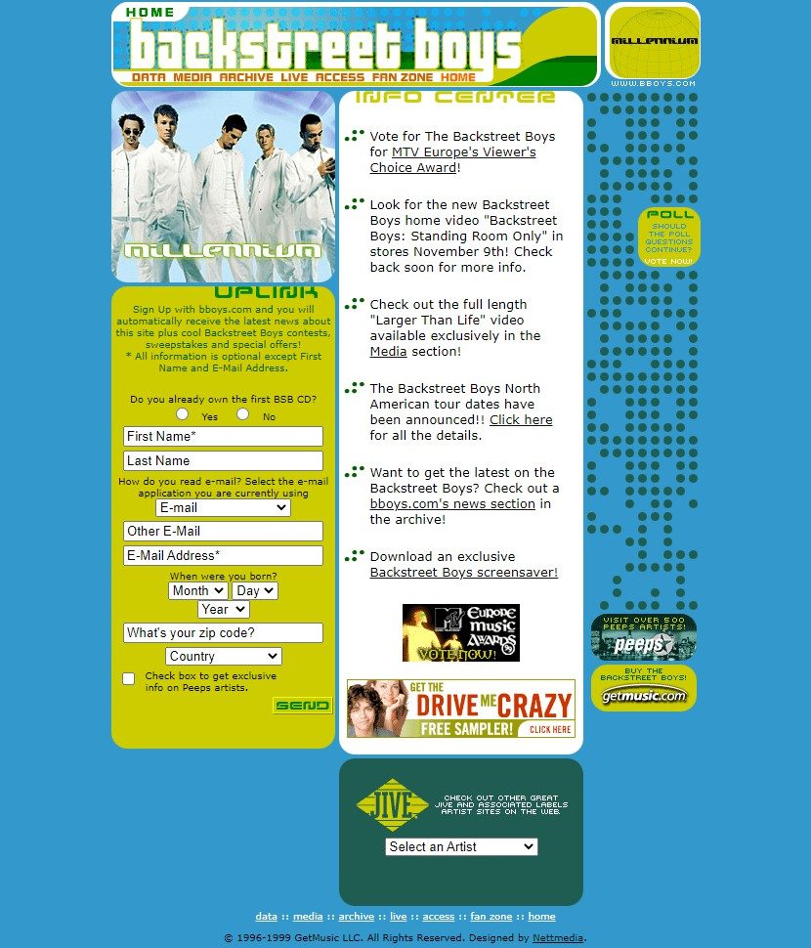
CSS

Slide 39
CSS
CSS rule
Selector
Declarations (separated by semicolon)
p {background-color : purple; }
Property Value

Slide 40
CSS
Same tag declaration:
<p style="color: red; margin-left: 20px">
Do not do this
Document declaration:
<head>
<style type="text/css"> p {
background-color: red; margin-left: 20px;
}
</style>
</head>
File declaration
<head>
<link rel="stylesheet" type="text/css" href="file.css" />
</head>

Slide 41
CSS properties
background-color: <color> color: <color>
font-weight: <normal|bold|lighter … > width: <number px,cm,… | number % …> height: <number px,cm,… | number % …>
For some values, you can use functions!
calc(), max(), min() rgb(), rgba()
https://www.w3schools.com/csSref/css_functions.asp

Slide 42
CSS selectors
Selectors:
p {…} applies over p
div, h1 {…} applies over div, h1
#id{…} applies over element with attribute id="id"
.class {…} applies over element with attribute class="class"
class is one of the most common ways of adding style

Slide 43
CSS selectors
A selector can select multiple HTML elements
p {background-color : purple; }
Affects every p element

Slide 44
CSS selectors
A HTML element can be affected by multiple selectors
p {background-color : purple; }
Affects every p element
.bold {font-weight: bold;}
Affects element with class bold

Slide 45
CSS selectors
A HTML element can be affected by multiple selectors
p {background-color : purple; }
Affects every p element
.bold {font-weight: bold;}
Affects element with class bold
Class are often used for CSS style An element can have multiple classes
A class can be assigned to multiple elements

Slide 46
CSS order of rules
Precedence of rules (for same rules)
Inline > Internal > External
More specific selectors over less specific
p{…. }< p.bold
Latest rule win (if equal specificity)
!important Always takes precedence

Slide 47
Add CSS
There are three ways of inserting a style sheet:
External CSS
Internal CSS
Inline CSS

Slide 48
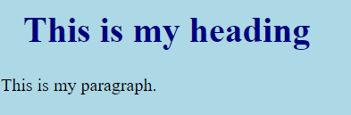
External CSS
With an external style sheet, you can change the look of an entire website by changing just one file!
Each HTML page must include a reference to the external style sheet file inside the <link> element, inside the head section.
<!DOCTYPE html>
<html>
<head>
<link rel="stylesheet" href="mystyle.css">
</head>
<body>
<h1>This is my heading</h1>
<p>This is my paragraph.</p>
</body>
</html>
body {
background-color: lightblue;
}
h1 {
color: navy;
margin-left: 20px;
}

Slide 49
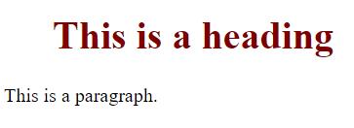
Internal CSS
The internal style is defined inside the <style> element, inside the head section.
An internal style sheet may be used if one single HTML page has a unique style.
<!DOCTYPE html>
<html>
<head>
<style>
h1 {
color: maroon;
margin-left: 40px;
}
</style>
</head>
<body>
<h1>This is a heading</h1>
<p>This is a paragraph.</p>
</body>
</html>

Slide 50
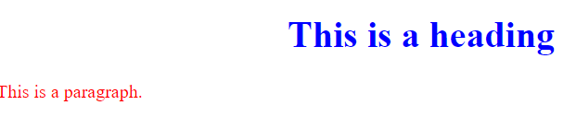
Inline CSS
An inline style may be used to apply a unique style for a single element.
To use inline styles, add the style attribute to the relevant element. The style attribute can contain any CSS property
<!DOCTYPE html>
<html>
<body>
<h1 style="color:blue;text-align:center;">This is a heading</h1>
<p style="color:red;">This is a paragraph.</p>
</body>
</html>

Slide 51
CSS order of rules
Precedence of rules (for same rules) Inline > Internal > External
More specific selectors over less specific
p {…} < p.bold
Latest rule win (if equal specificity)
!important Always takes precedence
Inline style (inside an HTML element)
External and internal style sheets (in the head section)

Slide 52
CSS advanced selectors
CSS can select elements inside other elements
ul li {}
Every descendant li of ul
ul > li {}
Every direct descendant li of ul

Slide 53
CSS advanced selectors
CSS can select siblings
p + p {}
Adjacent sibling p(right) of p(left)
div ~ p {}
Every sibling p of div

Slide 54




CSS pseudo-classes
CSS offers pseudo-classes to define styles for different states of an element during user interaction. These pseudo-classes are useful for creating dynamic effects without using JavaScript.
Define special states of elements
:visited, :active, :hover
Define special structure of elements
:first-child, :last-child, :nth-child

Slide 55
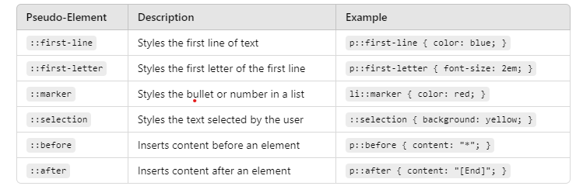
CSS pseudo-elements
For specific parts of an element
::first-line, ::first-letter, ::marker, ::selection
Insert elements
::before, ::after

Slide 56
Layout

Slide 57

Box Model
Content: Where the actual text or image sits.
Padding: Space between the content and the border.
Border: The visual outline of the element.
Margin: Space outside the border, affecting spacing between elements
https://www.w3schools.com/Css/css_boxmodel.asp

Slide 58
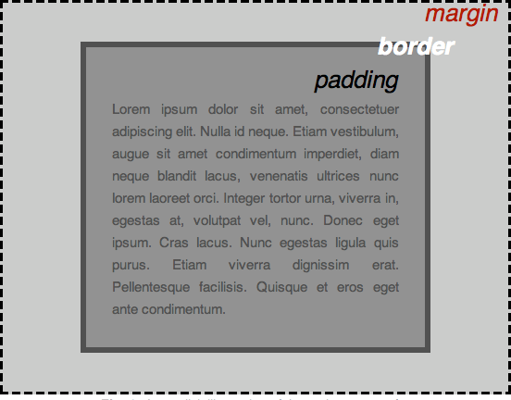
Box Model
div {
padding : 0 20px 20px 20px; border: 5px solid black;
margin: 0 20px 20px 20px;
}
https://developer.mozilla.org/en-US/docs/Learn/Getting_started_with_the_web/CSS_basics

Slide 59
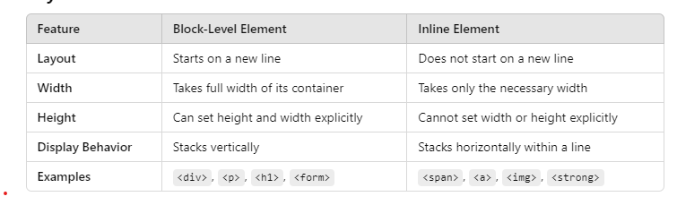
Layout
Block-level elements: new line and takes full available width
div, hx, p, form, header, footer
Inline elements: no new line and takes necessary width
span, a, img

Slide 60
Layout
Changing the default display value
div | {display: | none;}
div | {display: | inline;}
div | {display: | block;}
div | {display: | inline-block;}
Remove elements
div {display: none;}
div {visibility: hidden;}
as the element never existed disappears, but still takes space

Slide 61
Layout
Horizontal Alignment: how elements are positioned from left to right within a container
Vertical alignment: how elements are aligned from top to bottom within a container. This is typically more difficult than horizontal alignment, but there are several methods to achieve it
https://www.w3schools.com/css/css_align.asp

Slide 62
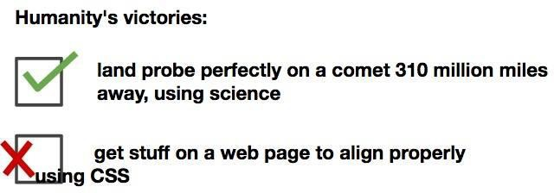
Layout
Vertical align
https://www.w3schools.com/css/css_align.asp

Slide 63

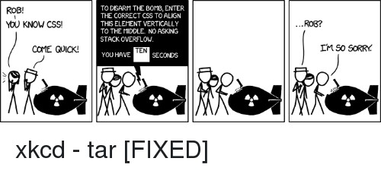
Layout
Vertical align
https://www.w3schools.com/css/css_align.asp
https://xkcd.com/1168/

Slide 64
Layout
Original comic
https://xkcd.com/1168/

Slide 65
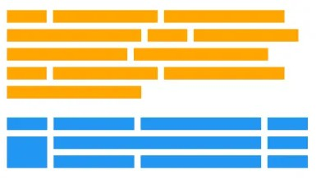
Layout
https://www.w3schools.com/csS/css3_flexbox.asp
Flexbox allows to align and distribute space among items in a container horizontally and vertically.
display: flex: for the container.
flex-direction: to set item direction (row/column).
justify-content: for horizontal alignment.
align-items: for vertical alignment.
Flexbox
Grid allows to create two-dimensional layouts with rows and columns. It provides precise control over both horizontal and vertical spacing.
display: grid: for the container.
grid-template-columns and grid-template-rows to define column and row sizes.
grid-area to place items into specific areas of the grid.
justify-items and align-items for item alignment within the grid cells.
https://www.w3schools.com/css/css_grid.asp

Slide 66
Summary

Slide 67
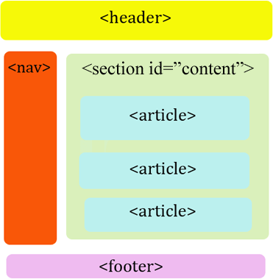
Summary
HTML CSS

Slide 68
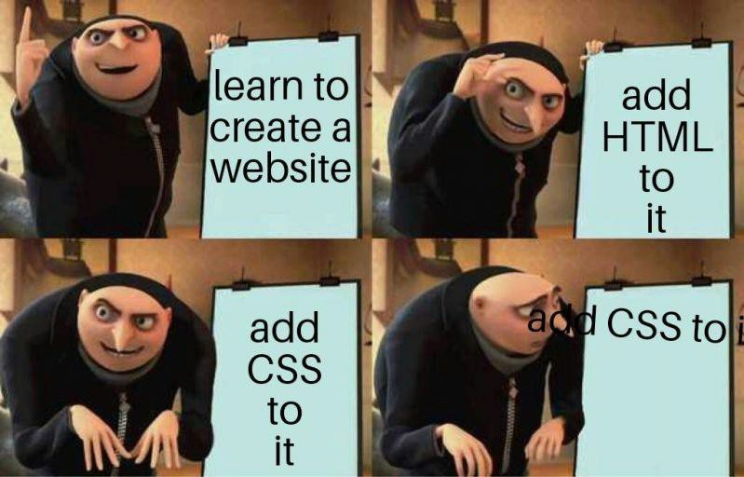
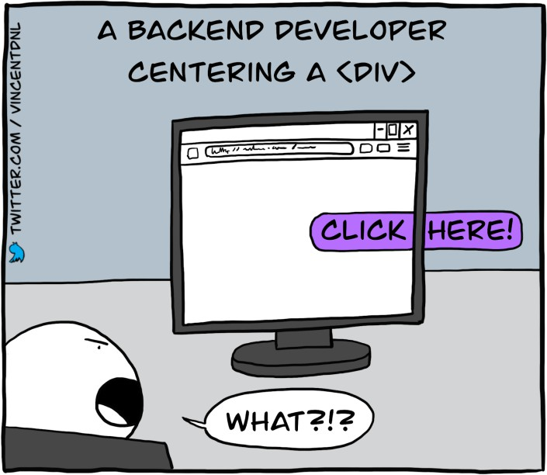
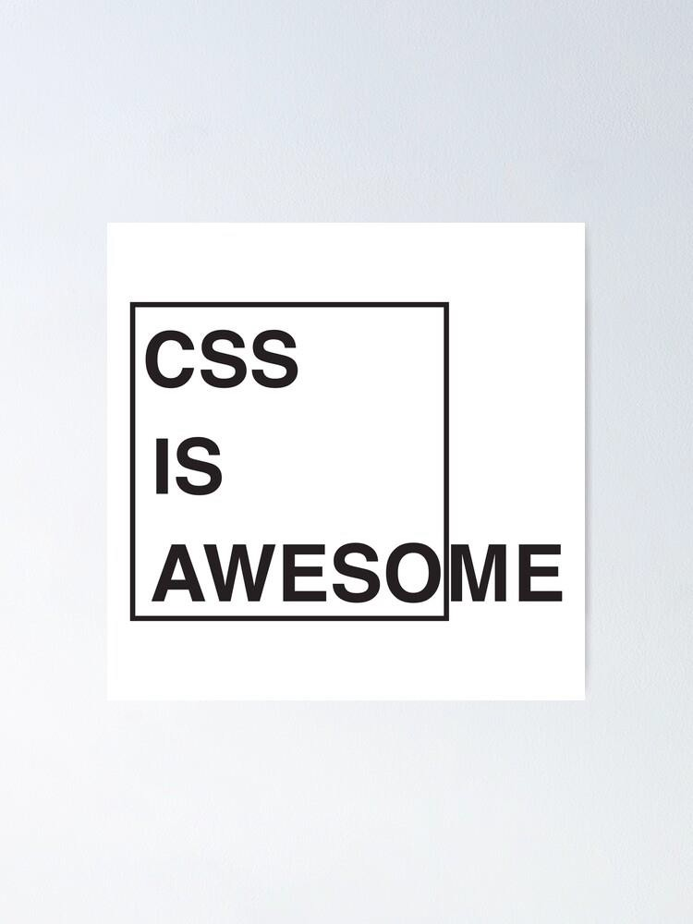

Summary

