Slide 1
学习资源
视频:
最常用ML算法汇总: https://youtu.be/E0Hmnixke2g?si=CHCM1yYQ5jasJf4w
文章:
最常用ML算法汇总: https://www.simplilearn.com/10-algorithms-machine-learning-engineers-need-to-know-article
ML学习网站:
Kaggle: https://www.kaggle.com
Huggingface: https://huggingface.co

Slide 2
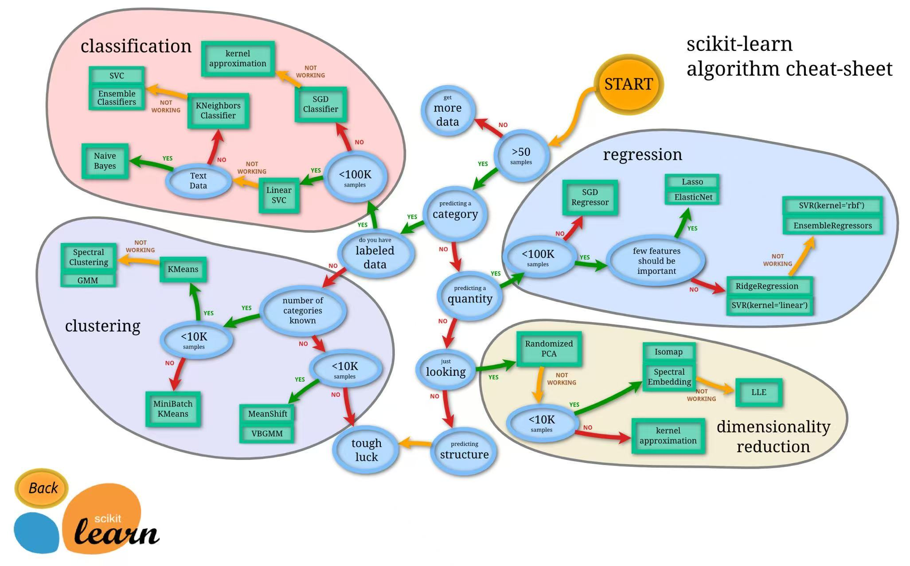
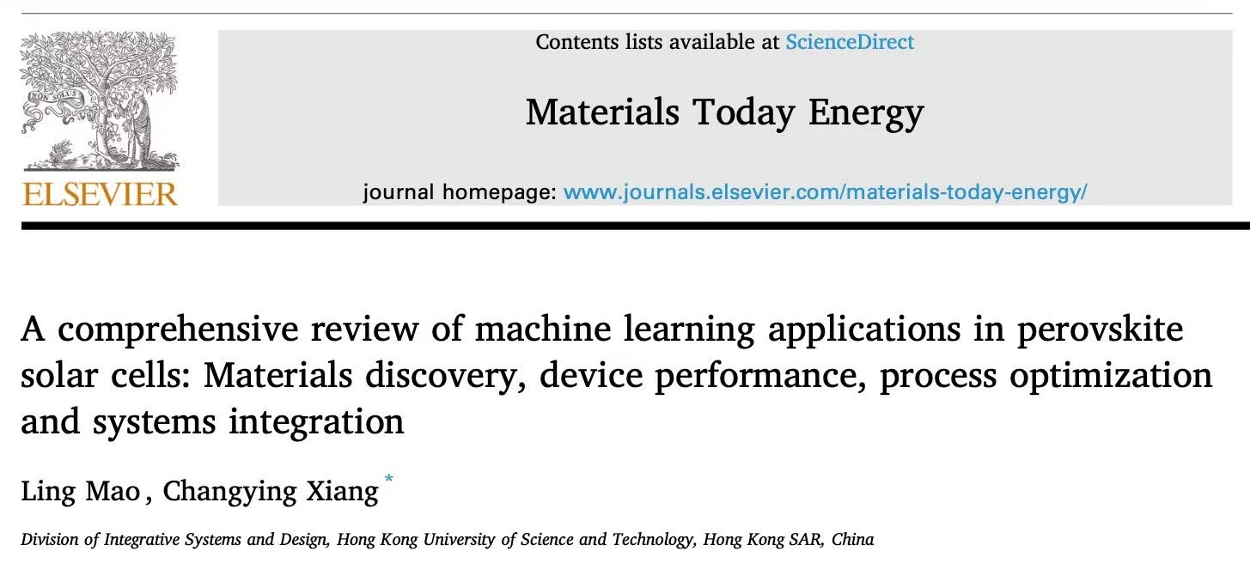
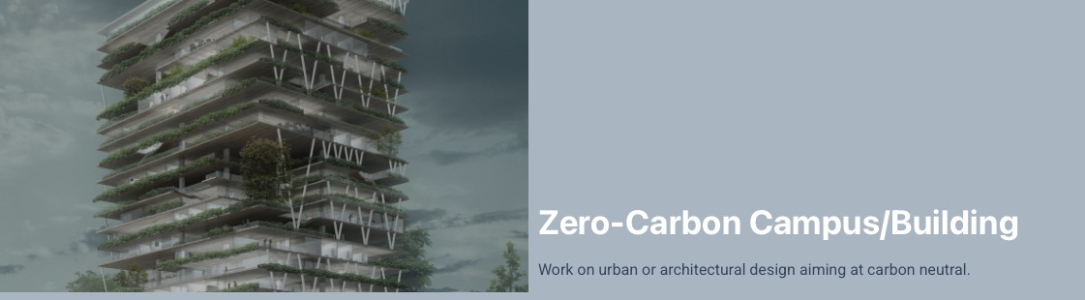
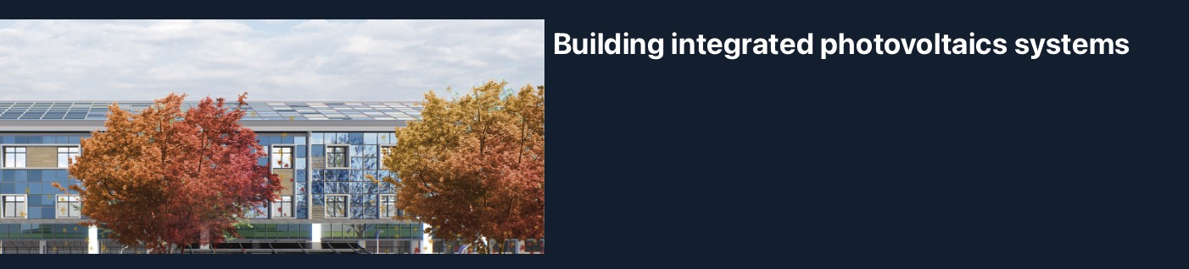
汇报内容
Most used ML algorithm
linear regression
support vector machine(svm)
logistic regression
k nearest neighbors
decision tree
k means
naïve bayes
random forest(rf)
boosting algorithm
dimensionality reduction algorithm

Slide 3
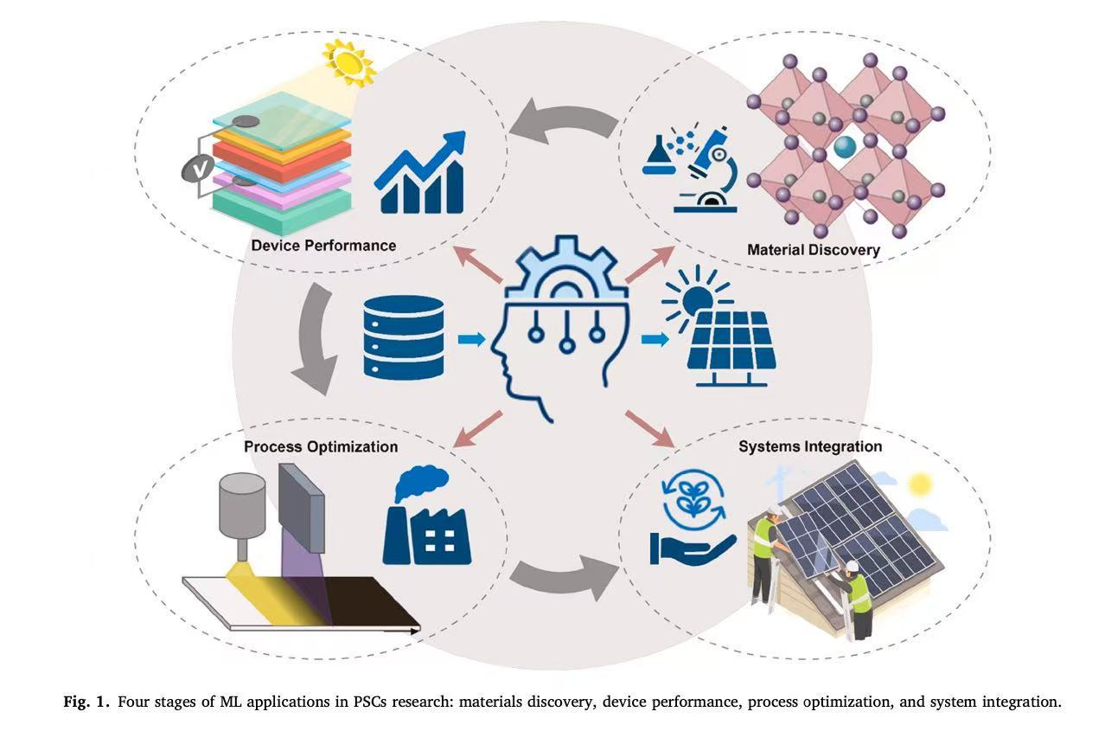
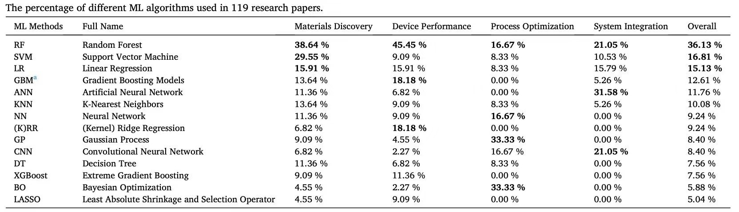
文章内容

Slide 4
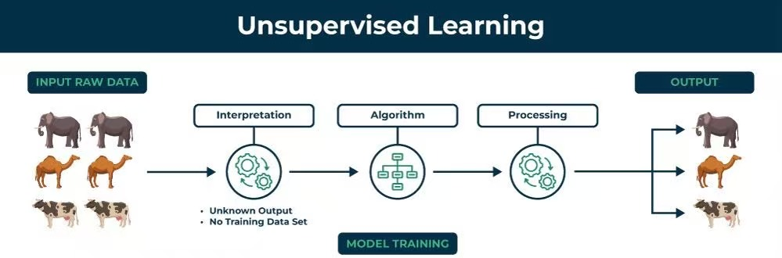
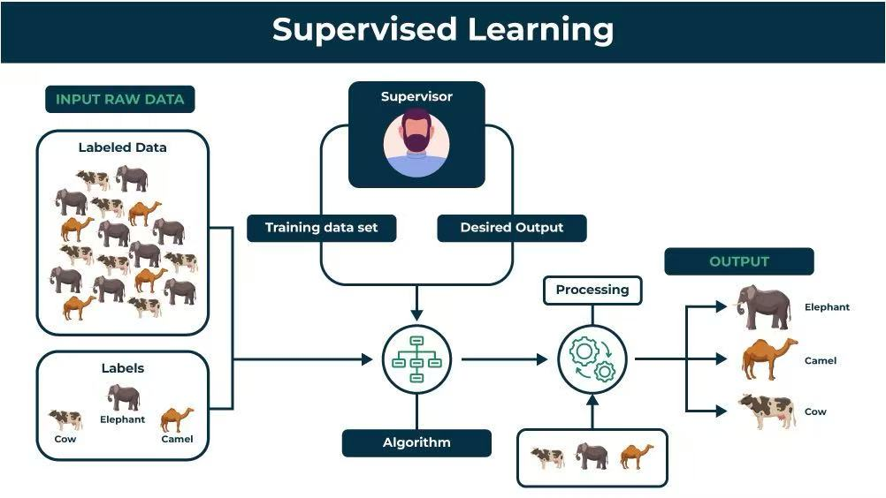
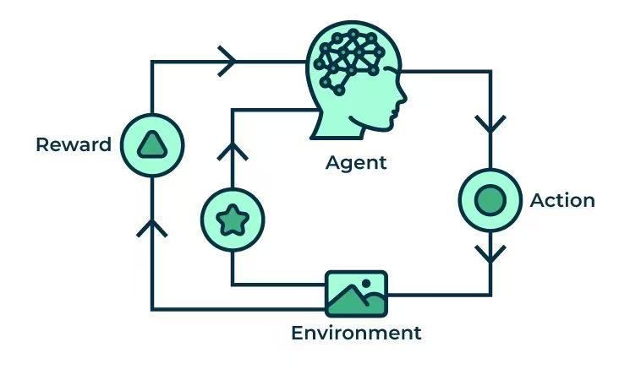
ML算法分类
Reinforcement learning

Slide 5
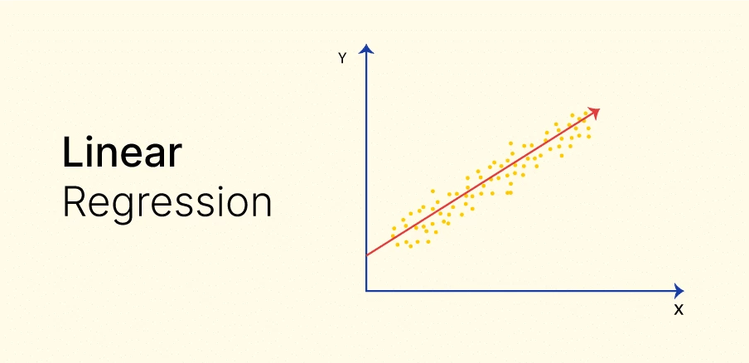
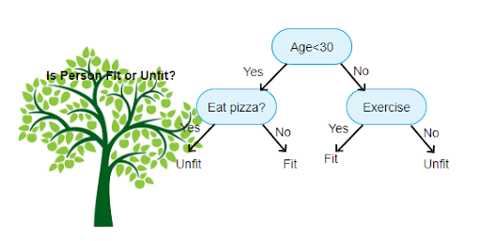
LINEAR REGRESSION
Mother of all algorithm
Y = aX + B
a&b -> minimizing the sum of the squared difference
DECISION TREE
Easiest: a bunch of yes or no questions

Slide 6
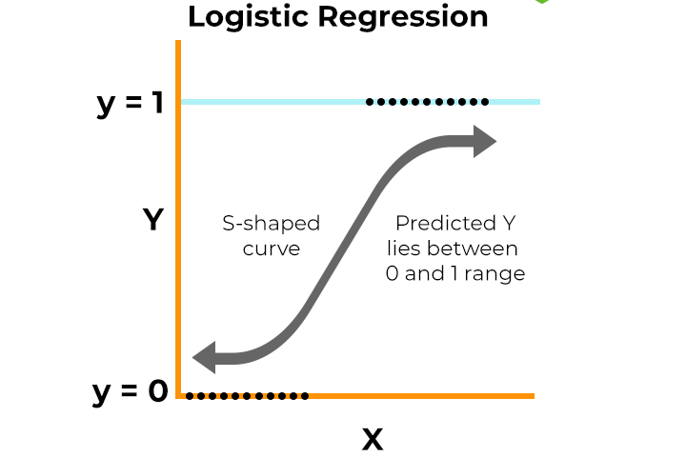
LOGISTIC REGRESSION
Attention: Y is discrete values(usually binary values like 0/1)
Using regression method to solve classification
problem

Slide 7
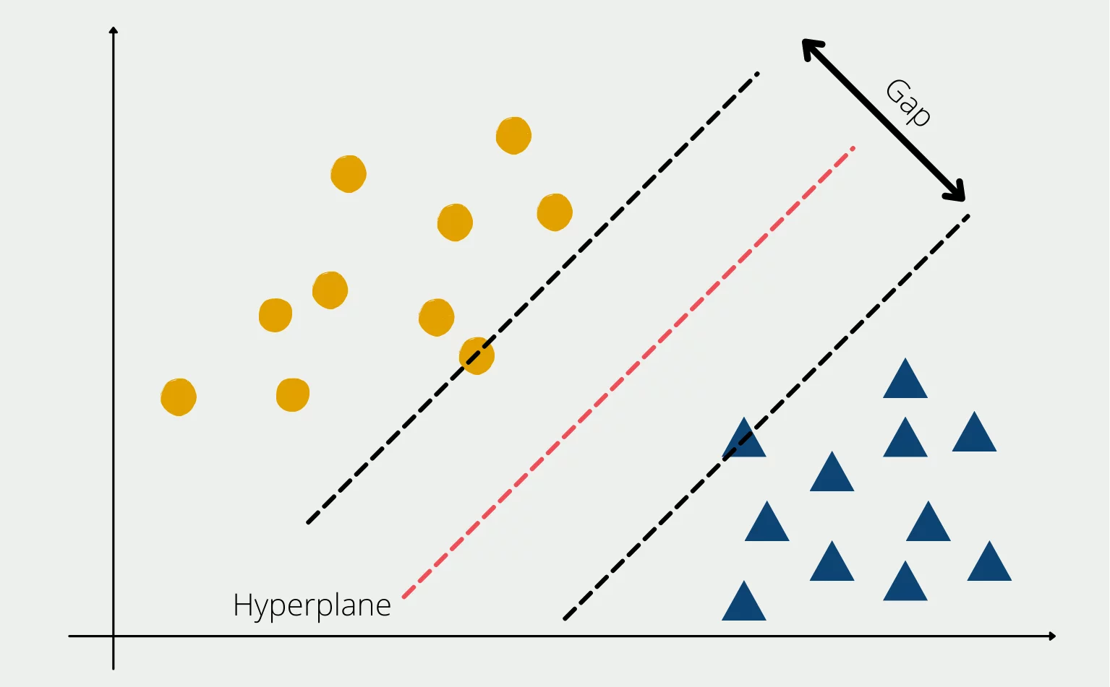
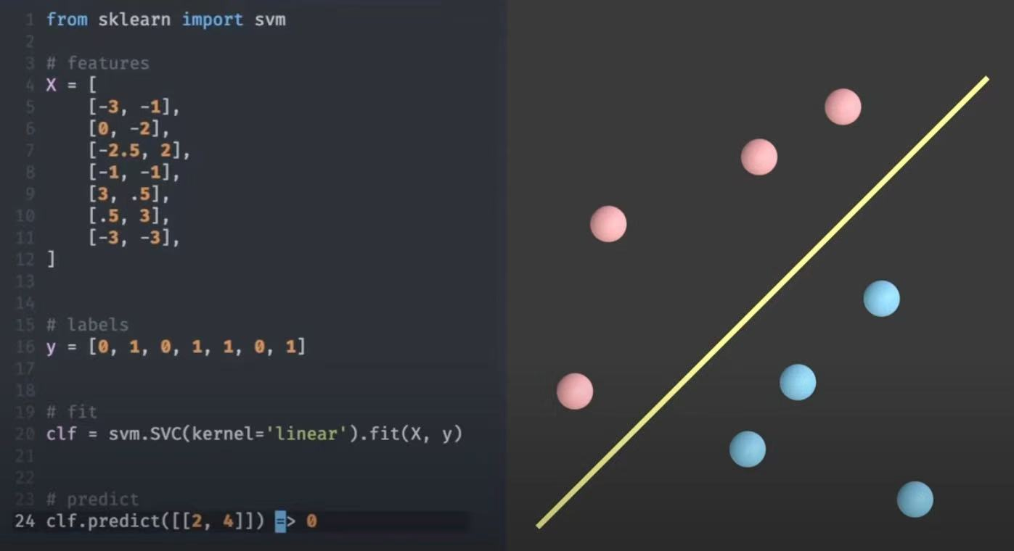
SUPPORT VECTOR MACHINE(SVM)
The separation is based on specific data point(vector)
Hyperplane: it might be a plane or line or multi-D separation

Slide 8
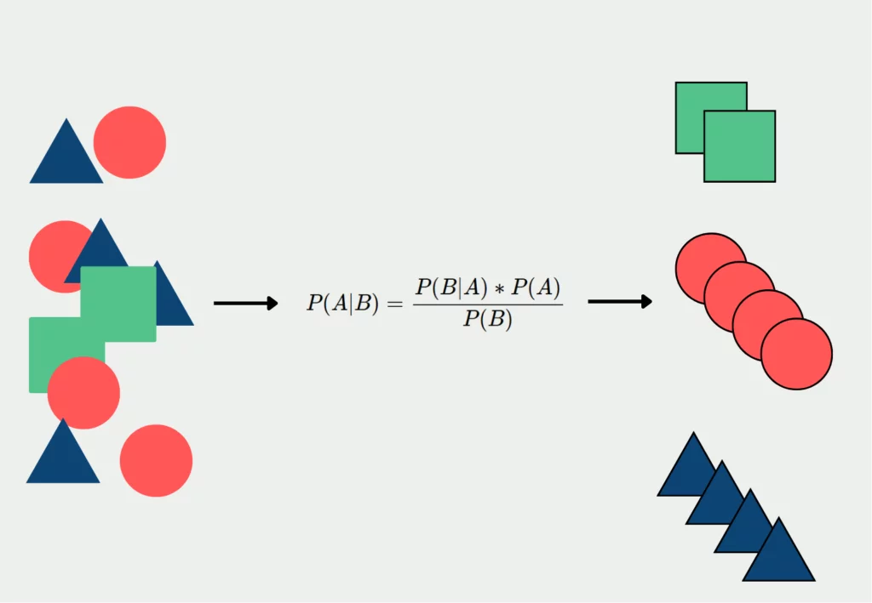
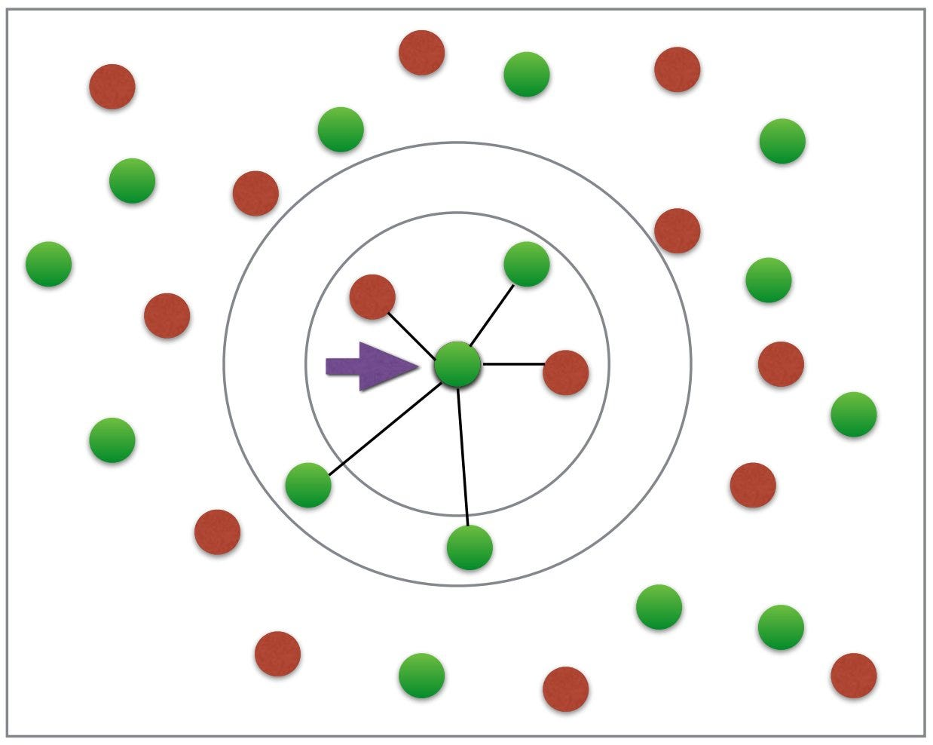
NAÏVE BAYES
Bayes: it consider also prior facts
Naïve: it doesn’t consider the correlation between different features
K NEAREST NEIGHBORS
一个人的工资是他身边最好朋友的5个朋友的平均值

Slide 9
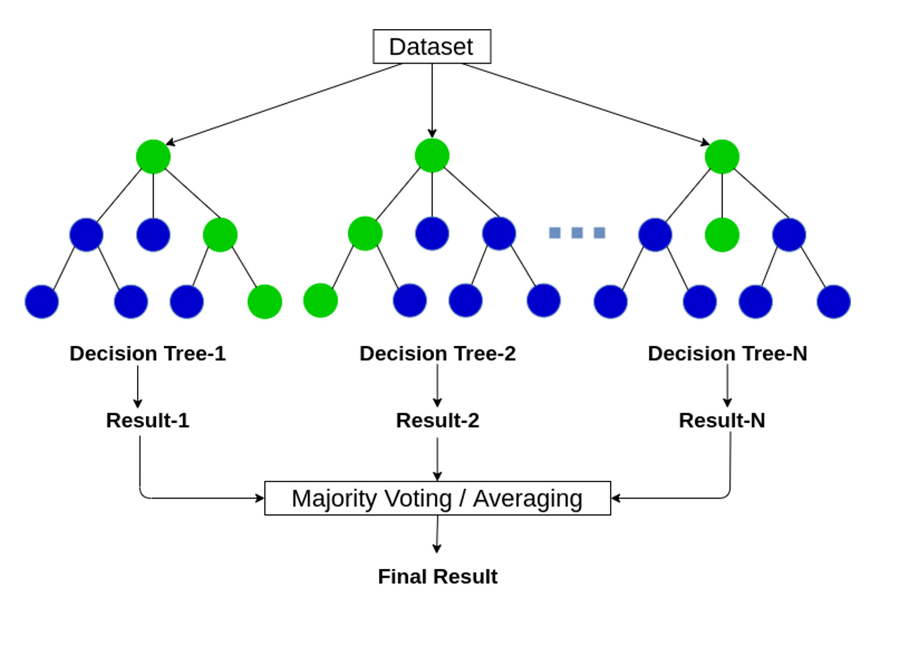
RANDOM FOREST(RF)
RF: a collective of decision trees
Each tree is trained with a random subset of the dataset
RF chooses the result having the most votes

Slide 10
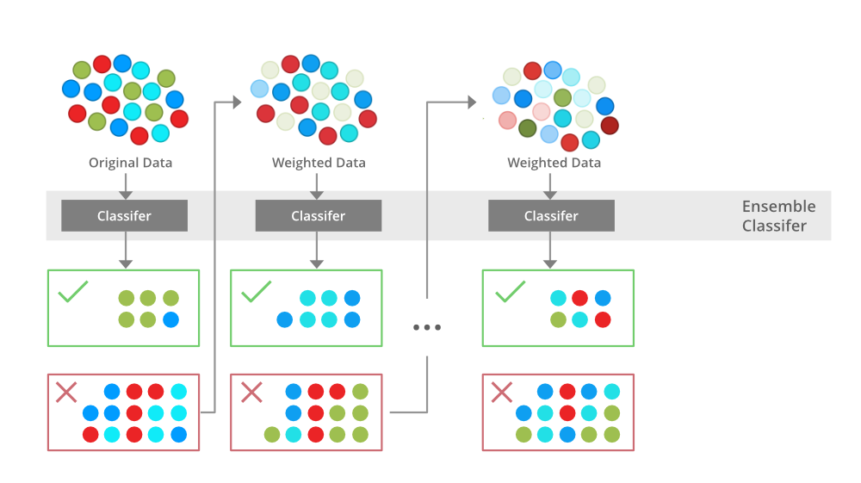
BOOSTING ALGORITHM
核心：使用一群中等模型来组成一个强大模型

Slide 11
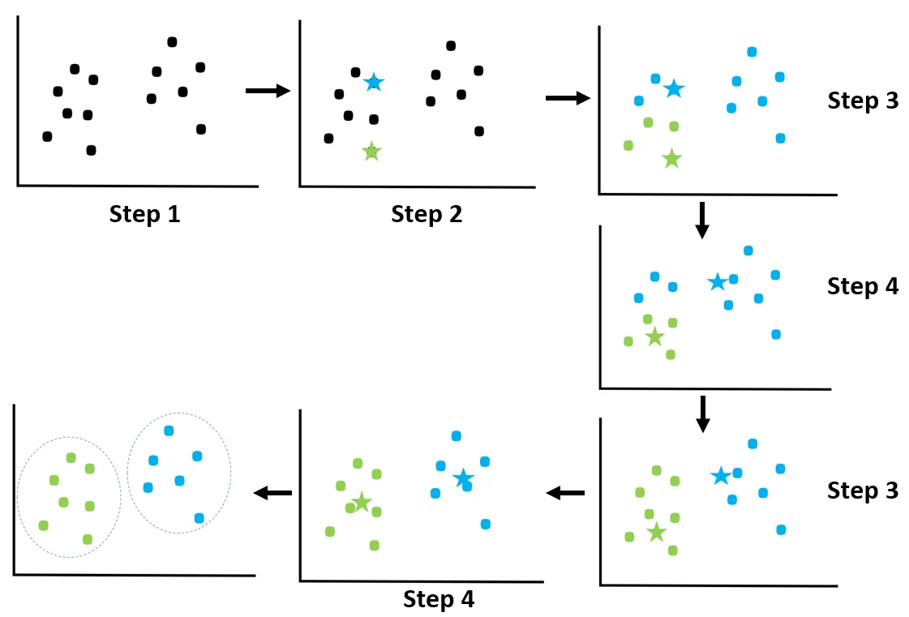
K MEANS
挑选中心
分组
否
重新挑选中心
是否稳定
是
是否稳定

Slide 12
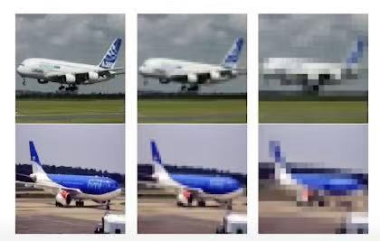
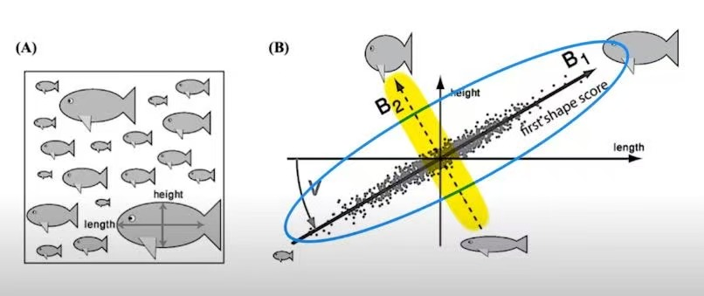
DIMENSIONALITY REDUCTION ALGORITHM
寻找描述符之间的联系
去掉多余的描述符

Slide 13
CHEAT SHEET OF SCIKIT-LEARN
随机挑选子集来优化参数，来使得模型更准确，不是ML算法，注意
Stochastic Gradient Descent
就是一个加了描述符挑选的线性回归（linear regression）
Least absolute shrinkage and selection operator
Kernel是一种转化数据空间的方式

Slide 14
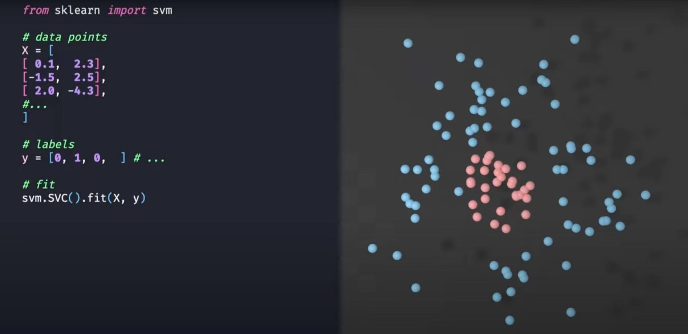
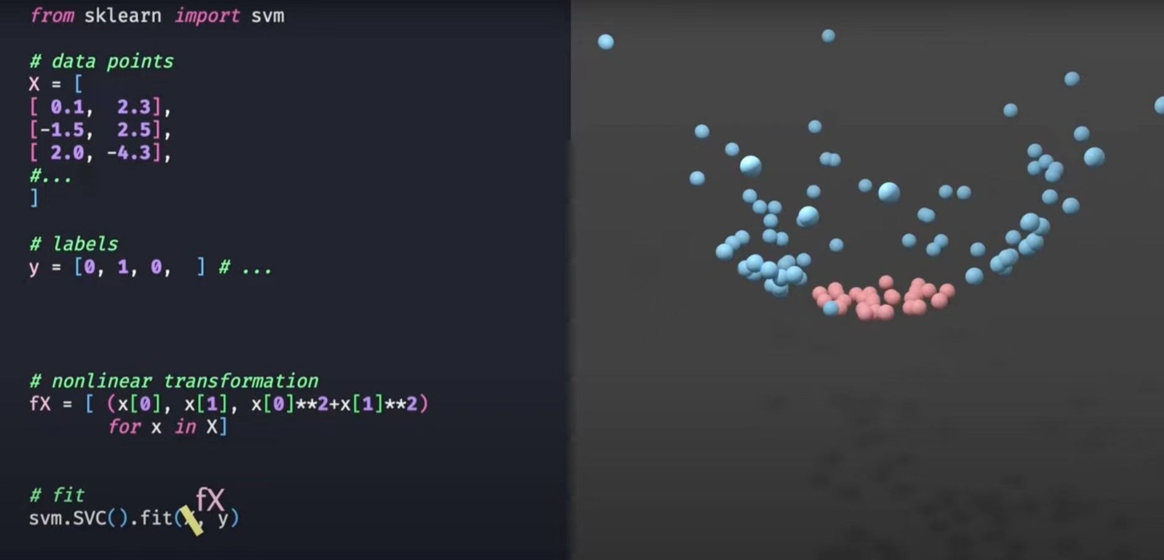
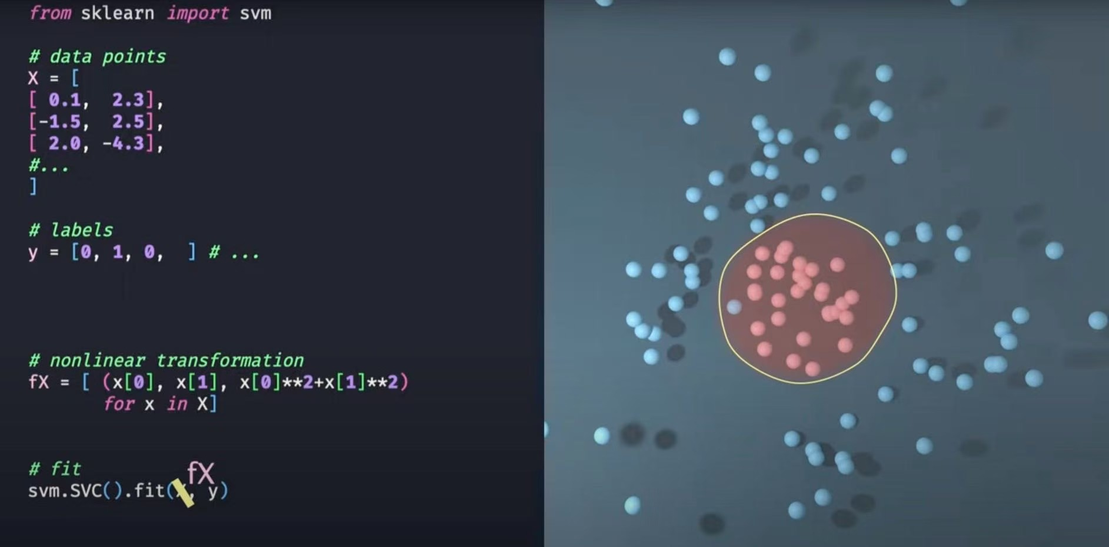
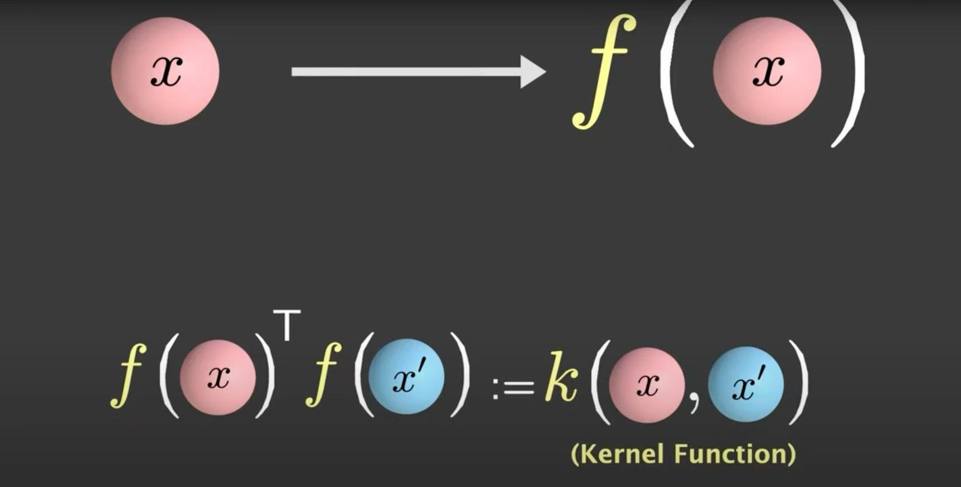
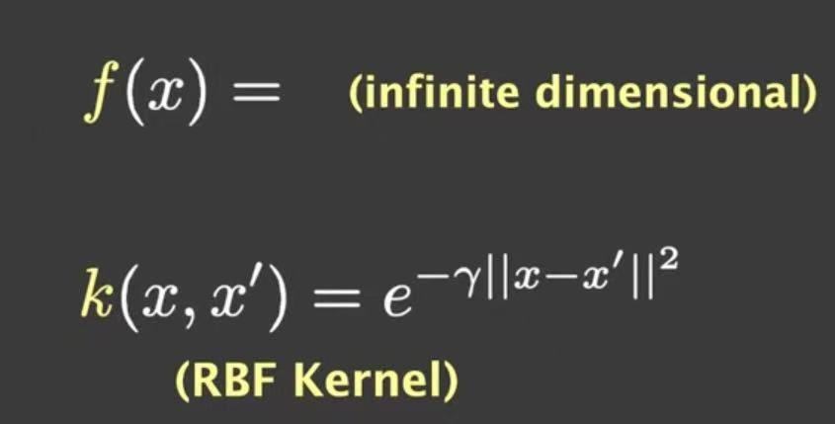
KERNEL
生成更有效的描述符
实现分类
为什么用kernel？

Slide 15
CHEAT SHEET OF SCIKIT-LEARN
能够检测非线性联系
Isometric mapping
Locally linear embedding
Principal component analysis
也能检测非线性联系
只能检测线性关系
模仿kernel的功能，但是不计算kernel矩阵

Slide 16
CHEAT SHEET OF SCIKIT-LEARN
先降低维度再聚类
每次都随机挑选一个子集
收敛之后在换子集，直到稳定
不需要提前确定聚类数量的K means方法

