Slide 1
Do something with your heritage!
A website for sharing information about significant artworks in private hands that are potentially viewable by the public.
By Fred Clausen.
February 2022

Slide 2
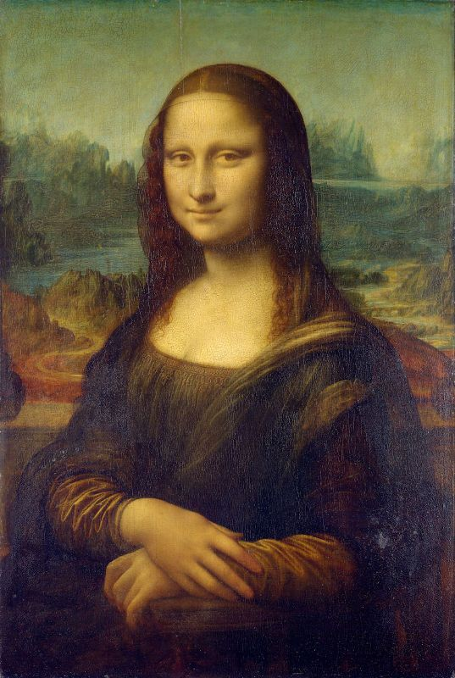
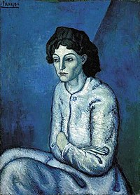
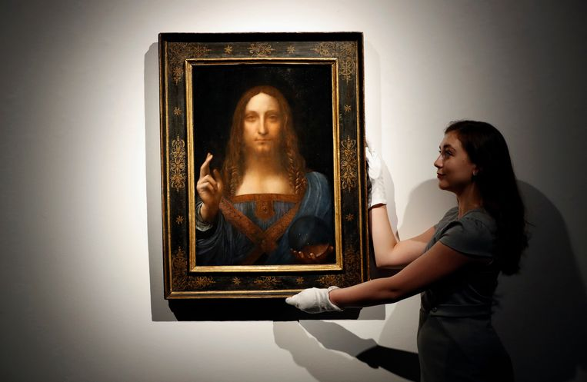
The Opportunity
Public
Private
Femme aux Bras Croisés
Salvator Mundi
Lesser-known
Famous

Slide 3
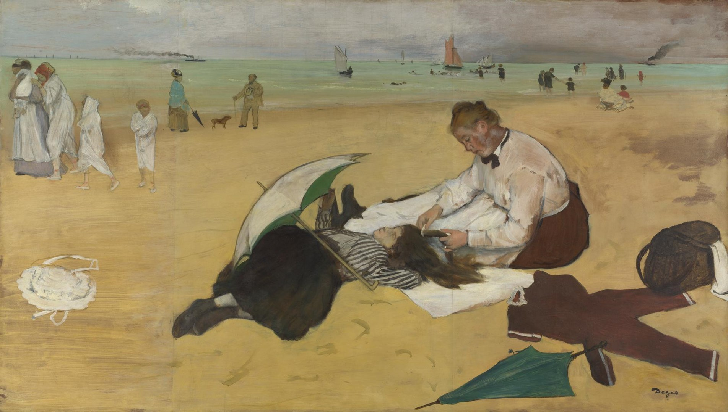
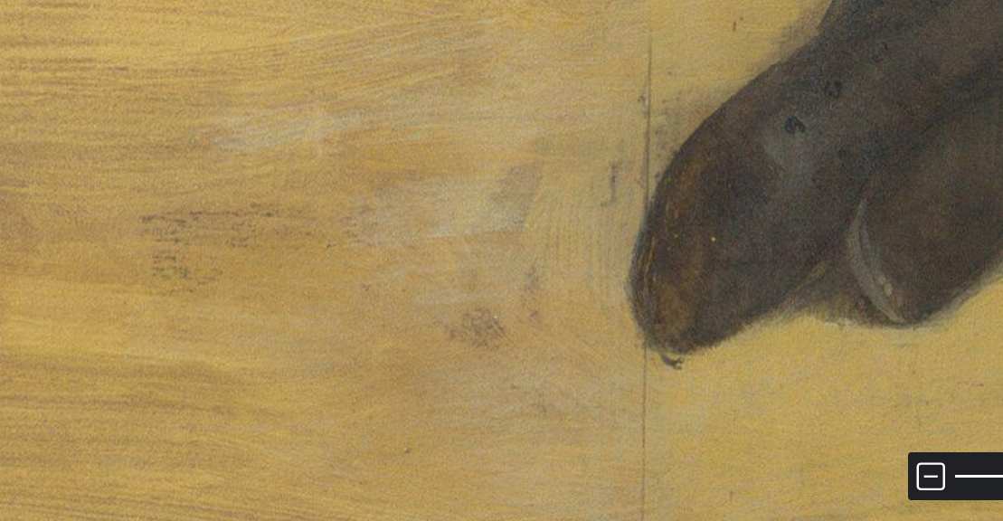
Why?
Examining the actual artwork makes you realise it is a painting made of the things you have, the brushes, paints, etc. With discipline and dedication you could achieve a similar result.
Sand particles on the painting show that great artists work with the same irritations that you face.

Slide 4
How?
Create a multilingual website where artworks and contact information are easily accessible.
Artworks, description, #keywords.
Contact details for viewing.
Allow users to create an account.
Keep a list of artworks visited.
Art owners can learn something about you before accepting your viewing request.
Maintain a wish list of artworks in private collections that are of interest.

Slide 5
The Ask
Ask private collectors to register the artworks where they allow visitors.
Treasures we never see. How much art is hidden away from the world? What are the top works of art the public would be grateful for viewing?
In the meantime, visit publically available art:
https://en.wikipedia.org/wiki/List_of_most-visited_art_museums

Slide 6
Artworks are Everywhere
Dosomethingwithyourheritage.com
Doeietsmetjeerfenis.nl
Dosomethingwithyourroots.com
Façaalgocomsuaherança.pt
Faitesquelquechoseavecvotrepatrimoine.fr
MachenSieetwasausIhremErbe.de

Slide 7
Initial project
Audience
Le Wagon Web Development Class 803

Slide 8
Personas
Joe Bloggs
Zé da Esquina
Otto Normalverbraucher
Max Mustermann
Jean Dupont
Jan Modaal
Academics, PhD students and researchers
It is fundamental for their careers, and their work often depends on how much access they have to pieces of artists they are studying or they wish they could study.

Slide 9
https://www.theguardian.com/commentisfree/2022/jan/28/britains-art-collection-works-tax-owners

Slide 10
In 1999
Of the 56,800 works exempt from tax, 32,000 are on long-term loans to museums, nearly 4,000 are on display in houses open to the public and the remaining ones are theoretically viewable by appointment. More than 60% of the items are owned by only 30 people.
https://www.theguardian.com/uk/1999/jul/08/fiachragibbons

Slide 11
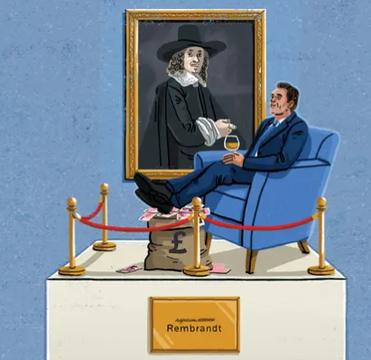

Slide 12
