Slide 1
Do something with your heritage!
A website for sharing information about significant artworks in private hands that are potentially viewable by the public.
By Fred Clausen.
February 2022

Slide 2
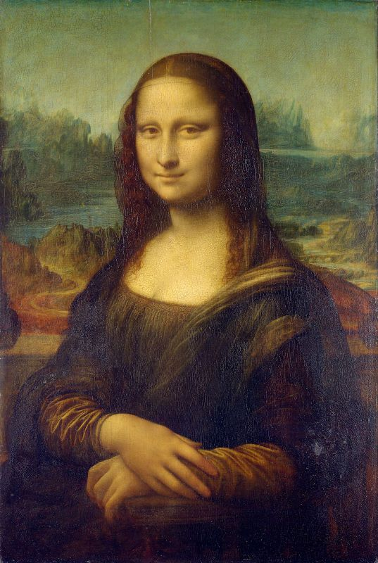
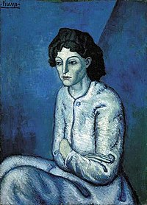
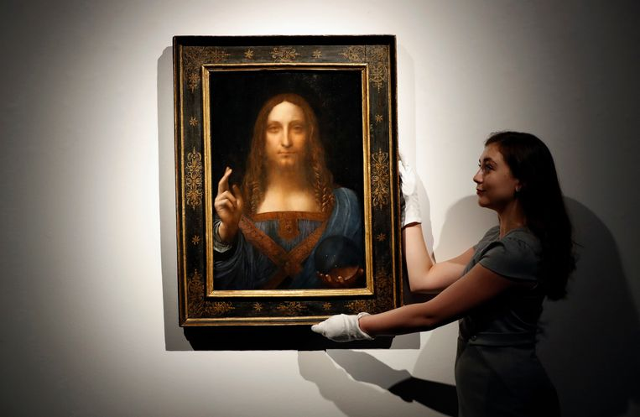
The Pain
Public
Private
Femme aux Bras Croisés
Salvator Mundi
Lesser-known
Famous

Slide 3
The Target
Joe Bloggs
Zé da Esquina
Otto Normalverbraucher
Max Mustermann
Jean Dupont
Jan Modaal
Academics, PhD students and researchers
It is fundamental for their careers, and their work often depends on how much access they have to pieces of artists they are studying or they wish they could study.

Slide 4
The Solution
Create a multilingual website where artworks and contact information are easily accessible.
Artworks, description, #keywords.
Contact details for viewing.
Allow users to create an account.
Keep a list of artworks visited.
Art owners can learn something about you before accepting your viewing request.
Maintain a wish list of artworks in private collections that are of interest.
Dosomethingwithyourheritage.com
Doeietsmetjeerfenis.nl
Dosomethingwithyourroots.com
Façaalgocomsuaherança.pt
Faitesquelquechoseavecvotrepatrimoine.fr
MachenSieetwasausIhremErbe.de

