Slide 1

Weather forecast web application
Team: MajdKitaláljuk
Members: Gellén Rebeka, Kósa Fruzsina, Dinó Ákos, Bukta Ádám

Slide 2
The base project
The goal of our application is to predict the weather using the Python programming language.
Our progam has a web interface which we aim to make as captivating and beautiful as possible.
We use API-s to get the data, but the actual processing and using of the data is done with the help of Scikit Learn, Pickle, TensorFlow and JavaScript.

Slide 3
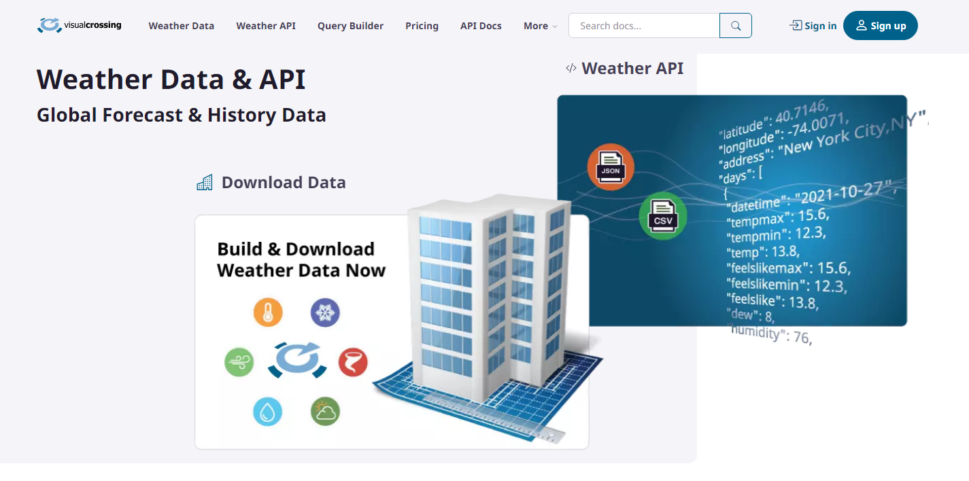
Backend
As mentioned before the data is collected using an API.

Slide 4
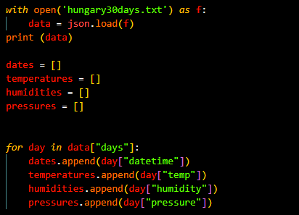
Backend
We refine the data so it only contains the statistics we deem useful.

Slide 5
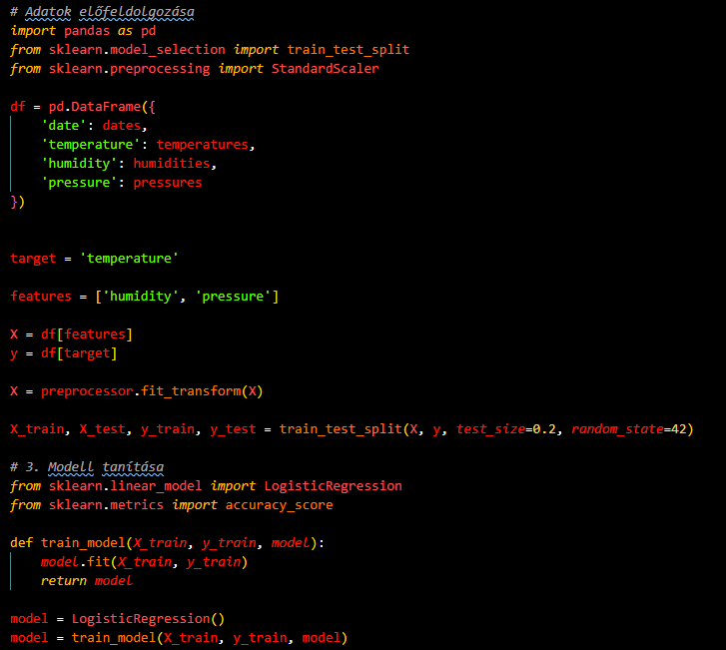
Backend
After this we use Scikit Learn to preprocess the data then we again use Scikit Learn to teach our model.

Slide 6
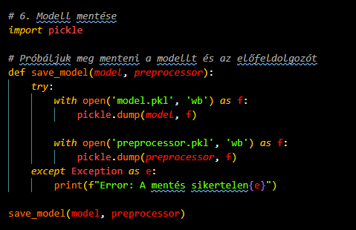
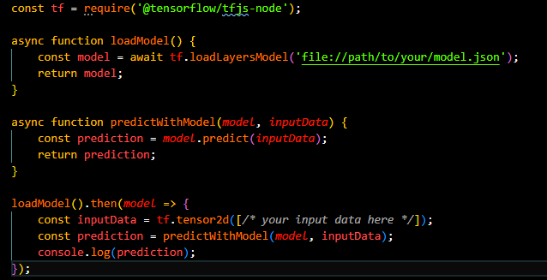
Backend
With the help of Pickle we save our model.
After that the saved model is used in combination with TensorFlow and JavaScript to make the predictions

Slide 7
Frontend
For the frontend we used html and css.
For use during the upcoming developments we have already made the login and registration screens.

Slide 8
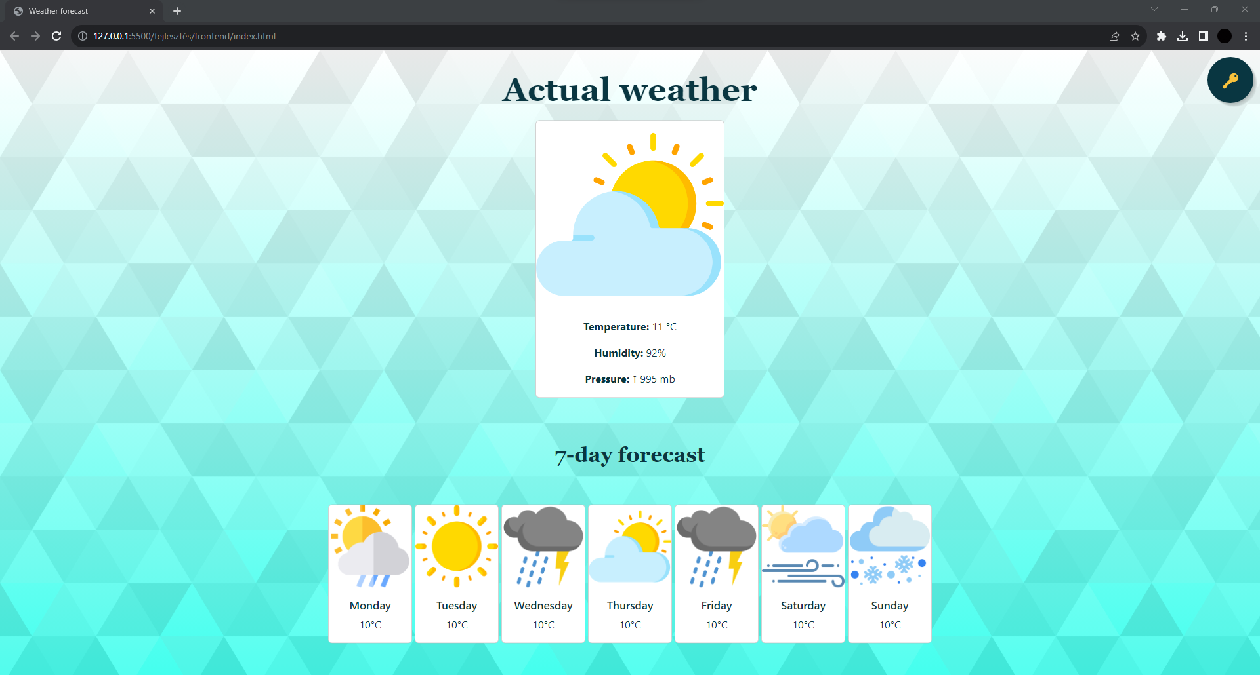
Frontend

Slide 9
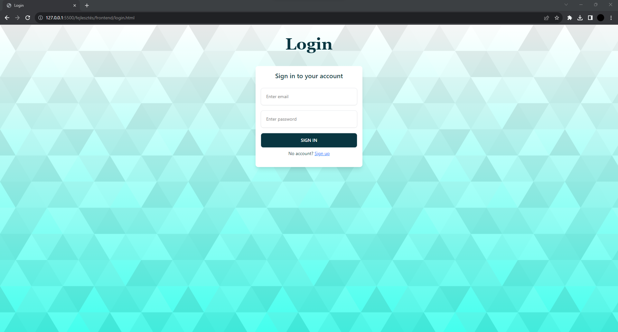
Frontend

Slide 10
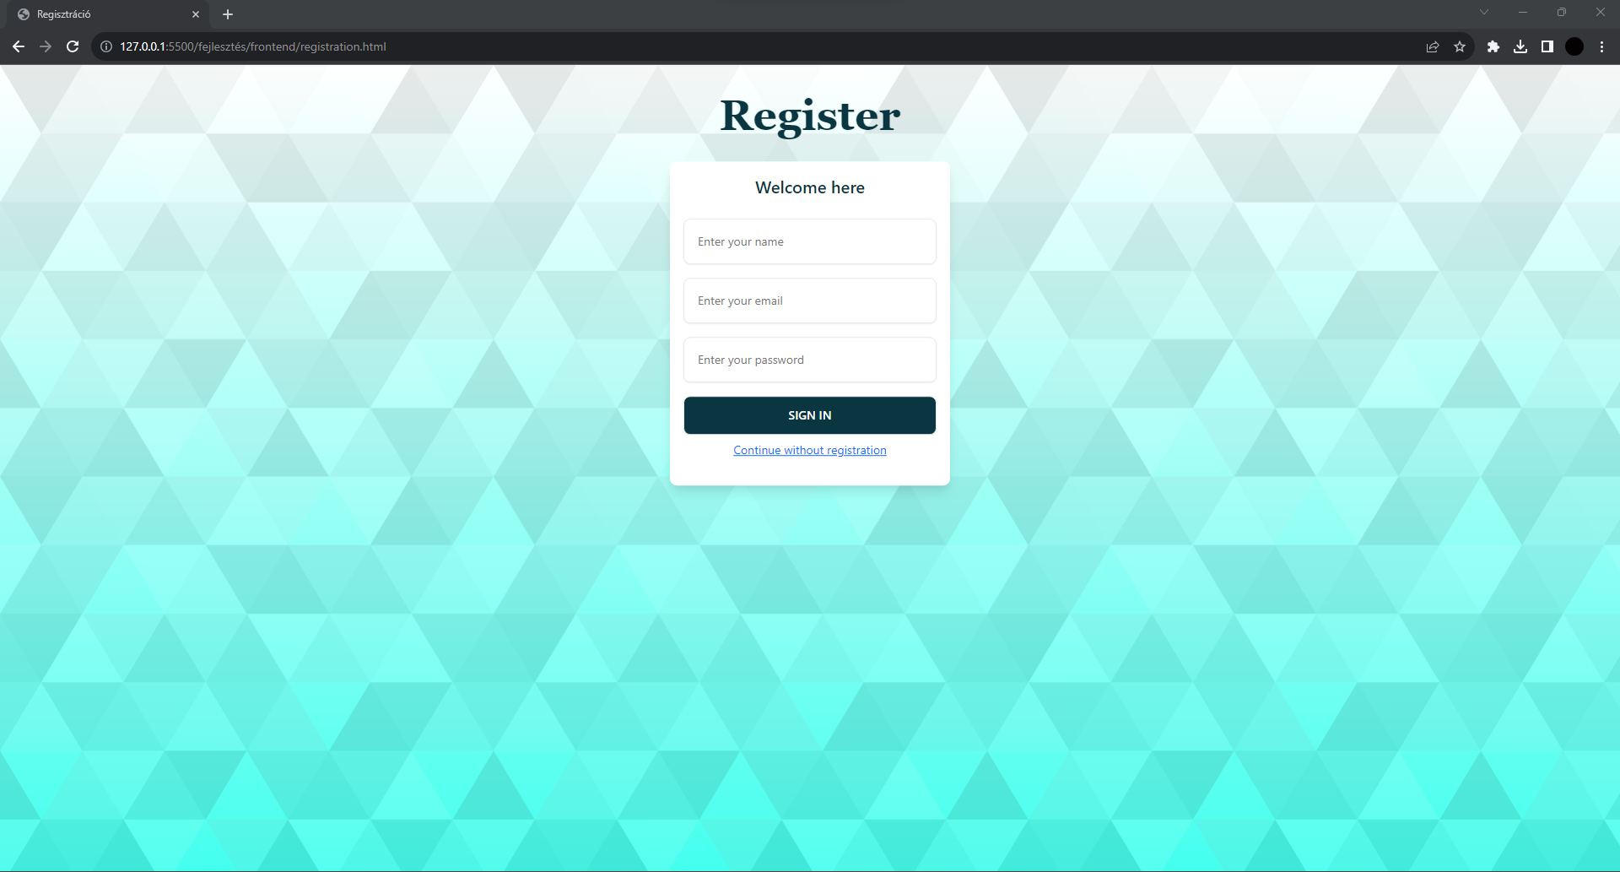
Frontend

Slide 11
Current progress
We have come so far.
The procurement and processing of the data is already done. Furthermore the frontend is completed.
The linking of the frontend and the backend and the login and register backend is remaing.

