Slide 1
Creighton Student COVID-19 Survey
Created By Ryan King and Jimmy Phelps

Slide 2

Outline
Decided on making a survey addressing the students about COVID
Brainstormed questions
Chose how we wanted them answered and scored
Development
Ryan – created a database, php, and mySQL to connect the pages and create an Admin page
Jimmy – created the CSS for the survey and login page, created the survey and all the elements needed to return information to the admin page

Slide 3
Outline (continued)
Integration
Ryan - connected the survey to our SQL database to record responses and emails
Jimmy – Created CSS for the login page and directed it to the real survey rather than a demo, spaced elements on the pages
Testing
Tested the email to make sure it responds only to a Creighton.edu email
Took the survey and made sure the information we received was being stored.

Slide 4
Why a Survey?
We wanted to gather the opinions of other students on Creighton life during the pandemic, and compare our thoughts to them
We also wanted to gain understanding of how people have been indirectly affected by COVID-19 (separation from friends, mental health issues, class issues)
We thought a survey like this could be beneficial for the school to understand the student body opinion
We wanted something that was quick, easy to respond to, and bug free to promote as much students to answer as possible.

Slide 5
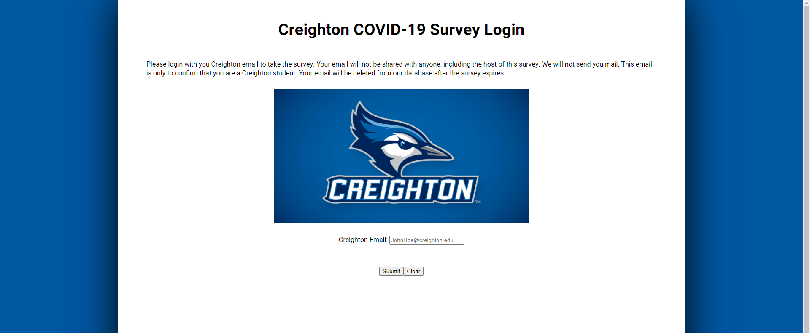




Login Page

Slide 6
Login Page
Has text at the top explaining the uses of the answers and email addresses for the survey
Styled with a Creighton image to show what group we are calling for
Only grants survey access to those with a Creighton.edu email address

Slide 7
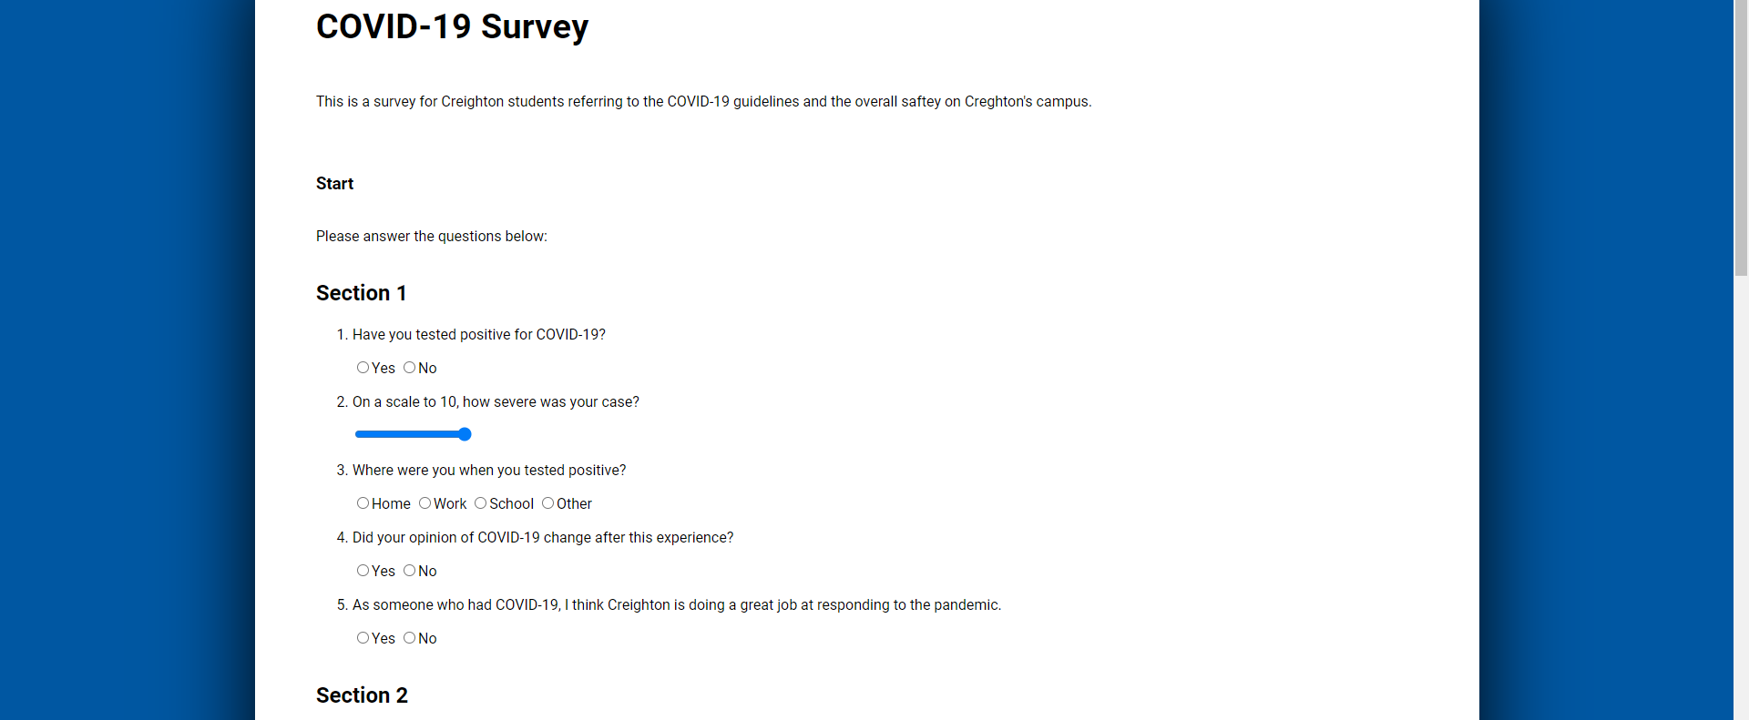
Survey Page

Slide 8
Survey Page
The survey is separated into 5 sections based on areas we wanted to cover
Disease and Quarantine
Creighton Fall 2020 Coronavirus response
Academics
College life
Mental Health
Uses radio buttons and sliders for the user to select answers
No = 0, Yes = 1
Sliders return values that correlate to the number range asked in the questions
Submits the survey with the push of a button at the end

Slide 9
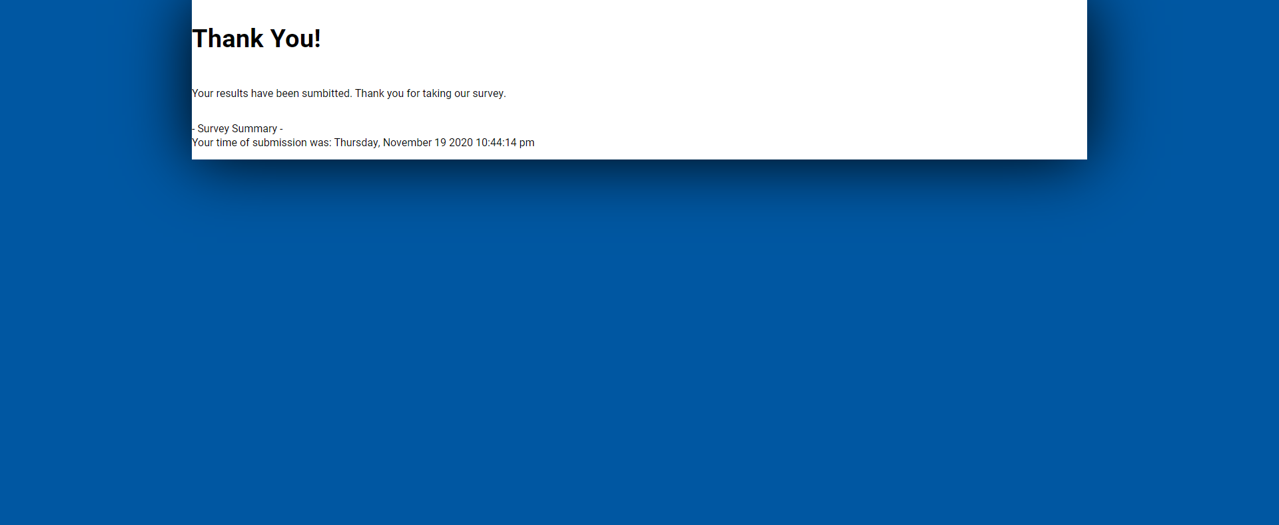
Submission Page

Slide 10
ER Diagram
Survey Results
participantID
cat1
cat2
cat3
cat4
cat5

Slide 11
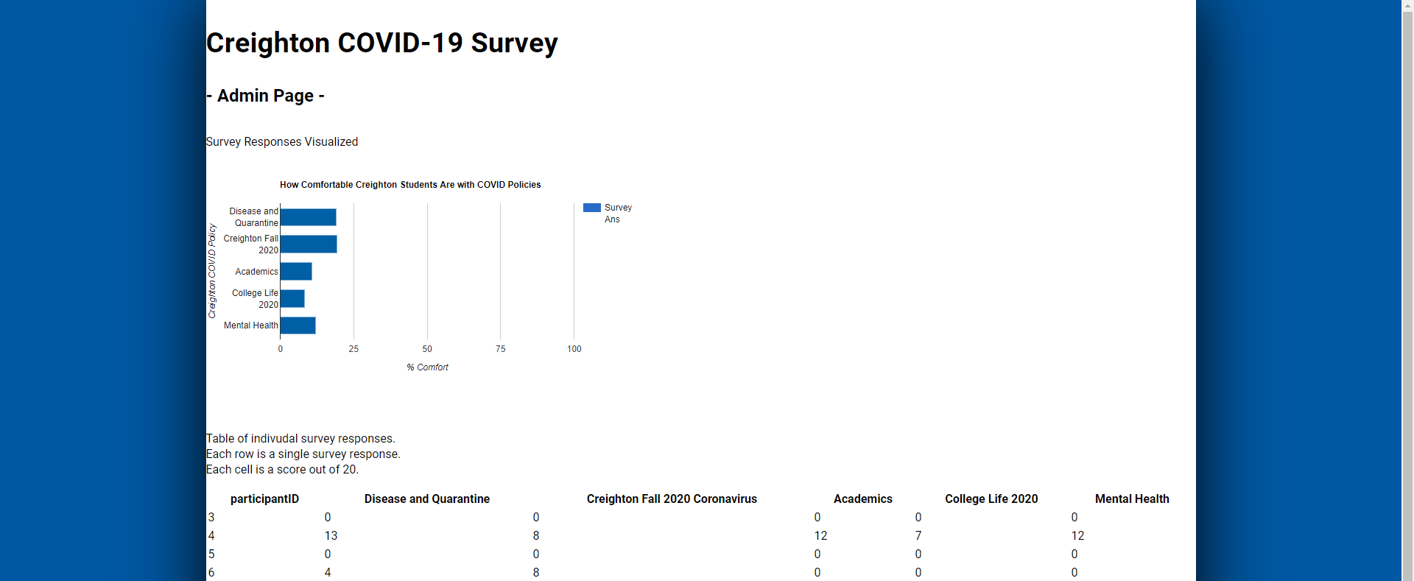
Admin Page

Slide 12
Admin Page
Has data tables and graphs reflecting our survey results from each category
We can see survey averages, which gives us insight on how comfortable students are attending classes at Creighton

Slide 13

Thank You!

