Slide 1
Project #4: Can we predict whether a Hotel Booking will be cancelled?
By Carl Liu
CSE 351

Slide 2
EDA

Slide 3
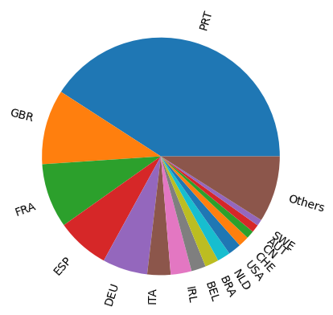
Bookings Per Country
Majority of Bookings are from Portugal(PRT)
United Kingdom and France make also contribute significantly to the bookings.

Slide 4
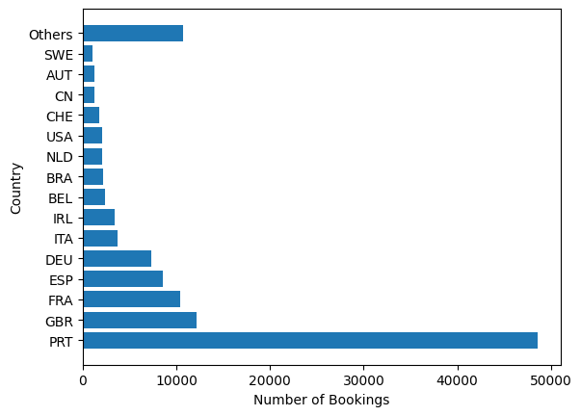
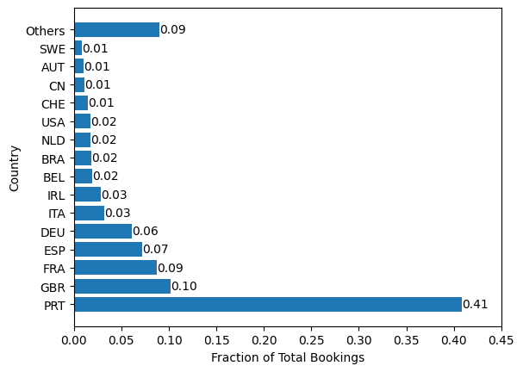
Bookings Per Country
Portugal has 48590 bookings
Portugal has 41% of all bookings. The second largest contribute, the united kingdom, only contributes 10%

Slide 5
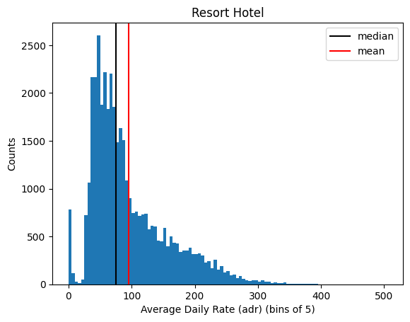
Pricing for each hotel
Histogram of the Average Daily Rate for Resort Hotel
Bin Size is 5
The median price for resort hotel is 75
The mean price for resort hotel is 94.96
right skewed, with an additional smaller peak close to 0

Slide 6
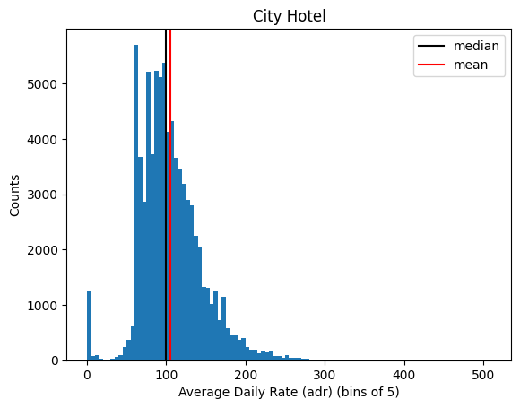
Pricing for each hotel
Histogram of Average Daily Rate of City Hotel.
Bin size is 5
Mean rate of 105.24
Median rate of 99.90
Closely matching mean and median
Right skewed pricing with small peak at 0
Overall Pricing of City Hotel is Higher than that of Resort Hotel

Slide 7
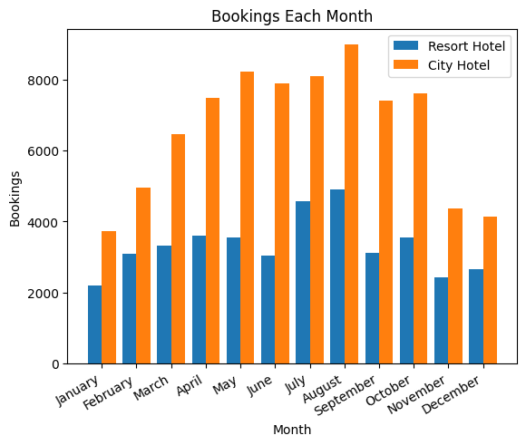
Monthly Rates
Bookings from each month for the two hotels
City hotel has a lot more bookings than resort hotel in every month.
City hotel has its peak season in august at around 9000 bookings
Resort hotel has its peak season in august at around 5000 bookings

Slide 8
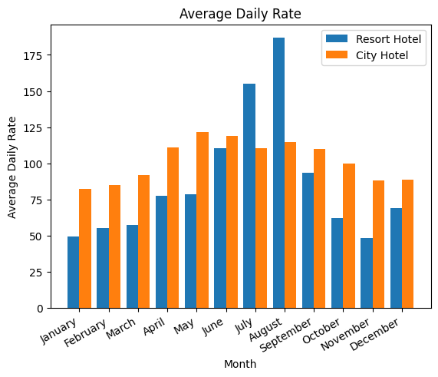
Monthly Rates
The average daily rates for each month for both hotels
Resort hotel has a high daily rate in august, corresponding to their highest busiest month.
City hotel's daily rate does not vary as much as resort hotel.
City hotel's daily rate is in May, corresponding to their second busiest month.

Slide 9
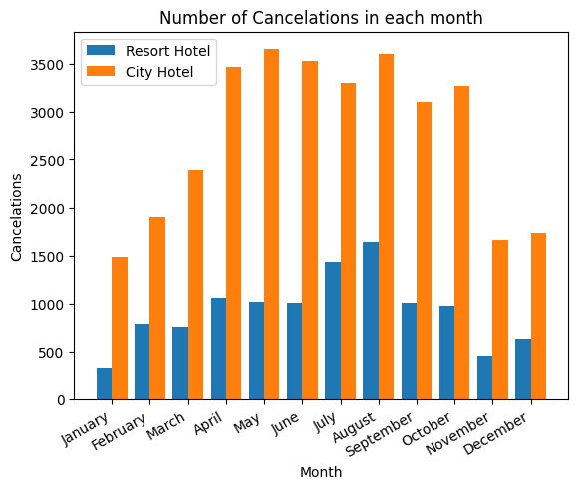
Monthly Rates
Number of cancelations in each month for both hotels
Resort hotel has their highest number of cancelations in august.
City hotel has their highest number of cancelations in may, but august is a close second
January sees the least number of cancelations for both hotels

Slide 10
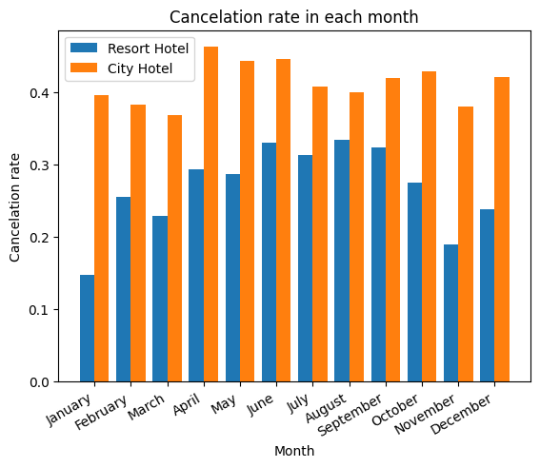
Monthly Rates
Cancelation Rates in each Month
Resort hotel sees their highest cancelation rate in august, with june coming in at a close second.
City Hotel has overall higher cancelation rates than Resort hotel.
City Hotel sees their highest cancelation rates in april.
Resort Hotel has a total cancelation rate of 27.8%
City Hotel has a total cancelation rate of 41.7%

Slide 11
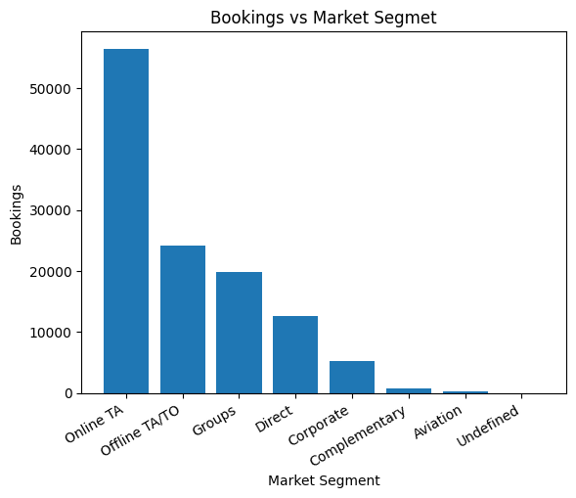
Bookings and Market Segment
Bookings by each market segment, includes both hotels
Online Travel agents comprise the majority of all bookings. Offline Travel agents/Tour operators come in second with half as many bookings

Slide 12
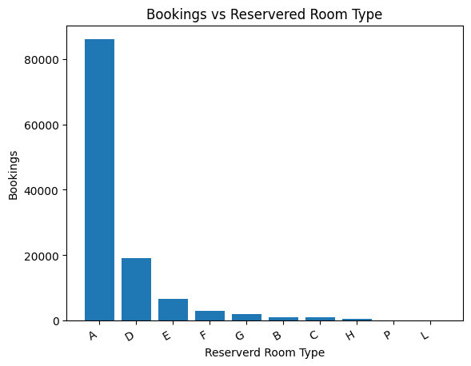
Bookings and Room Type
Number of bookings for each reserved room type, includes both hotels
Room type A is by far the room that is booked the most
Room booking falls off exponentially

Slide 13
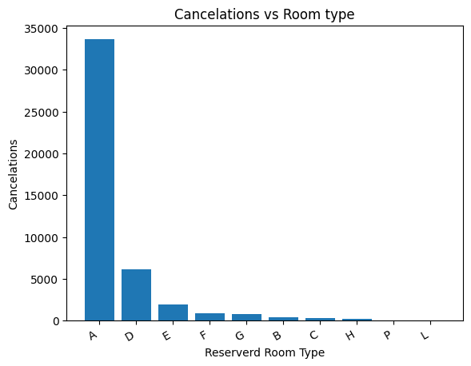
Bookings and Room Type
Cancelations for each room type
High number of cancelation in A corresponds to high number of bookings in A
Number of cancelations follow number of bookings

Slide 14
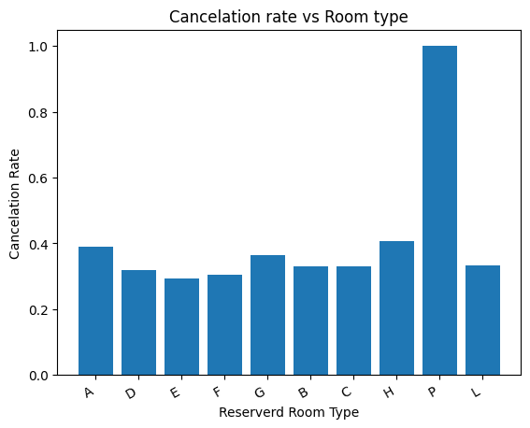
Bookings and Room Type
Cancelation rate for each room type
For room type P, we have a cancelation rate of 100%
For all other room types cancelation rates are similar.

Slide 15
Modeling and Question Answering

Slide 16
Preparing Data for training
Converted reserved_room_type, arrival_date_month, and country to integers.
Selected specific features to train on ('lead_time','country','arrival_date_month','stays_in_week_nights','stays_in_weekend_nights','adr')
Splitted data into 80% training and 20% testing
Target set is 'is_canceled'

Slide 17
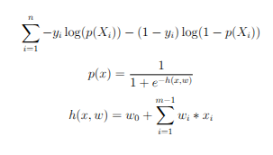
Algorithm 1: Logistic Regression
Logistic Regression, using a log cost function, classifies 0 and 1. Rounds probability to nearest class.
Log cost function of model after training, (0.5749).
Accuracy after training 0.707
Recall: 0.42​
Precision: 0.66​
Fscore: 0.52

Slide 18
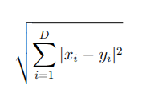
Algorithm 2: K-Nearest Neighbor
Algorithm 2 will be 5-nearest-neighbour classification. It will use the L2 metric to classify points. The L2 metric is defined below where x_i,y_i are in the same dimension and D is the number of dimensions. To classify new data points the 5 closest point to the new data point and uses them to vote on the classification of the new data point.
The accuracy of this algorithm after training is 0.79. The highest of all 3 algorithms.
Recall: 0.65
Precision: 0.75
Fscore: 0.7

Slide 19


Algorithm 3: Linear Regression
Algorithm 3 will be using Linear regression. Output will be rounded to 0 or 1. The loss function is mean square loss as defined below, where y_i is the target value, X_i are the features, and f(X_i) is the model prediction.
Mean squared error comes out to be 0.1612
Accuracy of model is 0.706
Recall: 0.41
Precision: 0.66
Fscore: 0.52

Slide 20
Cross-Validation
Cross Validation was applied by partitioning the training set into k parts taking the new training set to be (k-1)/k of the entire set and leaving 1/k for the test set
Repeated k times, leaving each partition as the training set.
In this case, all models used k=5
The new decisions take the 5 new models and does a majority vote.
Performance of cross validation is very similar to that of non cross validation

