Slide 1
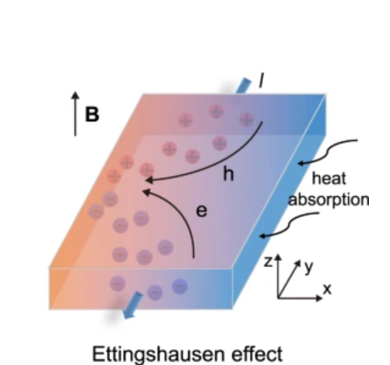
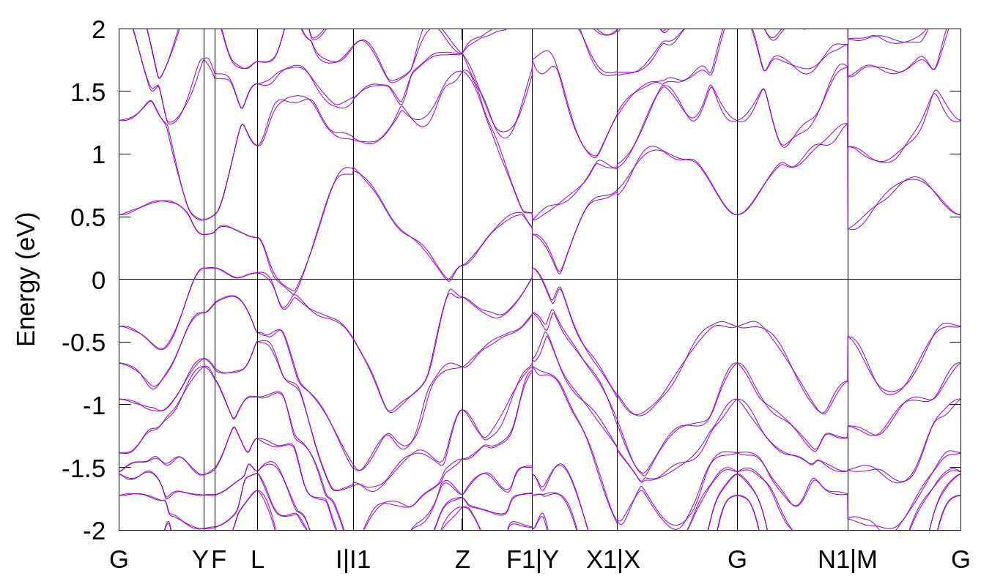
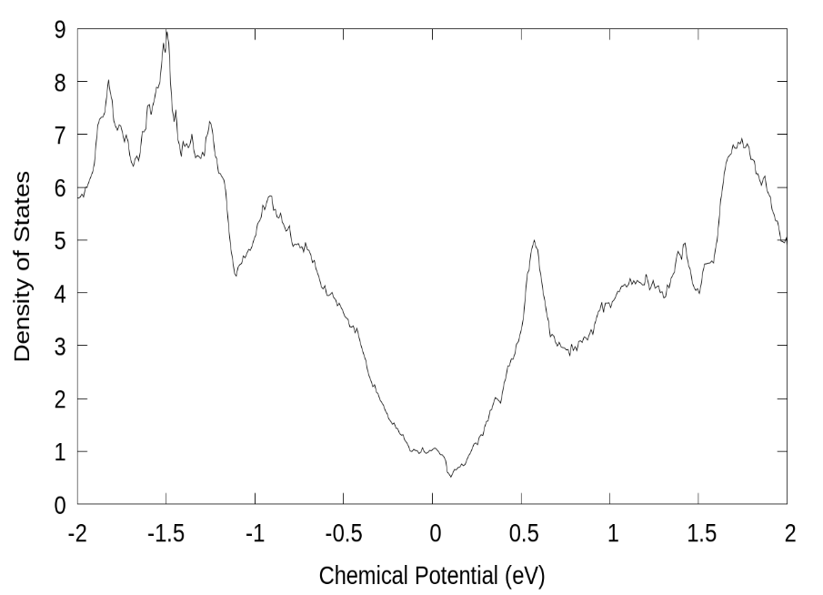
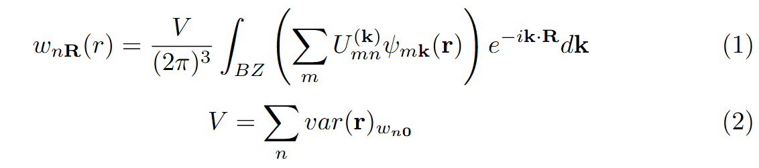
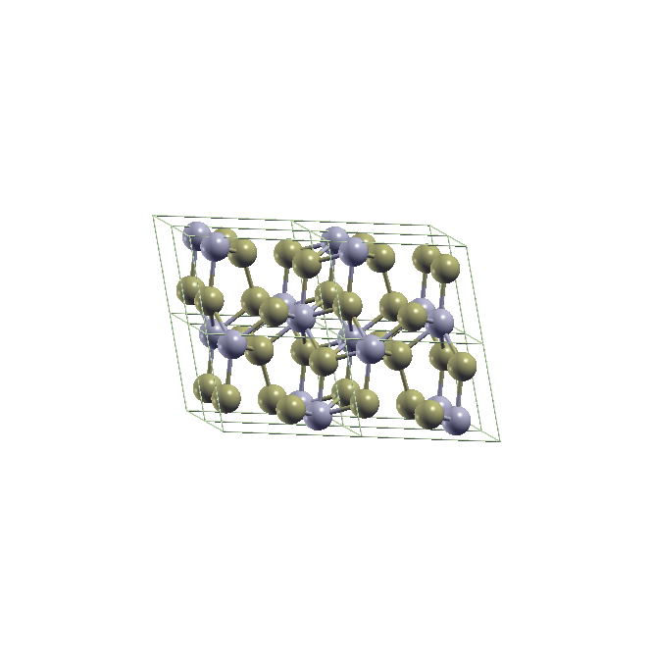
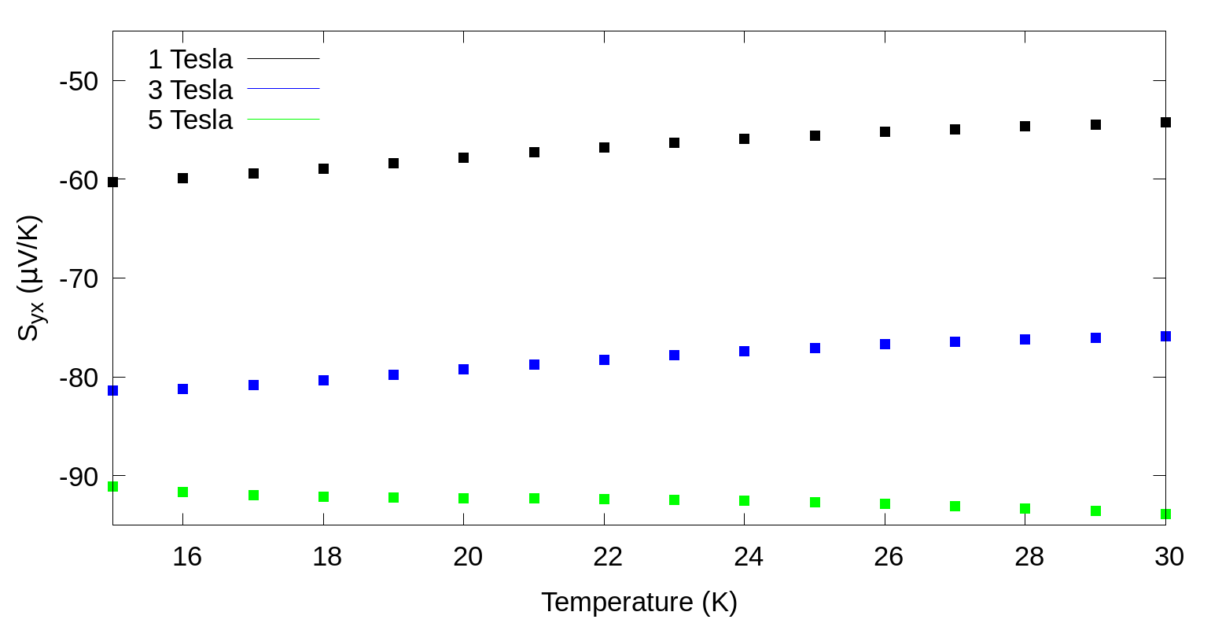
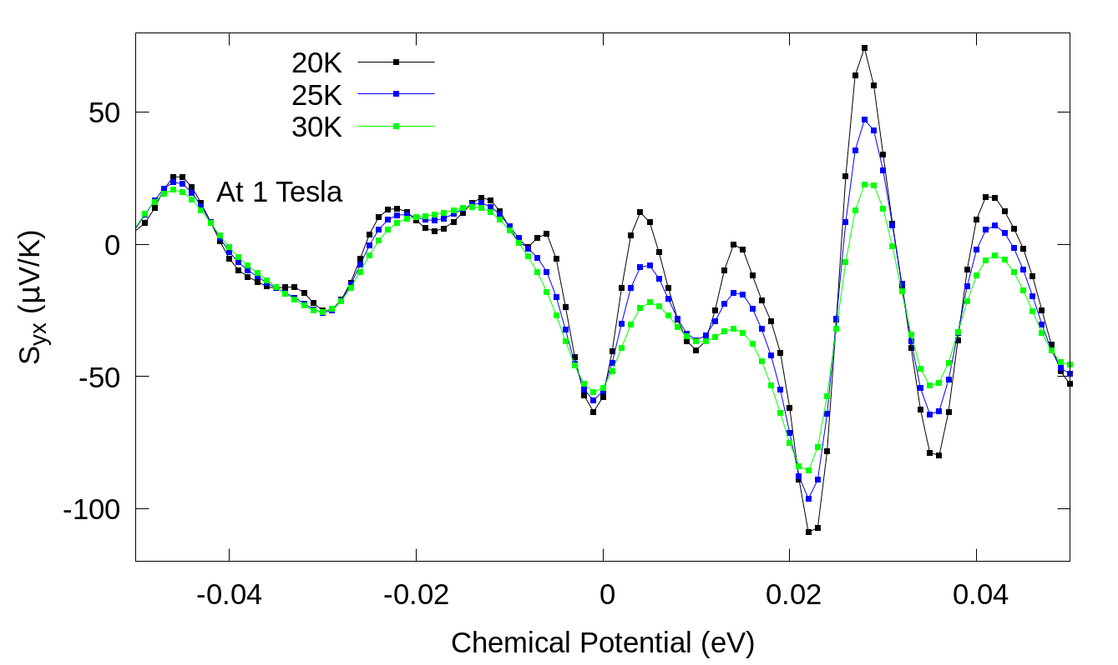
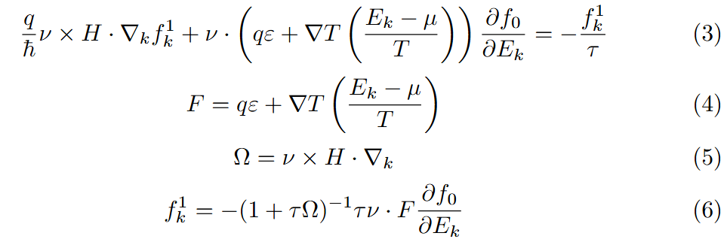
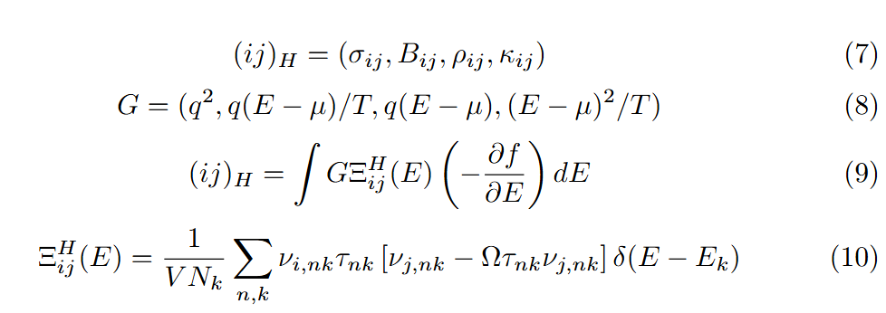
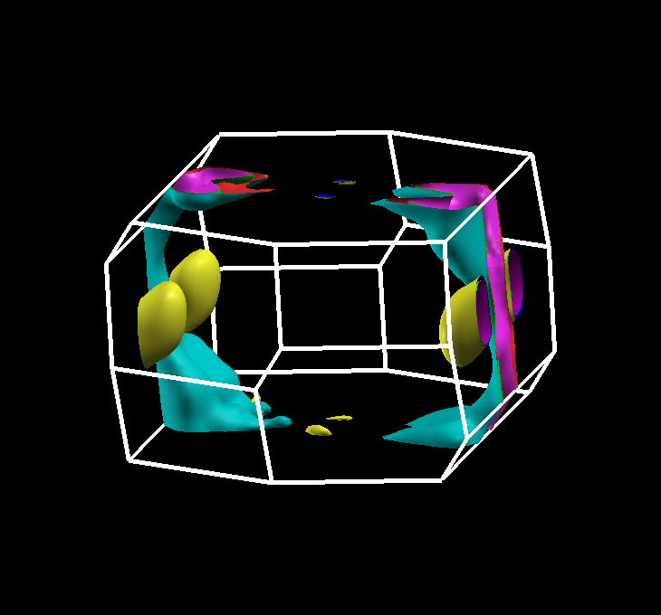
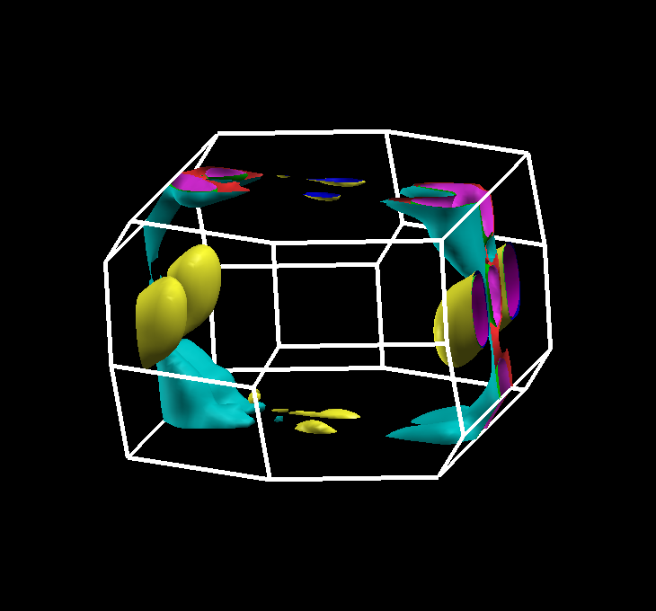
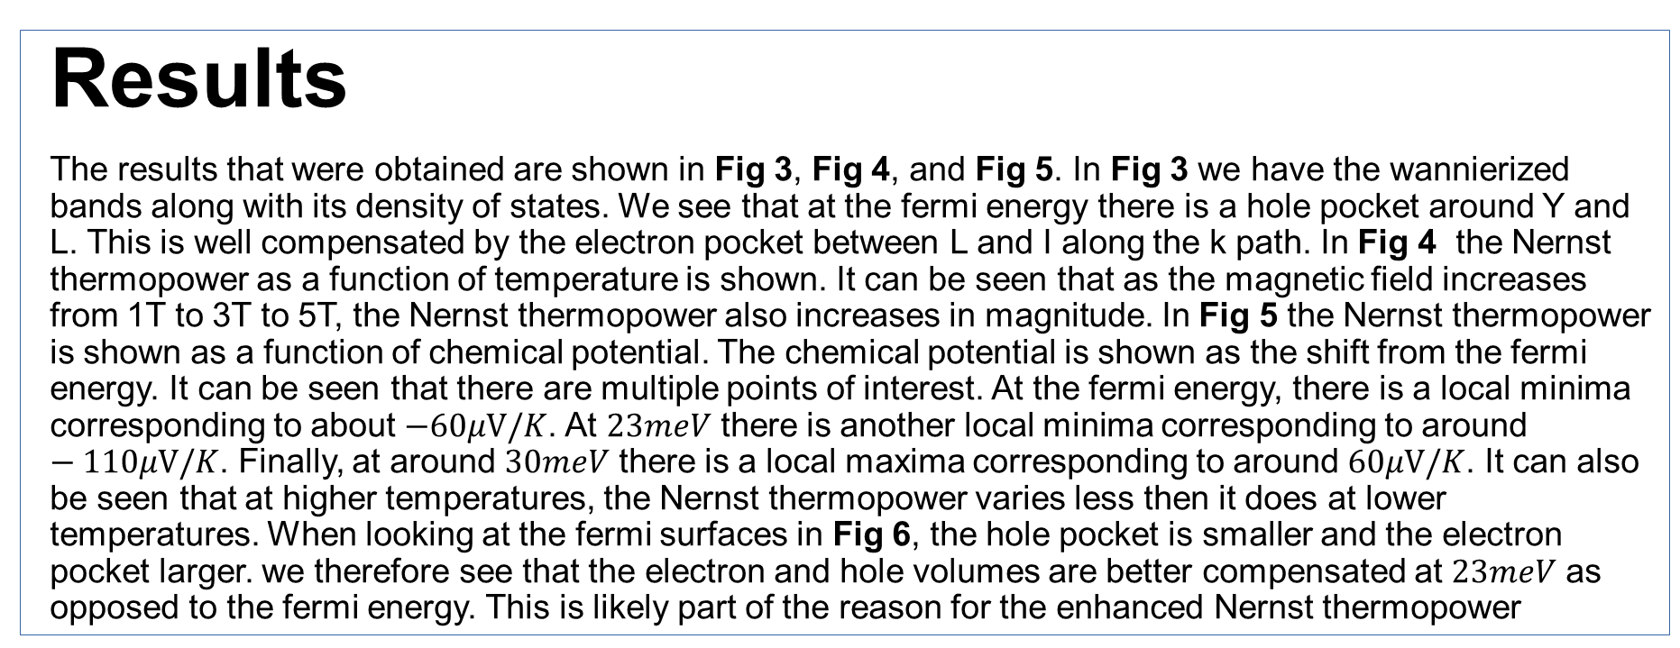
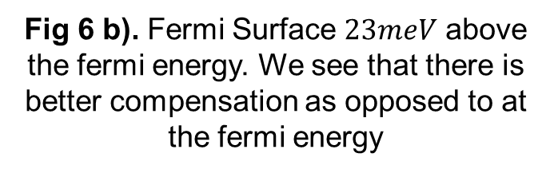
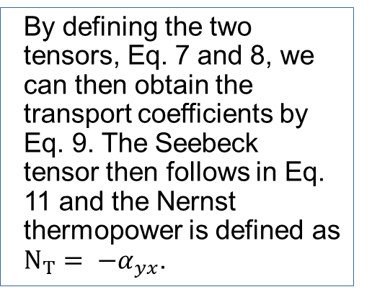
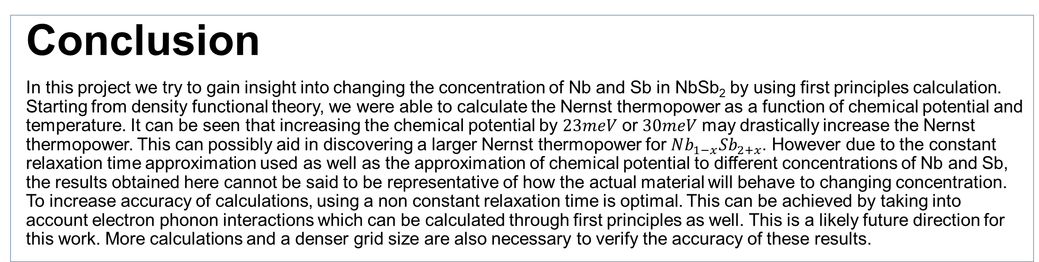
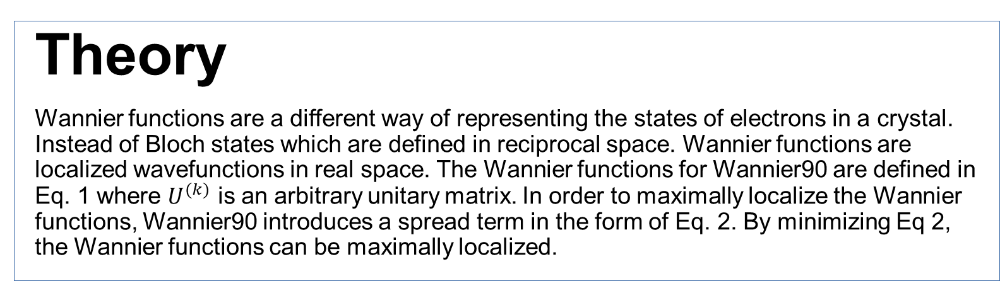
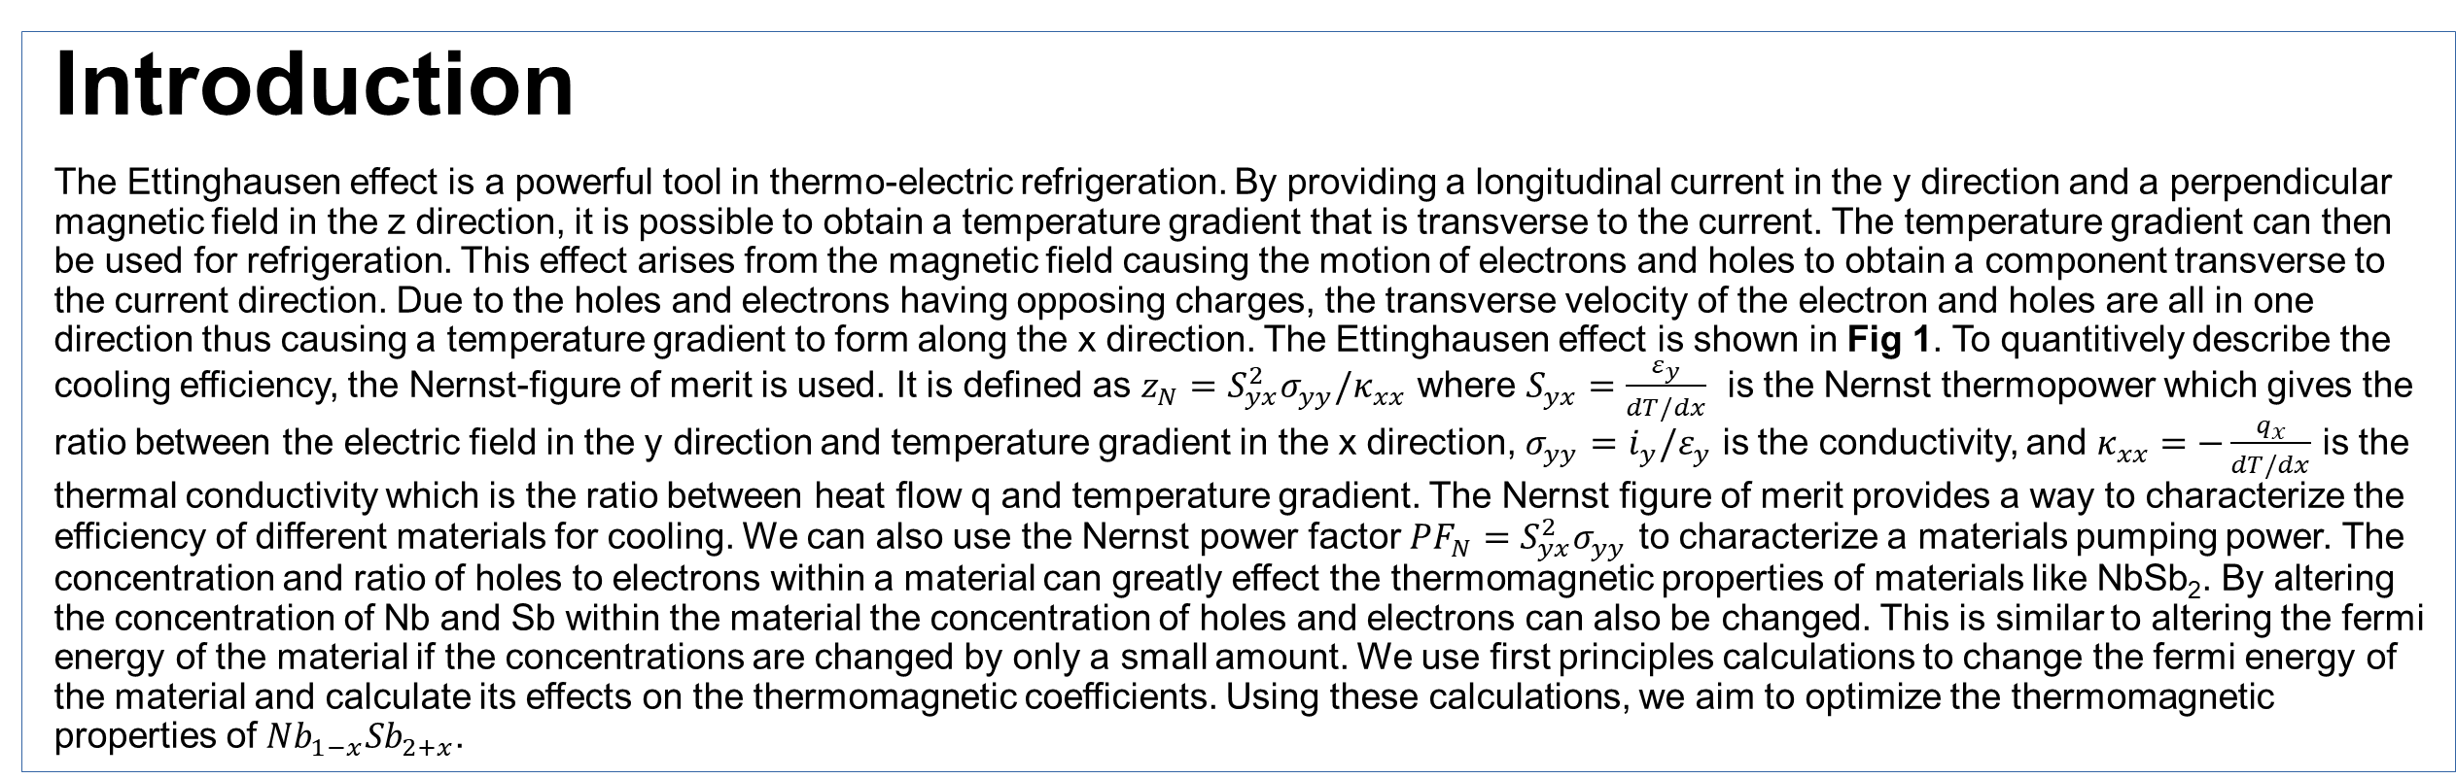
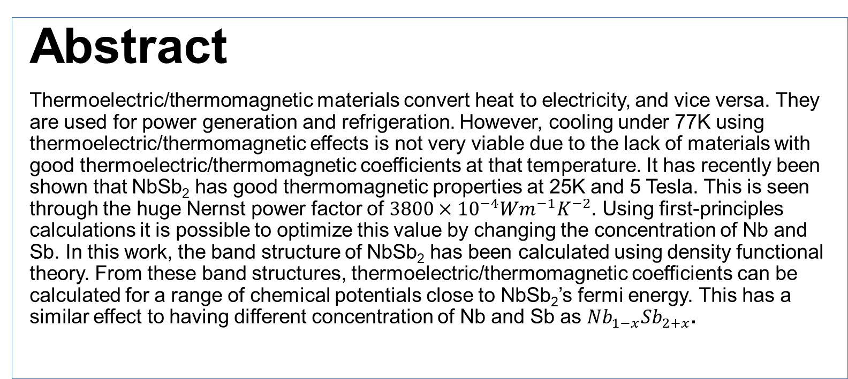
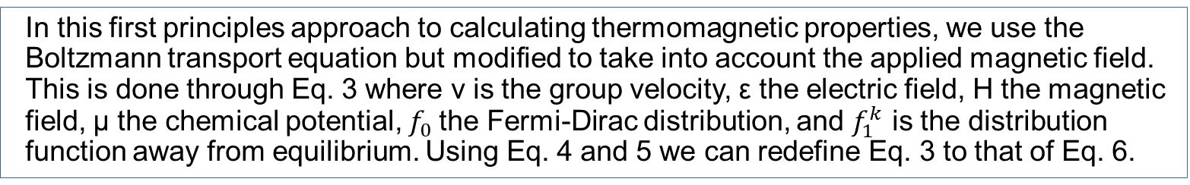
Calculation of thermal transport properties for NbSb₂ from density functional theory
Carl Liu, Physics Department, Stony Brook University, Stony Brook, NY 11794
Niraj Aryal, Condensed Matter Physics and Materials Science Division, BNL, Upton, NY 11973-5000
Qiang Li, Condensed Matter Physics and Materials Science Division, BNL, Upton, NY 11973-5000
Abstract
Thermoelectric/thermomagnetic materials convert heat to electricity, and vice versa. They are used for power generation and refrigeration. However, cooling under 77K using thermoelectric/thermomagnetic effects is not very viable due to the lack of materials with good thermoelectric/thermomagnetic coefficients at that temperature. It has recently been shown that NbSb₂ has good thermomagnetic properties at 25K and 5 Tesla. This is seen through the huge Nernst power factor of $3800×{10}^{−4}Wm^{−1}K^{−2}$. Using first-principles calculations it is possible to optimize this value by changing the concentration of Nb and Sb. In this work, the band structure of NbSb₂ has been calculated using density functional theory. From these band structures, thermoelectric/thermomagnetic coefficients can be calculated for a range of chemical potentials close to NbSb₂’s fermi energy. This has a similar effect to having different concentration of Nb and Sb as $Nb_{1−x}Sb_{2+x}$.
Introduction
The Ettinghausen effect is a powerful tool in thermo-electric refrigeration. By providing a longitudinal current in the y direction and a perpendicular magnetic field in the z direction, it is possible to obtain a temperature gradient that is transverse to the current. The temperature gradient can then be used for refrigeration. This effect arises from the magnetic field causing the motion of electrons and holes to obtain a component transverse to the current direction. Due to the holes and electrons having opposing charges, the transverse velocity of the electron and holes are all in one direction thus causing a temperature gradient to form along the x direction. The Ettinghausen effect is shown in Fig 1. To quantitively describe the cooling efficiency, the Nernst-figure of merit is used. It is defined as $z_{N}=S_{yx}^{2}σ_{yy}/κ_{xx}$ where $S_{yx}=\frac{ε_{y}}{dT/dx}$ is the Nernst thermopower which gives the ratio between the electric field in the y direction and temperature gradient in the x direction, $σ_{yy}={i_{y}/ε}_{y}$ is the conductivity, and $κ_{xx}=−\frac{q_{x}}{dT/dx}$ is the thermal conductivity which is the ratio between heat flow q and temperature gradient. The Nernst figure of merit provides a way to characterize the efficiency of different materials for cooling. We can also use the Nernst power factor ${PF_{N}=S}_{yx}^{2}σ_{yy}$ to characterize a materials pumping power. The concentration and ratio of holes to electrons within a material can greatly effect the thermomagnetic properties of materials like NbSb₂. By altering the concentration of Nb and Sb within the material the concentration of holes and electrons can also be changed. This is similar to altering the fermi energy of the material if the concentrations are changed by only a small amount. We use first principles calculations to change the fermi energy of the material and calculate its effects on the thermomagnetic coefficients. Using these calculations, we aim to optimize the thermomagnetic properties of $Nb_{1−x}Sb_{2+x}$.
Methods
Band structures were calculated from density functional theory using quantum espresso. This was followed up by converting the bands to maximally localized Wannier functions using Wannier90 [3], the brillouin zone bands were plotted on the k-path shown in Fig 3. Density of states in Fig 3 was obtained using the Boltzwann module implemented in Wannier90. the Nerwann module implemented in the Boltzwann module of Wannier90 was used to generate the transport distribution function[2]. The Nerwann module does this by using the band structure generated by quantum espresso to calculate terms for the modified transport distribution function. The constant relaxation time approximation was used for these calculations. The relaxation time of 7.8ps was found in the literature of experimental studies of NbSb₂. [4]
Results
The results that were obtained are shown in Fig 3, Fig 4, and Fig 5. In Fig 3 we have the wannierized bands along with its density of states. We see that at the fermi energy there is a hole pocket around Y and L. This is well compensated by the electron pocket between L and I along the k path. In Fig 4 the Nernst thermopower as a function of temperature is shown. It can be seen that as the magnetic field increases from 1T to 3T to 5T, the Nernst thermopower also increases in magnitude. In Fig 5 the Nernst thermopower is shown as a function of chemical potential. The chemical potential is shown as the shift from the fermi energy. It can be seen that there are multiple points of interest. At the fermi energy, there is a local minima corresponding to about $−60μV/K$. At $23meV$ there is another local minima corresponding to around $−110μV/K$. Finally, at around $30meV$ there is a local maxima corresponding to around $60μV/K$. It can also be seen that at higher temperatures, the Nernst thermopower varies less then it does at lower temperatures. When looking at the fermi surfaces in Fig 6, the hole pocket is smaller and the electron pocket larger. we therefore see that the electron and hole volumes are better compensated at $23meV$ as opposed to the fermi energy. This is likely part of the reason for the enhanced Nernst thermopower
Theory
Wannier functions are a different way of representing the states of electrons in a crystal. Instead of Bloch states which are defined in reciprocal space. Wannier functions are localized wavefunctions in real space. The Wannier functions for Wannier90 are defined in Eq. 1 where $U^{(k)}$ is an arbitrary unitary matrix. In order to maximally localize the Wannier functions, Wannier90 introduces a spread term in the form of Eq. 2. By minimizing Eq 2, the Wannier functions can be maximally localized.
Fig 1. The Ettingshausen effect. By providing a longitudinal current, and a perpendicular magnetic field, electrons and holes will move in the transverse direction, causing a temperature gradient which can be used for refrigeration. [1]
In this first principles approach to calculating thermomagnetic properties, we use the Boltzmann transport equation but modified to take into account the applied magnetic field. This is done through Eq. 3 where ν is the group velocity, ε the electric field, H the magnetic field, μ the chemical potential, $f_{0}$the Fermi-Dirac distribution, and $f_{1}^{k}$ is the distribution function away from equilibrium. Using Eq. 4 and 5 we can redefine Eq. 3 to that of Eq. 6.
Fig 2. Crystal Structure of NbSb₂. Blue atoms is niobium (Nb) and green atoms are antimony (Sb)
Fig 3. Band structure of NbSb₂ on the left with spin orbit coupling. Calculated using density functional theory as implemented in quantum espresso, converted to maximally localized Wannier functions then interpolated into the following bands. Density of states at each energy on the right. At 0 eV we have the fermi energy obtained from DFT.
By defining the two tensors, Eq. 7 and 8, we can then obtain the transport coefficients by Eq. 9. The Seebeck tensor then follows in Eq. 11 and the Nernst thermopower is defined as $N_{T}= −α_{yx}$.
Fig 4. Nernst Thermopower at different temperatures, for different magnetic field strengths. At fermi energy.
Fig 5. Nernst Thermopower as a function of chemical potential. Chemical potential is shown as shift from fermi energy. Plot is at 1 Tesla
Conclusion
In this project we try to gain insight into changing the concentration of Nb and Sb in NbSb₂ by using first principles calculation. Starting from density functional theory, we were able to calculate the Nernst thermopower as a function of chemical potential and temperature. It can be seen that increasing the chemical potential by $23meV$ or $30meV$ may drastically increase the Nernst thermopower. This can possibly aid in discovering a larger Nernst thermopower for $Nb_{1−x}Sb_{2+x}$. However due to the constant relaxation time approximation used as well as the approximation of chemical potential to different concentrations of Nb and Sb, the results obtained here cannot be said to be representative of how the actual material will behave to changing concentration. To increase accuracy of calculations, using a non constant relaxation time is optimal. This can be achieved by taking into account electron phonon interactions which can be calculated through first principles as well. This is a likely future direction for this work. More calculations and a denser grid size are also necessary to verify the accuracy of these results.
Fig 6 a). Fermi Surface at Fermi energy. Cyan is the hole pocket and yellow is the electron pocket.
Fig 6 b). Fermi Surface $23meV$ above the fermi energy. We see that there is better compensation as opposed to at the fermi energy
Acknowledgments
This project was supported in part by the U.S. Department of Energy, Office of Science, Office of Workforce Development for Teachers and Scientists (WDTS) under the Science Undergraduate Laboratory Internships Program (SULI). I’d also like to thank Niraj Aryal for this project idea and Qiang Li for the opportunity to learn about condensed matter physics at Brookhaven National Lab this summer. No export control.
References
[1] Li, P., Qiu, P., Xu, Q. et al. Colossal Nernst power factor in topological semimetal NbSb₂. Nat Commun 13, 7612 (2022). https://doi.org/10.1038/s41467-022-35289-z
[2] S. Emad Rezaei, Mona Zebarjadi, Keivan Esfarjani, Calculation of thermomagnetic properties using first-principles density functional theory, Computational Materials Science, Volume 210, 2022, 111412, ISSN 0927-0256, https://doi.org/10.1016/j.commatsci.2022.111412.
[3] G. Pizzi, V. Vitale, R. Arita, S. Blügel, F. Freimuth, G. Géranton, M. Gibertini, D. Gresch, C. Johnson, T. Koretsune, J. Ibañez-Azpiroz, H. Lee, J.M. Lihm, D. Marchand, A. Marrazzo, Y. Mokrousov, J.I. Mustafa, Y. Nohara, Y. Nomura, L. Paulatto, S. Poncé, T. Ponweiser, J. Qiao, F. Thöle, S.S. Tsirkin, M. Wierzbowska, N. Marzari, D. Vanderbilt, I. Souza, A.A. Mostofi, J.R. Yates, Wannier90 as a community code: new features and applications, J. Phys. Cond. Matt. 32, 165902 (2020) https://doi.org/10.1088/1361-648X/ab51ff
[4] arXiv:2104.07948 [cond-mat.mes-hall] https://doi.org/10.48550/arXiv.2104.07948

