Slide 1
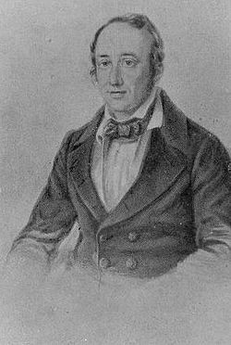
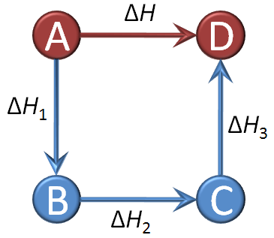
Hess’s Law
Germain Henri Hess

Slide 2
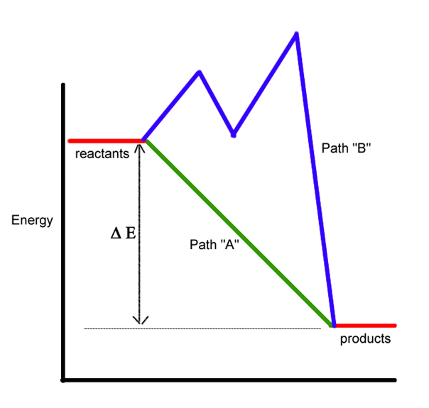
Hess’s Law
“In going from a particular set of reactants to a particular set of products, the change in enthalpy is the same whether the reaction takes place in one step or a series of steps.”

Slide 3
Hess’s Law Example Problem
Calculate ΔH for the combustion of methane, CH₄: CH₄ + 2O₂ → CO₂ + 2H₂O
Reaction | ΔHº
C + 2H₂ → CH₄ | -74.80 kJ
C + O₂ → CO₂ | -393.50 kJ
H₂ + ½ O₂ → H₂O | -285.83 kJ
CH₄ → C + 2H₂ +74.80 kJ
Step #1: CH₄ must appear on the reactant side, so we reverse reaction #1 and change the sign on ΔH.

Slide 4
Hess’s Law Example Problem
Calculate ΔH for the combustion of methane, CH₄: CH₄ + 2O₂ → CO₂ + 2H₂O
Reaction | ΔHº
C + 2H₂ → CH₄ | -74.80 kJ
C + O₂ → CO₂ | -393.50 kJ
H₂ + ½ O₂ → H₂O | -285.83 kJ
CH₄ → C + 2H₂ +74.80 kJ
C + O₂ → CO₂ -393.50 kJ
Step #2: Keep reaction #2 unchanged, because CO₂ belongs on the product side

Slide 5
Hess’s Law Example Problem
Calculate ΔH for the combustion of methane, CH₄: CH₄ + 2O₂ → CO₂ + 2H₂O
Reaction | ΔHº
C + 2H₂ → CH₄ | -74.80 kJ
C + O₂ → CO₂ | -393.50 kJ
H₂ + ½ O₂ → H₂O | -285.83 kJ
CH₄ → C + 2H₂ +74.80 kJ
C + O₂ → CO₂ -393.50 kJ
2H₂ + O₂ → 2 H₂O -571.66 kJ
Step #3: Multiply reaction #2 by 2

Slide 6
Hess’s Law Example Problem
Calculate ΔH for the combustion of methane, CH₄: CH₄ + 2O₂ → CO₂ + 2H₂O
Reaction | ΔHº
C + 2H₂ → CH₄ | -74.80 kJ
C + O₂ → CO₂ | -393.50 kJ
H₂ + ½ O₂ → H₂O | -285.83 kJ
CH₄ → C + 2H₂ +74.80 kJ
C + O₂ → CO₂ -393.50 kJ
2H₂ + O₂ → 2 H₂O -571.66 kJ
CH₄ + 2O₂ → CO₂ + 2H₂O
-890.36 kJ
Step #4: Sum up reaction and ΔH

Slide 7
Calculation of Heat of Reaction
Calculate ΔH for the combustion of methane, CH₄: CH₄ + 2O₂ → CO₂ + 2H₂O
ΔH_{rxn} = Σ ΔH_{f}(products) - Σ Δ H_{f}(reactants)
Substance | ΔH_{f}
CH₄ | -74.80 kJ
O₂ | 0 kJ
CO₂ | -393.50 kJ
H₂O | -285.83 kJ
ΔH_{rxn} = [-393.50kJ + 2(-285.83kJ)] – [-74.80kJ]
ΔH_{rxn} = -890.36 kJ

