Slide 1
Electrochemistry
Movement of Electrons
Chemistry of Metal Reactions
Batteries: Chemical Reaction
Corrosion

Slide 2
Overall Expectations
investigate through experimentation the ease of oxidation of metals, and build electrochemical cells and describe their functioning;
demonstrate an understanding of the chemical processes that take place in galvanic and electrolytic cells;
explain the importance for industry and the consequences for the environment of common electrochemical processes.

Slide 3
Understanding Basic Concepts
explain the chemical reactions involved in corrosion, and describe their similarity to chemical reactions occurring in an electrochemical cell;
name the components of galvanic and electrolytic cells, describe their role, and explain how they function in terms of oxidation and reduction;
identify and explain various techniques used to prevent corrosion of metals (e.g., painting, cathodic protection, galvanization).

Slide 4
Developing Skills of Inquiry and Communication
use appropriate scientific vocabulary to communicate ideas related to electrochemistry (e.g., ionic bonds, oxidation, anode, electrolyte);
use the following laboratory equipment and instruments safely and accurately: voltmeters, electrical sources, connecting wires;
classify, using experimental evidence, metals, acids, bases, salt solutions, and covalent substances as conductors or non-conductors of electricity;

Slide 5
Developing Skills of Inquiry and Communication
interpret observations from experiments to determine an activity series of some metals;
predict the spontaneity of displacement reactions between metal elements and metal salts based on the activity series, and verify the predictions through experimentation;
design and carry out procedures to determine the factors that affect rate of corrosion (e.g., stress, two-metal contacts, surface oxide, nature of electrolyte, nature of metal).

Slide 6
Developing Skills of Inquiry and Communication
describe an electrochemical cell in terms of half-cell reactions, location of electrodes, direction of electron flow, and direction of migration of ions;
construct a galvanic cell, and determine its advantages and disadvantages (e.g., source of energy, portability, rechargeability; chemical spillage, limited voltage);

Slide 7
Relating Science to Technology, Society, and the Environment
describe applications of electrochemical cells, such as batteries;
explain how electrolytic processes are used in the refining of metals (e.g., Al, Cu, or Ni), and evaluate the impact of such processes on the environment (e.g., production of acid rain, high-energy consumption);
identify electrochemical processes used in industry (e.g., chrome-plating);
describe the effects of road salt and acid rain on the process of corrosion, and suggest possible ways of counteracting these effects.

Slide 8
Agenda
Ionic Compounds, Ions electron transfer
Redox Reactions, Oxidation Numbers
Activity Series
Electrolytes, Non Electrolytes
Galvanic Cells, Cells, Batteries
Corrosion, Factors that affect Corrosion
Electrolytic Cells, Electrolysis

Slide 9
Remember Chemical Reactions
Ionic Bonds, Electron Transfer
Redox Reactions

Slide 10
What is Electrochemistry?
Electrochemistry is the study of the changes that cause electrons to flow, creating what we call electricity. This flow of electrons is created by reduction and oxidation reactions (redox).

Slide 11
Ionic Bonding, Ions, Metals
Electrons are transferred in ionic bonding(Metal and Nonmetal)
Electrons leave more reactive elements less reactive elements gain the electrons
Metals and metal ions (charged form) always compete for electrons
Electrochemistry deals with how electrons move between different metals and other ions
Reactivity of the metals determine its ability to donate electrons or take up electrons

Slide 12
Identify an Element’s ion charge
Metals are positive, Non metals are negative
Many charges correspond to the number of valence electrons and the need to have a full outer shell
Many metals have more than one charge
These are found by inspection of the compound
  Reverse crossover rule
  Total charge of compound must be zero

Slide 13
A Chemical Reaction
Place a Zinc metal strip is a solution of Copper II sulphate
Zn_{(S)} + Cu(SO₄)_{(aq)} ➔ Zn(SO₄)_{(aq)} + Cu_{(S)}
_{Net Ionic Equation}
Zn_{(S)} + Cu²⁺_{(aq)} ➔ Zn²⁺_{(aq)} + Cu_{(S)}
SO₄²⁻ is a spectator ion

Slide 14
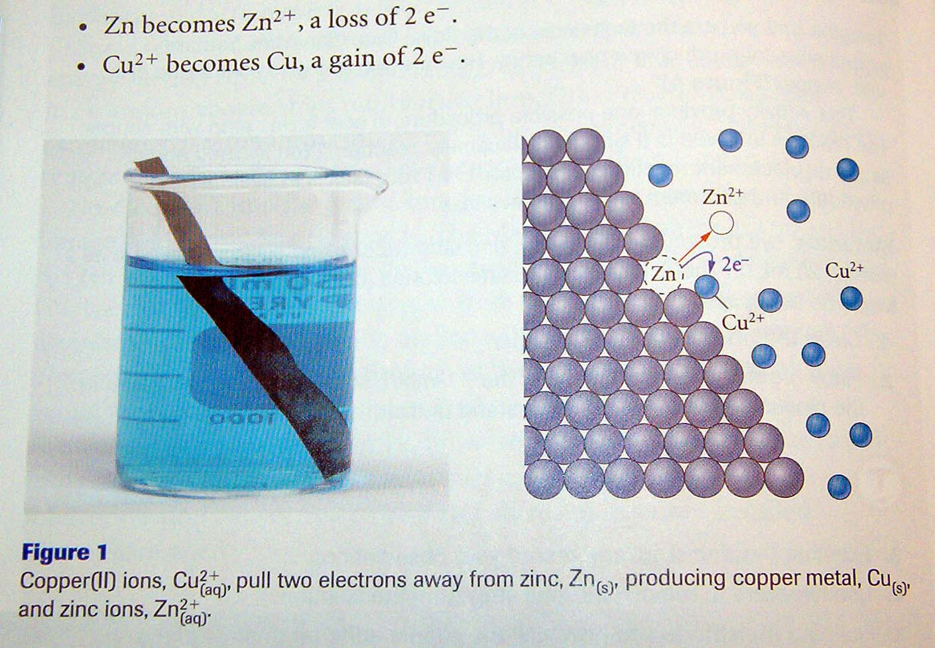

Slide 15
Gaining and Losing Electrons:
Zinc Metal and Copper ion
Zinc loses two electrons (half reaction)
  Zn⁰ ➔ Zn²⁺ + 2 e⁻
Copper gains two electrons (half reaction)
  Cu²⁺ + 2e⁻ ➔ Cu⁰
Net Equation Does Not include sulphate ion because it is not involved in reaction (Spectator ions)
  Cu²⁺ + Zn⁰ ➔ Zn²⁺ + Cu

Slide 16
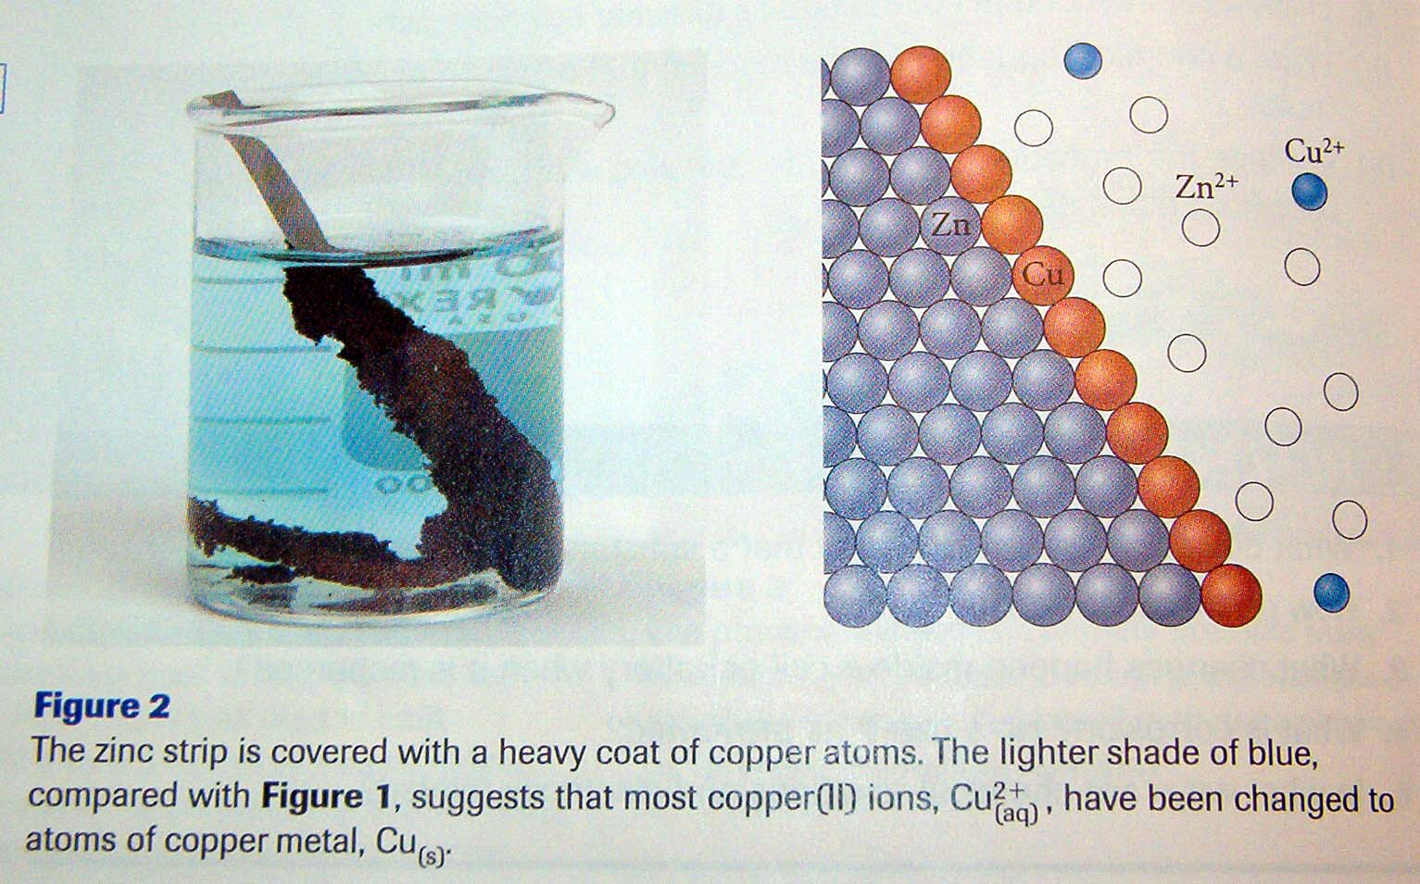

Slide 17
Oxidation-Reduction Reactions:
[Redox Reactions]
Oxidation is the process of losing electrons
  Results in an increase in charge (more positive)
Reduction is the process of gaining electrons
  Results in a decrease in charge (more negative)
Reduction and oxidation always occur together. If one thing is reduced, another thing is oxidized. The reactant that is reduced is called the oxidizing agent and accepts electrons. The reactant that is oxidized is called the reducing agent and supplies electrons.
OIL RIG or LEO goes GER

Slide 18
Who is reduced? Who is Oxidized?
All electrons gained by one reactant are the electrons lost by the other reactant
electrons lost = electrons gained
Write total ionic Equation
Write the net ionic equation
Label Charges
Identify Loss and Gain of electrons

Slide 19
Try some Examples
  4 Na + O₂ ➔ 2 Na₂O
  2 CuO ➔ 2 Cu + O₂
  Zn + FeCl₂ ➔ ZnCl₂ + Fe

Slide 20
Redox Reactions of Nonmetals
Although nonmetals “share electrons” the electronegativity of different elements pull electrons in one direction
If we assume that the pull of the electrons is complete then we can assign “apparent charges”.
Apparent charges are called Oxidation Numbers

Slide 21
Oxidation numbers (Not only for Metals)
Oxidation numbers tell which atoms gain or lose their electron(s) in a reaction.
Each atom in free form (not in compound), has an oxidation number of 0. For example, oxygen gas (O2), charcoal (C), and iodine (I2) all have an oxidation number of 0.
The oxidation of simple ions is equal to its ionic charge.
  Group (IA) always has an oxidation number of +1.
  Group (IIA) always has an oxidation number of +2.

Slide 22
Oxidation numbers (Not only for Metals)
The oxidation number of oxygen is -2 except in peroxides. In hydrogen peroxide (H₂O₂), the oxidation number is -1.
Hydrogen has a +1 oxidation number. Except in metal hydrides (for example: lithium hydride LiH). With metal hydrides the oxidation number is -1.
The sum of the oxidation numbers in a polyatomic ion must equal the charge of the ion
  ex. OH⁻, -2 for O and +1 for H = -1

Slide 23
Oxidation Number Examples
SO₂
Oxygen has a known charge of –2
There are 2 of them: 2 x (-2) = -4
The total charge must be 0
Therefore Sulfur must have a charge of +4

Slide 24
Oxidation Number Examples
H₂S
CO₂
Fe₂O₃
Na₂CO₃
HClO₃
MnO₄⁻
(OVERALL CHARGE = -1)

Slide 25
Identifying Redox Reactions
All redox reactions involve a transfer of electrons
  Therefore oxidation numbers must change
In reduction Oxidation numbers decrease
In oxidation Oxidation numbers increase

Slide 26
Oxidation Numbers to identify a Redox Reaction
Zn + S ➔ ZnS
Write all Known Oxidation Numbers
Zn + S ➔ ZnS
0 0 +2 -2
Zinc has changed from 0 to +2
Sulfur has changed from 0 to –2
If there is a change in Oxidation Numbers then a redox reaction has taken place

Slide 27
Identifying a Redox Reaction cont…
SO₃ + H₂O➔ H₂SO₄
Write all known charges
[?] -2 +1 -2➔ +1 [?] –2
Solve for Unknown Oxidation Number
[?=+6] -2(3) +1(2)-2(1)➔ +1(2) [?=+6] –2(4)
Identify if there was any change in Oxidation Numbers
No Change therefore not a redox reaction

Slide 28
Identifying a Redox Reaction cont…
2KClO₃ ➔ 2KCl + O₂
Fe₂O₃ + 3 CO ➔ 2Fe + 3 CO₂
CaCO₃ ➔ CaO +CO₂

Slide 29
Metal Reaction Chemistry
The Secret Behind Batteries

Slide 30
Metal Reactivity Test #1
The rate at which a metal reacts in acid provides a clue as to the reactivity of that metal
Need:
  Hydrochloric Acid
  5 strips of different Metals
  Sandpaper
  Test tubes and rack

Slide 31
Activity Series of Metals
Different combinations of metals and metal ions are used to compare the ability of the metal to react with other metal ions.
Metals with more reactions are very good at donating electrons
Metal ions with more reactions are very good at taking electrons
Whenever a metal combines with oxygen to form an oxide the metal loses electrons

Slide 32
Metal Reactivity Test #2
Metal and metal ions compete for electrons
Using a set of small experiments determine which metal is most reactive
Using an Activity Series we can predict if a reaction will occur
Metals at the top will react with metal ions below it and convert them into pure metal

Slide 33
Activity Series
Li
Li lithium
K potassium
Na sodium
Ca calcium
Mg magnesium
Al aluminum
Mn manganese
Zn zinc
Cr chromium
Fe iron
Cd cadmium
Ni nickel
Sn tin
Pb lead
H HYDROGEN
Cu copper
Hg mercury
Ag silver
Pt platinum
Au gold

Slide 34
Activity Series Examples
Metals tend to oxidize
Metals remain
Metal ions remain
Metals ions are reduced
Magnesium
Zinc
Iron
Tin
Lead
Hydrogen
Copper
Gold

Slide 35
Try these reactions:
(look at Activity Series)
Lead metal and copper ions
Magnesium metal and copper ions
Zinc and Iron ions
Would copper react with zinc nitrate?

Slide 36
Testing the Activity Series
Please look at the lab sheet

Slide 37
Components of a battery
Conductors
Electrolytes

Slide 38
Conductors and Nonconductors
A battery is built with substances that must conduct electricity
Solids parts
All metals conduct electricity
Non metals are nonconductors
Liquid parts
Electrolytes are solutions that conduct electricity
Acids (H+), Bases (OH-), Ionic compounds dissolved in solution conduct electricity, tap water
Molecular compounds (Non metals) and Distilled water don’t conduct electricity

Slide 39
Galvanic cells, or voltaic cells
basically batteries
a shiny piece of copper is placed into a solution of silver nitrate, a spontaneous reaction occurs. A grayish white silver deposit if formed on the copper and the solution turns blue because of copper (II) nitrate.
2Ag⁺ + Cu ==> Cu²⁺ + 2Ag
No usable energy could be harnessed from this reaction because it is dissipated as heat.

Slide 40
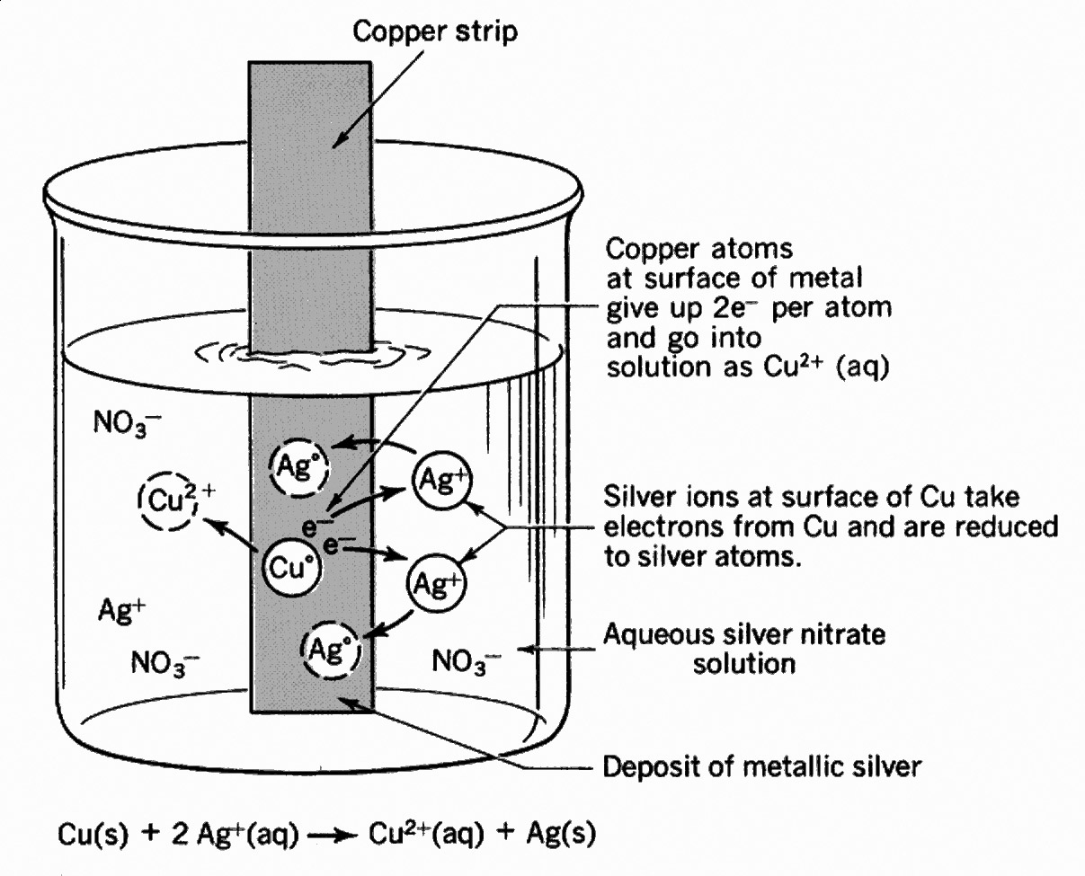

Slide 41
Galvanic cells, or voltaic cells
The same chemical reaction can occur and produce electricity if it was placed in a galvanic cell. A galvanic cell consists of two containers with a salt bridge between them. The two containers each store the half-reactions of the equation above.
reduction: Ag⁺ + e⁻ ==> Ag
oxidation: Cu ==> Cu²⁺ + 2e⁻

Slide 42
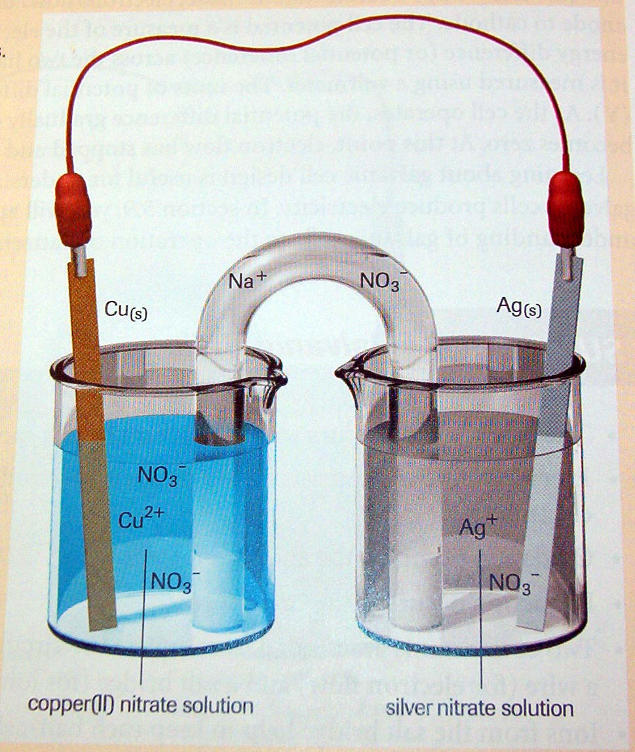

Slide 43
Components of a Galvanic Cell
Salt Bridge
Wire Connectors
Electrolyte
Two different metals

Slide 44
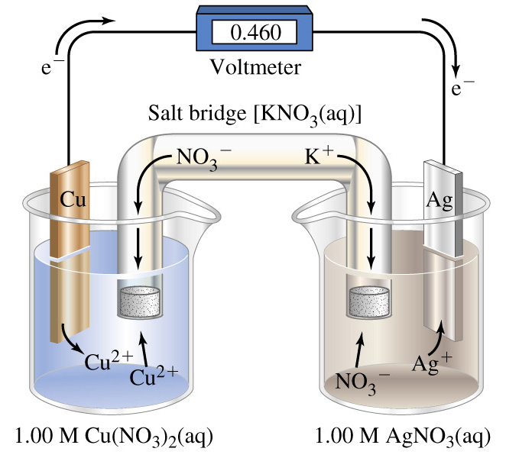

Slide 45
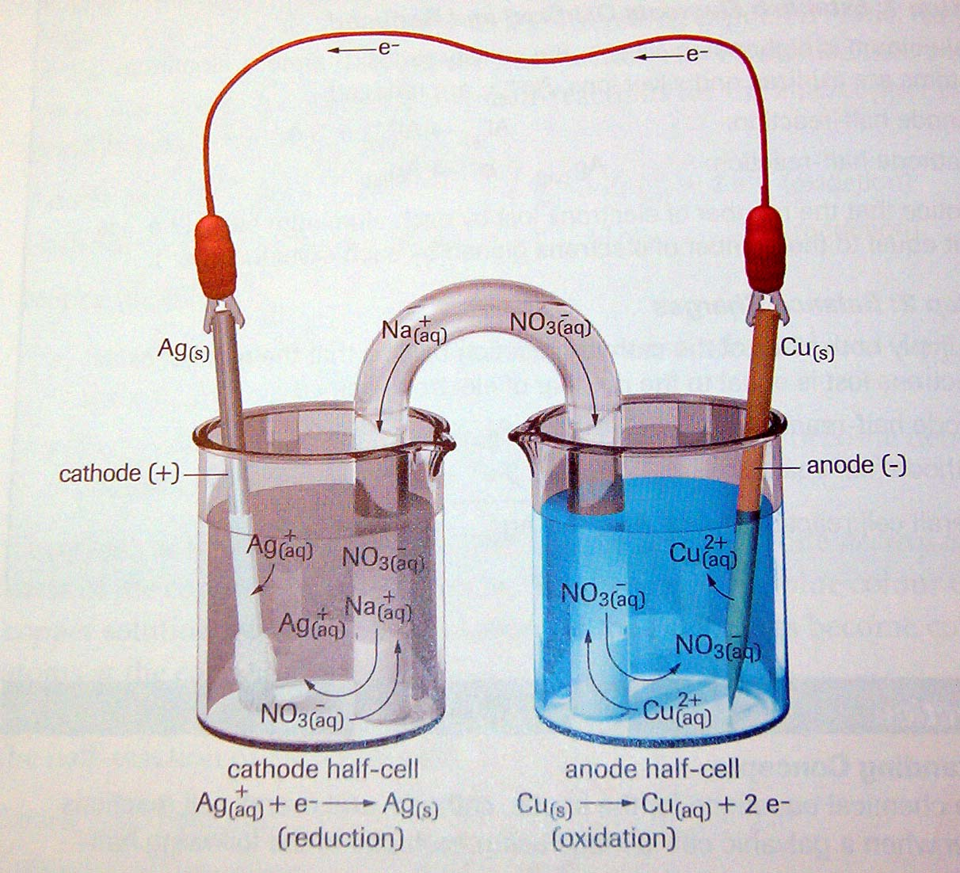

Slide 46
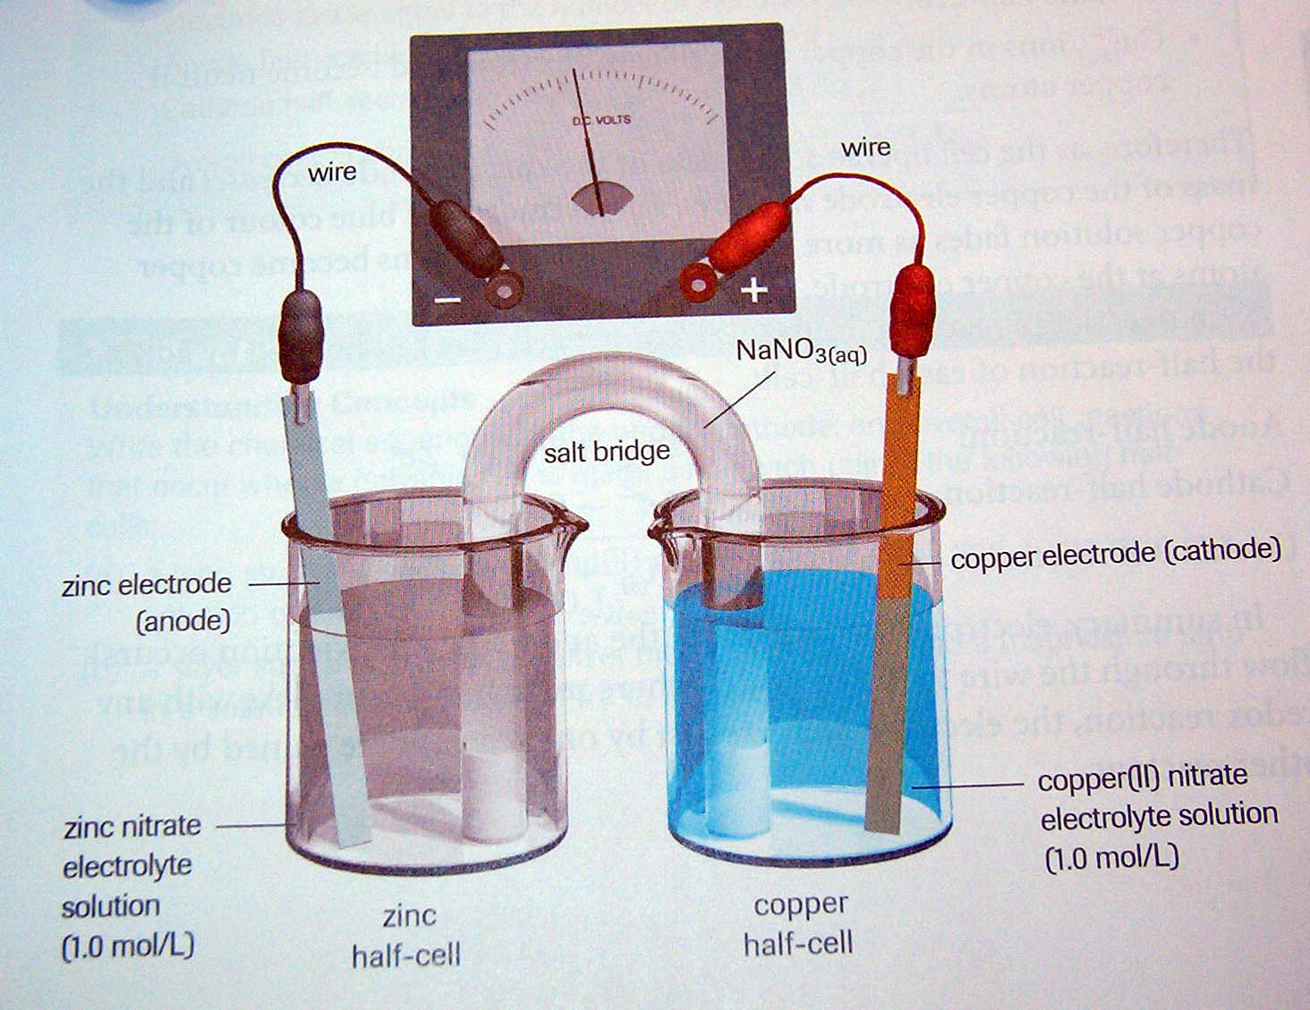

Slide 47
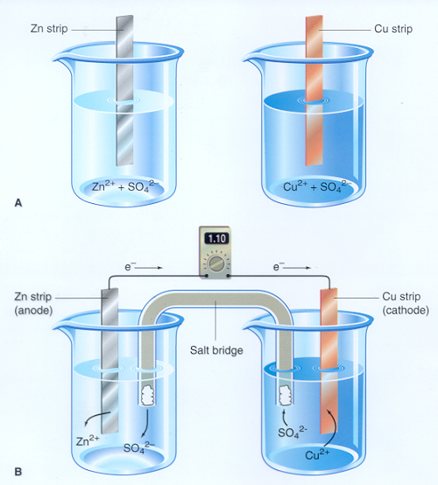

Slide 48
Galvanic cells, or voltaic cells
This works because the solutions in both compartments, or half-cells, remain electrically neutral. The salt bridge permits ions to enter or leave the solutions.
The electron flow from the anode to the cathode is what creates electricity. In a galvanic cell, the cathode is positive while the anode is negative, while in a electrolytic cell, the cathode is negative while the anode is positive.

Slide 49
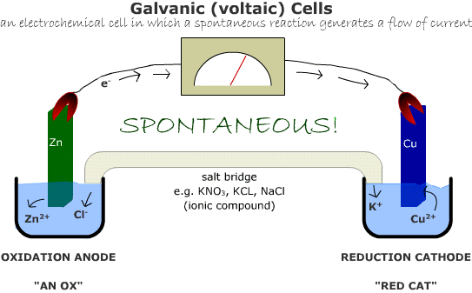

Slide 50
What's Happening in the Galvanic Cell Above??
The zinc electrode is losing mass as Zn metal is oxidized to Zn²⁺ ions which go into solution.
The concentration of the Zn²⁺ solution is increasing.
Anions, negative ions (e.g. Cl⁻), are flowing from the salt bridge toward the anode to balance the positive charge of the Zn²⁺ ions produced.
The copper electrode is gaining mass as Cu²⁺ ions in the solution are reduced to Cu metal.
The concentration of the Cu²⁺ solution is decreasing.
Cations, positive ions (e.g. K⁺), are flowing from the salt bridge toward the cathode to replace the positive charge of the Cu²⁺ ions that consumed.

Slide 51
Summary of a Galvanic Cell
The reaction is spontaneous
Consists of two different electrodes and electrolyte
Oxidation at the anode
Reduction at the cathode
Wires for electron flow, salt bridge for ion flow

Slide 52
Summary of a Galvanic Cell cont…
Ions and the salt bridge keep the cell neutral
Positive ions cations flow to the cathode
Negative ions anions flow to the anode
Cell potential or voltage measures the potential difference across the electrodes

Slide 53
Applications of Galvanic Cells
The Battery
Corrosion
Electrolysis

Slide 54
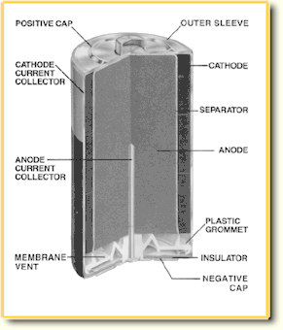
The Battery
Components
Reactions
Arrangements
Types
Questions

Slide 55
Components: Alkaline Battery
Outside
  Tightly Sealed (Explosive when Heated)
  Positive and Negative Terminals
  Size determines the amount of time it lasts
  Voltage determines energy of each electron
Inside
  Anode: Powdered Zinc
  Cathode: MnO2 and Carbon
  Porous Membrane keeps chemicals separate
  Electrolyte thick paste very strong base
  Corrosive

Slide 56
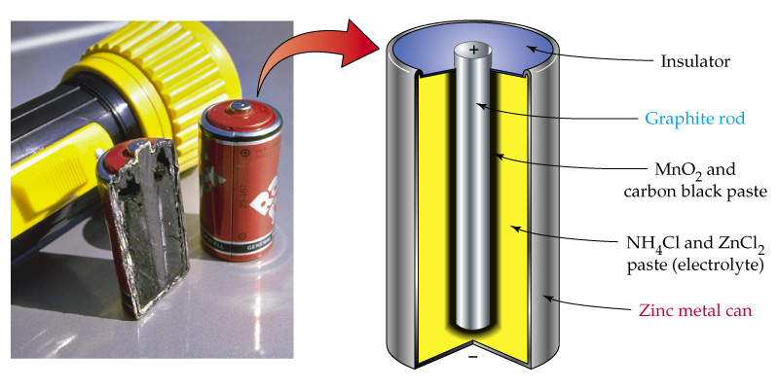
Cell Components

Slide 57
Cell Reactions
Different chemicals provide different voltages
Only when the positive and negative terminals are connected does the reaction take place
Anode➔Oxidation➔negative terminal➔ Positive Terminal➔Cathode➔Reduction

Slide 58
Cell Arrangements
Parallel
  Voltage stays the same, length of time increases
Series
  Voltage increases [addition] length of time remains the same
Primary: One time use
Secondary: Rechargeable

Slide 59
Types of Cells
Use the handout to compare the positive and negative properties of various primary cells and secondary cells
Ni Cad : Not perfect…Toxic Cadmium
Hydrogen Fuel Cells [The Future???]

Slide 60
Review on Batteries
Why “C” size instead of “AA”
Role of separator fabric in a battery
Battery leaks danger
What determines voltage
Series vs Parallel
Primary vs Secondary
Analysis of battery half reactions

Slide 61
Corrosion
What is it?
Factors that affect the rate of corrosion
Nickel Poisoning
Preventing Corrosion

Slide 62
Corrosion
The deterioration of a metal as a result of slow oxidation
This causes the metal to form an oxide of the metal: Ex. CuO, FeO, ZnO
Some metal oxides are brittle (FeO) and some form protective coatings for the metal (Al₂O₃)
The protective coatings allow more reactive metals to resist corrosion

Slide 63
Rusting of Iron (Fe)
Rust is a mixture of oxides and hydroxides of iron
It does not stick well to the metal, flakes off and exposes new metal to further oxidation
A corroding metal is a galvanic cell where the anode and cathode are found at two different points on the same metal surface
The metal also allows the electrons to flow
The anode is where damage or impurities exist in the metal, the cathode is anywhere else
Iron is oxidized and oxygen is reduced

Slide 64
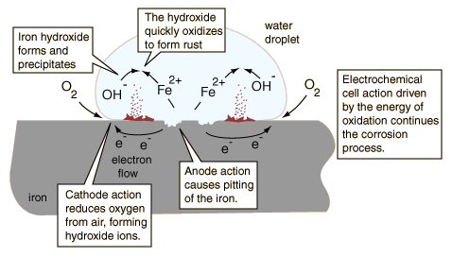

Slide 65
Considering the sketch of a water droplet, the oxidizing iron supplies electrons at the edge of the droplet to reduce oxygen from the air. The iron surface inside the droplet acts as the anode for the process
Fe(s) -> + Fe²⁺(aq) + 2e⁻
The electrons can move through the metallic iron to the outside of the droplet where
O₂(g) + 2H₂O(l) + 4e⁻ -> 4OH⁻(aq)
Within the droplet, the hydroxide ions can move inward to react with the iron(II) ions moving from the oxidation region. Iron(II) hydroxide is precipitated.
Fe²⁺(aq) + 2OH⁻(aq) -> Fe(OH)₂(s)
Rust is then quickly produced by the oxidation of the precipitate.
4Fe(OH)₂(s) + O₂(g) -> 2Fe₂O₃ •H₂O(s) + 2H₂O(l)
The rusting of unprotected iron in the presence of air and water is then inevitable because it is driven by an electrochemical process

Slide 66
Factors that Affect Corrosion
Moisture: Water is a reactant, corrosion can not occur without water
Electrolytes: Allows for electrical conductivity, acts as a salt bridge balancing charges
Contact with less reactive metals: Further apart the metals on the activity series the quicker the corrosion (iron nails with copper metal→ nails corrode, steel and copper pipe unions)
Mechanical Stresses: Bending, shaping, cutting, becomes corrosion sites

Slide 67
Preventing Corrosion
Protective Coatings
  Paints, plastic, tape
  Must remain completely covered
  Galvanizing (Covering steel with thin layer of zinc)
Corrosion-Resistant Metals
  Less impurities in the metal
  Corrosion resistent additives
  Alloys of aluminum, magnesium
  Titanium
  Stainless steel (alloy of iron, chromium, and nickel)
  Needed for artificial body parts, Airplanes

Slide 68
Preventing Corrosion
Cathodic Protection: forcing the protected metal to act as the cathode and a second metal to be the anode
Sacrificial Anode: A metal more easily oxidized than iron electrically connected to an iron object
Metal remains protected as long as there is an electrical connection

Slide 69
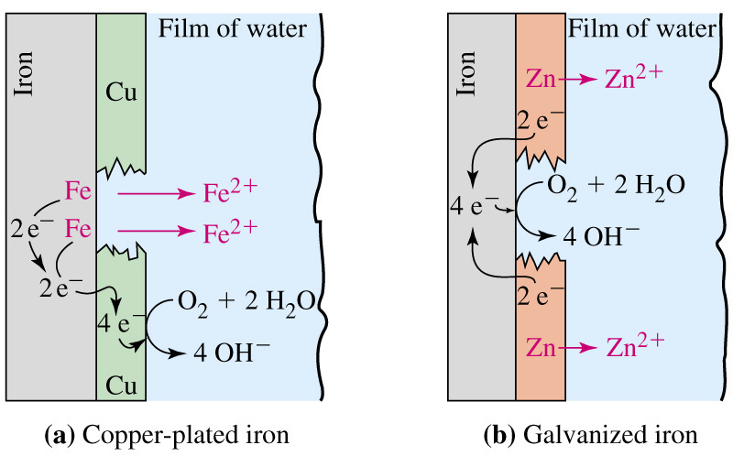
Corrosion Protection:
Copper versus Zinc

Slide 70
Electrolysis
Energy Required: Nonspontaneous
Applications
Environmental Impacts

Slide 71
Electrolysis
When electricity is passed through an liquid solution of an ion or an electrolyte, a chemical reaction called electrolysis occurs.
When electricity flows, chemical changes happen the solution is involved not the electrodes.
For example: Take a solution of sodium chloride.
At the positive electrode, the anode, oxidation occurs as electrons are pulled from negatively charged chloride ions.
2Cl⁻ ==> Cl₂ + 2e⁻

Slide 72
Electrolysis cont…
At the negative electrode, the cathode, reduction occurs as electrons are added to positively charged sodium ions.
Na⁺ + e⁻ ==> Na
In affect, it splits the sodium and chlorine back into their elements.
Remember the anode is where oxidation occurs (remember "an ox"). The cathode is where reduction occurs (remember "red cat").
The power supply determines the direction of the electron flow not the reaction

Slide 73
Electrolysis cont…
Anode
Cathode
Na⁺
Cl–
Cl–
Na⁺
Na⁺
Cl–
Na⁺
Cl–

Slide 74
Applications of Electrolysis
Rechargeable Batteries
Manufacturing Aluminum
Refining metals (increasing purities)
Electroplating
  Jewelery, Cutlery
  Chrome plating
  The “Loonie”(nickel with bronze plating)
  The penny (iron with copper plating)

Slide 75
Environmental Impact of Electrolysis
Aluminum production
  Carbon Dioxide (Global Warming), Sulfur Dioxide (Acid Rain), Polyaromatic hydrocarbons (Lung Cancer)
Consumption of Electricity
Electroplating
  Metal Cyanide + Acid → Hydrogen Cyanide Gas
  Many metals like Chromium are carcinogens

Slide 76
Time To Review

