Slide 1

Organic Chemistry
Naming Techniques
Functional Group
Reactions
Applications

Slide 2
Dangers of organic compounds (1)
– explain the dangers associated with the use of organic solvents (e.g., combustibility, toxicity) and the necessary precautions to be taken;
3.10 p215 p 624 safety section
The Carbon atom and bonding (1)
– demonstrate an understanding of the particular characteristics of the carbon atom in terms of the type of bonding and the formation of long chains;
3.1 p180-182
Properties of Hydrocarbons
Drawing and Naming Organic Compounds (3)
– draw Lewis structures to represent covalent bonding in organic molecules (e.g., methane, ethanol, butene, acetylene);
3.1 p182-186 Alkanes
Alkenes
Alkynes
Properties of Organic Compounds (2)
– explain the general properties of molecules containing oxygen or nitrogen (e.g., polarity, solubility in water);
– use appropriate scientific vocabulary to communicate ideas related to organic chemistry (e.g., electronegativity, covalent bond, functional group, polymer);
3.5 p199

Slide 3
Functional Groups ( )
– identify the functional group structures that define common families (e.g., alkenes, alkynes, alcohols, aldehydes, ketones, acids, esters, amines);
3.5 p199-201
3.7 p204 Alcohols and Ethers
3.9 p212 Aldehydes and Ketones
3.11 p218 Carboxylic Acids
3.13 p223 Esters
3.15 p228 Amines and Amides
Properties of Organic Compounds Lab (2)
– determine through experimentation the physical and chemical properties of some common organic compounds (e.g., aqueous and non-aqueous solubility, combustibility, conductivity, odour), and identify patterns and trends in these observations;
Lab activities for each type of functional group
Organic Reactions ( )
– describe, using structural formulae, typical organic reactions such as addition, combustion, and addition polymerization reactions;
3.1 p187, 188,
3.18 p237
– identify through experimentation some of the products of the combustion of a hydrocarbon and an alcohol, and write balanced chemical equations to represent the combustion reaction;
3.8 p209

Slide 4
Organic Reactions Lab (2)
– synthesize a condensation product (e.g., aspirin or an ester), a common organic compound (e.g., soap), and a synthetic polymer (e.g., cross-link polyvinyl alcohol using a solution of borax).
3.20 p244
Distillation (1)
- explain the principle underlying the use of distillation to separate organic compounds.
- select and use apparatus safely to separate a mixture of liquids by distillation;
3.4 p197
Cracking of Fuels by distillation (1)
- describe the role of distillation and cracking in the production of useful fuels from crude oil;
3.3 p193
Organic Chemistry and Industry (1)
– identify useful organic compounds (e.g., non-stick coatings for cookware) on the basis of information gathered from print and electronic sources, and illustrate their molecular structure and functional groups using representations drawn by hand or by computer;
– identify issues connected to the growing use of plastics (e.g., the consumption of fossil fuels, waste disposal), and suggest alternative materials that could be used;
3.17 p233
– describe how organic chemistry has led to the development of useful new products (e.g., synthetic fabrics, automobile body panels, artificial heart valves).
3.16 p231
3.19 p243
3.21 p247

Slide 5
Organic Chemistry: the study of carbon compounds.
Organic molecules contain both carbon and hydrogen.
While many organic chemicals also contain other elements, it is the carbon-hydrogen bond that defines them as organic.
Organic chemistry defines life. There are millions of different organic molecules, each with different chemical and physical properties.
Example: Gasoline, Sugar, DNA

Slide 6
Organic Solvents:Safety Concerns
Organic solvents are non polar, fat dissolving compounds
  Liquids spread quickly over a large surface area
  They are absorbed quickly, even through through skin
Volatile (evaporate quickly) – Inhalation toxicity
Some are Flammable – ignite and burn easily at room temperature
Some are Combustible – ignite and burn at warmer temperatures
Most have low Flashpoints – Lowest temperature at which the compound will vapourize and form a burnable mixture with air

Slide 7

The Magic Carbon
Carbon atoms have 4 valence electrons that form four covalent bonds
Carbon atoms can bond to oxygen, nitrogen, and up to four other carbon atoms
    One triple bond and one single bond
    Two double bonds
    OR Four single bonds
Carbon atoms form long chains, branched chains and rings
There appears to be almost no limit to the number of different structures that carbon can form.

Slide 8


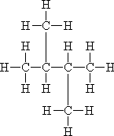
Carbon Compounds

Slide 9
Organic Compounds
Mainly chains of Carbon and Hydrogen
Hydrocarbons
  React with oxygen to produce water and CO₂
  Low O₂ levels produce carbon monoxide and pure carbon
  Separated using boiling points (distillation)
The rest have other atoms like Oxygen, Nitrogen and other non-metals attached

Slide 10
Polar vs. Non-polar
Different electro-negativities
Soluble in Water
Hydrocarbons with functional groups
C-O, C-N bonding
Increases intermolecular force
-OH, -NH groups creates hydrogen bonding
Increases boiling points
Symmetrical compounds
Hydrocarbons
C-C, equal C-H bonding
Low intermolecular forces
Low boiling points

Slide 11

Modeling Organic Compounds
Molecular Formula
  Number of atoms of each element present
  C2H4O2
Structural Formula
  Indicates element arrangement
  CH3COOH
Graphical Formula
  Models the shape and bonding occurring between atoms
  Example
C₅H₁₂
OR

Slide 12
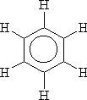
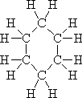
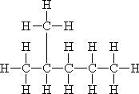
Classifying Organic Compounds
Hydrocarbon derivatives (functional groups present)
Hydrocarbon
Aromatic – Benzene ring
Aliphatic – No Benzene ring
  Cyclic – a ring structure present
    Cycloalkane – single bonds
    Cycloalkene – a double bond present
  Acyclic – linear or branched molecules
    Alkane – single bonds
    Alkene – double bond present
    Alkyne – triple bond present

Slide 13
Alkanes
Straight or branched chains containing only single bonds
Unreactive due to single bonds
Reaction = combustion (used as fuels)
Short chains are gases (propane, methane)
Longer chains are liquids and solids (decane, octane)
General Formula = C_{n}H_{2n+2}
Name of compound ends in “-ane”

Slide 14
Naming Alkanes
# of C | Prefix | Formula | # of C | Prefix | Formula
1 | Meth- | CH₄ | 6 | Hex- | C₆H₁₄
2 | Eth- | C₂H₆ | 7 | Hept- | C₇H₁₆
3 | Pro- | C₃H₈ | 8 | Oct- | C₈H₁₈
4 | But- | C₄H₁₀ | 9 | Non- | C₉H₂₀
5 | Pent- | C₅H₁₂ | 10 | Dec- | C₁₀H₂₂

Slide 15
Alkenes
Straight or branched chains containing a double bond
The presence of the double bond makes alkenes more reactive than alkanes.
Other atoms can be bonded to the molecule
Allows molecules to make polymers.
General formula: C_{n}H_{2n}
Ending changes to “-ene”

Slide 16
Alkynes
The presence of the triple bond makes these very reactive.
General Formula: C_{n}H_{2n-2}
Ending of molecule changes to “-yne”

Slide 17
Hydrocarbon Reactions
Combustion
Addition (alkenes, alkynes)

Slide 18
Combustion Reactions
All hydrocarbons will burn in air to produce large amounts of light and heat.
This reaction with the oxygen in air makes hydrocarbons useful fuels.
hydrocarbon + oxygen → carbon dioxide + water
The increasing carbon dioxide levels may be contributing to global climate changes.

Slide 19


Addition Reactions
Addition reactions are a good test for a double bond. A diatomic bromine solution is reacted with the suspected compound. If a double bond is present, red colour (from Br₂) will quickly fade.
+ Br₂

Slide 20
Saturated vs. Unsaturated
When C=C or C≡C bonds are present, the molecule contains less than the maximum number of hydrogen (or other) atoms.
When a hydrocarbon molecule can no longer add more atoms, the molecule is referred to as saturated
All C-C bonds are single bonds and no more entities can be added to them.
alkanes are saturated
alkenes and alkynes are unsaturated.

Slide 21
Separating Hydrocarbons
molecules of different sizes have different boiling points
The smallest molecules have the lowest boiling points and are all gases at room temperature (Ex. Propane)
The largest molecules have boiling points over 400°C
Ex. Asphalt can be heated to high temperatures to pave roads, without evaporating.

Slide 22
Separating Hydrocarbons cont…
nonpolar molecules like hydrocarbons are attracted to each other by relatively weak London dispersion forces
As the length of hydrocarbon molecules increase, the intermolecular forces increase
Higher temperatures are required to pull the molecules far enough apart to change into a gas.

Slide 23
Fractional Distillation
molecules of various sizes are separated into portions called fractions.
Each fraction contains similar-sized molecules.
The lighter fractions boil at lower temperatures, and the heavier fractions boil at higher temperatures.
entire mixture of hydrocarbons is first heated to very high temperatures
As the hot gases travel up through the lower, warmer sections, the larger molecules condense.
The smaller molecules with their low boiling points are still gases and ascend higher, to the top of the tower where the temperatures are lowest

Slide 24
Destructive Distillation (Cracking)
Fractionation of petroleum produces the less
useful straight-chain hydrocarbons. A process called cracking is used to
convert these straight-chain hydrocarbons into shorter branched-chain
alkanes.
straight-chain heptane is assigned
an octane number of 0.
cracking the process in which

Slide 25
Hydrocarbon Derivatives
Functional Groups

Slide 26
Functional Groups
A particular combination of atoms that contributes to the physical and chemical characteristics of a substance
Helps to explain solubility, melting and boiling points, and how they react with other molecules.
Understanding the effects of the functional groups allows chemists to predict the properties of organic molecules
Helps chemists design new compounds, ranging from high-tech fabrics to “designer drugs.”

Slide 27


Alcohols
contain the hydroxide group, OH, substituted for hydrogen. Suffix is -ol.
General formula R-OH, where R is an alkyl group. Hydrogen bonding in the -OH group causes alcohols to have a high boiling point.

Slide 28


Ethers
oxygen singly bonded to two carbon atoms.
General formula R-O-R‘
Do not contain any hydroxyl groups, they cannot form hydrogen bonds.
The polar C=O bonds and molecular shape of ether molecules, however, do make them more polar than hydrocarbons.
The boiling points of ethers are slightly higher than the boiling points of hydrocarbons, but lower than the boiling points of alcohols
Like alcohols, they mix readily with both polar and nonpolar substances.

Slide 29

Aldehydes
have carbonyl group (—C=O ) bonded to at least one hydrogen atom. Add the suffix -al.
The boiling point for aldehydes is lower than alcohol's, since there is no hydrogen bonding. The boiling point is much higher than corresponding saturated hydrocarbons, since (—C=O ) bond is highly polar.

Slide 30


Ketones
have a carbonyl (—C=O ) on the interior of the chain.
Suffix is an -one ending.
General formula:

Slide 31



Carboxylic Acids
contain a carboxyl group,
general form,
suffix is an -ioc ending. Organic Acid. (Vinegar)

Slide 32

Esters
are produced by a condensation reaction between an acid and an alcohol.
Most esters have a very pleasant odour.
+
+ H₂O
acetic acid
+
methanol
methyl acetate**
+ water

Slide 33

Amines
Derivatives of ammonia
One or more N-H bonds have been replaced with a N-C bond
-NH₂, -NH, -N functional group.

Slide 34

Amides
have a carbonyl group and an amine (pronounced a-mids)
Amides are produced by a condensation reaction between a carboxylic acid and an amine
Add -amide suffix.

Slide 35
Nitro- compounds
Hydrocarbon compounds containing a NO₂ group
Nitro- prefix.

Slide 36
Halides
Hydrocarbon compounds containing a halogen (group 17) element
Common formula and prefix for compound
  R-F fluoro-
  R-Cl chloro-
  R-Br bromo-
  R-I iodo-

Slide 37
Functional Group Flowchart
Molecule is not a hydrocarbon
Molecule has only C and H
Has a Cl, Br, I, F
Has a Nitrogen atom
Does not have
a N atom
Halide
Only has single
bonded carbon
atoms
Does not
have only single
bonded carbon
atoms
The C bonded
to the N is
also double
bonded to
an O atom
The C
bonded
to the N is
not bonded
to an
O atom
The N
is bonded
to two
O atoms
Does not
have 2
O atoms
O atom
bonded to
H and a C
atom
Alkane
O atom
bonded to
2 different
C atoms
Amide
Amine
Nitro
Double bonded
carbon atoms
Has 2
O atoms
Carbon in
C=O is not
bonded to 2
other C atoms
Triple bonded
carbon atoms
Ether
Alcohol
Has C=O
with an
OH group
Carbon in
C=O is
bonded to 2
other C atoms
Alkene
Alkyne
Has C=O
without an
OH group
Aldehyde
Carboxylic
Acid
Ester
Ketone

Slide 38
Industrial Uses for Organic Compounds
Fibers, Soaps, Glues
Aspirin, Cosmetics

Slide 39
Fibers
What is the name of the fibrous material that plants are made of? CELLULOSE
How many glucose molecules make up cellulose? 10000
What type of bonding holds the strands of cellulose together? HYDROGEN BONDING
List one positive and one negative characteristic of rayon. COLOURS, LOW DURABILITY
What functional group is found in nylon? AMIDE
List the two characteristics of nylon that Hydrogen bonding is responsible for. STRENGTH AND FLEXIBILITY
Graphite is very strong. What three factors are responsible for this strength? COVALENT & DOUBLE BONDING, METAL/PLASTIC COMPOSITE FRAMEWORK
What industry uses the most graphite? AERONAUTICAL, SPACE

Slide 40
Soaps
Explain why fat and oil will not mix with water. OILS ARE NONPOLAR WATER IS POLAR
What two compounds did the ancient Egyptians mix together to for the first known soap? ANIMAL FAT AND POTASH
Draw a micelle.
Explain how a micelle removes dirt from clothing. COVERS OIL IN SOAP MOLECULES, OIL FALLS OFF, SURFACE IS POLAR
Detergents contain primary alkyl sulphates. What type of product are these found in? SHAMPOOS, DETERGENTS, DOES NOT FORM SOAP SCUM DOES NOT REACT WITH MAGNESIUM AND CALCIUM IONS
What are shampoos made of? WATER, SOAP, GLYCEROL, CASTOR OIL

Slide 41
Glues
Why are materials able to be glued together? INTERMOLECULAR FORCES, ELECTROSTATIC ATTRACTION, HYDROGEN BONDING
A practical adhesive must have the following characteristics. LIQUID AT ROOM TEMP, TURN SOLID WITHOUT COOLING
Polymerization can occur with the proper catalyst. What are three types of catalyst that is useful in the glue industry? WATER, LIGHT, AIR, METAL IONS
Crazy glue contains cyanoacrylate, which is a monomer. Explain how this monomer adheres to surfaces. REACTS WITH WATER, CREATES A REACTIVE MOLECULE, REACTS WITH OTHER MOLECULES, FORMS A POLYMER
What is the glass transition temperature? TEMPERATURE THAT A GLUE BECOMES A SOLID
What are hot glue sticks made of? ACETYLENE VINYL ACETATE
How many industrial applications are there for hot glue? 14000

Slide 42
Aspirin
What functional groups are found in salicylic acid?
List three positive and two negative characteristics of salicylic acid.
What was the problem with sodium salicylate?
What was the name that the Bayer Company called acetylsalicylic acid?
What was the Bayer Company famous for before acetylsalicylic acid?

Slide 43
Aspirin Cont…
Explain how ASA blocks chemical messengers?
How much Aspirin is consumed each year?
What consequences can occur in the body by over using ASA?
There are many different name brands of ASA. What is their only difference?
How is Acetaminophen different from ASA?

Slide 44
Cosmetics
What happens to the skin as cells reproduce?
What happens to the dirt, bacteria and viruses found on the skin?
What negative consequences occur to the skin when it is cleaned with alcohol?
Why are cleansing creams with oil soluble products good for the skin?
What is the purpose of lanolin being added to soaps?
Since lips have no sweat glands, what problems can happen to the lips?
List the two types of dyes used in lipsticks.
What ingredients are used to make lipsticks?
What is the purpose of adding antioxidants to lipstick?

Slide 45
Miscellaneous
Organic Compounds
Soap
Aspirin

Slide 46
Soaps
Animal and vegetable fats are esters having two parts:
  Long-chain organic acids (fatty acids)
  Various alcohols, glycerol (glycerine) is the most common. Glycerol is a triol.
Reacting a fat with NaOH splits the fat into glycerine and the sodium salt of the fatty acid. This sodium salt is the soap.

Slide 47
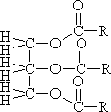


Making Soap
fat+ sodium hydroxide➔glycerol+3 soap
+ 3 NaOH
+
3

Slide 48
How Soap Works
Soap cleans because
  Long chain hydrocarbon has a good solvent action on other hydrocarbons.
  end has a high water solubility.
Soaps from 'scum" in hard water. "Scum" is a precipitates of the Ca²⁺ and Mg²⁺ of the soap. Detergents contain poly phosphorus ions, which tie up the Ca²⁺ and Mg²⁺ ions so the detergent can do its work.

Slide 49
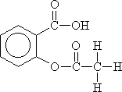

Aspirin
+
+ H₂O
salicylic acid
+
acetic acid
acetyl salicylic acid
(aspirin)
+ water

Slide 50
Polymers
Description
Addition Polymers
Condensation Polymers
Properties of polymers
Lab on making Polymers

Slide 51

Polymers
Polymers are huge molecules made by combining hundreds, thousands, tens of thousands of small molecules.
A linear polymer is a polymer molecule in which the atoms are more or less arranged in a long chain. This chain is called the backbone. Pendant chains normally have just a few atoms, but the backbone chain usually has hundreds of thousands of atoms.

Slide 52
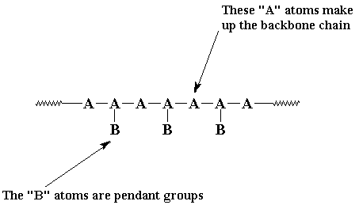

Slide 53
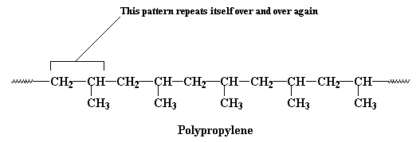
Polymers cont…
Polymers Are Like TV: Lots of Repeats
The backbone of a polymer chain come in a regular order, and this order repeats itself all along the length of the polymer chain.

Slide 54

Polymer Pattern
To make things simple, we usually only draw one unit of the repeat structure, like this:
The repeat unit is put inside brackets, and the subscript n just stands for the number of repeat units in the polymer chain

Slide 55
Polymer Reactions - Some Assembly Required
Polymers don't start out big. They start as little tiny molecules called monomers.
To make a polymer, a whole mess of monomers are strung together in a line to form a long polymer chain.
The monomers combine by breaking double bonds or by forming esters, amides.

Slide 56
Polymer Reactions: Addition
When ethylene is polymerised to make polyethylene, every atom of the ethylene molecule becomes part of the polymer.
An addition polymer is like a good friend who accepts everything about you, the pleasant and the unpleasant alike.

Slide 57
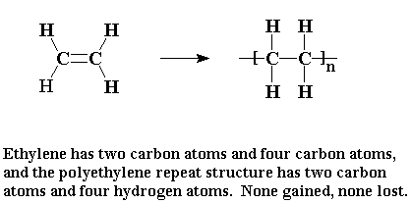

Slide 58
Properties of Addition Polymers

Slide 59
Polymer Reactions: Condensation
A condensation polymer is more like a snotty social club that says, "Sure you can join, but only if you ditch those friends of yours".
In a condensation polymerisation, some atoms of the monomer don't end up in the polymer.
For example, when nylon 6,6, HCl gas is expelled from the starting products.
Because there is less mass in the polymer than in the original monomers, we say that the polymer is condensed with regard to the monomers.
The by-product, whether it is HCl gas, water, or whatnot, is called a condensate.

Slide 60
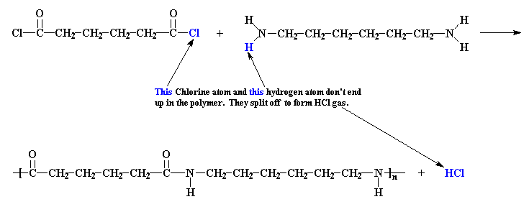

Slide 61
Properties of Condensation Polymers

Slide 62
Examples of Polymers
Polymers arranged in fibres can be spun into threads and used as textiles.
The clothes you're wearing are made out of polymeric fibres. So is carpet. So is rope.
Some of the polymers which can be drawn into fibres include: Polyethylene, Polypropylene, Nylon, Polyester, Kevlar, Polyacrylonitrile

