Slide 1
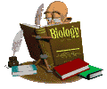
INTRO TO BIOLOGY

Slide 2
so... what IS Biology????
BIO = LIVING
OLOGY = STUDY OF
BUT WHAT IS THE DIFFERENCE BETWEEN LIVING & NON-LIVING?
  SCIENTISTS HAVE NOT BEEN ABLE TO AGREE ON A SINGLE DEFINITION THAT CHARACTERIZES LIFE!!!

Slide 3
LIVING VS. NON-LIVING:
Living things carry out almost all of the LIFE FUNCTIONS
  Nutrition, transport, respiration, excretion, regulation, synthesis, growth, reproduction, metabolism, immunity, locomotion
Living things are made of CELLS

Slide 4
So what is LIVING then?...
Living
Animals
Plants
Mushrooms
Bacteria
Viruses??
Non Living
Viruses??

Slide 5


NUTRITION:
Process by which an organism converts inorganic and organic “foods” into a more usable form of energy
Autotrophic organisms MAKE their own food – example: PLANTS
Heterotrophs cannot make their own food – people
  Nutrition involves both ingestion & digestion

Slide 6
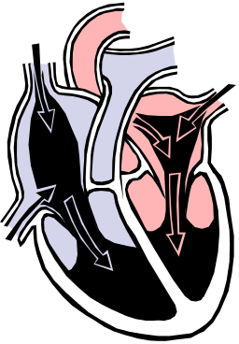

TRANSPORT:
Movement of materials (nutrients, essential gases, wastes, hormones, etc.) throughout the organism
WITHIN A CELL THIS IS KNOWN AS CIRCULATION
  Absorption takes nutrients into the cell – transport gets the nutrients to where they need to be!

Slide 7

MOVEMENT:
ACTUAL PHYSICAL MOTION
Also called LOCOMOTION
Usually associated with some sort of survival need and quite often dependent on the physical size of the organism
  (a blue whale will move much farther in its’ lifetime than an ant will, for example)

Slide 8
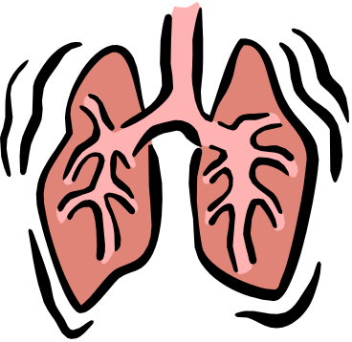
RESPIRATION:
THIS IS NOT BREATHING!!!!!!!!
THE PROCESS THAT CONVERTS THE ENERGY FROM FOOD INTO ATP (THE FORM OF ENERGY THAT CAN BE USED BY CELLS)
IT IS A RELEASE OF ENERGY by an EXCHANGE of gases!
  Organism that need OXYGEN for respiration are called AEROBIC
  Organisms that do not need Oxygen are called ANAEROBIC

Slide 9

EXCRETION:
Not what you think…. THIS IS NOT simply urination and defecation
It’s the release of cellular waste products into the transport system for removal from the organism
(CO2, water, urea, urine, sweat…)
  EGESTION – removal of UNDIGESTED material (regurgitation)
  EXCRETION – removal of waste/byproducts

Slide 10
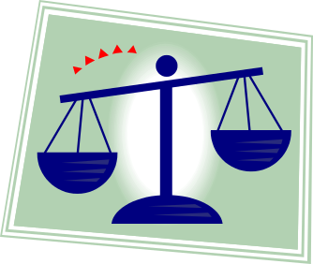
METABOLISM:
The energy level that an individual organism must maintain to stay alive
Every organism, even those within a species, has its’ own personal metabolic rate
  EX: Some people eat TONS of food but never seem to gain weight – they have very fast metabolisms that utilize the energy from food faster

Slide 11

REGULATION:
MAINTAINS A STATE OF HOMEOSTASIS IN THE BODY
Any activity which an organism does to try and maintain its’ internal environment. This includes: brain activity, nervous function, release of hormones, etc…
A change in the environment is called a STIMULUS which causes a physical response from an organism
  EX:
  NERVOUS & ENDOCRINE SYSTEM – deals with COORDINATION – controls various activities of the organism

Slide 12

HOMEOSTASIS is…
… the ability of living organisms to maintain a DYNAMIC EQUILIBRIUM with its surroundings by carrying out the LIFE FUNCTIONS
… a state of BALANCE between a living thing and its environment
… constantly threatened!

Slide 13
HOMEOSTASIS…
Ex: environmental temp increases ----> more sweating ---> more evaporation --< cools down body
Ex: Blood sugar regulation
insulin -- a hormone (chemical messenger) produced by the pancreas and carried through the blood
-- lowers blood sugar 2 major ways:
a.) Takes glucose into our cells to be used as fuel in cell respiration from our blood
b.) Converts excess glucose to the glycogen (animal starch) and stores it in our liver and muscles

Slide 14
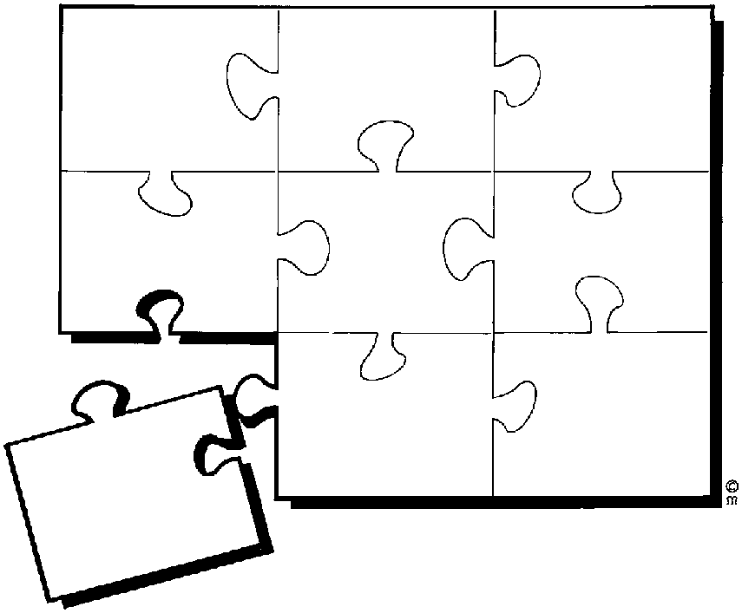
SYNTHESIS:
THE PRODUCTION OF MORE COMPLEX SUBSTANCES BY COMBINING 2 OR MORE SIMPLE SUBSTANCES
  EX: 1 Hydrogen + 2 Oxygen = water
  EX: FAT!

Slide 15

GROWTH:
Simply the increase in the size of cells (at an embryonic stage) or an increase in the number of cells (throughout life)
Growth stops when an organism experiences death

Slide 16
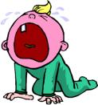
REPRODUCTION:
The making of more organisms of one's own kind -- not needed by an individual living thing but is needed by its species
You are reproducing right now!
This is not always a SEXUAL event
  Your cells are being replaced at all times
More often, it is ASEXUAL
  Some organisms are completely asexual

Slide 17


IMMUNITY:
The ability to defend yourself against disease or allergies
Organisms have a complex system of defending against both pathogens (disease causing organisms) and allergens (chemicals that cause allergic reaction)

Slide 18
What is living?
What is life?
If someone is in a coma are they alive?
At what point is something dead?
What about organ donation?
What about the human egg? Sperm? or embryo?
There is probably more to life than figuring out if something is alive.

