Slide 1
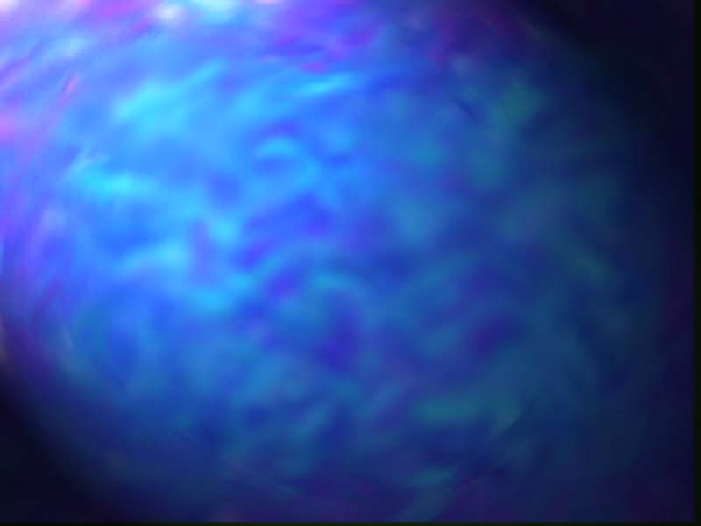
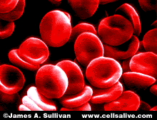
The Cell Theory

Slide 2
Some Random Cell Facts
The average human being is composed of around 100 Trillion individual cells!!!
It would take as many as 50 cells to cover the area of a dot on the letter “i”
WOW!!!

Slide 3
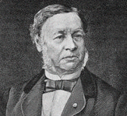
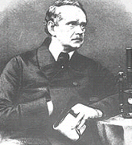
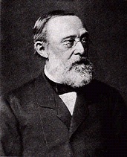
CELL THEORY
Schwann | Schleiden | Virchow
A theory resulting from many scientists’ observations & conclusions

Slide 4

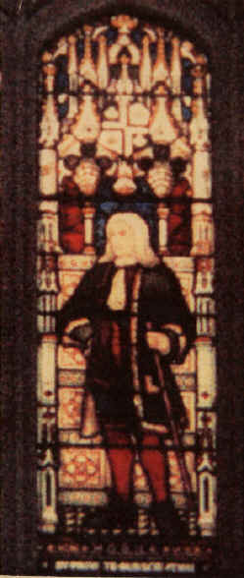
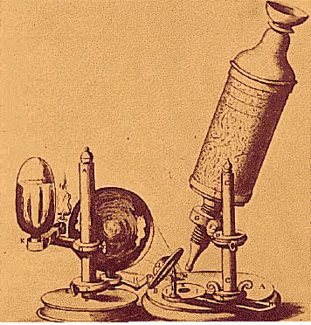
Discovery of Cells
1665- English Scientist, Robert Hooke, discovered cells while looking at a thin slice of cork.
He described the cells as tiny boxes or a honeycomb
He thought that cells only existed in plants and fungi

Slide 5
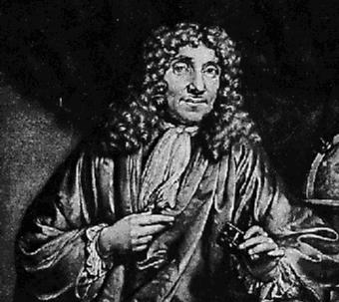
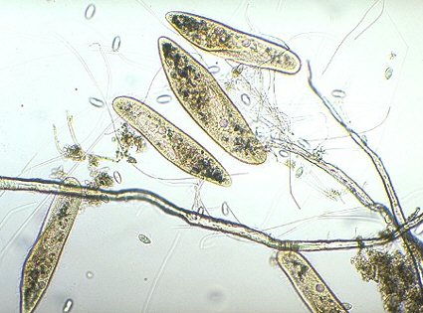
Anton van Leuwenhoek
1673- Used a handmade microscope to observe pond scum & discovered single-celled organisms
He called them “animalcules”
He also observed blood cells from fish, birds, frogs, dogs, and humans
Therefore, it was known that cells are found in animals as well as plants

Slide 6
150-200 Year Gap???
Between the Hooke/Leuwenhoek discoveries and the mid 19th century, very little cell advancements were made.
This is probably due to the widely accepted, traditional belief in Spontaneous Generation.
Examples:
-Mice from dirty clothes/corn husks
-Maggots from rotting meat

Slide 7
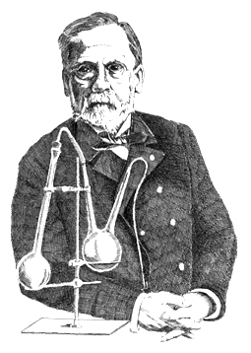


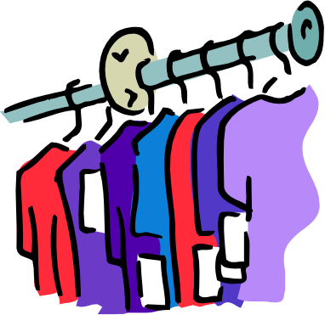
19th Century Advancement
Much doubt existed around Spontaneous Generation
Conclusively disproved by Louis Pasteur
Pasteur: Ummm, I don’t think so!!!
?
=
+

Slide 8
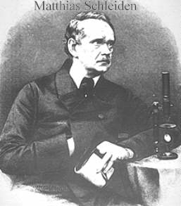
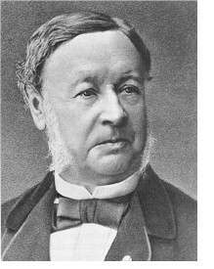
Development of Cell Theory
1838- German Botanist, Matthias Schleiden, concluded that all plant parts are made of cells
1839- German physiologist, Theodor Schwann, who was a close friend of Schleiden, stated that all animal tissues are composed of cells.

Slide 9
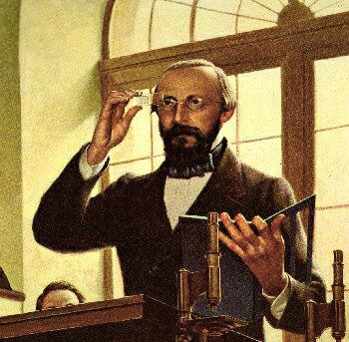
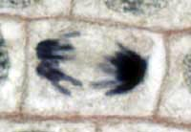
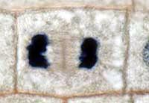
Development of Cell Theory
1858- Rudolf Virchow, German physician, after extensive study of cellular pathology, concluded that cells must arise from preexisting cells.

Slide 10
The Cell Theory Complete
The 3 Basic Components of the Cell Theory were now complete:
1. All organisms are composed of one or more cells. (Schleiden & Schwann)(1838-39)
2. The cell is the basic unit of life in all living things. (Schleiden & Schwann)(1838-39)
3. All cells are produced by the division of preexisting cells. (Virchow)(1858)

Slide 11

Modern Cell Theory
Modern Cell Theory contains 4 statements, in addition to the original Cell Theory:
The cell contains hereditary information(DNA) which is passed on from cell to cell during cell division.
All cells are basically the same in chemical composition and metabolic activities.
All basic chemical & physiological functions are carried out inside the cells.(movement, digestion,etc)
Cell activity depends on the activities of sub-cellular structures within the cell(organelles, nucleus, plasma membrane)

Slide 12
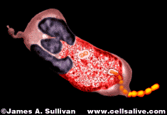
How Has The Cell Theory Been Used?
The basic discovered truths about cells, listed in the Cell Theory, are the basis for things such as:
  Disease/Health/Medical Research and Cures(AIDS, Cancer, Vaccines, Cloning, Stem Cell Research, etc.)

Slide 13
Some Parting Thoughts
It is amazing to think that the cells that make up our bodies are just as alive as we are. Humans are just an intricately designed community of cells, which must work together to survive.

Slide 14
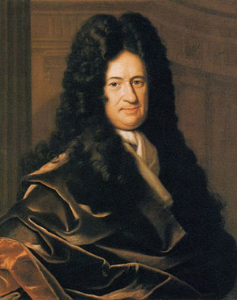
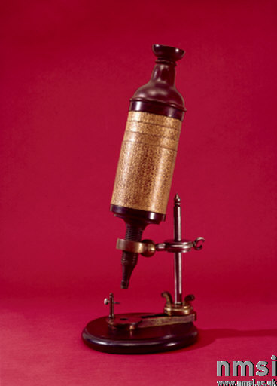
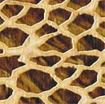
CELL THEORY
1. The basic unit of life is the cell. (Hooke)
In 1665, an English scientist named Robert Hooke made an improved microscope and viewed thin slices of cork viewing plant cell walls
Hooke named what he saw "cells"

Slide 15
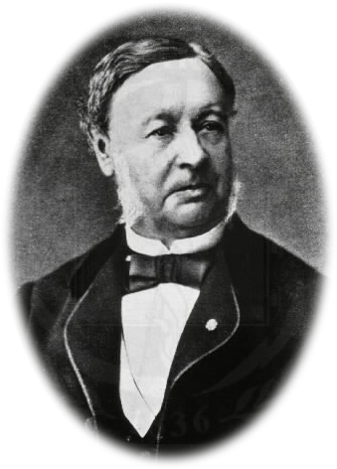
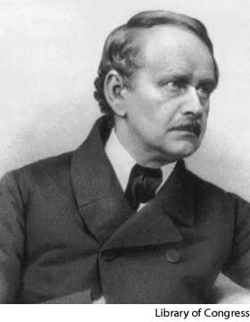
CELL THEORY
2. All living things are made of 1 or more cells.
Matthias Schleiden (botanist studying plants)
Theodore Schwann (zoologist studying animals) stated that all living things were made of cells
Schwann
Schleiden

Slide 16
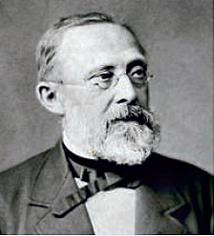
CELL THEORY
3. All cells divide & come from old cells. (Virchow)
Virchow

