Slide 1

“Viewing Cells”

Slide 2

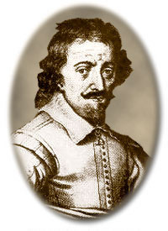
EARLY MICROSCOPES
Zacharias Janssen - made 1st compound microscope
a Dutch maker of reading glasses (late 1500’s)

Slide 3
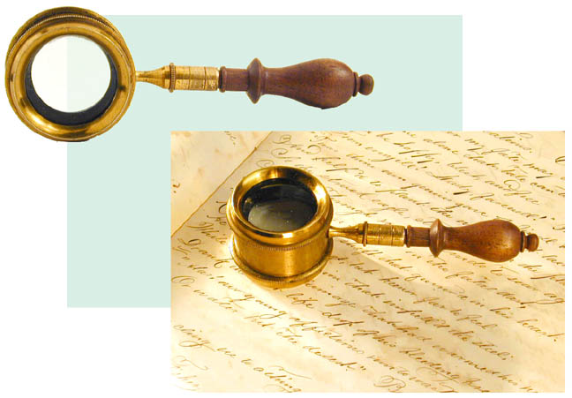
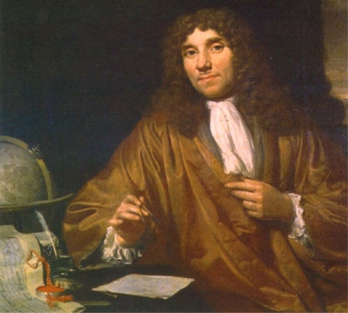
Leeuwenhoek
made a simple microscope (mid 1600’s)
magnified 270X
Early microscope lenses made images larger but the image was not clear

Slide 4

Leeuwenhoek's microscope
A) a screw for adjusting the height of the object being examined
B) a metal plate serving as the body
C) a skewer to impale the object and rotate it
D) the lens itself, which was spherical

Slide 5
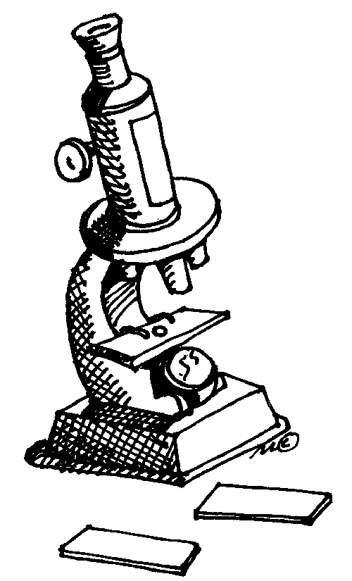
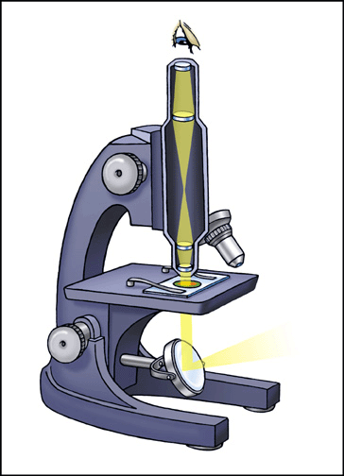
MODERN MICROSCOPES
A microscope is simple or compound depending on how many lenses it contains
A lens makes an enlarged image & directs light towards you eye

Slide 6

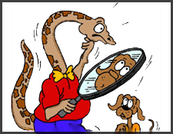
A simple microscope has one lens
Similar to a magnifying glass
Microscopes have two characteristics
Magnification is the change in apparent size produced by a microscope
Resolution refers to the amount of detail seen when viewing a specimen:
poor = blurry
good = clear and sharp
-the ability to show objects that are close together as separate and distinct

Slide 7
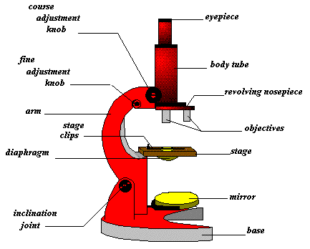
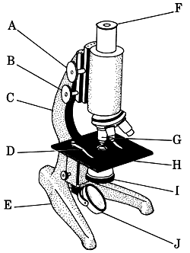
COMPOUND MICROSCOPE
A compound microscope has multiple lenses
  (eyepiece & objective lenses)
  Resolution 200nm

Slide 8
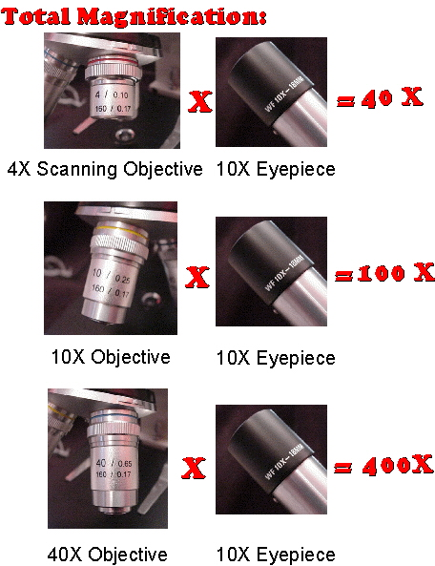
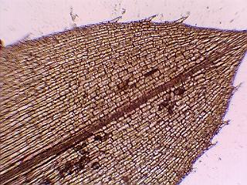
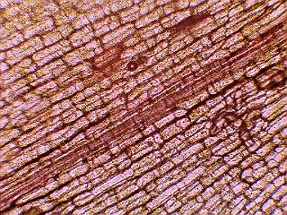
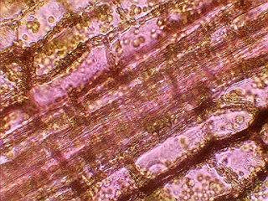
TOTAL MAGNIFICATION
Powers of the eyepiece (10X) multiplied by objective lenses determine total magnification.

Slide 9
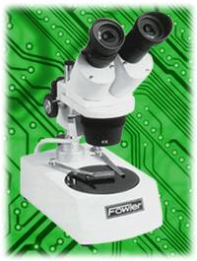
STEREOMICROSCOPE
creates a 3D image
Low magnification
Used for larger specimens
Also called a dissecting microscope

Slide 10
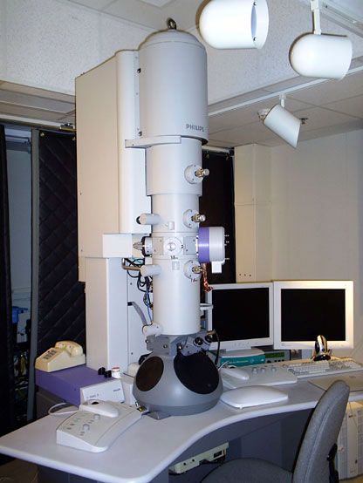
ELECTRON MICROSCOPES
More powerful; some can magnify up to 1,000,000X
Use a magnetic field in a vacuum to bend beams of electrons
Images must be photographed or produced electronically
Specimens can only be dead

Slide 11
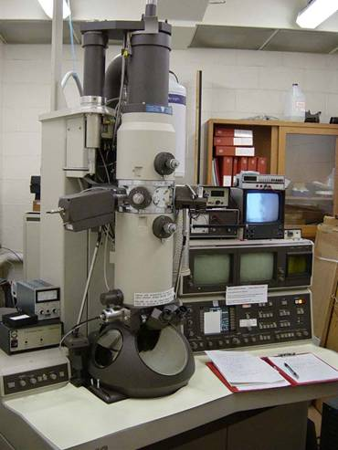
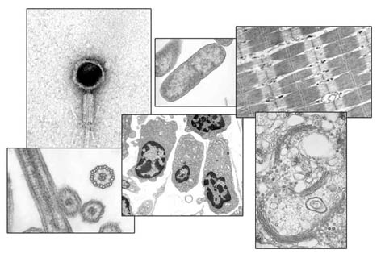
Transmission Electron Microscope (TEM)
produces 2D image of thinly sliced specimen
detailed cell parts (only inside a cell) can be observed
High magnification
Resolution 0.2nm

Slide 12
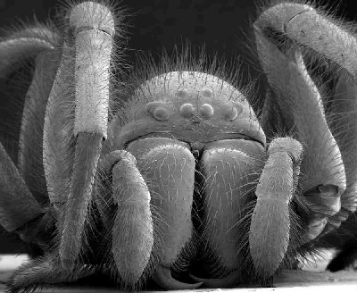
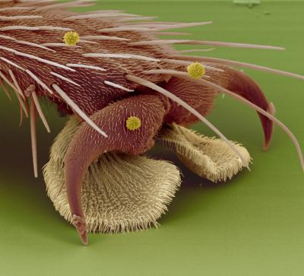
Scanning Electron Microscope (SEM)
Electron microscope image of a spider
Thicker specimens can be used
produces realistic 3D image
only the surface of specimen can be observed
Smaller magnification but greater contrast and depth
Resolution 10nm
Electron microscope image of a fly foot

Slide 13
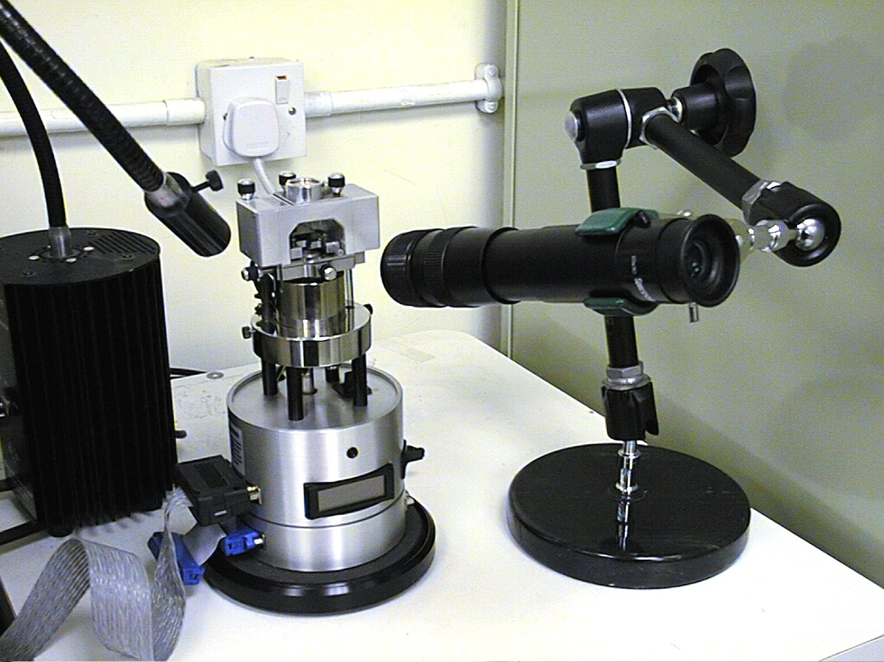
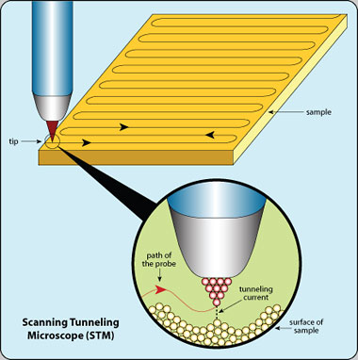
Scanning Tunneling Microscope (STM)
able to show arrangement of atoms

