Slide 1
Anatomy Unit 4:
Cell Theory &
Cellular Structures

Slide 2
Cell Theory
Term “cell” was coined in 1665 by Robert Hooke when he looked at a slice of dried cork.
  All living things are comprised of cells.
  Cells are the smallest “living” unit in an organisms.
  Cells come from previously existing cells.

Slide 3
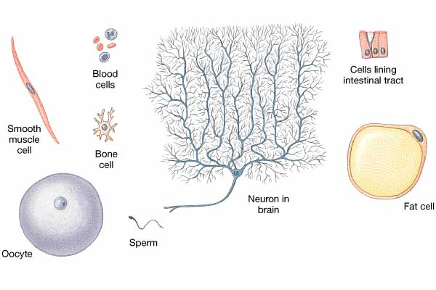
Cell Diversity:
Lots of shapes and sizes

Slide 4
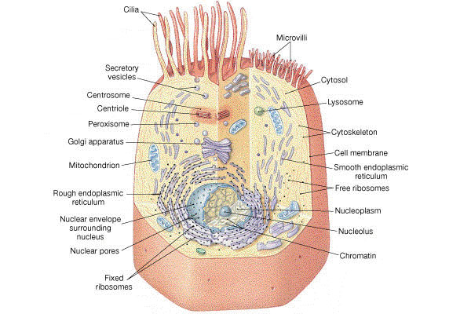
Typical Cell

Slide 5
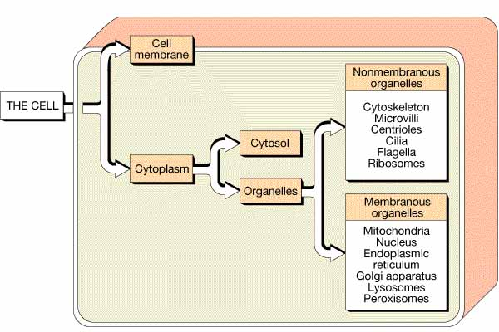
Cell Organization

Slide 6
Cell Organization
The cell includes two basic parts:
  Cell Membrane (outer covering of cell)
  Cytoplasm
    Cytosol (fluid portion of the cytoplasm)
    Organelles (cell “organs” or functional parts)

Slide 7
Cell Membrane
Outer boundary
Physical
Chemical
Comprised of two layers of lipid (fat)
  Outer and inner layers
Proteins
Proteins give the cell its unique “personality” or function

Slide 8
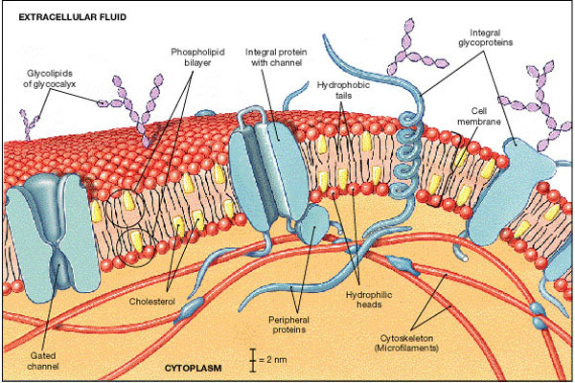
Cell Membrane

Slide 9
Function of Membrane Proteins
Transport (in and out of cell)
Receptors
Cell adhesion
Cell recognition

Slide 10
Cell Organization

Slide 11
Cytoplasm
Is comprised of:
Cytosol (fluid portion of the cytoplasm)
Organelles (cell “organs” or functional parts)

Slide 12
Cytosol
Intracellular fluid
Contains dissolved nutrients, ions, proteins and waste products

Slide 13
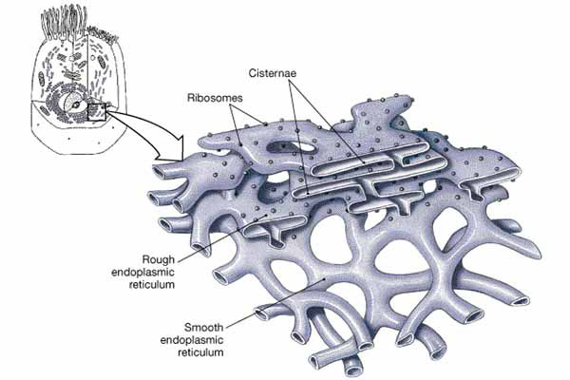
Organelles
Endoplasmic reticulum (ER)
A network of membrane-bound tunnels throughout the cytoplasm

Slide 14
ER
Rough ER
Smooth ER

Slide 15
Ribosomes
Particles attached to ER are ribosomes.
Ribosomes are the site of protein synthesis within every cell.

Slide 16
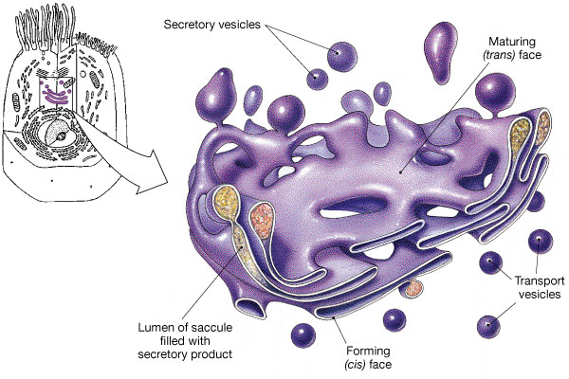
Golgi Apparatus
Flattened membranes
Involved in packaging and secretion of proteins

Slide 17
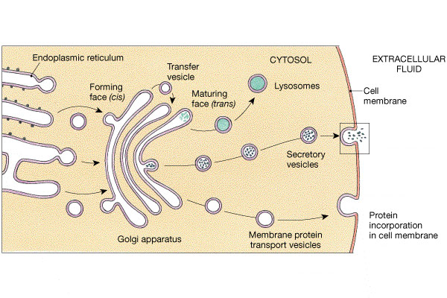
Golgi Apparatus

Slide 18
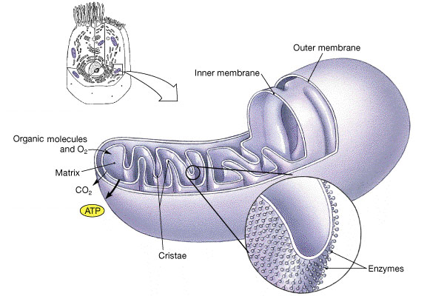
Mitochondria
Bean shaped
Outer and inner membranes

Slide 19
Mitochondria
Inner membrane folded into cristae
Adenosine triphosphate (ATP) produced on cristae.
ATP is high energy compound.
ATP only produced in mitochondria.

Slide 20
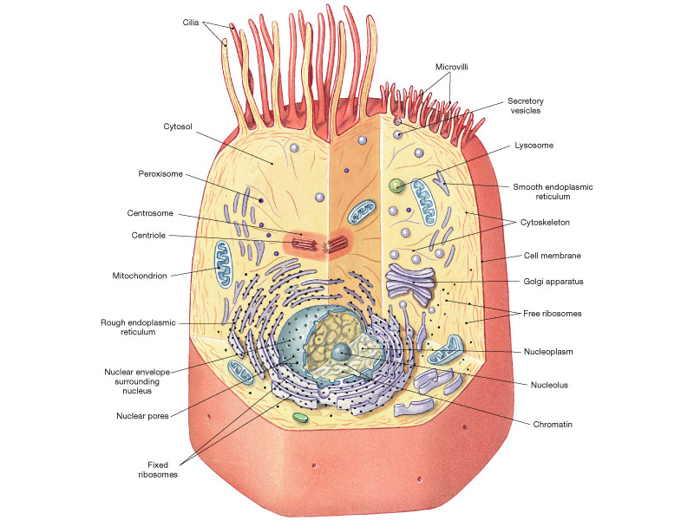
Nucleus

Slide 21
Nucleus
Control center of cell
Contains DNA/chromosomes
Genetic repository for ~ 35,000 genes
Genes control the synthesis of proteins in each cell.
Red blood cells don’t have a nucleus.
Skeletal muscle cells have multiple nuclei.

