Slide 1

Physics Unit
Basic Motion
Uniform Motion
Non Uniform Motion
Gravity and Applied Motion

Slide 2
Ch. 9 Language of Motion
Conversions, Significant Figures, Formulas, Scalar vs Vector, Direction, Vectors, Graphs, Rate of change,
Tools of Motion

Slide 3

9.1 History of Motion
Canadian Technology and the development of transportation
Types of Motion
  Falling Objects: Gravity is are only concern
  Projectile Motion: Parabolas
  Roller Coasters: Potential and Kinetic Motion
Worksheet & Questions on page 294

Slide 4
Motion Terminology
Vocabulary – Worksheet

Slide 5










9.2 The Symbols of Motion
Variable | Symbol | Unit | Formula | Scalar/Vector
Time | t | s | NA | Scalar
Time Interval | Δt | s |  | Scalar
Distance | d OR Δd | m |  | Scalar
Position |  | m & direction | NA | Vector
Displacement |  | m & direction |  | Vector
Speed | v | m/s |  | Scalar
Velocity |  | m/s & direction |  | Vector
Acceleration |  | m/s² & direction |  | Vector

Slide 6
9.2 The Language of Motion
Conventions
Converting Units: Conversion Factors
  Page 586
Scientific Notation
  Page 587
Accuracy vs Precision [Note]
  Significant Figures – Handout

Slide 7
Rules of the Game cont…
Positive and negative signs & direction
Scalar vs vector
Δd = d_{f} – d_{i} vs Δd = d₁ + d₂ + d₃ + …
Δt = t_{f} – t_{i}
Examples of distance, displacement
Read 9.3 page 305-307
Complete q 1-2 page 313

Slide 8
Distance versus Displacement
The Bug Race Activity

Slide 9
Vectors
Vectors Investigation 9-C
Note and Problems handout

Slide 10
Ch. 10 Uniform Motion
Position and Displacement
Position Time Graphs
Velocity Time Graphs

Slide 11
Chapter 10 Uniform Motion
Uniform Motion is defined as motion that has constant velocity
Velocity is a vector value that has a magnitude (speed) and a direction
  The direction stays the same
  The speed remains the same
Uniform motion is modeled on a position time graph as a straight line
There are three types of motion that are indicated on a graph (p322)

Slide 12
Position Time Graphs
No motion Occurring
  Slope = 0
Position (m)
Time (s)

Slide 13
Position Time Graphs
Positive Motion Occurring
  Slope = “+”
  Up, forwards, or to the right
Position (m)
Time (s)

Slide 14
Position Time Graphs
Negative Motion Occurring
  Slope = “-”
  Down, backwards, or to the left
Position (m)
Time (s)

Slide 15
Information from a Position Time Graph
There may be several straight line segments
Each segment models a different uniform motion
The slope of any line is the change in y values divided by change in x values
  Slope = rise/run
Any straight line has the same slope over any part of the line

Slide 16
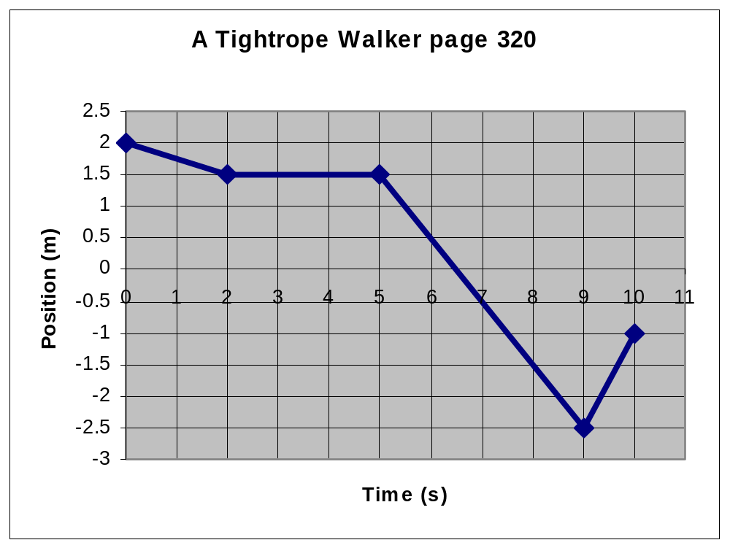

Slide 17
Complete the Position Time graph worksheet (Dog in Park)
For each Segment indicate the following
  Location of dog relative to owner
  Change in position (to the left or right)
  The related time interval for the change in position
  The velocity of the dog indicating with + or – signs for the direction

Slide 18
Dog in park Worksheet
Change in position = ; Time interval = ; Velocity =
Change in position = ; Time interval = ; Velocity =
Change in position = ; Time interval = ; Velocity =
Change in position = ; Time interval = ; Velocity =
Change in position = ; Time interval = ; Velocity =
Change in position = ; Time interval = ; Velocity =
Change in position = ; Time interval = ; Velocity =
Change in position = ; Time interval = ; Velocity =

Slide 19
Information from a Position Time Graph cont…
Velocity = change in position (y-values) divided by change in time (x-values)
Average velocity = total displacement over total time
Instantaneous velocity = (any position minus the initial position) divided by (the time covered at that point)
Slope=Velocity= v = (Δd / Δt)

Slide 20
Distance vs Position – Time graphs (a big difference)
Distance
  Only quantity of movement
  Relative to starting point
  Each movement is added to previous one
  No detail about trip direction
Position
  Direction and quantity of movement
  Relative to reference point
  Each movement separate analysis
  Detailed graph about movement with small time intervals
  May not describe total distance covered

Slide 21
Perform comparison of distance time and position time graphs
Distance (m)
Position (m)
Time (s)
Time (s)

Slide 22
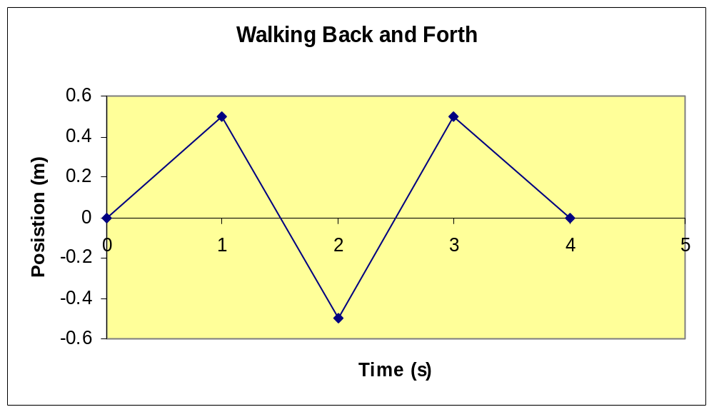
Going over the X-Axis indicates change of location relative to reference point (left or right; up or down)
Positive Slope = moving right, up forwards
Negative Slope = moving left down backwards

Slide 23
Speed Worksheet
GRASP

Slide 24
Solving Velocity or Speed Problems
GRASP or GRASS
  Given: state the variables in the problem
  Required: state the unknown in the problem
  Analysis: Manipulate the Formulas
  Solution: Solve for the unknown
  Statement / Paraphrase: State the solution in a sentence form

Slide 25
A car is moving east 50 km and then west 10 km from home after 30 minutes. What is the speed and velocity in m/s?
Given: d = 60 000m, d = 40 000m, t= 1800s
Required: v, v
Analysis: v=d/t, v=d/t
Solution: v = 60km/1800s, v = 40km/1800s
v = 33 m/s v = 22 m/s
Statement: The car’s speed is 33 m/s and the car’s velocity is 22 m/s east

Slide 26
Velocity Time Graphs
Position time graphs and velocity time graphs show uniform motion as a straight line
Velocity is calculated from the slope of a position time graph (Δd / Δt).
Since Uniform Motion has a straight line on a position time graph the slope never changes
Therefore the value of the slope will only equal one number
Velocity time graphs show uniform motion as a horizontal line (p343)

Slide 27
1. No motion occurring
+
Velocity (m/s)
_
Time (s)

Slide 28
2. Positive Motion Occurring
+
Velocity (m/s)
_
Time (s)

Slide 29
3. Negative Motion Occurring
+
Velocity (m/s)
_
Time (s)

Slide 30
Interpreting Velocity Time Graphs
They do not show an objects position
Positive and negative signs represent the direction of motion as it appears to a reference point
Most of our graphs are idealized
If the line is inclined the graph shows a change in speed or direction
  “accelerated motion”

Slide 31
Calculating Velocity from Position Time Graphs
*Worksheet*
Instantaneous Velocity
Average Velocity

Slide 32
Investigating Types of Motion
Uniform versus Non Uniform Motion
Running versus Walking
Intro to Acceleration

Slide 33
Lab Expectations
Description of 4 types of motion
Four tables describing the following
  Time
  Position
  Displacement from previous position
  Time interval
  Velocity (displacement/time interval
Position Time graph with legend
Velocity Line graph with legend
Eight statements (two for each type of motion describing how each motion relates to its graph shape.

Slide 34
Speed vs Velocity Worksheet
GRASP
Be careful: scalar vs vector quantities

Slide 35
Revisiting Velocity
Position versus Velocity
Non horizontal lines
Power of velocity time curves

Slide 36
Position Time vs Velocity Time graph
X axis is the location of the reference point
+ or – sign indicates position relative to a reference point
Positive or negative motion indicated by slope
Horizontal line represents zero motion
X axis indicates zero motion
+ or – sign indicates positive or negative motion
Slope indicates direction of acceleration
Horizontal line represents uniform motion

Slide 37
Position vs Velocity time Graphs
Time (s)
Position (m)
Velocity (m/s)
Time (s)

Slide 38
An object falling: as the object falls it increases speed down from the initial position
+
Velocity (m/s)
_
Time (s)

Slide 39
An accelerating object: as it moves to the right the speed becomes faster
+
Velocity (m/s)
_
Time (s)

Slide 40
A thrown and falling object: As it leave the hand it begins to slow down, stops, then changes direction and accelerates
+
Velocity (m/s)
_
Time (s)

Slide 41
Application of changes in velocity
The Pendulum
  Resting position = equilibrium
  Cycle = complete swing
Δd

Slide 42
One Complete cycle
Maximum displacement
Maximum displacement
Maximum Velocity
Minimum Velocity
Minimum Velocity
Minimum Displacement
Change in Direction
Change in Direction
Equilibrium Position

Slide 43
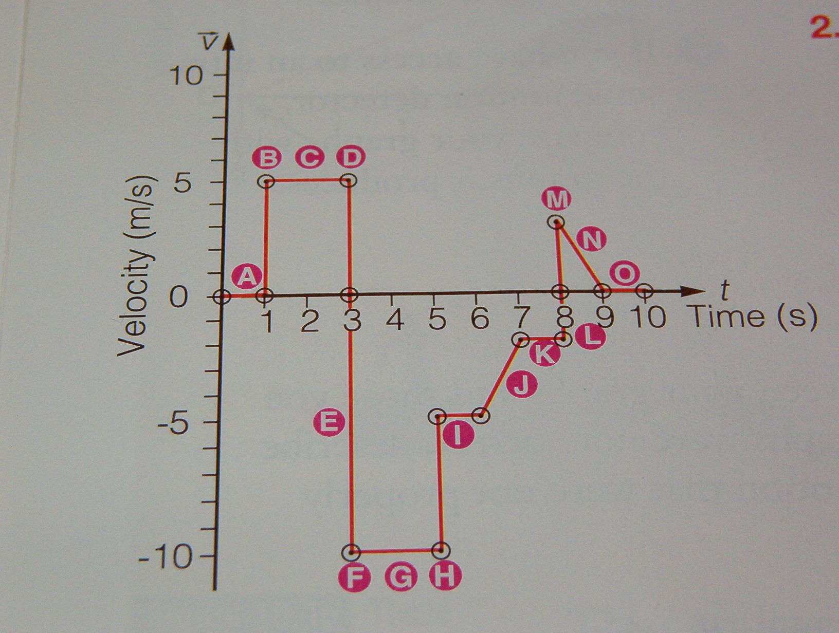
Page 348 Question 2
A, C, G, I, K, O
E – L
D, H, J, L, N
D
B – D

Slide 44
Position Time, Velocity Time Review Worksheet
Position Time
Velocity-Time

Slide 45
Topics on Ch.9 and Ch.10 Test
Significant figures, Conversions
Speed/velocity formula
Vectors simple, RCS, Compass
Scalar or Vector
  Position, distance, displacement, speed, velocity, acceleration
Average vs Instantaneous vs Constant Speed
Slope
Ticker Timer
Graphs, Position&Velocity Time

Slide 46
Ch. 11 Accelerated Motion
Change in Velocity
Gravity Problems
Roller Coasters

Slide 47
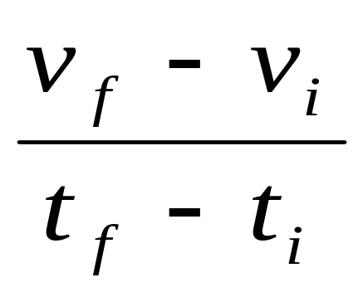
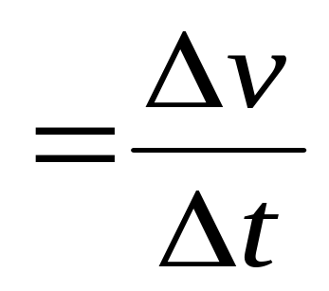
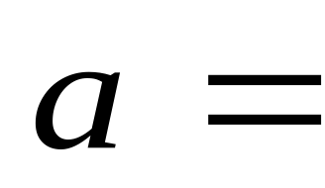
Accelerated Motion
Any change in velocity
  Change in speed
  Change in direction
Acceleration is the rate of change in velocity

Slide 48
Calculating Acceleration
The direction of the velocity is essential. It decides if acceleration or deceleration is occurring
Acceleration can be instantaneous at a point in time or averaged or calculated over a time interval
Acceleration is calculated by the slope of the velocity time curve
Model problems page 355-356

Slide 49
Perform Activity on page 357
What to do #1-#4
What did you discover #1

Slide 50
Positive and negative signs for motion terms
Displacement
+ = right ; - = left (observe slope)
Velocity
+ = right ; - = left (slope doesn’t matter)
Acceleration
In positive directions
+ = speeding up ; - = slowing down
In negative directions
+ = slowing down ; - = speeding up

Slide 51
Picturing Acceleration
Change in position over time
Position-Time graph
Slope of Position-Time graph
Velocity-Time graph
Slope of Velocity-Time graph
Instantaneous or Average Acceleration
Acceleration-Time graph

Slide 52
Uniform Motion Review
Position Time
Velocity Time
Acceleration

Slide 53
Non Uniform Motion
+
Position Time
Velocity Time
Acceleration
_

Slide 54
Non Uniform Motion (cont…)
_
Position Time
Velocity Time
Acceleration
+

Slide 55
Page 358 #2,#3,#4

Slide 56
Page 358 #2-#4
a=v/t
  26.8 / 3.2 = 8.4 m/s²
  6.6 s
a=v/t ; t=d/v
  18.3/14.57= 1.26m/s²
  400/18.3= 21.9 s
  +
  +
  +

Slide 57
Calculating the velocity from a Position Time curve
Average Velocity
  Change in position / time interval
  Slope of a position time curve = the velocity
Instantaneous Velocity
  Velocity of an object at a certain point in time
  Calculated using a tangent

Slide 58
The Tangent of a Curve
Slope at any point is calculated with a tangent (red line)
Slope = rise/run = velocity for position time curve
As the slope changes over time the velocity changes over time
Acceleration is occurring

Slide 59
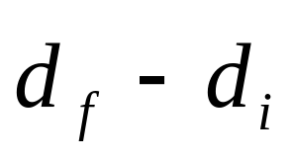
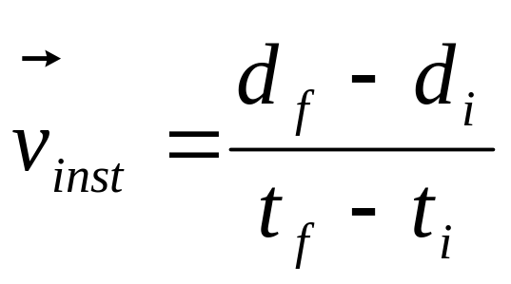
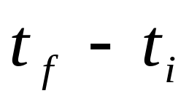
The Tangent of a Curve
RISE
Position (m)
RUN
Time (s)

Slide 60
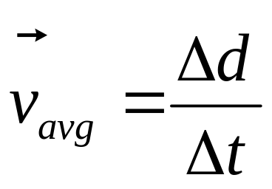
The Power of Velocity Graphs
Assume Acceleration is constant
Estimating Final Velocity
  Average Velocity = displacement / time
  Also Average Velocity =
  (Initial velocity + Final Velocity) / 2

Slide 61
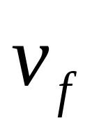
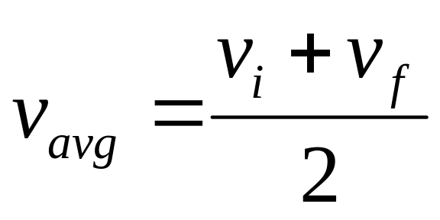
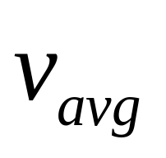
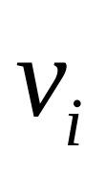
Estimating Final Velocity

Slide 62
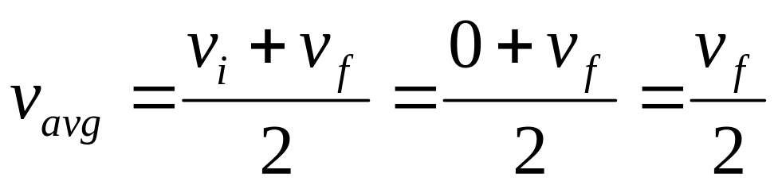
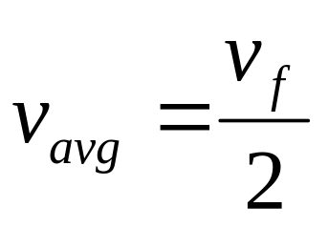
Combine velocity formulas
Final velocity is exactly double its average velocity when an object starts from rest
Therefore we can use two formulas to help solve velocity problems

Slide 63
Turn to page 368, #2-4
G→ d=-56.4 m; t_{falling}=3.1 s; t_{stopping}=0.015s; v_{i}=0.0 m/s
  G→ v_{avg} = 15.2 m/s; R→v_{f}; A→ v_{f}=2v_{avg}
  a = (v_{f} – v_{i}) / t
  a = (v_{f} – v_{i}) / t

Slide 64
Complete questions
2-5 page 376

Slide 65
Question 2
G→ t=0.001s; v=27m/s
R→ d
A→ d = vt
S→ d = 27m/s x 0.001s
S→ d = 0.027m

Slide 66
Question 3
G→ v_{i}=5.8m/s; v_{f}=0.0m/s; t=0.059s
R→ a
A→ a= (v_{f} – v_{i}) / t
S→ a= (-5.8m/s)/0.059s
S→ a=

Slide 67
Page 376 question #3
Vi=5.8m/s;Vf=0m/s;t=0.0059s
Acceleration=Vf-Vi/2
[0-5.8]/0.0059=-9.8x10²m/s²
Displacement=Vavg x t
Vavg=[0+5.8]/2=2.9m/s
d=2.9 x 0.0059 = 0.017 m

Slide 68
Page 376 question #3 cont…
Vi=0m/s Vf=5.8m/s d=6 cm
t= d / Vavg
d=0.06m Vavg =5.8/2 = 2.9m/s
t = 0.06 m / 2.9 m/s = 0.02 s
Homework finish #3 and #4 p376, #4 page 368

Slide 69
2. Calculating Displacement
Assume Acceleration is constant
Take two points on a graph
Calculate v_{avg}
Calculate Δt
Calculate Displacement
Page 376 question #3

Slide 70
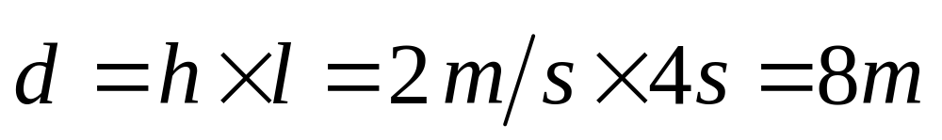
3. Area under the V-t Curve
2
1
Velocity m/s
1
2
3
4
Time (s)

Slide 71
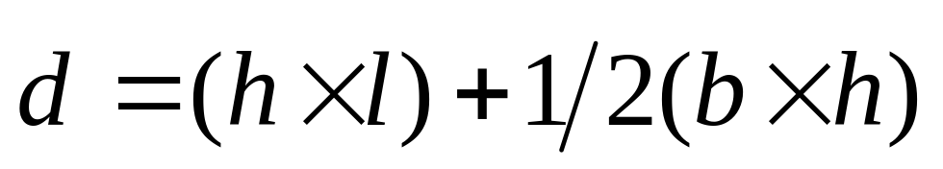
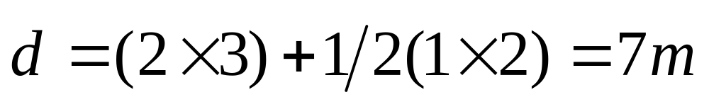
Area Under the V-t curve cont…
2
1
Velocity m/s
1
2
3
4
Time (s)

Slide 72
Area Under the V-t curve cont…
2
1
Velocity m/s
3
4
5
1
2
Time (s)
-2

Slide 73
Worksheet on Area Under the Curve

Slide 74
Acceleration: Life in Motion
Solving Problems due to Gravity
Terminal Velocity
Mathematics of acceleration

