Slide 1
Weather Unit – Science Power 10
Summary of the Expectations
Notes used in Class
End of Unit Assignment

Slide 2
General Outline Science Power 10
How Solar Energy Affects Weather
    Energy Transfer, Heat Capacity, Temperature Control, Humidity, Water cycle, Water vs. Land, the Atmosphere, Greenhouse gases
Solar Energy and the Movement of Air and Water
    Earth’s Shape, Wind Patterns, Coriolis, Jet Streams, Ocean Currents, Air Masses, El Nino
Local Weather Systems
    Clouds, Precipitation, Fronts, Highs and Lows, Thunderstorms, Tornadoes and Hurricanes
Humans and Weather
    Instruments, Weather maps, Forecasting, Past Present and Future

Slide 3
Ch. 13: How Solar Energy Affects Weather
Energy Transfer
Heat Capacity
Temperature Control
Humidity
Water cycle
Water vs Land
The Atmosphere
Greenhouse gases

Slide 4
Earth’s Energy Balance
Almost all the energy that the Earth requires to sustain life comes from the sun.
One exception is the ecosystems dependent on geothermal vents on the ocean floor.
Average temperature on Earth is 15°C

Slide 5
Earth’s Constant Temperature
The temperature balance occurs because of lost energy
Earth radiates as much energy as it absorbs from the Sun
Between absorbing and re-emitting radiation, the transfer of this energy drives our weather systems

Slide 6
Energy Transfer
There are 3 ways that energy is transferred around the Earth.
  Radiation (no medium)
    transfer through electromagnetic waves
  Conduction (S-L-G)
    transfer by contact
  Convection/Advection (L-G)
    transfer through movement

Slide 7
Radiation
Electromagnetic radiation can travel through a solid, liquid, gas or through a vacuum.
  It does not require a medium.
  This is how the energy of the sun reaches Earth.
  Travels at 300 000 km/s.

Slide 8
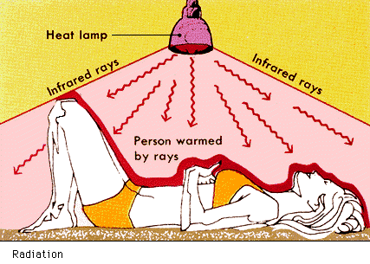
Radiation
Notes:
http://observe.ivv.nasa.gov/nasa/education/reference/emspec/emspectrum.html

Slide 9
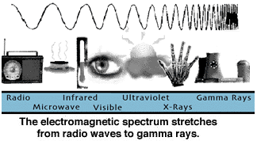
Electromagnetic Spectrum
Notes:
http://observe.ivv.nasa.gov/nasa/education/reference/emspec/emspectrum.html

Slide 10
Reflection & Absorption
The electromagnetic radiation can be reflected or absorbed.
Absorbed energy is converted to kinetic energy within the molecule causing it to vibrate or move faster.
Any object that absorbs energy and becomes warmer is called a heat sink.
    Water is a good heat sink, but rock and soil are not.

Slide 11

Reflection and Absorption of Energy

Slide 12
Albedo
A number indicating the amount of energy reflected by a substance compared to the amount absorbed.
Water has a higher albedo than land or soil.
Snow and ice have a very high albedo compared to a freshly tilled field.

Slide 13
Conduction
The transfer of energy through the collision of particles.
The greater the temperature the faster particles will move.
As the particles move they collide with other particles thereby transferring the energy.

Slide 14
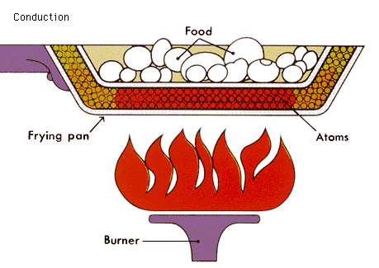
Conduction

Slide 15
Convection
The movement of particles in a fluid (liquid or gas).
Particles with greater energy move faster - take up a greater volume and therefore have a lower density.
Less dense regions will rise due to higher surrounding pressure.

Slide 16
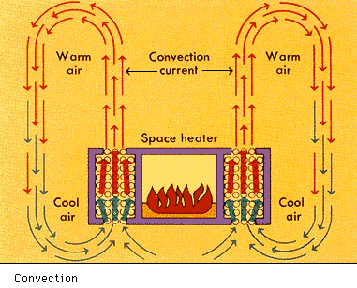
Convection

Slide 17
Water and Weather
Specific Heat Capity
Humidity
Climate Modifying

Slide 18
Heat Capacity
A measure of how much energy a substance requires to increase it temperature.
Water has a high heat capacity meaning it can absorb or hold a large amount of energy.

Slide 19
Specific Heat Capacity
The Earth is 70% Water
Solar Radiation and Water Interactions are very important
Earth constant temperature is due mainly to water’s heat capacity
S.H.C. is defined as the amount of heat that is required to raise the temperature of 1 gram of a substance 1 degree Celsius
Water has one of the highest S.H.C.

Slide 20
Formula for the Energy Required for a temperature change
Q = mcΔT
Q = amount of heat
m = amount of substance
c = specific heat capacity
ΔT = a given temperature change

Slide 21
Other Factors for Moderate Temperatures
High Heat of Vaporization
    From liquid to a gas or gas to a liquid
High Heat of Fusion
    From a liquid to a solid or a solid to a liquid
Water in different forms
    Reflective properties of snow and ice
    Quantity of liquid water
    Water vapour in the atmosphere

Slide 22
Humidity

Slide 23
Humidity
Measure of the water vapour in the air.
Air that holds the maximum amount of water vapour at that air temperature is termed SATURATED.
As air temperature rises the amount of water vapour the air can hold rises.

Slide 24
Relative Humidity
Measure of the amount of water vapour in the air relative to the amount held at saturation.
Relative humidity = 50%
    Air is holding half of the water vapour it could if it were saturated at that temperature
When air is saturated it condenses into droplets of water.
This water can condense on surfaces:
    Above freezing - dew
    Below freezing - frost

Slide 25
Saturation
The temperature at which air must be cooled to reach saturation is called the DEW POINT.
As warm, moist air rises, it cools to its dew point and condensation occurs.
Condensation of water vapour in the atmosphere forms clouds.

Slide 26
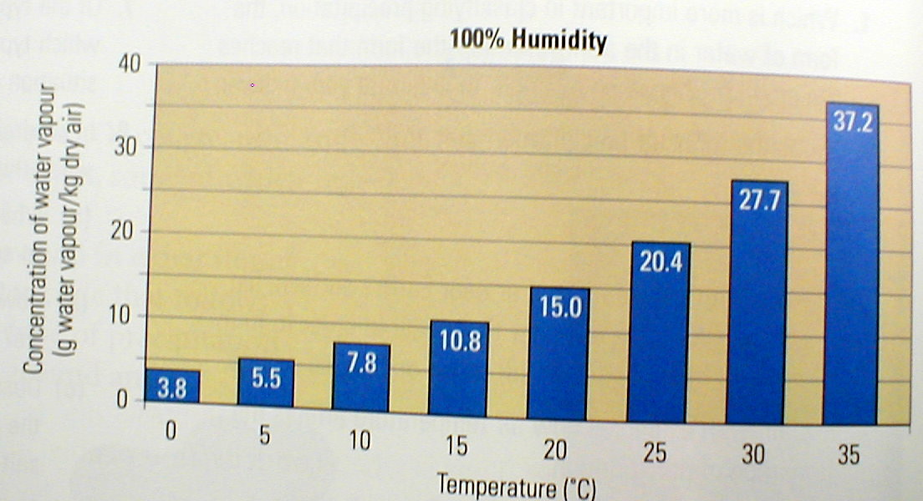
Humidity Chart
Notes:
Taken from “Nelson Science 10” Ritter, Plumb, Jenkins, van Kessel & Hirsch, 2001, Nelson Thompson Learning, Scarborough, Ontario.

Slide 27
Hydrosphere

Slide 28

Hydrosphere - Total Water
Notes:
http://www.earth.nasa.gov/science/water.html
NASA site for hydrological cycle with links to all aspects of research
in the cycle.

Slide 29

Hydrosphere - Fresh Water
Notes:
http://www.earth.nasa.gov/science/water.html
NASA site for hydrological cycle with links to all aspects of research
in the cycle.

Slide 30

Hydrosphere - Surface & Atmosphere
Notes:
http://www.earth.nasa.gov/science/water.html
NASA site for hydrological cycle with links to all aspects of research
in the cycle.

Slide 31
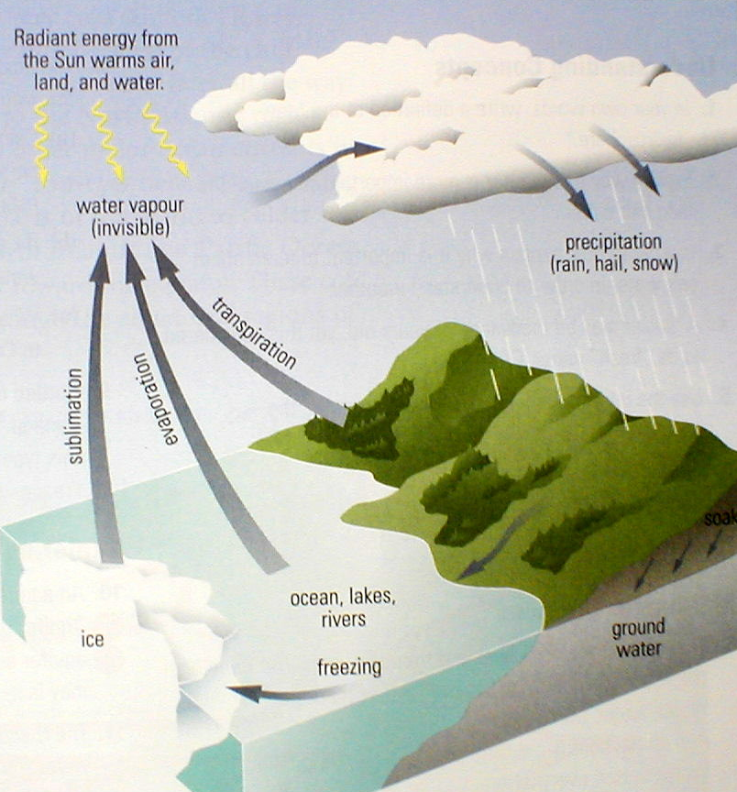
Hydrosphere
Water Cycle
Notes:
Taken from “Nelson Science 10” Ritter, Plumb, Jenkins, van Kessel & Hirsch, 2001, Nelson Thompson Learning, Scarborough, Ontario.

Slide 32
Solar Energy: Land vs. Water

Slide 33
Solar Energy: Land vs Water
(Absorption of radiant energy)
On Land
Low Heat Capacity
Only top surface
Only Conduction
In Water
High Heat Capacity
Penetrates deeply
Conduction and Convection

Slide 34
Heating the Air
Air absorbs very little solar energy
Air particles by the ground are heated by conduction
Convection allows the warm air to rise allowing the colder air to become heated
Air particles are great at absorbing infrared radiation our Earth emits

Slide 35
Uneven Heating of Air Causes Wind
During the day air above land is heated faster than above water.
Dense Cool air ends up beside less dense warm air
Cooler air pushes the warm air up and out of the way replacing it
This motion of air is called wind

Slide 36
The Atmosphere

Slide 37
Atmosphere
The blanket of air around the earth.
78% Nitrogen
21% Oxygen
Other

Slide 38
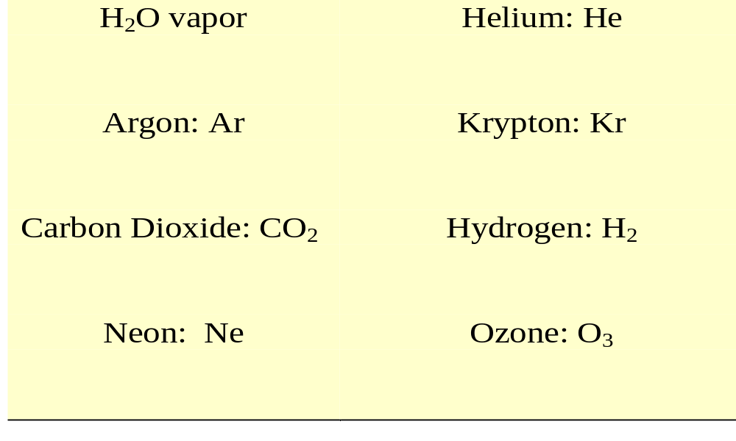
Other Atmospheric Components

Slide 39
Atmosphere
Altitude - measured above sea level
Troposphere
Stratosphere
Mesosphere
Thermosphere
Exosphere

Slide 40
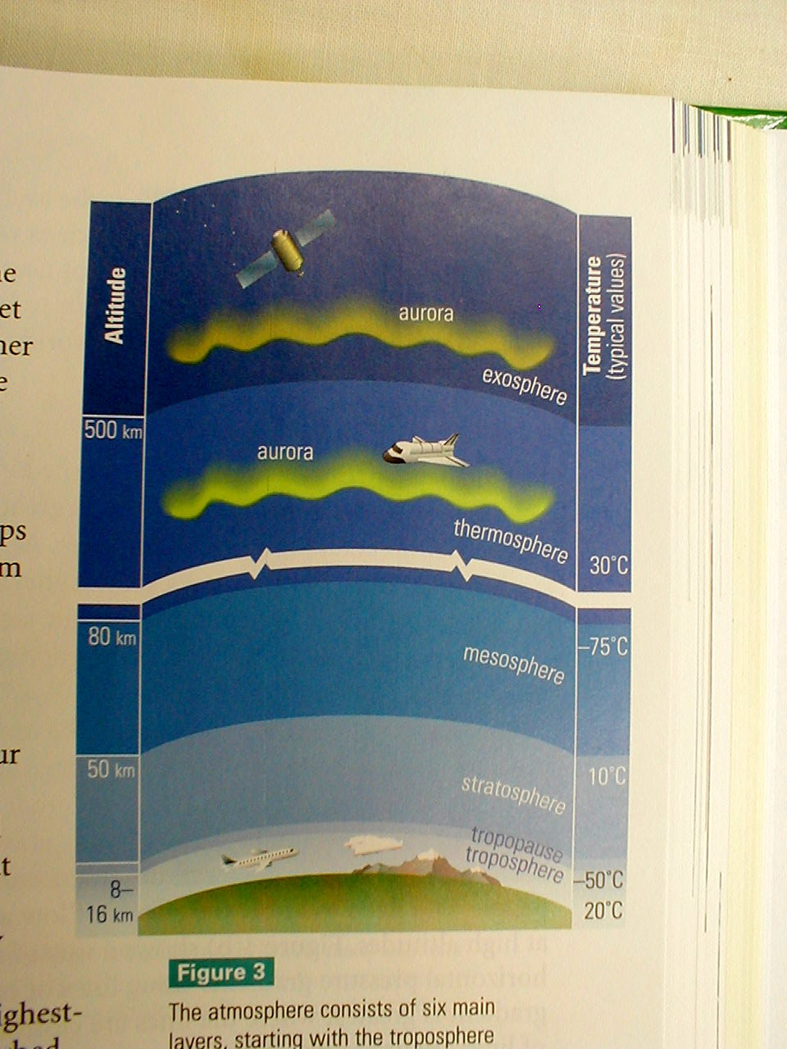
Atmospheric
Layers
Notes:
Taken from “Nelson Science 10” Ritter, Plumb, Jenkins, van Kessel & Hirsch, 2001, Nelson Thompson Learning, Scarborough, Ontario.

Slide 41
Troposphere
Contains 75% of the earth’s atmosphere.
Almost all weather occurs in the troposphere.
Contains most aerosols and water vapour.
Jet streams flow in the upper troposphere.

Slide 42
Troposphere
Ends in the tropopause at 10 km at the poles and 16 km at the equator.
Tropopause is -80°C above the equator.
Temperature decreases with altitude (6.5°C every 1000m).

Slide 43
Stratosphere
12 -50 km in altitude
Highest concentrations of ozone
Ozone absorbs UV & warms air
Very little moisture so few clouds.
Lower temperature is -55°C.
Stratopause temperature -2°C.

Slide 44
Mesosphere
50 - 80 km altitude
Temperature decreases with altitude.
Mesopause temperatures are
-113°C.
Strong winds blow E to W in summer and W to E in winter.

Slide 45
Thermosphere
80 - 480 km in altitude.
The air is very thin.
Inner layer is mostly oxygen atoms.
Outer layer is mostly hydrogen and helium.
Temperature climbs to 600°C at 200 km and 2000°C at the thermopause.

Slide 46
Ionosphere
Located in the upper mesosphere and lower thermosphere.
Caused by high energy electro-magnetic radiation causing atoms and molecules to ionize (lose electrons)
Reflects radio waves back to earth.

Slide 47
Exosphere
No true ending but it is about 480 km to where solar wind occurs.
Particles are so spread out that no temperature can be recorded
Offers very little resistance to orbiting satellites or spacecraft.

Slide 48
Air Pressure

Slide 49
Air Pressure
Measure of the weight per unit area of a column of air that reaches the top of the atmosphere.
Air pressure decreases with increasing altitude.
Air pressure changes with the air temperature.
    Cold air: more dense ; higher pressure.
    Warm air: less dense; low pressure.

Slide 50
Atmospheric Pressure
Pressure Gradients
    Vertical
      As altitude increases the pressure decreases.
    Horizontal
      Variations in pressure at the same altitude lead to movement of air called wind.
Measured with barometers

Slide 51
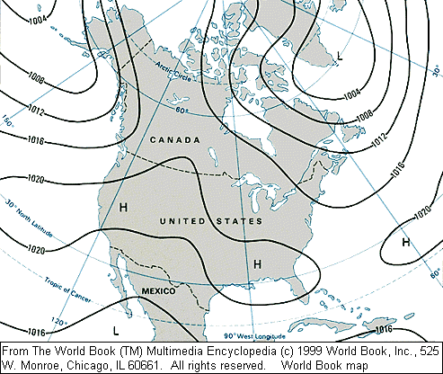
Areas of the same pressure can be connected with lines called Isobars.
Notes:
http://www.wunderground.com/US/Region/US/Fronts.html

Slide 52
Effects of Air Pressure
Warm low density air rises and cools leading to cloudy & stormy weather.
Cool, high density air stays near the ground and fair weather is the result.
Air moves from areas of high pressure to areas of low pressure
    WIND

Slide 53
Greenhouse Effect
Various factors:
    Carbon dioxide
    water vapour
    other greenhouse gases (methane, etc)
Global warming
    What are the causes?
    Is this a natural cycle?
    Are humans contributing to rising temperatures?

Slide 54
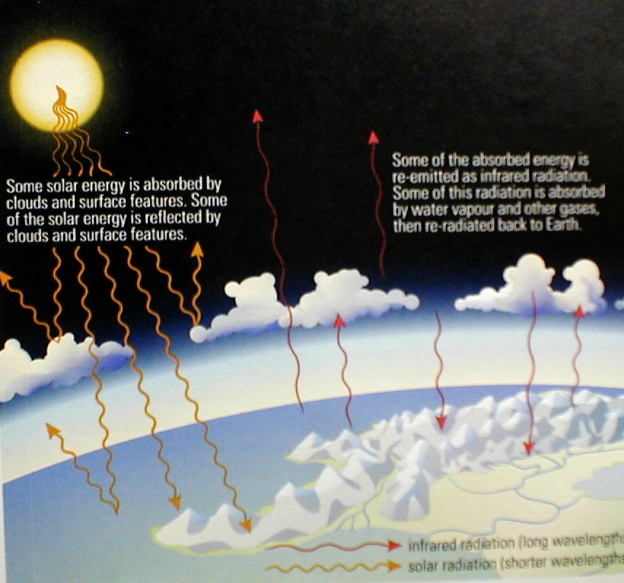
Greenhouse
Effect
Notes:
Taken from “Canada and the World” G. Matthews and R. Morrow, 1995,
Prentice Hall Inc, Scarborough, Ontario.

