Slide 1


Trends In The Periodic Table
(SCH 3U)

Slide 2
Trends in Atomic Radius
First problem: Where do you start measuring from?
The electron cloud doesn’t have a definite edge.
They get around this by measuring more than 1 atom at a time.

Slide 3
Atomic Size
}
Radius
Measure the Atomic Radius - this is half the distance between the two nuclei of a diatomic molecule.
Def^{n}: The distance from the center of the nucleus to the outermost electrons occupying an energy level.

Slide 4
Atomic Radius
Influenced by three factors:
1. Energy Level (Electron Shell)
  Higher energy level is further away.
2. Charge on nucleus (# protons)
  More charge pulls electrons in closer.
3. Shielding effect (Blocking effect)

Slide 5
Electrostatic Force Theory (EFT)
The degree of attraction or repulsion experienced by two charged particles depends on TWO main factors:
1. The distance between them
2. The magnitude of the charge.
As the # of protons in the nucleus increases, the electrons will experience a greater electrostatic attraction for the nucleus.
As electrons are positioned in energy shells further from the nucleus, they will experience less electrostatic attraction fro the positive nucleus.

Slide 6
Shielding (Z_{eff})
The force of attraction between positively charged protons and electrons is the force that holds atoms together.
The inner electrons partially block the attraction of the protons from the outer electrons in the outermost energy level.
This cancelling is called the Shielding Effect.
A Second electron has the same shielding, if it is in the same period
Thus, a 4s electron will feel less nuclear attraction than a 1s electron

Slide 7
What does this mean?
Look at the arrangement of electrons
Is being ‘pulled’ in by the 11 protons
11p⁺ 12n°
BUT is ‘shielded’ by 10 electrons in front of it
Chlorine
Sodium
Is being ‘pulled’ in by the 17 protons
17p⁺ 18n°
BUT is ‘shielded’ by 10 electrons in front of it
More protons means greater attraction between nucleus and outer electron thus higher ionization energy.

Slide 8
What do they influence?
Energy levels and Shielding have an effect on the GROUP ( ↕)
Nuclear charge has an effect on a PERIOD ( ↔ )

Slide 9
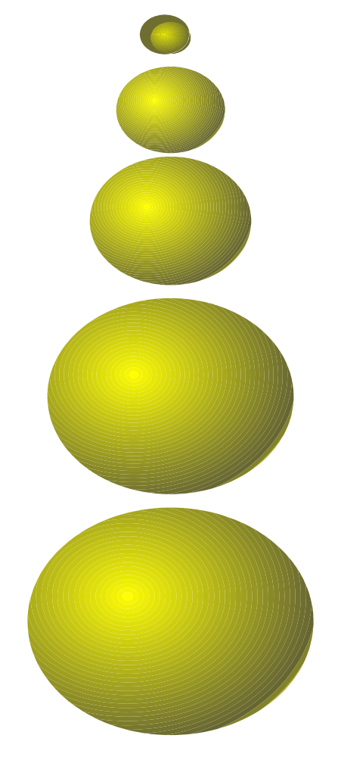
#1. Atomic Radius - Group Trends
Trend: (Atomic # ↑, AR↑)
Explanation:
As we increase the atomic number (or go down a group). . .
each atom has another energy level,
so the atoms get bigger.
H
Li
Na
K
Rb

Slide 10
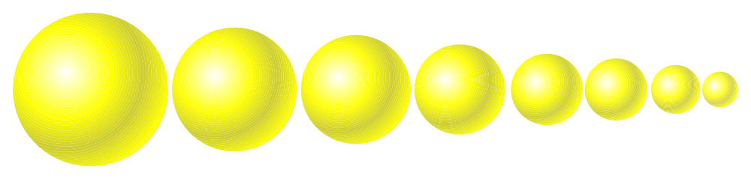
#1. Atomic Size - Period Trends
Trend: Going from left to right across a period, the size gets smaller. (Atomic # ↑, AR ↓)
Explanation:
Electrons are in the same energy level.
But, there is more nuclear charge.
Outermost electrons are pulled closer.
Na
Mg
Al
Si
P
S
Cl
Ar

Slide 11
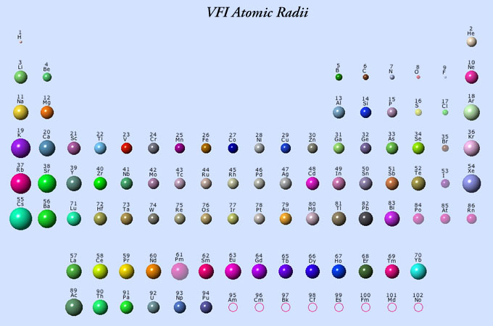
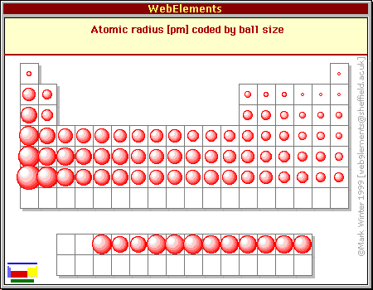
Atomic Radius

Slide 12
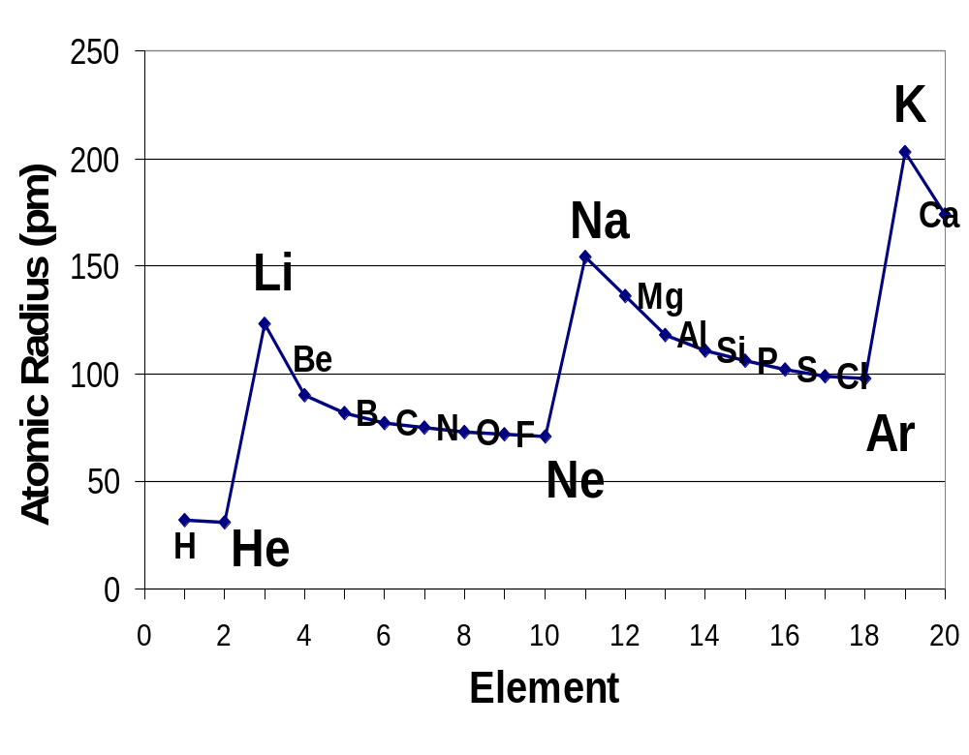
Atomic radius vs. atomic number

Slide 13
Ions
An electrically charged particle formed when an atom or molecule loses or gains an electron.
Q: what would the charge be on an atom that lost an electron?
    A: +1 (because your losing a -ve electron) called a cation
Q:Gained two electrons?
    A: -2 (because you gain 2 -ve electrons) called an anion

Slide 14
Trends in Ionic Size: Cations
Cations form by losing electrons.
Cations are smaller than the atom they came from – not only do they lose electrons, they lose an entire energy level.
Metals form cations.
Cations of representative elements have the noble gas configuration before them.

Slide 15
Ionic size: Anions
Anions form by gaining electrons.
Anions are bigger than the atom they came from – have the same energy level, and nuclear charge
Nonmetals form anions.
Anions of representative elements have the noble gas configuration after them.

Slide 16
Ionization Energy
Def^{n}: The amount of energy required to remove an electron form an atom or ion in the gaseous state.
-is an endothermic process
Expressed in units of kilojoules per mole.

Slide 17
Ionization Energy
First ionization energy is the energy required to remove the most weakly held electron from an neutral atom.
X_{(g)} + energy → X⁺_{(g)} + e⁻
First ionization energies of metals are lower than those of nonmetals.
2nd Ionisation Energy: The energy required to remove a second electron from a cation.

Slide 18
Ionization energy
Ionization energy is the energy required to remove one outer electron from an atom.
Most weakly held
+1
11p⁺ 12n°
11p⁺ 12n°
+
Ionization
Energy
+
1e⁻
Na
+
E _{ionization}
Na⁺¹ (g)
+
1e⁻

Slide 19
What factors determine IE?
The greater the nuclear charge, the greater IE.
Greater distance from nucleus decreases IE
Filled and half-filled orbitals have lower energy, so achieving them is easier, lower IE.
Shielding effect

Slide 20
Ionization Energy (IE)
Trends In a Group (as you go DOWN a group)
-Atomic # ↑, IE↓
As you go down a group, the first IE decreases because...
  The electron is further away from the attraction of the nucleus
  core shielding makes the removal of valence e⁻’s easier (Z_{eff} ↓) & electrons are farther away from the attraction of the nucleus

Slide 21

Ionization Energy - Period trends (Left – Right)
All the atoms in the same period have the same energy level.
Same shielding.
But, increasing nuclear charge
as the # of protons are added there is a larger force holding onto e⁻’s (Z_{eff} ↑)
So IE generally increases from left to right.

Slide 22
Ionization Energy
Symbol First Second Third
HHeLiBeBCNO F Ne
1312 2731 520 900 800 1086 1402 1314 1681 2080
5247 7297 1757 2430 2352 2857 3391 3375 3963
11810 14840 3569 4619 4577 5301 6045 6276

Slide 23
Symbol First Second Third
11810 14840 3569 4619 4577 5301 6045 6276
HHeLiBeBCNO F Ne
1312 2731 520 900 800 1086 1402 1314 1681 2080
5247 7297 1757 2430 2352 2857 3391 3375 3963
Why did these values increase so much?

Slide 24
He
He has a greater IE than H.
Both elements have the same shielding since electrons are only in the first level
But He has a greater nuclear charge
H
First Ionization energy
Atomic number

Slide 25
He
Li has lower IE than H
more shielding
further away
These outweigh the greater nuclear charge
H
First Ionization energy
Li
Atomic number

Slide 26
He
Be has higher IE than Li
same shielding
greater nuclear charge
H
First Ionization energy
Be
Li
Atomic number

Slide 27
He
B has lower IE than Be
same shielding
greater nuclear charge
By removing an electron we make s orbital half-filled
H
First Ionization energy
Be
B
Li
Atomic number

Slide 28
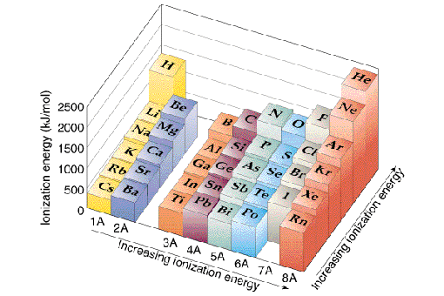
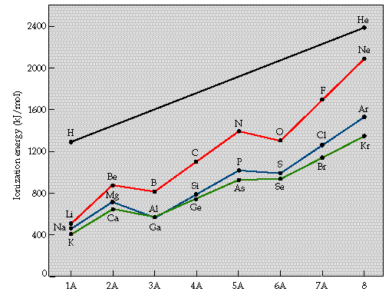
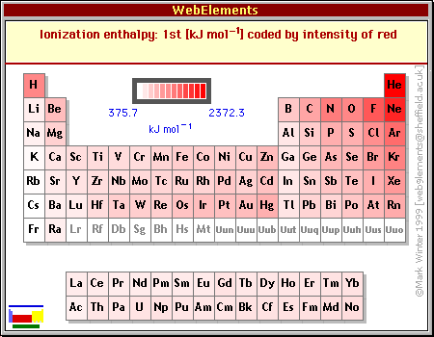
Ionization Energy

Slide 29
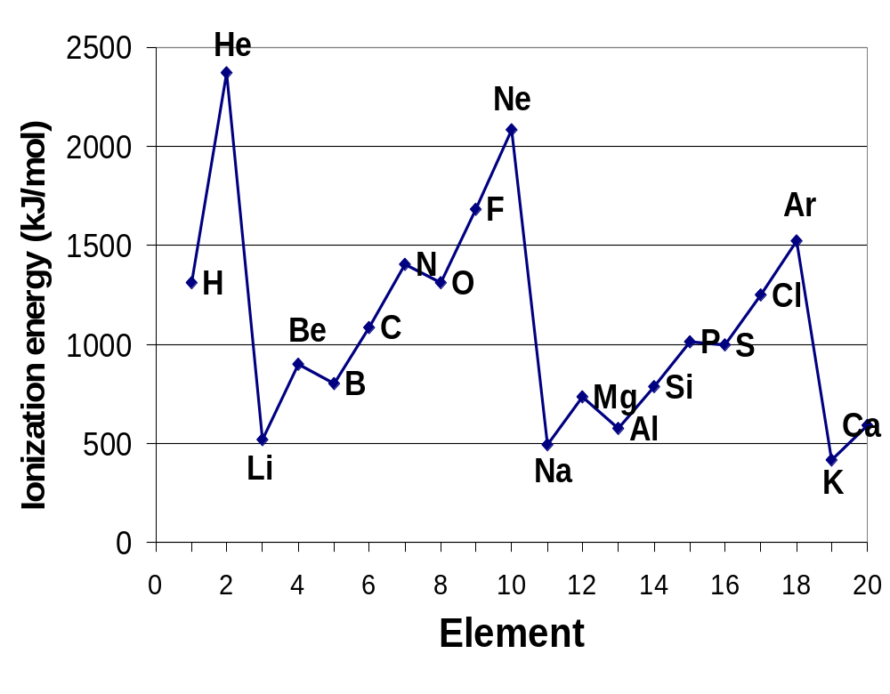
Ionization energy vs. atomic number

Slide 30
Ionization Energy
The ionization energies required to remove second, third and other electrons increases because of the smaller radius that is obtained when an atom becomes an ion. The electrons are then more strongly attracted to the nucleus.
A much larger amount of energy is required to remove an electron from a full valence shell.

Slide 31
Electron Affinity (KJ/mol)
Def^{n}: The energy released when an electron is added to a neutral gaseous atom to form a negative ion (anion).
  X_{(g)} + e⁻ → X⁻_{(g)} + energy
Trend: Electro affinity increases from bottom to top, and increases from left to right.

Slide 32
Electron Affinity
The energy released when a free electron is added to the lowest available energy shell of an atom in the gas phase/
-1
17p⁺ 18n°
17p⁺ 18n°
Electron
Affinity
+
1e⁻
+
Cl
+
1e⁻
Cl⁻¹ (g)
+
E.A.

Slide 33
Electron Affinity
Expressed in kilojoules per mole.
Electron affinity and atomic radius are generally inversely related. The smaller the atomic radius, the greater the electron affinity.
Electron affinity increases from left to right on the periodic table and decreases from top to bottom in a group.

Slide 34
Electron Affinity (EA)
-trends are more irregular than other trends
-is an exothermic process
-elements with high electron affinities form –ve ions in ionic compounds.
-elements with low electron affinities form +ve ions in ionic compounds.

Slide 35
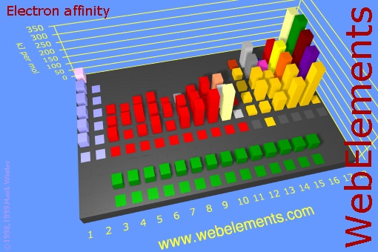
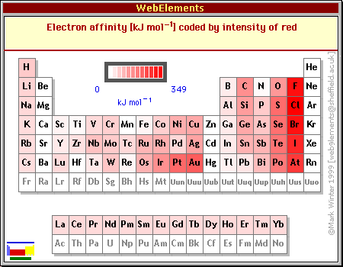
Electron Affinity

Slide 36
Electronegativity
Def^{n}: Represents a number that describes the relative ability of an atom, when bonded, to attract shared electrons.
combines ionization energies, electron affinity, the polarity of the molecule and the energy required to break the bond.

Slide 37
Electronegativity
Fluorine is given a value of 4.0, It has the greatest ability to attract electrons.
Trend: Electronegativity increases from bottom to top, and increases from left to right.

Slide 38
Electronegativity: Group Trend
The further down a group, the farther the electron is away from the nucleus, plus the more electrons an atom has.
Thus, more willing to share.
Low electronegativity.

Slide 39
Electronegativity: Period Trend
Metals are at the left of the table, they let their electrons go easily
At the right end are the nonmetals.
They want more electrons.
Try to take them away from others because of the small atomic radius and proximity of the it’s nucleus to the bonding electrons
High electronegativity.

Slide 40
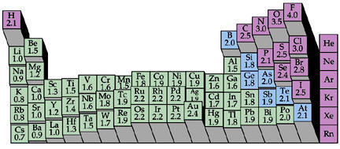
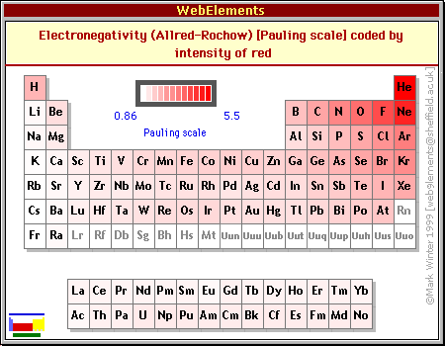
Electronegativity

Slide 41
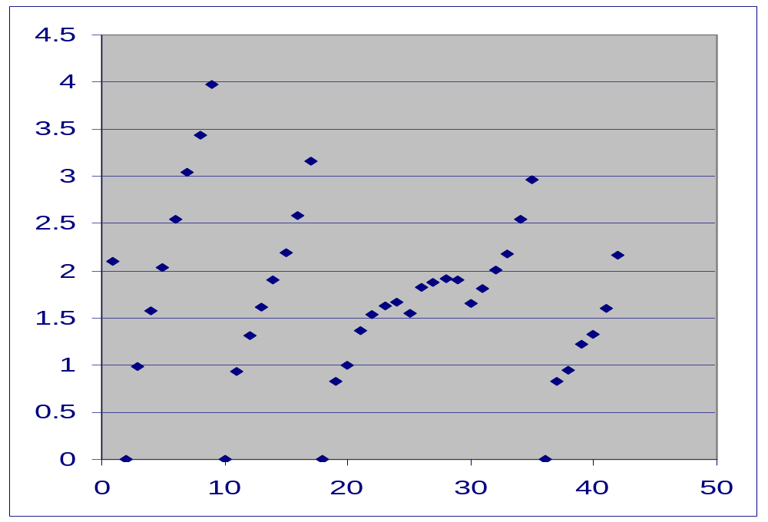
E
l
E
C
T
R
O
N
E
G
A
T
I
V
I
T
Y
GRAPH OF ELECTRONEGATIVITY
F
Cl
Br
He
Ne
Ar
Kr
ATOMIC NUMBER

Slide 42
Example Questions
E.g. #1) Using the periodic table, arrange the following in order of increasing atomic radius?
Na, Be, Mg
Ans: Be<Mg<Na
E.g. #2) Which has a larger atomic radius?
Cl or Cl⁻¹
Ans: Cl⁻¹ because as an anion, the atomic radius increases, since the ratio of –ve charges is greater than +ve charges and the electron cloud expands.

Slide 43
Example Questions
E.g. #3) Why would Na have a larger 2nd ionization energy?
Ans: because after losing 1 electron, sodium would be isoelectronic with a noble gas, which is very stable.
E.g. #4) Why would Ca have a smaller 2nd ionization energy?
Ans: because by losing two electrons calcium would be isolectronic with a noble gas, which is more stable than losing just one electron.

Slide 44
Example Questions
E.g. #5) Why do noble gases have the highest Ionization Energies on the periodic table?
ans: because they have a stable octet, which require the most amount of energy to remove an electron.
E.g. #6) Will the atom with the following electron configuration have a large 2nd Ionization Energy?
1s²2s²2p⁶3s²
Ans: No, because the element will lose 2 electrons to become isoelectronic with a noble gas, so to lose the second electron is easier.

