Slide 1
Information Retrieval
CS 144 Web Application
TA: Jin Wang and Zhehan Li
02/23/2018

Slide 2
Overview
Project 4
Install all packages
Setting Up Server app.js
Starting Server and Testing
Creating and Connecting to Database
Implementing Routing Middleware
Information Retrieval
Boolean Model
Vector Model
TF-IDF
Cosine Similarity
Corpus size estimation

Slide 3
Project 4: Dependencies
Install all packages needed in package.json
You can add any packages as needed in the project
$ npm install --save mongodb
For database connection
$ npm install --save commonmark
For generating markdown string
$ npm install --save bcrypt
For encrypting user password
$ npm install --save jsonwebtoken
For implementing JWT

Slide 4
Project 4: Dependencies
Other recommended packages
mongoose: promise mechanism in mongoDB connection
https://github.com/Automattic/mongoose
passport: use to authenticate requests
https://www.npmjs.com/package/passport
express-jwt: validate JSON Web tokens
https://www.npmjs.com/package/express-jwt

Slide 5
Project 4: Build a RESTful API
Correction on last week’s slides:
You should use JSON Web Token for authentication sent by Session-Cookies
Reference:
https://www.sitepoint.com/using-json-web-tokens-node-js/

Slide 6
Project 4: Build a RESTful API
Setting Up Server app.js
Configure app to use middleware
app.use(bodyParser.json());
app.use(‘/blog’, blogMiddleware);
app.use(‘/api’, apiMiddleware);
Listen to the port:
For server-side: app.listen(8080);
For the whole application: port number should be 3000
Test the Server only
node app.js
You can use the tool Postman for testing:
https://www.getpostman.com/

Slide 7
Project 4: Build a RESTful API
Creating and Connecting to Database
var mongoose = require('mongoose');
mongoose.connect('mongodb://localhost:27017/BlogServer’);
Implementing Routing Middleware
blogMiddleware.js // handle ‘/blog’ request
apiMiddleware.js // handle ‘/api’ request
Remember to make authentication!
Example: app.get(‘/api/:name’,[authen function],[method]);
Example of using Mongoose:
https://scotch.io/tutorials/build-a-restful-api-using-node-and-express-4

Slide 8
Overview
Project 4
Install all packages
Setting Up Server app.js
Starting Server and Testing
Creating and Connecting to Database
Implementing Routing Middleware
Information Retrieval
Boolean Model
Vector Model
TF-IDF
Cosine Similarity
Corpus size estimation

Slide 9
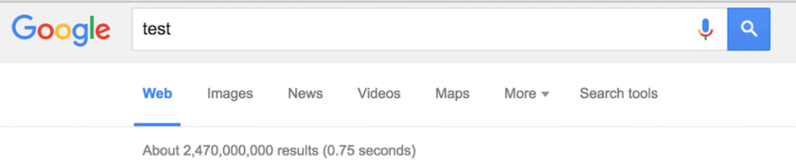
Information Retrieval
Keyword Search
How does search engine like Google work?
How could it be so fast?
Which website should be the first page?

Slide 10
The Boolean model
Three documents:
Doc1: Alice visits Wonderland
Doc2: Wonderland welcomes Alice
Doc3: Alice! Run, Alice!
Bag of words assumption: The order of the words doesn’t matter.
How does the inverted index look like?

Slide 11
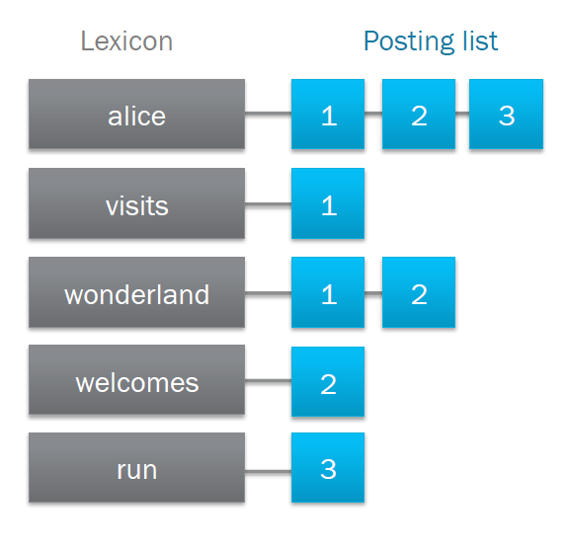
The Boolean model
Three documents:
Doc1: Alice visits Wonderland
Doc2: Wonderland welcomes Alice
Doc3: Alice! Run, Alice!
Why is it called Boolean model?
Is the word in this document? - True or False
Boolean queries: AND | OR | NOT

Slide 12
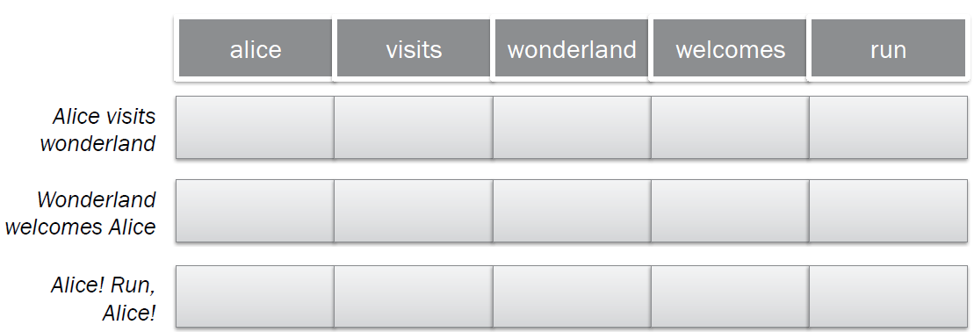
The Vector model
A document is considered an n-dimensional vector, where n is the number of different terms in the lexicon.
A query is also an n-dimensional vector.
What should be the value of each vector below?
TF-IDF

Slide 13
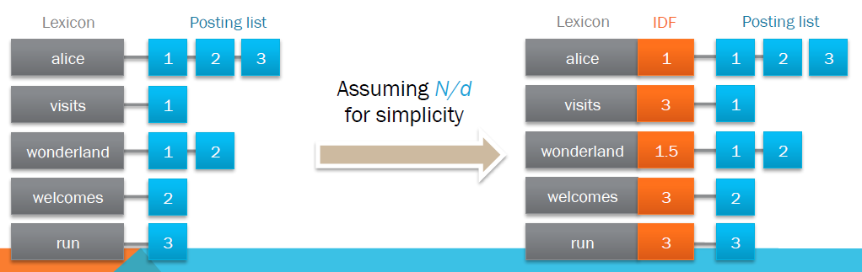
TF-IDF
TF (Term Frequency): # occurrence of t in D
IDF (Inverse Doucment Frequency): log (N/DF)
DF (Document Frequency): # of documents where t appears.
More common keywords are less specific

Slide 14
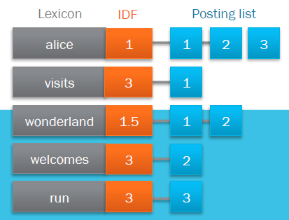
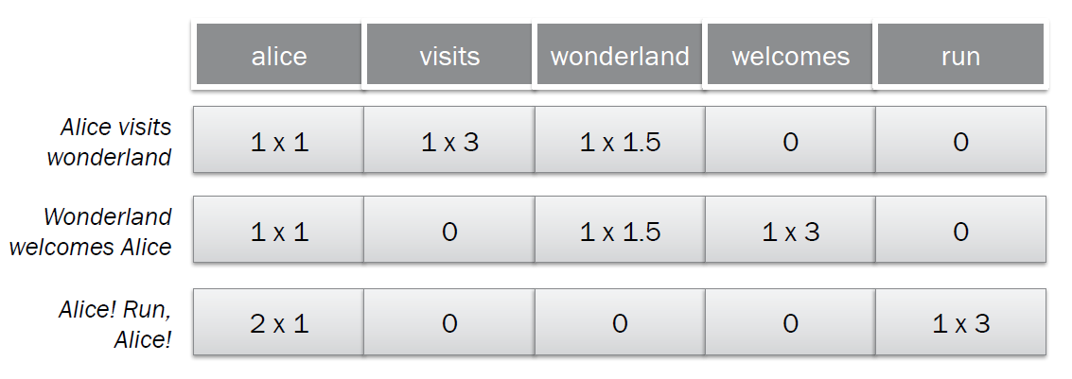
TF-IDF
Entry in the vector = TF × IDF:
e.g. “Alice” happens 2 times in third document -> TF = 2. The IDF of word “Alice” is 2
=> TF × IDF = 2 × 1 = 2

Slide 15
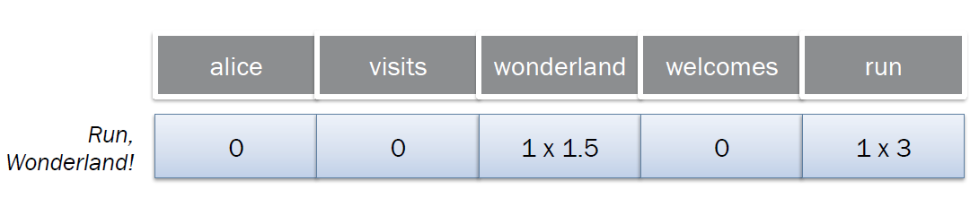
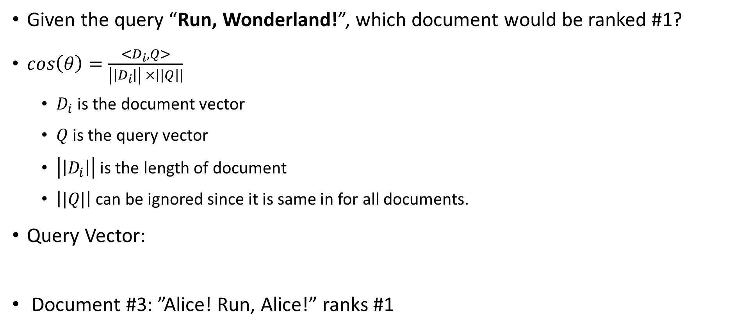
Cosine Similarity
Given the query “Run, Wonderland!”, which document would be ranked #1?
$\cos\left(θ\right)=\frac{<D_{i},Q>}{\left|\left|D_{i}\right|\right| ×\left||Q\right||}$
$D_{i}$ is the document vector
$Q$ is the query vector
$\left|\left|D_{i}\right|\right|$ is the length of document
$\left||Q|\right|$ can be ignored since it is same in for all documents.
Query Vector:
Document #3: ”Alice! Run, Alice!” ranks #1

Slide 16
Corpus Size Estimation
Given that
100 M docs
5 KB/doc
400 unique words/doc
20 bytes/word
10 bytes/docid
Size of Document Collection ?
100 M docs × 5 KB / doc ≅ 500 GB
Size of Inverted Index ?
Size of postings list?
100M docs x 400 unique words/doc x 10B/docid ≅ 400GB
Size of lexicon?
# of unique word = Cˑn^{k} , where n is # of documents
Assume C=1, k=0.5
(100M)^{0.5} x 20B ≅ 200KB

Slide 17
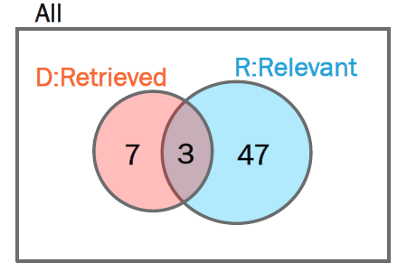
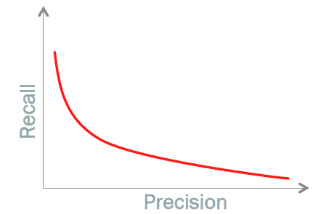
Precision and Recall
If we have 1000 documents:
50 relevant documents
A search engine retrieves 10 documents where
3 are relevant
7 are irrelevant
What is the Precision and Recall of this search engine?
Precision = |D & R| / |D| = 3/7
Recall = |D & R| / |R| = 3/50

