Slide 1
Internet Security
CS 144 Web Applications
TA: Zijun Xue, Zhehan Li
03/09/2018

Slide 2
Outline
Introduction to Cryptography
Symmetric Key
Asymmetric Key (Public-Key Infrastructure)
Common Web Vulnerability
Project 5

Slide 3
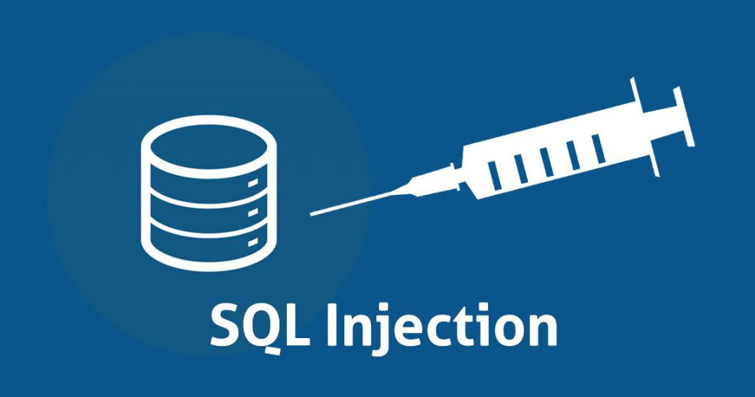
Some common attack techniques
DDoS (Distributed Denial of service)
Phishing
spoof web site to look like the real one
Pharming (DNS cache poisoning)
e.g. wrong DNS resolution
Packet sniffing
Cache theft
SQL injection
SELECT * FROM users WHERE (name='cs144') and (password='1' OR '1'='1');

Slide 4

Desired Guarantees
Confidentiality
Maintaining the privacy of the “conversation.”
Message/data integrity
No one can modify the content of the messages.
Authentication
Making sure the other party is who he/she claims to be.
Authorization
Managing access to resources upon successful authentication.
UNIX User and Group permission mechanism

Slide 5

Encryption Algorithm
Cipher
m, plain text
F(m, k_{e})
c, cyphertext
F ⁻¹(c, k_{d})
m
insecure channel
k_{e}, encryption key
k_{d}, decryption key
Symmetric: k_{e} = k_{d}
Asymmetric: k_{e} ≠ k_{d}

Slide 6
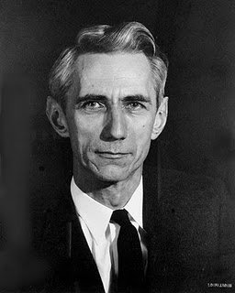
Cipher properties
(Shannon) Perfect Secrecy: P( m | c ) = P( m )
We should not be able to guess m by just looking at the cyphertext c.
One-Time Pad (OTP)
Guarantees Perfect Secrecy.
Use a brand new key to encrypt messages every time.
Never use the same key again.
Pad value (i.e. key) must be at least as long as the message
Very expensive in practical terms.

Slide 7
Symmetric-Key Cryptography
Same key for encrypting and decrypting: k_{e} = k_{d} = k
XOR is the simplest operator:
m, plain text
k, the key
=
c, cyphertext
11110000
10111001
01001001
c, cyphertext
k, the key
=
m, plain text
01001001
10111001
11110000
F = F⁻¹

Slide 8

Symmetric-Key Cryptography
DES, Data Encryption Standard, 64-bit cypher.
AES, Advanced Encryption Standard, 128-bit cypher, 128/192/256-bit key.
How do we ensure authentication?
Challenge message (a random number).
How do we ensure confidentiality?
Generate individual key for each conversation.
How do we ensure authorization?
Encrypting distinct data with distinct keys.
How do we ensure integrity?
Encrypting a checksum.
Any problem with symmetric-key cryptography?
Agreeing on key.
n(n-1)/2 keys for n parties

Slide 9
Asymmetric-Key Cryptography
Different keys
For encryption: e = k_{e} (Public Key)
c = F( m, e )
For decryption: d = k_{d} (Private Key)
m = F⁻¹( c, d )
Requirements:
F⁻¹( F( m, e ), d ) = m
c = F( m, e ) ⇏ m (Perfect Secrecy)
e ⇏ d

Slide 10
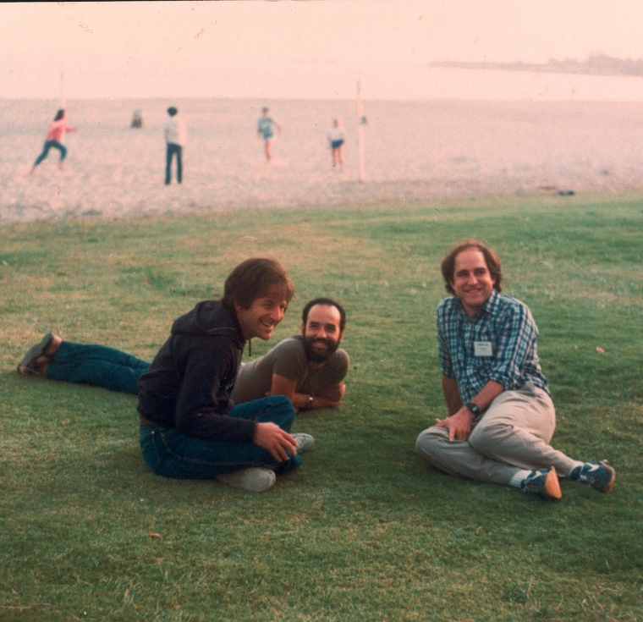
RSA Algorithm
Pick two large prime numbers: p and q.
Select e such that 1 < e < (p – 1)(q – 1)
e doesn’t have to be random.
e is coprime to (p – 1)(q – 1)
Solve for d in de mod (p – 1)(q – 1) = 1
Make n = pq and throw away p and q.
The new keys are k_{e} = (e, n) and k_{d} = (d, n)
Encryption c = F(m, k_{e}) = m^{e} mod n
Decryption m = F⁻¹(c, k_{d}) = c^{d} mod n
Rivest, Shamir, and Adleman

Slide 11
RSA Properties
F⁻¹( F( m, e ), d ) == m?
m = m^{ed} mod n
Can we obtain m from c = m^{e} mod n?
We know c, e, and n.
RSA problem
Can we obtain d from de mod (p – 1)(q – 1) = 1?
We know e, and n = pq.
Large-number factorization problem.
RSA is one thousand times slower than symmetric-key cryptography.

Slide 12

RSA Example
Let p = 7 and q = 11
e < (6)(10)
e = 13, being coprime to p and q
Solve for d in 13d mod 60 = 1
d = 37
n = (7)(11) = 77, and throw away p and q
If m = 3, then c = 3¹³ mod 77
c = 38
If c = 38, then m = 38³⁷ mod 77
m = 3

Slide 13
Asymmetric-Key Cryptography Applications
Confidentiality?
Asymmetric-Key Cryptography is very expensive.
Use it to agree on a common key, and continue communicating with symmetric-key cryptography.
Authentication?
A wants to make sure B is not someone else.
A generates a random number r, and sends c = F( r, k_{e}^{B} ) to B.
B decrypts c, and sends back r’ = F( c, k_{d}^{B} ) to A.
If r’ = r, then B is authentic.

Slide 14
Asymmetric-Key Cryptography Applications
Integrity?
Given a checksum h, A signs h with its private key k_{d}^{A}, and sends h’ = F⁻¹(h, k_{d}^{A}) to B.
B gets h’ and obtains the original checksum h by using the public key of A, k_{e}^{A}. Then h = F(h’, k_{e}^{A}).
How could we make sure that the public key is really the public key of the party we want to communicate in the first place?
Certificate Authorities

Slide 15

Certificate Authorities
Allow us to trust the w website and its public key k_{e}^{w}
The CA emits a certificate (with the public key k_{e}^{w}) for the w website, and signs it with its own private key k_{d}^{CA}
Our browsers contain a list of trusted CAs with their public keys k_{e}^{CA}
Website W introduces itself with this certificate when we start a secure connection
k_{e}^{w} is the public key of W
The certificate has been signed a CA with its private key.
Expires on 2015-12-31
k_{d}^{CA}

Slide 16
Outline
Introduction to Cryptography
Symmetric Key
Asymmetric Key (Public-Key Infrastructure)
Common Web Vulnerability
Project 5

Slide 17
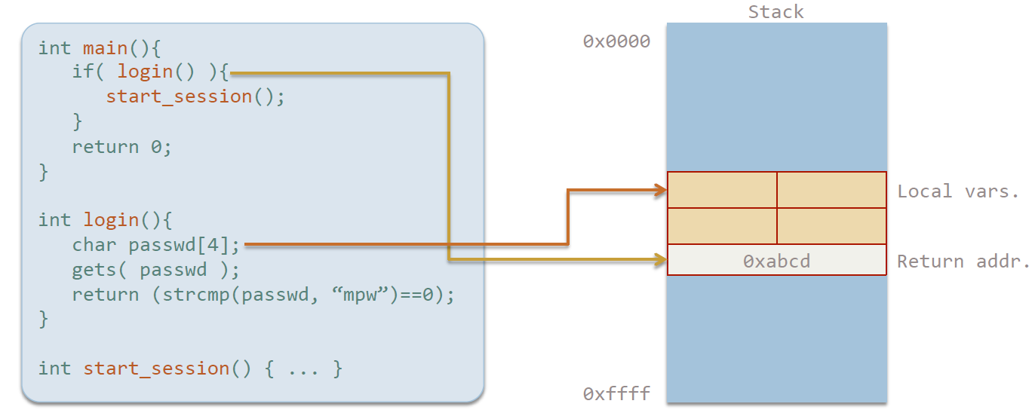
Common Vulnerabilities
Buffer overflow

Slide 18
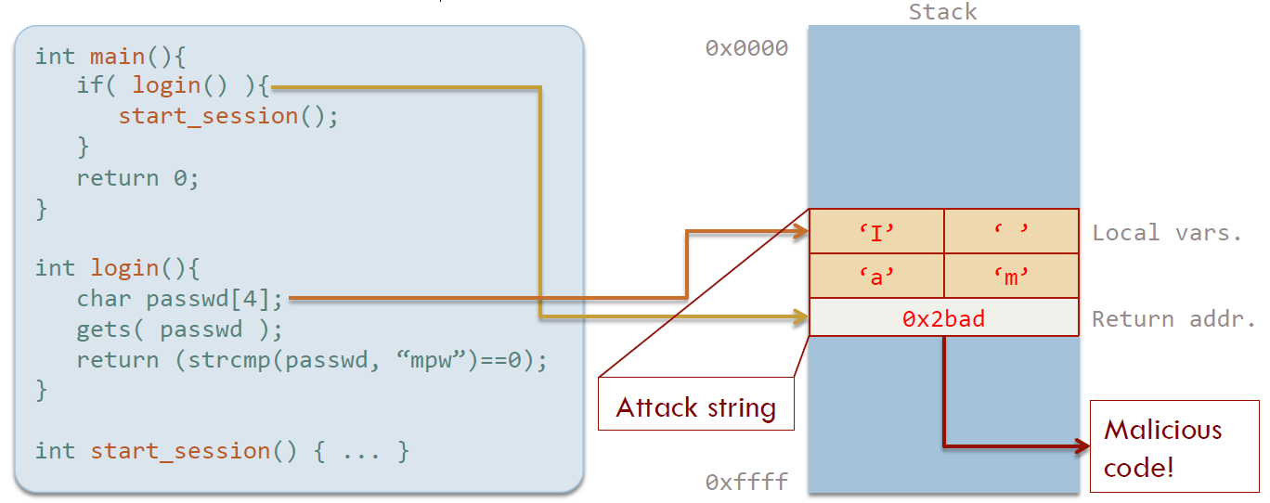
Common Vulnerabilities
Buffer overflow

Slide 19
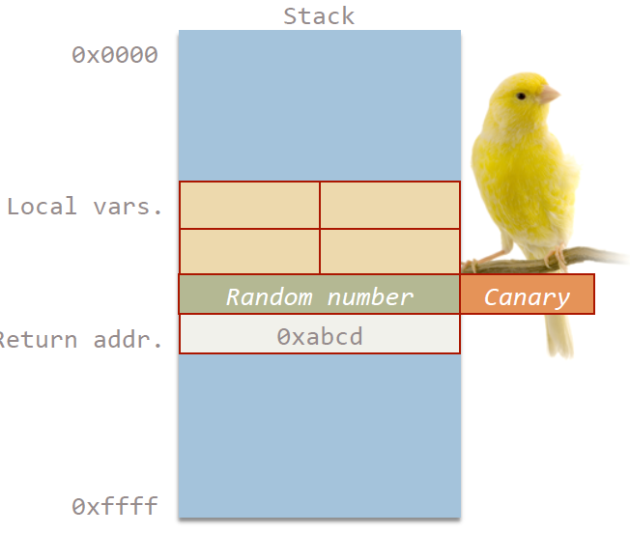
Common Vulnerabilities
Buffer Overflow (Solution)
Activate a “Stack Guard” to insert Canary.
Give minimum privileges to a program
Never trust user input: don’t use unsafe string functions in C (like strcpy, gets, strcat, sprintf, etc.)

Slide 20
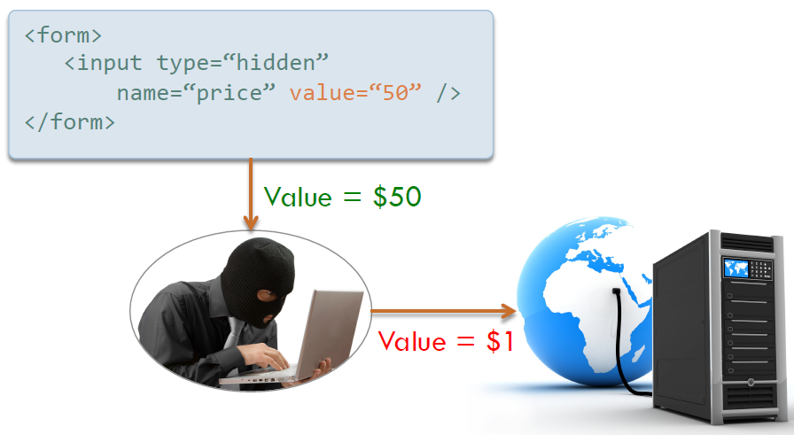
Common Vulnerabilities
Client-State Manipulation
Don’t store sensitive information in the client (only a Session ID)
Encrypt a checksum (using a signature prior storing in the client).
Attach either an expiration date or the Session ID to client’s state.

Slide 21
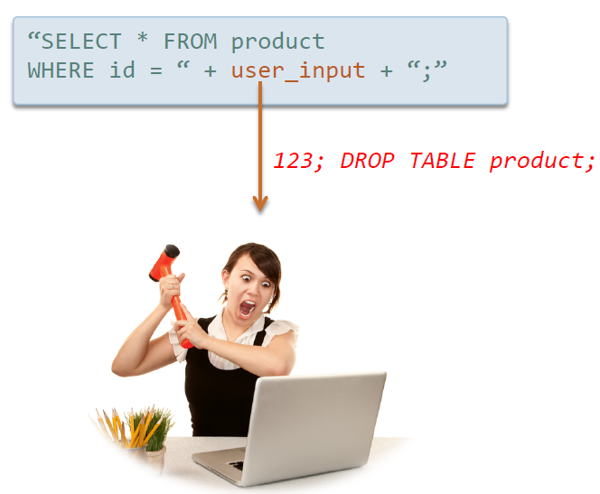
Common Vulnerabilities
SQL Injection
Create users with minimum privileges.
Use prepared statements
Encrypt sensitive data in DBMS
Don’t trust user input!

Slide 22
Common Vulnerabilities
SQL Prepared Statement
PreparedStatement s = db.prepareStatement("SELECT * from
Product WHERE id = ?"); s.setInt(1, Integer.parseInt(user_input));
ResultSet rs = s.executeQuery();

Slide 23
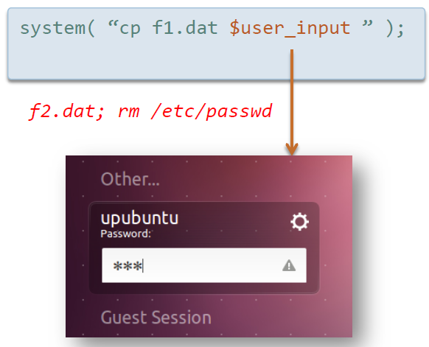
Common Vulnerabilities
Command Injection
Don’t use the System command. Use Runtime.exec() instead.
“Taint” variables.
Give minimum privileges to your application.

Slide 24
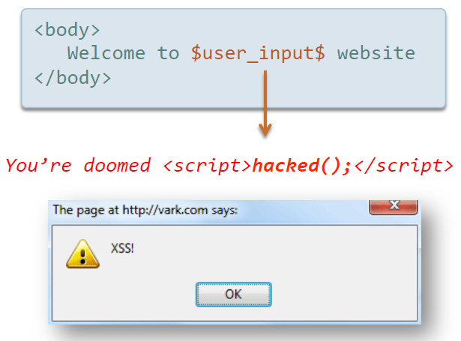
Common Vulnerabilities
Cross-Site Scripting (XSS)
Why is it called Cross-Site?
It’s very difficult to protect against it – we want to allow users insert HTML
2 options: white listing, black listing. Which one is better?

Slide 25
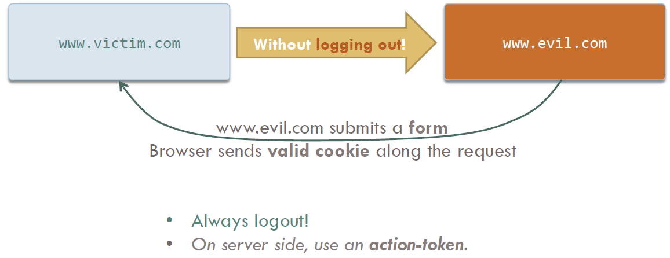
Common Vulnerabilities
Cross-Site Request Forgery (XSRF)

Slide 26
Outline
Introduction to Cryptography
Symmetric Key
Asymmetric Key (Public-Key Infrastructure)
Common Web Vulnerability
Project 5

Slide 27
Project 5
Part A - Testing Performance of Server
Learn to use Locust
Write some test cases for Locust
Find the max user number that the Server could handle
Part B – Apache Spark
Learn to use Spark (shell)
Learn some basic Scala
Write a 10-line code in Scala to solve a problem.

