Slide 1
Final Review
CS 144 Web Application
TA: Jin Wang and Zhehan Li
03/16/2018

Slide 2
Outline
General Information
JavaScript
MEAN stack
Scalability
Other topics

Slide 3
General Information
Final Exam
Time: 11:30 a.m. – 2:30 p.m. March 19th
Location: BH 3400
Rules
Similar format with sample final
Close book, close notes
Allow bring two double-sided cheat sheets
Programming languages (HTML, CSS, JavaScript etc.)
Know basic ideas and simple structured program
No need to recite the detailed concepts
Scope: contents through week 1 to 9 in lectures
Only the handouts provided by the instructor are official materials!

Slide 4
JavaScript: basic issues
Keywords and syntax
Case sensitive
Variables and identifiers
Primitive Types
number, string, boolean
undefined and null
Object Type
Properties
Object assignment
Array

Slide 5
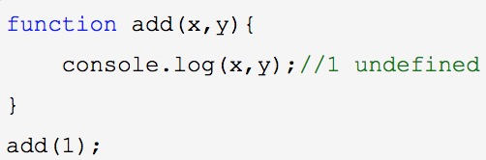
JavaScript: Function and Scope
Functions are objects
Can be assigned to a variable/passed as a parameter
Can have properties
Arrow Function
Do not have its own this
Cannot serve as constructor in OOP
Parameter
Do not check the type and number of parameters
When there are fewer number of arguments: initialized as undefined

Slide 6
JavaScript: Function and Scope
Nested Function
Closure: the nested function will return its context as well.
Global parameter
Declared out of a function, whether use let or not.
Declared inside a function, not use let. [not recommended!]
Local parameter
Declared inside a function, use let

Slide 7
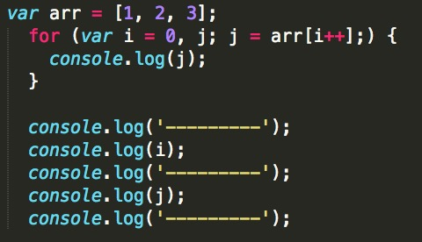
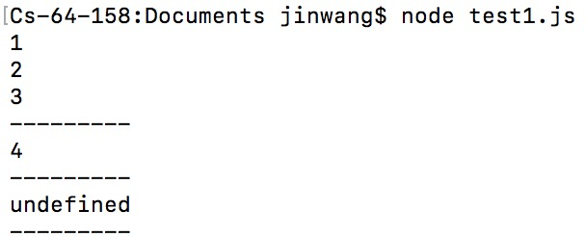
JavaScript: Example 1
What is the output of following program?

Slide 8
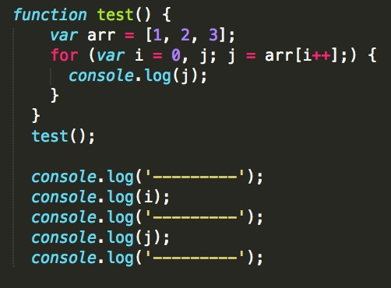
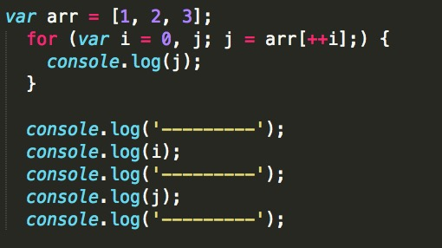
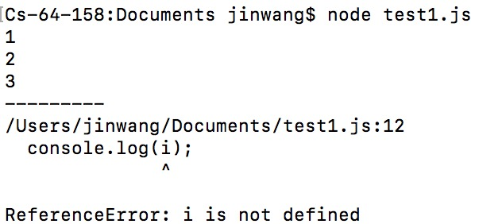
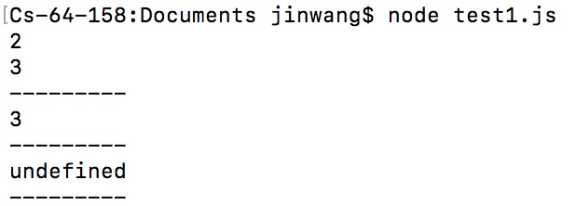
JavaScript: Example 1 Follow-up
What about these?

Slide 9
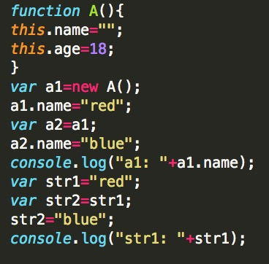
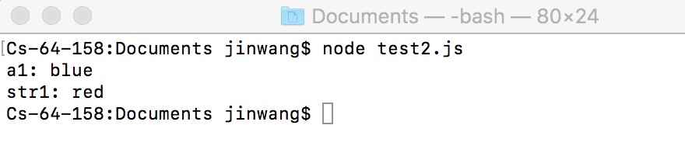
JavaScript: Example 2
What is the output of following program?

Slide 10
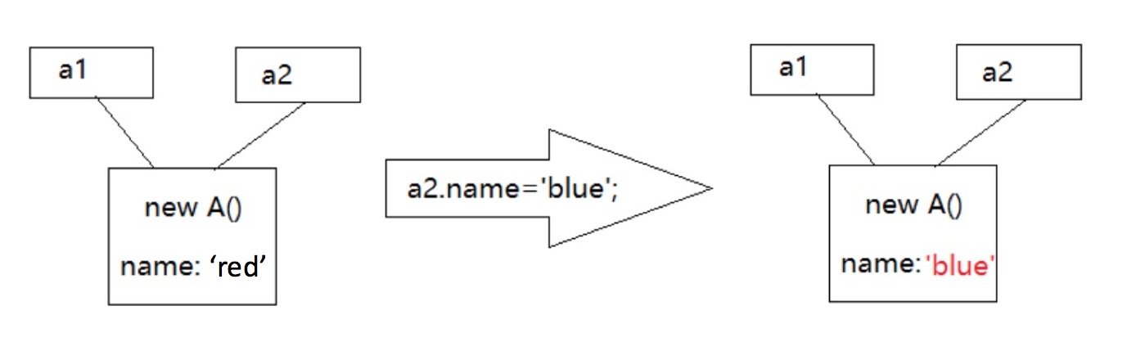
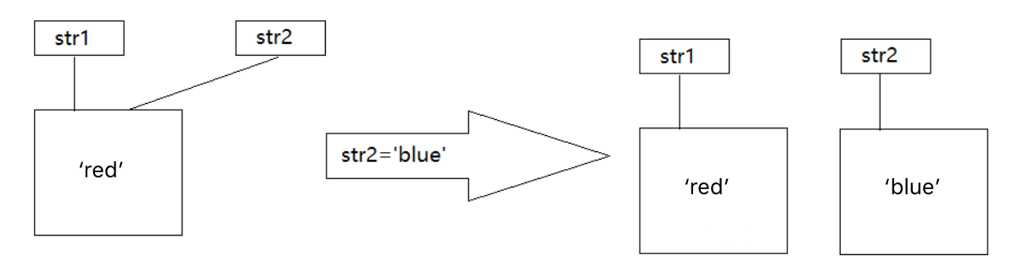
Explanation of Example 2
Notes:
a1, a2: object, name: property
Str1,str2: string

Slide 11
MEAN Stack
Traditional Web Development
HTML + CSS + JavaScript -> Front End
Java -> Back End
MySQL -> Database
Can we just learn JavaScript and get ride of Java?
Yes. Node.js
Can we use JSON as the data model for storage?
Yes. MongoDB
Can we reduce the complexity of Front End/Client side?
Yes. Angular

Slide 12
TypeScript
Superset of JavaScript
any JavaScript code is also a TypeScript code!
Type/Class(public, private, protected)/Interface/Generics
Decorators -> ‘@xxx’
TS code (Type mismatch error)
function printName(name: string): string {return "You are" + name;}
let num : number = 1
console.log(printName(num))
JS code (Success)
function printName(name) { return "You are" + name; }
var num = 1;
console.log(printName(num));

Slide 13
Angular
JavaScript/TypeScript framework for client-side development
Supporting Single-page application (SPA) -> Project 3
Module = Components + Services
Intra-component communication: Data binding
Interpolation ({{ expression }})
Property binding ([property]="expression")
Two-way binding ([(ngModel)]="property")
Event binding ((event)="statement")
Inter-component communication
Custom event generation + template reference variable
Service and Dependency Injection -> Who is responsible for creating service?

Slide 14
Node.js
JavaScript runtime environment – Server Side!
Single threaded & Asynchronous programming
Comparison among different projects
 | Project 2 | Project 3,4
Backend Language | Java | JavaScript
Runtime Environment | JRE | Node.js
Package/Framework | Tomcat | Express
MVC | MySQL-JSP-Java class | MongoDB-EJS-JavaScript file

Slide 15
Express
require ('xxxxx') -- VS -- import {xxxxx} from 'xxxxx’
package.json
Routing Support
E.g. app.get(‘/list/:username’, (req , res) = > {do()});
Specify the method (GET), path (‘/list/:username’), and action(do())
Middleware
Every request goes through the sequence of middleware, until one serves the response [e.g. app.use( bodyParser.json () );]
Create a separate module to handle requests coming from some URL [e.g. birds = require (‘./ birds’); app.use('/ birds ', birds );]

Slide 16
MongoDB
NoSQL Database, Document-oriented Database
MongoDB MySQL
Database ------------------- Database
Collection ------------------- Table
Document ------------------- Tuple
Field ------------------- Attribute
Allows data retrieval based on “non-key” fields

Slide 17
Scalability
Load Balance, Scale out
Distributed File System
NoSQL
maintaining a shared state
CAP Theorem
Different kinds of stores
Consistent hashing
Map Reduce and Hadoop (Refer to my slides in week 8)

Slide 18
Other Topics
Communication: HTTP
Cookies, Sessions
JSON
Web Server
Architecture
App server: MVC
Encoding
MIME
Unicode
AJAX

Slide 19
Principles to Answer Questions
Understand the requirement
Locate to the corresponding knowledge
Solve the problem with such knowledge, add necessary explanation
You may get partial credits once your answer is not fully correct.
Do highlight the important part in your answer.
Make a clear statement
Do not be optimistic!

Slide 20
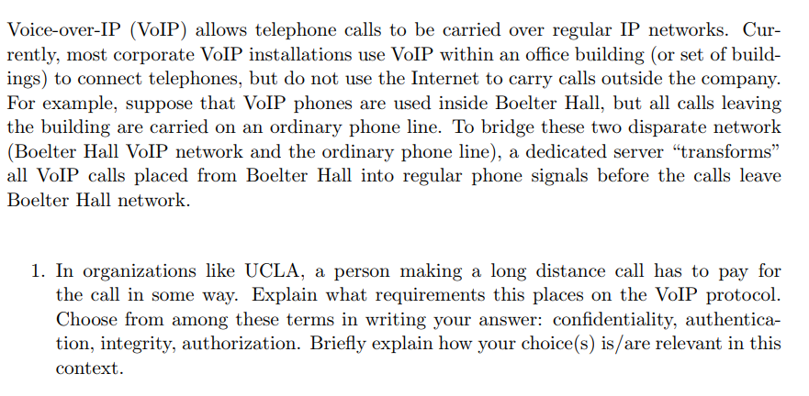
Example: Problem 7 in Sample Final
Notes:
Here we are not concerned about eavesdropping or communication integrity, we only need to ensure authentication and authorization.

Slide 21
General Grading Rubrics
Problem with specific answer
No partial credits will be considered.
E.g. Problem 5 in sample final.
Application Development Problem
Partial credits will be assigned for incomplete but correct answers
Question Answering
Correct conclusion: full credits
Partial correct/incorrect conclusion: partial credits for your effort
But if you include incorrect common sense in your answers, you will not have corresponding partial credits.

Slide 22
Thank you!

Slide 23
XML
Structure of XML
Namespace
DTD
XPath

Slide 24
Structure of XML: Tag and Element
Tag: label for a section of data
Element: section of data beginning with <tagname> and ending with matching </tagname>
Elements must be properly nested
Proper nesting
<account> … <balance> …. </balance> </account>
Formally: every start tag must have a unique matching end tag, in the context of the same parent element.
Every document must have a single top-level element (root)
Tree based model: DOM

Slide 25
Structure of XML :Attributes
Elements can have attributes
<account acct-type = “checking” >
<account-number> A-102 </account-number>
<branch-name> Perryridge </branch-name>
<balance> 400 </balance>
Attributes are specified by name=value pairs inside the starting tag of an element
An element may have several attributes, but each attribute name can only occur once
<account acct-type = “checking” monthly-fee=“5”>

Slide 26
Namespaces
XML data has to be exchanged between organizations
Same tag name may have different meaning in different organizations, causing confusion on exchanged documents
Specifying a unique string as an element name avoids confusion
Better solution: use unique-name:element-name
Avoid using long unique names all over document by using XML Namespaces
<bank Xmlns:FB=‘http://www.FirstBank.com’> …
<FB:branch>
<FB:branchname>Downtown</FB:branchname>
<FB:branchcity> Brooklyn</FB:branchcity>
</FB:branch> …
</bank>

Slide 27
Document Type Definition (DTD)
The type of an XML document can be specified using a DTD
DTD constraints structure of XML data
DTD does not constrain data types
DTD syntax
<!ELEMENT element (subelements-specification) >
<!ATTLIST element (attributes) >
Subelements can be specified as
names of elements, or
#PCDATA (parsed character data), i.e., character strings
EMPTY (no subelements) or ANY (anything can be a subelement)

Slide 28
XPath
XPath is used to address (select) parts of documents using path expressions
A path expression is a sequence of steps separated by “/”
Think of file names in a directory hierarchy
Result of path expression: set of values that along with their containing elements/attributes match the specified path
The initial “/” denotes root of the document (above the top-level tag)

Slide 29
XPath (Cont.)
Path expressions are evaluated left to right
Each step operates on the set of instances produced by the previous step
Selection predicates may follow any step in a path, in [ ]
E.g. /bank-2/account[balance > 400]
returns account elements with a balance value greater than 400
/bank-2/account[balance] returns account elements containing a balance subelement
Attributes are accessed using “@”
E.g. /bank-2/account[balance > 400]/@account-number
returns the account numbers of those accounts with balance > 400
IDREF attributes are not dereferenced automatically (more on this later)

Slide 30
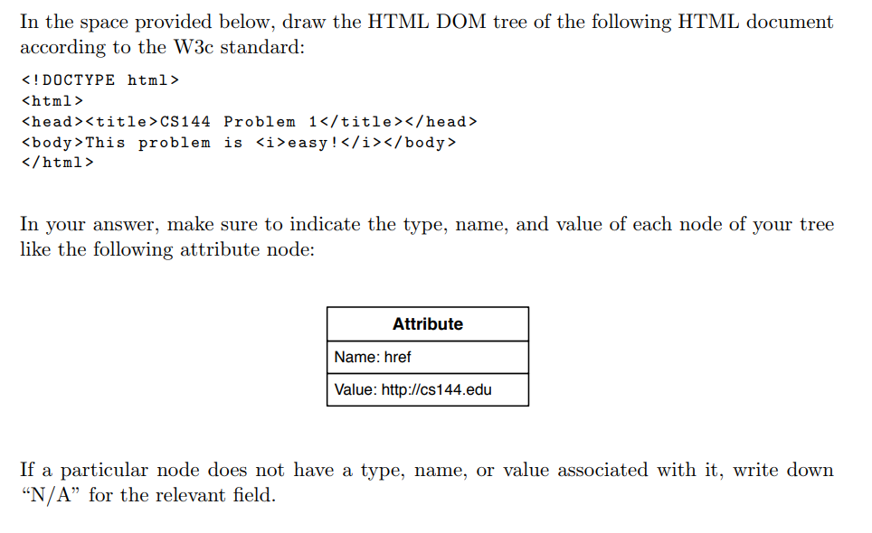
2017 Final: Problem 1

Slide 31
2017 Final: Problem 1
DOM Tree
An HTML element on a page becomes an element node
Text inside an HTML element becomes a text node
As a child of the element node
An attribute of an HTML element becomes an attribute node
associated with the element node, but is not a child node
nodeType: element, attribute, text, comment . . .
nodeName:
Element and attribute nodes: tag and attribute names
Text nodes: text
nodeValue:
Text and comment nodes: inside text
Attribute nodes: attribute value
null otherwise

Slide 32
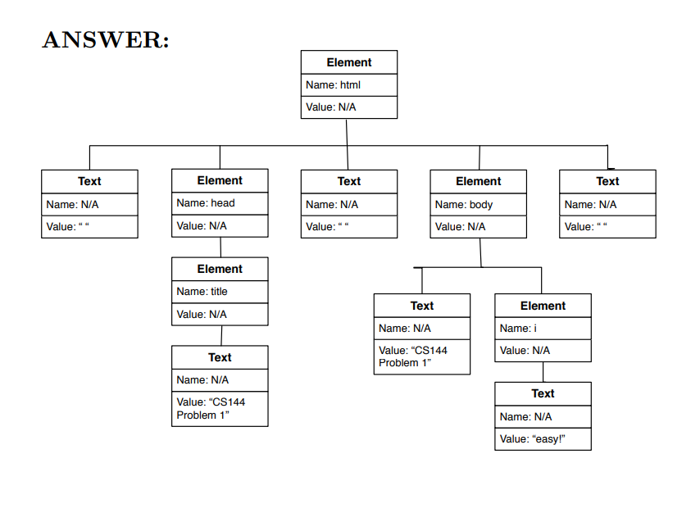
2017 Final: Problem 1

Slide 33
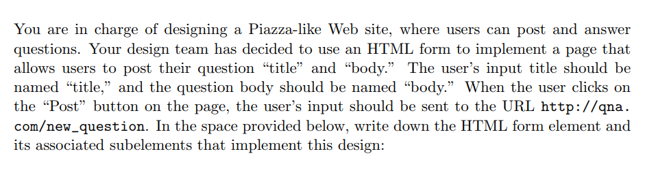
2017 Final: Problem 2
HTML Forms
Action
Method
<input type=“” value=“” name=“” />

Slide 34
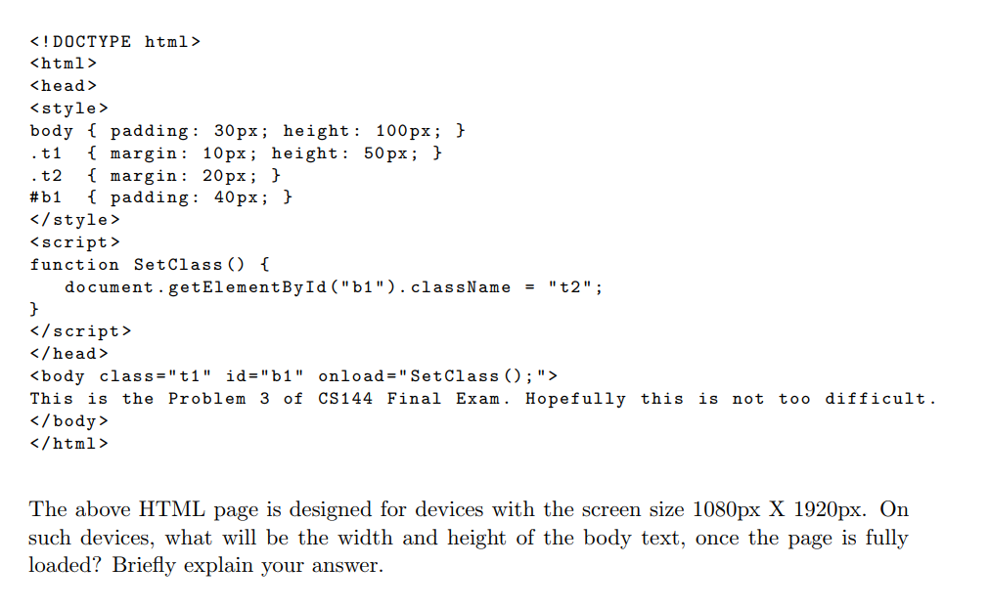
2017 Final: Problem 3

Slide 35
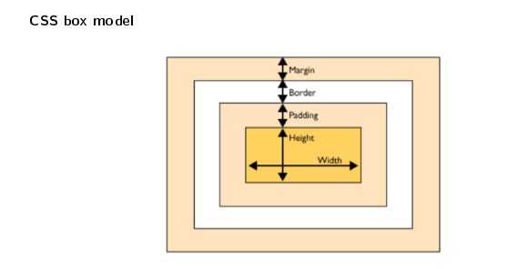
2017 Final: Problem 3
Once the page is fully loaded, the body has class ‘‘t2’’ and id ‘‘b1’’. Therefore, the body’s padding is 40px, margin is 20px and height is 100px, which means that its width is 1080 − (40 × 2 + 20 × 2) = 960px and its height is 100px.

Slide 36
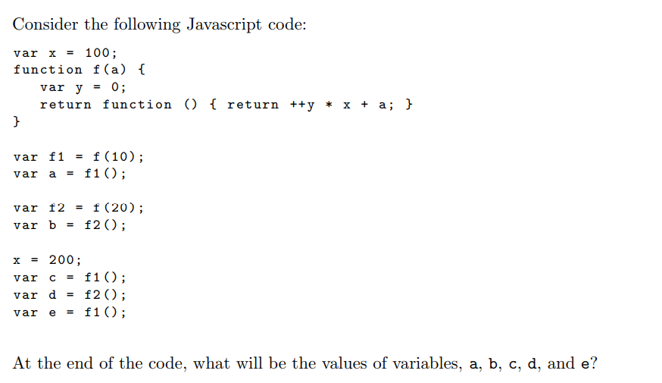
2017 Final: Problem 5
a: 110, b: 120, c: 410, d: 420, e: 610

Slide 37
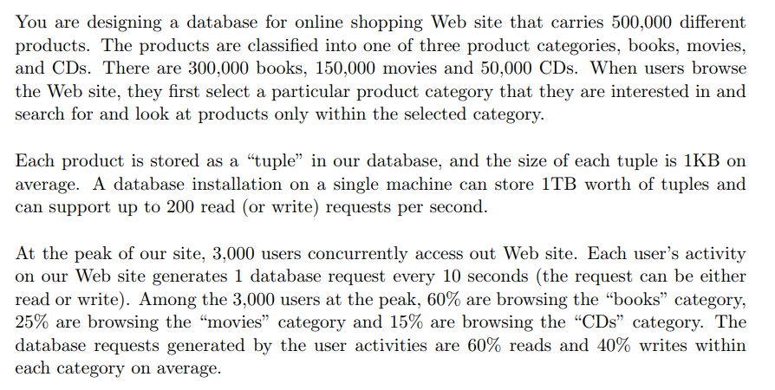
2017 Final: Problem 6

Slide 38
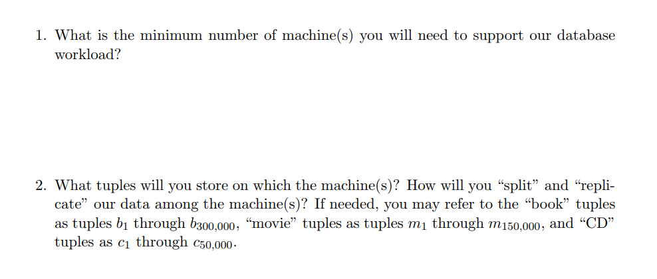
2017 Final: Problem 6
Notes:
Our workload is 300 requests/sec. Each machine can handle 200 requests/sec.
On one machine, we will store all tuples for books. On the other machine, we store all tuples for movies and CDs.

