Slide 1
Scalability and Map Reduce Programming
CS 144 Web Application
TA: Jin Wang
03/02/2018

Slide 2
Overview
Review of foundations about scalability
The Hadoop platform
Map Reduce Programming

Slide 3
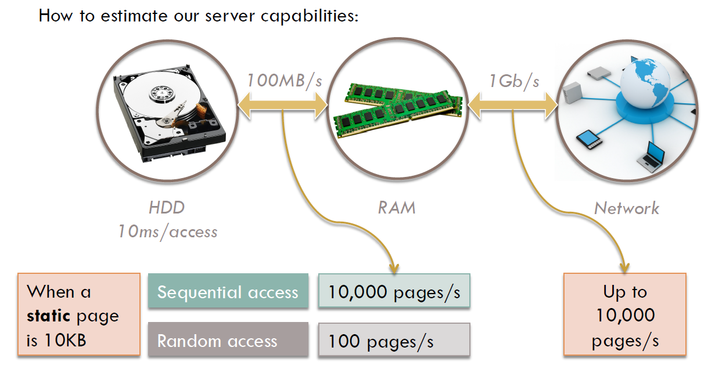
Scalability

Slide 4
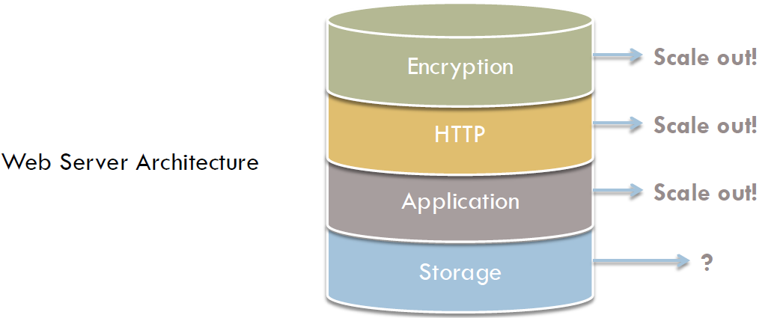
Scaling Web Applications
Scale out
Scale up

Slide 5
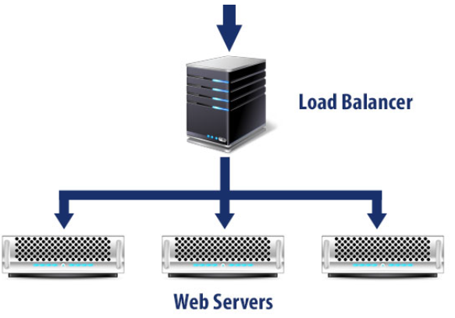
Scaling Web Applications
The Load Balancer
TCP-NAT Request Distributor:
DNS Round Robin, or software
In our projects, Apache Tomcat is both in the application and HTTP layers.

Slide 6
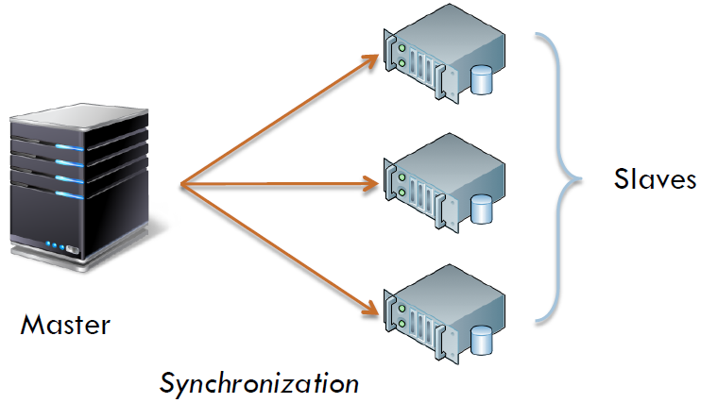
Scaling the Storage Layer
Scenario 1: Read Only
Information doesn’t change. Clients only read data.
Use replication

Slide 7
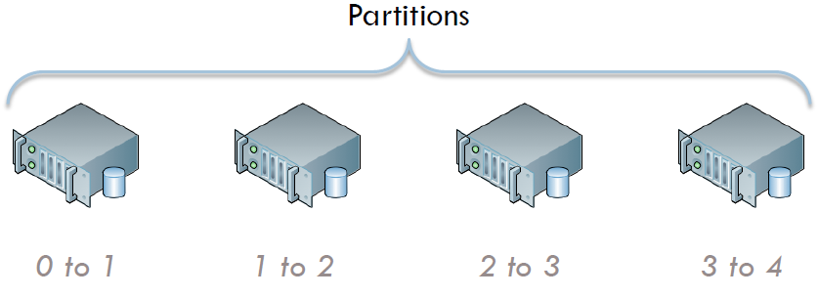
Scaling the Storage Layer
Scenario 2: Local Read/Write
Reads and writes are scoped to individual users
Use shard or partitioning

Slide 8
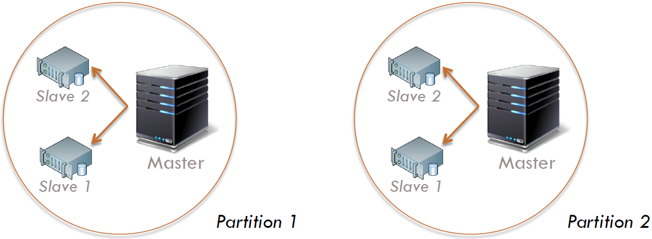
Scaling the Storage Layer
Scenario 3: Global Read/Write
Reads and writes are global, and all users can see everyone updates
Use partitioning and replication

Slide 9
Introduction to Hadoop
Download from hadoop.apache.org
To install locally, unzip and set JAVA_HOME
Docs: hadoop.apache.org/common/docs/current
Three ways to write jobs:
Java API
Hadoop Streaming (for Python, Perl, etc)
Pipes API (C++)
Note: The following slides are borrowed from Prof. Tyson Condie
Notes:
Mention local mode and pseudo-distributed mode

Slide 10
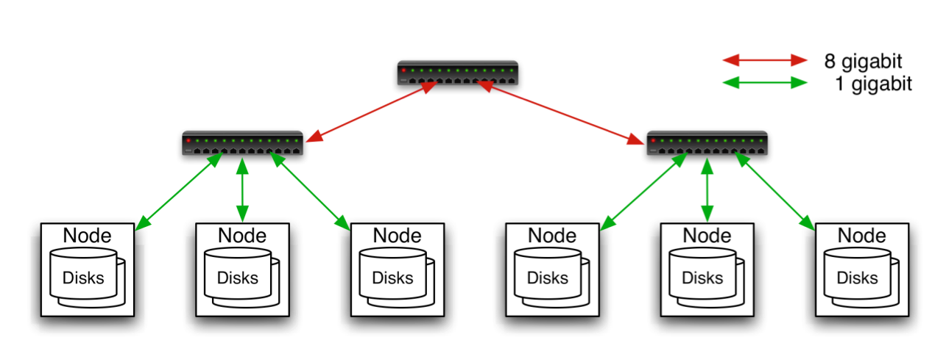
Typical Hadoop Cluster
Aggregation switch
Rack switch
40 nodes/rack, 1000-4000 nodes in cluster
1 Gbps bandwidth in rack, 8 Gbps out of rack
Node specs (Facebook): 8-16 cores, 32 GB RAM, 8×1.5 TB disks, no RAID

Slide 11

Typical Hadoop Cluster

Slide 12
Hadoop Components
Distributed file system (HDFS)
Single namespace for entire cluster
Replicates data 3x for fault-tolerance
MapReduce framework
Runs jobs submitted by users
Manages work distribution & fault-tolerance
Colocated with file system

Slide 13

Hadoop Distributed File System (HDFS)
Files split into 128MB blocks
Blocks replicated across several datanodes (often 3)
Namenode stores metadata (file names, locations, etc)
Optimized for large files, sequential reads
Files are append-only
Namenode
File1
1
2
3
4
1
2
1
3
2
1
4
2
4
3
3
4
Datanodes

Slide 14
What is MapReduce?
Programming model for data-intensive computing on commodity clusters
Pioneered by Google
Processes 20 PB of data per day
Popularized by Apache Hadoop project
Used by Facebook, Amazon, …

Slide 15
What is MapReduce Used For?
At Google:
Originally: Index building for Google Search
Article clustering for Google News
Statistical machine translation
At Facebook:
Data mining
Ad optimization
Spam detection

Slide 16
MapReduce Programming Model
Data type: key-value records
Map function:
(K_{in} , V_{in}) ➔ list(K_{inter} , V_{inter})
Reduce function:
(K_{inter} , list(V_{inter})) ➔ list(K_{out} , V_{out})

Slide 17
Example: Word Count
def mapper(line):
foreach word in line.split():
output(word, 1)
def reducer(key, values):
output(key, sum(values))

Slide 18
Word Count Execution
Input
Map
Shuffle & Sort
Reduce
Output
the, 1
brown, 1
fox, 1
the quick
brown fox
brown, 2
fox, 2
how, 1
now, 1
the, 3
Map
Reduce
the, 1
fox, 1
the, 1
the fox ate the mouse
Map
quick, 1
how, 1
now, 1
brown, 1
ate, 1
cow, 1
mouse, 1
quick, 1
ate, 1
mouse, 1
Reduce
how now
brown cow
Map
cow, 1

Slide 19
An Optimization: The Combiner
Local reduce function for repeated keys produced by same map
For associative ops. like sum, count, max
Decreases amount of intermediate data
Example: local counting for Word Count:
def combiner(key, values):
output(key, sum(values))

Slide 20
Word Count with Combiner
Input
Map
Shuffle & Sort
Reduce
Output
the, 1
brown, 1
fox, 1
the quick
brown fox
brown, 2
fox, 2
how, 1
now, 1
the, 3
Map
Reduce
the, 2
fox, 1
the fox ate the mouse
Map
quick, 1
how, 1
now, 1
brown, 1
ate, 1
cow, 1
mouse, 1
quick, 1
ate, 1
mouse, 1
Reduce
how now
brown cow
Map
cow, 1

Slide 21
MapReduce Execution Details
Mappers preferentially scheduled on same node or same rack as their input block
Minimize network use to improve performance
Mappers save outputs to local disk before serving to reducers
Allows recovery if a reducer crashes
Allows running more reducers than # of nodes

Slide 22
Examples of Map Reduce Programming

Slide 23
1. Search
Input: (lineNumber, line) records, a given pattern
Output: lines matching the pattern
Map: if(line matches pattern): output(line)
Reduce: identity function
Alternative: no reducer (map-only job)

Slide 24
2. Sort
Input: (key, value) records
Output: same records, sorted by key
Map: identity function
Reduce: identify function
Trick: Pick partitioning function p such that k₁ < k₂ => p(k₁) < p(k₂)
Map
ant, bee
Reduce
[A-M]
zebra
Aardvark
ant
bee
cow
elephant
cow
Map
pig
Reduce
[N-Z]
aardvark,
elephant
pig
sheep
yak
zebra
Map
sheep, yak

Slide 25
3. Inverted Index
Input: (filename, text) records
Output: list of files containing each word
Map: foreach word in text.split(): output(word, filename)
Combine: uniquify filenames for each word
Reduce: def reduce(word, filenames): output(word, sort(filenames))

Slide 26
Inverted Index Example
hamlet.txt
to, hamlet.txt
be, hamlet.txt
or, hamlet.txt
not, hamlet.txt
to be or not to be
afraid, (12th.txt)
be, (12th.txt, hamlet.txt)
greatness, (12th.txt)
not, (12th.txt, hamlet.txt)
of, (12th.txt)
or, (hamlet.txt)
to, (hamlet.txt)
12th.txt
be, 12th.txt
not, 12th.txt
afraid, 12th.txt
of, 12th.txt
greatness, 12th.txt
be not afraid of greatness

Slide 27
4. Most Popular Words
Input: (filename, text) records
Output: the 100 words occurring in most files
Two-stage solution:
Job 1:
Create inverted index, giving (word, list(file)) records
Job 2:
Map each (word, list(file)) to (count, word)
Sort these records by count as in sort job

Slide 28
5. Numerical Integration
Input: (start, end) records for sub-ranges to integrate
Can implement using custom InputFormat
Output: integral of f(x) over entire range
Map: def map(start, end): sum = 0 for(x = start; x < end; x += step): sum += f(x) * step output(“”, sum)
Reduce: def reduce(key, values): output(key, sum(values))

Slide 29
Hints for Map Reduce Programming
Decide the way to partition the original data
Avoid skewness
Try to reduce the workload of network transmission

