Slide 1

Introduction to Git

Slide 2
Introduction to Version Control Systems
Git Fundamentals
Branching
Merging
Collaborating
Common Workflows
Git and Ansible and Kubernetes(k8)
Advanced Topics
Hands on Exercises

Slide 3
Version Control Systems

Slide 4

Why Do We Care About Version Control Systems
Enables all modern practices (Infrastructure as Code, CI/CD, 12 factor, k8)
Revert production changes quickly (think outages)
Creates reusable code instead of reinventing the wheel
Provides a method for reverting to a prior state
Tracked Changes (Who, What, When, Where, Why)
Single Source of Truth
High Availability and Disaster Recovery

Slide 5
TL;DR
The 10 most important commands to know:
git clone - make a local copy of a remote repository
git add - adds a file to your local repository
git checkout - checks out a branch (“git checkout -b” creates a new branch)
git commit - does a local commit of changes so you can push them to remote
git push - pushes commit to remote repository
git merge - merges a branch into another (usually used to merge into main/master)
git stash - saves changes without a commit and reverts to last commit state
git log - shows log of commits (“git log --oneline --graph” makes it human readable)
git rebase - moves entire feature branch to begin on the tip of main/master branch
git diff - shows differences between branches

Slide 6
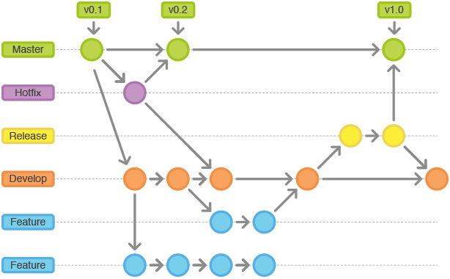
Why Version Control Systems
Management of changes to resources so they can be recalled at a later point
Records what changed and who changed them
Enables multiple individuals the opportunity to collaborate
Provides a method for reverting to a prior state
Makes code reusable
Standard for all code storage for Automation,
Kubernetes and Infrastructure as Code

Slide 7

Types of Version Control Systems
Centralized Version Control
Single copy of the project hosted on a central server
Changes are made (“Committed”) against the server
Server contains full project
End user never has a full copy of the project
  Only downloads what is needed
Common VCS types:
  CVS
  Subversion
  Perforce

Slide 8

Types of Version Control Systems
Distributed Version Control
No reliance on a centralized server
Each user has the full copy of the entire project
Changes are made locally
  No network dependencies
Users can exchange changes directly with others
  Most common approach is to use an agreed upon location the each member can reference
Common types:
  Git
  Mercurial

Slide 9
Git
Created by Linus Torvalds (Yes…. the very same)
  Initial use case: Managing Linux Kernel
Written in C
Think of git as something that sits on top of the file system and manipulates files
Git is an Open Source Distributed Version Control System

Slide 10

Git
Git is a binary
Executable file (git)
Executable installed by:
    yum install git
    Direct download
      git-scm.com

Slide 11


Git
Git has online presence
Several popular online repository managers available
Provides a centralized git repository
Additional features found in many providers:
  Repository viewer
  Issue tracking
  Task management
  Wiki
Features provided by these services not core git functions

Slide 12
Git Fundamentals

Slide 13

Git Key Concepts
Repository
Data structure that stores the configuration of files that change over time
Collection of files and their history organized in branches, tags, etc
Can be either local or remote
To work with Git, a repository must exist somewhere
New repositories are empty by default
Creating a new repository
$ cd myproject
$ touch README
$ git init

Slide 14

Git Key Concepts
Setting the Stage
Those with prior VCS experience may have knowledge of committing, but not staging
In Git, we are constantly dealing with changes to files and we only care about the lines that changed
Untracked
Staged
Committed

Slide 15

Git Key Concepts
Commit
Fundamental concept behind git
A commit is just a node in a tree
Represents a snapshot in time
Node contains:
  a Hash of the commit -- a UUID
  the Author
  a Date and time
  the commit Message
  the diff of changes
$ git add README.md
$ git commit -m “Added README”

Slide 16
Git Key Concepts
Viewing a Commit
git log - Command for viewing commits
$ git log
commit 09b129280c2b16c4d926d9b23a1ef544e8470936
Author: John Doe <jdoe@exxonmobil.com>
Date: Wed Sep 12 18:03:08 2018 -0600
created README
H
A
D
M

Slide 17
Git Key Concepts
Making More Commits
C0
C1
C2
make changes
git add [files]
git commit
make changes
git add [files]
git commit

Slide 18
Branching and Merging

Slide 19
Branching and Merging
Branches
Lightweight movable pointer on a commit
Branching model is one of the best capabilities of git
In Git, you are always working on a branch
  main is the default branch (typically long-term stable)
  Each branch is given a name
Only one branch can be active at a given time
  Signified by HEAD
Allows for features to be created
C0
C1
C3
C2
C4
main
feature

Slide 20
Branching and Merging
Branch Operations
Commands for managing branches
git branch - List branches
git branch <branch name> - Creates a new branch
git checkout <branch name> - Switches to new branch
C1
C2
main
C0
C3
C4
HEAD
feature
Notes:
The HEAD points out the last commit in the current checkout branch. It is like a pointer to any reference. The HEAD can be understood as the "current branch." When you switch branches with 'checkout,' the HEAD is transferred to the new branch.

Slide 21
Branching and Merging
C0
Merging
Integrates all commits from a specific branch into the current branch (HEAD)
git merge command
M5 is a merge commit
C1
C3
# Checkout main branch
$ git checkout main
# Merge feature branch into main branch
$ git merge feature
C2
C4
M5
HEAD
main

Slide 22
Collaborating
Showcasing the true power of Distributed Version Control Systems(DVCS)

Slide 23
Collaborating
Remotes
Enables sharing code with other locations
Versions of the project hosted on the internet or somewhere else
Enabled through the git remote command
origin is the name given to the default remote by convention
remote
origin
# Adding a remote
$ git remote add origin git@github.com:ansible/ansible.git
local

Slide 24
Collaborating
Pushing
Upload code from local repository to remote repository
Merge local changes into the remote branch
An existing remote must be defined
In our case
  remote is origin
  branch is main
main
origin
remote server
$ git push <remote> <branch>
local
main

Slide 25
Collaborating
Local
Remote
Fetching
Retrieve changes from remote repositories
Brings in changes from other contributors
Changes are retrieved, but does not modify local workspace
Creates new branch locally (<remote>/<branch>)
Afterward, a merge needs to occur to integrate
Single branch of all branches can be retrieved
C0
C0
C1
C1
main
$ git fetch <remote> <branch>
origin/main
C2
fetch
main

Slide 26
Collaborating
Local
Remote
Pulling
Streamlined method of retrieving changes from remote repositories
Performs a fetch and merge
C0
C0
C1
C1
$ git pull <remote> <branch>
main
origin/main
C2
fetch+merge
main

Slide 27

Collaborating
Cloning
Retrieves a full copy of a remote repository
Unlike other VCS tools, the entire content is retrieved
$ git clone <url>

Slide 28
Workshop 1 Clone, Commit, Push, Merge
[AzureDevOps] https://redhat-adsa.github.io/GitWorkshop/ado/02-advanced.html
[Bitbucket] https://redhat-adsa.github.io/GitWorkshop/bitbucket/02-advanced.html
[Github] https://redhat-adsa.github.io/GitWorkshop/github/02-advanced.html
[Gitlab] https://redhat-adsa.github.io/GitWorkshop/gitlab/02-advanced.html

Slide 29
Git Workflows

Slide 30

Git Workflows
Workflows in Git are guidelines and not structured rules

Slide 31
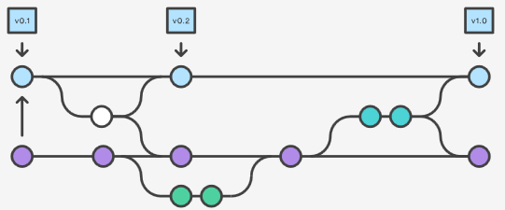
Git Workflows
Types of Workflows
Methods for working and collaborating with git
Basic/Centralized
Feature Branch
Pull/Fork
Plus several others:
Martin Fowler Blog

Slide 32
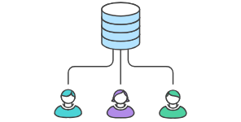
Git Workflows
Basic/Centralized Workflow
Simplified method where all changes are made against the same branch
Similar structure as a Subversion repository
All changes made against the main branch
  SVN equivalent to trunk
Ideal for small teams

Slide 33
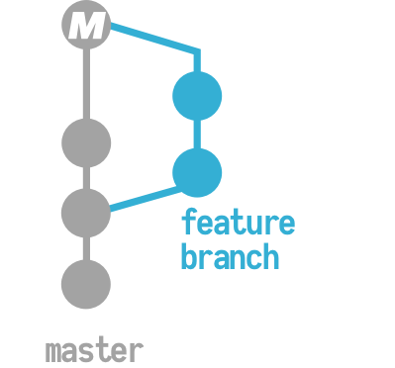
Git Workflows
Feature Branch
Separate branches created for each enhancement
main branch represent stable state of repository
Each developer works on their own separate feature
Features can be shared without disrupting main
Code review through pull request mechanism prior to integration
Main

Slide 34

Git Workflows
Pull/Fork
Each developer has their own copy (fork) of the repository that they work on
No centralized repository for pushing changes
Only project maintainers have access to push to official repository
Maintainers accept changes from contributors to official repository
  Pull/Merge request
Embraces security and distributed nature of Git
This is a common type in GitLab and GitHub based repositories

Slide 35
Advanced Git

Slide 36
Pull/Merge Requests
This is how most modern development collaborates on code.
Fork code to your own namespace
  Update code and commit back to your branch
  Perform a pull request to the upstream repository
Links to each type of repository server documentation on how to do a PR:
Azure Devops
Bitbucket
Github
Gitlab

Slide 37
Pull/Merge Requests
This is how most modern development collaborates on code.
Fork code to your own namespace
  Update code and commit back to your branch
  Perform a pull request to the upstream repository
Links to each type of repository server documentation on how to do a PR:
Azure Devops
Bitbucket
Github
Gitlab

Slide 38
Workshop 2 PR, Rebase, Rest, Diff, Stash
[AzureDevOps] https://redhat-adsa.github.io/GitWorkshop/ado/02-advanced.html
[Bitbucket] https://redhat-adsa.github.io/GitWorkshop/bitbucket/02-advanced.html
[Github] https://redhat-adsa.github.io/GitWorkshop/github/02-advanced.html
[Gitlab] https://redhat-adsa.github.io/GitWorkshop/gitlab/02-advanced.html

Slide 39
Git Ansible and K8

Slide 40
Git and Ansible
Branches by Environment
Each branch within a repository represents a deployment environment
Branches such as dev, test, prod in addition to main
main branch is starting point. Changes are promoted to upper level environments
  Bug fixes can be made against each branch as necessary
Extends concepts emphasized by multiple git workflows
  Feature branch
  Pull/Fork
Example: Ansible Tower projects created per branch. Job templates target each project

Slide 41
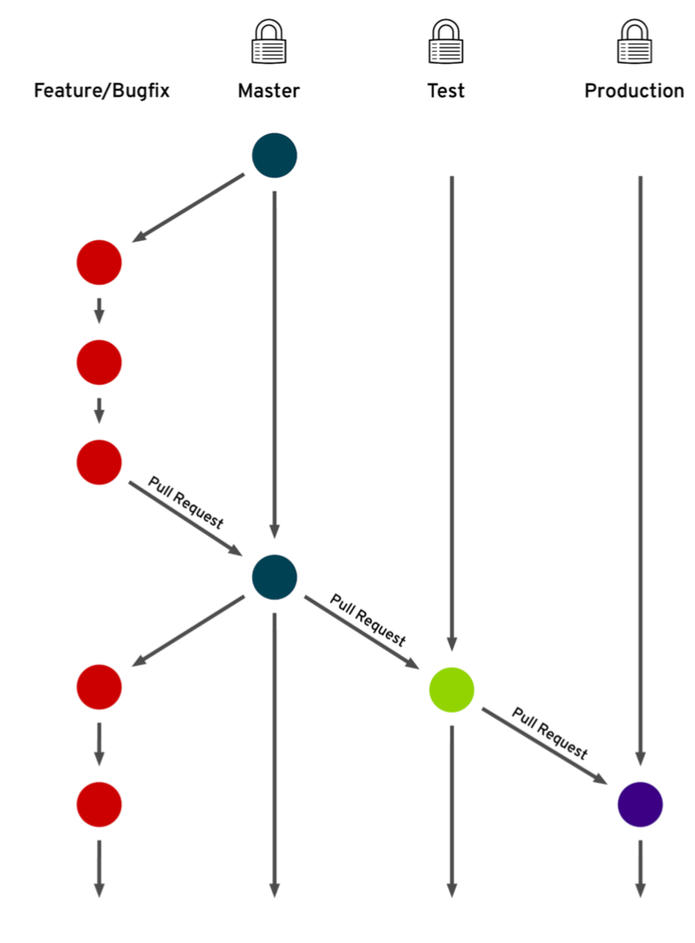
Git Ansible and k8
Branches by Environment
Now Main

Slide 42
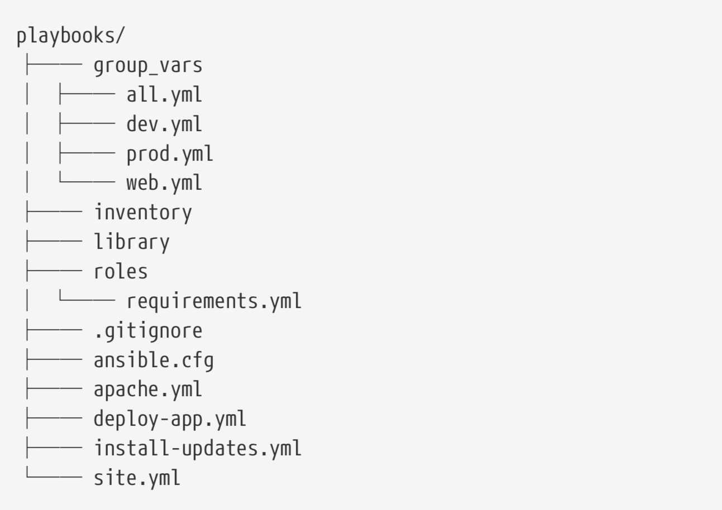
Git and Ansible
Typical Repository Structure

Slide 43
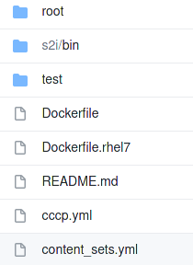
Git and Kubernetes
Typical S2I (source to image) Repository Structure

