Slide 1
GitOps Service: Creation Workflow

Slide 2
High-level Overview
Users communicate their intent to the GitOps Service by creating GitOpsDeployment resources in their namespace. The GitOpsDeployment resource tells us (the GitOps Service) which Git repository (example) contains K8s resources to deploy (source resources), and which K8s cluster to deploy those resources to (destination cluster).
Every GitOpsDeployment that exists needs to have a corresponding Argo CD Application resource, because Argo CD is responsible for the actual deploying (reading from Git and writing to K8s cluster).
The GitOps Service is responsible for creating the Argo CD Application resource, for each corresponding GitOpsDeployment resource. 1-1 relationship between the two.
Thus, this entire document can be summed up as follows:
When a GitOpsDeployment resource is created by a user, the GitOps Service need to create an equivalent Argo CD Application resource.
Everything else in the document is just about the steps to achieve the above goal.

Slide 3
For More Detailed Information
For more detailed information about what is described in this document:
Event handling in GitOps Service Backend
Resource Synchronization with Operations
And other sections in that document as well, which touch on other aspects of the interactions.

Slide 4

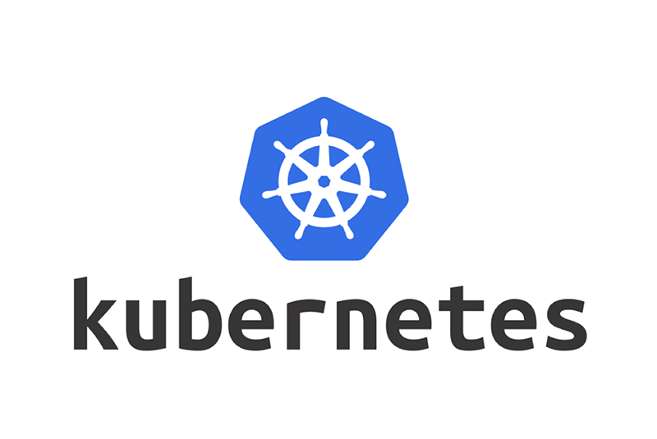

High-level Component Overview
PostgreSQL DB
Backend component
Cluster-agent component
Argo CD
User creates GitOpsDeployment resource in namespace
Backend component sees that and creates Application row in the database.
Cluster-agent sees that row, and creates Argo CD Application resource on the same cluster as Argo CD.
Argo CD sees that Application resource and reconciles it, deploying the Kubernetes resource in Git repository to the target cluster.
For more detailed information, see How Truth Flows in the GitOps Service

Slide 5
Diagram Format
GitOpsDeployment CR
Light-blue background: Resources in a Kubernetes namespace (on a KCP workspace).
Application Row
Dark-blue background: Rows in a PostgreSQL database.

Slide 6
Diagram Format
GitOpsDeployment CR
For each step, the resource that has a yellow border is the one that is created during that step.
So for each step, look for a yellow border to find the resource that is being acted on during the step.
For each step, the coloured arrow indicates which data is used to create a new option. So for A → B, data from object A is used to construct object B.

Slide 7
Namespace on KCP Workspace
(handled by backend component)
PostgreSQL DB:
GitOpsDeployment CR
Namespace on Argo CD Cluster
(handled by cluster-agent component)
Step 1: User creates an API resource
User (or another AppStudio service) creates a GitOpsDeployment resource in the user’s namespace.

Slide 8
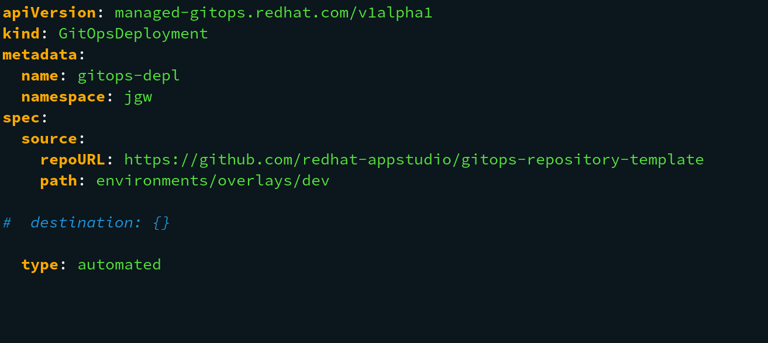
GitOpsDeployment resource
Step 1: continued
The user intent for this resource is:
I want to deploy the contents of the redhat-appstudio/gitops-repository-template Git repository, specifically the Kubernetes resources under ‘environments/overlays/dev’, into my namespace.
The contents of the GitOpsDeployment resource describes:
source: the Git repository they want to deploy Kubernetes resources from
destination: The Kubernetes cluster/namespace they want to deploy to (in this case, the field is empty because we want to deploy to the same cluster/namespace as the GitOpsDeployment resource: jgw)
type: if ‘automated’, then any changes to the Git repository will automatically be applied to the Kubernetes cluster. Otherwise ‘manual’.

Slide 9
Namespace on KCP Workspace
(handled by backend component)
PostgreSQL DB:
GitOpsDeployment CR
Application Row
Namespace on Argo CD Cluster
(handled by cluster-agent component)
Step 2: Application database entry is created, based on contents of the GitOpsDeployment
The backend component of the GitOps Service creates an Application row in the database, corresponding to the contents of the GitOps deployment.

Slide 10
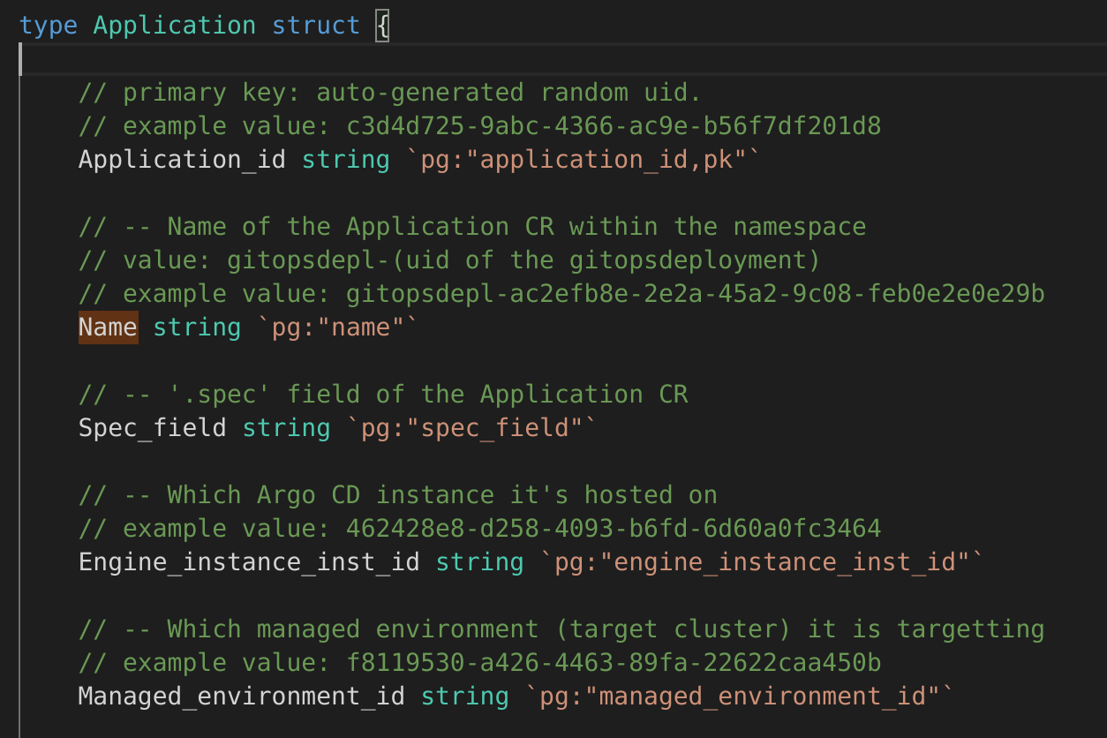
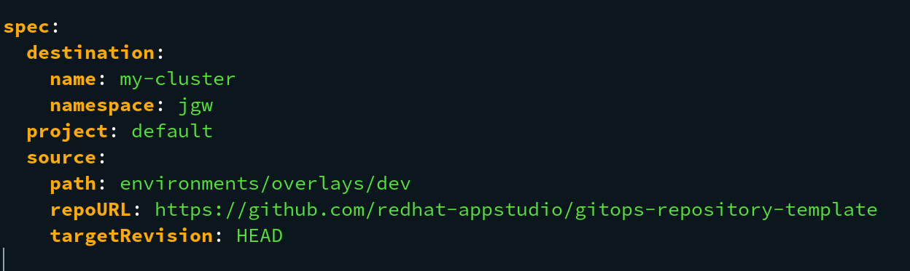
Application row
Application database row:
GitOpsDeployment resource:
Step 2: continued
The contents of the GitOpsDeployment resource are copied into the Application row.
You can see how the ‘spec’ field of the GitOpsDeployment resource is copied (with some minor tweaks) into the spec_field value of the Application row
Spec_field contents of Application database row:

Slide 11
Namespace on KCP Workspace
(handled by backend component)
PostgreSQL DB:`
GitOpsDeployment CR
Application Row
DeploymentToApplicationMapping
Row
Namespace on Argo CD Cluster
(handled by cluster-agent component)
Step 3: DeploymentToApplicationMapping is created, linking the GitOpsDeployment to the Application (and vice versa)
We need a way to keep track of which Application rows in the database correspond to which GitOpsDeployment resource in the Kubernetes namespace.
This is what the DeploymentToApplicationMapping row is for. It has two values: the name/namespace/UID of the GitOpsDeploment, and the primary key of the application.

Slide 12
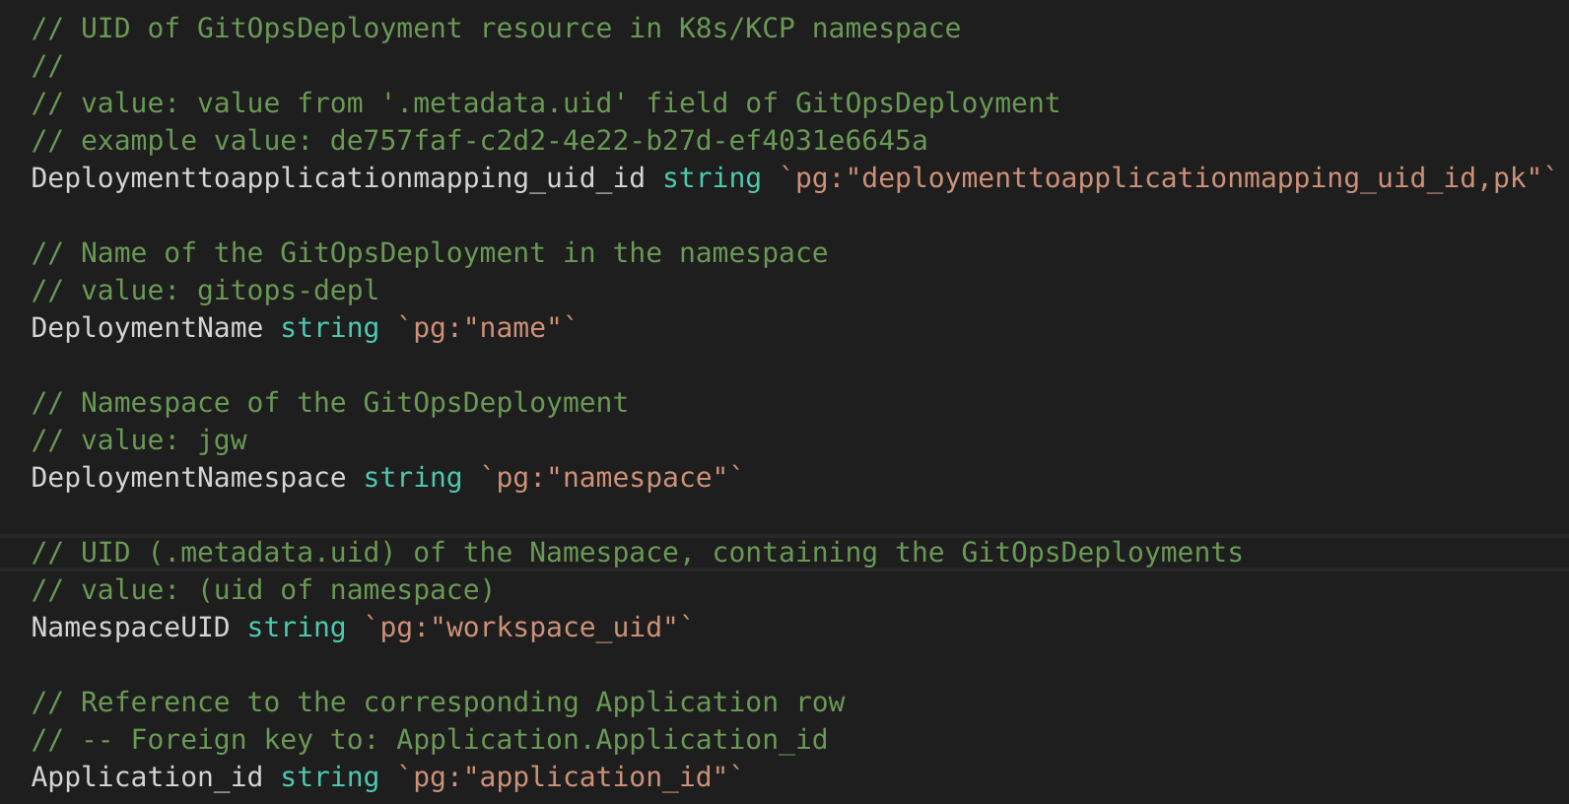
DeploymentToApplicationMapping row
Application database row:
GitOpsDeployment resource:
Namespace that contains the GitOpsDeployment resource
Step 3: continued
The DeploymentToApplicationMapping row maintains the 1-1 relationship between GitOpsDeployment K8s resource, and Application database row.
More information on the purpose of the mapping is here.

Slide 13
Namespace on KCP Workspace
(handled by backend component)
PostgreSQL DB:
GitOpsDeployment CR
Application Row
Operation
Row
DeploymentToApplicationMapping
Row
Namespace on Argo CD Cluster
(handled by cluster-agent component)
Step 4: Operation row is created, pointing to the Application.
The goal of the Operation is to inform the cluster-agent component that a user has created a new GitOpsDeployment resource, so that the cluster-agent (which is responsible for configuring Argo CD) can configure Argo CD, creating a new Argo CD Application resource that corresponds to the GitOpsDeployment resource.

Slide 14
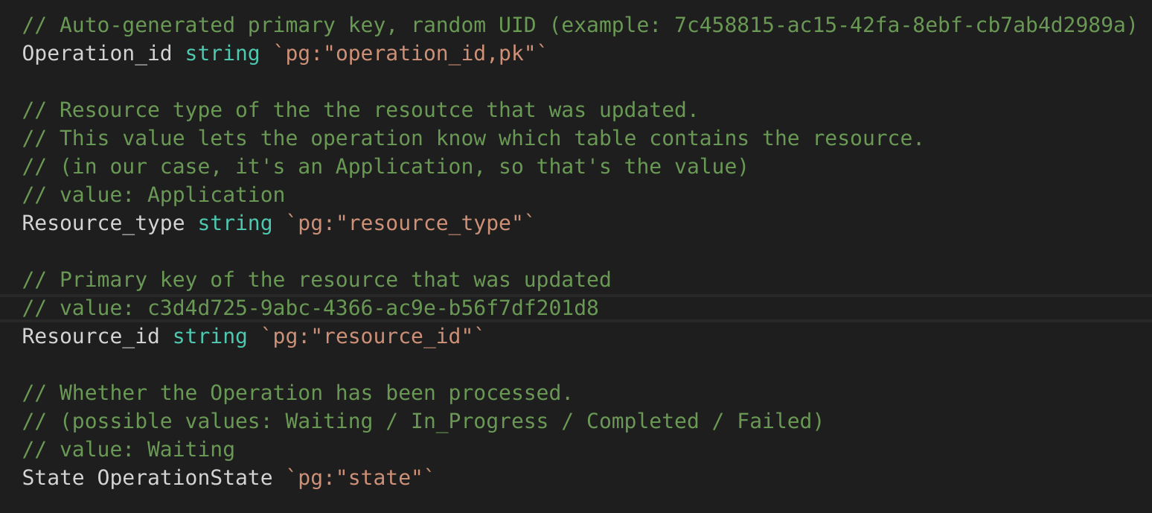
Operation row
Application database row:
Operation database row:
Step 4: continue - Operation row says ‘FYI cluster-agent: the Application row has been changed by the user in the DB’
The goal of the Operation row is to notify the cluster-agent component that a row in the database has changed. Therefore the Operation row needs to references the Application (which is the row in the database that has changed).
In this case, the Application row has changed, so the Operation row contains the resource_type of ‘Application’, and the resource_id is the primary key of the Application row.

Slide 15
Namespace on KCP Workspace
(handled by backend component)
PostgreSQL DB:
GitOpsDeployment CR
Application Row
Operation
Row
DeploymentToApplicationMapping
Row
Namespace on Argo CD Cluster
(handled by cluster-agent component)
Operation CR
5) Operation resource is created on the Argo CD cluster, pointing to the Operation.
Our overall goal for the next few steps is to ensure that an Argo CD Application resource is created, that corresponds to the Application row.
But first we need to inform the cluster-agent component (responsible for creating Argo CD Application resource) that a change has been made. We do that by creating an Operation resource, which the cluster-agent watches for.

Slide 16
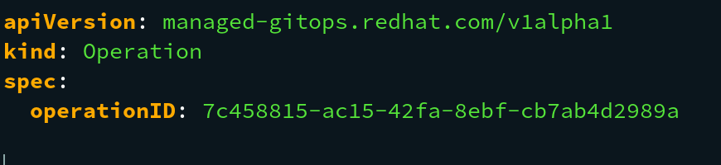
Operation resource on Argo CD Cluster
Operation database row:
Step 5: continued
The goal of the Operation resource is to notify the cluster-agent component that an Operation row has been created in the database.
Thus, the Operation resource is very simple: it just contains a reference to the primary key of the Operation row in the database.

Slide 17
Namespace on KCP Workspace
(handled by backend component)
PostgreSQL DB:
GitOpsDeployment CR
Application Row
Operation
Row
DeploymentToApplicationMapping
Row
Namespace on Argo CD Cluster
(handled by cluster-agent component)
Step 6: Argo CD Application Resource is created, based on the contents of the Application row.
The cluster-agent component (the Operation controller) is watching for the Operation resource that was created as part of the previous step.
It sees that, and retrieves the corresponding Operation row in the database.
The Operation row points to the Application row in the database.
The cluster-agent creates an Argo CD Application resource based on the contents of the Application row.
Operation CR
Application CR

Slide 18
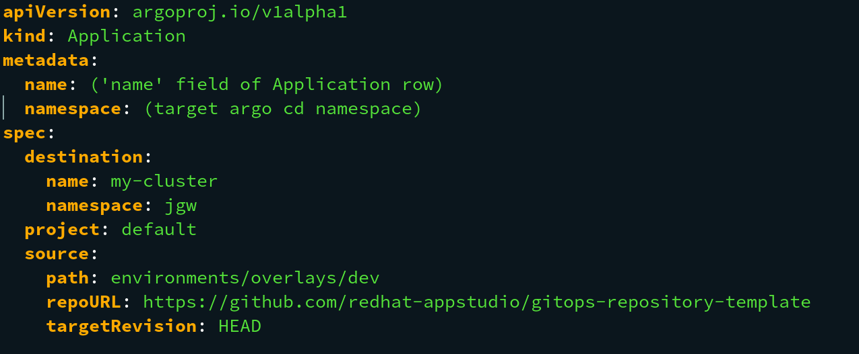
Cluster Agent creates Argo CD Application resource
Argo CD Application resource, created:
Application database row, spec field:
Step 6: continued
The cluster-agent component is informed that the Application row in the database has changed.
Whenever the database changes, it is necessary to make a corresponding change to Argo CD on the cluster that Argo CD lives on.
In this case, since the Application row was created, the cluster-agent knows how to turn that Application row into an Argo CD Application resource:
The Argo CD Application resource is created based on spec_field of the Application row

Slide 19
Backup Slides

Slide 20
Namespace on KCP Workspace
(handled by backend component)
PostgreSQL DB:
GitOpsDeployment CR
Application Row
Operation
Row
DeploymentToApplicationMapping
Row
Namespace on Argo CD Cluster
(handled by cluster-agent component)
Operation CR
Step X: Title
Description
Application CR

