Slide 1


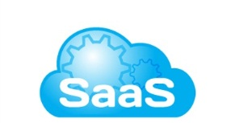




DESIRED SOLUTION - REALTIME DATA INTEGRATION
Data as a Service
Standard based interface
Contextual view of disparate source data
Single point of access / integration
Reuse of Data
But you cannot achieve this by writing more application code…
JDBC Request
JDBC Request
JBoss BPM BAM Reports
Analytical Applications
Enterprise Integration / SOA
JBoss BPM Process Applications
Mobile Applications
JBoss Data Virtualization
Query Results
REST Message
SQL Statement
SOAP Message
Data Sources
Siloed & Complex
Hadoop
NoSQL
Cloud Apps
Data Warehouse
& Databases
Mainframe
XML, CSV
& Excel Files
Enterprise Apps
Notes:
This approach has some key advantages, including:
Enabling reuse – using services, not copying code or implementations
• Published interfaces – the service is made available and its interface is explicitly and precisely described
• Formal definitions – the provider and consumer understand and accept the rules of interaction
• Enforcing abstraction – all aspects of the service implementation are hidden
• Functional relevance – functionality can be presented at a granularity that is appropriate and useful
for the consumer
Those advantages give companies increased agility to cope with changing business needs and requirements.
I just want to clarify that we are not advocating a single or unified canonical model, as we think it is impractical even if it may be philosophically ideal. A balance must be struck between a) data duplication across services so each has an independent, self-controlled data set, and b) a single canonical model that every data service must adhere to. The problem with a) is data copies, data movement, security and need for later reconciliation. The problem with b) is the canonical model is unlikely to serve the needs of a wide range of data services which leads to growing the model to account for all consumers or forcing service developer to deal with a sub-optimal data representation for their needs.
We are actually focused on easy to consume standard based interfaces support, data abstraction and breaking the tight coupling between services and physical data sources.

Slide 2
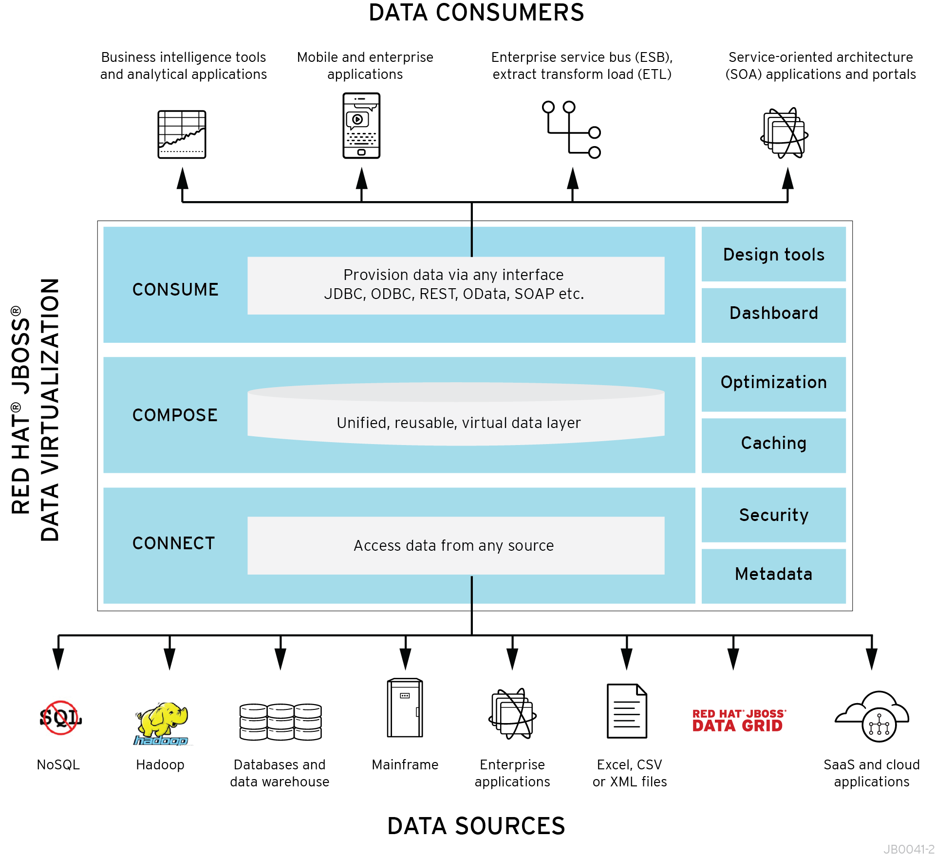
JBOSS DATA VIRTUALIZATION
DATA INTEGRATION & DATA AS A SERVICE SSOLUTION
Data Virtualization sits in front of multiple data sources and
allows them to be treated as a single source
delivering the desired data
in the required form
at the right time
to any application or user.
THINK VIRTUAL MACHINE FOR DATA

Slide 3
JBoss BPM Travel Agency
Single View of Bookings Processing
Unified 360* view use case
Situation / Needs:
  Management seeks visibility and control, while bookings operations needs to run smoothly through acquisition
  Bookings data now spread across multiple databases/systems
Solution:
  Consolidate all data into “virtual data mart”
  Transformation of data differences
  Provide real-time data access to management portal and travel bookings workflow system
Benefits:
  Management get timely information on bookings and operating metrics
  Travel agents receive all the information to process bookings faster
  Sensitive data preserved until acquisition integration
Management Reporting
Travel Booking Processing Workflow Mgmt.
JDBC
Web Services
and JDBC
JBoss Data Virtualization
Unified Views
1. Connect 2. Compose 3.Consume
SOAP Service
Micro Service
JDBC
Flight
Information
Booking
Information
Hotel
Information

