Slide 1
Azure Cosmos DB
Technical Deep Dive
Peter Lee
December 8, 2025

Slide 2



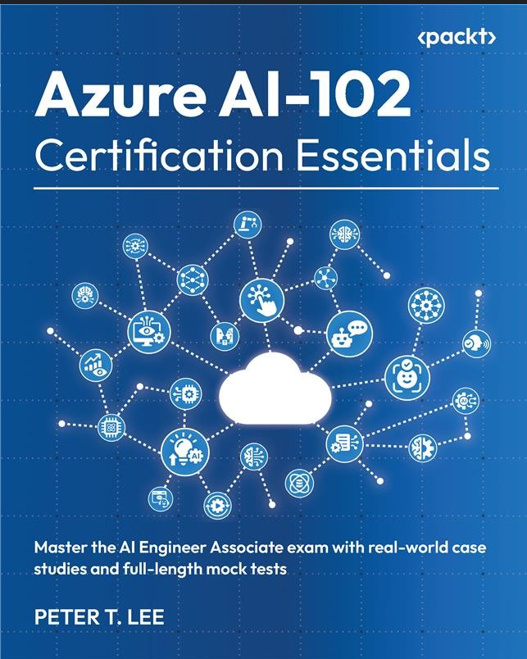

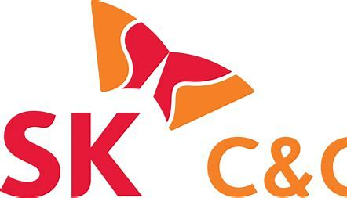







Who I am, Peter Lee – Sr. Cloud Solution Architect (AI/Data)
Fun facts:
Born in South Korea 🇰🇷, addicted to tennis 🎾, soccer ⚽, and golf ⛳. Also known to take long walks with my dog—he sets the pace, not me 🐶🚶‍♂️.
Released Aug 17, 2025
Personal Philosophy:
The past is a lesson, the present is a gift, and the future is full of opportunity..
Life is too short—enjoy the ride, try everything, and don’t be afraid to fail.

Slide 3


Azure Cosmos DB
Develop AI-powered apps and agents at any scale
Key differentiators
Schemaless Flexibility allows rapid iteration, and semi-structured data
206B daily transactions, 8PB
8x growth every 8 months
Chat history, memory, GPTs
Personalization, 50+ use cases
Fastest vector database with the lowest TCO, thanks to serverless, autoscale and industry leading DiskANN algorithm
Open AI transactions volume and physical partitions count
Billions
Thousands
Highly elastic with serverless
and instant autoscale options
Daily Transactions
Partitions
High resiliency and performance with SLA-backed <10 ms latency
and 99.999% availability
3
Notes:
To highlight our AI and scalability, OpenAI is one of our key customers.​
OpenAI runs ChatGPT on Cosmos storing chat history, memories and other workloads too.​
​
OpenAI picked Cosmos for a number of reasons:​
First, as a NoSQL database, OpenAI could evolve rapidly. Never needed to take ChatGPT down for database schema changes.​
Second, OpenAI had been running on an open source relational database prior to adopting Cosmos, struggled with having to manually manage sharding to keep growing.
Cosmos DB’s automatic partitioning allowed them to define their partitioning strategy and we took care of the rest allowing them to scale seamlessly
Once on Cosmos they grew to over 8PB in size and 200 billion TX a day. All on a single Cosmos database.​

Slide 4
Azure Cosmos DB
Develop AI-powered apps and agents at any scale
AI-ready
Mission-critical
scalable apps
Developer Productivity
Integrated Data Estate
Vector Search + DiskANN
Hybrid Search + Reranking
Serverless
Microsoft Agent Framework & LangGraph
Scale out
Partitioning
Fast (<10ms) @
any scale
5x 9’s High Availability
Flexible JSON Schema
Automatic Indexing
Dynamic Autoscale
Microsoft Fabric
Azure AppPlat
Microsoft Foundry
Notes:
If you’re not familiar with Azure Cosmos DB let me spend a moment going over what exactly it is.
Cosmos DB is Microsoft’s Distributed NoSQL database in Azure.​
Some of the key features and areas we invest in for Cosmos DB include:​
Native vector indexing and search using DiskANN developed by MS Research.
With DiskANN users can query billions of vectors for industry leading performance.
Full-text and hybrid search capabilities with reranking.​
Only database in Azure with serverless vector search, users can start small and pay only for what they use.
Deep integrations into the leading agentic frameworks including Microsoft’s Agent Framework and LangGraph.​
Cosmos is a scale out database. We don’t grow up, we grow out.
Provide automatic partitioning. Don’t have to manage shards.
We store data on-cluster that provided the lowest latency for any database in Azure <10ms, backed by SLA.
Combined with our scale-out, means you get that single-digit latency whether it’s 1MB or 1PB.
Native regional replication to every region in Azure gives 5-9s availability with active-active configuration for RTO=0.
As a JSON store, provide flexible schema-free design.
Evolve your schema as your app changes with zero downtime.
Automatically index data, including new data by default.
Dynamic autoscale, scale up and pay for only for the partitions and regions that scale.
Fully integrated across Microsoft including
Microsoft Fabric
Azure application platform services
Microsoft Foundry.
​

Slide 5




When is Azure Cosmos DB a good fit for a new app?
Should I use Azure Cosmos DB for my app?
YES
NO
Azure Cosmos DB is a good fit when apps need any of:
Azure Cosmos DB is a poor fit for:
A
B
D
Flexible Schema
for Iterative Development
Examples:
Accelerate time-to-market and avoid downtime due to schema+index management
Latency sensitive workloads
Example: Real-time Personalization
High throughput workloads
Example: User or Device Telemetry
Analytical workloads (OLAP)
Example: Interactive, streaming, and batch analytics to enable Data Scientist / Data Analyst scenarios
Highly relational apps
Example:
White-label CRM applications
RDBMS Migrations
C
E
Highly elastic workloads
Example: Sales Assistants
Highly available mission critical workloads
Example: E-commerce ordering pipelines
Azure
Cosmos DB
Microsoft Fabric
Azure Data RDBMS
Notes:
Show revenue split, on Cassandra : show the path to deprecation

Slide 6
Azure Cosmos DB
A FULLY-MANAGED GLOBALLY DISTRIBUTED DATABASE SERVICE BUILT TO GUARANTEE
EXTREMELY LOW LATENCY AND MASSIVE SCALE FOR MODERN APPS

Slide 7
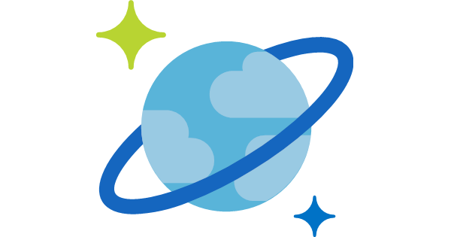

Azure Cosmos DB
A globally distributed, massively scalable, multi-model database service
Elastic scale out
of storage & throughput
Guaranteed low latency at the 99th percentile
Five well-defined consistency models
Turnkey global distribution
Comprehensive SLAs
Notes:
Azure Cosmos DB offers the first globally distributed, multi-model database service for building planet scale apps. It’s been powering Microsoft’s internet-scale services for years, and now it’s ready to launch yours.
You can add Azure locations to your database anywhere across the world, at any time, with a single click. Cosmos DB will seamlessly replicate your data and make it highly available.
Cosmos DB allows you to scale throughput and storage elastically, and globally! You only pay for the throughput and storage you need – anywhere in the world, at any time.

Slide 8
Azure Cosmos DB
A globally distributed, massively scalable, multi-model database service
Column-family
Document
Key-value
Graph
Elastic scale out
of storage & throughput
Guaranteed low latency at the 99th percentile
Five well-defined consistency models
Turnkey global distribution
Comprehensive SLAs
Notes:
Azure Cosmos DB offers the first globally distributed, multi-model database service for building planet scale apps. It’s been powering Microsoft’s internet-scale services for years, and now it’s ready to launch yours.
You can add Azure locations to your database anywhere across the world, at any time, with a single click. Cosmos DB will seamlessly replicate your data and make it highly available.
Cosmos DB allows you to scale throughput and storage elastically, and globally! You only pay for the throughput and storage you need – anywhere in the world, at any time.

Slide 9


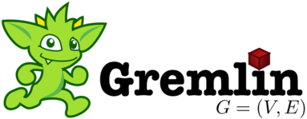
Azure Cosmos DB
A globally distributed, massively scalable, multi-model database service
Cosmos DB’s API for
MongoDB
Table API
Column-family
Document
Key-value
Graph
Elastic scale out
of storage & throughput
Guaranteed low latency at the 99th percentile
Five well-defined consistency models
Turnkey global distribution
Comprehensive SLAs
Notes:
Azure Cosmos DB offers the first globally distributed, multi-model database service for building planet scale apps. It’s been powering Microsoft’s internet-scale services for years, and now it’s ready to launch yours.
You can add Azure locations to your database anywhere across the world, at any time, with a single click. Cosmos DB will seamlessly replicate your data and make it highly available.
Cosmos DB allows you to scale throughput and storage elastically, and globally! You only pay for the throughput and storage you need – anywhere in the world, at any time.

Slide 10

Overview & Value Proposition

Slide 11
Elastically Scale Storage and Throughput
Independently and elastically scale storage and throughput across regions – even during unpredictable traffic bursts – with a database that adapts to your app’s needs.
Elastically scale throughput from 10 to 100s of millions of requests/sec across multiple regions
Scale throughput automatically using autopilot mode
Only pay for the throughput and storage you need
Notes:
Particularly useful for:
Small storage – large throughput (e.g. notification broadcast/poll)
Large storage – small throughput (e.g. classic data/log store)
Many customers (for example, online retailers) need to scale throughput up & down during different times of the year. Retailers, for example, have much higher numbers of read/writes in November and December since most shopping occurs during the holiday season. Azure Cosmos DB’s ability to easily scale up & down

Slide 12
Guaranteed Low Latency
Provide users around the world with fast access to data
Serve single digit millisecond reads and writes
Guarantee that reads and writes of documents 1 KB or smaller will be < 10 ms and the 99.999% availability
Notes:
Cosmos DB’s is one of few databases to have a financially back latency. Every database likes to claim that they are the fastest- Azure Cosmos DB goes a step further and puts an SLA on P99 latency.
This reliability low latency makes Azure Cosmos DB a great fit for any applications with real-time requirements. In many applications, a few extra milliseconds of latency can have a significant impact on customer satisfaction.

Slide 13
Turnkey Global Distribution
Put your data where your users are in minutes
Automatically replicate all your data around the world, and across more regions than Amazon and Google combined.
Available in all Azure regions
Manual and automatic failover
Automatic & synchronous multi-region replication
Configure multiple write regions to further reduce latency and increase availability
Notes:
More info on global distribution in Azure Cosmos DB: https://docs.microsoft.com/en-us/azure/cosmos-db/distribute-data-globally

Slide 14
Five Well-Defined Consistency Models
Choose the best consistency model for your app
Offers five consistency models
Provides control over performance-consistency tradeoffs, backed by comprehensive SLAs.
An intuitive programming model offering low latency and high availability for your planet-scale app.
Strong
Bounded-stateless
Session
Consistent prefix
Eventual
Notes:
Tunable Consistency -> Single digit latency
Instead of forcing you to choose between eventual and strong consistency, Cosmos DB gives you many additional useful options.
Bounded Staleness - Consistent Prefix. Reads lag behind writes by k prefixes or t interval
Session - Consistent Prefix. Monotonic reads, monotonic writes, read-your-writes, write-follows-reads
Consistent Prefix - Updates returned are some prefix of all the updates, with no gaps
Strong → You instantly see every new message
Bounded-Staleness → Messages may come a little late, but not too late
Session → You always see your messages right away
Consistent Prefix → Messages may come late, but always in the right order
Eventual → Messages eventually arrive, just not right away

Slide 15


Multiple Data Models and API’s
Use the model that fits your requirements, and the apis, tools, and frameworks you prefer
Cosmos DB offers a multitude of APIs to access and query data including, SQL, various popular OSS APIs, and native support for NoSQL workloads.
Use key-value, columnar, graph, and document data
Data is automatically indexed, with no schema or secondary indexes required
Blazing fast queries with no lag
MongoDB
Table API
SQL
Column-family
Document
Key-value
Graph
Notes:
Multi – Model -> Elastic Scale out
For any new app you are building on Azure Cosmos DB, we recommend the SQL API.
We have created Cassandra, API for Mongo DB, and Tables API for apps that are being migrated from these existing NoSQL databases to Azure Cosmos DB. This allows customers to experience the low latency and global distribution core features of Azure Cosmos DB without needing to alter their data model or application code.

Slide 16
Handle any Data with no Schema or Indexing Required
Azure Cosmos DB’s schema-less service automatically indexes all your data, regardless of the data model, to delivery blazing fast queries.
Automatic index management
Synchronous auto-indexing
Freedom from schema + index management
Works across every data model
Ingest and serve data back out in milliseconds
GEEK
Item | Color | Microwave safe | Liquid capacity | CPU | Memory | Storage
Geek mug | Graphite | Yes | 16ox | ??? | ??? | ???
Coffee Bean mug | Tan | No | 12oz | ??? | ??? | ???
Surface book | Gray | ??? | ??? | 3.4 GHz Intel Skylake Core i7-6600U | 16GB | 1 TB SSD
Notes:
Automatic and synchronous indexing of all ingested content - hash, range, geo-spatial, and columnar
No schemas or secondary indices ever needed
Resource governed, write optimized database engine with latch free and log structured techniques
Online and in-situ index transformations
While the database is fully schema-agnostic, schema-extraction is built in

Slide 17
Comprehensive SLA’s
Run your app on world-class infrastructure.
Azure Cosmos DB is the only service with financially-backed SLAs for millisecond latency at the 99th percentile, 99.999% HA and guaranteed throughput and consistency
Latency
HA
Throughput
Consistency
<10 ms
99.999%
Guaranteed
Guaranteed
99th percentile
Notes:
HA 99.999% for multi-region read; 99.99% for single region deployments

Slide 18
Trust your Data to Industry-Leading Security & Compliance
Azure is the world’s most trusted cloud, with more certifications than any other cloud provider.
Enterprise grade security
Encryption at Rest and Transit
Encryption is enabled automatically by default
Comprehensive Azure compliance certification
Notes:
Encryption at Rest
Always encrypted at rest and in motion
Data, index, backups, and attachments encrypted
Encryption is enabled automatically by default
No impact on performance, throughput or availability
Transparent to your application
Comprehensive Azure compliance certification
ISO 27001, ISO 27018, EUMC, HIPAA, PCI
SOC1 and SOC2 (Audit complete, Certification in Q2 2017)
FedRAMP, IRS 1075, UK Official (IL2) (Q2 2017)
HITRUST (H2 2017)
Updated and added to monthly

Slide 19
Use Cases

Slide 20








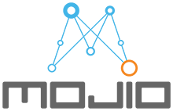


































Serving Industry-Leading Enterprise Customers
Notes:
Azure Cosmos DB is designed for use by both small and large customers. Large enterprise customers like Azure Cosmos DB because of it is a fully managed service with industry leading SLA’s. The time and money savings after moving to Azure Cosmos DB can be tremendous.

Slide 21
Top 10 Reasons Why Customers Use
Azure Cosmos DB
The 1st and only database with global distribution turnkey capability
Deliver massive storage/throughput scalability database
Provides guaranteed single digit millisecond latency at 99th percentile worldwide
Natively supports different types of data at massive scale
Boasts 5 well-defined consistency models to pick the right consistency/latency/ throughput tradeoff
Enables mission critical intelligent applications
Gives high flexibility to optimize for speed and cost
Tackles big data workloads with high availability and reliability
Provides multi-tenancy and enterprise-grade security
Naturally analytics-ready and perfect for event-driven architectures

Slide 22
Retail

Slide 23

Handle Peak Sales Periods with Ease
Azure CDN
Azure Storage (files)
Offer customers fast and reliable service quality during seasonal and other high-traffic sales periods.
  Instant, elastic scaling handles traffic and sales bursts
  Provisioned throughput ensures predictable performance for mission critical microservices (e.g. shopping cart)
  Low-latency data access from anywhere in the world for fast, robust user experiences
  High availability across multiple data centers
Azure API Apps (backend)
Azure Cosmos DB (database)
Apache Spark
(analytics)
Azure Functions
Azure Notification Hub (Push notifications)

Slide 24

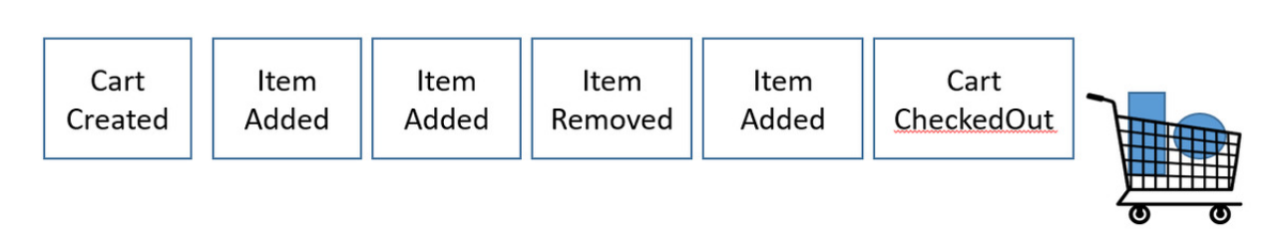


Order & Inventory Management Systems
Event-sourcing architecture, with Cosmos DB Change Feed
Moved from IaaS to PasS for inventory system
Chosen to handle high write-ingest for events & low latency guarantees
Scaled for Black Friday: 1 trillion RU’s over 24 hours
Walmart Labs (aka jet.com) ensures reliable app experience for customers on Black Friday, Cyber Monday, and other high traffic periods
Notes:
https://blogs.msdn.microsoft.com/azurecat/2018/05/17/azure-cosmos-db-customer-profile-jet-com/

Slide 25

Deliver Relevant Real-time Recommendation Systems
Online Recommendations Service
HOT path
Azure Service Fabric
(Personalization Decision Engine)
Azure Cosmos DB
(distributed model store)
Help customers discover items they’ll love with real-time personalization and product recommendations.
  Machine learning models generate real-time recommendations across product catalogues
  High volumes of product data can be analyzed in milliseconds
  Low-latency ensures high app performance worldwide
  Tunable data consistency models for rapid insight
Azure Data Factory
(scheduled job to refresh persisted models)
Shoppers
.com
(Product Details Page)
Azure Event Hub
Azure Data Lake Storage
(offline raw data)
Apache Spark
Offline Recommendations Engine
COLD path
ASOS deliver personalized shopping experiences and real-time order updates to 15 Million customers. Helping them grow and win with millennial shoppers.

Slide 26
IoT + Manufacturing

Slide 27


Leverage IoT Telemetry to Build Differentiated Experiences
Diverse and unpredictable IoT sensor workloads require a responsive data platform
  Real-time vehicle diagnostics
  Instant elastic scaling
  No loss in ingestion or query performance
Azure IoT Hub
Apache Storm on Azure HDInsight
Azure Cosmos DB
(Telemetry & device state)
Azure Web Jobs (Change feed processor)
Azure Storage (archival)
Azure Cosmos DB was chosen due to its ability to ingest data at massive scale with high availability (99.99%) guarantee.
Logic apps
Notes:
Toyota’s connected-car platform collects massive volumes of sensor data in Azure Cosmos DB to deliver real-time customer service and vehicle diagnostics
Elastically scale instantly to accommodate diverse and unpredictable IoT workloads without sacrificing ingestion or query performance
Seamlessly integrates car to the digital life of customers that is safe, productive and fun.

Slide 28
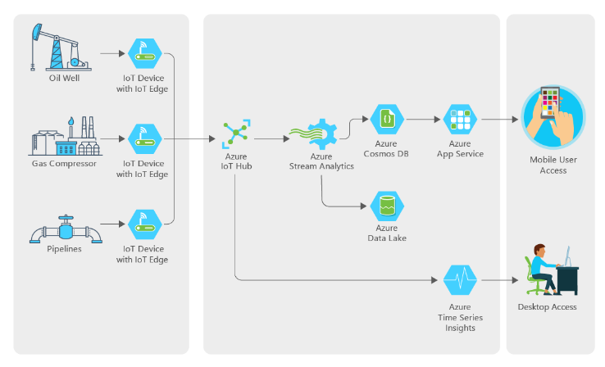

IoT, Big Data Optimize Operations at an Exxon Mobil Subsidiary
Find a better way to monitor remote wells and collect data on performance
  Must be cost efficient
  Unified device management and streaming
  Automate IOT and analytics
“We had a team of five people working on this, and they built it from scratch. The ease of use of the Azure services and the support we got from Microsoft made that possible. .”
Notes:
Another IOT scenario is in the oil and gas industry.
XTO energy is a subsidiary of ExxonMobil, they specialize in gas production from low margin fields. Their equipment is often in extreme and remote locations with spotty connectivity which makes gathering telemetry a manual and expensive process.
Working with Microsoft we helped them design a system that would allow them a better, and cheaper way to gather this telemetry and automate much of the work behind it providing data both to uses at the home office as well as to users in the field working on the equipment.

Slide 29
Gaming

Slide 30


Deliver High-Quality Experiences at any Scale Globally
Azure CDN
Azure Storage (files)
Need for a DB that to seamlessly respond to massive scale and performance demands
  Multi-player game play with low latency
  Instant capacity scaling from launch onward
  Uninterrupted global user experience
Azure API Apps (backend)
Azure Cosmos DB (database)
Apache Spark
(analytics)
Azure Functions
Azure Notification Hub (Push notifications)
The Walking Dead: No Man’s Land chose Azure Cosmos DB because of its extremely low latency and massive scale worldwide.
Notes:
Gaming is another scenario where Cosmos DB provides some unique capabilities you won’t find in other data services.
When you combine our global distribution with low latency this is ideally suited to supporting high-volume gaming use cases where you have millions of players located all over the globe.
The Walking Dead: No Man’s Land chose Azure Cosmos DB to manage massive traffic spikes at its launch and as its popularity increased

Slide 31
Financial Services

Slide 32

A Financial Trend SaaS Engine for Investors
Need for a DB that can handle any schema and adapt quickly to rapid changes
  Financial SAAS engine with no dev ops
  Super fast to handle financial data
  Scalable on demand, globally distributed
Business models are under attack, especially in the financial industry. Azure Cosmos DB is a technology that can adapt, evolve, and allow a business to innovate faster in order to turn opportunities into strategic advantages.
Notes:
Another customer story is clearTrend who has built a financial trend engine as Software as a Service for investment professionals that is completely managed, with zero dev ops.
Their use of Cosmos DB was centered around a few things. First, being schema agnostic allowed them to ingest and analyze very different kinds of data and also evolve their own schemas over time for their analytics. Second, clearTrend needed a service that would be super fast. In the investment world seconds can make the difference so they needed a back end that could deliver the kind of performance they needed to run their service for their customers, these investment professionals. Lastly, they needed to be able to programmatically re-size capacity to handle workload bursts. They have predictable workloads and the ability to easily scale Cosmos DB up and down was a great benefit to them.

Slide 33
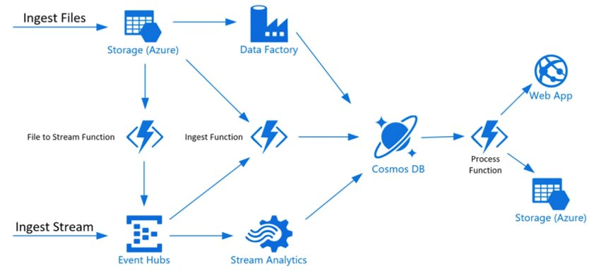

Real-time Payments Pipeline
Steady state - 10M transactions/day, peak hours - 3-4K transactions/sec
  Financial SAAS engine with no dev ops
  Super fast to handle financial data
  Scalable on demand, globally distributed
Centralize payment pipelines, build real time processing, analytics. Goal to introduce a common pipeline accepting transactions from all different sources and distributing them to the right pipeline and also other sources like analytics.​
Notes:
Yet another use case scenario is in real-time payments processing.
In this scenario DnB has built a centralized payment processing pipeline with analytics. Here too the goal was to build a complete solution on PaaS to ensure zero Dev Ops in offering a SaaS solution to their customers. Important characteristics here too is the solution need also to be incredibly fast, scale on demand and provide for global distribution of data, both for business continuity but also for low latency.

Slide 34

Fidelity Built Mortgage Insurance App To Enhance Customer
Fidelity built a new application – EXOS – it is the only mobile digital mortgage application designed specifically to extend and enhance every critical consumer touchpoint throughout the entire mortgage lending life cycle.
EXOS offers a real-time personalized experience for customers across the entire mortgage process including
  Appointment scheduling and communications – enhancing customer experience and process .
  Ensuring consistent , personalized and accurate information for customer throughout the process.
  EXOS Closing offers unmatched consumer satisfaction and transparency in to the closing process.
Fidelity chose Cosmos DB due to the Ease global distribution, ability to scale and fully managed service reducing the database management overhead.
Notes:
Fidelity built a new mortgage insurance application service for its customer using Cosmos DB.
Here too Fidelity chose Cosmos DB due to our global distribution capabilities that also provided low latency for fast application response times, high availability too. In addition, because Cosmos DB is schema agnostic, Cosmos DB is ideally suited for this type of scenario where you are fundamentally dealing with unstructured or rapidly changing data.
Lastly, implementing a service like this which has multiple steps during the process is a natural fit for our Change Feed feature which allows customers to create event-driven, micro-service architectures. In the case of a loan application process here, there are multiple steps in the process from initial application to submitting supporting documents, signing, etc. This is well suited for Cosmos DB.

Slide 35
Solve Industry Specific Needs
Highlight areas where data-driven app innovation can transform customer business
Solution
Areas
Financial Services
Manufacturing
& Resources
Retail
Government
Health
Education
Transactional
Customer experience management
Retail management system
Connected field service
Citizen services tracking
Care coordination
Educational lifecycle management
Real-time experiences
Seamless services
Commerce experience
Supply chain visibility
Secure global platform
Customer care experience
Global collaboration
Big data
processing
Risk compute
Demand forecasting
Server logs
Enterprise grade control
Genomic data
Student analytics
AI
Risk mitigation
Learn customer habits
Predictive processes
Smart buildings
Automated appointments
Intelligent resources for students
Examples of
SaaS apps
Customer Service
Banking Screen
Compliance Assessments
Pricing & Promotion
Retail Personalization
Inventory Optimization
Quote-to-cash system
Sales automation
Predictive Maintenance
Citizen Service Requests
Grants Management
Patient Coordination
Risk prediction
Medical Claim Analytics
Learning Management System
Personalized learning
Unique need
Security
User experience
Scale
Security
Compliance
Innovation
Notes:
Here, we you can see some of the ways customers in different industries are using the scenarios we just talked about to solve their industry-specific needs and reach their goals.

