Slide 1

Azure Cosmos DB
Security Overview
April 2nd, 2020

Slide 2
Overall Security model for Cosmos DB
Azure Cosmos DB is secure by design:
Your security team extended
Azure Security Foundation
Network Security
Web security (CORS)
Authorization
Global Replication
Local Replication
Backups
Monitoring for Attacks
Encryption at rest
Compliance
Notes:
https://docs.microsoft.com/azure/cosmos-db/database-security

Slide 3
Your Security Team Extended
Microsoft
CDOC
Azure
Security
Cosmos DB
Security
Your
Security
Notes:
http://azure.microsoft.com/en-us/documentation/articles/CosmosDB-manage-account/#keys

Slide 4
Azure Security Foundation
Foundation of common controls:
All products follow the Security Development Lifecycle (SDL).
All production is access via dedicated secure access workstations (SAWs).
All production access requires Just In Time (JIT) approval.
All production access is monitored.
All production deployments require multiple approvals including test sign off and approvers.
All products run a common security agent to collect anomalous activity.
All production resources are patched regularly.
All secrets / certificates / passwords have defined lifetimes and required rotations.
All production ports are scanned, and penetration tested regularly.
All source code is scanned looking for security issues.
All source code requires two approvers to check in.
All teams do breach drills.
Notes:
http://azure.microsoft.com/en-us/documentation/articles/CosmosDB-manage-account/#keys

Slide 5
New features since thes October 2019 Update
Completed Features
ARM control of database and collections
Detailed monitoring logs for ARM actions
Data only access with addition of disableKeyBasedMetadataWriteAccess (doc page)
TLS 1.2 Enforcement by Account Option
Customer Managed Keys (doc page)
Notes:
https://docs.microsoft.com/azure/cosmos-db/database-security

Slide 6
Network Security
All connections are HTTPS/SSL/TLS 1.2 w/ Enforcement Option
Standard HTTPS verbs and semantics
Requests are logged and available in Azure Monitoring
HTTPs 404 responses are available in Azure Metrics
IP Firewalls
VNET
Service Endpoints
Private Link (aka Private IP and Private Endpoints
Notes:
http://azure.microsoft.com/en-us/documentation/articles/CosmosDB-manage-account/#keys

Slide 7
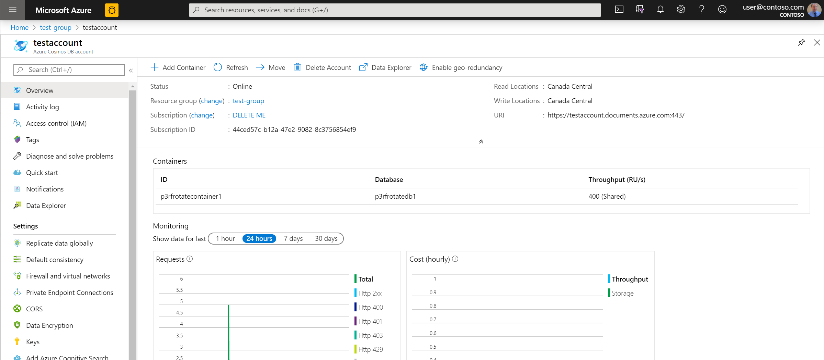
Network Security: IP Firewalls, vNETs, and Endpoints
Notes:
https://docs.microsoft.com/azure/cosmos-db/firewall-support

Slide 8
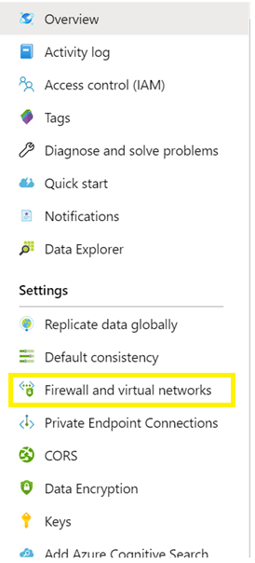
Network Security: IP Firewalls and vNETs
IP Firewalls
Multiple layers of protection for user data
Allow a specific IP 168.61.48.0
Allow an IP range 168.61.48.0/8
Allow combinations of IPs and ranges
Deny logs are available
vNets
Supports subnetting
Cosmos DB account appears in the vNET.
IP Firewalls and vNET work together.
Notes:
https://docs.microsoft.com/azure/cosmos-db/firewall-support

Slide 9
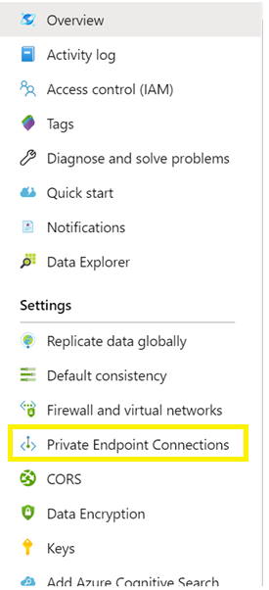
Network Security: Endpoints
Service Endpoints
Allows Azure Cosmos DB account in the vNET
Restricts access to the account from only the vNET
Public IP used for account access
Allows access to accounts not in a vNET
Private Endpoints
Places Azure Cosmos DB account in the vNET
Restricts access to the account from only the vNET
Assigns a private IP for the account
No access other accounts if public IPs are restricted.
Notes:
https://docs.microsoft.com/azure/cosmos-db/firewall-support

Slide 10
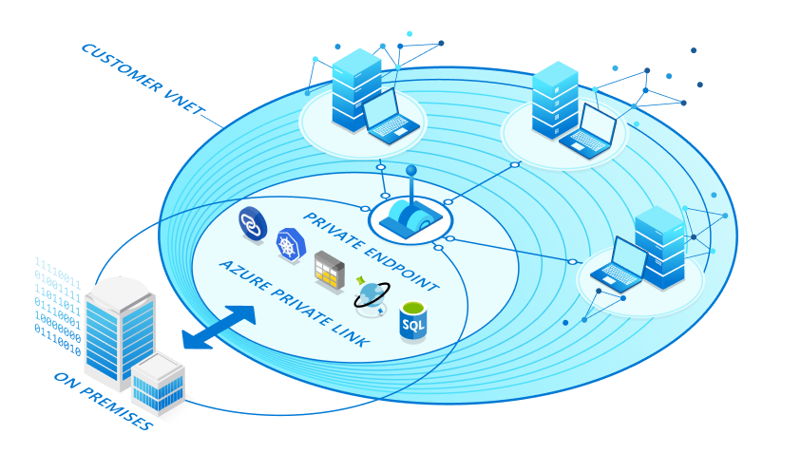
Network Security: Private Link / Private IP

Slide 11
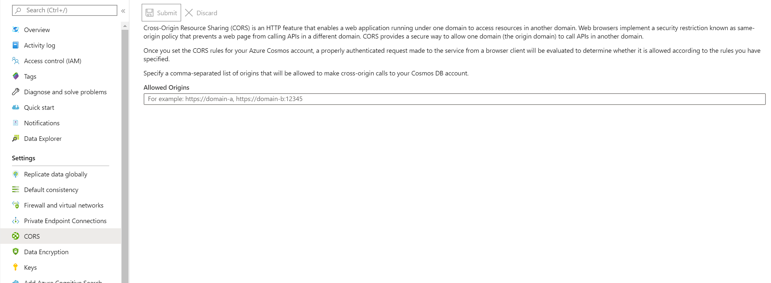
Web Security: CORS
CORS support allows web applications to directly call to Cosmos DB. Without CORS the browser will block the call.

Slide 12

Authorization
Azure Active Directory Integration at the Cosmos DB Account Level. This include operations and controls around firewalls, logging, and key access.
Master keys and Resource Tokens are used for data access. These control Read / Insert / Delete operations along with throughput control and collection creation.

Slide 13
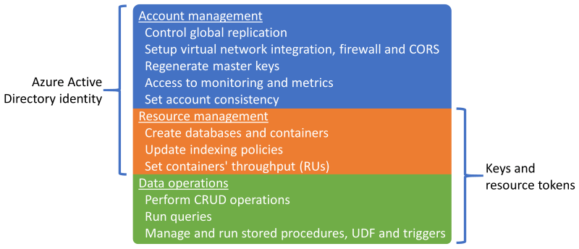
Authorization: How the Active Directory is moving toward the data

Slide 14





Authorization: **Coming – AAD for data access
key
authentication
authorization
logging
TODAY
Through network security (firewall, VNet etc.)
Key type
IP address
key
authentication
authorization
logging
IDENTITY
ENFORCEMENT
identity
AAD token
Verification of signature, time validity etc.
User ID, tenant ID etc.
identity
authentication
authorization
logging
IDENTITY-BASED
AUTHORIZATION
Down to container-level

Slide 15
Authorization: Azure Active Directory Roles
Azure Owner – All Access
Azure Contributor – All Access but no permission to add/remove other AAD principals.
Azure Reader – Access to account information. No data access.
Azure Cosmos DB Account Reader – Read access to all account information and read access to data.
Roles Actions are composable, so you can create your own.

Slide 16
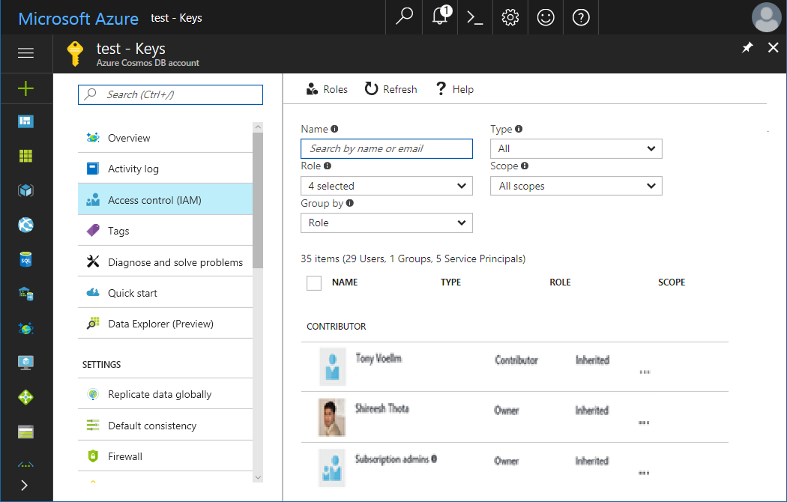
Identity and Access Management (IAM aka RBAC)
Access Control
Supports ActiveDirectory Integration
Handles Users and Groups
Controls access to database accounts via defined roles (Owner, Reader, Contributor, …)
Access
control
Notes:
http://azure.microsoft.com/en-us/documentation/articles/CosmosDB-manage-account/#keys

Slide 17
Authorization: Master Key
Master key - a security token to access all resources for an account. Individuals with the key have full access including read and write access to the all resources in the database account.
All keys are created during the creation of an account, but can be regenerated and rotated at anytime.
Each account consists of 2 Master keys: Primary key and Secondary key
Account administrators have the ability to regenerate the keys as needed. For instructions, see How to manage a Cosmos DB account.
Use caution when distributing master keys. The primary master key and secondary master key are available in the Keys blade of the Azure Portal.
Notes:
Master key
A master key is a security token to access all resources for an account. Individuals with the key have read and write access to the all resources in the database account. Use caution when distributing master keys. The primary master key and secondary master key are available in the Keys blade of the Azure Preview portal.
Access control on resources
Access to Cosmos DB resources is governed by a master key token or a resource token. The master key token is the all access key token that allows individuals to have full control of Cosmos DB resources in a particular account. The master key is created during the creation of an account. There are two sets of master keys, the primary key and the secondary key. The administrator of the account can then exercise key rotation using the secondary key. In addition, the account administrator can also regenerate the keys as needed. For instructions on regenerating and rolling keys, see How to manage a Cosmos DB account.
Resource tokens are created when users in a database are set up with access permissions for precise access control on a resource. A permission resource contains a hash resource token specifically constructed with the information regarding the resource path and access type a user has access to. The permission resource token is time bound and the validity period can be overridden. When a permission resource is acted upon on (POST, GET, PUT), a new resource token is generated. For information on permissions and resource tokens, see Operations on Cosmos DB Permissions.
All REST operations must include the authorization header with the authorization string in order to interact with a resource.
User operations
The Cosmos DB API supports basic CRUD operations on the resources under a database account. A user is a logical namespace for scoping permissions on containers, documents, attachment, stored procedures, triggers and user-defined functions. The user construct lives under a database resource thus cannot cross the database boundary it is under. The user resource is represented by users in the Cosmos DB REST resource mode. It is a system resource thus contains a fixed schema.
The top-level topic that outlines the basic CRUD operations on the resources under a Cosmos DB database account, that itemizes those resources and describes the URLs used to access them is Azure Cosmos DB REST API Reference.
Permission operations
The Cosmos DB API supports basic CRUD operations on the resources under a database account. Permission is an authorization token associated with a user for authorized access to a specific resource. It is used to manage access to containers, documents, attachments, stored procedures, triggers and user-defined functions for a particular user. You can associate only one permission to a particular resource for a user. For example, MarketingCollection with _rid xynsa== can only be associated with one permission for user JanetSmith@contoso.com. An attempt to add another permission to MarketingCollection for Janet will result in an error (409 Conflict). There are only two permissionMode, All and Read. All will provide read, write and delete access to a resource. Read is self-explanatory. A resource token is created every time a GET or PUT or POST is performed on a permission. By default, the validity period of a resource token is 1 hour. The validity period can be overridden to up to 5 hours.
Code execution security
JavaScript stored procedures and triggers are sandboxed so that the effects of one script do not leak to the other without going through the snapshot transaction isolation at the database level. The runtime environments are pooled but cleaned of the context after each run. Hence they are guaranteed to be safe of any unintended side effects from each other

Slide 18
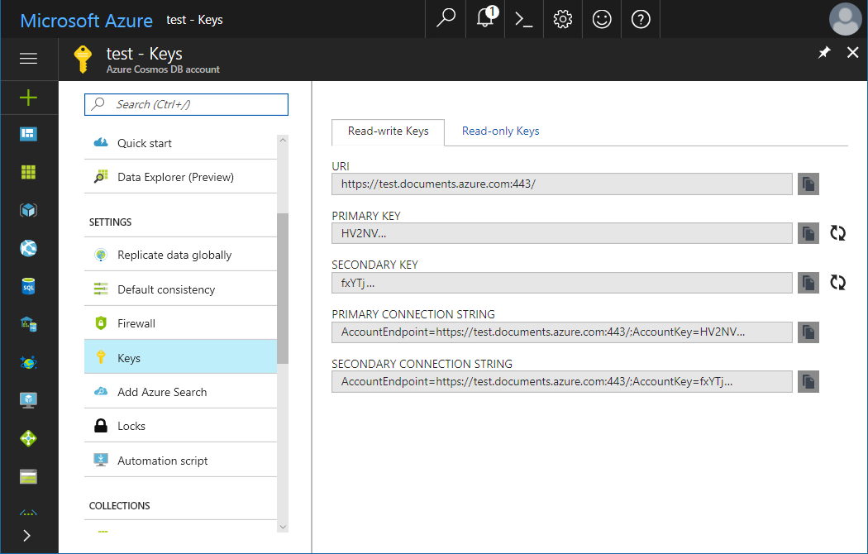
Authorization: View, copy and regenerate/rotate access keys
When you create a Cosmos DB account, the service generates two master access keys that can be used for authentication when Cosmos DB account is accessed. By providing two access keys, Cosmos DB enables you to regenerate/rotate the keys with no interruption to your Cosmos DB account.
View yours Keys from your Cosmos DB Account blade
Copy yours Uri + Keys from the Keys panel
Regenerate yours Keys from the Keys panel
Notes:
https://docs.microsoft.com/azure/cosmos-db/manage-account

Slide 19
Authorization Best practice: Regenerate/Rotate access keys
Periodically regenerate/rotate your Cosmos DB account access keys to keep your connections more secure.
Two master keys are assigned to each account to allow administrators to regenerate one key while the other maintains connections to the Cosmos DB account.
Recycling old master key
1
2
3
4
Navigate to Azure Portal
Retrieve your secondary key
Replace current primary key with secondary key
Rotate primary key in the Azure Portal
Notes:
http://azure.microsoft.com/en-us/documentation/articles/CosmosDB-manage-account/#keys

Slide 20
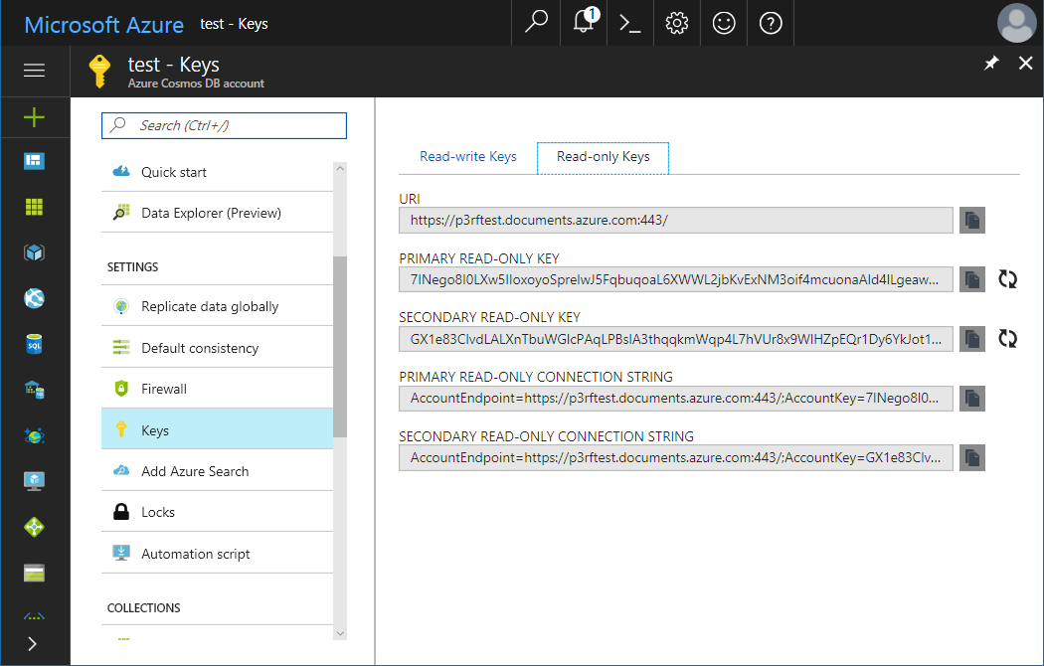
Authorization: Read-Only Keys
In addition to the 2 master keys for the Cosmos DB account, there are 2 read-only keys. These read-only keys will only allow Read operations on the account.
View your Read-only Keys from your Cosmos DB Account blade
Copy yours Uri + Read-only Keys from the Keys panel
Regenerate yours Read-only Keys from the Keys panel
Notes:
https://docs.microsoft.com/azure/cosmos-db/manage-account

Slide 21
Authorization: Resource Tokens
Resource Tokens all limited time access to resources such as documents, collections, and other key controlled resources.
Limited time access (default 4 hours)
Ability to associate labels with resources to scope the token.
Generated by the service
Best practice is to use an Azure Function to control via AAD who can generate a token. Pattern + video on Channel9.
77339876

Slide 22
Authorization: Create Your Own Roles
{
"Name": "Azure Cosmos Collection and Key Management",
"Id": "fa63e82d-7fa4-4e33-bfe5-295951d2e6a7",
"IsCustom": true,
"Description": "Use to give collection and data permisssions.",
"Actions": [
"Microsoft.DocumentDB/databaseAccounts/apis/databases/containers/*",
"Microsoft.DocumentDB/databaseAccounts/listKeys/action"
],
"NotActions": [],
"DataActions": [],
"NotDataActions": [],
"AssignableScopes": [
"/subscriptions/33ffd99e-b11a-56e8-8104-8c3736853ef7"
]
}
Granular AAD Actions unded the Microsoft.DocumentDB namespace to control exactly what you want developers and applications to access.
Ability to limit database and container opertions like create and delete to only ARM based access. This creates the opportunity for data access only permissions.
Control vNET
Control Firewall
Access Monitoring and Metrics
Create Database
Create Collection
Set Indexing Policy
Set RU's
Run Query
Read and Write Document
Control plane
AAD RBAC/IAM
Data plane
Key and Resource Token

Slide 23
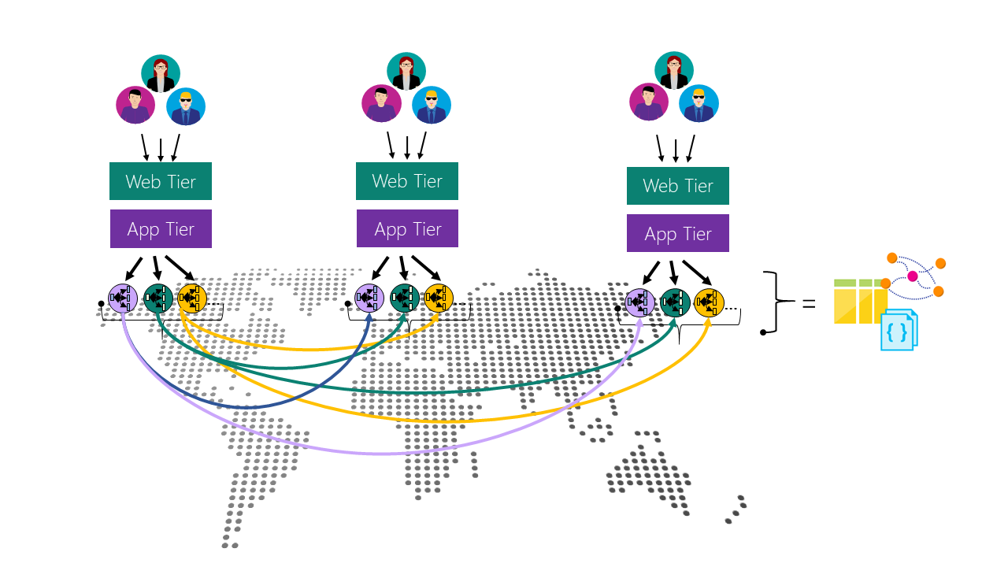
Global Replication
Azure Cosmos DB is available in 35+ geographical regions allowing you to globally distribute your data to ensure it is a available in the event of unexpected failure. Cosmos DB offers high availability, single digit ms latencies, well-defined consistency levels, transparent regional failover with multi-homing APIs, and the ability to elastically scale throughput and storage across the globe.
Notes:
https://docs.microsoft.com/azure/cosmos-db/distribute-data-globally
https://docs.microsoft.com/azure/cosmos-db/regional-failover

Slide 24
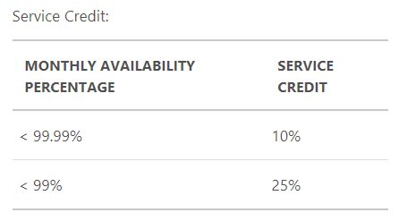
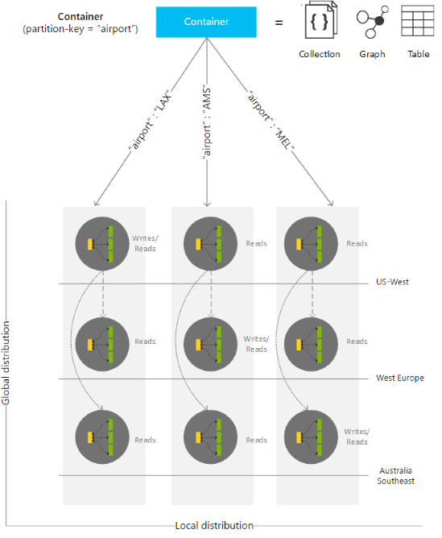
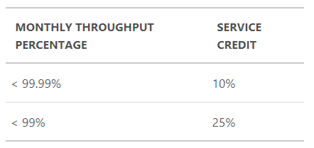
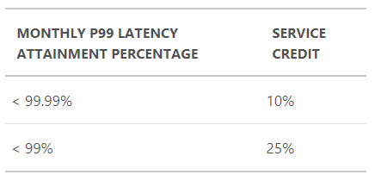
Local Replication
In addition to offering you the ability to globally replicate your data Cosmos DB automatically replicates your data locally to provide seamless operation. This automatic replication allows Cosmos DB to offer a financially backed SLA on both availability as well as performance.
Notes:
https://azure.microsoft.com/support/legal/sla/cosmos-db/v1_0/

Slide 25
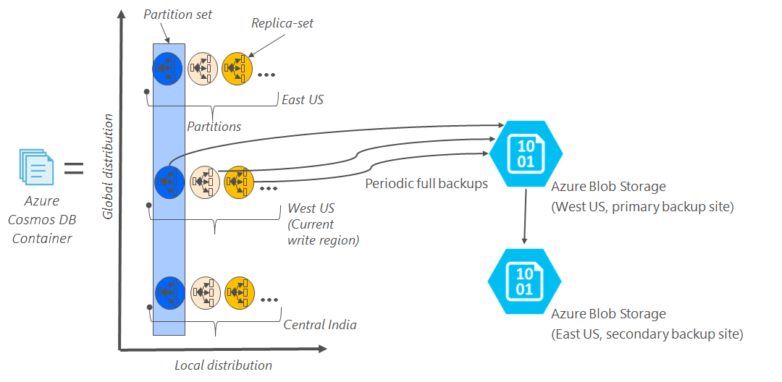
Backups
As an additional measure of data security backups are taken approximately every four hours and latest 2 backups are stored at all times for active accounts. When an account is deleted a backup is taken and stored for up to 90 days.
Notes:
https://docs.microsoft.com/azure/cosmos-db/online-backup-and-restore

Slide 26

Monitoring for Attacks
Cosmos DB offers multiple ways to monitor your data:
Azure Audit Logging – Monitor account access.
Azure Monitoring – All user events. Even supports Full Text Query Logging.
Azure Metrics – Review 404’s in the metrics dashboard.
Custom Log Requests
Notes:
https://docs.microsoft.com/azure/cosmos-db/database-security

Slide 27
Monitoring for Attacks: Telemetry Collection
Activity Log
IAM (RBAC)
Firewalls
vNETs
Key Access
Diagnostics Monitoring Logs
Create Collection
Offers
Indexing Policies
Read / Insert / … Documents
Metrics
401 – Unauthorized
403 – Access Denied
404 – Not Found

Slide 28
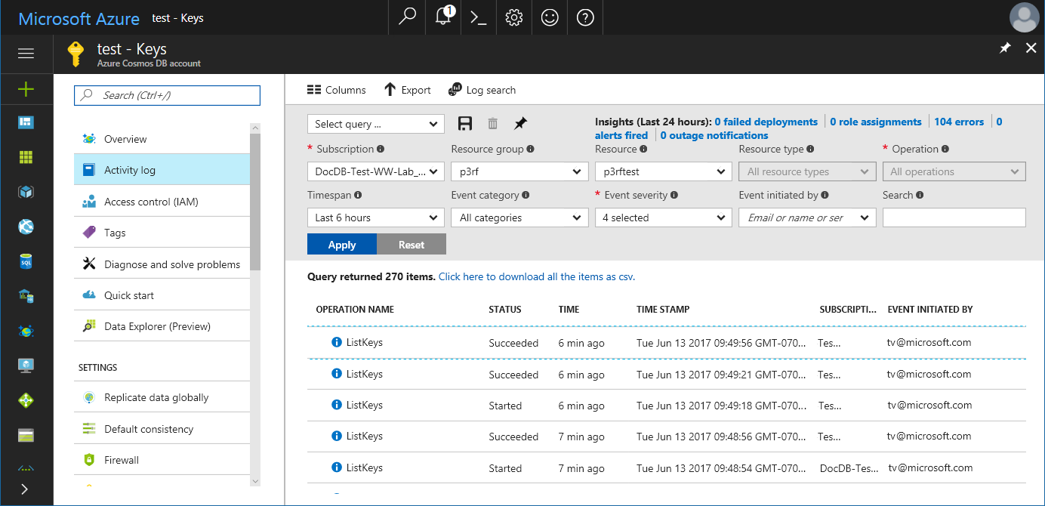
Monitoring for Attacks: Audit Logging
Through audit logging/activity logs, you can view what operations were taken on your resources, who initiated the operation, when the operation occurred, the status of the operation, and much more.
Configure to view logs for Cosmos DB account changes
View who is accessing your keys and making changes to the account
View logging that contains ip address, timestamps, usernames, etc.
Notes:
https://docs.microsoft.com/azure/cosmos-db/database-security

Slide 29
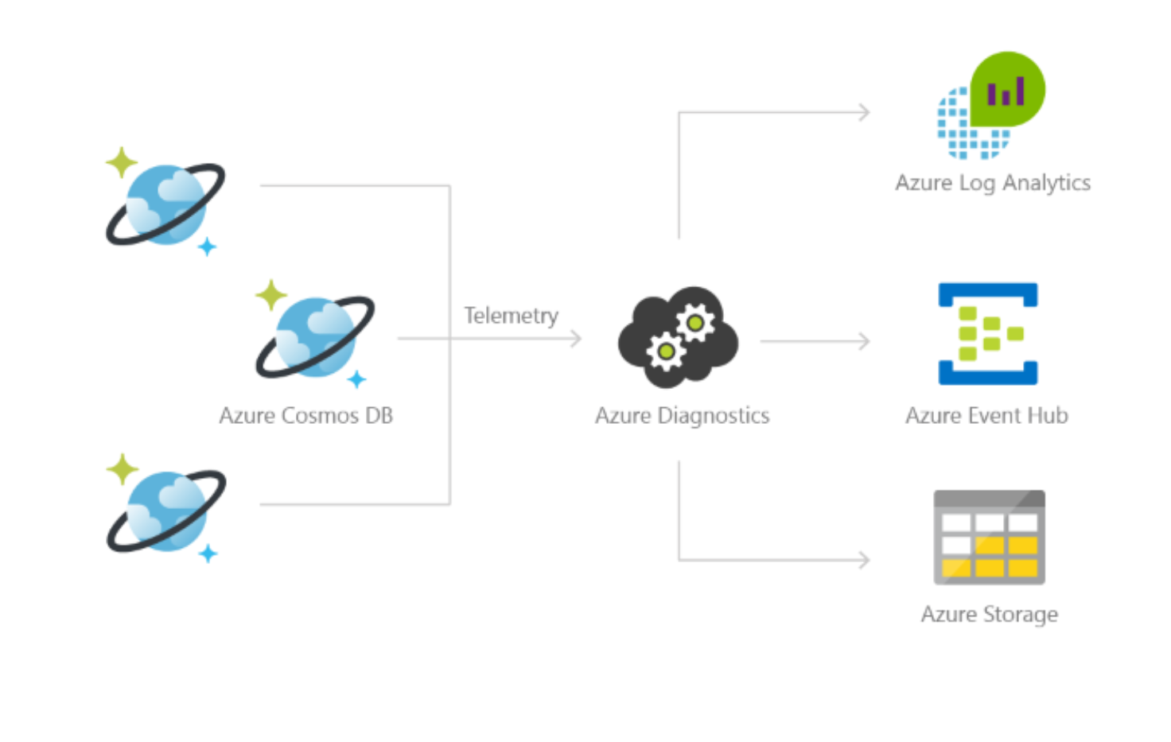
Monitoring for Attacks: Diagnostics

Slide 30
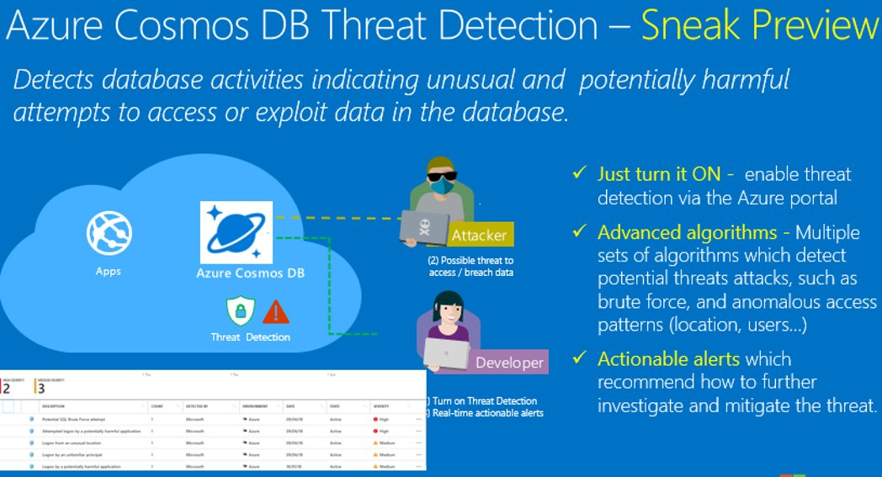

Slide 31





Azure Cosmos DB Encryption
Service Managed Keys
(GA)
Encryption by the service using the Service Managed Keys.
Key rotations and servicing fully managed by the service.
Independent implementation from Customer Managed Keys.
First layer of protection is always enabled.
Customer Managed Keys
(GA)
Encryption by the service using the Customer Managed Key
Key rotations are the responsibility of the customer.
Customer Key resides in Azure Key Vault
Second layer of protection (ie double encryption)
Client Side Encryption
(Alpha)
Encryption before transit
Full control by the developer of keys and storage of keys
One key per document (row)
Select terms (columns) to encrypt
Can be combined with Customer Managed Keys and Service Managed Keys.

Slide 32
Encryption At Rest
Layered
Encryption
Encryption at rest with
Customer Managed Keys
Encryption at rest with Service Managed Keys
User
Data

Slide 33
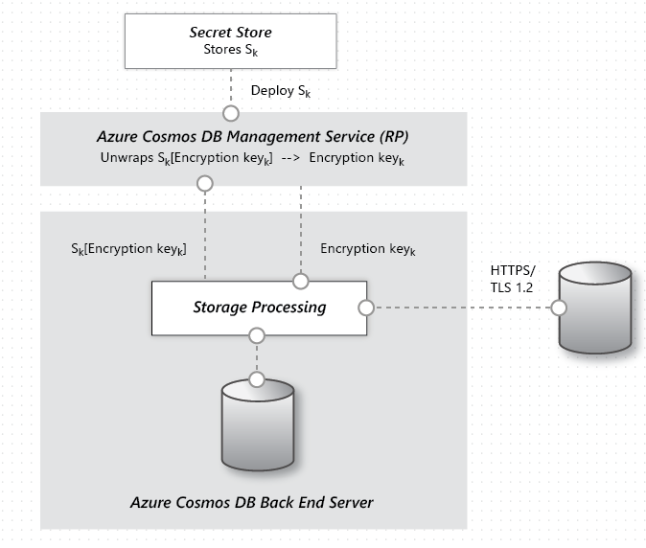
Layer 1: Encryption At Rest With Service Managed Keys
All data in Cosmos DB is encrypted at rest.
There are no user controls to turn it on or off.
Present in all regions with a minimum of FIPS-140 required AES-128.
All regions running AES-256.
Notes:
https://docs.microsoft.com/azure/cosmos-db/database-encryption-at-rest

Slide 34



Layer 2: Encryption At Rest With Customer Managed Keys
Enable on New Account
User
AKV
PS C:\> $MyAccountLocation = "centraluseuap"
PS C:\> $MyAzureCosmosDBAccountName = "mybyokaccount"
PS C:\> $MyResourceGroupName = "mybyokgroup"
PS C:\> $RegionalLocations = @(
@{ "locationName" = "Central US EUAP"; "failoverPriority" = 0 },
@{ "locationName" = "EAST US2 EUAP"; "failoverPriority" = 1 } )
PS C:\> $consistencyPolicy = @{
"defaultConsistencyLevel" = "BoundedStaleness";
"maxIntervalInSeconds" = 300;
"maxStalenessPrefix" = 100000; }
PS C:\> $CosmosDBProperties = @{
"databaseAccountOfferType" = "Standard";
"locations" = $RegionalLocations;
"consistencyPolicy" = $consistencyPolicy;
"enableMultipleWriteLocations" = "false";
"keyVaultKeyUri" =
"https://yourbyokvault.vault.azure.net/keys/yourbyokkey"; }
PS C:\> New-AzResource –ResourceType "Microsoft.DocumentDb/databaseAccounts”\
-ApiVersion "2019-12-12” \
-ResourceGroupName $MyResourceGroupName\
-Location $MyAccountLocation\
-Name $MyAzureCosmosDBAccountName \
-Properties $CosmosDBProperties -Force
1. Grant Access
to Azure Cosmos DB
Global Identity
Wrap/Unwap Requests
2. Enable BYOK with
AKV URI to KEY
User Code
And Services
User
Azure Cosmos DB

Slide 35

Encryption At Rest With Customer Managed Keys
Encryption at rest with self-managed keys in Azure Key Vault
Keys control who has access to the data.
Once key access is removed Cosmos DB stop all processing, purges all access, and waits for access to be restored to access data.

Slide 36
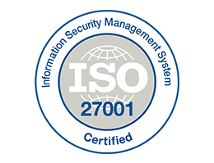



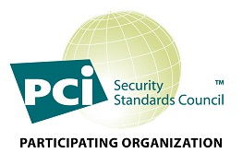

Compliance
GA for 1+ Years
Presence in 54+ Azure Regions, including Sovereign Clouds
  Will be in all Azure Data Centers
Certifications & Attestations:
  ISO 9001, 27001 & 27018
  SOC 1 Type 1, SOC 1 Type 2, SOC 3
  EU Model Clauses
  HIPAA
  PCI-DSS
  FedRAMP [Medium + High]
  HITRUST
Certifications & Attestations in Progress:
DoD DISA SRG Level 4, 5
Find the latest certifications here - https://gallery.technet.microsoft.com/Overview-of-Azure-c1be3942
Notes:
https://www.microsoft.com/en-us/trustcenter/compliance/complianceofferings
Look for Azure and then click on certification to products covered.

Slide 37
Thank you!
© 2016 Microsoft Corporation. All rights reserved. Microsoft, Windows, Windows Vista and other product names are or may be registered trademarks and/or trademarks in the U.S. and/or other countries.
The information herein is for informational purposes only and represents the current view of Microsoft Corporation as of the date of this presentation. Because Microsoft must respond to changing market conditions, it should not be interpreted to be a commitment on the part of Microsoft, and Microsoft cannot guarantee the accuracy of any information provided after the date of this presentation. MICROSOFT MAKES NO WARRANTIES, EXPRESS, IMPLIED OR STATUTORY, AS TO THE INFORMATION IN THIS PRESENTATION.

Slide 38
Appendix

Slide 39
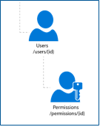
Users and Permissions: Users
Database account access is controlled by IAM/RBAC
Data operations have a user as a logical namespace for scoping permissions on containers, documents, attachments, stored procedures, triggers and user-defined functions.
The user construct cannot cross the database boundary it is under. The user resource is represented by users in the Cosmos DB REST resource mode. It is a system resource thus contains a fixed schema.
The top-level topic that outlines the basic CRUD operations on the resources under a Cosmos DB database account, that itemizes those resources and describes the URLs used to access them is Azure Cosmos DB REST API Reference.
Notes:
https://docs.microsoft.com/azure/cosmos-db/secure-access-to-data

Slide 40
Users and Permissions: Resource Tokens
Resource tokens are created when users in a database are set up with access permissions for precise access control on a resource.
Permission resource contains a hash resource token specifically constructed with the information regarding the resource path and access type a user has access to.
Permission resource token is time bound and the validity period can be overridden. It is used to manage access to containers, documents, attachments, stored procedures, triggers and user-defined functions for a particular user
When a permission resource is acted upon on (POST, GET, PUT), a new resource token is generated. For information on permissions and resource tokens, see Operations on Cosmos DB Permissions.
All REST operations must include the authorization header with the authorization string in order to interact with a resource.
Notes:
https://docs.microsoft.com/azure/cosmos-db/secure-access-to-data

Slide 41

Microsoft Data Centers: Physical Security
Learn more: Azure Data Center Virtual Tour

