Slide 1
A Parallel RBF-RA Method
Alex Shaffer

Slide 2
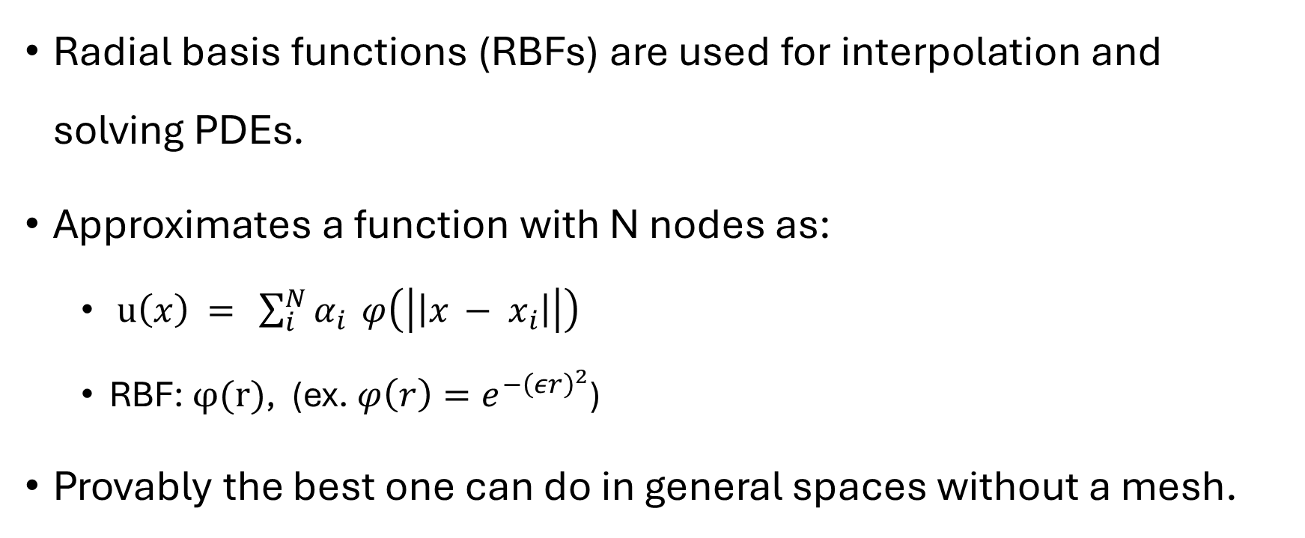
Radial Basis Functions
Radial basis functions (RBFs) are used for interpolation and solving PDEs.
Approximates a function with N nodes as:
$u\left(x\right) = \sum_{i}^{N}{α_{i}} φ\left(\left|\left|x − x_{i}\right|\right|\right)$
RBF: $φ(r)$, (ex. $φ\left(r\right)=e^{−{\left(εr\right)}^{2}}$)
Provably the best one can do in general spaces without a mesh.

Slide 3
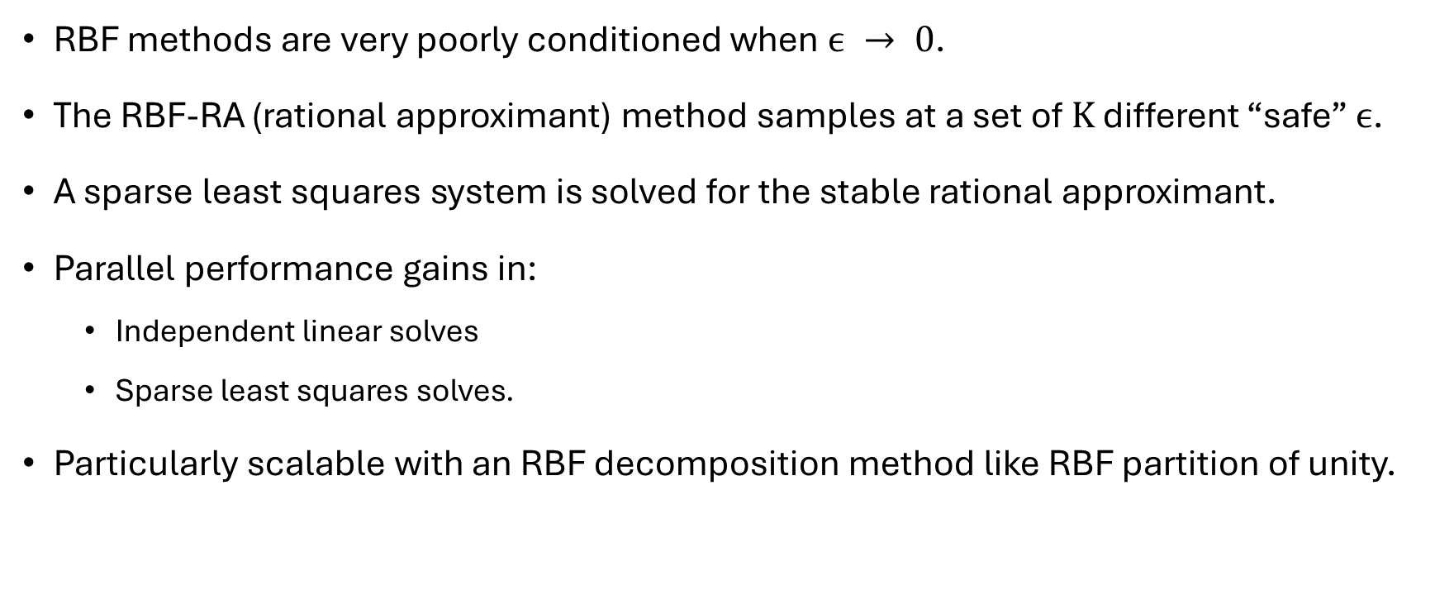
RBF-RA
RBF methods are very poorly conditioned when $ϵ → 0$.
The RBF-RA (rational approximant) method samples at a set of $K$ different “safe” $ϵ$.
A sparse least squares system is solved for the stable rational approximant.
Parallel performance gains in:
Independent linear solves
Sparse least squares solves.
Particularly scalable with an RBF decomposition method like RBF partition of unity.

Slide 4
Project
Implement the RBF-RA method in a parallel manner.
Use it to solve Poisson, Navier Stokes, etc.
Analyze performance on a theoretical and implementation level.

Slide 5
References
Wright, Fornberg. Stable computations with flat radial basis functions using vector-valued rational approximations. 2016.

