Slide 1


Arrhythmia Detection using Deep Learning
November 27th, 2023
Robarts Research Institute
Department of biomedical
Engineering
Notes:
Thank you for the introduction.

Slide 2
Arrhythmia
Arrhythmias are deviations from the normal heart rhythm
It can be broadly classified into atrial, ventricular, and supraventricular types.
Most frequently occurring arrhythmia Atrial fibrillation, Premature ventricular contractions, Supraventricular tachycardia, Ventricular tachycardia and Atrial flutter.

Slide 3
Arrhythmia Detection using DL
Using computer-based algorithms to analyze realize automatic detection of arrhythmia can provide more effective and reliable diagnosis basis for medical workers.

Slide 4
Arrhythmia Detection using DL
Data Collection and preparation
Data Preprocessing
DL Model
Model Training and Optimization
Performance Evaluation

Slide 5
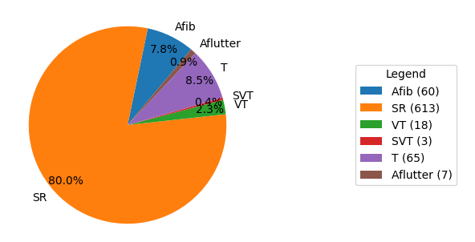
Data Collection And Preparation
We have collected around 1000 12 lead ECG data from Ethiopia.
Dataset distribution

Slide 6
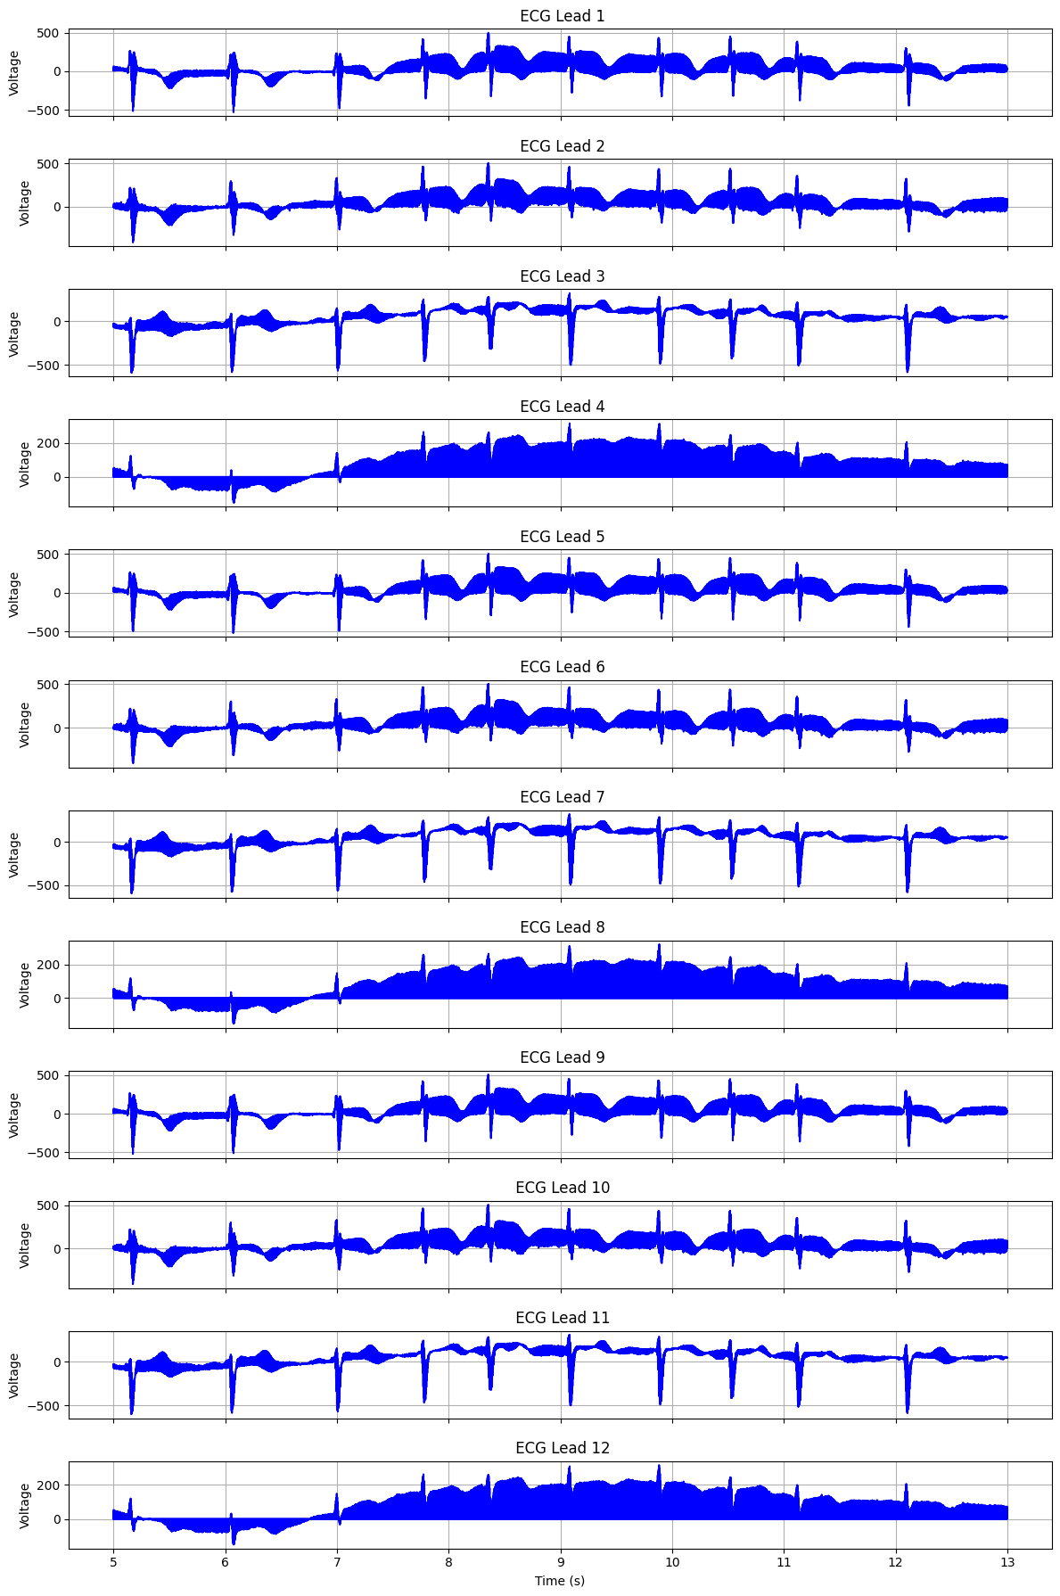
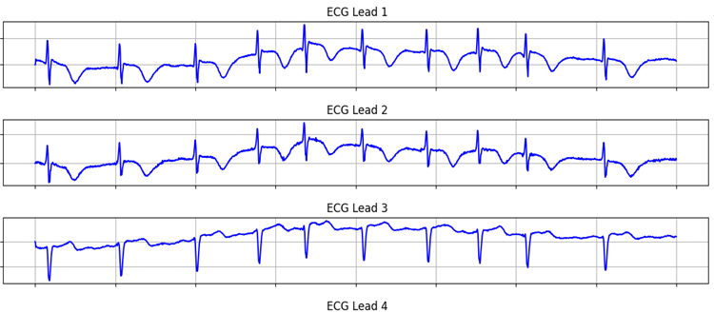
ECG signal preprocessing
ECG signal processing, with a low-pass filter with a cutoff frequency of 150 Hz.
For filtering high-frequency noise from ECG signals.
Original data filtered data

Slide 7
ECG signal preprocessing
Data augmentation to increase the diversity and size of a dataset.
Augmentation enhances a dataset by applying transformations, such as rotation, scaling, flipping, and time warping.

Slide 8
Model Architecture
The model is a deep Convolutional Neural Network (CNN) designed for detection of ventricular tachycardia (VT) and Atrial Fibrillation using ECG signals.
It consists of ten convolutional blocks with increasing filter sizes, batch normalization, and dropout layers.

Slide 9
Model Architecture
The architecture concludes with fully connected layers leading to a two-node softmax output.
Training utilizes class-weighted binary cross-entropy loss with the Adam optimizer, incorporating early stopping and model checkpointing.

Slide 10
Performance Evaluation
we utilized metrics such as accuracy, sensitivity, and specificity.
We choose 1 lead which is strong representation of cardiac activity and used for arrhythmia detection.
To assess the impact on model performance, the model is provide with one lead and then with two leads.
For a comparison of the model's performance

Slide 11
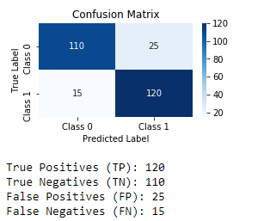
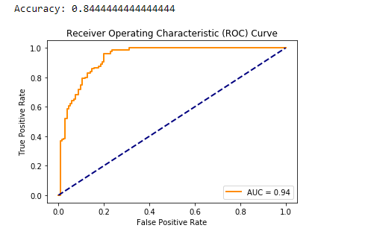
Performance Evaluation for AF detection with one lead

Slide 12
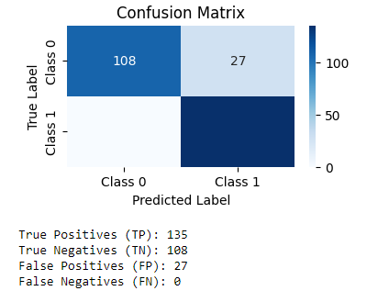
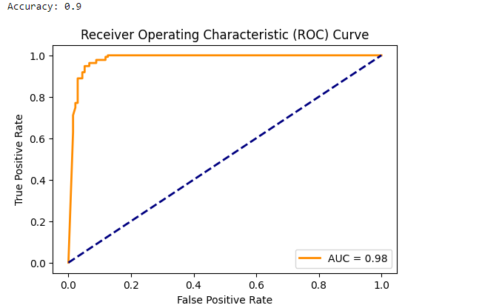
Two leads

Slide 13
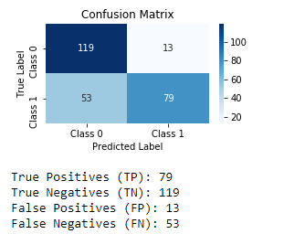
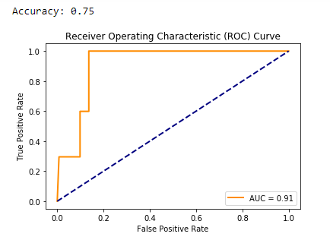
Performance Evaluation for VT detection with one lead

Slide 14
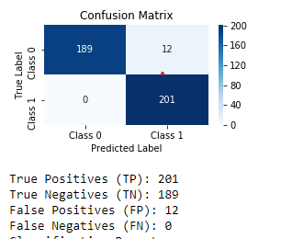
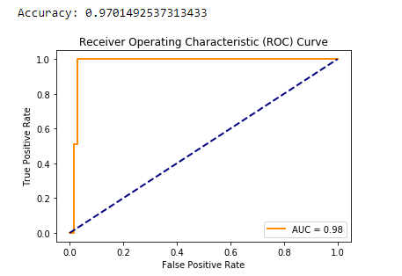
Two lead

Slide 15
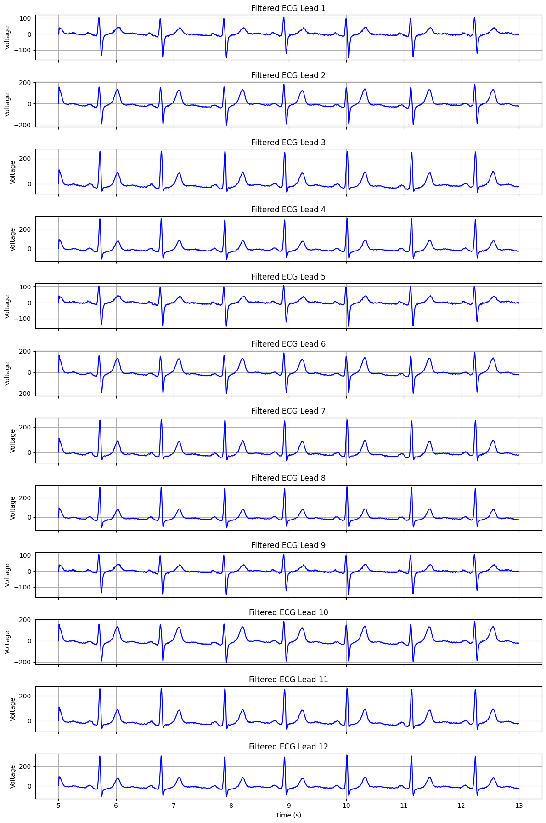
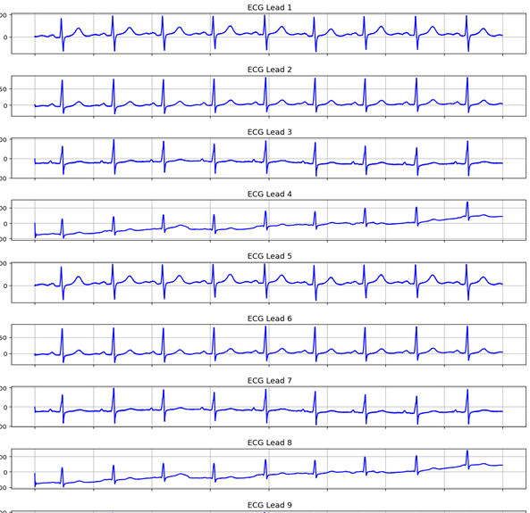
Challenge
Data imbalance
The dataset includes 12 ECG leads, but some exhibit similarities when plotted.

Slide 16
Next step
Segmenting the QRS complex before inputting it into a Convolutional Neural Network (CNN) model.
This segmentation allows us to focus on the specific region of interest, capturing fine details critical for VT identification.

Slide 17
Next step
The QRS complex segmentation involves isolating the QRS region from the rest of the ECG signal.
Collecting more data to enrich the dataset.
Hyperparameter tuning to optimizing the performance of model.

Slide 18
Reference
[S. Sahoo , M. Dash , S. Behera c S. Sabut, "Machine Learning Approach to Detect Cardiac Arrhythmias in ECG Signals: A Survey," Elsevier masson, 2019.
Malek Badr ,Shaha Al-Otaibi , Nazik Alturki, and Tanvir Abir , "Detection of Heart Arrhythmia on Electrocardiogram using Artificial Neural Networks," Hindawi, 2022.

Slide 19
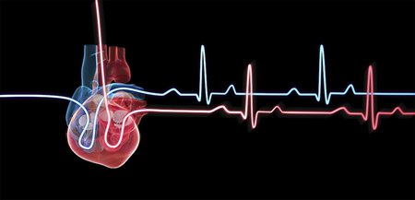
THANK YOU !

