Slide 1
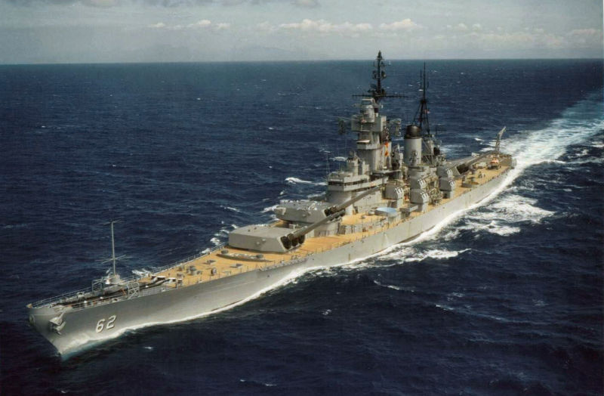

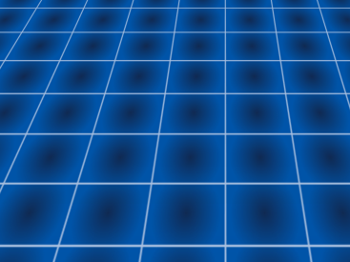
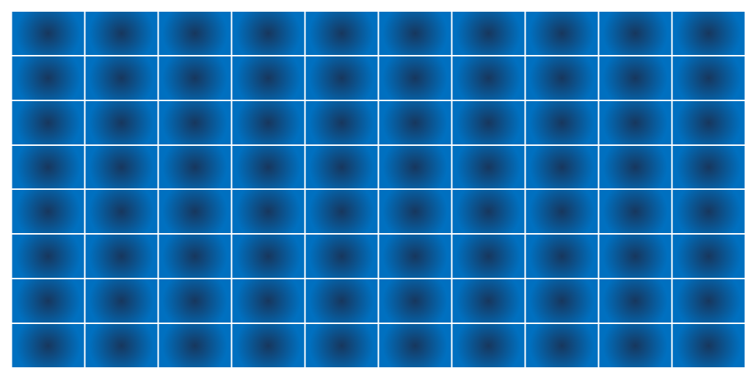
EEE212-04:
GROUP 9:
8052
BATTLESHIPS
GONZALES SIZED!

Slide 2
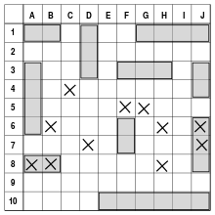
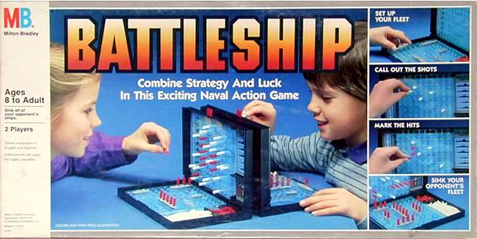
INTRODUCTION
Battleship is a classic, two-player pen AND PAPER GAME.

Slide 3
How to play
Goal: BOMBARD ALL OF YOUR OPPONENT’s SHIPS BEFORE OPPONENT BOMARDS YOURS!
IN EACH TURN CHOOSE A TILE
OPPONENT SAYS IF HIT/MISS
REPEAT UNTIL ONE PLAYER LOSES ALL SHIPS.

Slide 4
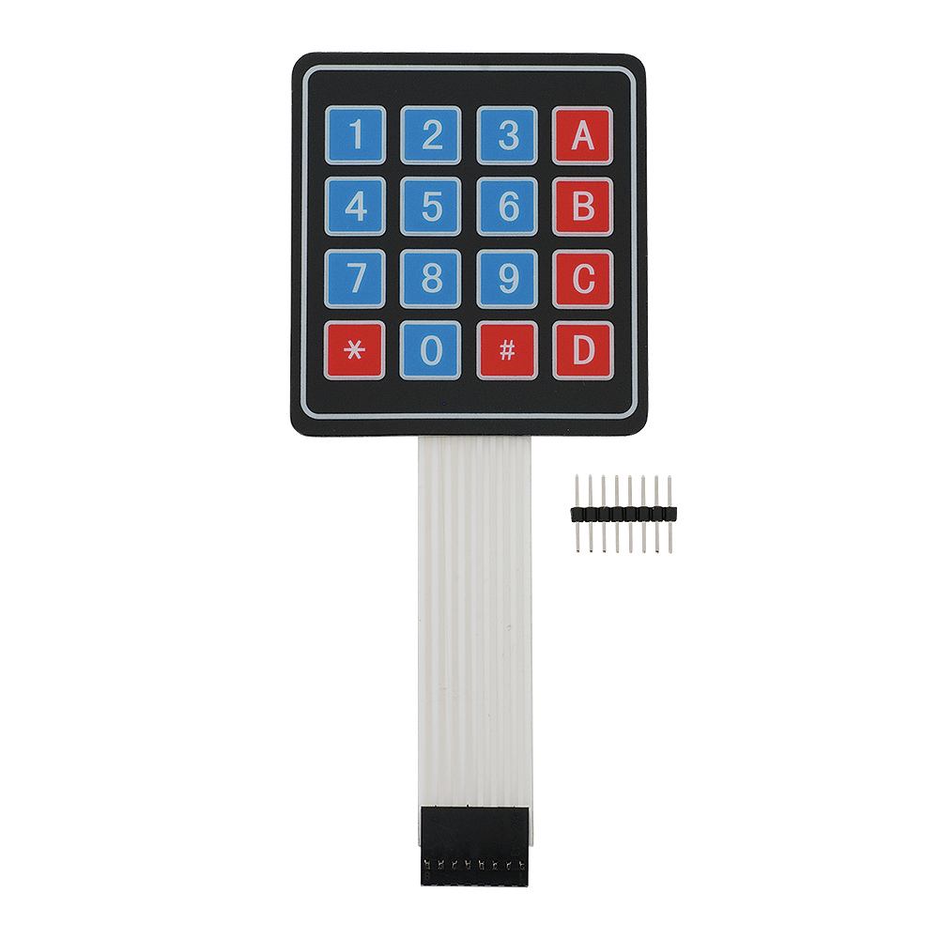
YOUR RADAR (OPPONENT MAP)
HOW TO PLAY
START:
Enter map number to choose a (preset) map (out of 0-79) (14 implemented)
TURN:
Enter 9 to begin turn
Enter row letter and column number of tile to bombard.
Enter 8 to clear input
Enter 9 to bombard
Your radar is updated. Enter 9 to end turn.
END:
Game ends automatically when any player loses 12 (or another preset number) of ship tiles.
INPUTS:
# | 1 | 2 | 3 | 4 | 5 | 6 | 7
A
B
C
D
E
F
G
# | 1 | 2 | 3 | 4 | 5 | 6 | 7
A
B
C
D
E
F
G
G
0F
E
YOUR MAP

Slide 5
Maps are saved into the RAM
Display tiles co-respond directly with
RAM locations
# | 1 | 2 | 3 | 4 | 5 | 6 | 7
A
B
C
D
E
F
G
 | RAM USAGE
00H | REGISTERS
08H : 20H | STACK
28H | PROGRAM BITS
30H 38H | PROGRAM BYTES
40H : 78H | P1 MAP
80H : B8H | P2 MAP
C0H : FFH | TEXT SCREEN MAP
Tile Row
 | 0 | 1 | 2 | 3 | 4 | 5 | 6 | 7
0 | # | 1 | 2 | 3 | 4 | 5 | 6 | 7
1 | A | O | O | SE | SH | SH | SW | O
2 | B | O | O | O | O | O | O | O
3 | C | SS | O | O | O | O | O | O
4 | D | SV | O | O | O | O | O | O
5 | E | SN | O | O | O | O | O | SS
6 | F | O | O | SE | SW | O | O | SV
7 | G | O | O | O | O | O | O | SN
Tile Col

Slide 6
EEPROM USAGE
Preset maps were generated and encoded using a random map generator app we wrote on Java.
They are all stored on an EEPROM.
An 8x8 map can be expressed with 64 tiles, as 64B. 15B are the axes, 49B are the ships.
The EEPROM maps are encoded and so occupy 19B of space instead of 49B, saving about 60% of space.
We can easily fit 80 maps into 2kB of EEPROM

Slide 7
Two Types of Data Used for Maps
7 (M) | 6 (P) | 5 (L) | 4 | 3 | 2 | 1 | 0
M = 1
M = 0
Row Mapper Byte
Tile ID Byte
1 | # | # | # | # | # | # | #
0 | # | # | # | # | # | # | #

Slide 8
TILE ID BYTES
7 (M) | 6 (P) | 5 (L) | 4 # | 3 # | 2 # | 1 # | 0 #
TILE ID LOGIC:
M = 0 for all tiles
PL = 00 Digit & Symbol Tiles (LUT 1)
PL = 01 Letter Tiles (LUT 2)
PL = 10 Picture Tiles (LUT 3)
PL = 11 Unused

Slide 9
Row Mapper Bytes
7 1 | 6 0 | 5 0 | 4 0 | 3 1 | 2 0 | 1 1 | 0 0
LOGIC:
M = 1 for all row mappers.
Other bits are 0 for sea tiles and 1 for ship tiles.
Each row mapper is followed by the ID’s of mapped ships, in order of occurrence.
Examples:
# | 1 | 2 | 3 | 4 | 5 | 6 | 7
A
B
C
D
E
F
G
1 | 0 | 0 | 1 | 1 | 1 | 1 | 0
1 | 0 | 0 | 0 | 0 | 0 | 0 | 1

Slide 10
MAP ENCODING
Using row mappers and tile ID’s in logical order, each map can be expressed using 19B.
Example:
0 5 0 5 0 0 0
0 6 0 6 0 0 0
0 3 0 3 0 0 0
0 0 0 0 5 0 0
0 0 0 0 6 0 0
0 0 0 0 6 0 0
2 4 0 0 3 0 0
Bytes:
|10101000| |01001001|01001001| Row mapper + ID’s of 2 ship tiles
|10101000| |01001010|01001010| etc.
|10101000| |01000111|01000111|
|10000100| |01001001|
|10000100| |01001010|
|10000100| |01001010|
|11100100| |01000110|01001000|01000111|
Map
DB 0A8H, 049H, 049H, 0A8H, 04AH, 04AH, 0A8H, 047H, 047H, 084H, 049H, 084H, 04AH, 084H, 04AH, 0E4H, 046H, 048H, 047H
Bytes for LUT

Slide 11
LCD USAGE
Tiles are 8 pixels wide and high.
So 8 tiles fit nicely onto a 64x64 px map.
And 2 maps fit onto the 64x128 LCD, one as player map, one as player radar.
The LCD is setup in 8px – wide “pages”.
8 tiles fit nicely onto a page.

Slide 12
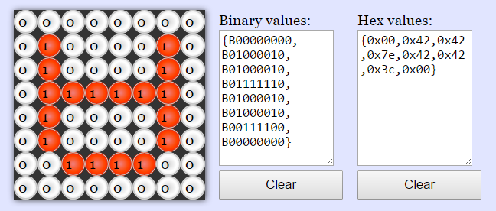
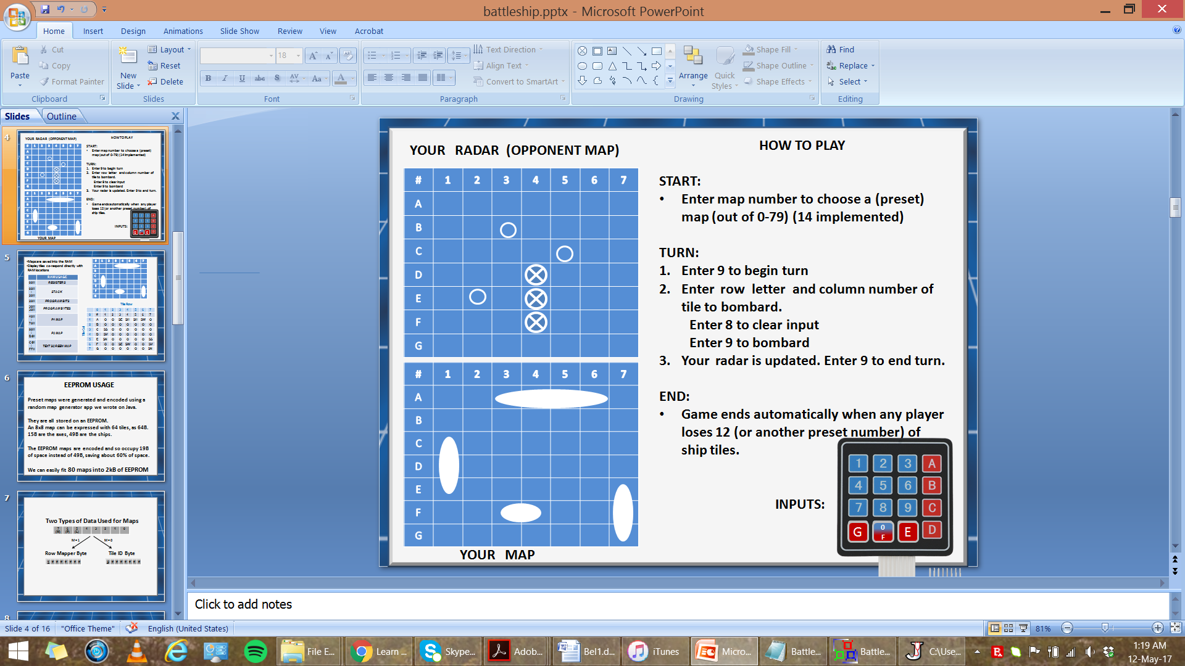
LCD USAGE
Tiles are encoded upside-down, because the LCD is used sideways, and tiles can be loaded from bottom to top, in columns.
Loading is from red to violet
Encoding help from:
https://www.riyas.org/2013/12/online-led-matrix-font-generator-with.html

Slide 13
LCD USAGE
To display a tile,
1) its TILE_ID is fetched from the RAM map
2) And used to navigate DPTR through the tile pixels LUT.
3) And 8 bytes of pixel information for the tile are sent to the LCD.

Slide 14
IMPORTANT REGISTERS
(see code)
IMPORTANT SUBROUTINES
SELECT_TILE (according to given row,col)
WRITE_TILE (to LCD)
UPDATE_LCD_ALL (Writes everything)

Slide 15
Lessons learned:
*Scrutinizing datasheets and writing code from scratch
*Connecting several peripherals
*Planning all concepts on paper to make coding quicker and easier
*Flexible job distribution

Slide 16
Work Distribution (Out of 4, Redion : Levent)
*Learn EEPROM (3 : 1)
*Learn Graphic LCD (2 : 2)
*Test program for EEPROM and LCD (2 : 2)
*Random map generator program (Java) (0:4)
*Subroutine plan (0:4)
*Circuit construction (4:0)
*Font (tile pixels) generation (3:1)
*Load EEPROM (2:2)
*Write program model (1:3)
*Integrate peripherals into model (2:2)
*Debugging over 1000 lines of code (2:2)

Slide 17
MISSION ACCOMPLISHED

