Slide 1

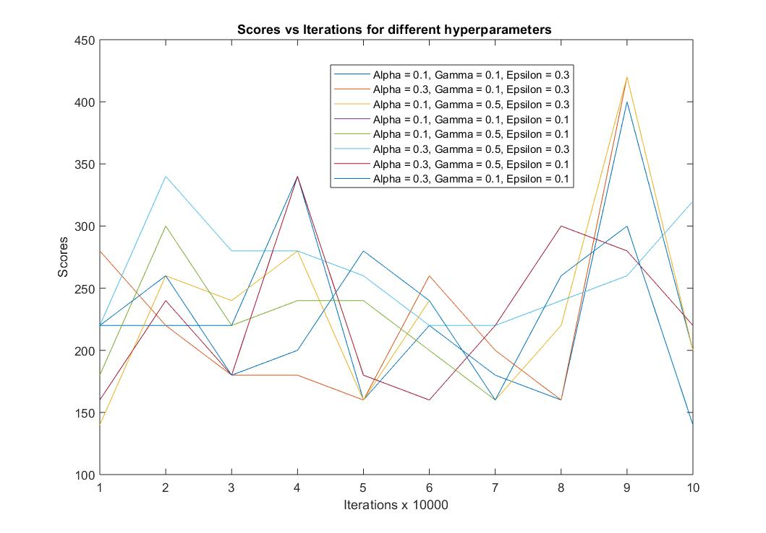
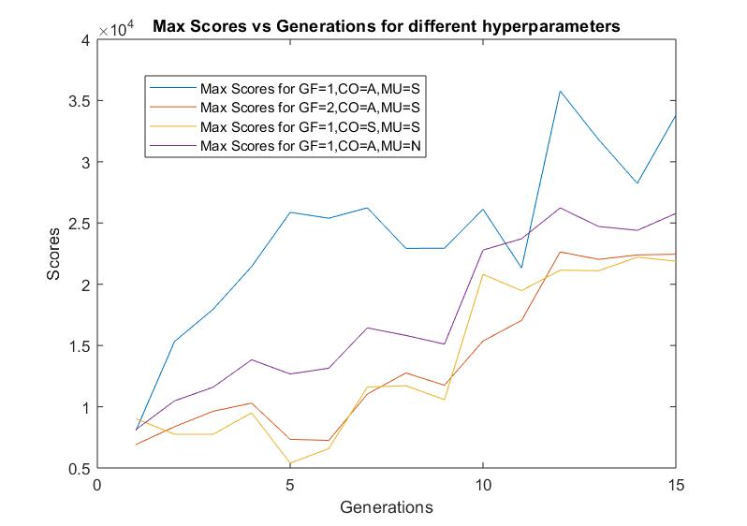
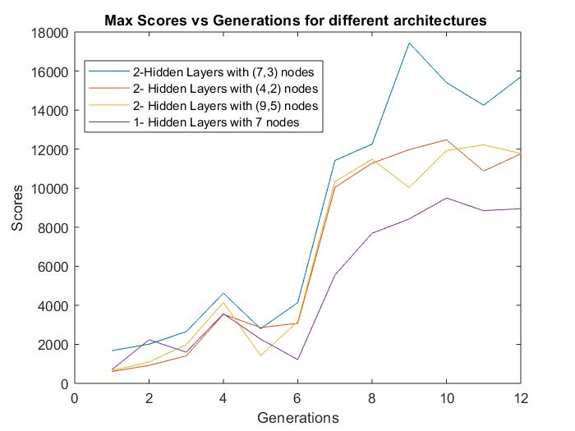
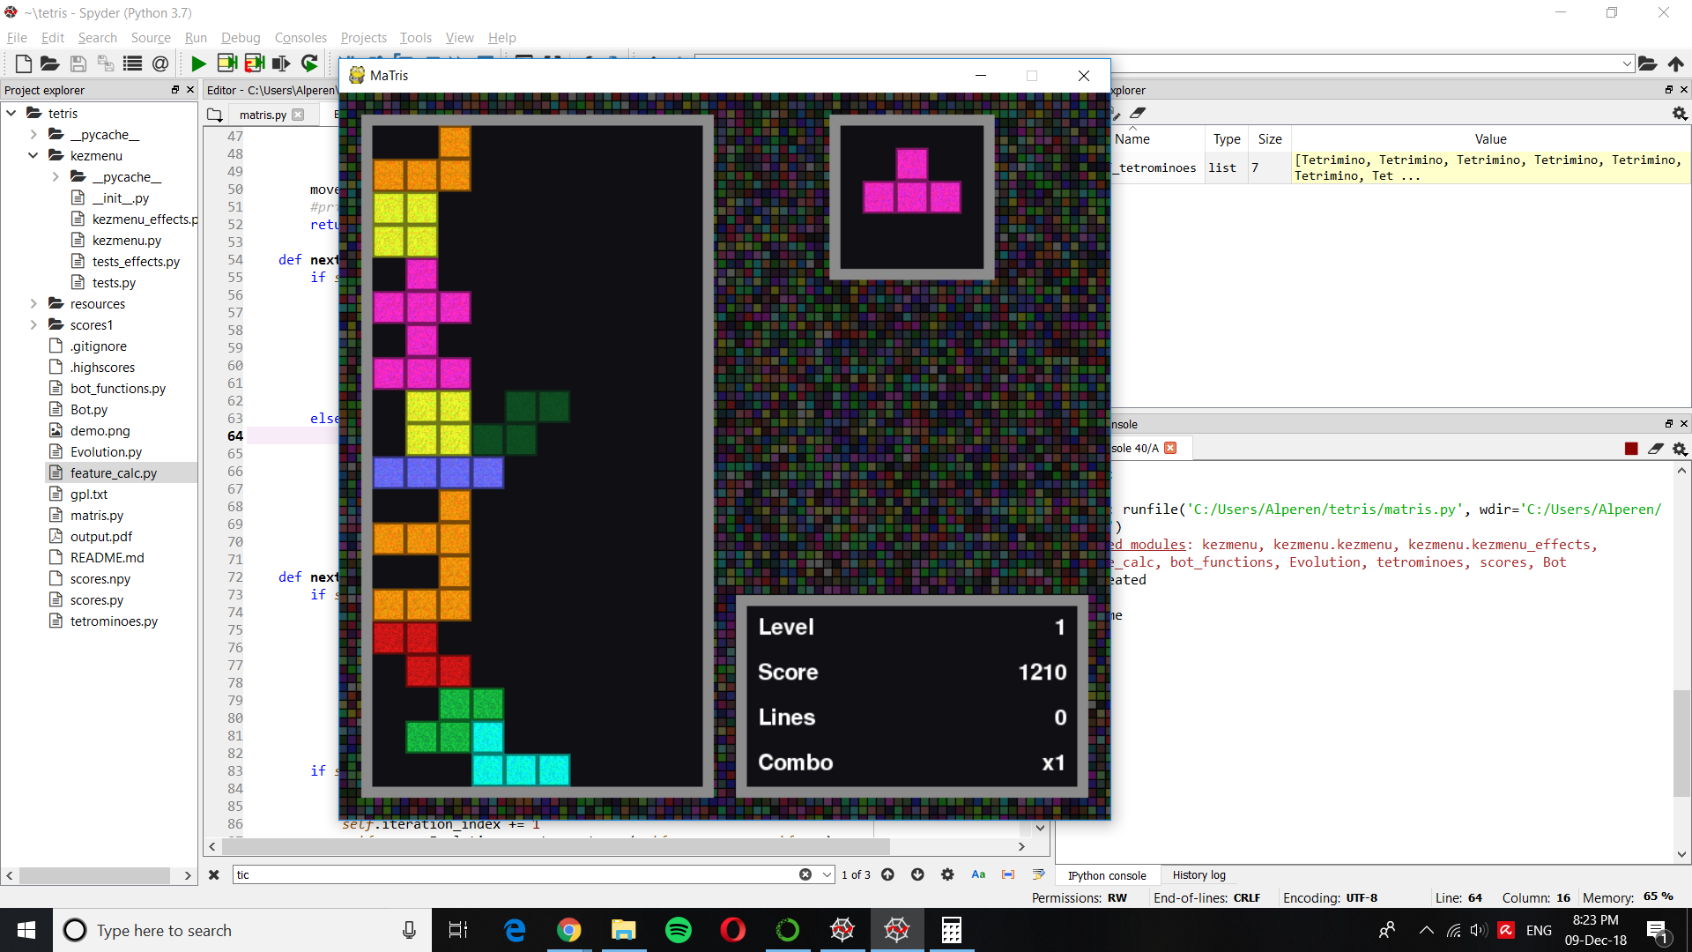
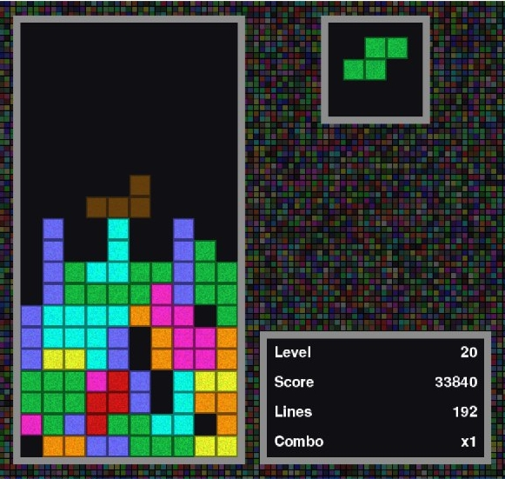
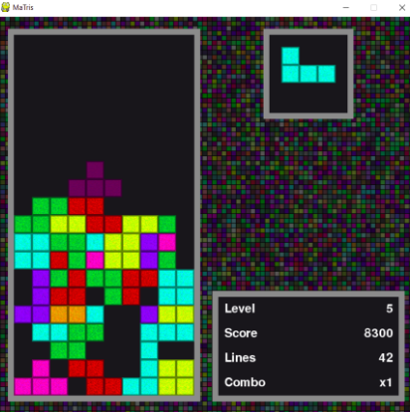
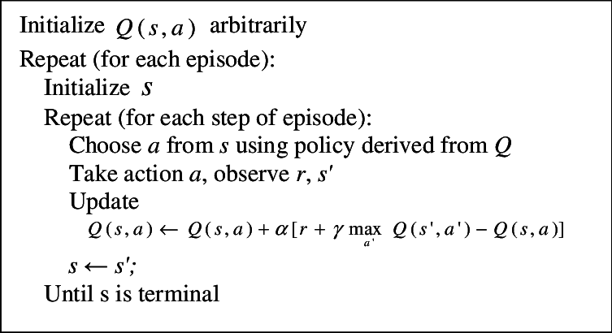
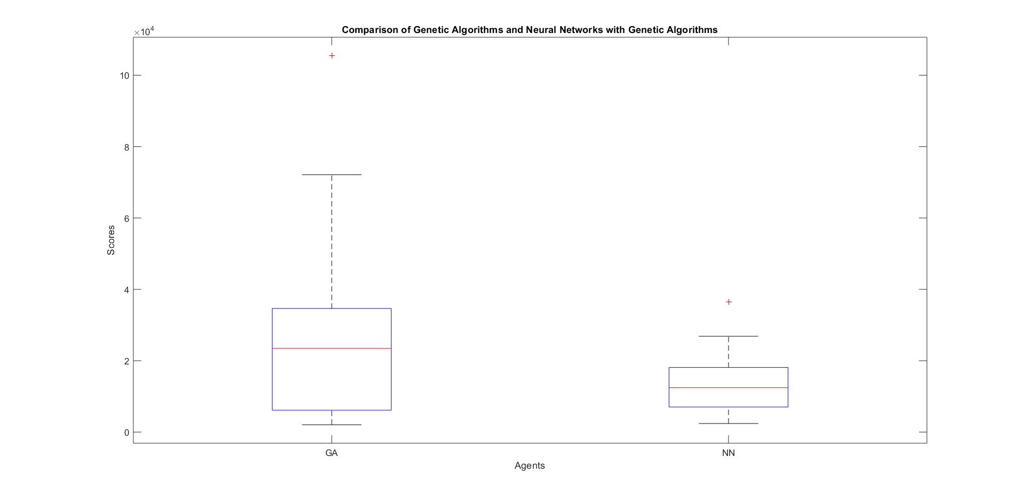
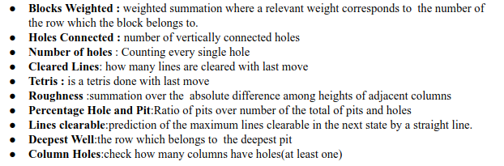
Playing Tetris using Reinforcement Learning Methods
Alperen Tercan and Redion Xhepa
Department of Electrical and Electronics Engineering, Bilkent University
alperen.tercan@ug.bilkent.edu.tr, redion.xhepa@ug.bilkent.edu.tr
Introduction
Emulator
Tetris is the classic falling blocks video game invented by Russian programmer Alexey Pajitnov in 1984.
Tetris is a demanding game in terms of playing because the falling tetromino is random and has a multitude of variety.
Player(AI agent) is expected to independently develop long-term strategies to cope with the inherent stochasticity of the falling tetromino.RTIAL AND SUBJECTIVE FEEDBAC
OBJECTIVE : The aim of this project is to be able to train a bot which will be able to play Tetris using three different algorithms:Q Learning,Genetic Algorithm and Neural Networks with Genetic Algorithm
Considering that we are using unsupervised machine learning techniques we do not need to have ready labelled data.In order to be able to make our “AI agent” play itself the game, we had first to find and then adjust a Tetris emulator according to our need. For this reason, we tried to use the open-source code found in [1].
Our first duty was to skip the pressing of the button.
Later on, we had to alter the code even more in order to adjust the speed since we needed a lot of time to train and test our system
1,200 TEST EXECUTIONS IN TOTAL
Q Learning
Genetic Algorithms
Neural Network with Genetic algorithms
Q Learning
Genetic Algorithms
Neural Network with Genetic algorithms
Q Value:
The expected long-term return of state s, performing the action a under a policy π[2].
State Reduction
We map height difference between consecutive columns 0 to 0,1 to 1,-1 to 2,2 to 3, -2 to 4 and the rest to 5.As a result there are 9072 states.
Algorithm:
PseudoCode
Reward Function
Genetic Algorithms are an approach to optimization by simulating natural selection[3]. A population of candidate inputs is maintained. The better a candidate performs, the more likely it will contribute to the next generation, resulting in better candidates each generation
Weights are modelled corresponding to the features as genes. Hence, each individual has 10 genes. We initialize that these genes as random number sampled from a uniform distribution with zero mean and 5 range.
We used average of 10 games and population size of 10
Features
The idea to combine Neural Networks with Genetic Algorithms was being used in [3].
We use could Genetic Algorithm as a method to train the neural network.
We anticipated that the Neural Network would capture more nonlinear relation of the data(adding fidelity to the system) whereas just the simple linear relation that the Genetic algorithm alone would do.
Genetic vs Genetic +Neural
Conclusion
Reducing the state-space of deteriorates the learning of the Q-Learning Algorithm
Genetic Algorithm is a superior learning algorithm which gives the best performance
Neural Networks with Genetic Algorithm is the second best.It develops aggressive strategies.Given enough training it would better than Genetic Algorithm in its own
References
[1]https://github.com/Uglemat/MaTris
[2]Lundgaard , Nicholas, and Brian McKee. Reinforcement Learning and Neural Networks for Tetris.
[3]Lewis, Jason. Playing Tetris with Genetic Algorithms. 2015.

