Slide 1
Hit

Slide 2
Retrieves the cursor that should be displayed by the OS
FViewportClient
virtual EMouseCursor::Type GetCursor(FViewport* Viewport,int32 X,int32 Y) { return EMouseCursor::Default; }
当光标查询，才调用下面函数
const TArray<FColor>& FViewport::GetRawHitProxyData(FIntRect InRect)；

Slide 3
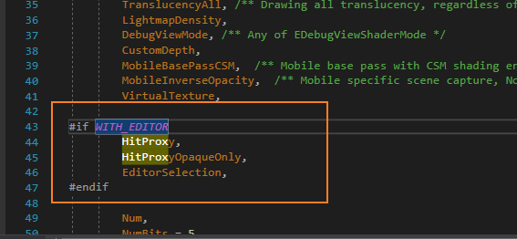
HitProxy Pass
Renderer\Public\MeshPassProcessor.h

Slide 4
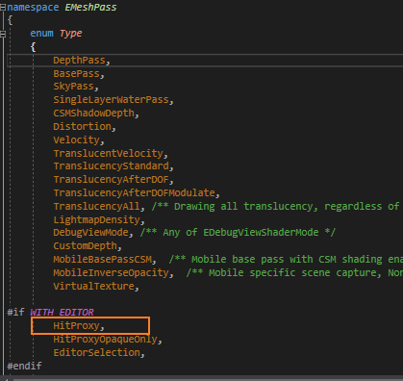
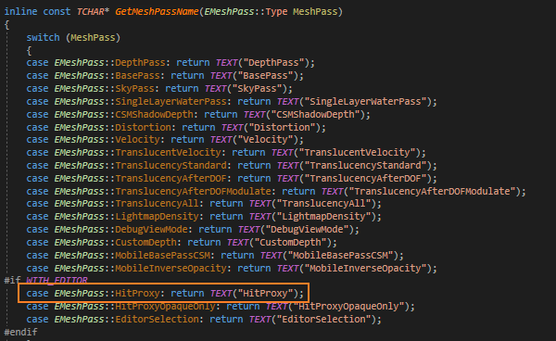
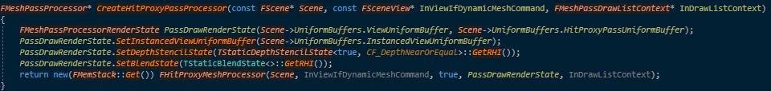
声明MeshPass
命名
创建Pass对应的Processor并且注册
Renderer\Private\SceneHitProxyRendering.cpp
AddMeshBatch
在MarkRelevant方法中添加静态的MeshBatch
在ComputeDynamicMeshRelevance中添加动态的MeshBatch。
Renderer\Private\SceneHitProxyRendering.cpp
下一页

Slide 5
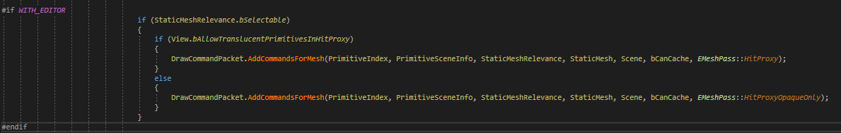
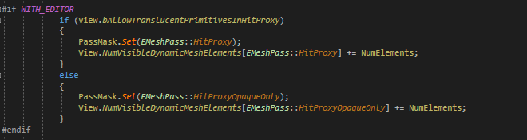
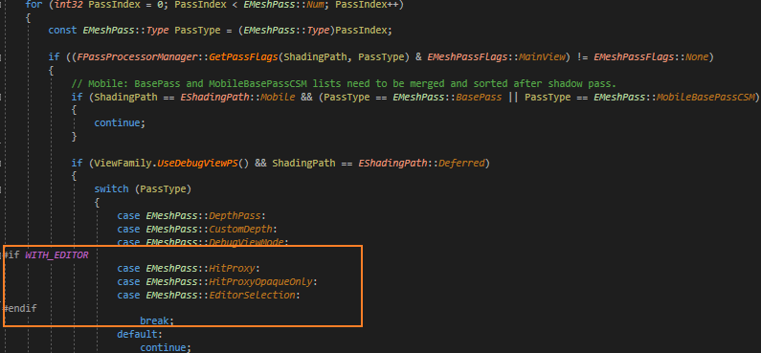
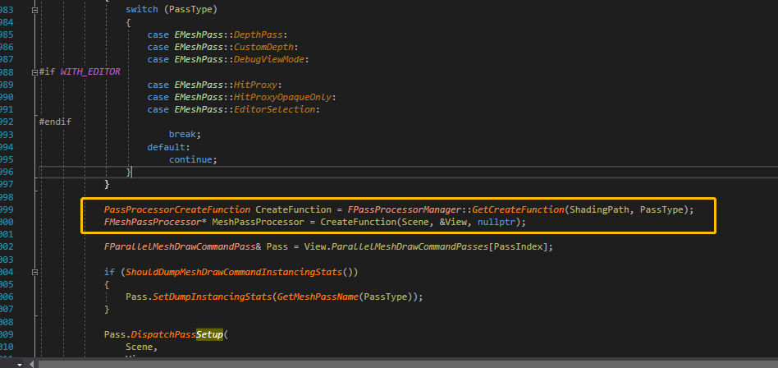
MarkRelevant(静态)
Renderer\Private\SceneVisibility.cpp
SetupMeshPass
https://papalqi.cn/index.php/2019/11/22/ue4-%E8%A7%A3%E6%9E%90initview/
ComputeDynamicMeshRelevance（动态）
Renderer\Private\SceneVisibility.cpp
AddMeshBatch
ComputeDynamicMeshRelevance（）
一个是SceneRendering.cpp的SetupMeshPass，这里在对所有的Pass都会有一个Dispatch方法,对Pass做派发
SceneRendering.cpp
InitView

Slide 6
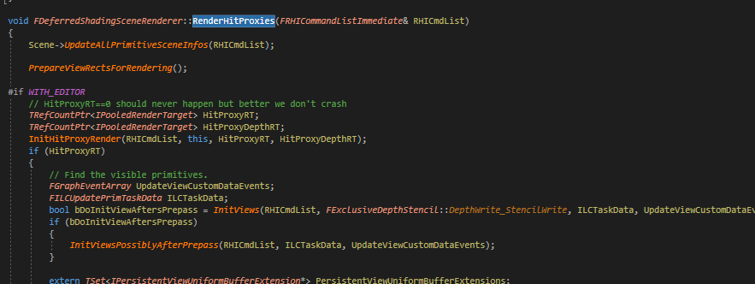
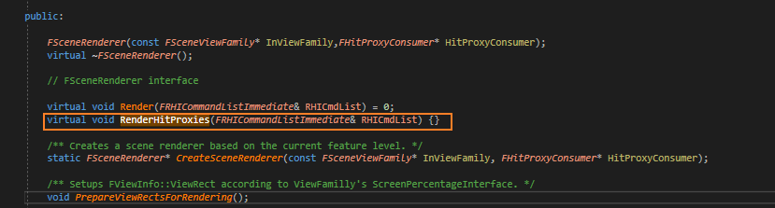
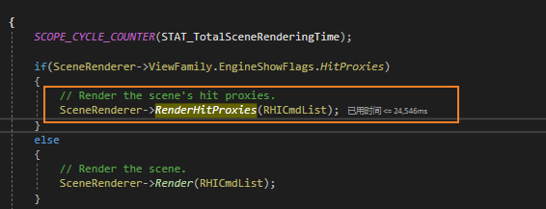
生成DrawCommand
Renderer\Private\SceneHitProxyRendering.cpp中实现该函数
SceneRendering.h，添加声明函数
SceneVisibility.cpp
SceneRendering.cpp
RenderViewFamily_RenderThread函数 调用
Renderer\Private\SceneRendering.cpp
ViewFamily.EngineShowFlags.HitProxie
与Render()线程分开，要么调用RenderHitProxy，要么调用Render;进入游戏不调用RenderHitProxies;在编辑器模式下鼠标抬起才调用RenderHitProxies

Slide 7
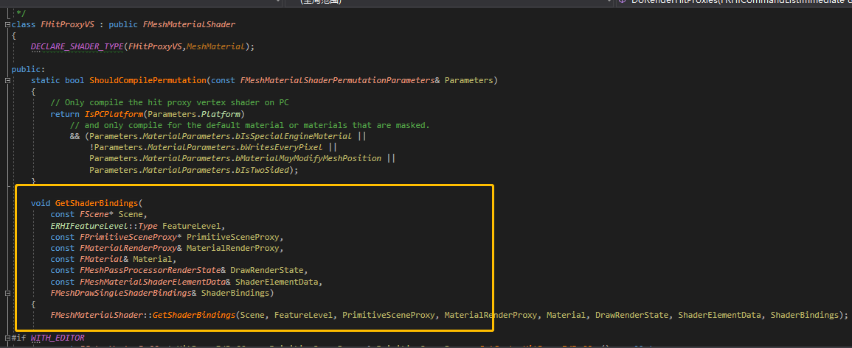
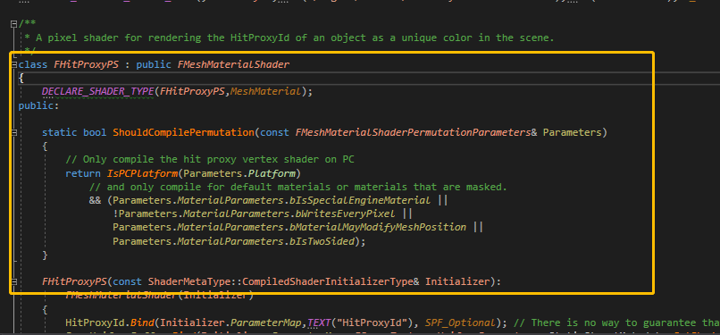
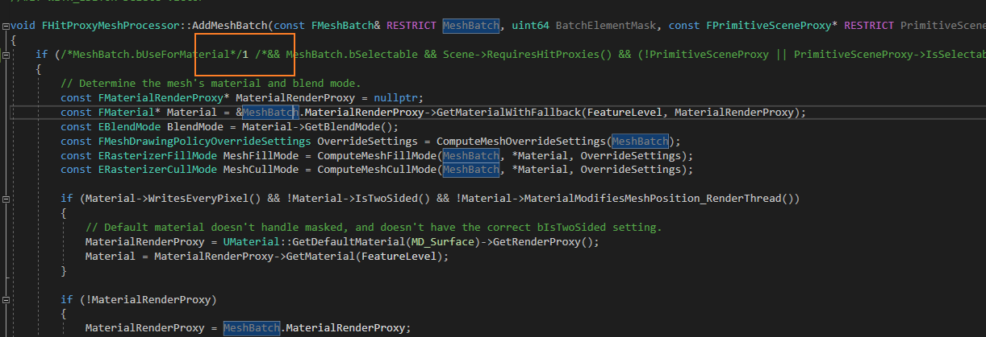
在SceneHitProxyRendering.cpp中的GetShaderBindings函数中将HitProxyId传入shader中进行着色。
后面是渲染的事了……
SceneHitProxyRendering.cpp中修改

Slide 8
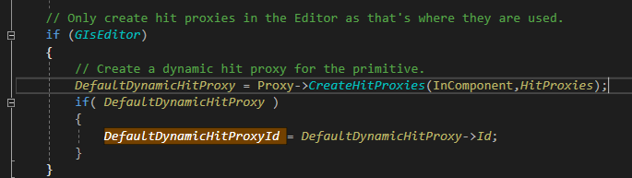
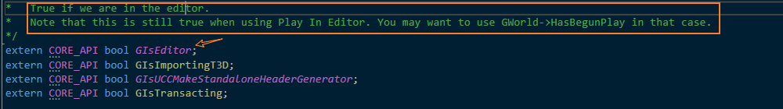
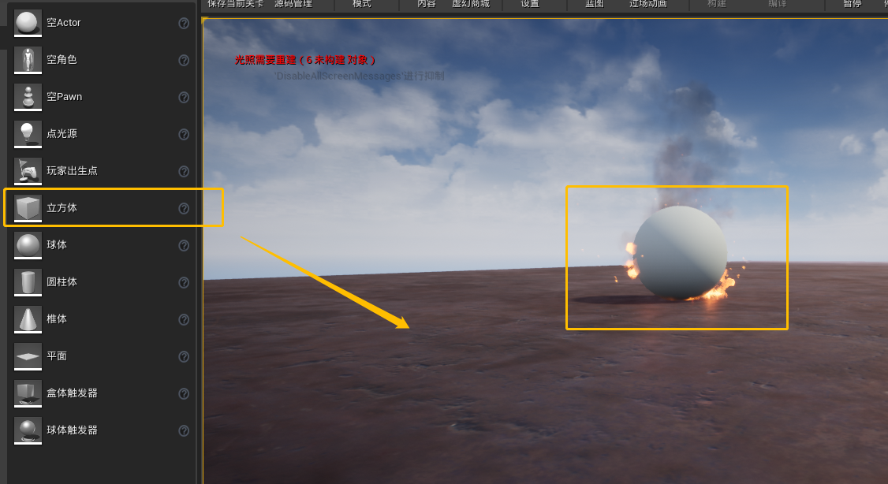
创建HitProxy
每个ActorComponent的基类中都有一个FPrimitiveSceneProxy类来记录一些渲染信息，以及HitProxy信息。在Coponent的创建过程中会为每个Component生成一个动态的HitProxy，并加入到全局的Array中。
`FPrimitiveSceneInfo`的构造函数中
在游戏中创建物体会调用FPrimitiveSceneInfo的构造函数，生成HitProxy；从编辑器中拖入物体也是一样。

Slide 9

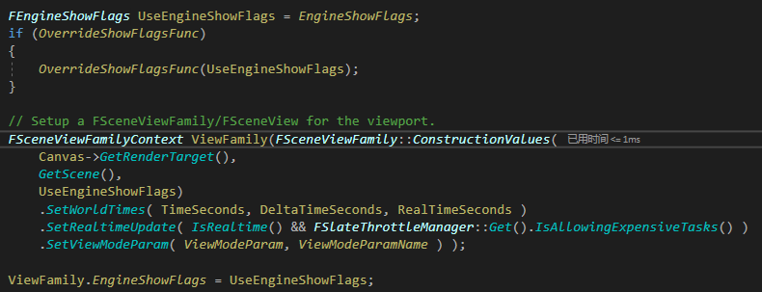
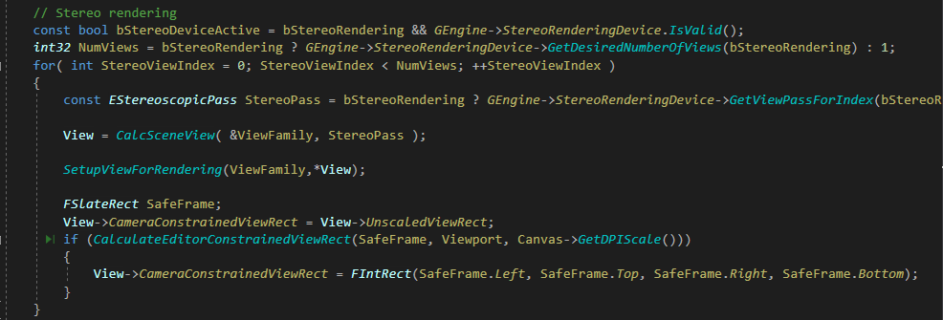
HitProxy更新与查询
GetCursor -> GetHitProxy -> GetHitProxyMap -> GetRawHitProxyData -> Draw
在EditorViewportClient中调用
EditorViewportClient的Draw函数
函数原型： void FEditorViewportClient::Draw(FViewport* InViewport, FCanvas* Canvas)
传入的InViewport会进行比较，并且Editor会保存自己本来的后端Viewport
设置FEngineShowFlags和创建ViewFamily
VR渲染

Slide 10
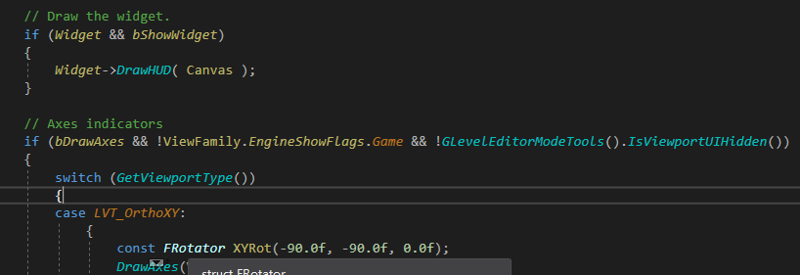
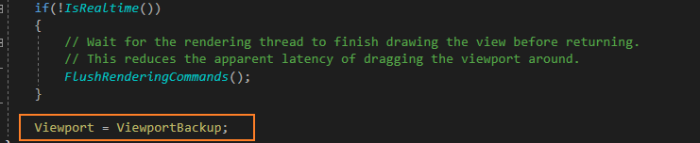
HitProxy更新与查询
渲染三维场景，进入主渲染线程
画组件和轴指示器
设置回原来的Viewport
End Draw……

Slide 11
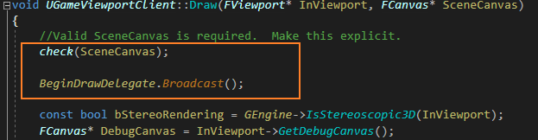
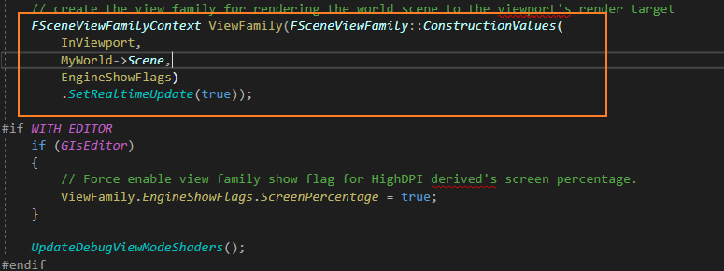
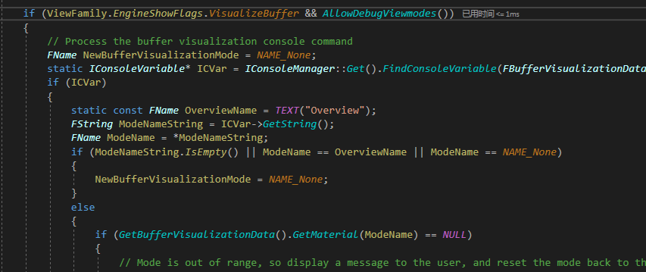
GetCursor -> GetHitProxy -> GetHitProxyMap -> GetRawHitProxyData -> Draw
HitProxy更新与查询
GameViewportClient的Draw函数
void Draw(FViewport* Viewport,FCanvas* SceneCanvas)
开始检查并且广播
设置FEngineShowFlags和创建ViewFamily
处理可视化

Slide 12
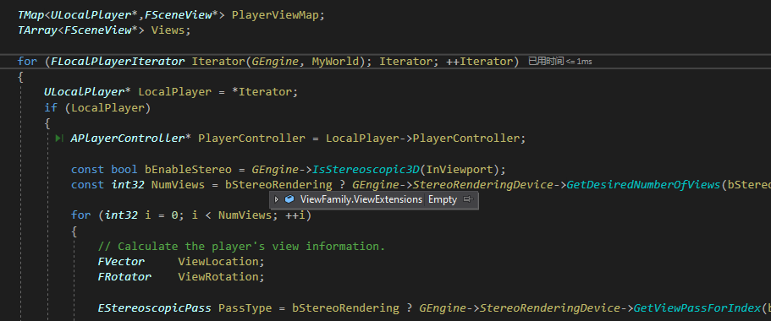
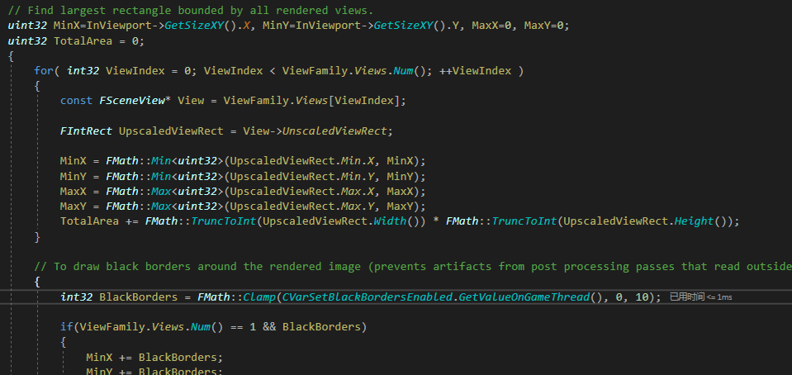
HitProxy更新与查询
创建Player和View的映射
画一些边框和边界
设置视图的动态显示百分比等等

Slide 13
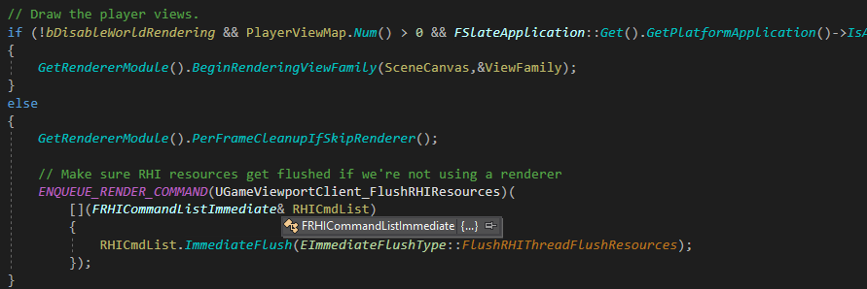
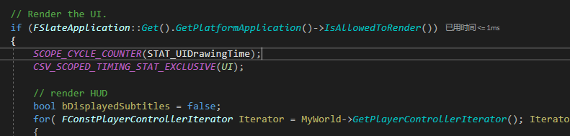
HitProxy更新与查询
开始绘制Player的View
渲染UI、HUD
EndDrawDelegate.Broadcast();

Slide 14
BeginRenderingViewFamily
Draw
RenderViewFamily_RenderThread
FSceneRenderer::CreateSceneRenderer
InitHitProxyRender
InitViews(可视计算)
DoRenderHitProxies
BeginHitProxyRenderpass
RenderHitProxies
（Clear_HitProxies)
View.ParallelMeshDrawCommandPasses[EMeshPass::HitProxy].DispatchDraw(nullptr, RHICmdList);
Ord
View.ParallelMeshDrawCommandPasses[EMeshPass::HitProxyOpaqueOnly].DispatchDraw(nullptr, RHICmdList);
从Main到Render发出命令
从Main端发出Rendering命令非常困难，流程如下。 在BeginRenderingViewFamily（）中，全局帧计数器增加。 此外，每帧创建一个FSceneRenderer实例，并将其传递给RenderCommand。
生成框架

Slide 15
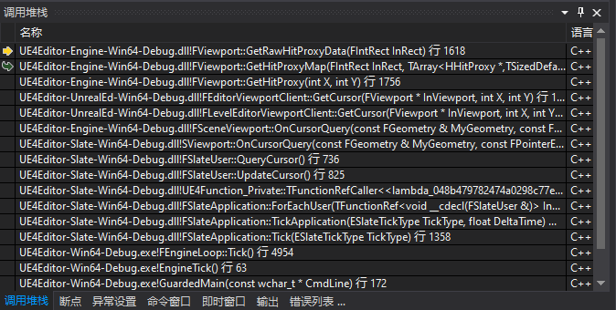
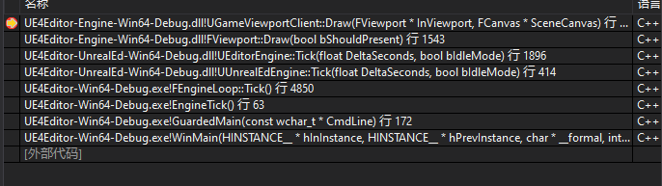
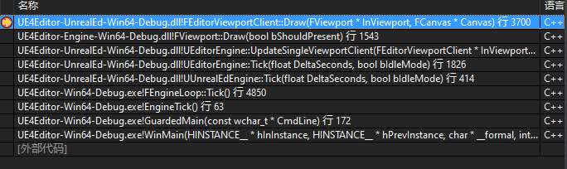
GetCursor -> GetHitProxy -> GetHitProxyMap -> GetRawHitProxyData -> Draw
FCanvas
封装画布状态。
Game
Editor
RenderViewFamily_RenderThread。。。
UUrealEdEngine::tick -> UEditorEngine::tick -> Fviewport::Draw ->UGameViewportClient::draw
UUrealEdEngine::tick -> UEditorEngine::tick -> UEditorEngine::UpdateSingleViewportClient -> Fviewport::Draw ->UEditorViewportClient::draw

Slide 16
在EditorEngine.cpp文件中
// Render view parents, then view children.
bool bEditorFrameNonRealtimeViewportDrawn = false;
if (GCurrentLevelEditingViewportClient && GCurrentLevelEditingViewportClient->IsVisible())
{
if (!bAllWindowsHidden || GCurrentLevelEditingViewportClient->WantsDrawWhenAppIsHidden())
{
bool bAllowNonRealtimeViewports = true;
bool bWasNonRealtimeViewportDraw = UpdateSingleViewportClient(GCurrentLevelEditingViewportClient, bAllowNonRealtimeViewports, bUpdateLinkedOrthoViewports);
if (GCurrentLevelEditingViewportClient->IsLevelEditorClient())
{
bEditorFrameNonRealtimeViewportDrawn |= bWasNonRealtimeViewportDraw;
}
}
}
……
if( FSlateThrottleManager::Get().IsAllowingExpensiveTasks() )
{
for (auto ContextIt = WorldList.CreateIterator(); ContextIt; ++ContextIt)
{
FWorldContext &PieContext = *ContextIt;
if (PieContext.WorldType != EWorldType::PIE)
{
continue;
}
PlayWorld = PieContext.World();
GameViewport = PieContext.GameViewport;
// Render playworld. This needs to happen after the other viewports for screenshots to work correctly in PIE.
if (PlayWorld && GameViewport && !bIsSimulatingInEditor)
{
// Use the PlayWorld as the GWorld, because who knows what will happen in the Tick.
UWorld* OldGWorld = SetPlayInEditorWorld( PlayWorld );
// Render everything.
GameViewport->LayoutPlayers();
check(GameViewport->Viewport);
GameViewport->Viewport->Draw();
// Pop the world
RestoreEditorWorld( OldGWorld );
}
}
}

Slide 17
/** The view's batched elements. */
视图的批处理元素
FBatchedElements BatchedViewElements;
/** The view's batched elements, above all other elements, for gizmos that should never be occluded. */
该视图的批处理元素比其他所有元素都要重要，这些小控件永远都不会被遮挡。
FBatchedElements TopBatchedViewElements;
/** The view's mesh elements. */
视图的网格元素。
TIndirectArray<FMeshBatch> ViewMeshElements;
/** The view's mesh elements for the foreground (editor gizmos and primitives )*/
视图的前台网格元素(编辑器小工具和原语)
TIndirectArray<FMeshBatch> TopViewMeshElements;
BatchElements
批处理元素
DrawDynamicMeshPass
提供一个回调来构建FMeshDrawCommands，然后立即提交它们。对于遗留编辑器代码路径非常有用。做许多动态分配-不用于游戏渲染。
DrawDynamicMeshPass | 1. DynamicEditorMeshElements
 | 2. ViewMeshElements
 | 3. TopViewMeshElements
 | TopViewMeshElements TopViewMeshElements（twice)

Slide 18
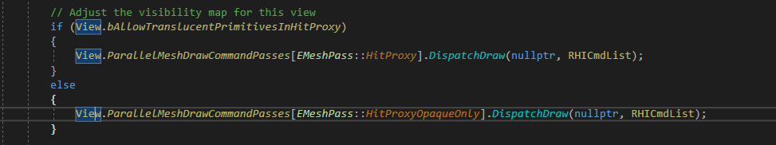
执行点选渲染
每一个Pass都会调用FParallelMeshDrawCommandPass::DispatchDraw函数

Slide 19
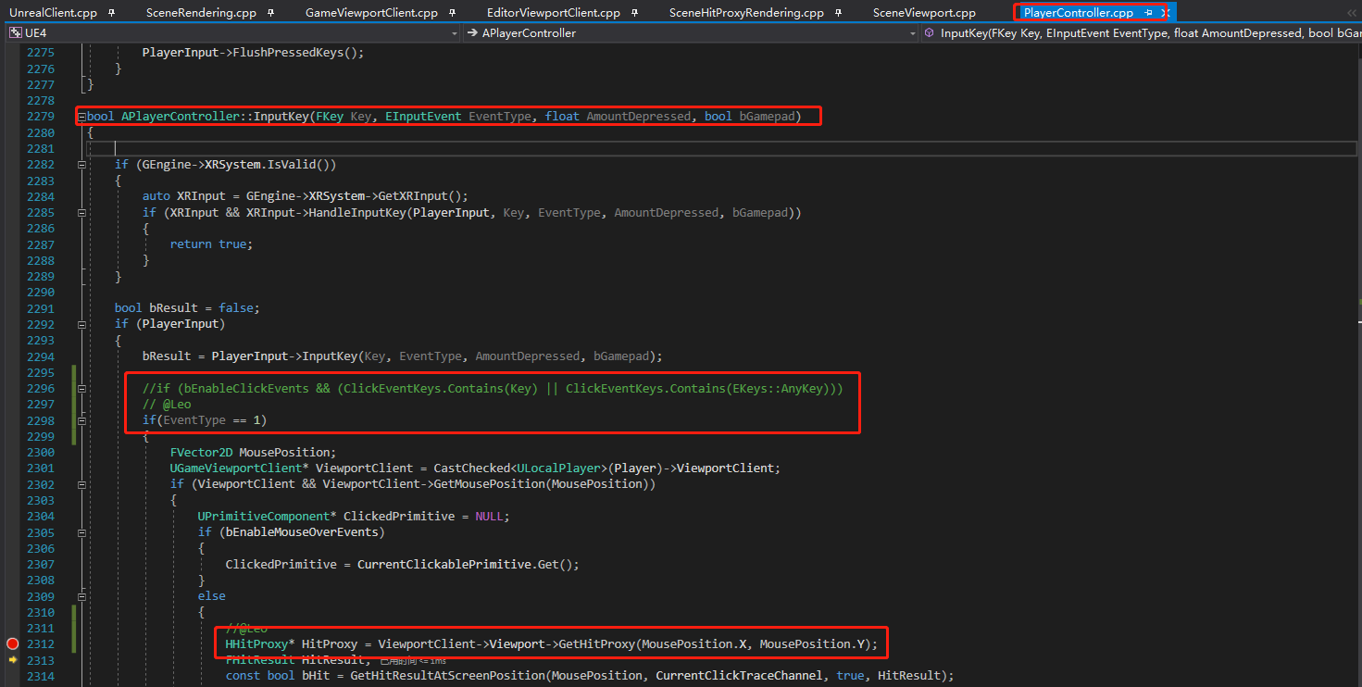
GetGameViewport

Slide 20
类型
FHitProxyConsumer
An interface to a hit proxy consumer
FSceneRenderer
在Main端调用FSceneRenderer :: CreateSceneRenderer，并为每个帧创建一个要在RenderThread端使用的SceneRenderer实例。渲染结束后，将在RenderThread端丢弃SceneRenderer。 要初始化FSceneRenderer，请传递FSceneViewFamily和FHitProxyConsumer。 FSceneViewFamily被复制到FSceneRenderer的成员。从FSceneViewFamily获取场景指针。 将FSceneViewFamily成员的视图（FSceneView类型）转换为视图（FViewInfo类型）并存储。 FViewInfo继承FSCeneView。FViewInfo应该存储由SceneRenderer使用的与视图相关的渲染信息。
BeginRenderingViewFamily函数中SceneRendering.cpp文件中创建
FCanvas Canvas(this, nullptr, ViewportWorld, ViewportWorld ? ViewportWorld->FeatureLevel.GetValue() : GMaxRHIFeatureLevel, FCanvas::CDM_DeferDrawing, ViewportClient->ShouldDPIScaleSceneCanvas() ? ViewportClient->GetDPIScale() : 1.0f);
FCanvas::FCanvas(FRenderTarget* InRenderTarget, FHitProxyConsumer* InHitProxyConsumer, UWorld* InWorld, ERHIFeatureLevel::Type InFeatureLevel, ECanvasDrawMode InDrawMode, float InDPIScale)
:ViewRect(0,0,0,0),ScissorRect(0,0,0,0),RenderTarget(InRenderTarget),HitProxyConsumer(InHitProxyConsumer),Scene(InWorld ? InWorld->Scene : NULL),AllowedModes(0xFFFFFFFF),bRenderTargetDirty(false),CurrentRealTime(0),CurrentWorldTime(0),CurrentDeltaWorldTime(0),FeatureLevel(InFeatureLevel),bUseInternalTexture(false),DrawMode(InDrawMode),DPIScale(InDPIScale)
{Construct();
if (InWorld)
{
CurrentRealTime = InWorld->GetRealTimeSeconds();
CurrentWorldTime = InWorld->GetTimeSeconds();
CurrentDeltaWorldTime = InWorld->GetDeltaSeconds();
}}
Fcanvas构造函数
在Fviewport中传入的FHitProxyConsumer为NULL
FCanvas Canvas(&HitProxyMap, &HitProxyMap, World, World ? World->FeatureLevel.GetValue() : GMaxRHIFeatureLevel, FCanvas::CDM_DeferDrawing, ViewportClient->ShouldDPIScaleSceneCanvas() ? ViewportClient->GetDPIScale() : 1.0f);//唯一使用在获取Hitmap的时候，函数GetRawHitProxyData中

Slide 21
类型
FEngineShowFlags
ShowFlags是一组存储在ViewFamily中的位（某些位在SHIPPING中已固定）。
FMeshDrawCommand 存储了rhi在一个mesh pass渲染调用需要知道的所有信息
包含管线状态、shader及资源绑定、渲染命令参数等。

Slide 22
void FEditorViewportClient::Tick(float DeltaTime)
{
ConditionalCheckHoveredHitProxy();
FViewportCameraTransform& ViewTransform = GetViewTransform();
const bool bIsAnimating = ViewTransform.UpdateTransition();
if (bIsAnimating && GetViewportType() == LVT_Perspective)
{
PerspectiveCameraMoved();
}
if ( bIsTracking )
{
FEditorViewportStats::BeginFrame();
}
if( !bIsAnimating )
{
bIsCameraMovingOnTick = bIsCameraMoving;
// Update any real-time camera movement
UpdateCameraMovement( DeltaTime );
UpdateMouseDelta();
UpdateGestureDelta();
EndCameraMovement();
}
const bool bStereoRendering = GEngine->XRSystem.IsValid() && GEngine->IsStereoscopic3D( Viewport );
if( bStereoRendering )
{
// Every frame, we'll push our camera position to the HMD device, so that it can properly compute a head-relative offset for each eye
if( GEngine->XRSystem->IsHeadTrackingAllowed() )
{
auto XRCamera = GEngine->XRSystem->GetXRCamera();
if (XRCamera.IsValid())
{
FQuat PlayerOrientation = GetViewRotation().Quaternion();
FVector PlayerLocation = GetViewLocation();
XRCamera->UseImplicitHMDPosition(false);
XRCamera->UpdatePlayerCamera(PlayerOrientation, PlayerLocation);
}
}
}
if ( bIsTracking )
{
// If a mouse button or modifier is pressed we want to assume the user is still in a mode
// they haven't left to perform a non-action in the frame to keep the last used operation
// from being reset.
const bool LeftMouseButtonDown = Viewport->KeyState(EKeys::LeftMouseButton) ? true : false;
const bool MiddleMouseButtonDown = Viewport->KeyState(EKeys::MiddleMouseButton) ? true : false;
const bool RightMouseButtonDown = Viewport->KeyState(EKeys::RightMouseButton) ? true : false;
const bool bMouseButtonDown = ( LeftMouseButtonDown || MiddleMouseButtonDown || RightMouseButtonDown );
const bool AltDown = IsAltPressed();
const bool ShiftDown = IsShiftPressed();
const bool ControlDown = IsCtrlPressed();
const bool bModifierDown = AltDown || ShiftDown || ControlDown;
if ( bMouseButtonDown || bModifierDown )
{
FEditorViewportStats::NoOpUsing();
}
FEditorViewportStats::EndFrame();
}
// refresh ourselves if animating or told to from another view
if ( bIsAnimating || ( TimeForForceRedraw != 0.0 && FPlatformTime::Seconds() > TimeForForceRedraw ) )
{
Invalidate();
}
// Update the fade out animation
if (MovingPreviewLightTimer > 0.0f)
{
MovingPreviewLightTimer = FMath::Max(MovingPreviewLightTimer - DeltaTime, 0.0f);
if (MovingPreviewLightTimer == 0.0f)
{
Invalidate();
}}
// Invalidate the viewport widget if pending
if (bShouldInvalidateViewportWidget)
{
InvalidateViewportWidget();
}
// Tick the editor modes
ModeTools->Tick(this, DeltaTime);
}
void UGameViewportClient::Tick( float DeltaTime )
{
TickDelegate.Broadcast(DeltaTime);
}

Slide 23
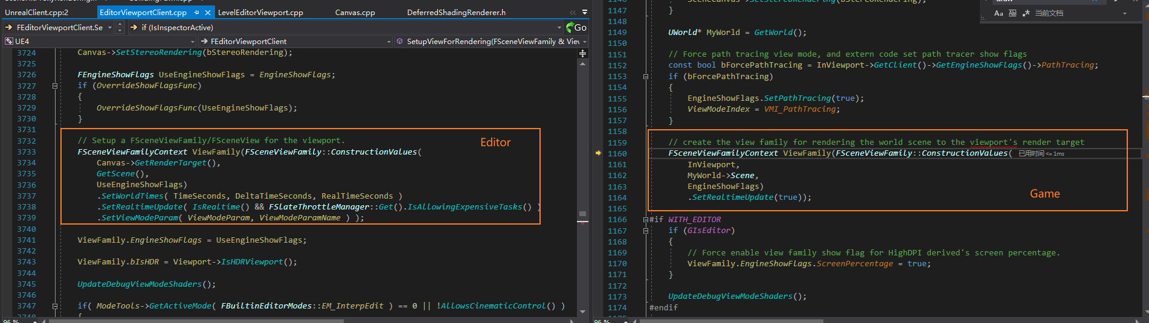
Draw的Elememts不一样？

Slide 24
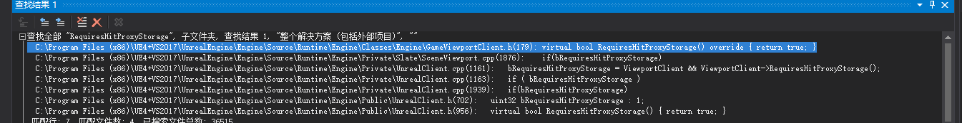
调用isrequire

Slide 25
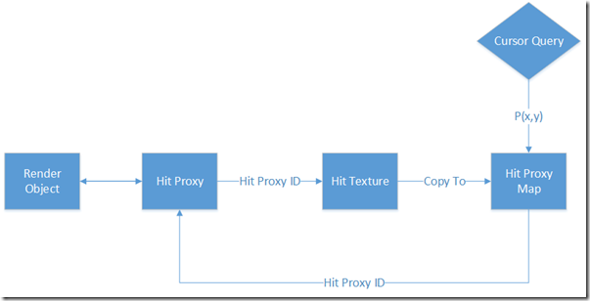
在渲染期间，HHitProxyId和渲染对象已经建立起了映射
https://arenas0.com/2019/04/20/UE4_Learn_HitProxy/
HitProxy更新与查询
const TArray<FColor>& FViewport::GetRawHitProxyData(FIntRect InRect)；
UWorld* World = ViewportClient->GetWorld(); FCanvas Canvas(&HitProxyMap, &HitProxyMap, World, World ? World->FeatureLevel.GetValue() : GMaxRHIFeatureLevel, FCanvas::CDM_DeferDrawing, ViewportClient->ShouldDPIScaleSceneCanvas() ? ViewportClient->GetDPIScale() : 1.0f); { ViewportClient->Draw(this, &Canvas); } Canvas.Flush_GameThread();
......
//Resolve surface to texture.
ENQUEUE_UNIQUE_RENDER_COMMAND_ONEPARAMETER(
UpdateHitProxyRTCommand,
FHitProxyMap*, HitProxyMap, &HitProxyMap,
{
// Copy (resolve) the rendered thumbnail from the render target to its texture
RHICmdList.CopyToResolveTarget(HitProxyMap->GetRenderTargetTexture(), HitProxyMap->GetHitProxyTexture(), false, FResolveParams());
RHICmdList.CopyToResolveTarget(HitProxyMap->GetRenderTargetTexture(), HitProxyMap->GetHitProxyCPUTexture(), false, FResolveParams());
});
.....

