Slide 1
TCO Assessment
ISW2 - Rossi Giacomo Lorenzo

Slide 2
Analysis of UC & workload assessment
Credit card (CC) transaction of a bank
“Every CC transaction has to be approved by checking the CC is valid, the POS is valid, the money amount is valid (for single transaction and for other limits such as monthly or daily limits), check if suspect, if the POS type requires a second identification step, to run that step and check complete successfully, issue OK or abort storing the attempt.”
NFR-1 The average number of transactions per second (TPS) is 2.000. 90% of the time the peak is below 4.000 TPS. The maximum peak that the system must handle is 8000 TPS.
NFR-2 The system must ensure a HA at 99.999%.
NFR-3 In case of a disaster, such as Earthquake or flooding in the Data Center site area, the system functionality must be restored and be able to provide Production and Non-Production capabilities and at least 50% of the Dev and Test Capabilities.
NFR-4 The Development team has available an environment that is half the size of the full Production environment.
NFR-5 Before putting in production any new release of software a complete round of functional test must be completed. The Test environment is the same size of the development environment.
NFR-6 Before putting in production any new release of software a complete round of performance test must be completed stressing the system at TPS peaks.
NFR-7 The Software is written in Java and must run on Oracle WebLogic Server Enterprise Edition
NFR-8 The DB used by the system is Oracle DB Enterprise Edition

Slide 3
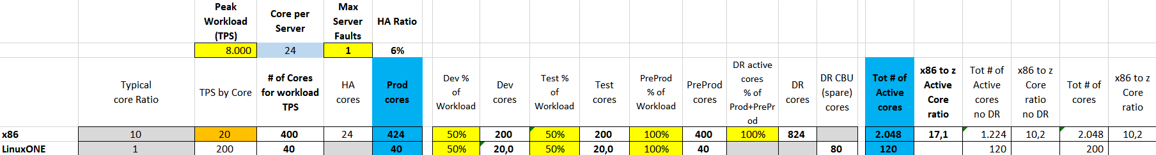
Sizing
The input provided is that the system must support up to 8000 TPS (peak).
Assuming the x86 core is able to process 20 TPS
Assuming the LinuxOne core is able to process 200 TPS
Assuming 1 max server fault to ensure HA ratio of 24% with 2000 average TPS.
In both cases NFR-3 is met.

Slide 4
Assumptions for Target Platform #1: x86
Hardware: Rack server R1-XES08ef with Xeon Gold 6126 12C 2.60Ghz (2 Chips, 24 Cores, 128GB total RAM 2666Mhz)
Acquisition Cost 6806 € - Including 4 years on-site next-day manteinance
Assuming support for following years is 20% of purchase price
Software:
OS: SUSE Linux Enterprise Server 15 for x86 & x86-64 (Unlimited VM) - 3 Year std subscription: 2702€ + 540€/year manteinance cost.
VM: Included in Hardware
Application Server: Oracle WebLogic Server Enterprise Edition: 29830€ for acquisition and 5966€ for support per socket per year.
DB: Oracle DB Enterprise Edition: 40489€ for acquisition and 8098€ for support per socket per year.
Data replication tools: GoldenGate: 14915€ + 3000€/year for support per socket.
Monitoring Tools: assuming 5000€+1000€/year for support with 40% discount
Security Tools: assuming 5000€+1000€/year for support with 40% discount
Network: Assuming 7000€ per server and manteinance 10% of purchase price beginning from year 2.
People: Assuming one full time equivalent covers 30 servers, it costs 100.000€/year
Space: Assuming fully loaded cost of sq. meter: 2.800€
Electricity: Average Cost 0,06€ per kWh as of March 2021

Slide 5
Assumptions for Target Platform #2: LinuxOne
Hardware: 2 LinuxOne servers configured with 100 cores each. Assuming acquisition cost of 600.000€ and manteinance cost of 60.000€/year starting from year 4.
Software:
OS: SUSE Linux Enterprise Server 15 for x86 & x86-64 (Unlimited VM) - 3 Year std subscription: 2702€ + 540€/year manteinance cost.
VM: Included in hardware.
Application Server: Application Server - Oracle WebLogic Server Enterprise Edition: 29830€ for acquisition and 5966€ for support per year.
DB: Oracle DB Enterprise Edition: 40489€ for acquisition and 8098€ for support per year.
Data replication tools: GoldenGate: 14915€ + 3000€/year for support.
Monitoring Tools: assuming 5000€+1000€/year for support with 40% discount
Security Tools: assuming 5000€+1000€/year for support with 40% discount
Network: assuming 14000€ per LinuxOne server and manteinance 10% of purchase price beginning from year 2.
People: Assuming one full time equivalent covers 10 servers, it costs 120.000€/year
Space: Assuming fully loaded cost of sq. meter: 2.800€
Electricity: Average Cost 0,06€ per kWh as of March 2021

Slide 6
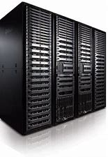
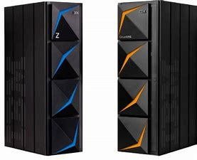
Technical Architecture for the two cases
Rack server R1-XES08ef with Xeon Gold 6126 (2 Chips, 24 Cores)
Site 1 | Production | Development | Test | Pre-Production
Servers | 18 | 9 | 9 | 17
Cores | 400+24HA | 200 | 200 | 400
Site 2 | Disaster recovery
Servers | 35
Cores | 824
Allocated servers: 88 | Allocated cores: 2048 | Spare cores: 64
LinuxONE Server
Site 1 | Production | Development | Spare
Cores | 40 | 20 | 40
Site 2 | Pre-Production | Test | Spare
Cores | 40 | 20 | 40
Allocated servers: 2| Allocated cores: 120 | Spare cores: 80
8000 TPS Peak Workload

Slide 7
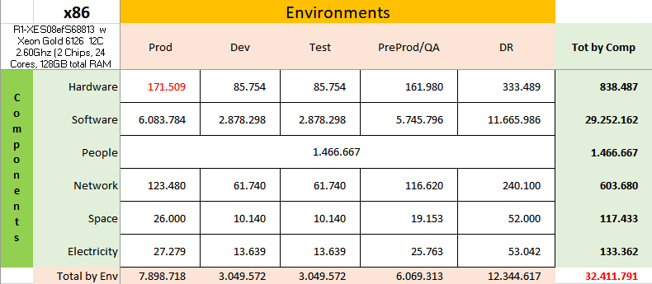
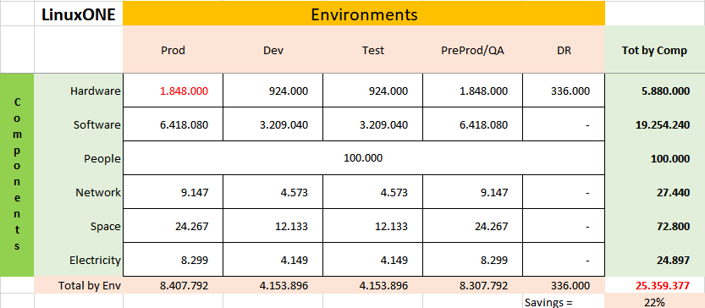
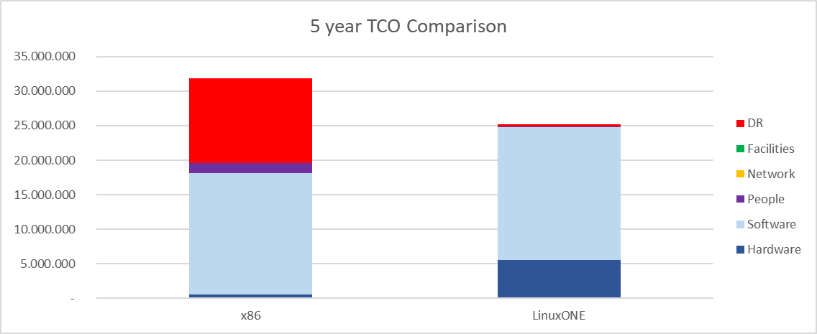
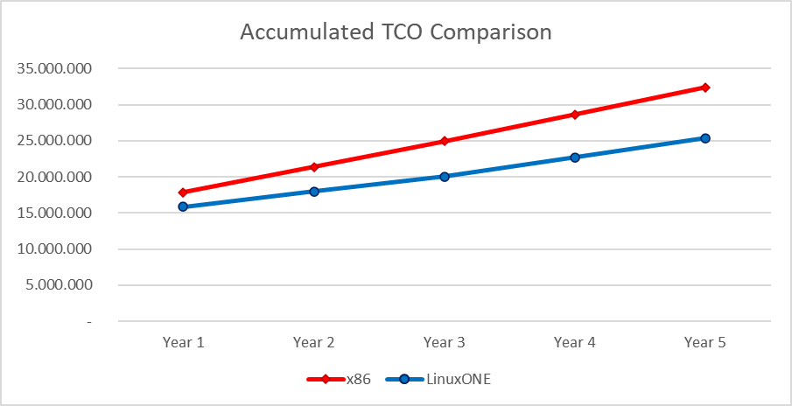
TCO - 5 years Comparisons
x86
LinuxOne
Tables shows the TCO for the chosen environments for 5 years.
The savings with LinuxOne servers are 22% compared to x86 equivalent platform.
Charts shows the total cost and accumulated cost per year

Slide 8
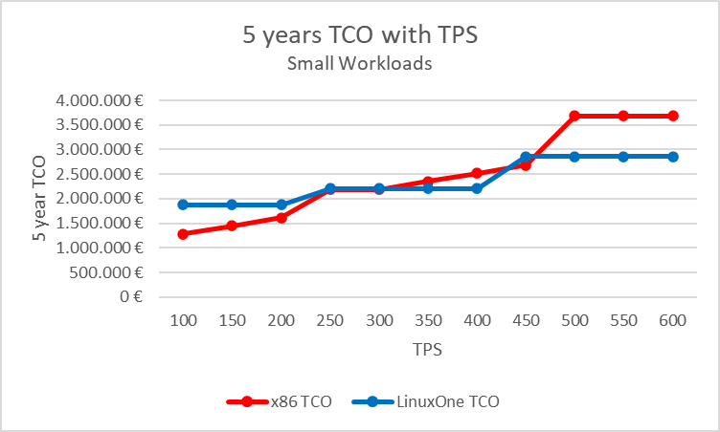
TCO & TPS for small workloads
This charts highlights the 5-year TCO cost with different TPS
For small workloads the LinuxOne server is a too high hardware investment
For big workloads costs of Disaster Recovery and software become too high if x86 is chosen.

Slide 9
Outcomes & Considerations
For target x86 servers:
Software and DR are the most impactful costs.
For LinuxOne mainframe
Software is the most impactful cost, followed by Hardware.
With the Xeon Gold x86 server, the two platform have similar costs if the target Peak TPS woud have been between 250-300 TPS.
Below 300 TPS, the Xeon Gold x86 servers are always more convenient than LinuxOne.
Above 300 TPS, LinuxOne servers are almost always more convenient than x86.
Note that if we would have chosen a more powerful x86 server (Xeon Platinum 8160T 24C 2.1Ghz), it would have been always more convenient than LinuxOne no matter what the target TPS target is. (Check excel tool)

