Slide 1

Introduction to C#
Nitin Reddy Katkam, SAE – k.nitin.r@gmail.com
Notes:
Magicka

Slide 2
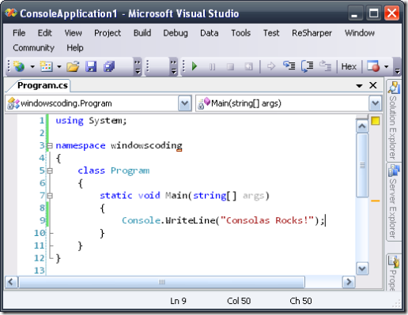
Software
MS Windows
MS Visual Studio

Slide 3


Content
Introduction to .NET
Object-Oriented Programming
Data Types
Console Programming
Windows Forms Programming
Q & A
Notes:
Blazing Birds, Mining Wars

Slide 4

Introduction to .NET
.NET Framework by Microsoft in 2002
To compete with Java
Runs on
MS Windows
Windows Phone
Xbox

Slide 5
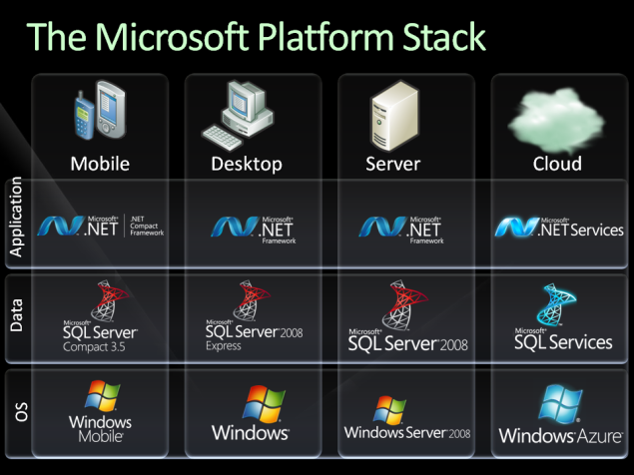
Introduction to .NET (Contd)

Slide 6
Introduction to .NET (Contd)
Programming Languages
C#
Visual Basic
Other (J#, F#, Boo, ...)

Slide 7

Object Oriented Programming

Slide 8
Object Oriented Programming
Block class
Length
Width
Height
Color

Slide 9
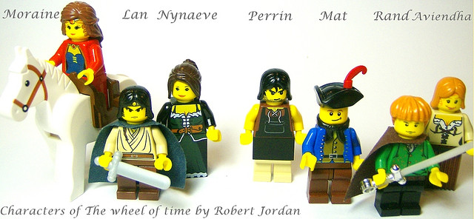
Object Oriented Programming (Contd)

Slide 10
Object Oriented Programming (Contd)
Character class
HairColor
Gender

Slide 11
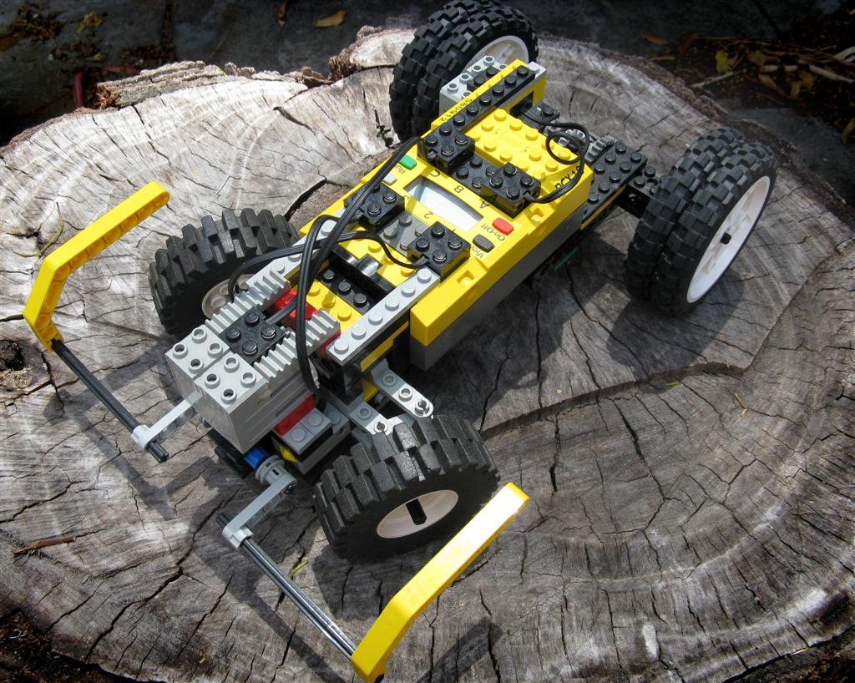
Object Oriented Programming (Contd)

Slide 12
Object Oriented Programming (Contd)
Motor class
Move()
Stop()

Slide 13
Data Types
bool
byte/sbyte (8-bit)
int/uint (32-bit)
long/ulong (64-bit)
short/ushort (16-bit)
char (16-bit)
decimal (128-bit)
double (64-bit)
float (32-bit)

Slide 14
Data Types (Contd)
1 bit
0
2 values
1

Slide 15
Data Types (Contd)
2 bits
0
0
0
1
4 values
1
0
1
1

Slide 16
Data Types (Contd)
1 bit → 2 values
2 bits → 4 values
4 bits → 16 values
...
n bits → 2^{n} values

Slide 17
Data Types (Contd)
bool
byte/sbyte (8-bit)
int/uint (32-bit)
long/ulong (64-bit)
short/ushort (16-bit)
char (16-bit)
decimal (128-bit)
double (64-bit)
float (32-bit)

Slide 18
Console Programming

Slide 19
Console Programming (Contd)
Execution begins at Main
Console.Write/Console.WriteLine to display values
Console.Read/Console.ReadLine to read values

Slide 20
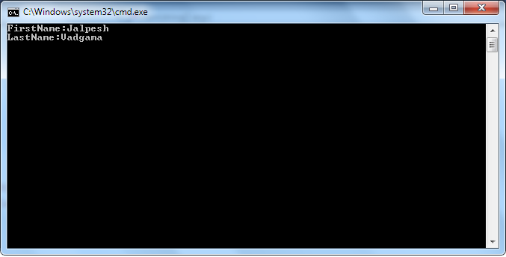
Console Programming (Contd)

Slide 21
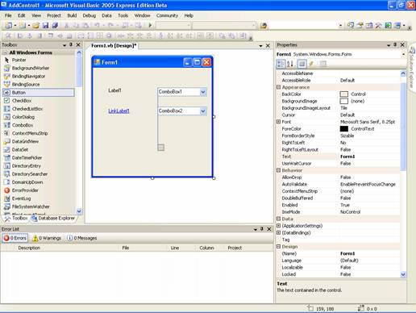
Windows Forms Programming

Slide 22
Windows Forms Programming (Contd)
Execution starts with a form
User interface designer
Events to trigger function execution
Modify properties
TextBox1.Text = “hello”;

Slide 23
Q & A
k.nitin.r@gmail.com

Slide 24
Taking it forward
String class
Namespaces
Methods (functions) and parameters
Loops and Control Structures
Interfaces
GUI Controls

