Slide 1
MARXISM AS A CRITICAL THEORY FOR LIBRARIANSHIP
Sam Popowich, University of Alberta @redlibrarian

Slide 2
Outline
Who was Karl Marx and what is Marxism? Marx and Engels' Major Works
Marx's Eleventh Thesis on Feuerbach Marxist Critical Theory
Three sources and three component parts Librarianship and Philosophy Librarianship and Politics
Librarianship and Political Economy

Slide 3
Who was Karl Marx?

Slide 4
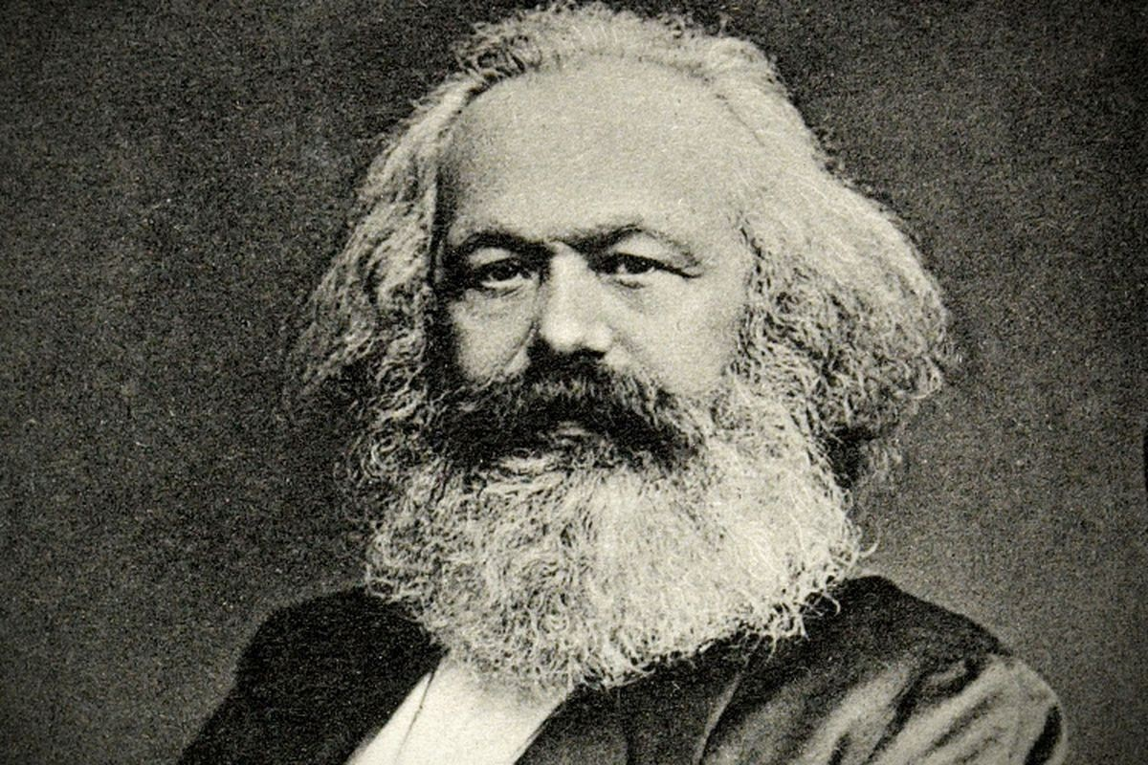
Born: Trier, Prussia, 1818. Died: 1883, London, England.

Slide 5
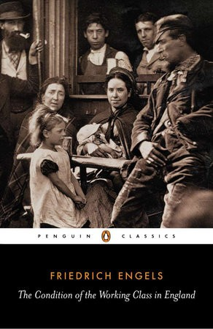
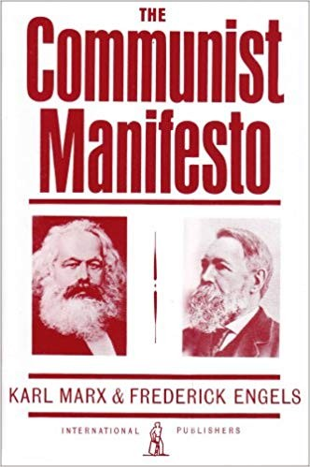
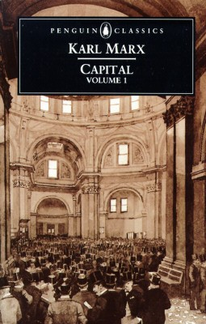
Marx and Engels' Major Works
(1844) (1848) (1867, 1885, 1894)

Slide 6
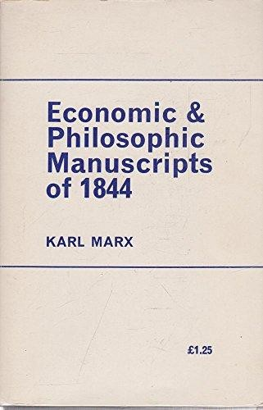
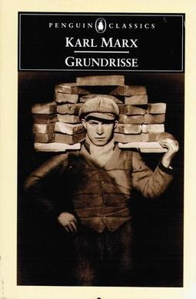

(1844) (1857/8) (1884)

Slide 7
Theses on Feuerbach (1845)
Philosophers have hitherto only interpreted the world in various ways; the point is to change it.

Slide 8
Marxist Critical Theory Scientific vs. Critical Theory

Slide 9
Scientific Theory:
It's "aim or goal [is] successful manipulation of the external world." Objectifying: "one can distinguish clearly between the theory and the 'objects' to which the theory refers."
Evidence: "require empirical confirmation through observation and experiment."

Slide 10
Critical Theory:
"Aim at emancipation and enlightenment, at making agents aware of hidden coercion, thereby freeing them from that coercion." Reflective or self-referential: "a critical theory is always part of the object-domain which it describes; critical theories are always in part about themselves.
Evidence: "are cognitively acceptable only if they survive a more complicated process of evaluation, the central part of which is that they are 'reflectively acceptable'."
Source: Raymond Geuss, The Idea of a Critical Theory: Habermas and the Frankfurt School
(Cambridge University Press, 1981), pp. 55-56

Slide 11
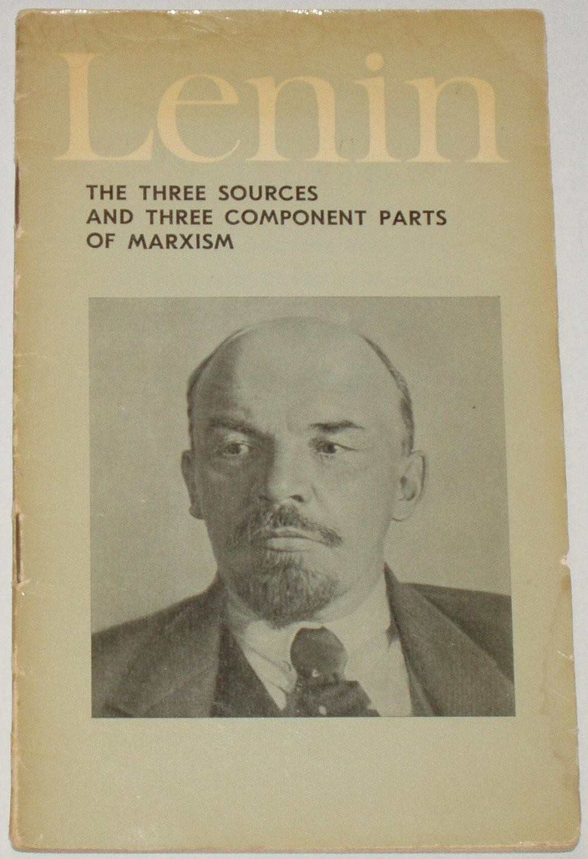
(1913)

Slide 12

Librarianship and philosophy

Slide 13
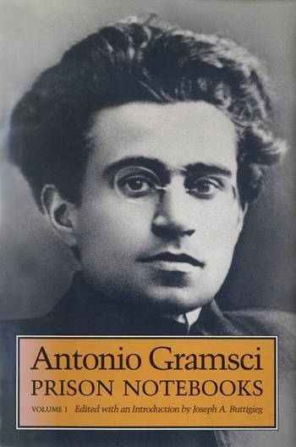
Librarianship and politics

Slide 14

Librarianship and political economy

Slide 15
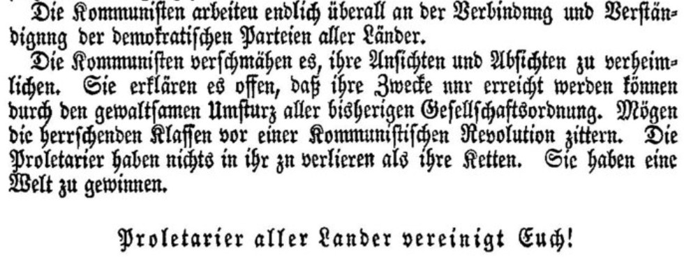
Conclusion

Slide 16
Thank you! Questions?

