Slide 1
INTRODUCTION: CRITICIZING, CRITICISM, AND CRITIQUE

Slide 2
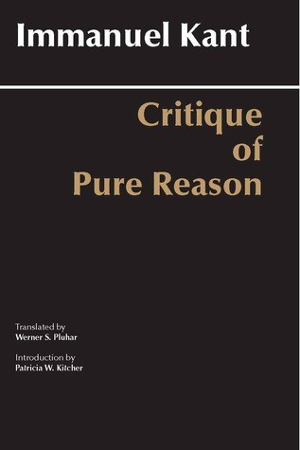

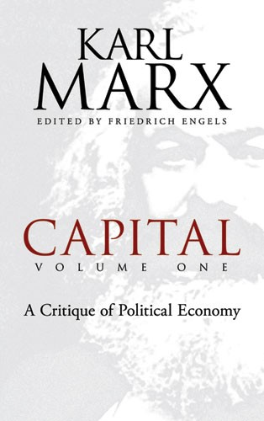

Slide 3
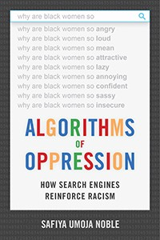
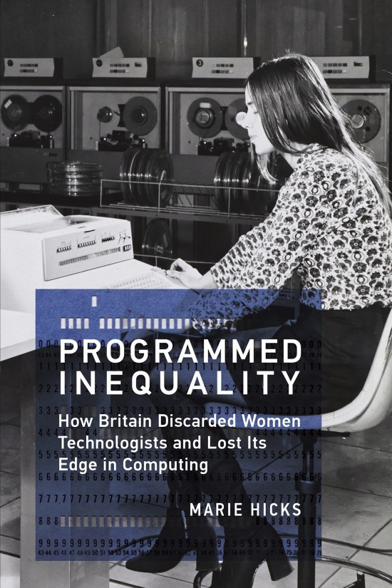


Slide 4






Slide 5





Slide 6


