Slide 1
Technical vs. Biological Replicates – Pseudoreplication
Example: cell viability under one experimental condition
Biological replicate
Technical replicate
A culture independent of the others (B1, B2, B3, B4).
Captures variability between biological units.
Three measurements of the same culture.
Captures measurement variability, not three new cultures.
B1
B2
B3
B4
·
·
·
·
·
·
·
·
·
·
·
·
4 biological units
3 measurements per unit
cstats · Fundamentals of Experimental Design
2

Slide 2
Technical vs. Biological Replicates – Pseudoreplication
Treating technical measurements as independent observations artificially inflates n
Incorrect: n = 12
Correct: n = 4
4 cultures × 3 measurements = 12 rows
The 12 measurements are NOT 12 biological replicates.
We average the 3 measurements from each culture.
We analyze 4 values, one per biological unit.
Pseudoreplication
Artificially inflated sample size
Underestimated uncertainty: standard errors too small
Artificially low p-values
cstats · Fundamentals of Experimental Design
3

Slide 3
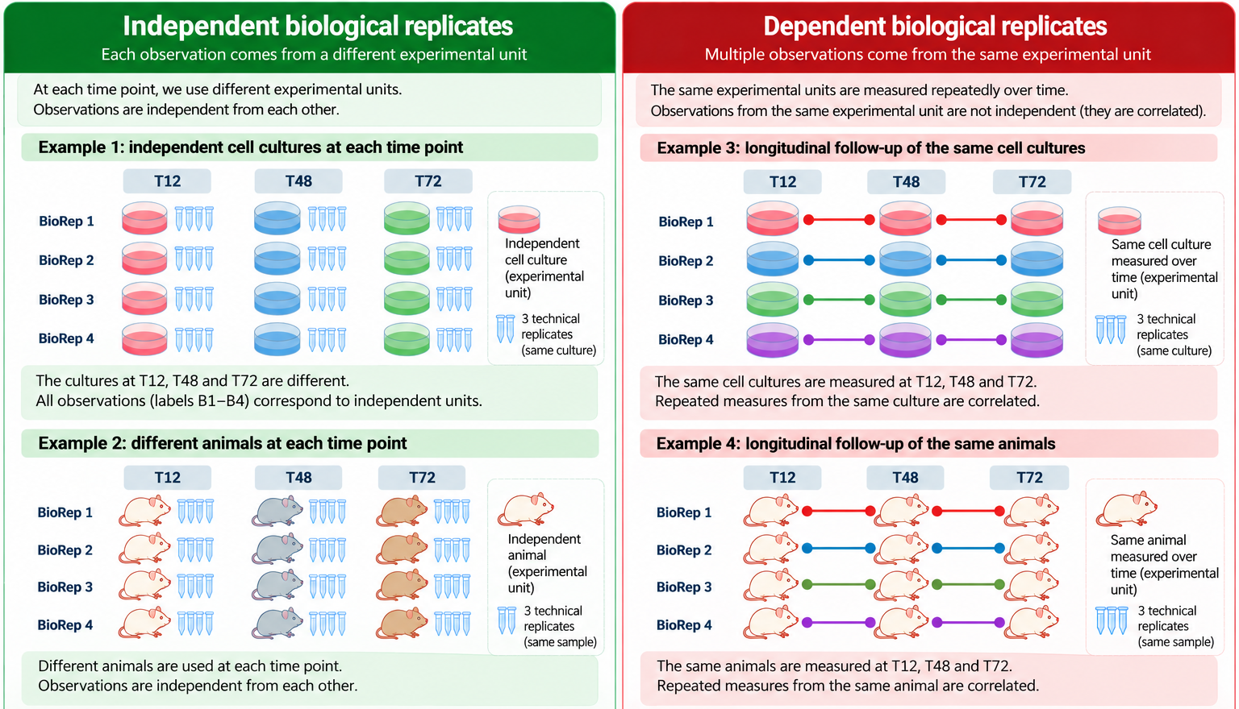
Biological Replicates – Independent vs. Dependent
4

Slide 4
Which Statistical Test Should We Use?
Independence is an assumption shared by many statistical tests
Comparison
Independent observations
Dependent observations
2 groups · parametric
Welch’s t-test
Paired t-test
2 groups · nonparametric
Mann–Whitney U / Wilcoxon rank-sum
Wilcoxon signed-rank
Multiple groups / factors
Conventional factorial ANOVA
Mixed-effects model / repeated measures
Note: data distribution, test assumptions, and experimental design also matter.
cstats · Fundamentals of Experimental Design
5

