Slide 1
Problem

Slide 2
Problem
«How has the population developed in Zurich and Basel since 1900?»
The bot must search the web portal. And most portals are optimized for humans, not for machines…
Sounds simple, but it isn’t…
City or canton?
What about municipal incorporations?
What is being counted? Is the definition always and everywhere the same?
In tables, this information is usually well hidden.
The problem is no the calculation, but the meaning of the numbers, the so-called semantics.

Slide 3
Episode 2: Linked Open Data

Slide 4
Episode 2: Linked Open Data
Five-star model of open data: «Use identifiers, shared vocabularies, and link you data». Within and outside your data.
Agentic systems can navigate the graph.
This allows them to navigate from a number to ist meaning without anyone having programmed this path beforehand.
With Linked Data, the meaning of the data point is clear.
And it is also machine-readable, linked directly to the data point!
The public statistics have had this concept for 15 years.

Slide 5
But isn’t RDF super complex?

Slide 6
But isn’t RDF super complex?
The standard objection, and it was justified:
Understand structure
Know ontologies
Write descriptions by hand
Implement pipeline for data conversion
Initial effort is high!

Slide 7
Conclusion

Slide 8
Conclusion
Machines are our primary consumers – therefore we need machine-readable semantics. LOD provides exactly that.
OGD to LOD
is an OpenSource tool,
can convert OGD in high-quality LO¨D,
thus lowers the entry barrier for existing data.
¨Whoever published Linked Open Data today gets the semantic layser for free and is ready for agentic analysis.
Huwise customers: You can start right away, CKAN is coming soon!

Slide 9
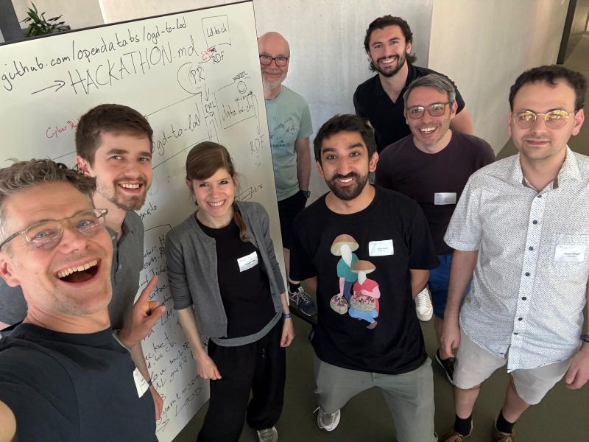
Invitation
If you are interested in publishing your OGD as LOD: Contact us, we are happy to help you!
Image: GovTech Hackathon, Mai 2026

Slide 10
Thank you very much
Rorschach, 25.08.2026
Jonas Bieri, Thomas Kurz, Rolf Schenker

