Slide 1

Hello everyone,
No Man’s Sky Beyond Fantasy is a complete game overhaul and the result of the compilation of all the mods that I did since 2 years of modding No Man’s Sky. They have evolved following the NMS updates needs. Some were removed, some had evolved, and others managed to make their way to the vanilla game.
The whole mod is flexible ( it can be switch to vanilla any time and how many times you want ) and customizable with alternate versions of mods, or by removing some. You can also use any aspect of it separately.
I do not use any third party assets for my mods, it is all Hello Games works but with different tweaks.

Slide 2
Beyond update is heavily Multiplayer focused, that's why I am focusing even more than before that aspect for my mods. Previously the mod were compatible with vanilla players, allowing to encounter random people. But the changes were only visible locally. For this reason, I am putting a hold on my mods changing skins ( "Super Vehicles" and "Redmas spaceship Generations" ) but I am planning to release them more later. So, the next step for me to match beyond is to allow people, willing to play in multiplayer, to share the same modded experience. That's why I created a discord for NMS BEYOND FANTASY. This is a place where you can meet users of the Beyond Fantasy mod, but also share other mods with them, create groups or meet places, or share your screenshots / feedback. This place will also be very helpfull to keep you informed on the patches i do for the mod. I hope , you will enjoy the time here or in No Man's Sky,
Chears
https://discord.gg/5NR8bWw

Slide 3
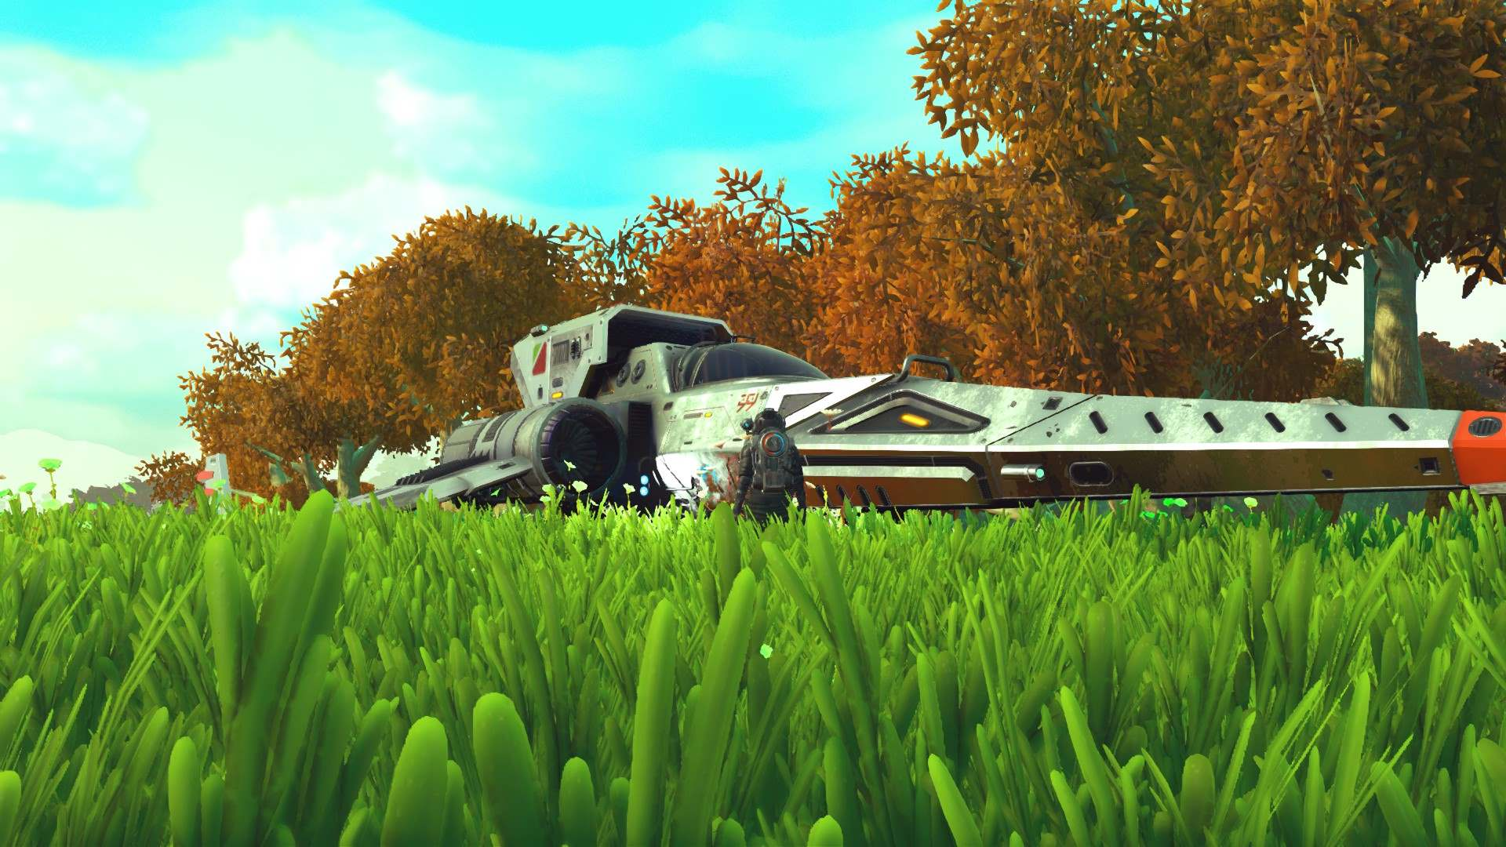

Slide 4
Features
Visuals
- Improved clouds animations ( __CloudsFix , __NMS_BEYOND_Fantasy)
More natural looking clouds ( __CloudsFix , __NMS_BEYOND_Fantasy)
- Metal looking Spaceships (_METAL_SPACESHIPS )
Custom Filters while playing ( _REDMAS-FILTER_ , __NMS_BEYOND_Fantasy)
no more blue filter on Analysis Visor ( _REDMAS-FILTER_ , __NMS_BEYOND_Fantasy)
NEW Warping effects for stations portals and systems’ warps (_Sliders_PORTALS_EFFECT, PEGASUS_WARP , __NMS_BEYOND_Fantasy )
The fog has been improved to create a nicer field of view on distance (___FANTASY_WORLDS , __NMS_BEYOND_Fantasy)
- Rainbows can now be seen more easily ( bigger and closer ) (___FANTASY_WORLDS , __NMS_BEYOND_Fantasy)
Water colors are variations of Blue only ( _COLORS-GEN_, __NMS_BEYOND_Fantasy)
Suns colors are improved (___FANTASY_WORLDS , __NMS_BEYOND_Fantasy)
Higher range and optimized grass (___FANTASY_WORLDS , __NMS_BEYOND_Fantasy)
Concept Art Spaceships Trails (__ORANGE_TRAILS )
Concept Art Blue Space Colors (_BLUE_SPACE )
Colorfulll Planets Lights FANTASY_WORLDS , __NMS_BEYOND_Fantasy)
Darker Nights FANTASY_WORLDS , __NMS_BEYOND_Fantasy)

Slide 5
Gameplay
. Gameplay Polish
- Shoulder cam inside interiors. (_CAM_OVERHAUL , __NMS_BEYOND_Fantasy)
- A more far view on spaceships and using the jetpack. (_CAM_OVERHAUL , __NMS_BEYOND_Fantasy) - Using alt key + mouse axes allows free look around the spaceship. (_CAM_OVERHAUL , __NMS_BEYOND_Fantasy)
( right stick by using a gamepad controller)
- Polished player’s 3D model turning animations. (__IMPROVED_CHAR_MOVEMENTS, __NMS_BEYOND_Fantasy)
- Player can walk if you use the walk version. ( this is not a toogle)
(__IMPROVED_CHAR_MOVEMENTS_WALK, __NMS_BEYOND_Fantasy)
- Improved Deaths ragdoll effect. (__IMPROVED_CHAR_MOVEMENTS, __NMS_BEYOND_Fantasy)
- Start the game in first person view. (_Improved_game_start, __NMS_BEYOND_Fantasy)
- Player’s shadow enabled on first person view. (_Improved_game_start, __NMS_BEYOND_Fantasy)
- Start the game with a random spaceship. (_Improved_game_start, __NMS_BEYOND_Fantasy)
- Start the game with a random multi-tool. (_Improved_game_start, __NMS_BEYOND_Fantasy)
- Start the game with better multi-tool inventory slots. (_Improved_game_start, __NMS_BEYOND_Fantasy)
- Larger FOV (_CAM_OVERHAUL , __NMS_BEYOND_Fantasy)
- More efficient lightings in player’s base (_ MORE_BASE_INTERACTIONS, __NMS_BEYOND_Fantasy)
- More Buildable Decorations on Freigters and on planets ( _ADVANCED_BASEBUILDING , __NMS_BEYOND_Fantasy)

Slide 6
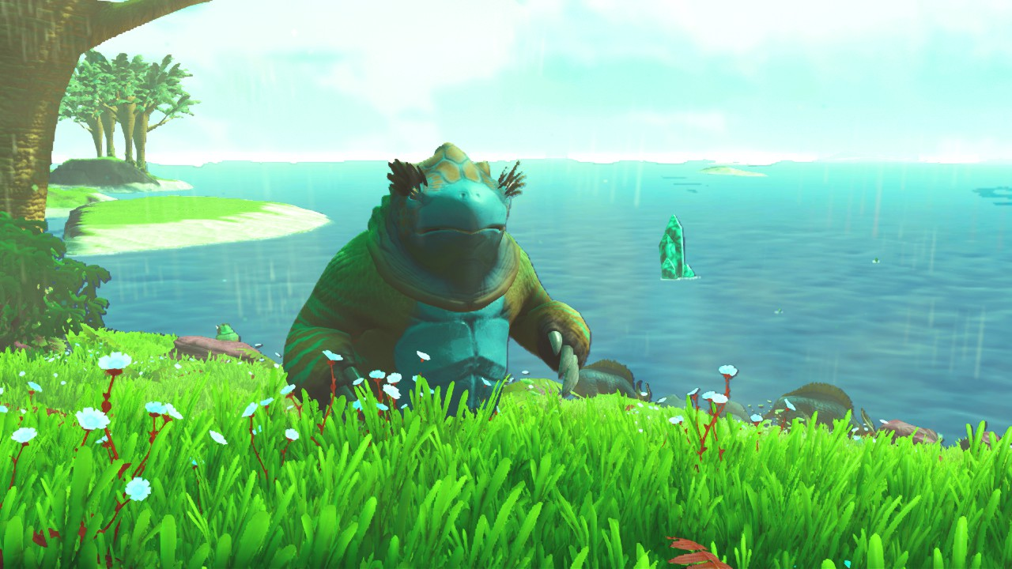

Slide 7
Gameplay
. Gameplay Balance
- Player swims faster. (__IMPROVED_CHAR_MOVEMENTS, __NMS_BEYOND_Fantasy)
- Improved underwater jetpack effeciency. (__IMPROVED_CHAR_MOVEMENTS, __NMS_BEYOND_Fantasy)
- Improved jetpack flight controls. ( can now go more far forward ) (__IMPROVED_CHAR_MOVEMENTS, __NMS_BEYOND_Fantasy)
- Jetpack have an emergency back up when tanks are empty. (__IMPROVED_CHAR_MOVEMENTS, __NMS_BEYOND_Fantasy)
- Base jetpack tank is more efficient. (___ONLINE_SPACE_EXPLORER_GAMEPLAY, __NMS_BEYOND_Fantasy)
- Rocket boots are more efficient. (__IMPROVED_CHAR_MOVEMENTS, __NMS_BEYOND_Fantasy)
- almost infinite jetpack can be purchased as an jetpack upgrade. (_SPACE_EXPLORER_GAMEPLAY, __NMS_BEYOND_Fantasy)
- Launching thrusters cost 5% of the tank – instead of 50% on vanilla. (_SPACE_EXPLORER_GAMEPLAY, __NMS_BEYOND_Fantasy)
- 1 Warp cell can be used 5 times. (___ONLINE_SPACE_EXPLORER_GAMEPLAY, __NMS_BEYOND_Fantasy)
- Higher Hyperdrive range for basic and upgraded spaceships hyperdrives. (_SPACE_EXPLORER_GAMEPLAY, __NMS_BEYOND_Fantasy)
- Easy cross the galaxy with basic and upgraded Freighter hyperdrives. (_SPACE_EXPLORER_GAMEPLAY, __NMS_BEYOND_Fantasy)
- Mine trees, rocks and plants x5 faster. (_MINING_SPEEDx5_BY_Redmas, __NMS_BEYOND_Fantasy)
- Spaceships ’ pulse engine speed x5. (_FLASH_PULSE_, __NMS_BEYOND_Fantasy)
- Chests have more slots [Requires a new game start] (9 instead of 5) (_Improved_game_start, __NMS_BEYOND_Fantasy)
- Vanilla rare Spaceships are more current. (_All_Rare_Spaceships_, __NMS_BEYOND_Fantasy)

Slide 8
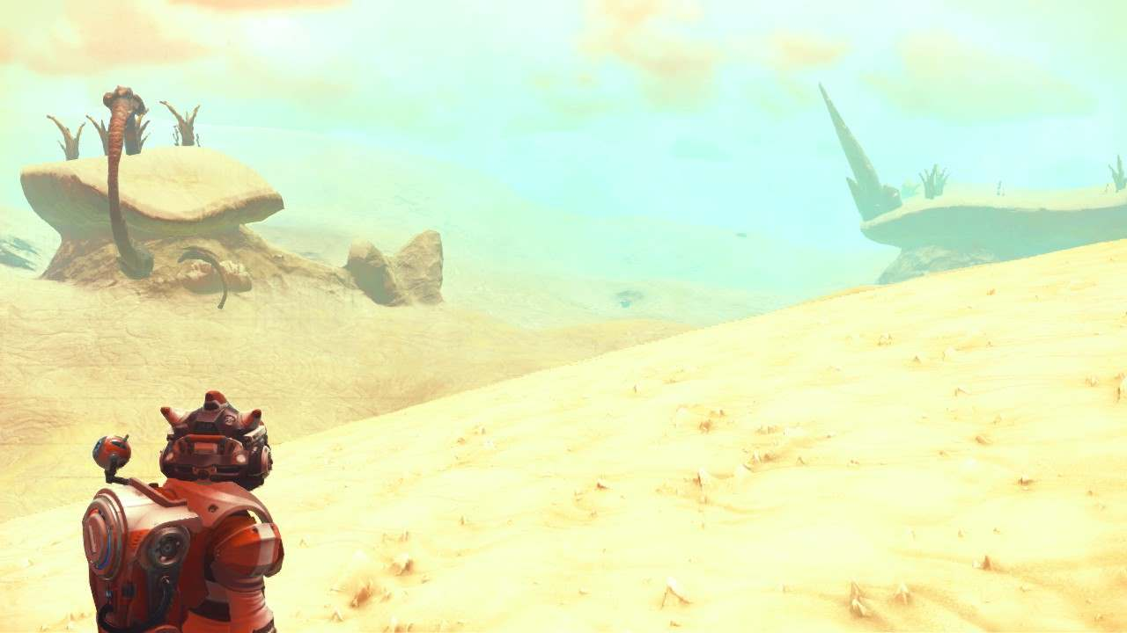

Slide 9
Gameplay
. New Gameplay features
Large Computer Desks are signal scanners. (MORE_BASE_INTERACTIONS, __NMS_BEYOND_Fantasy)
Shelf storage , Lockers, Worktops, & Draws, opens character customization. (MORE_BASE_INTERACTIONS, __NMS_BEYOND_Fantasy)
Beds & Light Tables are save points. (MORE_BASE_INTERACTIONS, __NMS_BEYOND_Fantasy)
Screen monitors open NPC's missions' interface. (MORE_BASE_INTERACTIONS, __NMS_BEYOND_Fantasy)
Weaponrack allows to infinitly buy new multitools (the seed depends on the weaponrack ‘s). (MORE_BASE_INTERACTIONS, __NMS_BEYOND_Fantasy)
Wall Cabinet generates Coprite. (MORE_BASE_INTERACTIONS, __NMS_BEYOND_Fantasy)
Octa Cabinet generates Mordite. (MORE_BASE_INTERACTIONS, __NMS_BEYOND_Fantasy)
Plants pot decorations Generates Sodium, Salt, Carbone, or Oxygen. (MORE_BASE_INTERACTIONS, __NMS_BEYOND_Fantasy)
Fan Ventilation generates oxygene . (MORE_BASE_INTERACTIONS, __NMS_BEYOND_Fantasy)
Roof Monitors & Robotic Arm infinitly open upgrade suit interface. (same costs that on space stations) . (MORE_BASE_INTERACTIONS, __NMS_BEYOND_Fantasy)
- Collect All ferrite substances in Large Flat Crates. (MORE_BASE_INTERACTIONS, __NMS_BEYOND_Fantasy)
Collect Silver, Copper,Platine&more in Cubic Crates. (MORE_BASE_INTERACTIONS, __NMS_BEYOND_Fantasy)
Collect Chromatic Metal, Ionised Cobalt,Nanites and more in Freighters Hangars Crates. (MORE_BASE_INTERACTIONS, __NMS_BEYOND_Fantasy) - Collect Chore on sea plants Decorations (MORE_BASE_INTERACTIONS, __NMS_BEYOND_Fantasy)

Slide 10
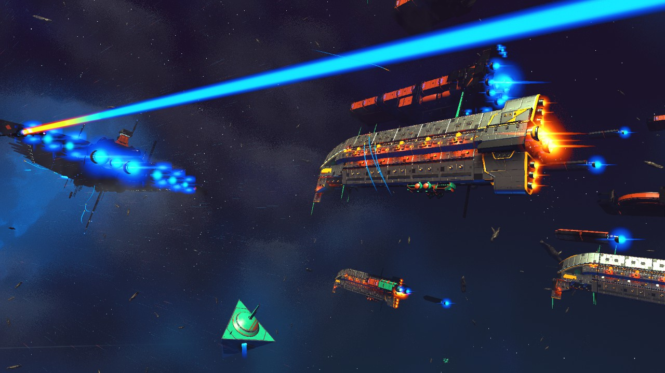

Slide 11
SPACE Gameplay OVERHAUL
Asteroids overhaul ( more parse ). (_PEGASUS_FANTASY-SPACE_OVERHAUL, __NMS_BEYOND_Fantasy)
Space is decorated with space oddities and wrecked Freighters. (_PEGASUS_FANTASY-SPACE_OVERHAUL, __NMS_BEYOND_Fantasy)
Sentinel Ships and Freighters are roaming. (_PEGASUS_FANTASY-SPACE_OVERHAUL, __NMS_BEYOND_Fantasy)
Re-activated Pre-Release Pirate Ship. (_PEGASUS_FANTASY-SPACE_OVERHAUL, __NMS_BEYOND_Fantasy)
Pirates are always fighters class ships. (_PEGASUS_FANTASY-SPACE_OVERHAUL, __NMS_BEYOND_Fantasy)
Spaceships fights are more intense. (_PEGASUS_FANTASY-SPACE_OVERHAUL, __NMS_BEYOND_Fantasy)
Improved NPC’s Spaceships Flight and weapon. (_PEGASUS_FANTASY-SPACE_OVERHAUL, __NMS_BEYOND_Fantasy)
Solar systems are more filled with spaceships life and freighters. (_PEGASUS_FANTASY-SPACE_OVERHAUL, __NMS_BEYOND_Fantasy)
Trade directly with trader spaceships while flying in space. (_PEGASUS_FANTASY-SPACE_OVERHAUL, __NMS_BEYOND_Fantasy)
Formation Flight on combat and on roaming. (_PEGASUS_FANTASY-SPACE_OVERHAUL, __NMS_BEYOND_Fantasy)
Alerts are visible around all near by spaceships and stations. (_PEGASUS_FANTASY-SPACE_OVERHAUL, __NMS_BEYOND_Fantasy)
Spaceships explosions are more spectacular. (_PEGASUS_FANTASY-SPACE_OVERHAUL, __NMS_BEYOND_Fantasy)
Improved Traders docking approach . (_PEGASUS_FANTASY-SPACE_OVERHAUL, __NMS_BEYOND_Fantasy)
Docked Spaceships Rotate slower. (_PEGASUS_FANTASY-SPACE_OVERHAUL, __NMS_BEYOND_Fantasy)
Improved Freighters turrets efficiency and range. (_PEGASUS_FANTASY-SPACE_OVERHAUL, __NMS_BEYOND_Fantasy)
Wingman rescue arrives much later. (_PEGASUS_FANTASY-SPACE_OVERHAUL, __NMS_BEYOND_Fantasy)
Sentinels spawn more quickly. (_PEGASUS_FANTASY-SPACE_OVERHAUL, __NMS_BEYOND_Fantasy)
Trading routes are no more visible in space. (_PEGASUS_FANTASY-SPACE_OVERHAUL, __NMS_BEYOND_Fantasy)
Spaceships fly at high speed in space. (_PEGASUS_FANTASY-SPACE_OVERHAUL, __NMS_BEYOND_Fantasy)
More spectacular spaceships taking off stations. (_PEGASUS_FANTASY-SPACE_OVERHAUL, __NMS_BEYOND_Fantasy)
Space stations are always filled with spaceships. (_PEGASUS_FANTASY-SPACE_OVERHAUL, __NMS_BEYOND_Fantasy)
And more

Slide 12
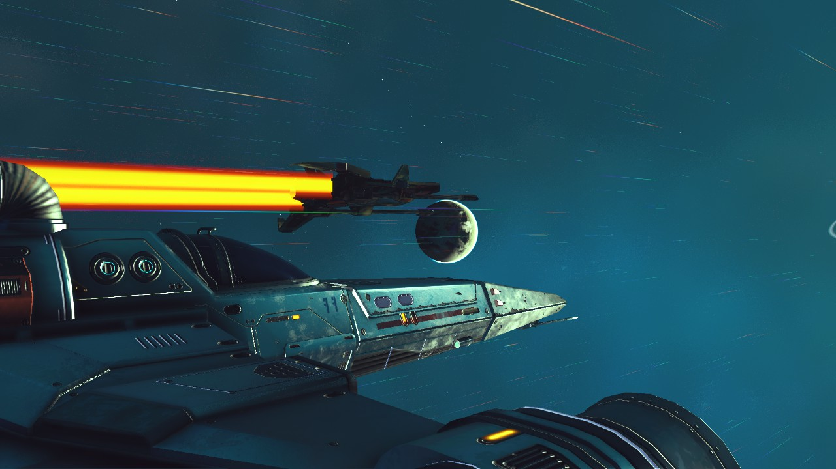

Slide 13
NEW SPACESHIPS Gameplay
Hovering is possible. (_PEGASUS_FANTASY-SPACE_OVERHAUL, __NMS_BEYOND_Fantasy)
Undestructible obstacles can be avoided using rear speed. (_PEGASUS_FANTASY-SPACE_OVERHAUL, __NMS_BEYOND_Fantasy)
More efficient Turns. (_PEGASUS_FANTASY-SPACE_OVERHAUL, __NMS_BEYOND_Fantasy)
More efficient Rolls. (_PEGASUS_FANTASY-SPACE_OVERHAUL, __NMS_BEYOND_Fantasy)
Thrusters and boosts allow to fly at high speed in space keeping direction controls. (_PEGASUS_FANTASY-SPACE_OVERHAUL, __NMS_BEYOND_Fantasy)
Pulse Engine speed x5 ( but now less needed ) . (_PEGASUS_FANTASY-SPACE_OVERHAUL, __NMS_BEYOND_Fantasy)
Precise speed controls. (_PEGASUS_FANTASY-SPACE_OVERHAUL, __NMS_BEYOND_Fantasy)
Your spaceships have an inertia in space and in combat situation ( like the mod does with the A.I. Spaceships ) (_PEGASUS_FANTASY-SPACE_OVERHAUL, __NMS_BEYOND_Fantasy)
Planetary flight allows improved planet surface exploration. ( For example, going in caves or canyons without risking any spaceships crash ) (_PEGASUS_FANTASY-SPACE_OVERHAUL, __NMS_BEYOND_Fantasy)
Warning you now need to reduce your spaceships speed while entering planets atmospheres.

Slide 14
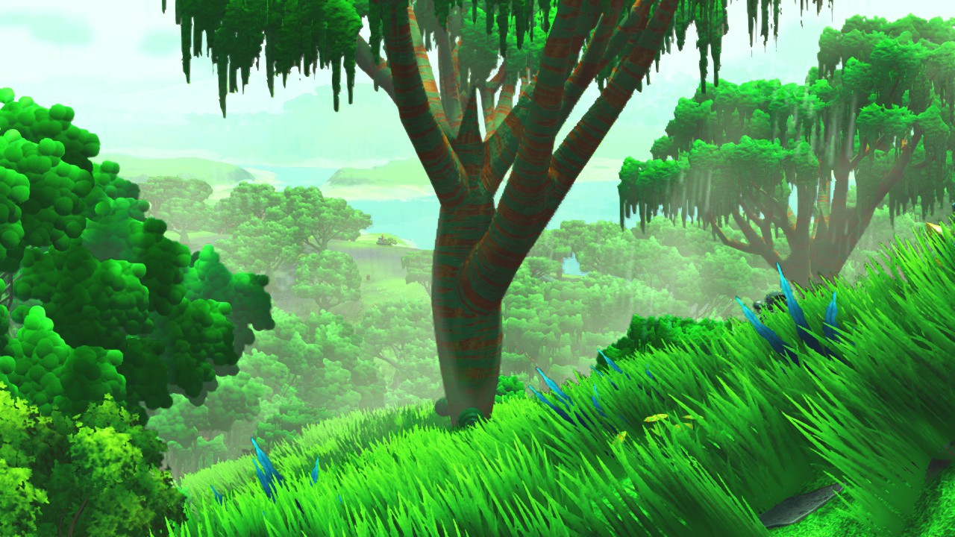

Slide 15
Creatures Improvements
- Increased the fauna spawn number. (FANTASTIC_BEASTS, __NMS_BEYOND_Fantasy)
- Changed some creatures sizes (Godzilla-esk enabled ). (FANTASTIC_BEASTS, __NMS_BEYOND_Fantasy)
- Some creatures can be giant. (FANTASTIC_BEASTS, __NMS_BEYOND_Fantasy)
- Improve creatures draw distance. FANTASTIC_BEASTS, __NMS_BEYOND_Fantasy)
- prevents the birds vanilla ground colliding glitch. FANTASTIC_BEASTS, __NMS_BEYOND_Fantasy)
- Improved birds sizes and group behaviors (FANTASTIC_BEASTS, __NMS_BEYOND_Fantasy)
- Birds can flight lower to the ground (FANTASTIC_BEASTS, __NMS_BEYOND_Fantasy)
- Improved Flying Lizards flight animations. FANTASTIC_BEASTS, __NMS_BEYOND_Fantasy)
- Enabled Flying snakes tails physic. FANTASTIC_BEASTS, __NMS_BEYOND_Fantasy)
- Improved Flying snakes tails animations. (FANTASTIC_BEASTS, __NMS_BEYOND_Fantasy)
- Butterflies are easy to scan. (FANTASTIC_BEASTS, __NMS_BEYOND_Fantasy)

Slide 16
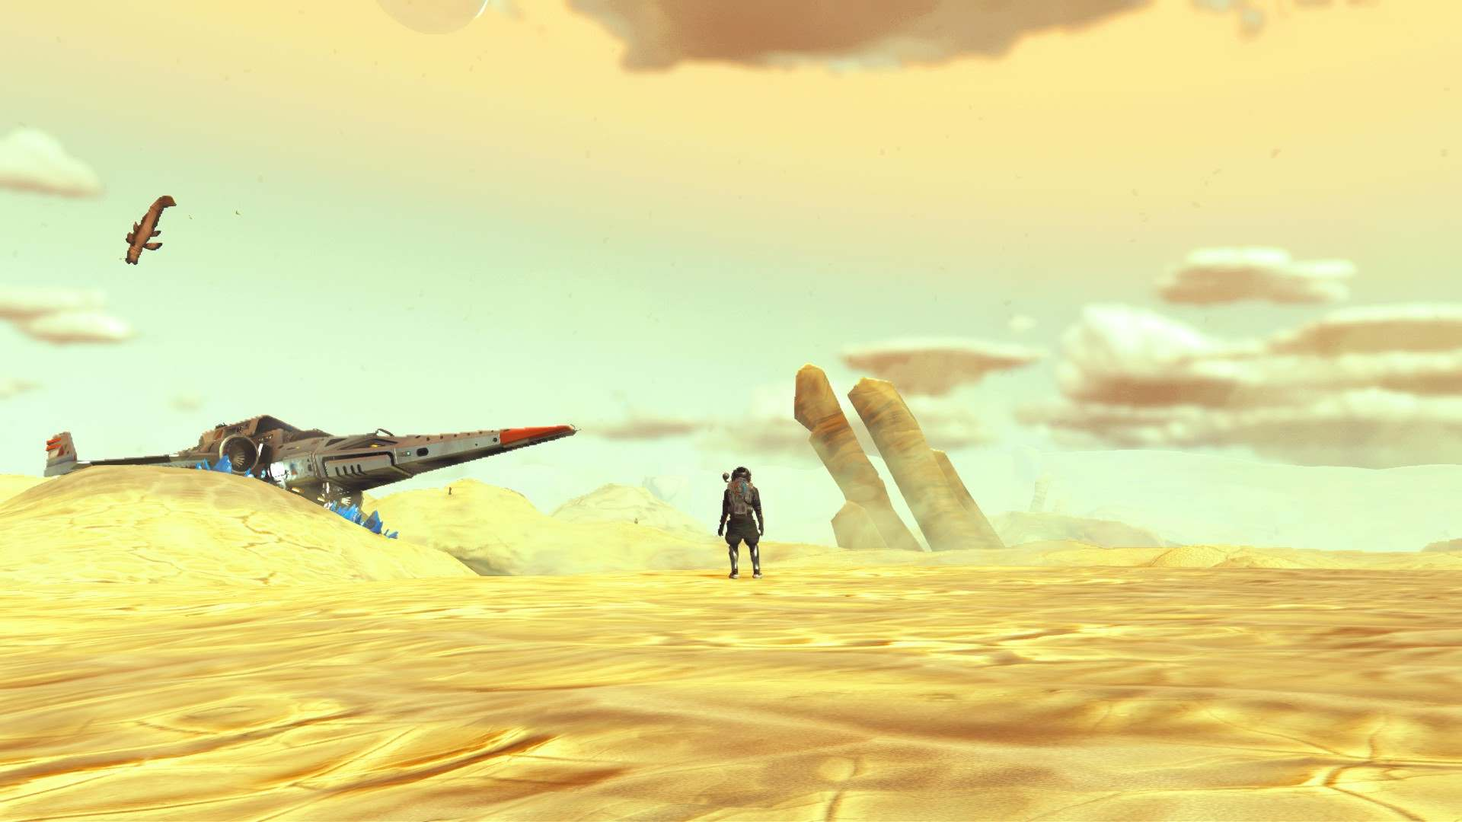

Slide 17
Worlds Generation – Fantasy Aspects
- E3 style big crystals ( tweaked vanilla crystals ) (___FANTASY_WORLDS , __NMS_BEYOND_Fantasy)
- Redesign of the biomes (inspired by Hello Games 2014 concepts arts) (___FANTASY_WORLDS , __NMS_BEYOND_Fantasy) - Planets have more often "Fantastic" Creatures (___FANTASY_WORLDS , __NMS_BEYOND_Fantasy) - The planets have the E3 2015 Demo Structures (___FANTASY_WORLDS , __NMS_BEYOND_Fantasy)
- Massively increased planets variety (___FANTASY_WORLDS , __NMS_BEYOND_Fantasy) - Improves caves variety (___FANTASY_WORLDS , __NMS_BEYOND_Fantasy) - Planets have sub-biomes. (___FANTASY_WORLDS , __NMS_BEYOND_Fantasy)
- Planets with sand only can now be generated (___FANTASY_WORLDS , __NMS_BEYOND_Fantasy) - Interactives E3 2015 Wordstones (____FANTASY_WORDSTONES , __NMS_BEYOND_Fantasy)
- Sand, water, fauna and flora colors are reworked (___GEN_COLORS_FANTASY_WORLDS , ___GEN_COLORS_AW3_WORLDS , ___GEN_COLORS_AW4_WORLDS , __NMS_BEYOND_Fantasy)
- Unused Fonctionnal E3 Building on Gek systems’ planet deposits (ALIEN_CIVILIZATION_DEPOTS , __NMS_BEYOND_Fantasy)
- Unused Alien Rings machines on Korvax systems’ planet deposits (ALIEN_CIVILIZATION_DEPOTS , __NMS_BEYOND_Fantasy)
- Unused Fonctional E3 Stone Monolith on Vy'keen systems’ planet deposits (ALIEN_CIVILIZATION_DEPOTS , __NMS_BEYOND_Fantasy)
- Redesign of the portals from the original E3 Portal model from the pre-game-release trailers (FUNCTIONAL_E32015_PORTALS , __NMS_BEYOND_Fantasy)
- Sentinels walkers and dogs can be encountered on planet surface (___FANTASY_WORLDS , __NMS_BEYOND_Fantasy)

Slide 18
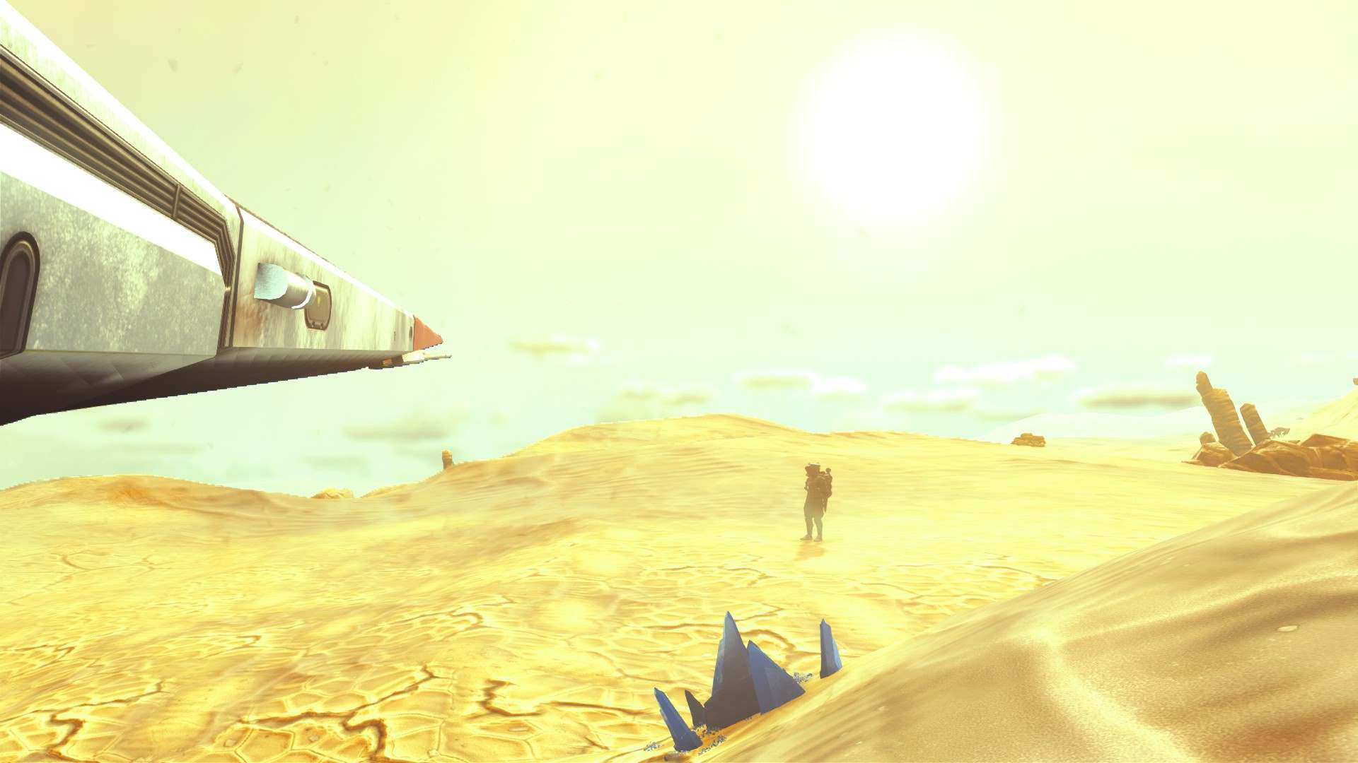

Slide 19
Exocrafts
- Improved all exocrafts handlings in water (__Badass_Handlings_ , __NMS_BEYOND_Fantasy)
- Changed Pilgrim handlings: Can reach high speed, longer boost effect, shorter boost cooldown (__Badass_Handlings_ , __NMS_BEYOND_Fantasy) - Changed Roamer handlings : More heavy and bumpy. Can go faster than vanilla but slightly less fast than the pilgrim at full speed. Easily performs drifts. Repitive short boost use. (__Badass_Handlings_ , __NMS_BEYOND_Fantasy) - Changed Nomad handlings : Can go faster than modded pilgrim. High jumps. High air control, can get boost speed while in air. (__Badass_Handlings_ , __NMS_BEYOND_Fantasy)
- Nomad is now an hybrid submarine (__Badass_Handlings_ , __NMS_BEYOND_Fantasy)
- Changed Colossus handlings : Can reach higher speed than on vanilla using the boost. The boost has a very long effect and a longer cooldown. (__Badass_Handlings_ , __NMS_BEYOND_Fantasy) - Nautilon goes now faster than on vanilla. (__Badass_Handlings_ , __NMS_BEYOND_Fantasy)
- Enhanced exocrafts cameras angles. (_CAM_OVERHAUL , __NMS_BEYOND_Fantasy)
- The exocrafts summon stations are smaller and are easier to craft (_POCKET_EXOCRAFTS , __NMS_BEYOND_Fantasy)
( 2 Metal plates + 1 Battery )
- More powerfull Headlights (_HEADLIGHTS_BOOST)

Slide 20
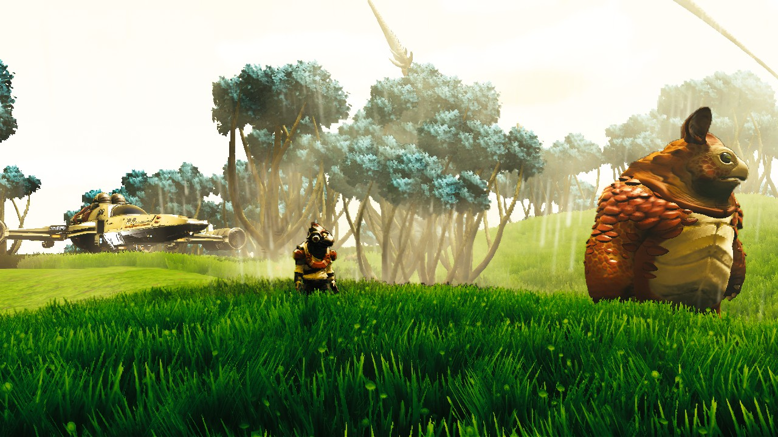

Slide 21
Menus And Interface
changed the menu with No Man's Sky ARTWORKS. They are semi transparent making the menu customized according to when you pause the game Concept Arts by Beau Lamb https://www.artstation.com/beaulamb (_MENUS_ __NMS_BEYOND_Fantasy)
A Hello Games loading screen using the NMS NEXT Game cover (_MENUS_ __NMS_BEYOND_Fantasy)
Several loading screens using the lastest NMS updates visuals (updated at every vanilla major updates) (_MENUS_ __NMS_BEYOND_Fantasy)
Customized game title for NMS Beyond Fantasy and for Beyond. (_MENUS_ __NMS_BEYOND_Fantasy)
A pre-release inspired blury green background for the inventories menus. (_MENUS_ __NMS_BEYOND_Fantasy)
Main pause menus ( discoveries, log, journey, options, etc ) has a semi transparent game logo has background. (Note that he matching with the paused game creates interresting merged screens.) (_MENUS_ __NMS_BEYOND_Fantasy)

Slide 22
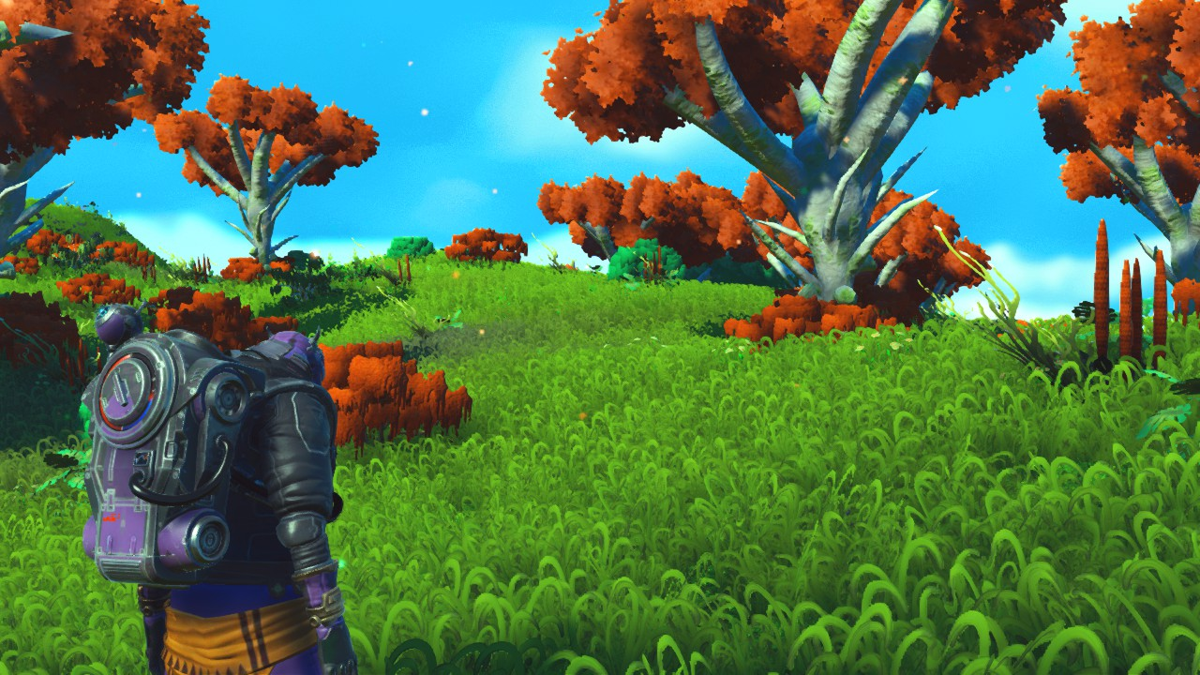

Slide 23
Vanilla game fixes
Birds no longer go through ground (FANTASTIC_BEASTS, __NMS_BEYOND_Fantasy)
No More visual glitches with clouds inside orbital freighters ( __CloudsFix , __NMS_BEYOND_Fantasy)
No more buzzing sounds on Monitor desks and on large computer desks (MORE_BASE_INTERACTIONS, __NMS_BEYOND_Fantasy)
Lighting Tables, Aquarium, terrarium, plant pots can now be placed on every surfaces (_ ADVANCED_BASEBUILDING, __NMS_BEYOND_Fantasy)
Removes invisible wall around Ceiling ring lamps (_ADVANCED_BASEBUILDING, __NMS_BEYOND_Fantasy)
Cheats
Mine trees, rocks and plants x10 faster. (_MINING_SPEEDx10 )
No meteo effects (_Cheat_No_storms)
- 1 Warp cell can be used 20 times. (_SPACE_EXPLORER_GAMEPLAY_1of100launch_20warps_version)
- Launching thrusters cost 1% of the tank – instead of 50% on vanilla. (_SPACE_EXPLORER_GAMEPLAY_1of100launch_20warps_version)

Slide 24
Alternate Versions
Menus redesign with « BEYOND » theme (__BEYOND_MENU_IMPROVEMENTS )
Recolor of the world generation with Alien Worlds 3 colors (previous biome mod) (_COLORS-GEN_AW3)
Recolor of the world generation with Alien Worlds 4 colors (previous biome mod) (_COLORS-GEN_AW4)
- No Bubbles Version of Fantasy Worlds world generation (GEN_FANTASY_WORLDS_No_Bubbles_version)
A version of Fantasy worlds generation that match vanilla biomes type
( but with less variations than on the default version of the mod ) (_GEN_FANTASY_WORLDS_VANILLA-MATCH)
A version of the world Generation without exotics creatures on common planets (_NoexoticCreatures_for_Fantasy_Worlds)
A Nomad floating version of the « badass handlings » mod (_Badass_Handlings_FLOAT_version)
A Clean Visor Filter (__Redmas-CLEANGLASS-VISOR-FILTER)

Slide 25
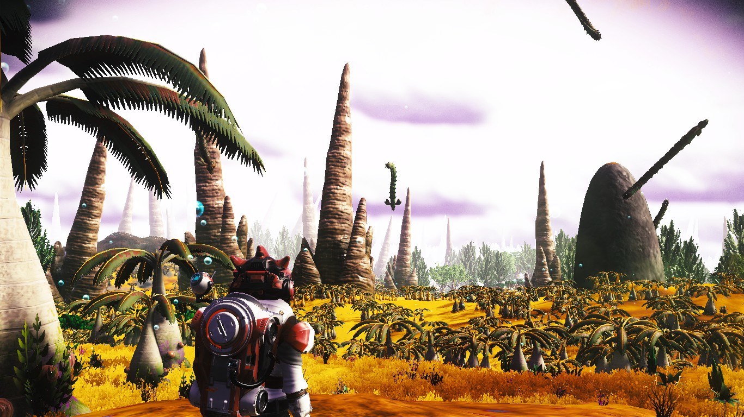

Slide 26
Installation
- Place the content of the archive’s “MODS” folder at this location \No Man's Sky\GAMEDATA\PCBANKS\MODS\
If your game has not been modded yet:
you will need to create the “MODS” folder and Delete or rename the “DISABLEMODS.TXT” at this location \No Man's Sky\GAMEDATA\PCBANKS\
- for advanced customisations , you can use the mods in the folder called « modular split of the main pak » instead of using the all in one version named __NMS_BEYOND_Fantasy.pak
In order to use anothers mods from other modders , you must force those mods to be readen by adding underscores at the beginning of the mod filename ( the more underscores, the higher priority )
The “LOCAL” prefix tells when the mod effects are visible for the mod owner only.
The “ONLINE” prefix tells when the mod effects are visible by other players not using the mod.
NB: Require latest version of NMS / The mods need to be updated after every vanilla updates.
Only the Mods placed at the “Mods” folder root will be active

Slide 27
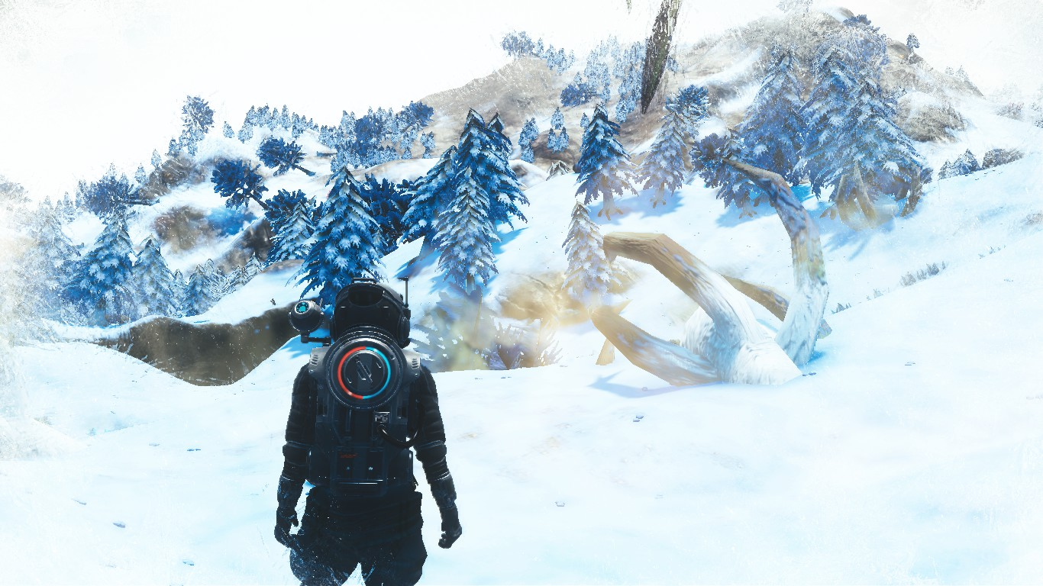

Slide 28
Credits
Concept Arts by Beau Lamb https://www.artstation.com/beaulamb
Mbincompiler & PSArcTool by Monkeyman192 https://github.com/monkeyman192

