Slide 1
Group Project – Team 5
Sprint 0
Fergal Byrne
Ger Hennessy
Ian Murray
Muireann Walsh (Product Owner)
Paula Suciu
Ronan Monahan (Scrum Master)

Slide 2
Overview of M.O. to date
The team held 8 daily standups
  The first 3 dealt with Project Planning
    -Overall approach – Epic User Stories (tasks/subtasks)
    -JIRA Implementation -Assumption formation -Database design
  The next 3 with Sprint 0 coding
      Muireann/Paula xls ->(Java) -> mySQL DB
      Ronan input validation (Java)
      Ian/Fergal Web Technologies (HTML JS)
      Ger Code Review (meta)/Documentation
  The final 2 with Sprint 0 deployment/code submission/demo
    -Integration -Testing -Submission of Sprint 0 code/docs
    -Demo Runthrough

Slide 3
Database design
In designing the database
we focussed on three main aspects
  Linking related data
    Through assumptions
    Confirmation with product owner
  Removing redundancy
    Identifying identical columns
    Finding functional dependencies
    Creating additional tables
  Optimization through removal of repetition
    e.g. Storing “GSM 800” as AutoNumber “1”

Slide 4
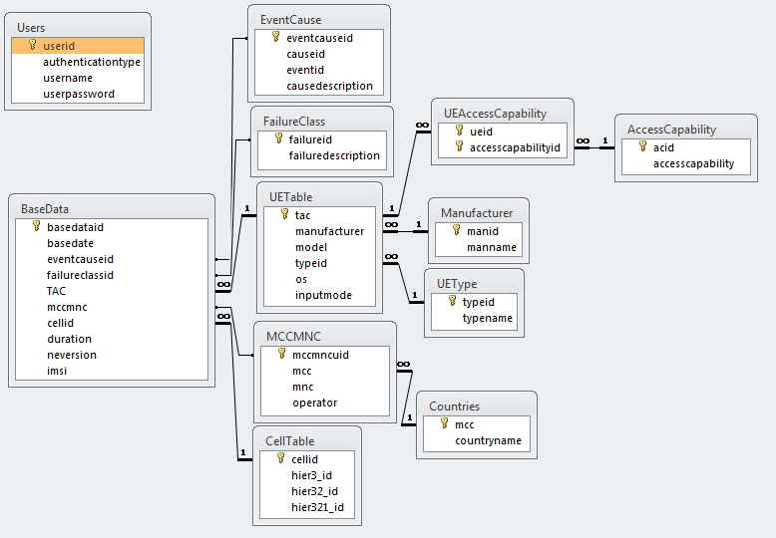
Initial Database Design

Slide 5
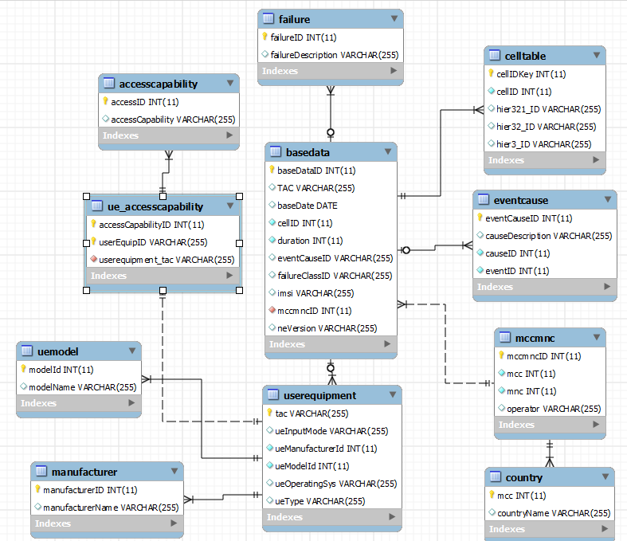
Current Database Design

Slide 6
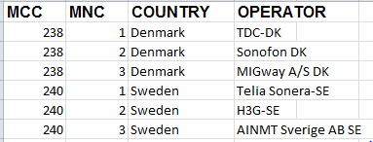
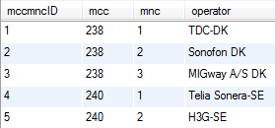
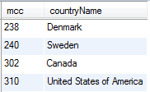
MCC-MNC Table
Optimisation: Country field extracted into a separate table, linked to the MCC
MCCMNC
Country

Slide 7
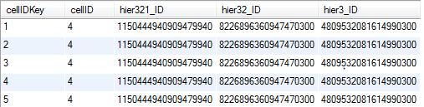
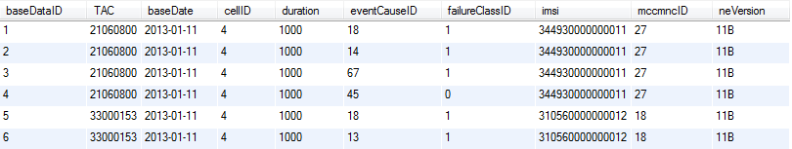
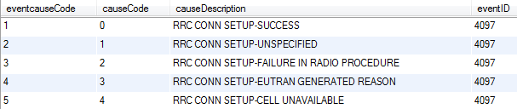
BaseData Table
CellID, Hier3_ID, HIER32_ID,HIER321_ID
extracted into a separate table
From 14 initial fields down to 8 fields
CellTable
EventCause

Slide 8
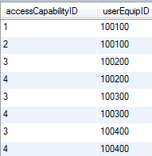
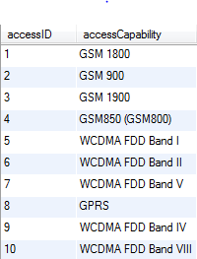
Normalisation and Optimisation
Original UE Table
UE_AccessCapability
Repeating fields:
Model = Marketing Name
Manufacturer = Vendor Name
Solution: both Model and Manufacturer columns extracted into their own table(optimisation)
TAC - AccessCapability: 1-to-many relationship
Each access capability stored in a separate table and given an ID
An extra table connecting the TAC(UserEquipmentID ) to the AccessCapabilityID
AccessCapability

Slide 9
Normalisation and Optimisation
Original UE Table
UE_AccessCapability
Repeating fields:
Model =Marketing Name
Manufacturer = Vendor Name
Solution: both Model and Manufacturer columns extracted into their own table(optimisation)
TAC - AccessCapability: 1 →* relationship
Each access capability stored in a separate table and given an ID
An extra table connecting the TAC(UserEquipmentID ) to the AccessCapabilityID
AccessCapability

Slide 10
Data Validation
Base Data table is the only table where data validation takes place.
Date Column: DD/MM/YYYY HH:MM, before today’s date.
EventId: must exist in EventCause Table
Failure Class: must exist in Failure Table
UE Type: must exist in User Equipment Table as “TAC”
Market: must exisit in Country Table as “MCC”
Operator: must exist in conjunction with MCC in MCCMNC Table
CellId: This must be an Integer
Duration: This must be an Integer
CauseCode: must exist in the CauseCode Table
EventId: stored in the EventCause Table
NE Version: No restriction
IMSI: This value must consist of 15 digits
HierIDs: These values should be no longer than 19 digits long

Slide 11
INSERT BURN DOWN CHART HERE

