Slide 1
Chapter Two
Programming with numbers and strings

Slide 2
Introduction
Numbers and character strings are important data types in any Python program
These are the fundamental building blocks we use to build more complex data structures
In this chapter, you will learn how to work with numbers and text. We will write several simple programs that use them

Slide 3
Chapter Goals
To declare and initialize variables and constants
To understand the properties and limitations of integers and floating-point numbers
To appreciate the importance of comments and good code layout
To write arithmetic expressions and assignment statements
To create programs that read, and process inputs, and display the results
To learn how to use Python strings
To create simple graphics programs using basic shapes and text

Slide 4
Contents
2.1 Variables
2.2 Arithmetic
2.3 Problem Solving: First Do It By Hand
2.4 Strings
2.5 Input and Output
2.6 Graphics: Simple Drawings

Slide 5
2.1 Variables

Slide 6
Variables
A variable is a named storage location in a computer program
There are many different types of variables, each type used to store different things
You ‘define’ a variable by telling the compiler:
What name you will use to refer to it
The initial value of the variable
You use an assignment statement to place a value into a variable

Slide 7
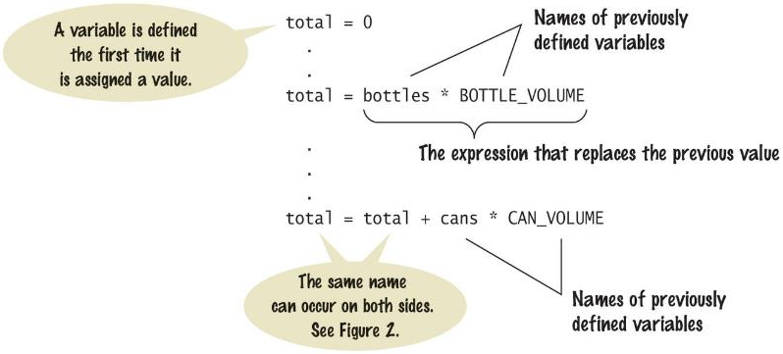
Variable Definition
To define a variable, you must specify an initial value.

Slide 8
The assignment statement
Use the assignment statement '=' to place a new value into a variable
cansPerPack = 6 # define & initializes the variable cansPerPack
Beware: The “=“ sign is NOT used for comparison:
It copies the value on the right side into the variable on the left side
You will learn about the comparison operator in the next chapter
In an assignment:
the left side of the '=' operator has to be a memory location
the right side is a data value that will be stored in the memory location
Python supports the swapping of 2 data values with an assignment:
var1, var2 = var2, var1

Slide 9

Assignment syntax
The value on the right of the '=' sign is assigned to the variable on the left

Slide 10
An example: soda deal
Soft drinks are sold in cans and bottles. A store offers a six-pack of 12-ounce cans for the same price as a two-liter bottle. Which should you buy? (12 fluid ounces equal approximately 0.355 liters.)
List of variables:
Number of cans per pack
Ounces per can
Ounces per bottle
Type of Number
Whole number
Whole number
Number with fraction

Slide 11
Why different types?
There are three different types of data that we will use in this chapter:
A whole number (no fractional part) 7 (integer or int)
A number with a fraction part 8.88 (float)
A sequence of characters "Bob” (string)
The data type is associated with the value, not the variable:
cansPerPack = 6 # int
canVolume = 12.0 # float

Slide 12
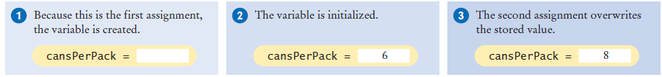
Updating a Variable (assigning a value)
If an existing variable is assigned a new value, that value replaces the previous contents of the variable.
For example:
cansPerPack = 6
cansPerPack = 8

Slide 13
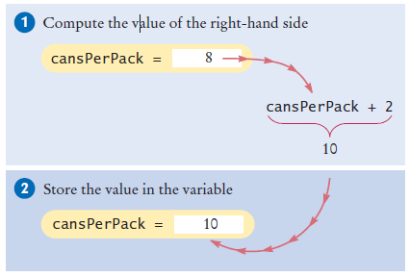
Updating a Variable (computed)
Executing the Assignment:
cansPerPack = cansPerPack + 2
Step by Step:
Step 1: Calculate the right hand side of the assignment. Find the value of cansPerPack, and add 2 to it.
Step 2: Store the result in the variable named on the left side of the assignment operator

Slide 14
A Warning…
Since the data type is associated with the value and not the variable:
A variable can be assigned different values at different places in a program
taxRate = 5 # an int
Then later…
taxRate = 5.5 # a float
And then
taxRate = “Non- taxable” # a string
If you use a variable and it has an unexpected type an error will occur in your program

Slide 15
Our First Program of the Day…
Open Wing (our IDE) and create a new file
type in the following
save the file as typetest.py
Run the program
# Testing different types in the same variable
taxRate = 5 # int
print(taxRate)
taxrate = 5.5 # float
print(taxRate)
taxRate = "Non-taxable" # string
print(taxRate)
print(taxRate + 5)
So…
Once you have initialized a variable with a value of a particular type you should take great care to keep storing values of the same type in the variable

Slide 16
A Minor Change
Change line 8 to read:
print(taxRate + “??”)
Save your changes
Run the program
What is the result?
When you use the “+” operator with strings the second argument is concatenated to the end of the first
We’ll cover string operations in more detail later in this chapter

Slide 17
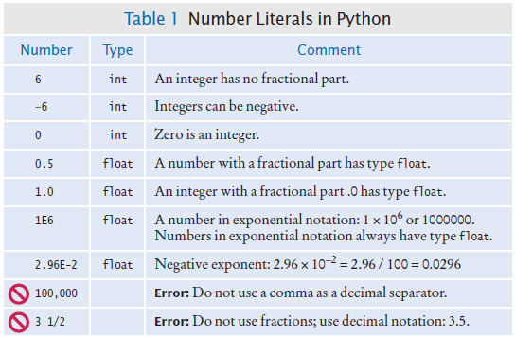
Table 1: Number Literals in Python

Slide 18
Naming variables
Variable names should describe the purpose of the variable
‘canVolume’ is better than ‘cv’
Use These Simple Rules
Variable names must start with a letter or the underscore ( _ ) character
Continue with letters (upper or lower case), digits or the underscore
You cannot use other symbols (? or %...) and spaces are not permitted
Separate words with ‘camelCase’ notation
Use upper case letters to signify word boundaries
Don’t use ‘reserved’ Python words (see Appendix C, pages A6 and A7)

Slide 19
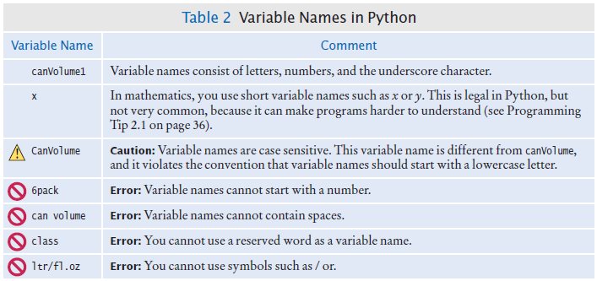
Table 2: Variable Names in Python

Slide 20
Programming Tip: Use Descriptive Variable Names
Choose descriptive variable names
Which variable name is more self descriptive?
canVolume = 0.35
cv = 0.355
This is particularly important when programs are written by more than one person.

Slide 21
constants
In Python a constant is a variable whose value should not be changed after it’s assigned an initial value.
It is a good practice to use all caps when naming constants
BOTTLE_VOLUME = 2.0
It is good style to use named constants to explain numerical values to be used in calculations
Which is clearer?
totalVolume = bottles * 2
totalVolume = bottles * BOTTLE_VOLUME
A programmer reading the first statement may not understand the significance of the “2”
Python will let you change the value of a constant
Just because you can do it, doesn’t mean you should do it

Slide 22
Constants: Naming & Style
It is customary to use all UPPER_CASE letters for constants to distinguish them from variables.
It is a nice visual cue
BOTTLE_VOLUME = 2 # Constant
MAX_SIZE = 100 # Constant
taxRate = 5 # Variable

Slide 23
Python comments
Use comments at the beginning of each program, and to clarify details of the code
Comments are a courtesy to others and a way to document your thinking
Comments to add explanations for humans who read your code.
The compiler ignores comments.

Slide 24
Commenting Code: 1st Style
##
# This program computes the volume (in liters) of a six-pack of soda
# cans and the total volume of a six-pack and a two-liter bottle
#
# Liters in a 12-ounce can
CAN_VOLUME = 0.355
# Liters in a two-liter bottle.
BOTTLE_VOLUME = 2
# Number of cans per pack.
cansPerPack = 6
# Calculate total volume in the cans.
totalVolume = cansPerPack * CAN_VOLUME
print("A six-pack of 12-ounce cans contains", totalVolume, "liters.")
# Calculate total volume in the cans and a 2-liter bottle.
totalVolume = totalVolume + BOTTLE_VOLUME
print("A six-pack and a two-liter bottle contain", totalVolume, "liters.")

Slide 25
Commenting Code: 2nd Style
##
# This program computes the volume (in liters) of a six-pack of soda
# cans and the total volume of a six-pack and a two-liter bottle
#
## CONSTANTS ##
CAN_VOLUME = 0.355 # Liters in a 12-ounce can
BOTTLE_VOLUME = 2 # Liters in a two-liter bottle
# Number of cans per pack.
cansPerPack = 6
# Calculate total volume in the cans.
totalVolume = cansPerPack * CAN_VOLUME
print("A six-pack of 12-ounce cans contains", totalVolume, "liters.")
# Calculate total volume in the cans and a 2-liter bottle.
totalVolume = totalVolume + BOTTLE_VOLUME
print("A six-pack and a two-liter bottle contain", totalVolume, "liters.")

Slide 26
Undefined Variables
You must define a variable before you use it: (i.e. it must be defined somewhere above the line of code where you first use the variable)
canVolume = 12 * literPerOunce
literPerOunce = 0.0296
The correct order for the statements is:
literPerOunce = 0.0296
canVolume = 12 * literPerOunce

Slide 27
2.2 Arithmetic

Slide 28


Basic Arithmetic Operations (1)
Python supports all of the basic arithmetic operations:
Addition “+”
Subtraction “-”
Multiplication “*”
Division “/”
You write your expressions a bit differently

Slide 29
Basic Arithmetic Operations (2)
Python supports update operators:
Addition and assign “+=”
Subtraction and assign “-=”
Multiplication and assign “*=”
Division and assign “/=”

Slide 30
Precedence
Precedence is similar to Algebra:
PEMDAS
Parenthesis, Exponent, Multiply/Divide, Add/Subtract

Slide 31
Mixing numeric types
If you mix integer and floating-point values in an arithmetic expression, the result is a floating-point value.
7 + 4.0 # Yields the floating value 11.0
Remember from our earlier example:
If you mix strings with integer or floating point values the result is an error

Slide 32
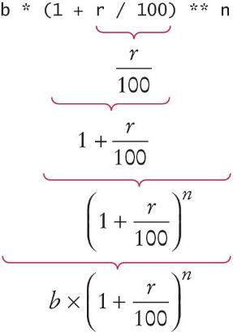
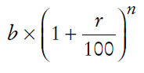
Powers
Double stars ** are used to calculate an exponent
Analyzing the expression:
Becomes:
b * ((1 + r / 100) ** n)

Slide 33
Floor division
When you divide two integers with the / operator, you get a floating-point value. For example,
7 / 4
Yields 1.75
We can also perform floor division using the // operator.
The “//” operator computes the quotient and discards the fractional part
7 // 4
Evaluates to 1 because 7 divided by 4 is 1.75 with a fractional part of 0.75, which is discarded.

Slide 34
Calculating a remainder
If you are interested in the remainder of dividing two integers, use the “%” operator (called modulus):
remainder = 7 % 4
The value of remainder will be 3
Sometimes called modulo divide

Slide 35
A Simple Example:
Open a new file in the Wing IDE:
Type in the following:
# Convert pennies to dollars and cents
pennies = 1729
dollars = pennies // 100 # Calculates the number of dollars
cents = pennies % 100 # Calculates the number of pennies
print("I have", dollars, "and", cents, "cents")
Save the file
Run the file
What is the result?

Slide 36
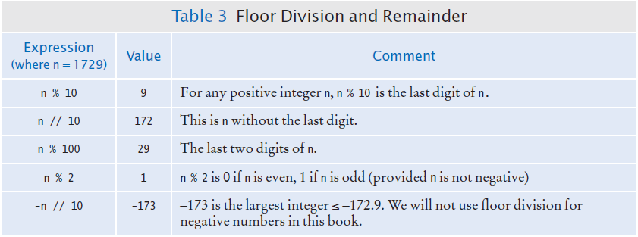
Integer Division and Remainder Examples
Handy to use for making change:
pennies = 1729
dollars = pennies / 100 # 17
cents = pennies % 100 # 29

Slide 37
Calling functions
Recall that a function is a collection of programming instructions that carry out a particular task.
The print() function can display information, but there are many other functions available in Python.
When calling a function you must provide the correct number of arguments
The program will generate an error message if you don’t

Slide 38
Calling functions that return a value
Most functions return a value. That is, when the function completes its task, it passes a value back to the point where the function was called.
For example:
The call abs(-173) returns the value 173.
The value returned by a function can be stored in a variable:
distance = abs(x)
You can use a function call as an argument to the print function
Go to the python shell window in Wing and type:
print(abs(-173))

Slide 39
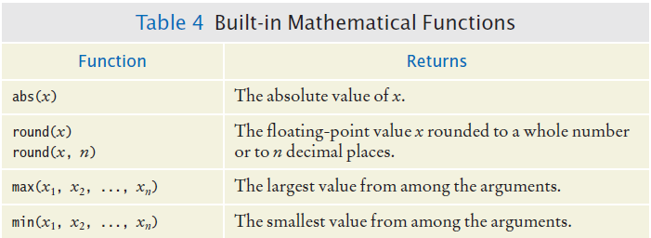
Built in Mathematical Functions

Slide 40
Python libraries (modules)
A library is a collection of code, written and compiled by someone else, that is ready for you to use in your program
A standard library is a library that is considered part of the language and must be included with any Python system.
Python’s standard library is organized into modules.
Related functions and data types are grouped into the same module.
Functions defined in a module must be explicitly loaded into your program before they can be used.

Slide 41
Using functions from the Math Module
For example, to use the sqrt() function, which computes the square root of its argument:
# First include this statement at the top of your
# program file.
from math import sqrt
# Then you can simply call the function as
y = sqrt(x)

Slide 42
Built-in Functions
Built-in functions are a small set of functions that are defined as a part of the Python language
They can be used without importing any modules

Slide 43
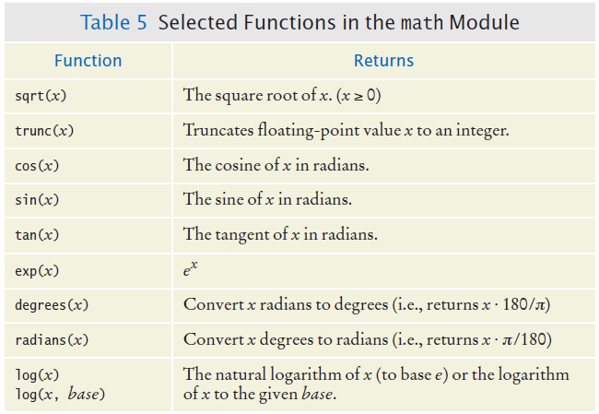
Functions from the Math Module

Slide 44
Floating-point to integer conversion
You can use the function int() and float() to convert between integer and floating point values:
balance = total + tax # balance: float
dollars = int (balance) # dollars: integer
You lose the fractional part of the floating-point value (no rounding occurs)

Slide 45
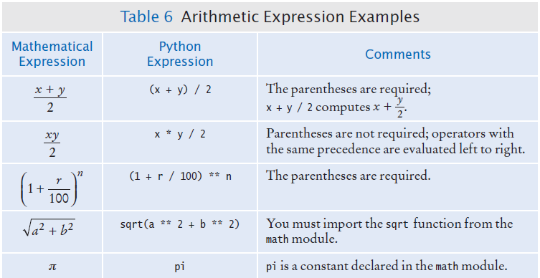
Arithmetic Expressions

Slide 46
Roundoff Errors
Floating point values are not exact
This is a limitation of binary values; not all floating point numbers have an exact representation
Open Wing, open a new file and type in:
price = 4.35
quantity = 100
total = price * quantity
# Should be 100 * 4.35 = 435.00
print(total)
You can deal with roundoff errors by
rounding to the nearest integer (see Section 2.2.4)
or by displaying a fixed number of digits after the decimal separator (see Section 2.5.3).

Slide 47
Unbalanced Parentheses
Consider the expression
((a + b) * t / 2 * (1 - t)
What is wrong with the expression?
Now consider this expression.
(a + b) * t) / (2 * (1 - t)
This expression has three “(“ and three “)”, but it still is not correct
At any point in an expression the count of “(“ must be greater than or equal to the count of “)”
At the end of the expression the two counts must be the same

Slide 48
Additional Programming Tips
Use Spaces in expressions
totalCans = fullCans + emptyCans
Is easier to read than
totalCans=fullCans+emptyCans
Other ways to import modules:
From math import, sqrt, sin, cos # imports the functions listed
From math import * # imports all functions from the module
Import math # imports all functions from the module
If you use the last style you have to add the module name and a “.” before each function call
y = math.sqrt(x)

Slide 49
Complex Numbers
In addition to integers and floats, Python also supports complex numbers
>>> x = 2 + 3j
>>> print(x)
(2+3j) # rectangular format, real + imaginary parts
>>> print(x.real, x.imag)
2.0 3.0
>>> print(polar(x))
(3.605551275463989, 0.982793723247329) # polar format,
# magnitude and angle
There is a cmath (for complex math) module, similar to the math module, that has math functions for complex numbers

Slide 50
2.3 Problem Solving
Develop the algorithm first, then write the Python

Slide 51
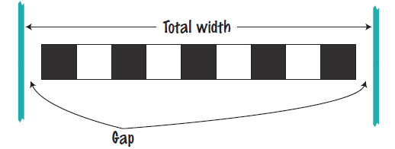
2.3 Problem Solving: First by Hand
A very important step for developing an algorithm is to first carry out the computations by hand.
If you can’t compute a solution by hand, how do you write the program?
Example Problem:
A row of black and white tiles needs to be placed along a wall. For aesthetic reasons, the architect has specified that the first and last tile shall be black.
Your task is to compute the number of tiles needed and the gap at each end, given the space available and the width of each tile.

Slide 52

Start with example values
Givens
Total width: 100 inches
Tile width: 5 inches
Test your values
Let’s see… 100/5 = 20, perfect! 20 tiles. No gap.
But wait… BW…BW “…first and last tile shall be black.”
Look more carefully at the problem….
Start with one black, then some number of WB pairs
Observation: each pair is 2x width of 1 tile
In our example, 2 x 5 = 10 inches

Slide 53
Keep applying your solution
Total width: 100 inches
Tile width: 5 inches
Calculate total width of all tiles
One black tile: 5”
9 pairs of BWs: 90”
Total tile width: 95”
Calculate gaps (one on each end)
100 – 95 = 5” total gap
5” gap / 2 = 2.5” at each end

Slide 54
Now devise an algorithm
Use your example to see how you calculated values
How many pairs?
Note: must be a whole number
Integer part of: (total width – tile width) / 2 x tile width
How many tiles?
1 + 2 x the number of pairs
Gap at each end
(total width – number of tiles x tile width) / 2

Slide 55
The algorithm
Calculate the number of pairs of tiles
Number of pairs = integer part of (total width – tile width) / (2 * tile width)
Calculate the number of tiles
Number of tiles = 1 + (2 * number of pairs)
Calculate the gap
Gap at each end = (total width – number of tiles * tile width / 2
Print the number of pairs of tiles
Print the total number of tiles in the row
Print the gap

Slide 56
2.4 Strings

Slide 57
Strings
Start with some simple definitions:
Text consists of characters
Characters are letters, numbers, punctuation marks, spaces, ….
A string is a sequence of characters
In Python, string literals are specified by enclosing a sequence of characters within a matching pair of either single or double quotes.
print("This is a string.", 'So is this.')
By allowing both types of delimiters, Python makes it easy to include an apostrophe or quotation mark within a string.
message = 'He said "Hello"‘
Remember to use matching pairs of quotes, single with single, double with double

Slide 58
String Length
The number of characters in a string is called the length of the string. (For example, the length of "Harry" is 5).
You can compute the length of a string using Python’s len() function:
length = len("World!") # length is 6
A string of length 0 is called the empty string. It contains no characters and is written as "" or ''.

Slide 59
String Concatenation (“+”)
You can ‘add’ one String onto the end of another
firstName = "Harry"
lastName = "Morgan"
name = firstName + lastName # HarryMorgan
print(“my name is:”, name)
You wanted a space in between the two names?
name = firstName + " " + lastName # Harry Morgan
Using “+” to concatenate strings is an example of a concept called operator overloading. The “+” operator performs different functions of variables of different types

Slide 60
String repetition (“*”)
You can also produce a string that is the result of repeating a string multiple times.
Suppose you need to print a dashed line.
Instead of specifying a literal string with 50 dashes, you can use the * operator to create a string that is comprised of the string "-" repeated 50 times.
dashes = "-" * 50
results in the string
"-------------------------------------------------“
The “*” operator is also overloaded.

Slide 61
Converting Numbers to Strings
Use the str() function to convert between numbers and strings.
Open Wing, then open a new file and type in:
balance = 888.88
dollars = 888
balanceAsString = str(balance)
dollarsAsString = str(dollars)
print(balanceAsString)
print(dollarsAsString)
To turn a string containing a number into a numerical value, we use the int() and float() functions:
id = int("1729")
price = float("17.29")
print(id)
print(price)
This conversion is important when the strings come from user input.

Slide 62
Strings and Characters
strings are sequences of characters
Python uses Unicode characters
Unicode defines over 100,000 characters
Unicode was designed to be able to encode text in essentially all written languages
Characters are stored as integer values
See the ASCII subset on Unicode chart in Appendix A
For example, the letter ‘H’ has a value of 72

Slide 63
Copying a character from a String
Each char inside a String has an index number:
0 | 1 | 2 | 3 | 4 | 5 | 6 | 7 | 8 | 9
c | h | a | r | s |  | h | e | r | e
The first char is index zero (0)
The [] operator returns a char at a given index inside a String:
name = "Harry”
start = name[0]
last = name[4]
0 | 1 | 2 | 3 | 4
H | a | r | r | y

Slide 64
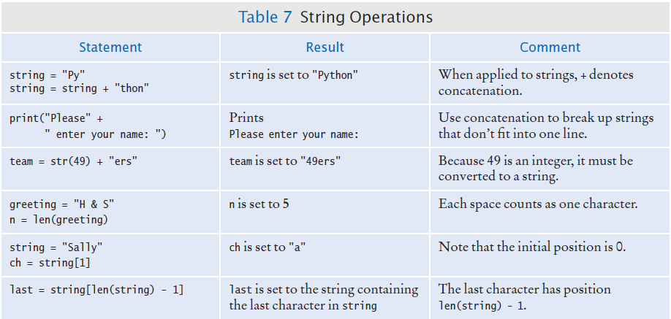
String Operations

Slide 65
Methods
In computer programming, an object is a software entity that represents a value with certain behavior.
The value can be simple, such as a string, or complex, like a graphical window or data file.
The behavior of an object is given through its methods.
A method is a collection of programming instructions to carry out a specific task – similar to a function
But unlike a function, which is a standalone operation, a method can only be applied to an object of the type for which it was defined.
Methods are specific to a type of object
Functions are general and can accept arguments of different types
You can apply the upper() method to any string, like this:
name = "John Smith"
# Sets uppercaseName to "JOHN SMITH"
uppercaseName = name.upper()

Slide 66
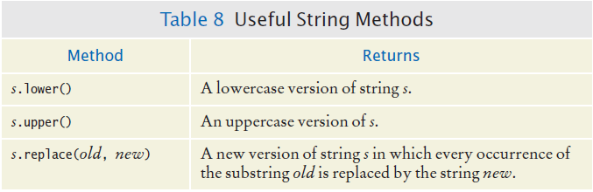
Some Useful String Methods

Slide 67
String Escape Sequences
How would you print a double quote?
Preface the " with a “\” inside the double quoted String
print("He said \"Hello\"")
OK, then how do you print a backslash?
Preface the \ with another \
print("C:\\Temp\\Secret.txt")
Special characters inside Strings
Output a newline with a ‘\n’
print("*\n**\n***\n")
*
**
***

Slide 68
2.5 Input and Output

Slide 69
Input and Output
You can read a String from the console with the input() function:
name = input("Please enter your name")
Converting a String variable to a number can be used if numeric (rather than string input) is needed
age = int(input("Please enter age: "))
The above is equivalent to doing it two steps (getting the input and then converting it to a number):
aString = input("Please enter age: ") # String input
age = int(aString) # Converted to int

Slide 70
Formatted output
Outputting floating point values can look strange:
Price per liter: 1.21997
To control the output appearance of numeric variables, use formatted output tools such as:
print("Price per liter %.2f" %(price))
Price per liter: 1.22
print("Price per liter %10.2f" %(price))
Price per liter: 1.22
The %10.2f is called a format specifier
10 spaces
2 spaces

Slide 71
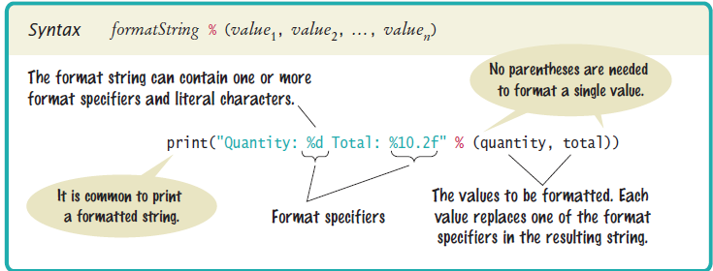
Syntax: formatting strings

Slide 72
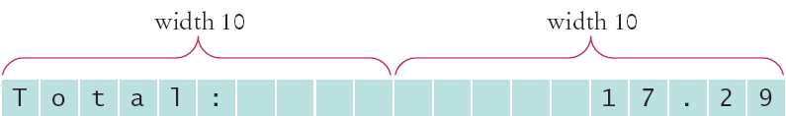


Format flag examples
Left Justify a String:
print("%-10s" %("Total:"))
Right justify a number with two decimal places
print("%10.2f" %(price))
And you can print multiple values:
print("%-10s%10.2f" %("Total: ", price))

Slide 73
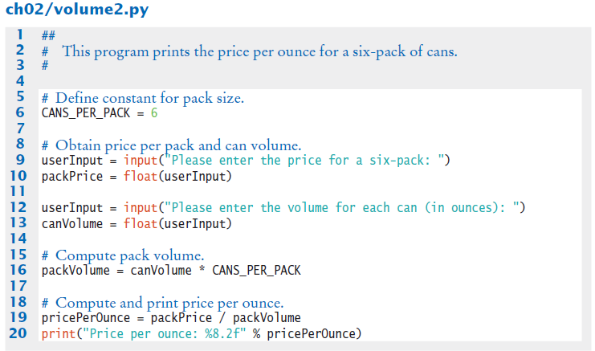
Volume2.py

Slide 74
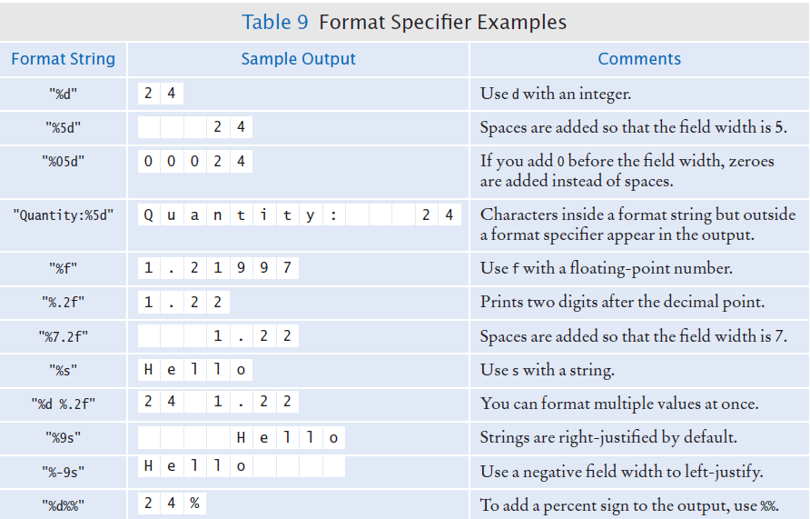
Format Specifier Examples

Slide 75
2.6 Graphics
Simple Drawings

Slide 76
Drawing Simple Graphics
To help you create simple drawings, we have included a graphics module with the book that is a simplified version of Python’s more complex library module.
The module code and usage instructions are available with the source code for the book on its companion web site.

Slide 77
Using the graphics module (1)
To create a graphical application using the graphics module, carry out the following at the top of your program:
from ezgraphics import GraphicsWindow
Create a graphics window (640 x 480 pixels):
win = GraphicsWindow(640, 480)
Access the canvas contained in the graphics window:
canvas = win.canvas()

Slide 78
Using the graphics module (2)
Create your drawing.
canvas.drawRect(15, 10, 20, 30)
Have the program wait for the user to close the window (by clicking the close button).
Without this statement, the program would terminate immediately and the graphics window would disappear, leaving no time for you to see your drawing.
win.wait()

Slide 79
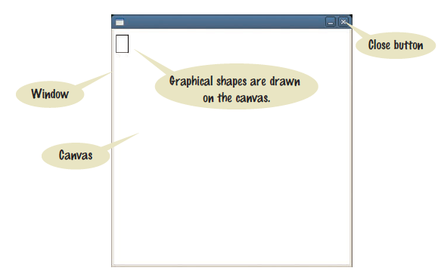
A graphics window

Slide 80
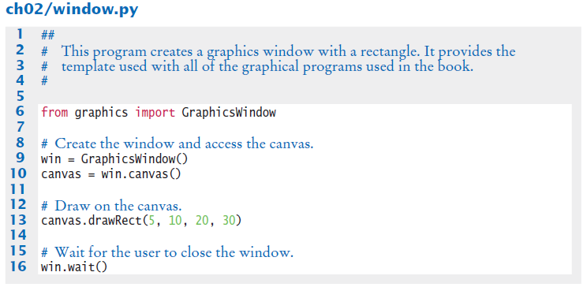
A complete drawing example

Slide 81
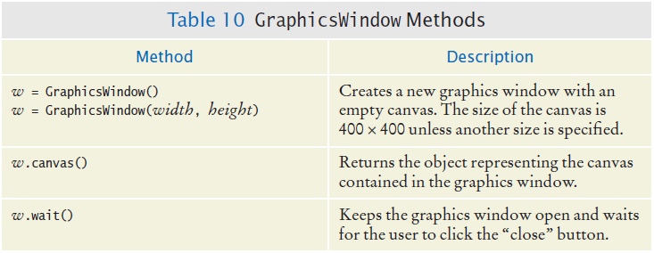
Table 10: GraphicsWindow Methods

Slide 82
Drawing shapes
Basic shapes have 4 properties: x coordinate, y coordinate, width and height.
Example:
canvas.drawRect(15, 10, 20, 30)
This statement draws a rectangle with the upper top left corner at point (x = 15, y = 10) in the window with a height of 20 and a width of 30.
Common shapes that can be drawn include: rectangles, squares, circles and ovals.

Slide 83
Drawing lines
Lines require 4 slightly different properties than drawing shapes:
Point 1(x coordinate, y coordinate)
Point 2(x coordinate, y coordinate)

Slide 84
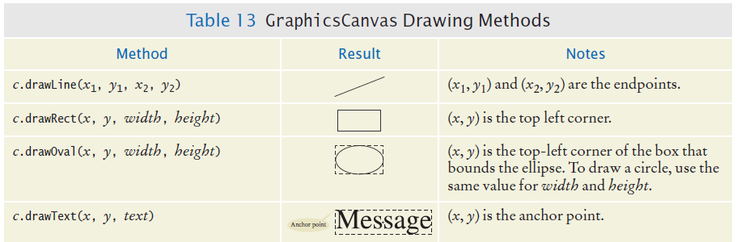
Table 13: Common Shapes, Lines and Text

Slide 85
The canvas and shapes can be colored
If you use the default setting (not changing the fill or outline), shapes are outlined in black and there is no fill color.
The fill color and outline can be set to different colors with the method calls:
setFill(<color name>)
OR
setFill(<red level>, <green level>, <blue level>)
setOutline(<color name>)
OR
setOutline(<red level>, <green level>, <blue level>)

Slide 86

Example of setting color
The following statements draw a rectangle that is outlined in black and filled with green.
canvas.setOutline("black")
canvas.setFill(0, 255, 0)
canvas.drawRect(10, 20, 100, 50)

Slide 87
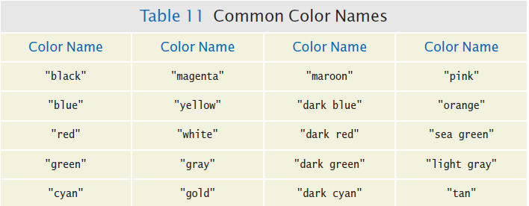
Table 11: Common Color Names

Slide 88
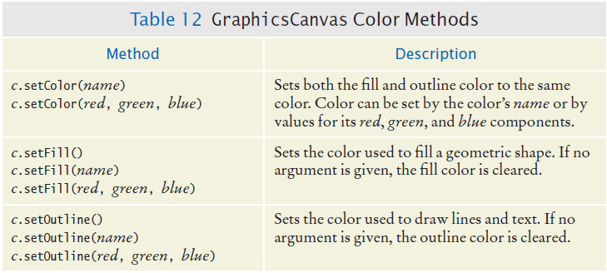
Table 12: GraphicsCanvas Color Methods

Slide 89
Summary: variables
A variable is a storage location with a name.
When defining a variable, you must specify an initial value.
By convention, variable names should start with a lower case letter.
An assignment statement stores a new value in a variable, replacing the previously stored value.

Slide 90
Summary: operators
The assignment operator = does not denote mathematical equality.
Variables whose initial value should not change are typically capitalized by convention.
The / operator performs a division yielding a value that may have a fractional value.
The // operator performs a division, the remainder is discarded.
The % operator computes the remainder of a floor division.

Slide 91
Summary: python overview
The Python library declares many mathematical functions, such as sqrt() and abs()
You can convert between integers, floats and strings using the respective functions: int(), float(), str()
Python libraries are grouped into modules. Use the import statement to use methods from a module.
Use the input() function to read keyboard input in a console window.

Slide 92
Summary: python overview
Use the format specifiers to specify how values should be formatted.

Slide 93
Summary: Strings
Strings are sequences of characters.
The len() function yields the number of characters in a String.
Use the + operator to concatenate Strings; that is, to put them together to yield a longer String.
In order to perform a concatenation, the + operator requires both arguments to be strings. Numbers must be converted to strings using the str() function.
String index numbers are counted starting with 0.

Slide 94
Summary: Strings
Use the [ ] operator to extract the elements of a String.

Slide 95
Summary: graphics
Graphical shapes (such as squares, rectangles, circles, ovals), or lines and text can be drawn using the graphics module.
The color of graphical objects can be set with the setOutline() and setFill() methods.

