Slide 1
Chapter Five: Functions

Slide 2
Chapter Goals
To be able to implement functions
To become familiar with the concept of parameter passing
To understand default arguments in a function
To develop strategies for decomposing complex tasks into simpler ones
To be able to determine the scope of a variable
To learn how to think recursively

Slide 3
Contents
Functions as Black Boxes
Implementing and Testing Functions
Parameter Passing
Return Values
Functions without Return Values
Reusable Functions
Stepwise Refinement
Variable Scope
Graphics: Building an Image Processing Toolkit
Recursive Functions

Slide 4
Functions as Black Boxes
Section 5.1

Slide 5
Functions as Black Boxes
A function is a sequence of instructions with a name
For example, the round function, which was introduced in Chapter 2, contains instructions to round a floating-point value to a specified number of decimal places

Slide 6
Calling Functions
You call a function in order to execute its instructions
price = round(6.8275, 2) # Sets result to 6.83
By using the expression round(6.8275, 2), your program calls the round function, asking it to round 6.8275 to two decimal digits

Slide 7
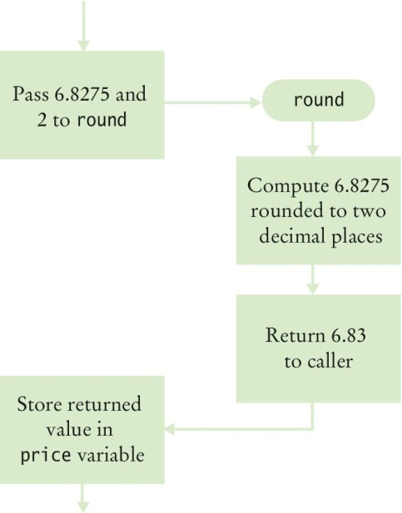
Calling Functions (2)
The round function returns its result back to where the function was called and your program resumes execution

Slide 8
Function Arguments
When another function calls the round function, it provides “input”, such as the values 6.8275 and 2 in the call: round(6.8275, 2)
These values are called the arguments of the function call
Note that they are not necessarily input provided by a human user
They are the values for which we want the function to compute a result

Slide 9
Function Arguments
Functions can receive multiple arguments or it is also possible to have functions with no arguments

Slide 10
Function Return Values
The “output” that the round function computes is called the return value
Functions return only one value
The return value of a function is returned to the point in your program where the function was called
price = round(6.8275, 2)
When the round function returns its result, the return value is stored in the variable ‘price’ statement)
Do not confuse returning a value with producing program output which is produced when using a print() statement

Slide 11
Black Box Analogy
A thermostat is a ‘black box’
Set a desired temperature
Turns on heater/AC as required
You don’t have to know how it really works!
How does it know the current temp?
What signals/commands does it send to the heater or A/C?
Use functions like ‘black boxes’
Pass the function what it needs to do its job
Receive the answer

Slide 12
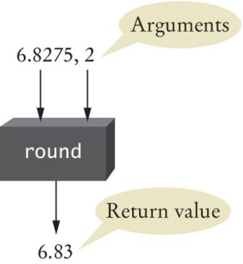
The round Function as a Black Box
You pass the round function its necessary arguments (6.8275 & 2) and it produces its result (6.83)

Slide 13
The round Function as a Black Box
You may wonder how the round function performs its job
As a user of the function, you don’t need to know how the function is implemented
You just need to know the specification of the function:
If you provide arguments x and n, the function returns x rounded to n decimal digits

Slide 14
Designing Your Own Functions
When you design your own functions, you will want to make them appear as black boxes to other programmers
Even if you are the only person working on a program, making each function into a black box pays off: there are fewer details that you need to keep in mind

Slide 15
Implementing and Testing Functions
Section 5.2

Slide 16
Implementing and Testing Functions
A function to calculate the volume of a cube
What input does it need to do its job?
What does it return or output with?
When writing (or defining or implementing) this function
Pick a name for the function (cubeVolume)
Declare a variable for each incoming argument
(sideLength) (which is called a parameter)
Put all this information together along with the def keyword to form the first line of the function’s definition:
After the function header is the function body, which is the block of code that does the work of the function.
This line is called the header of the function
def cubeVolume(sideLength):

Slide 17
Testing a Function
If you run a program containing just the function definition, then nothing happens
After all, nobody is calling the function
In order to test the function, your program should contain
The definition of the function
Statements that call the function and print the result

Slide 18
Calling/Testing the Cube Function
Implementing or defining the function (function definition)
def cubeVolume(sideLength) :
volume = sideLength ** 3
return volume
Calling / testing the function
result1 = cubeVolume(2)
result2 = cubeVolume(10)
print("A cube with side length 2 has volume", result1)
print("A cube with side length 10 has volume", result2)

Slide 19
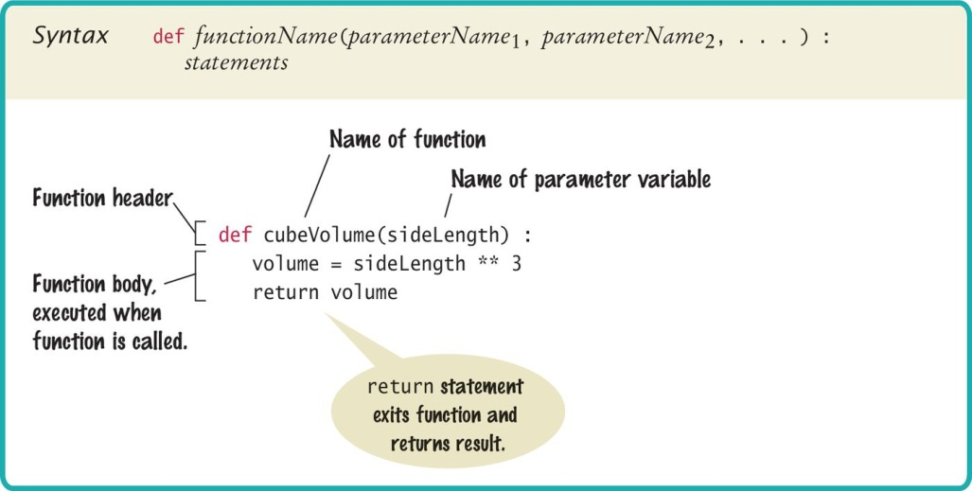
Syntax: Function Definition

Slide 20
Documentation: docstrings (1)
Whenever you write a function, you should comment its behavior
Comments for a function follow Python’s docstring convention:
Appear immediately after the function header
Start with 3 double quotes
On the same line as the 3 double quotes, a short description of what the function does. Use action verbs: ask the user for input, calculate the total price, print sales receipt, etc.
Optional: Description of input arguments, return value
End with 3 double quotes on a separate line
If not using the optional description of input arguments and return value, then the docstring can be on one line: start double quotes, description of function, end double quotes

Slide 21
Documentation: docstrings (2)
Example multi-line docstring
Example one-line docstring:
def cubeVolume(sideLength) :
”””Calculate the volume of a cube.
Argument: sideLenght - the length of one side
Return: the volume of the cube
”””
volume = side ** 3
return volume
def cubeVolume(sideLength) :
”””Calculate the volume of a cube.”””
volume = side ** 3
return volume

Slide 22
The main Function
When defining and using functions in Python, it is good programming practice to place all statements into functions, and to specify one function as the starting point
Any legal name can be used for the starting point, but we chose ‘main’ since it is the required function name used by other common languages
Of course, we must have one statement in the program that calls the main function

Slide 23
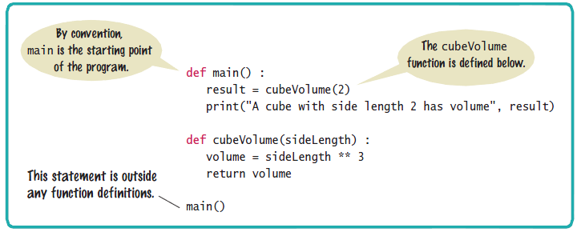
Syntax: The main Function

Slide 24
Using Functions: Order (1)
It is important that you define any function before you call it
For example, the following will produce a compile-time error:
print(cubeVolume(10))
def cubeVolume(sideLength) :
volume = sideLength ** 3
return volume
Python cannot tell that the cubeVolume function will be defined later in the program

Slide 25
Using Functions: Order (2)
However, a function can be called from within another function before the former has been defined
The following is perfectly legal:
def main() :
result = cubeVolume(2)
print("A cube with side length 2 has volume",
result)
def cubeVolume(sideLength) :
volume = sideLength ** 3
return volume
main()

Slide 26
Parameter Passing
Section 5.3

Slide 27
Parameter Passing
Parameter variables receive the argument values supplied in the function call
The argument value may be:
The content of a variable
A ‘literal’ value (2)
The parameter variable is:
Declared in the called function
Initialized with the value of the argument value
Used as a variable inside the called function
Calling function
Argument value
out
Parameter variable
in
Called function

Slide 28




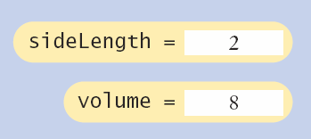
Parameter Passing Steps
result1 = cubeVolume(2)
def cubeVolume(sideLength):
volume = sideLength * 3
return volume

Slide 29
Common Error 5.1
Trying to modify parameter variables
A copy of the argument values is passed (the Value is passed)
Called function (addTax) can modify local copy (price)
total = 10
addTax(total, 7.5);
copy
total
10.0
def addTax(price, rate):
tax = price * rate / 100
# No effect outside the function
price = price + tax
return tax;
price
10.75

Slide 30
Programming Tip 5.2
Do not modify parameter variables
Many programmers find this practice confusing
def totalCents(dollars, cents) :
cents = dollars * 100 + cents # Modifies parameter variable.
return cents
To avoid the confusion, simply introduce a separate variable:
def totalCents(dollars, cents) :
result = dollars * 100 + cents
return result

Slide 31
Return Values
Section 5.4

Slide 32
Return Values
Functions can (optionally) return one value
Add a return statement that returns a value
A return statement does two things:
Immediately terminates the function
Passes the return value (if there is one) back to the calling function
def cubeVolume (sideLength):
volume = sideLength * 3
return volume
return statement
The return value may be a value, a variable or an expression

Slide 33
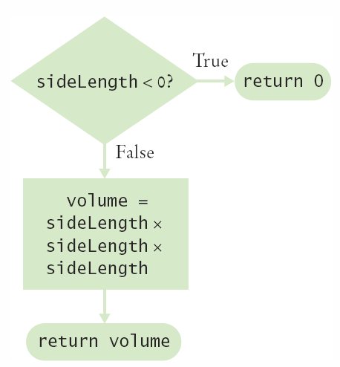
Multiple return Statements
A function can use multiple return statements if there is branching
But every branch must have a return statement
def cubeVolume(sideLength):
if (sideLength < 0):
return 0
return sideLength * 3

Slide 34
Multiple return Statements (2)
Alternative to multiple returns (e.g., one for each branch):
You can avoid multiple returns by storing the function result in a variable that you return in the last statement of the function
For example:
def cubeVolume(sideLength) :
if sideLength >= 0:
volume = sideLength ** 3
else :
volume = 0
return volume

Slide 35
Make Sure A Return Catches All Cases
Missing return statement
Make sure all conditions are handled
In this case, sideLength could be equal to 0
No return statement for this condition
The compiler will not complain if any branch has no return statement
It may result in a run-time error because Python returns the special value None when you forget to return a value
def cubeVolume(sideLength) :
if sideLength >= 0 :
return sideLength ** 3
# Error—no return value if sideLength < 0

Slide 36
Make Sure A Return Catches All Cases (2)
A correct implementation:
def cubeVolume(sideLength) :
if sideLength >= 0
return sideLength ** 3
else :
return 0

Slide 37
Implementing a Function: Steps
Describe what the function should do
Provide a simple description of what the functions does, such as
“Compute the volume of a pyramid with a square base”
Determine a list of all of the function input
Make a list of all of the parameters that can vary
Determine the types of the parameter variables and the return value
Write pseudocode for obtaining the desired result
Express an mathematical formulas, branches and loops in pseudocode
Implement the function body
Test your function
Design test cases and code

Slide 38
Functions Without Return Values
Section 5.5

Slide 39

Functions Without Return Values
Functions are not required to return a value
No return statement is required
The function can generate output even when it doesn’t have a return value
...
boxString("Hello")
...
def boxString(contents) :
n = len(contents) :
print("-" * (n + 2))
print("!" + contents + "!")
print("-" * (n + 2))

Slide 40
Using return Without a Value
You can use the return statement without a value
The function will terminate immediately if the return statement is reached. The code after the return statement will not be executed.
def boxString(contents) :
n = len(contents)
if n == 0 :
return # Return immediately
print("-" * (n + 2))
print("!" + contents + "!")
print("-" * (n + 2))

Slide 41
Reusable Functions
Section 5.6

Slide 42
Problem Solving: Reusable Functions
Find repetitive code
May have different values but same logic
hours = int(input("Enter a value between 0 and 23: "))
while hours < 0 or hours > 23 :
print("Error: value out of range.")
hours = int(input("Enter a value between 0 and 23: "))
minutes = int(input("Enter a value between 0 and 59: "))
while minutes < 0 or minutes > 59 :
print("Error: value out of range.")
minutes = int(input("Enter a value between 0 and 59: "))
0 - 23
0 - 59

Slide 43
Write a ‘Parameterized’ Function
## Prompts a user to enter a value up to a given maximum until the user provides
# a valid input.
# @param high an integer indicating the largest allowable input
# @return the integer value provided by the user (between 0 and high, inclusive)
#
def readIntUpTo(high) :
value = int(input("Enter a value between 0 and " + str(high) + ": "))
while value < 0 or value > high :
print("Error: value out of range.")
value = int(input("Enter a value between 0 and " + str(high) + ": "))
return value

Slide 44
Stepwise Refinement
Section 5.7

Slide 45
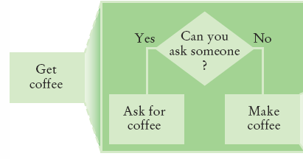
Stepwise Refinement
To solve a difficult task, break it down into simpler tasks
Then keep breaking down the simpler tasks into even simpler ones, until you are left with tasks that you know how to solve

Slide 46
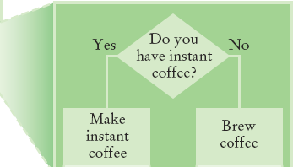
Get Coffee
If you must make coffee, there are two ways:
Make Instant Coffee
Brew Coffee

Slide 47
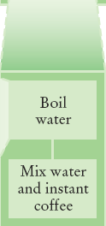
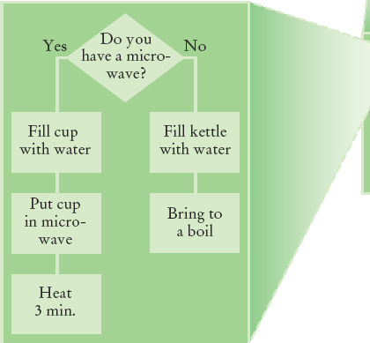
Instant Coffee
Two ways to boil water
1) Use Microwave
2) Use Kettle on Stove

Slide 48
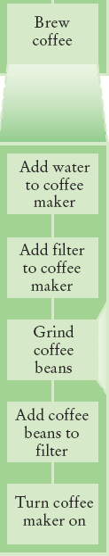
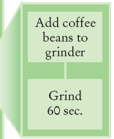
Brew Coffee
Assumes coffee maker
Add water
Add filter
Grind Coffee
Add beans to grinder
Grind 60 seconds
Fill filter with ground coffee
Turn coffee maker on
Steps are easily done

Slide 49
Stepwise Refinement Example
When printing a check, it is customary to write the check amount both as a number (“$274.15”) and as a text string (“two hundred seventy four dollars and 15 cents”)
Write a program to turn a number into a text string
Wow, sounds difficult!
Break it down
Let’s take the dollar part (274) and come up with a plan
Take an Integer from 0 – 999
Return a String
Still pretty hard…

Slide 50
Stepwise Refinement Example
Take it digit by digit (2, 7, 4) – left to right
Handle the first digit (hundreds)
If empty, we are done with hundreds
Get first digit (Integer from 1 – 9)
Get digit name (“one”, “two”, “three”…)
Add the word “hundred”
Sounds easy!
Second digit (tens)
Get second digit (Integer from 0 – 9)
If 0, we are done with tens… handle third digit
If 1, … may be eleven, twelve... Teens… Not easy!
Let’s look at each possibility left (1x-9x)…

Slide 51
Stepwise Refinement Example
If second digit is a 0
Get third digit (Integer from 0 – 9)
Get digit name (“”, “one”, “two”…) … Same as before?
Sounds easy!
If second digit is a 1
Get third digit (Integer from 0 – 9)
Return a String (“ten”, “eleven”, “twelve”…)
If second digit is a 2-9
Start with string “twenty”, “thirty”, “forty”…
Get third digit (Integer from 0 – 9)
Get digit name (“”, “one”, “two”…) … Same as before
Sounds easy!

Slide 52
Name the Sub-Tasks
digitName
Takes an Integer from 0 – 9
Return a String (“”, “one”, “two”…)
tensName (second digit >= 20)
Takes an Integer from 0 – 9
Return a String (“twenty”, “thirty”…) plus
digitName(third digit)
teenName
Takes an Integer from 0 – 9
Return a String (“ten”, “eleven”…)

Slide 53
Write Pseudocode
part = number (The part that still needs to be converted)
name = “” (The name of the number)
If part >= 100
name = name of hundreds in part + " hundred"
Remove hundreds from part
If part >= 20
Append tensName(part) to name
Remove tens from part
Else if part >= 10
Append teenName(part) to name
part = 0
If (part > 0)
Append digitName(part) to name
Identify functions that we can use (or re-use!) to do the work

Slide 54
Plan The Functions
Decide on name, parameter(s) and types and return type
def intName (number):
Turns a number into its English name
Returns a String that is the English description of a number (e.g., “seven hundred twenty nine”)
def digitName (digit):
Return a String (“”, “one”, “two”…)
def tensName (number):
Return a String (“twenty”, “thirty”…) plus
Return from digitName(thirdDigit)
def teenName (number):
Return a String (“ten”, “eleven”…)

Slide 55

Convert to Python: intName Function
Open the file intname.py in Wing
main calls intName
Does all the work
Returns a String
Uses functions:
tensName
teenName
digitName

Slide 56
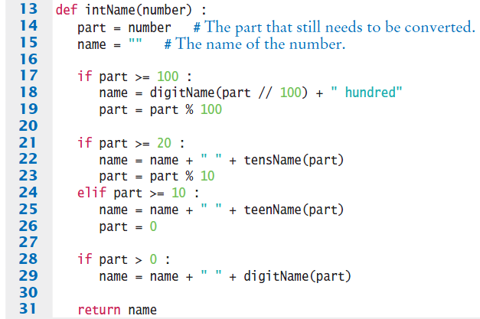
intName

Slide 57
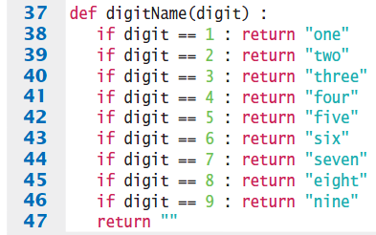
digitName

Slide 58
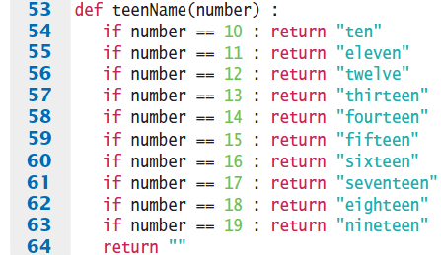
teenName

Slide 59
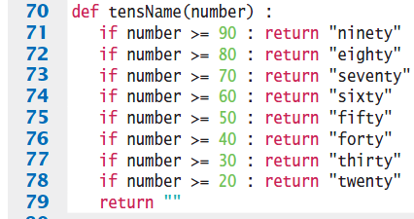
tensName

Slide 60
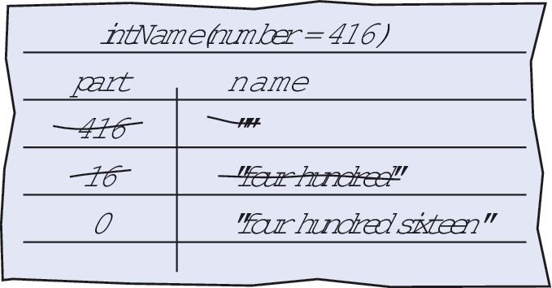
Programming Tips
Keep functions short
If more than one screen, break into ‘sub’ functions
Trace your functions
One line for each step
Columns for key variables
Use Stubs as you write larger programs
Unfinished functions that return a ‘dummy’ value

Slide 61
Variable Scope
Section 5.8

Slide 62
Variable Scope
Variables can be declared:
Inside a function
Known as ‘local variables’
Only available inside this function
Parameter variables are like local variables
Outside of a function
Sometimes called ‘global scope’
Can be used (and changed) by code in any function
How do you choose?
The scope of a variable is the part of the program in which it is visible

Slide 63
Examples of Scope
sum, square & i are local variables in main
def main() :
sum = 0
for i in range(11) :
square = i * i
sum = sum + square
print(square, sum)
sum
i
square

Slide 64
Local Variables of functions
Variables declared inside one function are not visible to other functions
sideLength is local to main
Using it outside main will cause a compiler error
def main():
sideLength = 10
result = cubeVolume()
print(result)
def cubeVolume():
return sideLength * sideLength * sideLength # ERROR

Slide 65
Re-using Names for Local Variables
Variables declared inside one function are not visible to other functions
result is local to square and result is local to main
They are two different variables and do not overlap
This can be very confusing
def square(n):
result = n * n
return result
def main():
result = square(3) + square(4)
print(result)
result
result

Slide 66
Global Variables
They are variables that are defined outside functions
A global variable is visible to all functions that are defined after it
However, any function that wishes to use a global variable must include a global declaration

Slide 67
Example Use of a Global Variable
If you omit the global declaration, then the balance variable inside the withdraw function is considered a local variable
balance = 10000 # A global variable
def withdraw(amount) :
# This function intends to access the
# global ‘balance’ variable
global balance
if balance >= amount :
balance = balance - amount

Slide 68
Programming Tip
There are a few cases where global variables are required (such as pi defined in the math module), but they are quite rare
Programs with global variables are difficult to maintain and extend because you can no longer view each function as a “black box” that simply receives arguments and returns a result
Instead of using global variables, use function parameter variables and return values to transfer information from one part of a program to another

Slide 69
Default and Named Arguments

Slide 70
Default Arguments
Python functions can have optional arguments.
When calling a function with an optional argument, you don’t have to pass in any value for the optional argument.
Example: the documentation of the built-in round() function shows
number is a required argument, ndigits is an optional argument. The [ ] shows optional arguments.
When calling round() you need at minimum one argument, and you can optionally have a second argument:
Output: 3.87 (round to 2 digits)
4 (no ndigits value means round to a whole number)
round(number[, ndigits])
round(3.87384, 2)
round(3.87384)

Slide 71
Default Argument Value (1)
For a function to have optional arguments, in the function definition header the optional arguments must have a default value.
This is why optional arguments are also called default arguments.
If the caller doesn’t pass in a value for the optional argument, then this argument gets the default value. Otherwise, the passed in value has higher precedence.
Example:
Output: Name: Fred, age: 36 Name: Wilma, age: 20
def printInfo(name, age = 20):
print(“Name: %s, age: %d” % (name, age))
printInfo(“Fred”, 36)
printInfo(“Wilma”)

Slide 72
Default Argument Value (2)
In an argument list, if an argument has a default value, then the rest of the arguments following it must have default values
Example:
def printInfo(name, age = 20, employed = False): # OK
# code for body of function
def printInfo(name, age = 20, employed): # Not OK
# code for body of function

Slide 73
Named Arguments (1)
When calling a function with multiple arguments, by default you must pass arguments in the required order.
However, if you name the arguments in the function call, then you can pass arguments in any order.
Example:
Run: Output: Name: Fred, age: 36
Error!
Name: Fred, age: 36
def printInfo(name, age = 20):
print(“Name: %s, age: %d, job: %s” % (name, age)
printInfo(“Fred”, 36)
printInfo(36, “Fred”)
printInfo(age = 36, name = “Fred”)

Slide 74
Named Arguments (2)
When calling a function with multiple default arguments and you only want to pass data to some of them, you must name the default arguments to which you want to pass data. Otherwise you must pass all data in the order listed in the argument list.
Example:
Run:
def printInfo(name, age = 20, location = “Cupertino”, employed = False, occupation = “student”,
address = “unknown”, status = “single”,
affiliation = None):
# code to print information here
printInfo(“Fred”, occupation=“crane operator”, employed = True)
printInfo(“Fred”, 40, “Bedrock”, status = “married”)

Slide 75
Graphics: Building an Image Processing Toolkit
Section 5.9

Slide 76
Building Your Own Tools
As we learned earlier, Python’s standard libraries contain a large collection of function and classes
You import a module (containing functions and / or classes) into your program if you need it
What do you do when the standard libraries don’t have what you need?
You create your own collection of tools and organize them into modules or a software toolkit

Slide 77
Creating Your Toolkit
The tools of functions in the toolkit should all be related
The function names should be easy to remember
The parameters should be as consistent as possible
Place the functions in a separate file
Import them into your programs as needed

Slide 78
Recursive Functions
Section 5.10

Slide 79
Recursive Functions
A recursive function is a function that calls itself
A recursive computation solves a problem by using the solution of the same problem with simpler inputs
For a recursion to terminate, there must be special cases for the simplest inputs

Slide 80
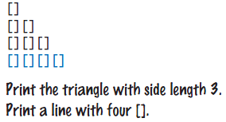
Recursive Triangle Example
def printTriangle(sideLength) :
if sideLength < 1 : return
printTriangle(sideLength - 1)
print("[]" * sideLength)
Special Case
Recursive Call
The function will call itself (and not output anything) until sideLength becomes < 1
It will then use the return statement and each of the previous iterations will print their results
1, 2, 3 then 4

Slide 81
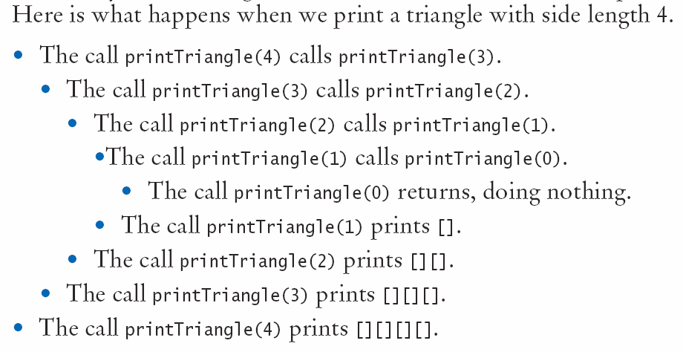
Recursive Calls and Returns

Slide 82
A Second Example
Open the file digits.py
This program computes the sum of the digits in a number (n)
We solved this last chapter in Section 4.2
We will use n = 1729 as our example
Our algorithm was:
Remove the last digit by computing n // 10 and add the remainder to our total
To use recursion we can use the recursive function:
digitsum(n // 10) + n % 10
Our special case is n == 0 to terminate the recursion

Slide 83
Summary

Slide 84
Summary: Functions
A function is a named sequence of instructions
Arguments are supplied when a function is called
The return value is the result that the function computes
When declaring a function, you provide a name for the function and a variable for each argument
Function comments explain the purpose of the function, the meaning of the parameters and return value, as well as any special requirements
Parameter variables hold the arguments supplied in the function call

Slide 85
Summary: Function Returns
The return statement terminates a function call and yields the function result
Complete computations that can be reused into functions
Use the process of stepwise refinement to decompose complex tasks into simpler ones
When you discover that you need a function, write a description of the parameter variables and return values
A function may require simpler functions to carry out its work

Slide 86
Summary: Scope
The scope of a variable is the part of the program in which the variable is visible
Two local or parameter variables can have the same name, provided that their scopes do not overlap
You can use the same variable name within different functions since their scope does not overlap
Local variables declared inside one function are not visible to code inside other functions

Slide 87
Summary: Recursion
A recursive computation solves a problem by using the solution of the same problem with simpler inputs
For recursion to terminate, there must be special cases for the simplest inputs
The key to finding a recursive solution is reducing the input to a simpler input for the same problem
When designing a recursive solution, do not worry about multiple nested calls
Simply focus on reducing a problem to a slightly simpler one

