Slide 1
Chapter 6: Lists

Slide 2
Chapter Goals
To collect elements using lists
To use the for loop for traversing lists
To use list comprehension
To learn common algorithms for processing lists
To use lists with functions
To work with tables of data

Slide 3
Contents
Basic Properties of Lists
List Operations
Common List Algorithms
Using Lists with Functions
Problem Solving: Adapting Algorithms
Problem Solving: Discovering Algorithms by Manipulating Physical Objects
Tables

Slide 4
Basic Properties of Lists
Section 6.1

Slide 5
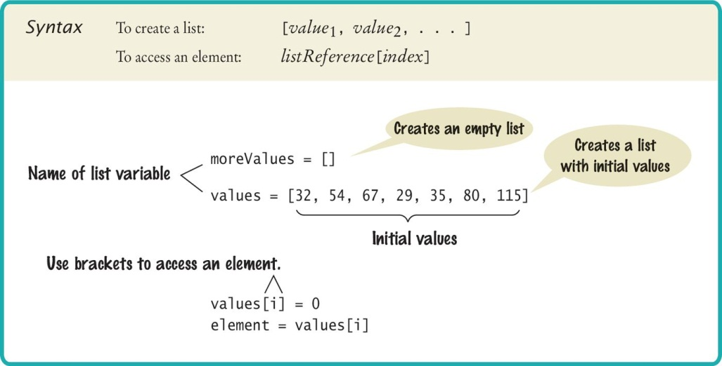
Creating a List
Specify a list variable with the subscript operator []

Slide 6
Accessing List Elements
A list is a sequence of elements, each of which has an integer position or index
To access a list element, you specify which index you want to use. That is done with the subscript operator in the same way that you access individual characters in a string
Accessing list elements
Replacing list elements
print(values[5])
values[5] = 87

Slide 7
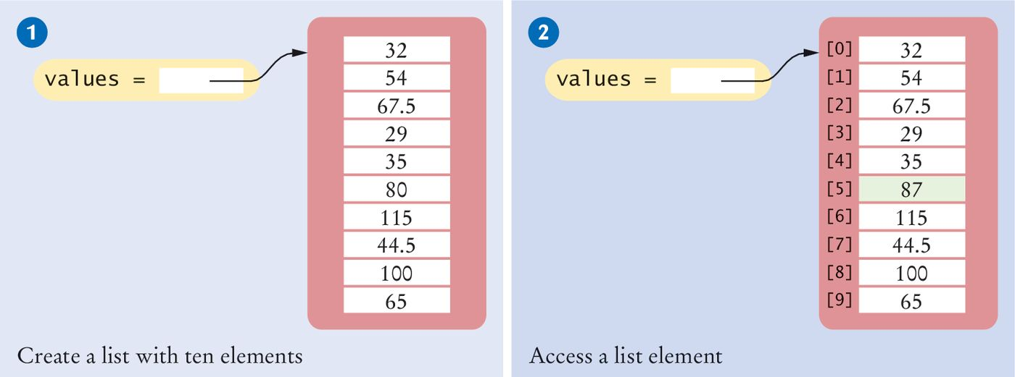
Creating Lists/Accessing Elements
# 1: Creating a list
values = [32, 54, 67.5, 29, 35, 80, 115, 44.5, 100, 65]
# 2: Accessing a list element
values[5] = 87

Slide 8
Lists vs. Strings
Both lists and strings are sequences, and the [] operator is used to access an element in any sequence
There are two differences between lists and strings:
Lists can hold values of any type, whereas strings are sequences of characters
Moreover:
strings are immutable— you cannot change the characters in the sequence
Lists are mutable

Slide 9
Out of Range Errors
Out-of-Range Errors:
Perhaps the most common error in using lists is accessing a nonexistent element
If your program accesses a list through an out-of-range index, the program will generate an exception at run time
values = [2.3, 4.5, 7.2, 1.0, 12.2, 9.0, 15.2, 0.5]
values[8] = 5.4
# Error––values has 8 elements,
# and the index can range from 0 to 7

Slide 10
Determining List Length
You can use the len() function to obtain the length of the list; that is, the number of elements:
numElements = len(values)

Slide 11
Using The Square Brackets
Note that there are two distinct uses of the square brackets. When the square brackets immediately follow a variable name, they are treated as the subscript operator:
values[4]
When the square brackets follow an “=“ they create a list:
values = [4]

Slide 12
Loop Over the Index Values (1)
Given the values list that contains 10 elements, we will want to set a variable, say i, to 0, 1, 2, and so on, up to 9
# First version (list index used)
for i in range(10) :
print(i, values[i])
# Better version (list index used)
for i in range(len(values)) :
print(i, values[i])
# Third version: index values not needed (traverse
# list elements)
for element in values :
print(element)

Slide 13
Loop Over the Index Values (2)
(continued)
# Fourth version: index values not needed (traverse
# list elements)
for i,element in enumerate(values):
print(i, element)

Slide 14

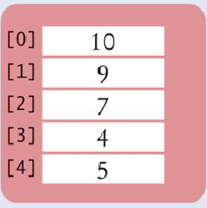
List References
Make sure you see the difference between the:
List variable: The named ‘alias’ or pointer to the list
List contents: Memory where the values are stored
values = [32, 54, 67.5, 29, 35, 80, 115, 44.5, 100, 65]
List variable
List contents
Reference
A list variable contains a reference to the list contents. The reference is the location of the list contents (in memory).
Values

Slide 15
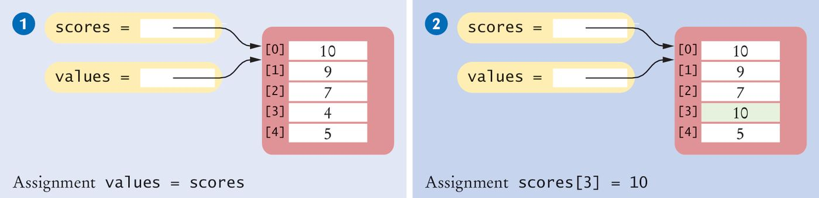
List Aliases
When you copy a list variable into another, both variables refer to the same list
The second variable is an alias for the first because both variables reference the same list
scores = [10, 9, 7, 4, 5]
values = scores # Copying list reference
List contents
A list variable specifies the location of a list. Copying the reference yields a second reference to the same list.
References

Slide 16
Modifying Aliased Lists
You can modify the list through either of the variables:
scores[3] = 10
print(values[3]) # Prints 10

Slide 17
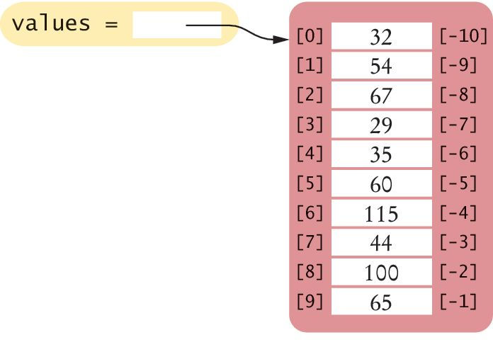
Reverse Subscripts
Python, unlike other languages, uses negative subscripts to provide access to the list elements in reverse order.
For example, a subscript of –1 provides access to the last element in the list:
Similarly, values[-2] is the second-to-last element.
last = values[-1]
print("The last element in the list is", last)

Slide 18
List Operations
Section 6.2

Slide 19
List Operations
Appending Elements
Inserting an Element
Finding an Element
Removing an Element
Concatenation
Equality / Inequality Testing
Sum, Maximum, Minimum, and Sorting
Copying Lists

Slide 20
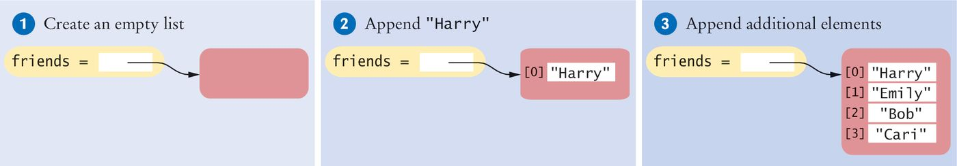
Appending Elements
Sometimes we may not know the values that will be contained in the list when it’s created
In this case, we can create an empty list and add elements to the end as needed
#1
friends = []
#2
friends.append("Harry")
#3
friends.append("Emily")
friends.append("Bob")
friends.append("Cari")

Slide 21
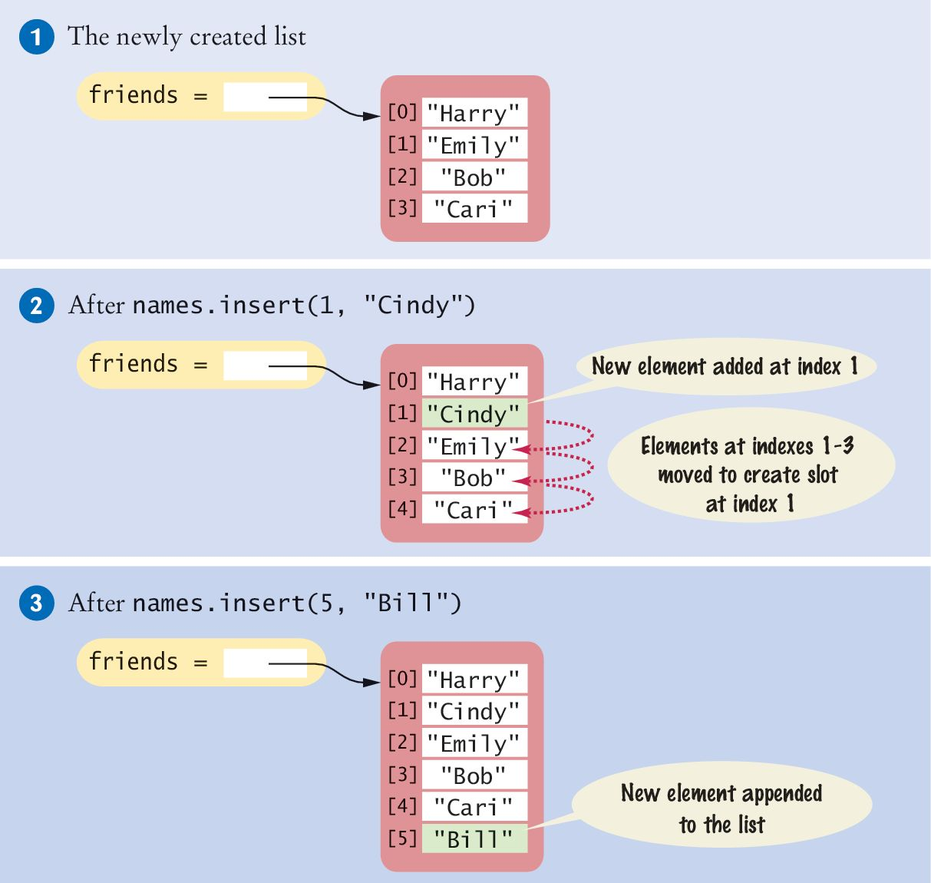
Inserting an Element
Sometimes the order in which elements are added to a list is important
A new element has to be inserted at a specific position in the list
#1
friends = ["Harry", "Emily", "Bob", "Cari"]
#2
friends.insert(1, "Cindy")

Slide 22
Finding an Element
If you simply want to know whether an element is present in a list, use the in operator:
if "Cindy" in friends :
print("She's a friend")
Often, you want to know the position at which an element occurs
The index() method yields the index of the first match
friends = ["Harry", "Emily", "Bob", "Cari", "Emily"]
n = friends.index("Emily") # Sets n to 1

Slide 23
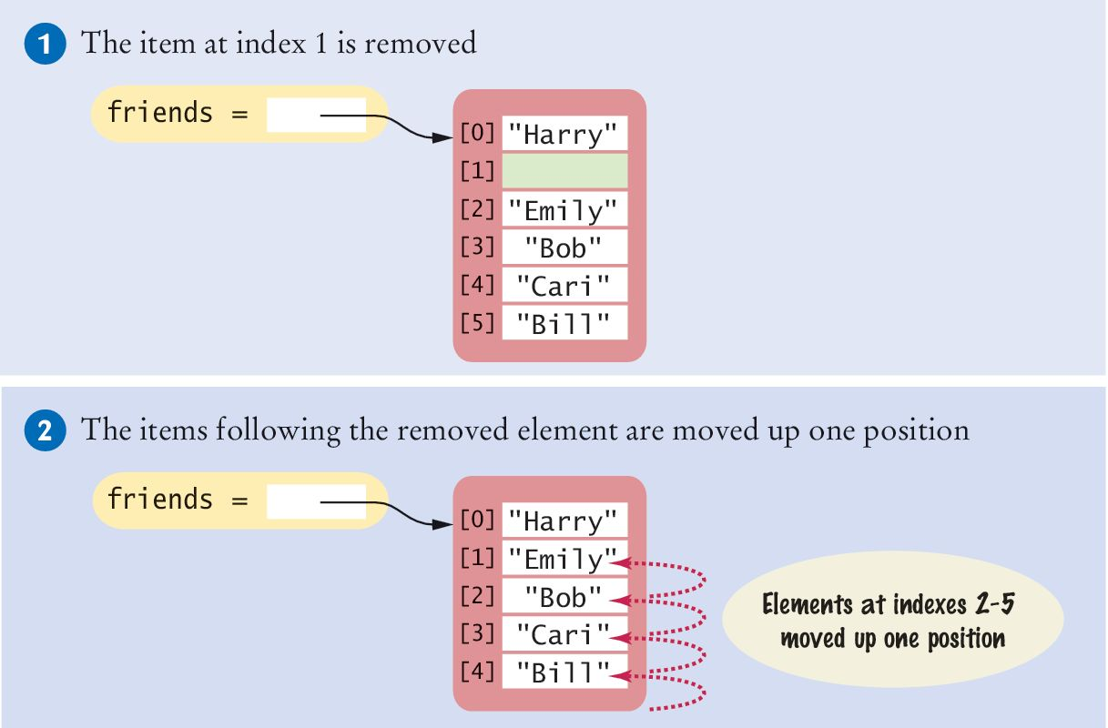
Removing an Element (1)
The pop() method removes the element at a given position
friends = ["Harry", "Cindy", "Emily", "Bob", "Cari","Bill"]
friends.pop(1)
All of the elements following the removed element are moved up one position to close the gap
The length of the list is reduced by 1

Slide 24
Removing an Element (2)
When there is no input argument, the pop() method removes the last element in the list.
>>> friends = ["Harry","Emily", "Bob", "Cari", "Bill"]
>>> friends.pop()
'Bill'
>>> print(friends)
['Harry', 'Emily', 'Bob', 'Cari']
The pop() method returns the element that is removed.

Slide 25
Concatenation
The concatenation of two lists is a new list that contains the elements of the first list, followed by the elements of the second
myFriends = ["Fritz", "Cindy"]
yourFriends = ["Lee", "Pat", "Phuong"]
Two lists can be concatenated by using the plus (+) operator:
ourFriends = myFriends + yourFriends
# Sets ourFriends to ["Fritz", "Cindy", "Lee", "Pat","Phuong"]

Slide 26
Replication
As with string replication of two lists is a new list that contains the elements of the first list, followed by the elements of the second
monthInQuarter = [ 1, 2, 3] * 4
Results in the list [1, 2, 3, 1, 2, 3, 1, 2, 3, 1, 2 ,3]
You can place the integer on either side of the “*” operator
The integer specifies how many copies of the list should be concatenated
One common use of replication is to initialize a list with a fixed value
monthlyScores = [0] * 12

Slide 27
Equality / Inequality Testing
You can use the == operator to compare whether two lists have the same elements, in the same order.
[1, 4, 9] == [1, 4, 9] # True
[1, 4, 9] == [4, 1, 9] # False.
The opposite of == is !=.
[1, 4, 9] != [4, 9] # True.

Slide 28
Sum, Maximum, Minimum
If you have a list of numbers, the sum() function yields the sum of all values in the list.
sum([1, 4, 9, 16]) # Yields 30
For a list of numbers or strings, the max() and min() functions return the largest and smallest value:
max([1, 16, 9, 4]) # Yields 16
min("Fred", "Ann", "Sue") # Yields "Ann"

Slide 29
Sorting
The sort() method sorts a list of numbers or strings.
values = [1, 16, 9, 4]
values.sort() # Now values is [1, 4, 9, 16]

Slide 30
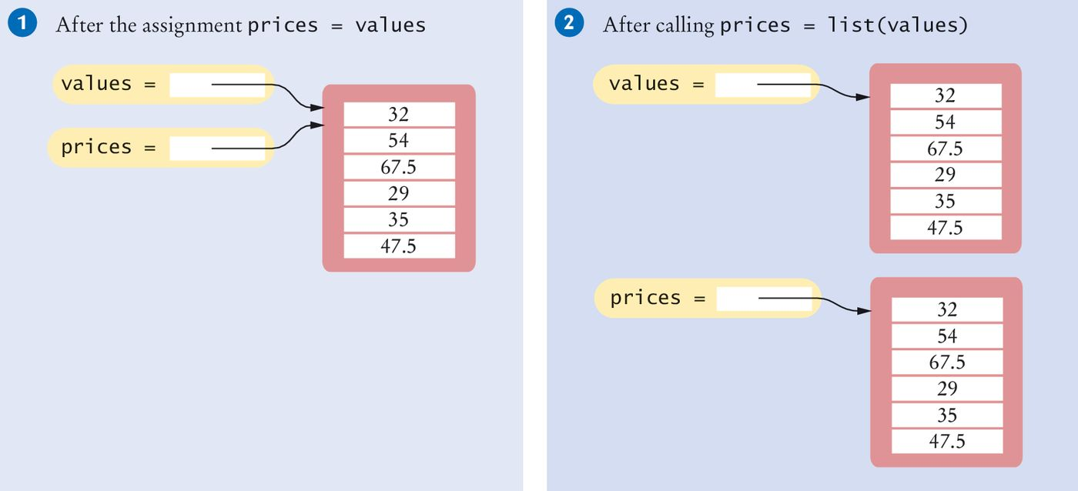
Copying Lists
As discussed, list variables do not actually contain the list elements
They hold a reference to the actual list
If you copy the reference, you get another reference to the same list:
prices = values

Slide 31
Copying Lists (2)
Sometimes, you want to make a copy of a list; that is, a new list that has the same elements in the same order as a given list
Use the list() function:
prices = list(values)

Slide 32
Slices of a List
Sometimes you want to look at a part of a list. Suppose you are given a list of temperatures, one per month:
temperatures = [18, 21, 24, 33, 39, 40, 39, 36, 30, 22, 18]
You are only interested in the temperatures for the third quarter, with index values 6, 7, and 8
You can use the slice operator to obtain them:
thirdQuarter = temperatures[6 : 9]
The arguments are the first element to include, and the first to exclude
So in our example we get elements 6, 7, and 8

Slide 33
Slices (2)
Both indexes used with the slice operator are optional
If the first index is omitted, all elements from the first are included
The slice temperatures[ : 6] includes all elements up to, but not including, position 6
The slice temperatures[6 : ] includes all elements starting at position 6 to the end of the list
You can assign values to a slice:
temperatures[6 : 9] = [45, 44, 40]
replaces the values in elements 6, 7, and 8
You can copy a list with a slice:
newTemp = temperatures[:]
newTemp is a new list that contains a copy of all elements of temperatures

Slide 34
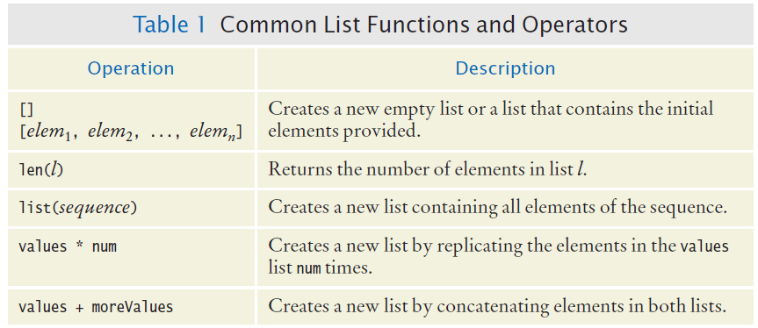
Common List Functions And Operators

Slide 35
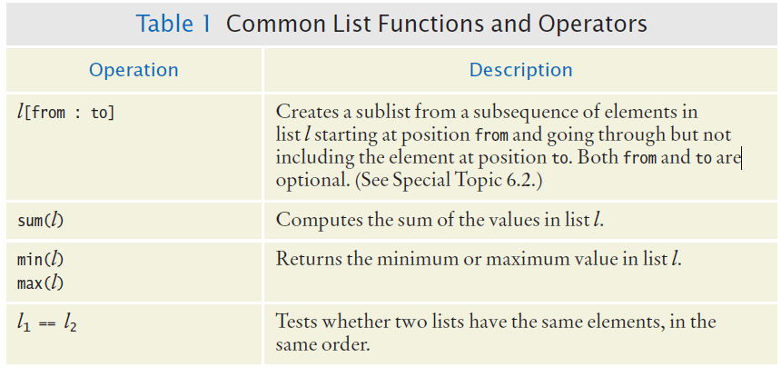
Common List Functions And Operators (2)

Slide 36
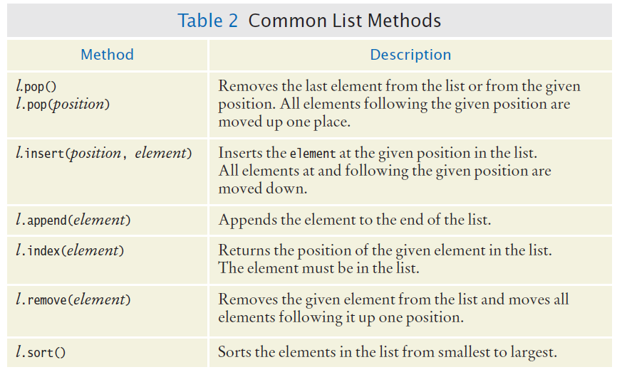
Common List Methods

Slide 37
Common List Algorithms
Section 6.3

Slide 38
Common List Algorithms
Filling a List
Combining List Elements
Element Separators
Maximum and Minimum
Linear Search
Collecting and Counting Matches
Removing Matches
Swapping Elements
Reading Input

Slide 39
Filling a List
This loop creates and fills a list with squares (0, 1, 4, 9, 16, ...)
values = []
for i in range(n) :
values.append(i * i)

Slide 40
Combining List Elements
Here is how to compute a sum of numbers:
result = 0.0
for element in values :
result = result + element
To concatenate strings, you only need to change the initial value:
result = ""
for element in names :
result = result + element

Slide 41
Element Separators
When displaying the elements of a list, you usually want to separate them with a separator, such as a comma: Harry, Emily, Bob
Add the separator before each element (there’s one fewer separator than there are numbers) in the sequence except the initial one (with index 0), like this:
If you want to print values without adding them to a string:
for i in range(len(names)) :
if i > 0 :
result = result + ", "
result = result + names[i]
for i in range(len(values)) :
if i > 0 :
print(" | ", end="")
print(values[i], end="")
print()

Slide 42
Maximum and Minimum
Here is the implementation of the max and min algorithms:
What’s a faster way?
What’s a faster way?
largest = values[0]
for i in range(1, len(values)) :
if values[i] > largest :
largest = values[i]
smallest = values[0]
for i in range(1, len(values)) :
if values[i] < smallest :
smallest = values[i]

Slide 43
Linear Search
Finding the first value that is > 100. You need to visit all elements until you have found a match or you have come to the end of the list:
What are the faster ways?
limit = 100
pos = 0
found = False
while pos < len(values) and not found :
if values[pos] > limit :
found = True
else :
pos = pos + 1
if found :
print("Found at position:", pos)
else :
print("Not found")
A linear search
inspects elements
in sequence until a
match is found.

Slide 44
Collecting and Counting Matches
Collecting all matches
limit = 100
result = []
for element in values :
if (element > limit) :
result.append(element)
Counting matches
limit = 100
counter = 0
for element in values :
if (element > limit) :
counter = counter + 1

Slide 45
Removing Matches
Remove all elements that match a particular condition
Example: remove all strings of length < 4 from a list
i = 0
while i < len(words) :
word = words[i]
if len(word) < 4 :
words.pop(i)
else :
i = i + 1

Slide 46

Swapping Elements (1)
You can sort a list by repeatedly swapping elements that are not in order
Swap the elements at positions i and j of a list values
We’d like to set values[i] to values[j]. But that overwrites the value that is currently stored in values[i], so we want to save that first:
Before moving a new value into a location (say blue) copy blue’s value elsewhere and then move black’s value into blue. Then move the temporary value (originally in blue) into black.

Slide 47
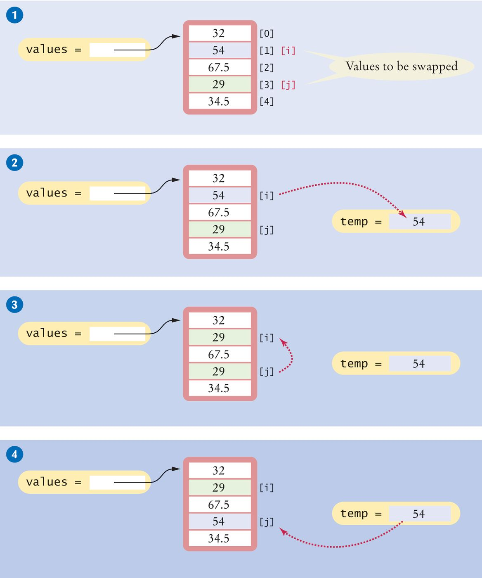
Swapping Elements (2)
Swapping elements [1] and [3]
This sets up the scenario for the actual code that will follows

Slide 48
Swapping Elements (3)
# Step 2
temp = values[i]
# Step 3
values[i] = values[j]

Slide 49
Swapping Elements (4)
# Step 4
# temp contains values[i]
values[j] = temp

Slide 50
Reading Input
It is very common to read input from a user and store it in a list for later processing.
values = []
print("Please enter values, Q to quit:")
userInput = input("")
while userInput.upper() != "Q" :
values.append(float(userInput))
userInput = input("")
Please enter values, Q to quit:
32
29
67.5
Q
Program execution

Slide 51
Built-In Operations For Lists
Use the insert() method to insert a new element at any position in a list
The in operator tests whether an element is contained in a list
Use the pop() method to remove an element from any position in a list
Use the remove() method to remove an element from a list by value
Two lists can be concatenated using the plus (+) operator
Use the list() function to copy lists
Use the slice operator (:) to extract a sublist or substrings

Slide 52
Using Lists With Functions
Section 6.4

Slide 53
Using Lists With Functions
A function can accept a list as an argument
The following function visits the elements of the list called values, but it does not modify them
def sum(values) :
total = 0
for element in values :
total = total + element
return total

Slide 54
Modifying List Elements
The following function multiplies all elements of a list by a given factor:
def multiply(values, factor) :
for i in range(len(values)) :
values[i] = values[i] * factor

Slide 55
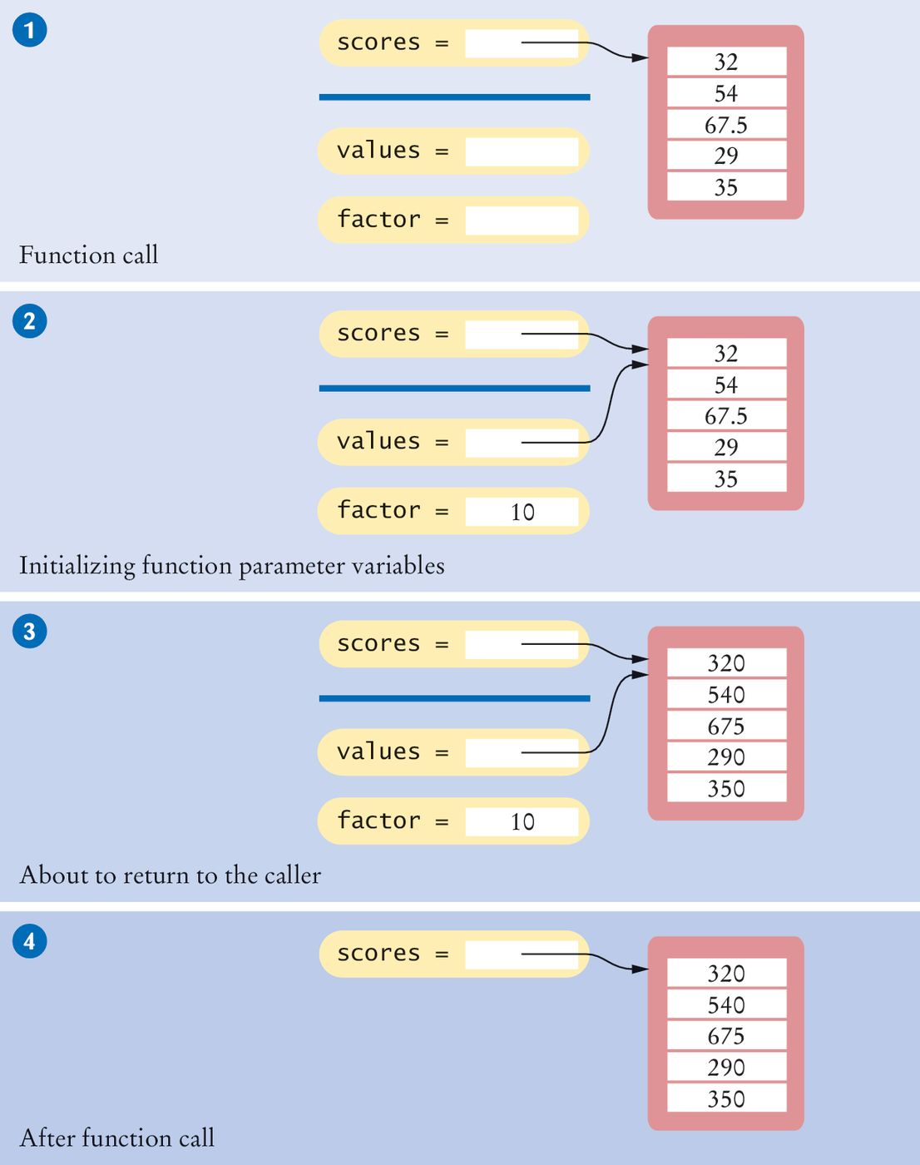
Example: Step 1
The parameter variables values and factor are created

Slide 56
Example: Step 2
The parameter variables are initialized with the arguments that are passed in the call
In our case, values is set to scores and factor is set to 10
Note that values and scores are references to the same list
# Function call
multiply(scores, 10)

Slide 57
Example: Step 3
The function multiplies all list elements by 10
def multiply(values, factor) :
for i in range(len(values)) :
values[i] = values[i] * factor

Slide 58
Example: Step 4
The function returns. Its parameter variables are removed
However, scores still refers to the list with the modified elements

Slide 59
Returning Lists From Functions
Simply build up the result in the function and return it
In this example, the squares() function returns a list of squares from 0² up to (n – 1)²:
def squares(n) :
result = []
for i in range(n) :
result.append(i * i)
return result

Slide 60
Call By: Value vs. Reference
Call by value:
When the content or value of a variable is passed to a function, the function cannot change that variable’s content.
Example: if you pass a string or numeric variable to a function, the function cannot change it.
Call by reference:
When a reference to a mutable object is passed to a function, then the function can change the object.
Example: if you pass a reference to a list (which is mutable) to a function, then the function can mutate or change the content of the list.

Slide 61
Tuples
Section 6.4

Slide 62
Tuples (1)
A tuple is similar to a list, but once created, its contents cannot be modified. A tuple is an immutable version of a list.
A tuple is created by specifying its contents as a comma-separated sequence. A tuple is typically enclosed in parentheses:
triple = (5, 10, 15)
If you prefer, you can omit the parentheses, but this is less readable:
triple = 5, 10, 15
To create an empty tuple:
emptyTuple = ()
To create a tuple with one value, you need to add a comma:
smallTuple = (5,)

Slide 63
Tuples (2)
To create a tuple you need to have at least one comma to separate the elements. Therefore, to create a tuple with one value, the comma is still require:
smallTuple = (5,)
Any set of multiple values, comma-separated, written without identifying symbols, i.e., brackets for lists, parentheses for tuples, etc., default to tuples:
>>> x = "abc", 2, 8.5, "xyz"
>>> x
('abc', 2, 8.5, 'xyz')
>>> type(x)
<class 'tuple'>

Slide 64
Working with Tuples
To access data in a tuple, use [ ] and an index, just like with a list
A slice can be used to access multiple data values in a tuple
It is not possible to remove data or change a data value in a tuple
Tuples work with all the sequencing operators in list:
len(myTuple) returns the number of elements
tup1 + tup2 concatenates 2 tuples
myTuple * 3 duplicates myTuple 3 times
“abc” in myTuple checks if “abc” is in myTuple
for elem in myTuple: iterates through each element of the tuple

Slide 65
Returning Multiple Values
It is common practice in Python to use tuples to return multiple values.
# Function definition
def readDate() :
print("Enter a date:")
month = int(input(" month: "))
day = int(input(" day: "))
year = int(input(" year: "))
return (month, day, year) # Returns a tuple.
# Function call: assign entire value to a tuple
date = readDate()
# Function call: use tuple assignment:
(month, day, year) = readDate()

Slide 66
Built-In Functions For Tuples
sum() to find the sum of elements: sum(tup1, tup2)
len() to find the number of elements: len(tup1)
max() to find the max element: max(tup1)
min() to find the min element: min(tup1)
tup() to convert a sequence of data to a tuple: tup(sequence)

Slide 67
Problem Solving
Section 6.5: Adapting Algorithms

Slide 68
Adapting Algorithms
Consider this example problem: You are given the quiz scores of a student. You are to compute the final quiz score, which is the sum of all scores after dropping the lowest one
For example, if the scores are
8 7 8.5 9.5 7 5 10
then the final score is 50

Slide 69

Adapting a Solution
What steps will we need?
Find the minimum
Remove it from the list
Calculate the sum
What tools do we know?
Finding the minimum value (Section 6.3.4)
Removing matches (Section 6.3.7)
Calculating the sum (Section 6.4)
But wait… We need to find the POSITION of the minimum value, not the value itself
Hmmm. Time to adapt

Slide 70


Planning a Solution
Refined Steps:
Find the minimum value
Find its position
Remove it from the list
Calculate the sum
Let’s try it
Find the position of the minimum:
At position 5
Remove it from the list
Calculate the sum

Slide 71
Adapting the code
Adapt smallest value to smallest position:
Original algorithm
smallest = values[0]
for i in range(1, len(values)) :
if values[i] < smallest :
smallest = values[i]
Adapted algorithm
smallestPosition = 0
for i in range(1, len(values)) :
if values[i] < values[smallestPosition] :
smallestPosition = i

Slide 72
Working Out an Example
Problem Statement: The final quiz score for a student is computed by adding up all of the scores except the lowest two
For example, if the scores are: 8, 4, 7, 9, 9, 7, 5, 10
The final score is 50
We are going develop the algorithm and write a program to compute the final score

Slide 73
Step One
We want to start with a high level decomposition of the problem:
Read the data into a list
Process the data
Display the results
We will refer back to the algorithms and list operations to help guide our design. Most of the tasks associated with this problem can be solved by using or adapting one or more of the algorithms
Our next step in the stepwise refine is to identify the step we need to process the data:
Read inputs
Remove the minimum
Remove the minimum again
Calculate the sum

Slide 74
Step Two
Now we start to determine the algorithms we need
We have working algorithms for reading the inputs, and calculating the sum
To remove the minimum value we can find the minimum (we have an algorithm for that) and remove it.
It is a bit more efficient to find the position of the minimum value and “pop” that position

Slide 75
Step Three
Plan the functions we need
We can compute the sum with the existing sum function
We need a function to read the floating point numbers; readFloats()
We need a function to remove the minimum; removeMinimum() (we will call this twice)
Our main function can be structured as:
scores = readFloats()
removeMinimum(scores)
removeMinimum(scores)
total = sum(scores)
print(“Final Score : “, total)

Slide 76
Step Four
Assemble and test your code
Review your code and make sure you handle the “normal” and “exceptional” cases.
How do you handle an empty list?
A list with a single element?
What if you don’t find a smallest number?
Remember in our problem statement we are dropping two grades
It is not possible to compute a minimum if the list is empty or has a single element
In that case we should terminate the program with an error message before attempting to call the remove minimum function
Develop your test cases, and the expected outputs

Slide 77
Testing
Develop your test cases, and the expected outputs
Test Case | Expected Output | Comment
8 4 7 8.5 9.5 7 5 10 | 50 | Example case
8 7 7 7 9 | 24 | Make sure only two instances of the low score are removed
8 7 | 0 | After removing the two low scores, none remain
(no inputs) | Error | That is not a legal input

Slide 78
Tables
Section 6.7

Slide 79
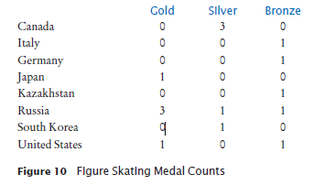
Tables
Lists can be used to store data in two dimensions (2D) like a spreadsheet
Rows and Columns
Also known as a ‘matrix’

Slide 80
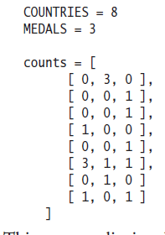
Creating Tables
Here is the code for creating a table that contains 8 rows and 3 columns, which is suitable for holding our medal count data:

Slide 81
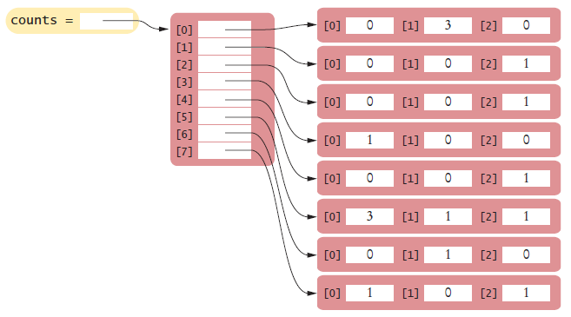
Creating Tables (2)
This creates a list in which each element is itself another list:

Slide 82
Creating Tables (3)
Sometimes, you may need to create a table with a size that is too large to initialize with literal values
First, create a list that will be used to store the individual rows
table = []

Slide 83
Creating Tables (4)
Then create a new list using replication (with the number of columns as the size) for each row in the table and append it to the list of rows:
ROWS = 5
COLUMNS = 20
for i in range(ROWS) :
row = [0] * COLUMNS
table.append(row)
The result is a table that consists of 5 rows and 20 columns

Slide 84
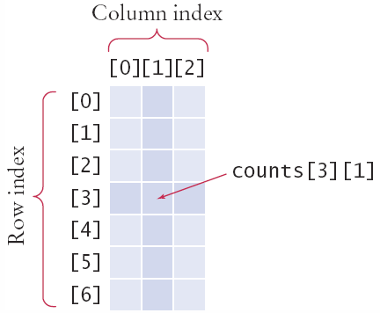
Accessing Elements
Use two index values:
Row then column
medalCount = counts[3][1]
To print
Use nested for loops
Outer row(i) , inner column(j) :
for i in range(COUNTRIES):
# Process the ith row
for j in range(MEDALS) :
# Process the jth column in the ith row
print("%8d" % counts[i][j], end="")
print() # Start a new line at the end of the row

Slide 85
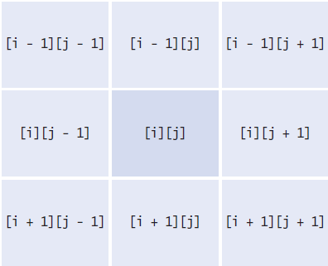
Locating Neighboring Elements
Some programs that work with two-dimensional lists need to locate the elements that are adjacent to an element
This task is particularly common in games
You are at loc i, j
Watch out for edges!
No negative indexes!
Not off the ‘board’

Slide 86
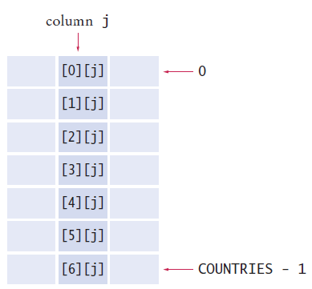
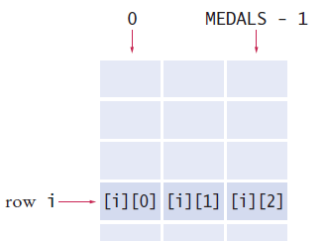
Adding Rows and Columns
Rows (x) Columns (y)
total = 0
for j in range(MEDALS):
total = total + counts[i][j]
total = 0
for i in range(MEDALS):
total = total + counts[i][j]

Slide 87
Using Tables With Functions
When you pass a table to a function, you will want to recover the dimensions of the table. If values is a table, then:
len(values) is the number of rows
len(values[0]) is the number of columns
For example, the following function computes the sum of all elements in a table:
def sum(values) :
total = 0
for i in range(len(values)) :
for j in range(len(values[0])) :
total = total + values[i][j]
return total

Slide 88
List Comprehension

Slide 89
What Is List Comprehension
A list comprehension creates a list out of an existing sequence of data.
It iterates through the existing sequence of data and filters out some of the elements, does work with each of these elements, and stores each result into the new list. The existing sequence of data is not modified.
Here is what a list comprehension looks like in the format of a for loop:
Here is the actual list comprehension:
newList = []
for elem in existingSeq:
if condition_with_elem: # filter out certain elements
newList.append( do_work_with_elem ) # transform the elem # and store in newList
newList = [ do_work_with_elem for elem in existingSeq if condition_with_elem ]

Slide 90
Examples (1)
myList contains negative and positive integers. Create a new list of the absolute value of all the negative values in myList.
Loop format:
List comprehension:
newList = []
for elem in myList:
if elem < 0:
newList.append( abs(elem) )
newList = [ abs(elem) for elem in myList if elem < 0 ]

Slide 91
Examples (2)
celsius is a tuple contains temperatures in degrees celsius. Create a new list fahrenheit of the same temperatures in degrees fahrenheit.
In this case we convert all elements of the tuples, there is no filtering out of data.
Loop format:
List comprehension:
fahrenheit = []
for temp in myList:
fahrenheit.append( temp * 9/5 + 32 )
Fahrenheit = [ temp * 9/5 + 32 for temp in celsius ]

Slide 92
Use of List Comprehension
List comprehension can be used when you need to loop through a sequence of data and append a subset of this data (modified or not) to a list.
List comprehension results in more efficient code than the “loop and append” combination.
However, readability is important. If the list comprehension takes several wrapped around lines of code, then a loop might be a better choice, if time is not critical.

Slide 93
Summary

Slide 94
Summary: Lists
A list is a container that stores a sequence of values
Each individual element in a list is accessed by an integer index i, using the notation list[i]
A list index can be a positive or negative integer and must be less than the number of elements in the list
An out-of-range error, which occurs if you supply an invalid list index, can cause your program to terminate
You can iterate over the index values or the elements of a list
You can use list comprehension when looping through a list to append to a new list.

Slide 95
Summary: Lists
A list reference specifies the location of a list. Copying the reference yields a second reference to the same list, and not a copy of the list.
A linear search inspects elements in sequence until a match is found
Lists can occur as function parameters and return values
When calling a function with a list argument, the function receives a list reference, not a copy of the list
A tuple is created as a comma-separated sequence enclosed in parentheses
A tuple is an immutable list
By combining fundamental algorithms, you can solve complex programming tasks

Slide 96
Summary: Lists
Use a two-dimensional list to store tabular data
Individual elements in a two-dimensional list are accessed by using two index values, table[i][j]

Slide 97
Built-In Operations For Lists
Use the insert() method to insert a new element at any position in a list
The in operator tests whether an element is contained in a list
Use the pop() method to remove an element from any position in a list
Use the remove() method to remove an element from a list by value
Two lists can be concatenated using the plus (+) operator
Use the list() function to copy lists
Use the slice operator (:) to extract a sublist or substrings

