Slide 1
Chapter Seven
FILES AND EXCEPTIONS

Slide 2
Chapter Goals
To read and write text files
To process collections of data
To process command line arguments
To raise and handle exceptions

Slide 3
Contents
Reading and Writing Text Files
Text Input and Output

Slide 4
Reading and Writing Text Files
Section 7.1

Slide 5
Reading and Writing Text Files
Text files are very commonly used to store information
They are the most ‘portable’ types of data files
Examples of text files include files that are created with a simple text editor, such as Windows Notepad, and Python source code and HTML files

Slide 6
Opening Files: Reading
To access a file, you must first open it
Suppose you want to read data from a file named input.txt, located in the same directory as the program
To open a file for reading, you must provide the name of the file as the first argument to the open function and the string "r" as the second argument:
You can also omit the “r” mode, the default is open for reading
infile = open("input.txt", "r")
infile = open("input.txt")

Slide 7
Opening Files: Reading (2)
Important things to keep in mind:
When opening a file for reading, the file must exist (and otherwise be accessible) or an exception occurs
The object returned by the open function is a file handle, and the file handle must be saved in a variable
All operations for accessing a file are made via the file handle

Slide 8
Opening Files: Writing
To open a file for writing, you provide the name of the file as the first argument to the open function and the string "w" as the second argument:
outfile = open("output.txt", "w")
If the output file already exists, it is emptied before the new data is written into it. The new data overwrites all existing data.
If the file does not exist, an empty file is created

Slide 9
Opening Files: Appending
To open a file for appending, you provide the name of the file as the first argument to the open function and the string “a" as the second argument:
outfile = open("output.txt", “a")
If the output file already exists, the new data is appended to the existing data, or added to the end of the existing data.
If the file does not exist, an empty file is created

Slide 10
Closing Files: Important
When you are done processing a file, be sure to close the file using the close() method:
infile.close()
outfile.close()
If your program exits without closing a file that was opened for writing, some of the output may not be written to the disk file

Slide 11
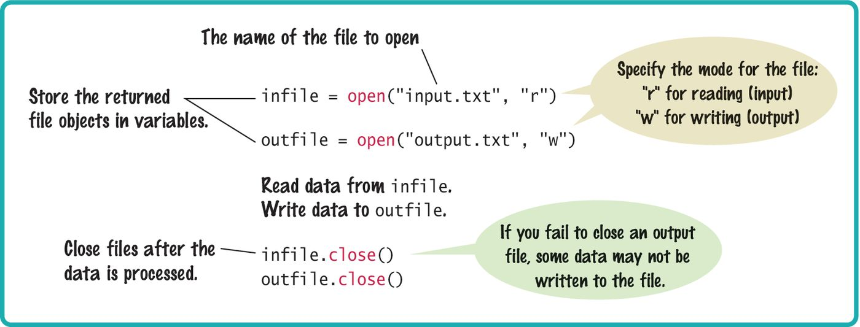
Syntax: Opening And Closing Files

Slide 12
Open File Using the With Statement
The with statement provides a shorter and more convenient way to open a file
The with statement provides a way to clean up and close the file so you don’t have to close it.
Examples
with open (“inputFile.txt”) as infile:
# block of code to read data from infile
# no close() needed
with open (“outputfile.txt, “w”) as outfile:
# block of code to write data to outfile
# no close() needed

Slide 13
Reading From a File
To read a line of text from a file, call the readline() method with the file object that was returned when you opened the file:
line = infile.readline()
When a file is opened, an input marker is positioned at the beginning of the file
The readline() method reads the text, starting at the current position and continuing until the end of the line is encountered
The input marker is then moved to the next line
This is called a sequential read, the lines are read one after another in sequence

Slide 14
Reading From a File (2)
For example, suppose input.txt contains the lines
flying
circus
The first call to readline() returns the string "flying\n"
Recall that \n denotes the newline character that indicates the end of the line
If you call readline() a second time, it returns the string "circus\n"

Slide 15
Reading From a File (3)
Calling readline() again yields the empty string "" because you have reached the end of the file
If the file contains a blank line, then readline() returns a string containing only the newline character "\n"

Slide 16
Reading Multiple Lines From a File
You repeatedly read a line of text and process it until the sentinel value is reached:
The sentinel value is an empty string, which is returned by the readline() method after the end of file has been reached
line = infile.readline()
while line != "" :
# Process the line
line = infile.readline()

Slide 17
Converting File Input
As with the input function, the readline() method can only return strings
If the file contains numerical data, the strings must be converted to the numerical value using the int() or float() function:
value = float(line)
The newline character at the end of the line is ignored when the string is converted to a numerical value

Slide 18
Writing To A File
We can write the string "Hello, World!" to our output file using the statement:
outfile.write("Hello, World!\n")
Unlike print(), when writing text to an output file, you must explicitly write the newline character to start a new line
You can also write formatted strings to a file with the write method:
outfile.write("Number of entries: %d\nTotal: %8.2f\n"
% (count, total))

Slide 19
Common Error
Backslashes in File Names for Windows system:
When using a String literal for a file name with path information, you need to supply each backslash twice:
infile = open("c:\\homework\\input.txt", "r")
A single backslash inside a quoted string is the escape character, which means the next character is interpreted differently (for example, ‘\n’ for a newline character)
When a user supplies a filename into a program, the user should not type the backslash twice

Slide 20
Text Input and Output
Section 7.2

Slide 21
Text Input and Output
In the following sections, you will learn how to process text with complex contents, and you will learn how to cope with challenges that often occur with real data
Reading Words Example:
Mary had a little lamb
input
for line in inputFile :
line = line.rsplit()
output
Mary
had
a
little
lamb

Slide 22
Processing Text Input
There are times when you want to read input by:
Each word
Each line
A single character
Python provides methods such: read(), split() and strip() for these tasks
Processing text input is required for almost all types of programs that interact with the user

Slide 23
Text Input and Output
Python can treat an input file as though it were a container of strings in which each line comprises an individual string
For example, the following loop reads all lines from a file and prints them:
for line in infile :
print(line)
At the beginning of each iteration, the loop variable line is assigned the value of a string that contains the next line of text in the file
There is a critical difference between a file and a container:
Once you read the file you must close it before you can iterate over it again

Slide 24

Removing The Newline (1)
We have a file that contains a collection of words; one per line:
spam
and
eggs
Recall that each input line ends with a newline (\n) character
Generally, the newline character must be removed before the input string is used
When the first line of the text file is read, the string line contains

Slide 25

Removing The Newline (2)
To remove the newline character, apply the rstrip() method to the string:
line = line.rstrip()
This results in the string:

Slide 26
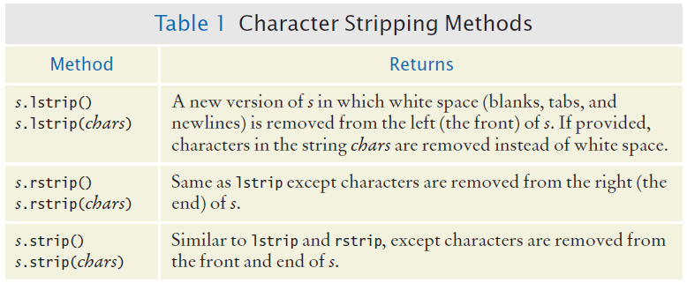
Character Strip Methods

Slide 27
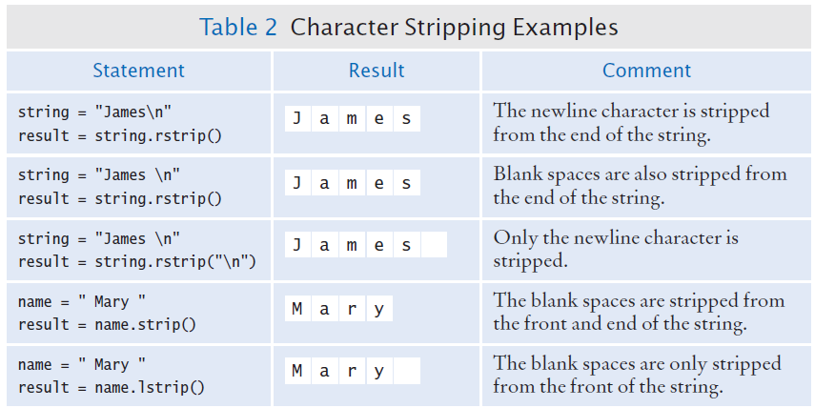
Character Strip Examples

Slide 28
Reading Words
Sometimes you may need to read the individual words from a text file
For example, suppose our input file contains two lines of text
Mary had a little lamb,
whose fleece was white as snow

Slide 29
Reading Words (2)
We would like to print to the terminal, one word per line
Mary
had
a
little
. . .
Because there is no method for reading a word from a file, you must first read a line and then split it into individual words
line = line.rstrip()
wordlist = line.split()

Slide 30
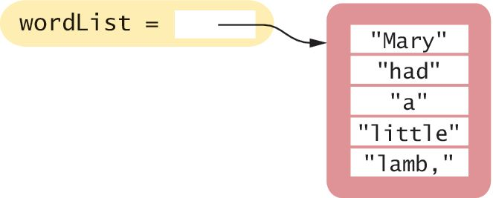
Reading Words (3)
The split method returns the list of substrings that results from splitting the string at each blank space
For example, if line contains the string:
It will be split into 5 substrings that are stored in a list in the same order in which they occur in the string:

Slide 31
Reading Words (4)
Notice that the last word in the line contains a comma
If we only want to print the words contained in the file without punctuation marks, we can strip those from the substrings using the rstrip() method introduced in the previous section:
word = word.rstrip(".,?!")

Slide 32
Reading Words: Complete Example
inputFile = open("lyrics.txt", "r")
for line in inputFile :
line = line.rstrip()
wordList = line.split()
for word in wordList :
word = word.rstrip(".,?!")
print(word)
inputFile.close()

Slide 33
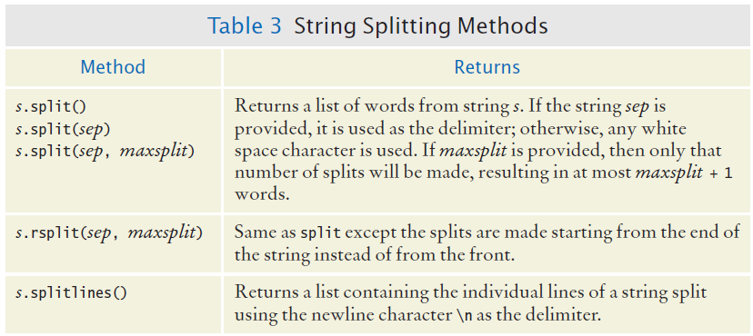
Additional String Splitting Methods

Slide 34
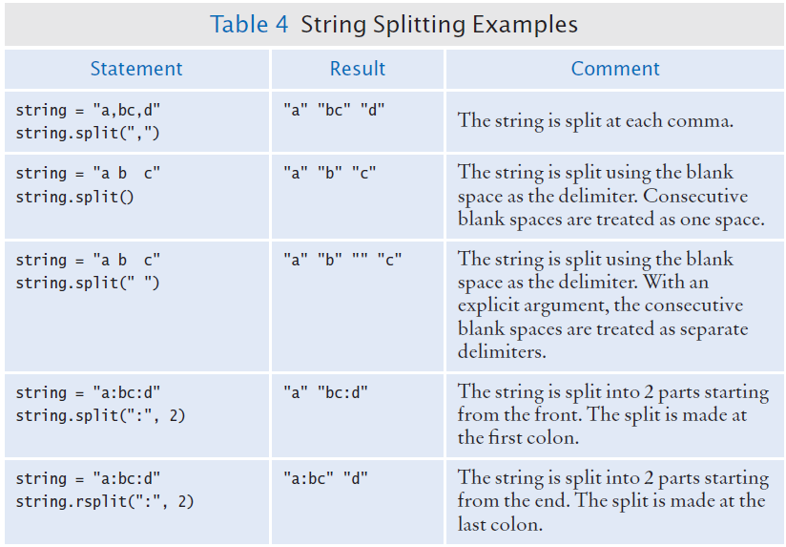
Additional String Splitting Examples

Slide 35
Reading Characters
The read() method takes a single argument that specifies the number of characters to read
The method returns a string containing the characters
When supplied with an argument of 1, the read() method returns a string consisting of the next character in the file
char = inputFile.read(1)
If the end of the file is reached, it returns an empty string ""

Slide 36
Algorithm: Reading Characters
while char != "" :
Process character
char = inputFile.read(1)

Slide 37
Reading Records
A text file can contain a collection of data records in which each record consists of multiple fields
For example, a file containing student data may consist of records composed of an identification number, full name, address, and class year
When working with text files that contain data records, you generally have to read the entire record before you can process it:
For each record in the file
Read the entire record
Process the record

Slide 38
Record Formats: Example
The organization or format of the records can vary, however, making some formats easier to read than others
A typical format for such data is to store each field on a separate line of the file with all fields of a single record on consecutive lines:
China
1330044605
India
1147995898
United States
303824646
. . .

Slide 39
Record Formats: Example
Reading the data in this format is rather easy
Because each record consists of two fields, we read two lines from the file for each record
line = infile.readline()
while line != "" :
countryName = line.rstrip()
line = infile.readline()
population = int(line)
Process data record
line = infile.readline()

Slide 40
Record Formats: Example 2
Another common format stores each data record on a single line
If the record’s fields are separated by a specific delimiter “:” you can extract the fields by splitting the line with the split() method
China:1330044605
India:1147995898
United States:303824646
. . .

Slide 41
Record Formats: Example 3
But what if the fields are not separated by a delimiter?
China 1330044605
India 1147995898
United States 303824646
. . .
Because some country names have more than one word, we cannot simply use a blank space as the delimiter because multi-word names would be split incorrectly
Can we use rsplit in this case?
inputString = "United States 303824646"
result = inputString.rsplit(" ",1)
print(result)

Slide 42
Record Formats: Example 3
One approach for reading records in this format is to read the line, then search for the first digit in the string returned by readline():
i = 0
char = line[0]
while not line[0].isdigit() :
i = i + 1
You can then extract the country name and population as substrings using the slice operator:
countryName = line[0 : i - 1]
population = int(line[i : ])

Slide 43
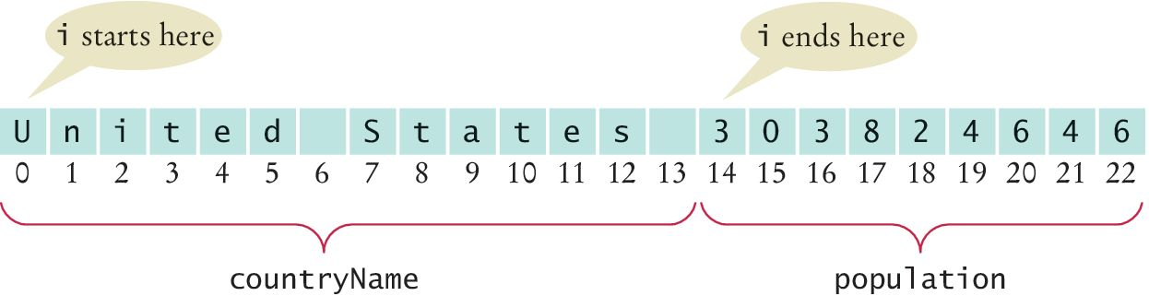
Record Formats: Example 3
‘Slicing’ the string read from file

Slide 44
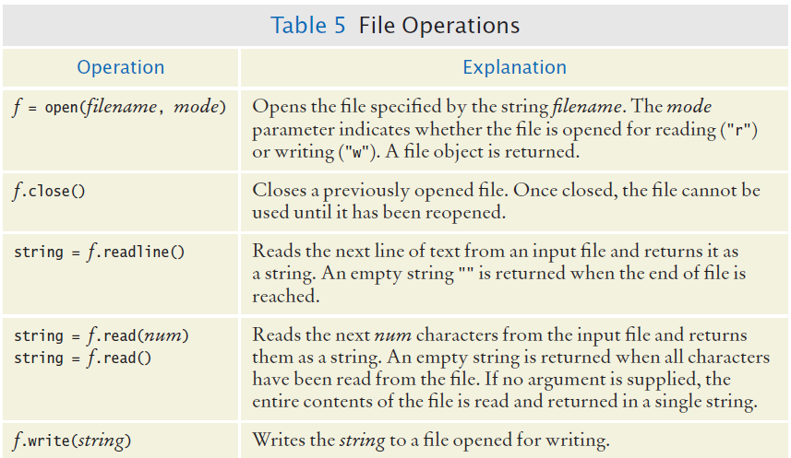
File Operations

Slide 45
Processing Text Files Example
Page 360

Slide 46
Steps to Processing Text Files
Problem Statement:
Read two country data files, worldpop.txt and worldarea.txt
Write a file world_pop_density.txt that contains country names and population densities with the country names aligned left and the numbers aligned right
Afghanistan 50.56
Akrotiri 127.64
Albania 125.91
Algria 14.18
American Samoa 288.92
. . .

Slide 47
Six Steps to Processing Text Files
Understand the Processing Task
Process the data “on the go” or store data and then process?
Determine which files you need to read and write
Choose a mechanism for obtaining the file names
Choose between iterating over the file or reading individual lines
If all data is on one line, normally use line input
With line-oriented input, extract required data
Examine the line and plan for whitespace, delimiters…
Use functions to factor out common tasks

Slide 48
Processing Text Files: Pseudocode
Step 1: Understand the Task
While there are more lines to be read
Read a line from each file
Extract the country name
population = number following the country name in the line from the first file
area = number following the country name in the line from the second file
If area != 0
density = population / area
Print country name and density
Afghanistan 50.56
Akrotiri 127.64
Albania 125.91
Algria 14.18
American Samoa 288.92

Slide 49
Step Two
Determine the file you need to read and write
There are two input files:
worldpop.txt
worldarea.txt
There is one output file:
world_pop_density.txt

Slide 50
Step Three
Choose a mechanism for obtaining the file names
We have three options:
Hardcode the filename as a constant
Prompt the user
Use a command line argument
We will use hard-coded files names
The file names are constant in this example

Slide 51
Step Four
Choose between iterating over the file or reading individual lines
Generally if the data is grouped on lines we iterate over the file
If the data is spread over several line, we read the individual lines
In this example we will read individual lines since we are reading from two input files

Slide 52
Step Five
Extract the data into the individual fields
Use split or rsplit to extract the data elements

Slide 53
Step Six
Use functions to factor out common tasks
Find the repetitive tasks and develop functions to handle them

Slide 54
Exception Handling
Section 7.4

Slide 55
Exception Handling
There are two aspects to dealing with run-time program errors:
Detecting Errors
Handling Errors
The open function can detect an attempt to read from a non-existent file
The open function cannot handle the error
There are multiple alternatives, the function does not know which is the correct choice
The function reports the error to another part of the program to be handled
Exception handling provides a flexible mechanism for passing control from the point of the error to a handler that can deal with the error

Slide 56
Detecting Errors
What do you do if someone tries to withdraw too much money from a bank account?
You can raise an exception
When you raise an exception, execution does not continue with the next statement
It transfers to the exception handler
Use the raise statement to signal an exception
if amount > balance :
raise ValueError("Amount exceeds balance")

Slide 57
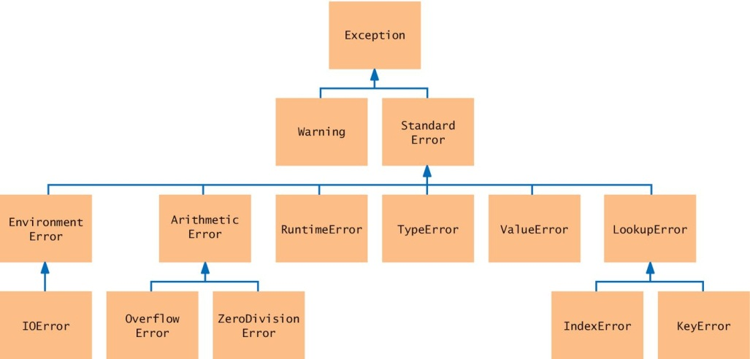
Exception Classes (a subset)
Look for an appropriate exception

Slide 58
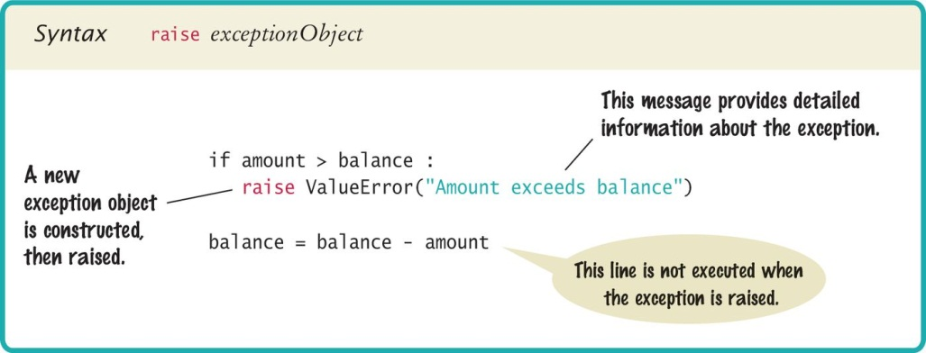
Syntax: Raising an Exception

Slide 59
Handling Exceptions
Every exception should be handled somewhere in the program
This is a complex problem
You need to handle each possible exception and react to it appropriately
Handling recoverable errors can be done:
Simply: exit the program
User-friendly: Ask the user to correct the error

Slide 60
Handling Exceptions: Try-Except
You handle exceptions with the try/except statement
Place the statement into a location of your program that knows how to handle a particular exception
The try block contains one or more statements that may cause an exception of the kind that you are willing to handle
Each except clause contains the handler for an exception type

Slide 61
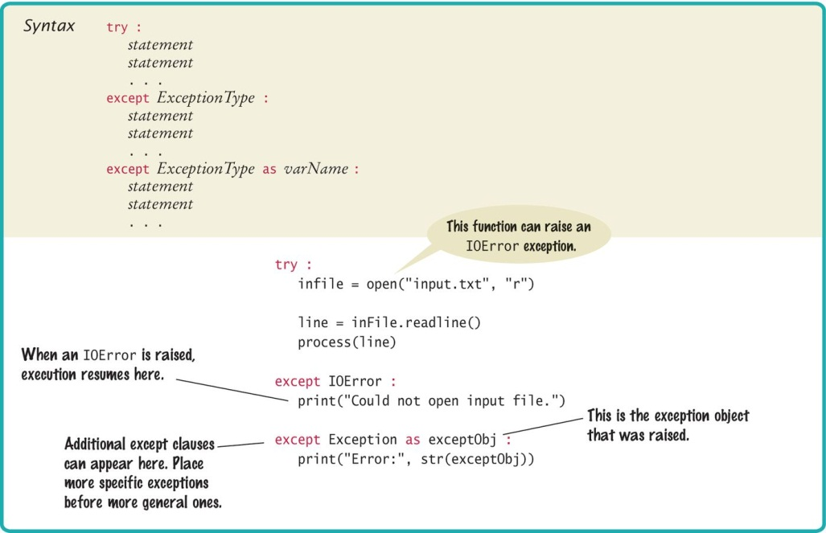
Syntax: Try-Except

Slide 62
Try-Except: An Example
try :
filename = input("Enter filename: ")
infile = open(filename, "r")
line = infile.readline()
value = int(line)
. . .
except IOError :
print("Error: file not found.")
except ValueError as exception :
print("Error:", str(exception))
open() can raise an IOError exception
int() can raise a ValueError exception
Execution transfers here if file cannot be opened
Execution transfers here if the string cannot be converted to an int
If either of these exceptions is raised, the rest of the instructions in the try block are skipped

Slide 63
Example
If an IOError exception is raised, the except clause for the IOError exception is executed
If a ValueError exception occurs, then second except clause is executed
If any other exception is raised it will not be handled by any of the except blocks

Slide 64
Output Messages
When the body of this handler is executed, it prints the message included with the exception
except ValueError as exception :
print("Error:", str(exception))
For example, if the string passed to the int() function was "35x2", then the message included with the exception will be:
invalid literal for int() with base 10: '35x2'

Slide 65
Output Messages (2)
To obtain the message, we must have access to the exception object itself
You can store the exception object in a variable with the as syntax:
except ValueError as exception :
When the handler for ValueError is executed, exception is set to the exception object. In our code, we then obtain the message string by calling str(exception)

Slide 66
Source of Output Messages
When you raise an exception, you can provide your own message string. For example, when you call
raise ValueError("Amount exceeds balance")
The message of the exception, "Amount exceeds balance", is the string provided as the argument to the constructor

Slide 67
The finally Clause
The finally clause is used when you need to take some action whether or not an exception is raised
Here is a typical situation
It is important to always close an output file whether or not an exception was raised (to ensure that all output is written to the file)
Place the call to close() inside a finally clause:
outfile = open(filename, "w")
try :
writeData(outfile)
finally :
outfile.close()

Slide 68
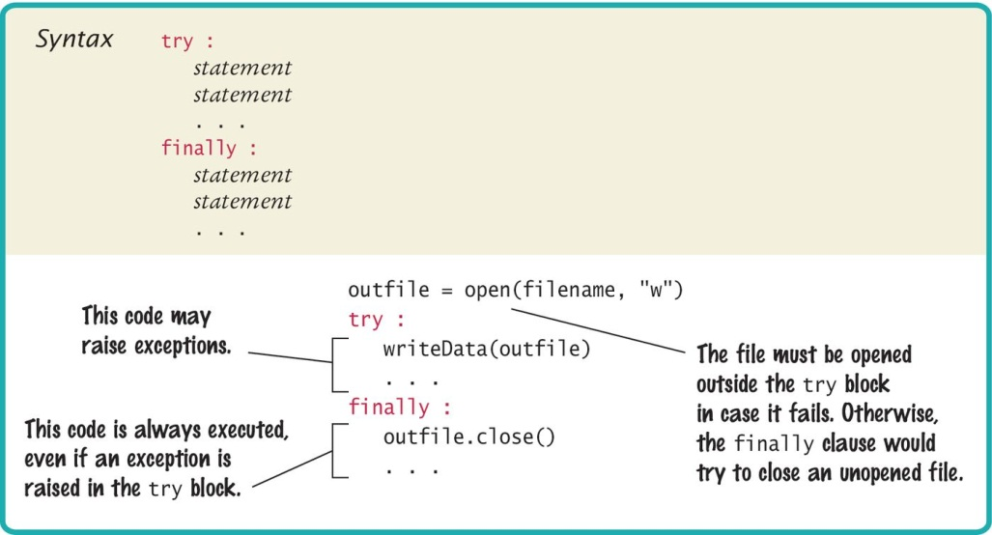
Syntax: The Finally Clause

Slide 69
Programming Tip
Throw exceptions early
When a method detects a problem that it cannot solve, it is better to throw an exception rather than try to come up with an imperfect fix
Catch exceptions late
Conversely, a method should only catch an exception if it can really remedy the situation
Otherwise, the best remedy is simply to have the exception propagate to its caller, allowing it to be caught by a competent handler

Slide 70
Programming Tip
The finally clause is executed whenever the try block is exited in any of three ways:
1. After completing the last statement of the try block
2. After completing the last statement of a except clause, if this try block caught an exception
3. When an exception was raised in the try block and not handled
try
except
finally

Slide 71
Programming Tip
Sometime you need to split the except and finally into two nested try block
try
try :
outfile = open(filename, "w")
try :
# Write output to outfile
finally :
out.close() # Close resources
except IOError :
# Handle exception
try
finally
except

Slide 72
The With Statement
Because a try/finally statement for opening and closing files is so common, it’s more common to use the with statement to open a file:
with open(filename, "w") as outfile :
# Write output to outfile
This with statement opens the file with the given name, sets outfile to the file object, and closes the file object when the end of the statement has been reached or an exception is raised

Slide 73
Handling Input Errors
Section 7.6

Slide 74
Handling Input Errors
File Reading Application Example
Goal: Read a file of data values
First line is the count of values
Remaining lines have values
Risks:
The file may not exist
The open() function will raise an exception when the file does not exist
The file might have data in the wrong format
When there are fewer data items than expected, or when the file doesn’t start with the count of values, the program will raise a ValueError exception
Finally, when there are more inputs than expected, a RuntimeError exception should be raised
3
1.45
-2.1
0.05

Slide 75
Handling Input Errors: main()
Outline for method with all exception handling
done = False
while not done :
try:
# Prompt user for file name
data = readFile(filename) # May raise exceptions
# Process data
done = true;
except IOError:
print("File not found.")
except ValueError :
print("File contents invalid.")
except RuntimeError as error:
print("Error:", str(error))

Slide 76
Handling Input Errors: readFile()
Creates the file object and calls the readData() function
No exception handling (no except clauses)
finally clause closes file in all cases (exception or not)
def readFile(filename) :
inFile = open(filename, "r") # May throw exceptions
try
return readData(inFile)
finally
in.close()

Slide 77
Handling Input Errors: readData()
No exception handling (no try or except clauses)
raise creates an ValueError exception and exits
RuntimeError exception can occur
def readData(inFile) :
line = inFile.readline()
numberOfValues = int(line) # May raise a ValueError exception.
data = []
for i in range(numberOfValues) :
line = inFile.readline()
value = int(line) # May raise a ValueError exception.
data.append(value)
# Make sure there are no more values in the file.
line = inFile.readline()
# Extra data in file
if line != "" :
raise RuntimeError("End of file expected.")
return data

Slide 78
One Scenario
main calls readFile
readFile calls readData
readData calls int
There is no integer in the input, and int raises a ValueError exception
readData has no except clause; it terminates immediately
readFile has no except clause; it terminates immediately after executing the finally clause and closing the file
The IOError except clause is skipped
The ValueError except clause is executed

Slide 79
Summary: File Input/Output
When opening a file, you supply the name of the file stored on disk and the mode in which the file is to be opened
Close all files when you are done processing them, unless you use the with statement to open the file
Use the readline() method to obtain lines of text from a file
Read one or more characters with the read() method
Write to a file using the write() method or the print() function

Slide 80
Summary: Processing Text Files
You can iterate over a file object to read the lines of text in the file
Use the rstrip() method to remove the newline character from a line of text
Use the split() method to split a string into individual words

Slide 81
Command Line Arguments
Programs that start from the command line receive the command line arguments in the argv list defined in the sys module

Slide 82
Summary: Exceptions (1)
To signal an exceptional condition, use the raise statement to raise an exception object
When you raise an exception, processing continues in an exception handler
Place the statements that can cause an exception inside a try block, and the handler inside an except clause
Once a try block is entered, the statements in a finally clause are guaranteed to be executed, whether or not an exception is raised

Slide 83
Summary: Exceptions (2)
Raise an exception as soon as a problem is detected
Handle it only when the problem can be handled
When designing a program, ask yourself what kinds of exceptions can occur
For each exception, you need to decide which part of your program can competently handle it

