Slide 1
Chapter 8
SETS AND DICTIONARIES

Slide 2
Chapter Goals
To build and use a set container
To learn common set operations for processing data
To build and use a dictionary container
To work with a dictionary for table lookups
To work with complex data structures

Slide 3
Contents
Sets
Dictionaries
Complex Structures

Slide 4
Sets
Section 8.1

Slide 5
Sets
A set is a container that stores a collection of unique values
Unlike a list, the elements or members of the set are not stored in any particular order and cannot be accessed by position
Operations are the same as the operations performed on sets in mathematics
Because sets do not need to maintain a particular order, set operations are much faster than the equivalent list operations

Slide 6
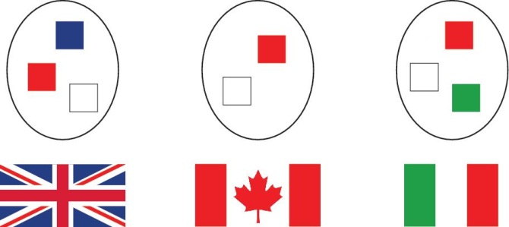
Example Set
This set contains three sets of colors––the colors of the British, Canadian, and Italian flags
In each set, the order does not matter, and the colors are not duplicated in any one of the sets

Slide 7
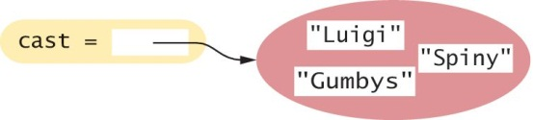
Creating and Using Sets
To create a set with initial elements, you can specify the elements enclosed in braces, just like in mathematics:
cast = { "Luigi", "Gumbys", "Spiny" }
Alternatively, you can use the set() function to convert any sequence into a set:
names = ["Luigi", "Gumbys", "Spiny"]
cast = set(names)

Slide 8

Creating an Empty Set
For historical reasons, you cannot use {} to make an empty set in Python
Instead, use the set() function with no arguments:
cast = set()
As with any container, you can use the len() function to obtain the number of elements in a set:
numberOfCharacters = len(cast) # In this case it’s zero

Slide 9
Set Membership: in
To determine whether an element is contained in the set, use the in operator or its inverse, the not in operator:
if "Luigi" in cast :
print("Luigi is a character in Monty Python’s Flying Circus.")
else :
print("Luigi is not a character in the show.")

Slide 10
Accessing Set Elements
Because sets are unordered, you cannot access the elements of a set by position as you can with a list
We use a for loop to iterate over the individual elements:
print("The cast of characters includes:")
for character in cast :
print(character)
Note that the order in which the elements of the set are visited depends on how they are stored internally

Slide 11
Accessing Elements (2)
For example, the previous loop above displays the following:
The cast of characters includes:
Gumbys
Spiny
Luigi
Note that the order of the elements in the output is different from the order in which the set was created

Slide 12
Displaying Sets In Sorted Order
Use the sorted() function, which returns a list (not a set) of the elements in sorted order
The following loop prints the cast in sorted order:
for actor in sorted(cast) :
print(actor)

Slide 13
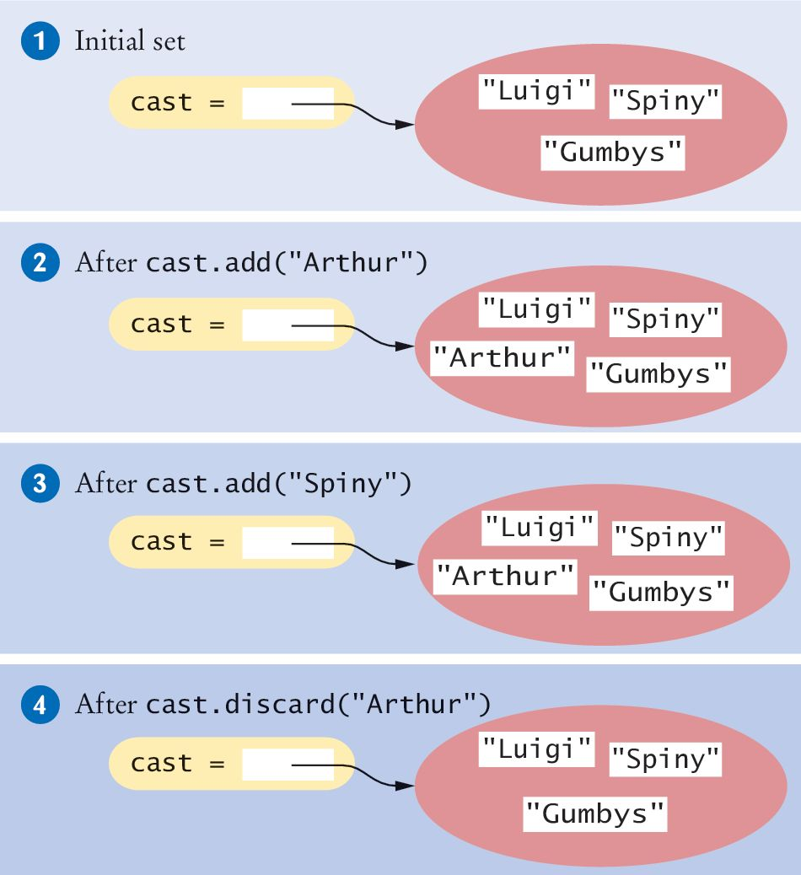
Adding Elements
Sets are mutable collections, so you can add elements by using the add() method:
cast = set(["Luigi", "Gumbys", "Spiny"]) #1
cast.add("Arthur") #2
cast.add("Spiny") #3
Arthur is not in the set, so it is added to the set and the size of the set is increased by one
Spiny is already in the set, so there is no effect on the set

Slide 14
Removing Elements: discard()
The discard() method removes an element if the element exists:
cast.discard("Arthur") #4
It has no effect if the given element is not a member of the set:
cast.discard("The Colonel") # Has no effect

Slide 15
Removing Elements: remove()
The remove() method, on the other hand, removes an element if it exists, but raises an exception if the given element is not a member of the set:
cast.remove("The Colonel") # Raises an exception
For this class we will use the discard() method

Slide 16
Removing Elements: clear()
Finally, the clear() method removes all elements of a set, leaving the empty set:
cast.clear() # cast now has size 0

Slide 17
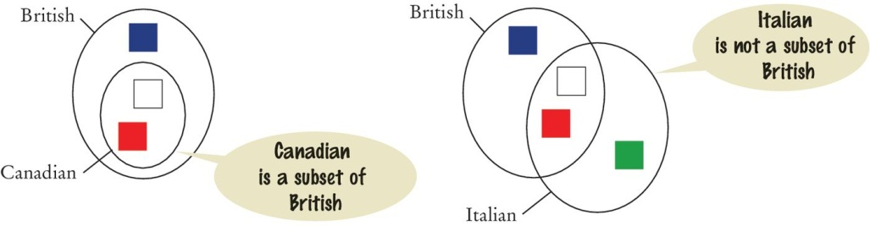
Subsets
A set is a subset of another set if and only if every element of the first set is also an element of the second set
In the image below, the Canadian flag colors are a subset of the British colors
The Italian flag colors are not.

Slide 18
The issubset() Method
The issubset() method returns True or False to report whether one set is a subset of another:
canadian = { "Red", "White" }
british = { "Red", "Blue", "White" }
italian = { "Red", "White", "Green" }
# True
if canadian.issubset(british) :
print("All Canadian flag colors occur in the British flag.")
# True
if not italian.issubset(british) :
print("At least one of the colors in the Italian flag does
not.")

Slide 19
Set Equality / Inequality
We test set equality with the “==“ and “!=“ operators
Two sets are equal if and only if they have exactly the same elements
french = { "Red", "White", "Blue" }
if british == french :
print("The British and French flags use the same colors.")

Slide 20
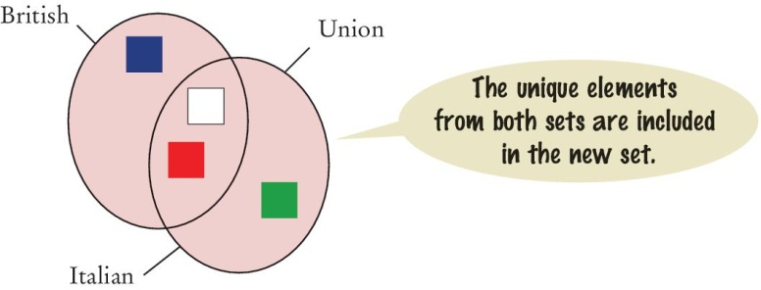
Set Union: union()
The union of two sets contains all of the elements from both sets, with duplicates removed
# inEither: The set {"Blue", "Green", "White", "Red"}
inEither = british.union(italian)
Both the British and Italian sets contain the colors Red and White, but the union is a set and therefore contains only one instance of each color
Note that the union() method returns a new set. It does not modify either of the sets
in the call

Slide 21
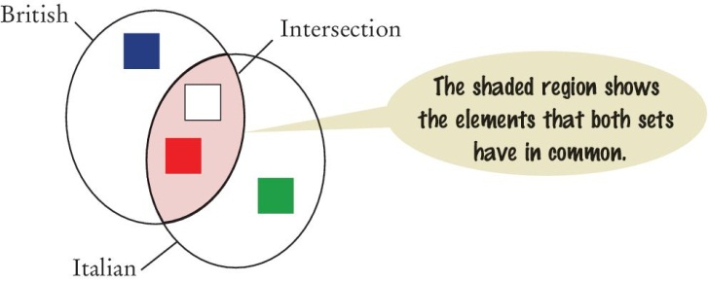
Set Intersection: intersection()
The intersection of two sets contains all of the elements that are in both sets
# inBoth: The set {"White", "Red"}
inBoth = british.intersection(italian)

Slide 22
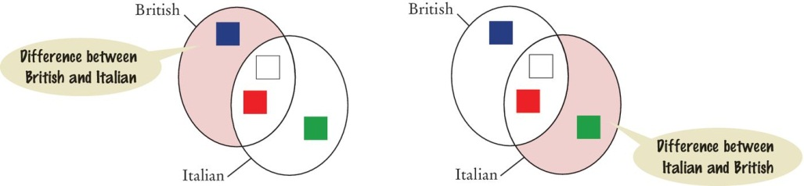
Difference of Two Sets: difference()
The difference of two sets results in a new set that contains those elements in the first set that are not in the second set
print("Colors that are in the Italian flag but not the British:")
print(italian.difference(british)) # Prints {'Green'}

Slide 23
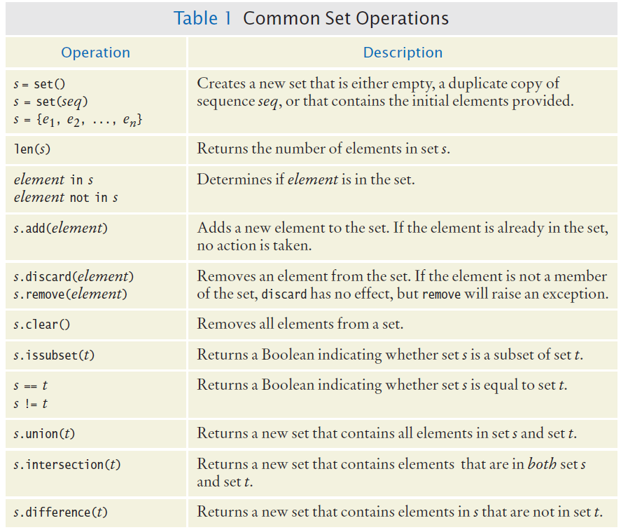
Common Set Operations

Slide 24
Common Set Operations (2)
Remember: union, intersection and difference return new sets
They do not modify the set they are applied to

Slide 25
Set Example: Spell Checking
The program spellcheck.py reads a file that contains correctly spelled words and places the words in a set
It then reads all words from a document––here, the book Alice in Wonderland––into a second set
Finally, it prints all words from the document that are not in the set of correctly spelled words
Open the file spellcheck.py

Slide 26
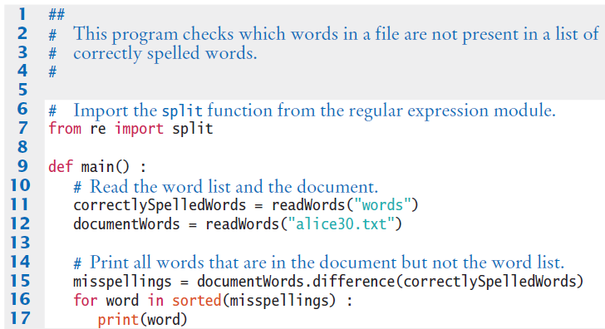
Example: Spellcheck.py

Slide 27
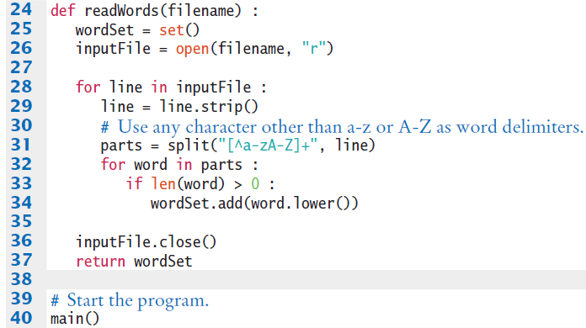
Example: Spellcheck.py

Slide 28
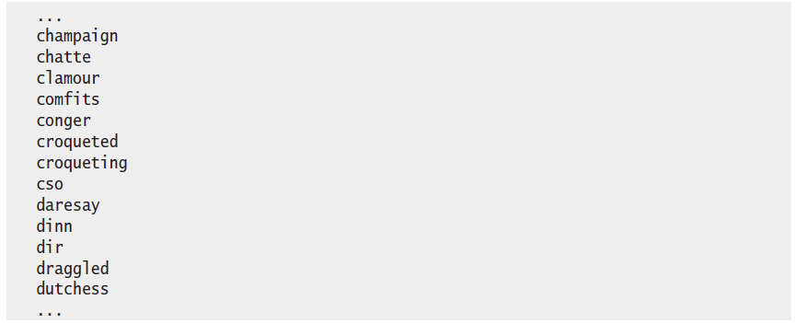
Execution: Spellcheck.py

Slide 29
Programming Tip
When you write a program that manages a collection of unique items, sets are far more efficient than lists
Some programmers prefer to use the familiar lists, replacing
itemSet.add(item)
with:
if (item not in itemList)
itemList.append(item)
However, the resulting program is much slower.
The speed factor difference is over 10 times

Slide 30
Counting Unique Words

Slide 31
Problem Statement
We want to be able to count the number of unique words in a text document
“Mary had a little lamb” has 57 unique words
Our task is to write a program that reads in a text document and determines the number of unique words in the document

Slide 32
Step One: Understand the Task
To count the number of unique words in a text document we need to be able to determine if a word has been encountered earlier in the document
Only the first occurrence of a word should be counted
The easiest way to do this is to read each word from the file and add it to the set
Because a set cannot contain duplicates we can use the add method
The add method will prevent a word that was encountered earlier from being added to the set
After we process every word in the document the size of the set will be the number of unique words contained in the document

Slide 33
Step Two: Decompose the Problem
The problem can be split into several simple steps:
Create an empty set
for each word in the text document
Add the word to the set
Number of unique words = the size of the set
Creating the empty set, adding an element to the set, and determining the size of the set are standard set operations
Reading the words in the file can be handled as a separate task

Slide 34
Step Three: Build the Set
We need to read individual words from the file. For simplicity in our example we will use a literal file name
inputFile = open(“nurseryrhyme.txt”, “r”)
For line in inputFile :
theWords = line.split()
For words in theWords :
Process word
To count unique words we need to remove any nonletters and remove capitalization
We will design a function to “clean” the words before we add them to the set

Slide 35
Step Four: Clean the Words
To strip out all the characters that are not letters we will iterate through the string, one character at a time, and build a new “clean” word
def clean(string) :
result = “”
for char in string :
if char.isalpha() :
result = result + char
return result.lower()

Slide 36
Step Five: Some Assembly Required
Implement the main() function and combine it with the other functions

Slide 37
Dictionaries
Section 8.2

Slide 38
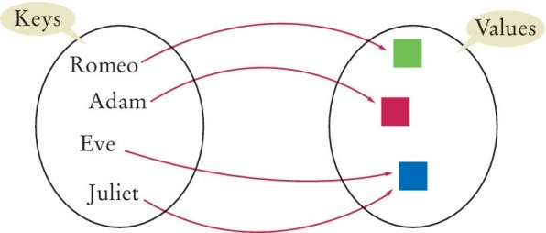
Dictionaries
A dictionary is a container that keeps associations between keys and values
Every key in the dictionary has an associated value
Keys are unique, but a value may be associated with several keys
Example (the mapping between the key and value is indicated by an arrow):

Slide 39
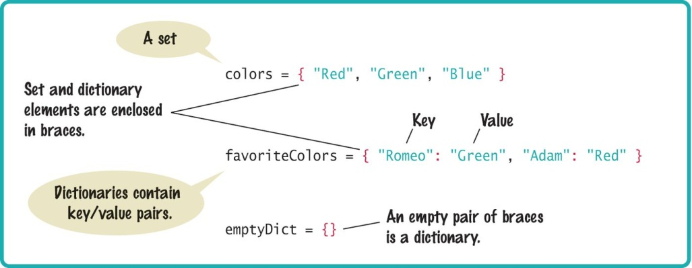
Syntax: Sets and Dictionaries

Slide 40
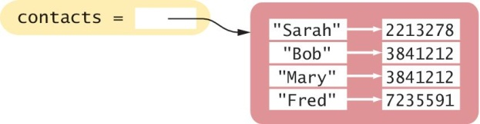
Creating Dictionaries
Suppose you need to write a program that looks up the phone number for a person in your mobile phone’s contact list
You can use a dictionary where the names are keys and the phone numbers are values
contacts = { "Fred": 7235591, "Mary": 3841212, "Bob": 3841212, "Sarah": 2213278 }

Slide 41
Duplicating Dictionaries: Dict()
You can create a duplicate copy of a dictionary using the dict() function:
oldContacts = dict(contacts)

Slide 42
Accessing Dictionary Values []
The subscript operator [] is used to return the value associated with a key
The statement
# prints 7235591.
print("Fred's number is", contacts["Fred"])
Note that the dictionary is not a sequence-type container like a list.
You cannot access the items by index or position
A value can only be accessed using its associated key
The key supplied to the subscript operator must be a valid key in the dictionary or
a KeyError exception will be raised

Slide 43
Dictionaries: Checking Membership
To find out whether a key is present in the dictionary, use the in (or not in) operator:
if "John" in contacts :
print("John's number is", contacts["John"])
else :
print("John is not in my contact list.")

Slide 44
Default Keys
Often, you want to use a default value if a key is not present
Instead of using the in operator, you can simply call the get() method and pass the key and a default value
The default value is returned if there is no matching key
number = contacts.get("Fred", 411)
print("Dial " + number)

Slide 45
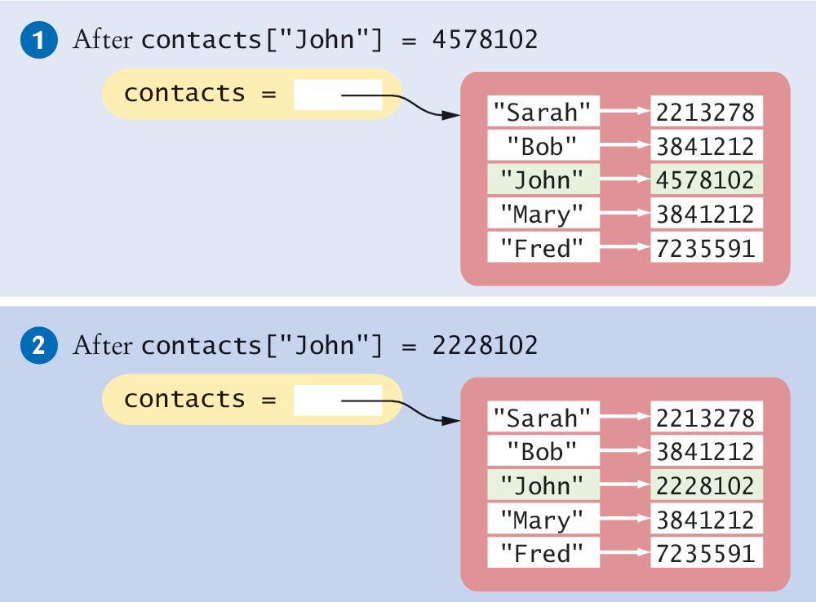
Adding/Modifying Items
A dictionary is a mutable container
You can add a new item using the subscript operator [] much as you would with a list
contacts["John"] = 4578102 #1
To change the value associated with a given key, set a new value using the [] operator on an existing key:
contacts["John"] = 2228102 #2

Slide 46
Adding New Elements Dynamically
Sometimes you may not know which items will be contained in the dictionary when it’s created
You can create an empty dictionary like this:
favoriteColors = {}
and add new items as needed:
favoriteColors["Juliet"] = "Blue"
favoriteColors["Adam"] = "Red"
favoriteColors["Eve"] = "Blue"
favoriteColors["Romeo"] = "Green"

Slide 47
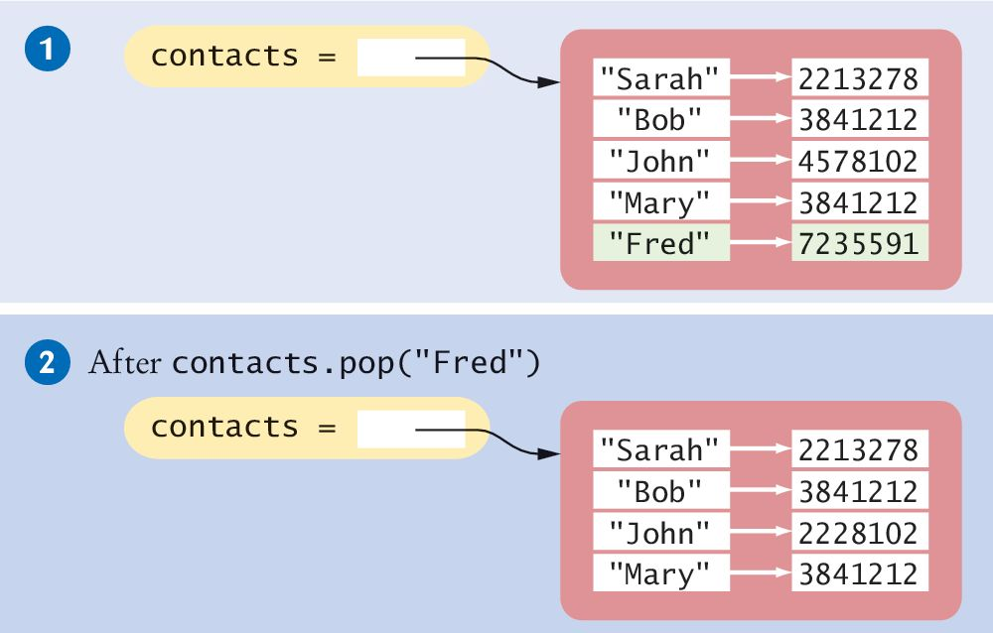
Removing Elements
To remove an item from a dictionary, call the pop() method with the key as the argument:
contacts = { "Fred": 7235591, "Mary": 3841212, "Bob": 3841212, "Sarah": 2213278 }
This removes the entire item, both the key and its associated value.
contacts.pop("Fred")

Slide 48
Removing and Storing Elements
The pop() method returns the value of the item being removed, so you can use it or store it in a variable:
fredsNumber = contacts.pop("Fred")
Note: If the key is not in the dictionary, the pop method raises a KeyError exception
To prevent the exception from being raised, you should test for the key in the dictionary:
if "Fred" in contacts :
contacts.pop("Fred")

Slide 49
Traversing a Dictionary
You can iterate over the individual keys in a dictionary using a for loop:
print("My Contacts:")
for key in contacts :
print(key)
The result of this code fragment is shown below:
My Contacts:
Sarah
Bob
John
Mary
Fred
Note that the dictionary stores its items in an order that is optimized for efficiency,
which may not be the order in which they were added

Slide 50
Traversing a Dictionary: In Order
To iterate through the keys in sorted order, you can use the sorted() function as part of the for loop :
print("My Contacts:")
for key in sorted(contacts) :
print("%-10s %d" % (key, contacts[key]))
Now, the contact list will be printed in order by name:
My Contacts:
Bob 3841212
Fred 7235591
John 4578102
Mary 3841212
Sarah 2213278

Slide 51
Iterating Dictionaries More Efficiently
Python allows you to iterate over the items in a dictionary using the items() method
This is a bit more efficient than iterating over the keys and then looking up the value of each key
The items() method returns a sequence of tuples that contain the keys and values of all items
Here the loop variable item will be assigned a tuple that contains the key in the first slot and the value in the second slot
for item in contacts.items() :
print(item[0], item[1])

Slide 52
Storing Data Records
Data records, in which each record consists of multiple fields, are very common
In some instances, the individual fields of the record were stored in a list to simplify the storage
But this requires remembering in which element of the list each field is stored
This can introduce run-time errors into your program if you use the wrong list element when processing the record
In Python, it is common to use a dictionary to store a data record

Slide 53
Dictionaries: Data Records
You create an item for each data record in which the key is the field name and the value is the data value for that field
For example, this dictionary named record stores a single student record with fields for ID, name, class, and GPA:
record = { "id": 100, "name": "Sally Roberts", "class": 2, "gpa": 3.78 }

Slide 54
Dictionaries: Data Records
To extract records from a file, we can define a function that reads a single record and returns it as a dictionary
The file to be read contains records made up of country names and population data separated by a colon:
def extractRecord(infile) :
record = {}
line = infile.readline()
if line != "" :
fields = line.split(":")
record["country"] = fields[0]
record["population"] = int(fields[1])
return record

Slide 55
Dictionaries: Data Records
The dictionary record that is returned has two items, one with the key "country" and the other with the key "population"
This function’s result can be used to print all of the records to the terminal
infile = open("populations.txt", "r")
record = extractRecord(infile)
while len(record) > 0 :
print("%-20s %10d" % (record["country"],
record["population"]))
record = extractRecord(infile)

Slide 56
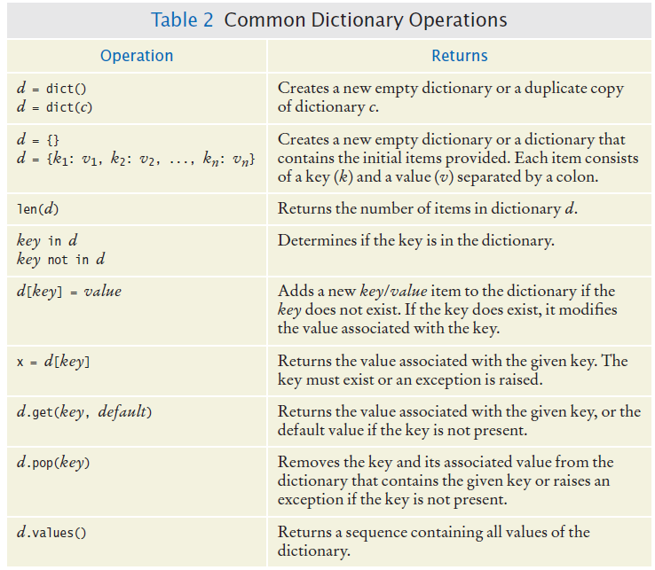
Common Dictionary Operations (1)

Slide 57
Common Dictionary Operations (2)

Slide 58
Complex Structures
Sections 8.3

Slide 59
Complex Structures
Containers are very useful for storing collections of values
In Python, the list and dictionary containers can contain any type of data, including other containers
Some data collections, however, may require more complex structures.
In this section, we explore problems that require the use of a complex structure

Slide 60
A Dictionary of Sets
The index of a book specifies on which pages each term occurs
Build a book index from page numbers and terms contained in a text file with the following format:
6:type
7:example
7:index
7:program
8:type
10:example
11:program
20:set

Slide 61
A Dictionary of Sets
The file includes every occurrence of every term to be included in the index and the page on which the term occurs
If a term occurs on the same page more than once, the index includes the page number only once

Slide 62
A Dictionary of Sets
The output of the program should be a list of terms in alphabetical order followed by the page numbers on which the term occurs, separated by commas, like this:
example: 7, 10
index: 7
program: 7, 11
type: 6, 8
set: 20

Slide 63
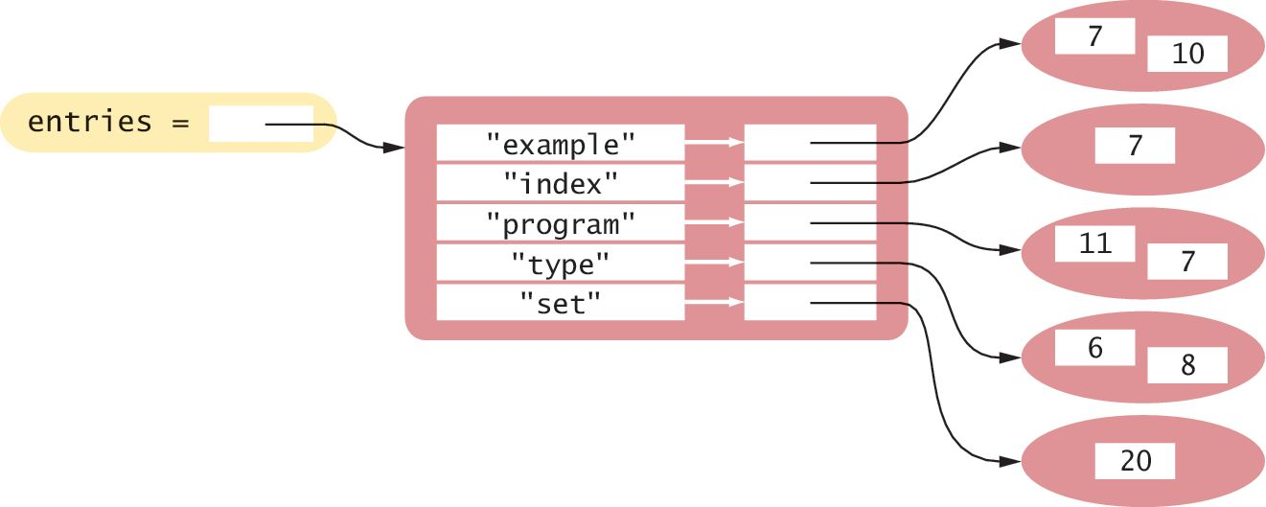
A Dictionary of Sets
A dictionary of sets would be appropriate for this problem
Each key can be a term and its corresponding value a set of the page numbers where it occurs

Slide 64
Why Use a Dictionary?
The terms in the index must be unique
By making each term a dictionary key, there will be only one instance of each term.
The index listing must be provided in alphabetical order by term
We can iterate over the keys of the dictionary in sorted order to produce the listing
Duplicate page numbers for a term should only be included once
By adding each page number to a set, we ensure that no duplicates will be added

Slide 65
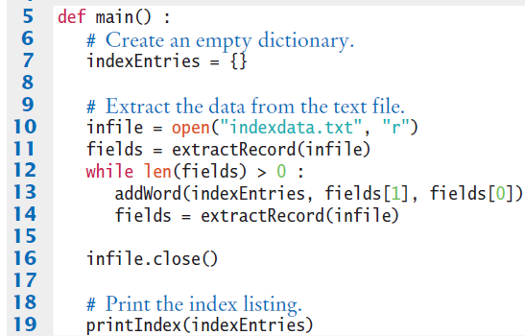
Dictionary Sets: Buildindex.py

Slide 66
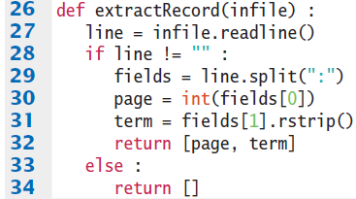
Dictionary Sets: Buildindex.py

Slide 67
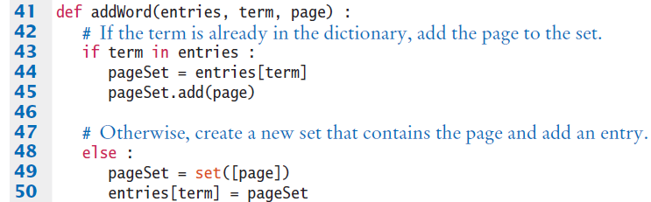
Dictionary Sets: Buildindex.py

Slide 68
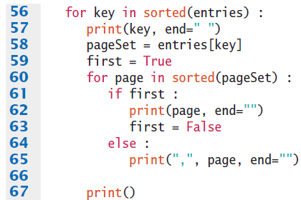
Dictionary Sets: Buildindex.py

Slide 69
A Dictionary of Lists
A common use of dictionaries in Python is to store a collection of lists in which each list is associated with a unique name or key
For example, consider the problem of extracting data from a text file that represents the yearly sales of different ice cream flavors in multiple stores of a retail ice cream company
vanilla:8580.0:7201.25:8900.0
chocolate:10225.25:9025.0:9505.0
rocky road:6700.1:5012.45:6011.0
strawberry:9285.15:8276.1:8705.0
cookie dough:7901.25:4267.0:7056.5

Slide 70
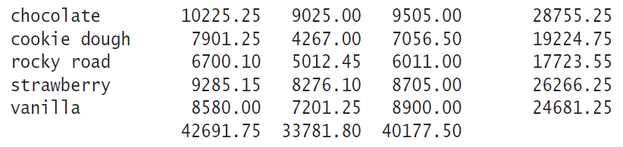
A Dictionary of Lists
The data is to be processed to produce a report similar to the following:
A simple list is not the best choice:
The entries consist of strings and floating-point values, and they have to be sorted by the flavor name

Slide 71
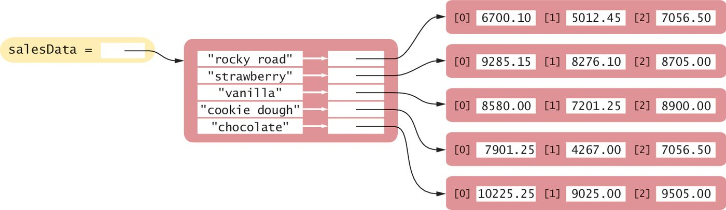
A Dictionary of Lists
With this structure, each row of the table is an item in the dictionary
The name of the ice cream flavor is the key used to identify a particular row in the table.
The value for each key is a list that contains the sales, by store, for that flavor of ice cream

Slide 72

Example: Icecreamsales.py

Slide 73
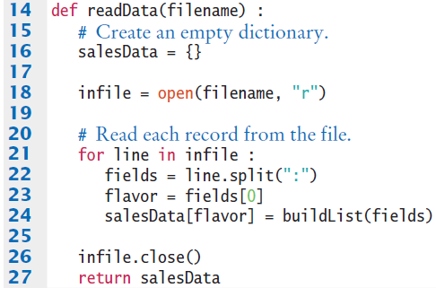
Example: Icecreamsales.py

Slide 74
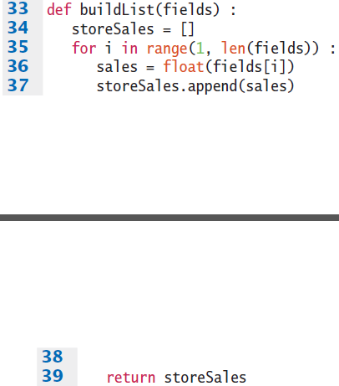
Example: Icecreamsales.py

Slide 75
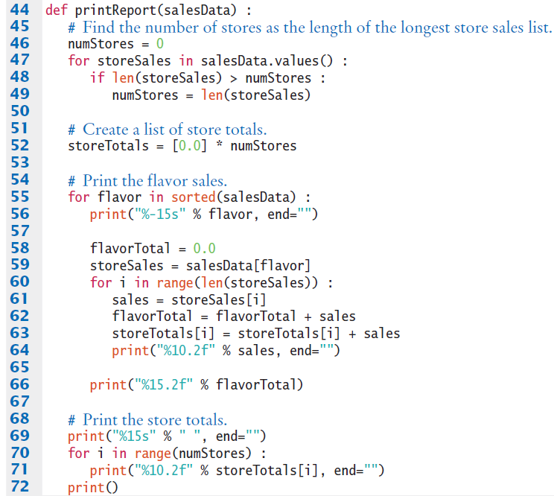
Example: Icecreamsales.py

Slide 76
Example: Icecreamsales.py

Slide 77
The Pythonic Ways (1)
Lists, tuples, sets, and dictionaries are called iterables. We can iterate or walk from one end to the other end of these structures and access each element.
Since Python is an interpreted language, using loops with iterables is not very efficient. Therefore, Python has special ways to work with iterables that make the code run faster.
We’ve seen an example of the Pythonic way: building a list from another list is with list comprehension.
Pythonic way: faster!
Slow way
list2 = [ ]
for elem in list1:
if elem > 0:
list2.append(elem)
list2 = [elem for elem in list1 if elem > 0 ]

Slide 78
The Pythonic Ways (2)
To create a set from a list, the slow way would be to iterate through the list, check if an element has not appeared in the set before adding it to the set. The Pythonic way:
To create a dictionary from 2 parallel lists, the slow way:
Python has a zip function to “zip” the 2 lists together into a list of tuples:
mySet = set(myList)
myDictionary = { ]
for i in range(len(keyList)):
myDictionary[keyList[i]] = valList[i]
myDictionary = dict(zip(keyList, valList))

Slide 79
Modules
Splitting our programs into pieces

Slide 80
Modules
When you write small programs, you can place all of your code into a single source file
When your programs get larger or you work in a team, that situation changes
You will want to structure your code by splitting it into separate source files (a “module”)

Slide 81
Reasons for Employing Modules
Large programs can consist of hundreds of functions that become difficult to manage and debug if they are all in one source file
By distributing the functions over several source files and grouping related functions together, it becomes easier to test and debug the various functions
The second reason becomes apparent when you work with other programmers in a team
It would be very difficult for multiple programmers to edit a single source file simultaneously
The program code is broken up so that each programmer is solely responsible for a unique set of files

Slide 82
Typical Division Into Modules
Large Python programs typically consist of a driver module and one or more supplemental modules
The driver module contains the main() function or the first executable statement if no main function is used
The supplemental modules contain supporting functions and constant variables

Slide 83
Modules Example
Splitting the dictionary of lists into modules
The tabulardata.py module contains functions for reading the data from a file and printing a dictionary of lists with row and column totals
The salesreport.py module is the driver (or main) module that contains the main function
By splitting the program into two modules, the functions in the tabulardata.py module can be reused in another program that needs to process named lists of numbers

Slide 84
Using Code That are in Modules
To call a function or use a constant variable that is defined in a user module, you can first import the module in the same way that you imported a standard library module:
from tabulardata import readData, printReport
However, if a module defines many functions, it is easier to use the form:
import tabulardata
With this form, you must prepend the name of the module to the function name:
tabulardata.printReport(salesData)

Slide 85
Review

Slide 86
Python Sets
A set stores a collection of unique values
A set is created using a set literal or the set function
The in operator is used to test whether an element is a member of a set
New elements can be added using the add() method
Use the discard() method to remove elements from a set
The issubset() method tests whether one set is a subset of another set

Slide 87
Python Sets
The union() method produces a new set that contains the elements in both sets
The intersection() method produces a new set with the elements that are contained in both sets
The difference() method produces a new set with the elements that belong to the first set but not the second
The implementation of sets arrange the elements in the set so that they can be located quickly

Slide 88
Python Dictionaries
A dictionary keeps associations between keys and values
Use the [] operator to access the value associated with a key
The in operator is used to test whether a key is in a dictionary
New entries can be added or modified using the [] operator
Use the pop() method to remove a dictionary entry

Slide 89
Complex Structures
Complex structures can help to better organize data for processing
The code of complex programs is distributed over multiple files

