Slide 1
Variables, Expressions, and IO
CIS 40 – Introduction to Programming in Python
De Anza College Clare Nguyen

Slide 2
Intro
In this module we learn new Python instructions so we can tell the computer to do more tasks:
Instructions to tell the computer to do arithmetic computation.
Instructions to have our script interact with the user.
We also learn how to document our script

Slide 3
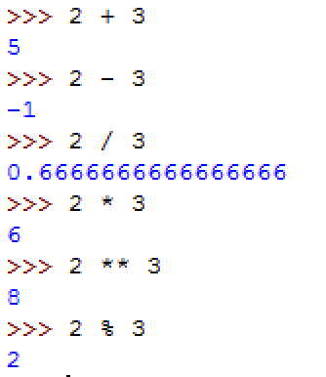
Arithmetic Operators (1 of 2)
Arithmetic operators are used to tell the computer to do arithmetic operations on numbers.
To tell the computer to do computation, we simply type the math expression at the Python shell prompt, hit Enter, and the expression will be interpreted by Python, sent to the CPU, calculated by the CPU and the result appears on screen.
Here are the 6 common arithmetic operators and how they run at the shell:
addition
subtraction
division
multiplication
exponentiation
modulus

Slide 4
Arithmetic Operators (2 of 2)
The addition, subtraction, and division operators are the same as in math.
The multiplication operator is the symbol * (not x as in math).
The exponentiation operator ** raises a number to a power. Examples: 3**2 => 9 2**4 => 16 5**0 => 1 4**0.5 => 2.0
The modulus (%) operator does not calculate the percentage, it returns the remainder of an integer division. Examples:
5 / 3 => 1 with a remainder of 2, 5 % 3 => 2
8 / 4 => 2 with a remainder of 0, 8 % 4 => 0
11 / 30 => 0 with a remainder of 11, 11 % 30 => 11

Slide 5
Order of Operations
When there are multiple operators in an instruction, the operators follow the same order of evaluation as in math.
If 2 operators are at the same level, evaluate from left to right.
Example: Evaluate the expression 8 + 4 * 3 / (7 – 5)
7 – 5 => 2
4 * 3 => 12
12 / 2 => 6.0
8 + 6.0 => 14.0
Highest | ( ) | parentheses
 | ** | exponentiation
 | * / % | multiply, divide, modulus
 | + – | add, subtract
Lowest | = | assign (store data)

Slide 6
Data Types (1 of 2)
When we type in data values in a Python statement, such as 2 * 3.14 or print (“hello”) the values 2, 3.14, and “hello” are data values.
Python classifies these data values into different basic data types:
int: short for integer, the set of whole numbers. In the example above, 2 is an int data type.
float: short for floating point number, the set of decimal numbers or numbers with decimal point. In the example above, 3.14 is a float data type.
str: short for string, a group of text characters that are strung together, thus giving the name to the data type. In the example above, “hello” is a str data type.

Slide 7
Data Types (2 of 2)
The type of a data dictates what we can do with that data. For example, we can add an int and a float data together because they’re numbers, but we cannot add a float and a str data together.
When typing an int or a float data in a Python statement, we simply type the value as is. Example: 2 + 5.25 or print (10)
When typing in a str data in a statement, we need to surround the data with single quotes or double quotes. Example: print (‘What is the air speed of an unladen swallow?’) or print (“That’s all folks!”)

Slide 8
Demo
Click for a video demo discussing arithmetic operators data types

Slide 9
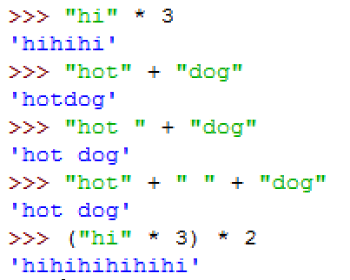
String Operators
The data type str has 2 common operators
The multiplication operator * repeats a string a certain number of times.
The add operator + concatenates 2 strings together, which means it joins 2 strings end to end.
Examples:

Slide 10
Variables (1 of 2)
Recall that when the CPU runs a list of statements, it runs one statement at a time.
If a statement produces some output data that is needed by the next statement, then the output data must be saved.
Example script, version 1 We want to write a script that does the following 2 steps:
Add 564 and 83
Multiply 200 with the result of step 2
Problem!
After the add statement is executed,
the resulting sum is not saved!
Script
564 + 83
200 * ??
Therefore when we get to this statement, we
don’t have the sum to multiply with 200

Slide 11
Variables (2 of 2)
To save the result of an operation, we store the data in a variable.
A variable is a space in memory that has a name. The variable name is called an identifier because it identifies the memory space.
We give the variable a name when we create it, and when we use the name in a statement, the CPU works with the data at the memory space with that name.
Example script, version 2:
Script
1. The result is stored in a variable called sum.
A memory space is created to store the result, and the name sum is attached to it.
sum = 564 + 83
result = 200 * sum
2. Now we can use sum to access the result stored there and do the multiply.
3. Another variable is created to store the product after multiplying.

Slide 12
Assigning Data to a Variable (1 of 2)
Any time we need to store data in our code, we use a variable.
To store data in a variable, or to assign data to a variable, we use the = operator (called the assignment operator).
The variable name is always on the left side of the = The data value is always on the right side of the = name = “De Anza” or age = 20
When the Python interpreter sees the = operator and a data value of type int, float, or str, it creates a memory space to store the data value, and then it sets the variable name to this new memory space.
If we re-use a variable name, which means the name has already been set to an existing memory space and now we set it to some new memory space, then we will no longer be able to access the old memory space.

Slide 13
Assigning Data to a Variable (2 of 2)
Example:
myClass = “CIS 40”
myClass
CIS 40
Memory space is created
Data is stored
Name is set
myClass = 37
37
Memory space is created
Data is stored
Name is set
Notice that we can no longer access the value “CIS 40”
because we don’t have a name for it.

Slide 14
Naming a Variable
We can use any descriptive word or words for a variable name.
If a variable name is made up of multiple words, use underscore to separate the words or uppercase the first letter of each word: student_id or payRatePerHour
A variable name must start with a letter or an underscore, and the rest of the name can be letters, numbers, or underscores. No other kinds of characters can be used in a variable name.
Variable names are case sensitive. Age is not the same as age or AGE.
A variable name should be descriptive so it’s easy to remember what kind of data is stored there.

Slide 15
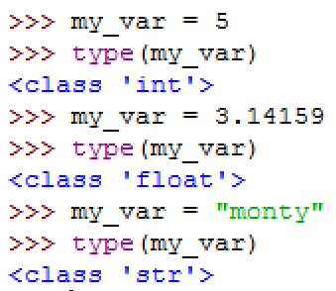
Data Type of a Variable
A variable data type changes depending on the type of data that is stored.
To see what type of data is stored in a variable, use type

Slide 16

Keywords (1 of 2)
Sometime, even when you name a variable correctly (using only letters, numbers, and underscores), you still get mysterious syntax error messages:
This is because the word class is a keyword in the Python language.
All programming languages contain keywords that are specific to the language.
A keyword is a word that has a specific meaning to the Python interpreter, therefore it cannot be used as an identifier. (Remember what an identifier is?) In this case, the word class is used in Python to declare a data type (more on this later).

Slide 17
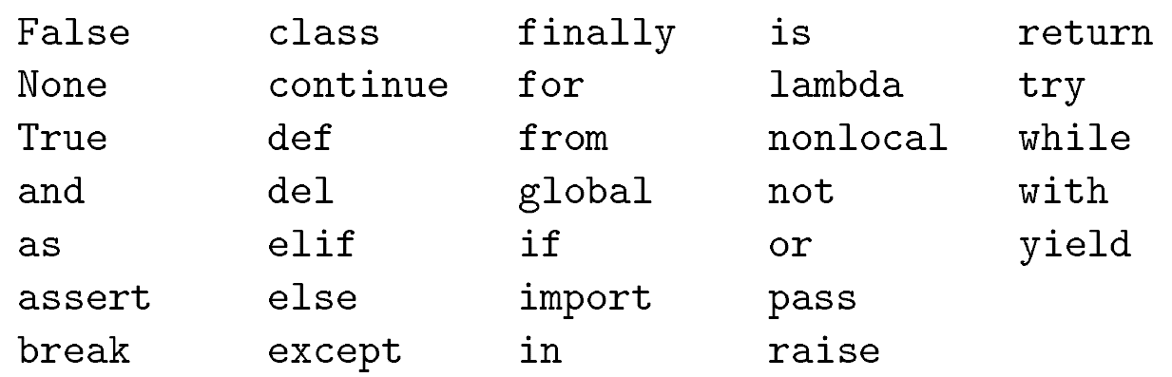
Keywords (2 of 2)
Here is a list of Python keywords that should not be used as variable names:
You don’t need to memorize the list of keywords. As we go through the quarter you will use some of these keywords and learn their meaning. Except for the word class, most of the keywords are not “natural” variable names because most descriptive variable names are nouns such as tax_rate, total, count, yearOfBirth, etc., while most keywords are not nouns.

Slide 18
Demo
Click for a video demo discussing variables

Slide 19
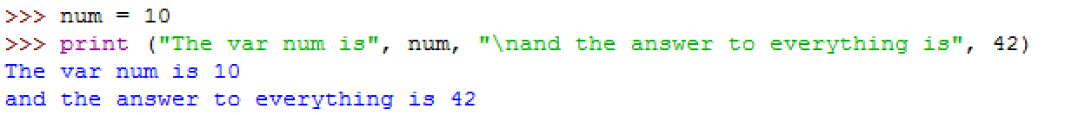
Output (1 of 2)
So far we’ve seen how to print a text string or a number by using the print function
print can also print more than one data values if we give print a list of data values, separated by comma:
Set num to 10
For the input of print, we have 4 comma separated values:
A text string, which is printed to screen as expected.
A variable name, the data in the variable (the value 10) is printed.
A text string, which is printed to screen as expected, with the exception of the \n characters (in front of the word ‘and’). The \n inside quotes tells print to move to the next line of output before printing the next values. This is why there are 2 lines of output.
A numeric value, which is printed as expected.

Slide 20
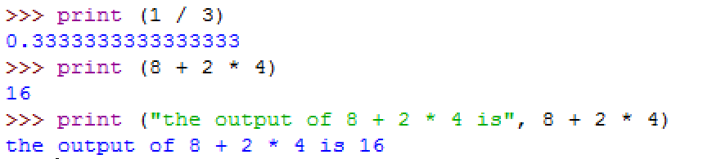
Output (2 of 2)
print can also be used to print the result of an expression:

Slide 21
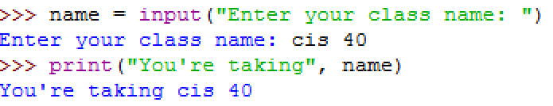
Input (1 of 2)
A script can have many sources of input data, such as a sensor, database, microphone, text file, mouse, etc.
One of the most common input is from the keyboard, when a user types in some data.
To read data from the user, Python provides the input function.
Format: variable = input(“prompt string”)
variable is used to store the user input from the keyboard
prompt string is the text that we print to screen to ask for input data
Example:
Prompt and read in user input
User types this at the prompt
Print to acknowledge that data is read in

Slide 22
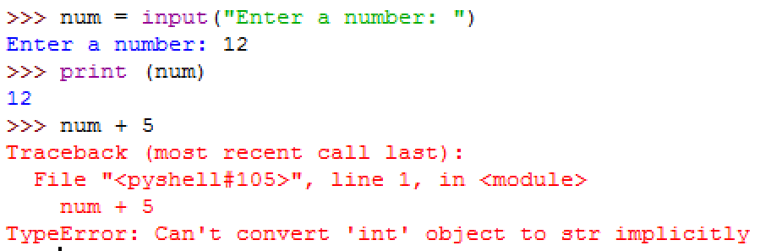
Input (2 of 2)
The function input reads all user input as text strings, which means the user input has the data type str
To use the input data as a number, we need to tell Python to convert the string into a number.
To read input data and convert to an int:
To read input data and convert to a float:
This is str data type, not int data type
Therefore we cannot add it to a number

Slide 23
Demo
Click for a video demo discussing standard input and output

Slide 24
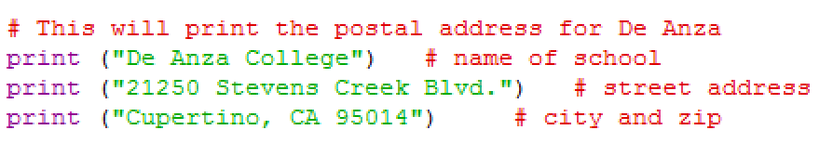
Documentation
Python provides a way for us to make notes or comments in our script, in order to explain what the code does.
The comments that we write in the script are for human readers and don’t have to follow Python syntax.
To tell Python that a line of text is a comment, add a # symbol at the front of the line:
Note that a comment can be a single line by itself, or it can appear at the end of a line of instruction.
The comments are between the # and the end of the line.

Slide 25
What’s Next
At this point we can write a Python script that interacts with the user by prompting for data and reading in the input.
The script can do arithmetic computation with numeric data and print the output for the user. To do multi-step calculations, we create variables to store intermediate values.
Now that we can write code that does work and interacts with the user, in the next module, we will learn about functions so that we can write blocks of code that can be re-used.

