Slide 1
Functions
CIS 40 – Introduction to Programming in Python
De Anza College Clare Nguyen

Slide 2
Intro
In this module we work with Python functions.
We learn some common built-in functions, and how to call or run these functions.
We also learn how to define or create our own Python functions.
Then we coordinate multiple functions to perform more complex tasks, and learn modularization concepts.

Slide 3
What Is a Function? (1 of 2)
A function is a group of Python statements that work together to perform a task.
Examples :
A function that calculates the gas mileage of a car
A function that darkens the color of an image
A function that counts the number of words in a text file
A function that prints text to screen
Properties of a function:
Contains multiple statements
Has a name
Can accept one or more input data to work with them
Can produce one output data
Input
Function Name
Statement 1
Statement 2
…
Statement N
Output

Slide 4
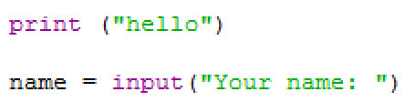
What Is a Function? (2 of 2)
Some of the functions that we have worked with are:
When we type the function name followed by ( ) in a Python statement, we call the function and cause the function to run.
When a function runs, the statements that make up the function are run by the CPU one by one.
We can give the input to the function by typing input data inside the ( ) that follows the function name.
If a function has an output, we save the output by assigning it to a variable.
function input
function name
output is saved in a variable

Slide 5
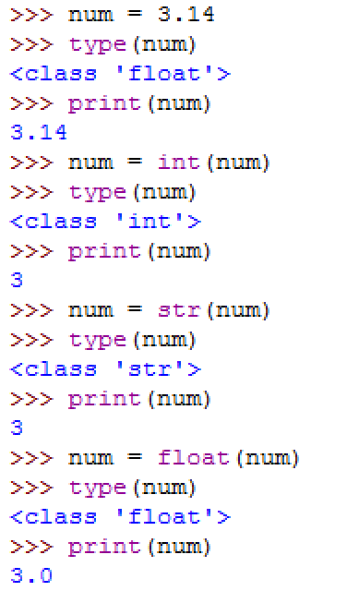
Built-in Functions (1 of 3)
Python has many built-in functions that are part of the Python language, just like the print and input functions.
Functions for data type:
The type function:
accepts a data value as input
returns (or outputs) the type of the data
The int, float, str conversion functions:
accept a data value as input
return the same data but as a new type
Note how the output of these functions are handled in the example:
The type function output is sent back to the shell, so the shell prints the output.
The int function output is assigned (stored) in num
so num is updated to a new type. Since the output is stored, there is no output for the shell to print.

Slide 6
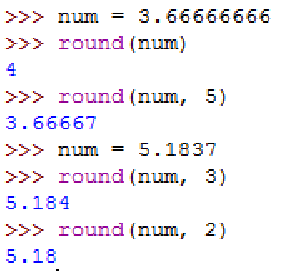
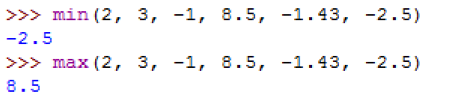
Built-in Functions (2 of 3)
The round function
input: (1) a float data value
(2 - optional) the requested number of digits after the decimal point
returns: the input value rounded to
the correct number of digits
The min and max functions
- input: a comma separated list of values
returns: the minimum or maximum value in the list

Slide 7
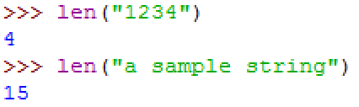
Built-in Functions (3 of 3)
The len function
input: a string
returns: the number of characters in the string, which is the length of the string
Click here to see a complete list of Python built-in functions. We will continue to work with some of them in later modules.

Slide 8
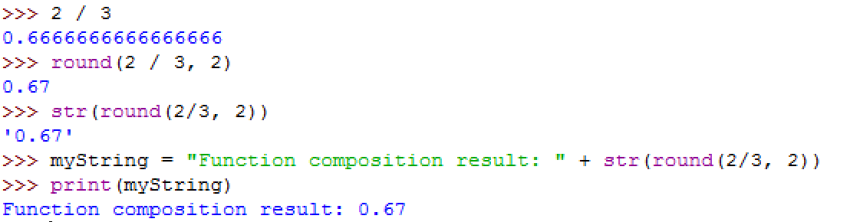
Composition
Recall that when we type a function name and function input in a Python statement, we are calling the function or running it.
Just like other programming languages, Python supports function composition, which means it lets us chain function calls together to do a more complex task.
Example of using function composition to build a text string which is the rounded result of 2 / 3:
# Standard output of 2/3
# Rounded output of 2/3
# String form of rounded output of 2/3
# Using string form of rounded output of 2/3

Slide 9
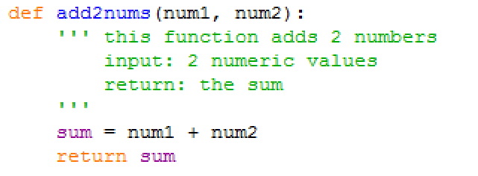
User-defined Functions
We are not limited to using just the built-in functions. Python also allows us to create our own functions to use.
To define or create a function (in 5 easy steps):
1. Start with the keyword def (for define)
2. Next add the function name
3. Declare input parameters inside ( ),
and end with :
4. Optional but highly recommended:
Add comments to describe the function
!! Important !!
Indent and line up all statements after the first header statement
5. Add statements that do the task of the function

Slide 10
Function Definition (1 of 2)
The function definition is the block of code that makes up the function.
A function definition starts with a function header, which is the first line and has 3 parts:
The keyword def, which tells Python that we’re defining this block of statement with a name.
A function name, which should be descriptive.
A list of input parameters, which are variables that will store input data of the function. The list is separated by comma.
The line ends with a colon ( : ).
header

Slide 11
Function Definition (2 of 2)
Following the header is the function body:
Indent the function body with the exact same spacing.
Highly recommended: start with a docstring, which is a comment block to describe the function purpose, the expected input, the output. The docstring starts with 3 single quotes or 3 double quotes, and must end with 3 matching type of quotes.
After the docstring is the list of Python statements that make up the function. Together they do the work of the function.
If the function has an output, use the return keyword for the output value.
function body

Slide 12
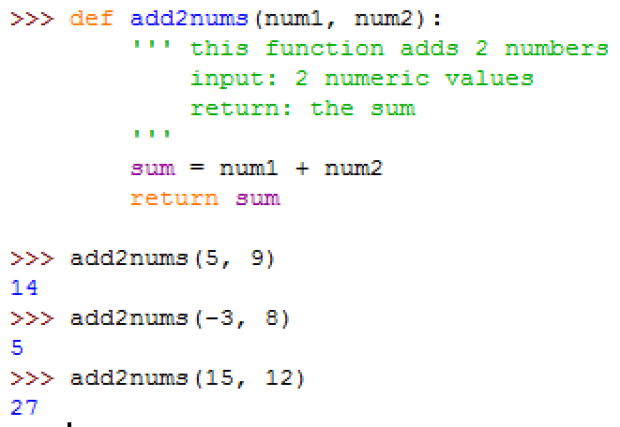
Flow of Execution
Let’s observe how a function call works
3
The function is defined so that the Python interpreter sees it.
When we want to add 2 numbers: we call add2nums, and pass in the 2 arguments or input data (5 and 9, for example) .
Execution jumps to the function block, and the input data are stored in the parameters num1 and num2 of add2nums.
1
4
2
5
The code of add2nums runs, producing a sum (14, for example). At the end of add2nums, the sum is returned or sent back to the caller line of code.
In these examples, the returned value is not assigned to a variable, so the shell prints it to screen.

Slide 13
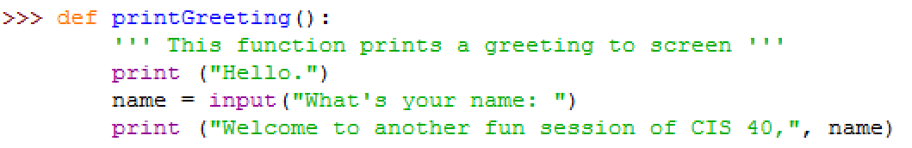
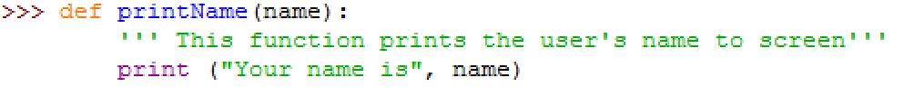
Function IO (1 of 2)
A function can accept 0 or more input arguments, and it can return 0 or 1 value.
We have seen that the function add2nums has 2 input arguments and 1 return value.
Example of a function that has no input argument and no return value:
Example of a function that has 1 input argument and no return value:

Slide 14
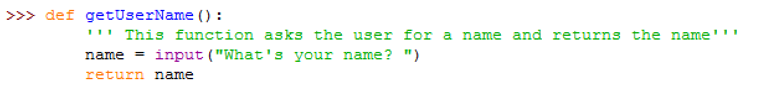
Function IO (2 of 2)
Example of a function that has no input argument and 1 return value

Slide 15
Demo
Click for a video demo of working with user-defined functions

Slide 16
Why Use Functions (1 of 2)
From this example we can see that if we invest the effort one time to define a function, we can then call it many times.
This is because a function always behaves the same way, but given different input data, it will produce a different output.
This make a function very adaptable. We can use add2nums any time we need to add 2 numbers, without having to re-type the code to add the numbers. This is the concept of re-usability in programming.

Slide 17
Why Use Functions ( of 2)2
A good example of re-usability is the print function. Someone wrote the print function at one time, and the rest of us can keep using print without having to write code to work with the screen to print data.
Functions also allow us to take a large project and divide it into small logical blocks or functions. This concept is called modularization.
Modularization makes it easier to manage a large project because if we need to change a part of the project, we can simply replace some of the functions in the project. We don’t have to take apart the whole project.
Modularization also makes it easier to arrive at the complete solution to a large problem by solving one small part at a time.

Slide 18
What’s Next
Now that we know how to work with functions, the basic building blocks of all programs, we will be able to take advantage of different Python libraries of functions.
Next we will work with the built-in Python graphics tool to display output in a more interesting way.

