Slide 1
Loops
CIS 40 – Introduction to Programming in Python
De Anza College Clare Nguyen

Slide 2
Intro (1 of 2)
In this module we learn about loops, which are instructions that cause the CPU to run a block of code over and over.
The idea of running a block of code repeatedly may at first seem like a bug rather than something we want. For example, if we go to an ATM and withdraw $40, we want the machine to take out only $40 from our account. We don’t want it to repeatedly withdraw $40 from our account ten more times.
However, we recall that at the end of a withdrawal transaction, the ATM asks if we want to do another transaction. And if we select yes, we could do another withdrawal or a deposit. The code running the ATM will loop, or run the transaction code again, as many times as we choose.
A loop that is put in the correct location in the code can be a useful tool.

Slide 3
Intro (2 of 2)
In this module we start the discussion with a few features of Python that support loops.
Then we explore the 2 loops in Python: for and while loops.

Slide 4
Update a Variable
A variable in a program often needs to be updated to have the newest data value.
The simplest way to update a variable is to assign the new data back to the variable:
num = 5 # initialize num with 5
num = num * 2 # multiply 5 * 2 and store 10 back in num
# The value in num is updated to 10
Two very common ways to update a variable is by incrementing or decrementing it.
Increment: num = num + 1 the value of num increases
Decrement: num = num – 1 the value of num decreases

Slide 5
The range Function
The range function creates a range of integers as the output.
Examples:
range (6) Output: 0, 1, 2, 3, 4, 5
range(2, 5) Output: 2, 3, 4
range(10, 18, 2) Output: 10, 12, 14, 16
range(10, 4, -1) Output: 10, 9, 8, 7, 6, 5
Format: range( start, stop, step )
start: an optional number which is the starting number for the output. If not used, the start is 0.
stop: a required number which is the stopping point of the range. The range does not include the stopping number.
step: an optional number to specify the step or difference between values in the range. If not used, the step is +1.

Slide 6

Repetition
Recall our first line of code:
The print statement will output one line of text.
What if we want the same line of text to be printed 50 times? Instead of having to copy and paste the print statement 50 times, we write the print statement one time and then ask the computer to repeatedly run it 50 times for us.
To ask the computer to run a block of code repeatedly for a specific number of time, we use a for loop.

Slide 7
The for Loop (1 of 2)
Format:
Flow chart:
for iterator in list:
statement block
a list of data values
an iteration
variable
loop body (indented)
The size of the list determines how many times the loop body will be run. If the list has 5 data values, the loop body will run 5 times.
Each time that the loop body runs is called an iteration.
During each iteration, the iterator contains the value of one data in the list.
iterator = first data in list
iterator has data?
no
yes
done
run loop body one time
iterator = next data in list

Slide 8

The for Loop (1 of 2)
Example:
There are 6 values in the list, from the range function output: 0, 1, 2, 3, 4, 5
1st loop iteration: i is 0 “Hello world!” is printed 2nd iteration: i is 1 “Hello world!” is printed 3rd iteration: i is 2 “Hello world!” is printed 4th iteration: i is 3 “Hello world!” is printed 5th iteration: i is 4 “Hello world!” is printed 6th iteration: i is 5 “Hello world!” is printed No more data in list, loop stops
There are 6 data values in the list, and the text is printed 6 times.

Slide 9


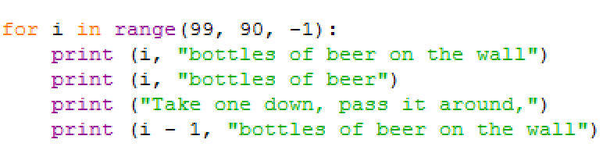
More for Loop Examples
Note how the iterator i contains each value in the list, one value for each iteration of the loop:
What does this print?
What is the last number that is printed?
code
output

Slide 10
Demo
Click for a video demo of how to use the for loop to calculate a running sum

Slide 11
The while Loop
Python provides us with a second way to tell the computer to run a block of code repeatedly: the while loop.
The while loop is used when we want the block of code to keep running repeatedly while some condition (a Boolean expression) is True.
Format: while Boolean_expression: statement block (or loop body)
Flow chart:
The Boolean_expression is called the test condition because it is the condition that determines whether the loop continues.
Looping continues as long as the test condition is True.
evaluate
Boolean_expression
False
True
done
run loop body one time

Slide 12
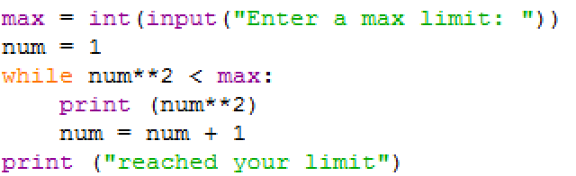
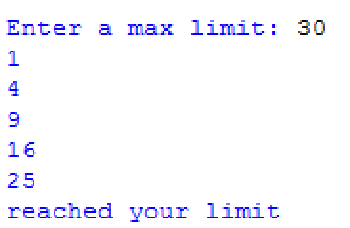
while Loop Example (1 of 2)
The following script prints the square of positive integers, starting from 1, up to a max limit.
The max limit is from a user input, so we don’t know how large it is. If it’s large, there will be many iterations of the loop before we can reach the limit. If it’s small, then there may be only a couple of iterations.
Since we can’t tell how many times the loop might run, we use the while loop, which runs the loop body as long as the test condition (square < max limit) is True.
Code:
Output:
code

Slide 13
while Loop Example (2 of 2)
Taking a closer look at how the example code runs:
We start by initializing num to 1, the first number that will be squared.
Start with test: 1² < 30 is True => print 1 num is updated to 2
Loop back to test: 2² < 30 is True => print 4 num is updated to 3
Loop back to test with num = 3, 4, 5 and run loop body
Loop back to test: 6² < 30 is False => the loop stops
Print final line of text

Slide 14
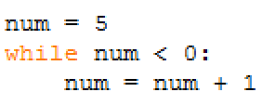
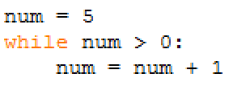
Number of Iterations
What is the minimum number of iterations for a while loop?
The test condition is False right away on the very first test, so the loop never runs. The minimum number of iterations is 0.
What is the maximum number of iterations for a while loop?
The test condition is True on the first test, so num is incremented. This means the test condition is also True on the next tests as num keeps incrementing. The test condition never becomes False so the loop keeps running. This is known as an infinite loop. The maximum number of iterations is infinity (in theory). In practice most of us will stop the run away loop with control-c.

Slide 15
Test Condition Must-Haves
Since the test condition controls how many iterations the loop will run, it is important that we set this condition properly.
There are 2 steps that we must ensure for the test condition:
Initialize: before the test statement
Update: in the loop body
In the example code:
If we didn’t initialize num to 1, then there is no data to use for the test condition.
If we didn’t update num in the loop body, then num will stay at the value 1, and the test condition will always be True.
initialize
update

Slide 16
Demo
Click for a video demo of how to use the while loop to check the user input

Slide 17
Which Loop To Use
We have 2 types of loops to use whenever we want the computer to re-run a block of code: for and while.
If we want the block of code to be repeatedly run for a certain number of times, then it is simplest to use the for loop.
The while loop can also be used for repeating code a number of times, but it takes more effort to remember to initialize and update the test condition.
If we want the block of code to be repeatedly run as long as a condition is True, then it is simplest to use the while loop because it has a built-in test condition in its format.
When using the while loop, we should make sure that there is an initialization and an update of the test condition so that the loop will run the correct number of iterations.

Slide 18
What’s Next (1 of 2)
We have learned a very useful construct that allows computers to keep running: a loop.
Whether we are at an ATM machine and do one transaction after another, or we’re at the Python shell and keep getting the >>> prompt to enter another instruction, it’s a loop that drives the repetitive behavior of a device.
We have now learned how to use all the basic components of modern programming language:
A way to store data (variables)
A way to perform computation (operators and expressions)
A way to communicate with the outside world (standard IO)
A way to modularize code (functions)
A way to make decisions (if statements)
A way to repeat instructions (loops)

Slide 19
What’s Next (2 of 2)
For the rest of the modules in this class we will get an overview of the more advanced features of many current programming languages:
A way to read from and store data to files
A way to organize data into collections (or groups) to process them more efficiently
A way to use the class data type to create our own data type so that we’re not limited to just the Python data types
We will begin with file IO in the next module.

