Slide 1
File IO and Strings
CIS 40 – Introduction to Programming in Python
De Anza College Clare Nguyen

Slide 2
Intro
Data that we store in variables are saved (or kept) only while the script or the code is running. As soon as the code stops running, the data and the code are no longer available.
If we want the data in our code to be kept and accessed even after the code has stopped running, then we need to store them in a file.
A file is a block of data that has a name and is saved in secondary memory. Secondary memory can be physically close by such as a hard disk or a flash drive (USB drive), or it can be located farther away but is connected to our computer through the network or the internet. These include servers (computers) or the cloud (also servers).
In this module we use instructions that will write data to and read data from a text file that is on a disk. This way we can save data between program runs.

Slide 3
Accessing Files
This diagram shows how our code interacts with a text file.
We call the functions open, read, write, and close to access the text file through a file handle in these steps:
Call the function open to ask for a file handle. If the file open is successful, we’re given a file handle.
Call the read function or write function to access data in the text file through the file handle.
When done, close the file handle.
open
read
write
close
file
handle
Text file
our code

Slide 4
File Open (1 of 2)
To open or request a file handle:
handle_name = open(“filename”)
open will search for a file with the given filename and check that we have permission to access the file.
If we can access the file, a file handle is created and we store it in the variable handle_name.
If we cannot access the file, open will cause an exception, and we can write exception handling code for it.
Example:
variable for file handle
file name
If the file is not in the same folder (or directory) as the code, add a file path also.

Slide 5
File Open (2 of 2)
There is a small difference when calling open for reading a file vs. writing a file.
Open for reading: handle_name = open(“filename”) Reading means data goes from the text file into our code.
Open for writing: handle_name = open(“filename”, “w”) Writing means data goes from our code into the file. If the file already exists, the file will be overwritten with new data. If the file doesn’t exist, a new file will be created.
Open for appending: handle_name = open(“filename”, “a”) Appending means data also goes from our code into the file. If the file already exists, new data will be appended or added to the end of the existing data. If the file doesn’t exist, a new file will be created.

Slide 6
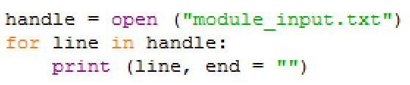
Read From File (1 of 2)
There are 2 ways to read from a text file: read one line at a time or read the entire file.
Read one line of a time: for line in file_handle The file_handle acts as a list of lines from the file. The for loop means that one line of the file goes into the “line” variable with each loop iteration.
Example:
With each iteration of the for loop, one line of the file is read in and stored in the “line” variable.
The line from file is read in with its newline character at the end of the line. Therefore, when we print, we need to tell the print function not to print with the default newline.

Slide 7
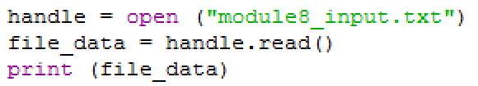
Read From File (2 of 2)
Read the entire file: file_input = file_handle.read() file_input is a string variable (data type str). The file_handle has a read function which reads in all lines of the file into a string.
Example of reading all lines of the file and printing them:
Read in the entire file only with small files. With large files, read in one line at a time.

Slide 8
Write To File
There are 2 ways to write to text file: overwrite existing data or append to existing data.
The 2 modes are chosen with the file open function. The write function is the same for both modes.
Write one line of text to the file: file_handle.write(“text\n”)
The file_handle has a write function that writes “text” to the file. The write function doesn’t add the newline character at the end of the line, so if you want the text to be a single line of text in the file, add the newline (\n) character.
Example:

Slide 9
Close File
When finishing reading or writing the file, close the file handle.
Format: file_handle.close()
If we forget to close the file handle, the computer will eventually close it for us. However, it’s not considered good practice to leave a file handle opened when it’s not needed. If we don’t close the file handle, the text file cannot be opened by another program that needs to access it.

Slide 10
Demo
Click for a video demo of file IO.

Slide 11

String Operations
Since the data in the text file are strings, we review some string operators and function:
str1 + str2 means str1 and str2 are joined end to end.
str1 * 4 means str1 is repeated 4 times, joined end to end.
str1 == str2 returns True if str1 and str2 are identical (every character is the same).
len(str1) returns the total number of characters in str1.
A newline character is \n and causes the print function to move to the next line of output. Example: the string “a\nb\nc\n” has 6 characters and will print 4 lines of text.
Line 1
Line 2
Line 3
Line 4

Slide 12
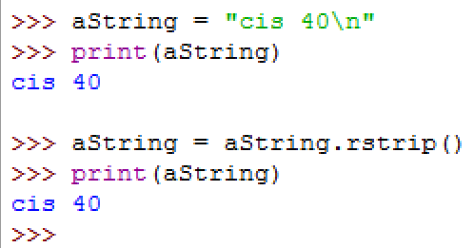
String Methods (1 of 3)
Just like how the turtle object has many methods that can help us draw on screen, the string is also an object that has many methods that can help us manipulate the characters in the string.
In the following discussion of string methods, the variable s is a string object and we call string methods with this s object.
s.rstrip(): returns s without the newline character at the end
blank line
due to \n
no more blank line

Slide 13
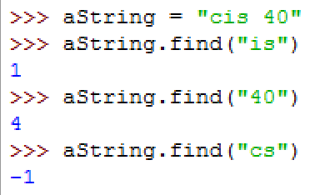
String Methods (2 of 3)
s.find(“text”):
returns -1, if “text” is not part of s
returns the position of “text” in s, if s contains “text”
position starts at 0 for the beginning of the string, and counts up with each character in the string

Slide 14
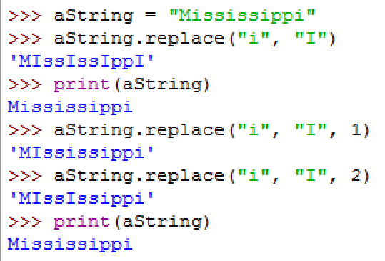
String Methods (3 of 3)
s.replace(“old_text”, “new_text”, num):
replaces old_text in s with new_text in s
num is optional:
no num value: replace all instances of old_text
with num value: replace num instances of old_text
There are many other string functions that are useful to work with text strings. They are covered in the next Python course.

Slide 15
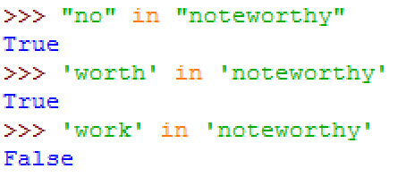

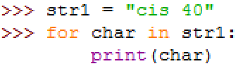
Strings and the in Operator
A substring is a part of a string. Example: “all” and “low” are both substrings of “swallow”
The in operator returns a Boolean to indicate whether a string is a substring of a larger string.
Example:
When used with a for loop, the in operator separates each character of the string into the iteration variable.
Example:
Code
Output

Slide 16
What’s Next
We learned some basic operations and functions to work with text strings because our code can access data in text files.
Having our code save data into a file or read data from a file means that we can save data in between program runs.
Being able to access a file from our code is also important when we need to work with a large number of data values, since files can store much more data than main memory, where our code resides during run time.
Now that we can write code to access a large number of data values, in the next module we will have an overview of how Python can help us organize the data into collections or meaningful groups of data.

